Slide 1
DRAFT REVISED TOTAL COLIFORM REGULATIONS
STATE WATER RESOURCES CONTROL BOARD
DIVISION OF DRINKING WATER
Bruce Burton, P.E.
March 30, 2017
Notes:
The purpose of this workshop is to go over in detail with you the draft California version of the Revised Total Coliform Rule; get you comments and hopefully answer your questions. I want to emphasize two points; the regulation we are going to present today is a draft. What is finally adopted will not be exactly what we present at the six workshops we are holding. We expect to get feedback that will result in some changes. Second, we are interested in getting your feedback because we want this regulation to be as clear and concise as we can make it. These workshops are intended to helo resolve any major issues that are identified before we get to the official 45 day

Slide 2
Revised Total Coliform Rule (RTCR)
California Proposed RTCR vs Federal RTCR
CA Draft RTCR
Federal RCTR
Parts of the federal RTCR less stringent than the proposed CA RTCR
Current more stringent CA TCR Requirements
MAJORITY OF CA RTCR IS THE SAME AS THE FEDERAL RTCR
Requirements left to States by federal RTCR
Additional CA Requirements

Slide 3
Acronym Definitions
BAT – best available technology/treatment
BSSP – bacteriological sample siting plan
CCR – consumer confidence report
CFU - colony formation unit
CWS – community water system
EC – E. coli
GWR – ground water rule
GWUDI – groundwater under the direct influence of surface water
HAA5 - haloacetic acids (Five)
  IOC – inorganic chemicals
LPA – local primacy agency
MCL – maximum contaminant level
mL – milliliters
M&R – monitoring and reporting
MPN – most probable number
NTNC – non-transient non-community
NTU – nephelometric turbidity unit
PN – public notification
REP – repeat sample site
PSI – pounds per square inch
PWS – public water system
REP – repeat sample site
ROU – routine sample site
RTCR – revised total coliform rule
  SC – service connections
  SW – surface water
  TC – total coliform
  TNC – transient non-community

Slide 4
Sections 64400 & 64401
Adding the following definitions:
  Clean Compliance History
  Level I Assessment
  Level II Assessment
  Protected Water Source
  Sanitary Defect
  Seasonal System

Slide 5
Section 64415
Laboratory and Personnel
Standard sample volume regardless of method is
100 mL
The time from collection to initiation of test medium incubation is 30 hours
Allowable analytical methods specified

Slide 6
Section 64421
General Requirements
Other monitoring is required when:
  Pressure loss to <5 PSI and sample(s) collected must be representative
  Continuously disinfected public water system using groundwater (not GWUDI) collect at least one (1) raw water sample per quarter
Non-certified water operators, sampling training documentation required to be on file
Plans, procedures, and requests must be made in writing to the State Board/LPA and include basis and supporting documentation

Slide 7
Section 64422
Bacteriological Sample Siting Plan
New Bacteriological Sample Siting Plans (BSSP) are required to be developed & submitted to the State Board/LPA 3 months after the RTCR effective date for review & approval
  BSSP must include:
    Physical location of ROU, REP, & GWR sample points
    ROU/REP sample sites representative of distribution system (including pressure zones, water source(s), and/or reservoir
  ROU samples can be rotated, if the number of BSSP sites exceeds the monthly sampling requirement

Slide 8
Section 64422
Bacteriological Sample Siting Plan (con’t)
Sampling must be done in accordance with approved BSSP by the State Board/LPA
Updated BSSP is required:
  At least once every 10 years
  Within 30 days when the PWS or State Board/LPA determines the BSSP is no longer representative of PWS
  Within 30 days when the PWS determines an alternate location or the standard operating procedure for repeat sites or dual purpose sample sites need revisions.

Slide 9
Section 64423 - Routine Sampling
Regulatory Summary Chart
Orange cells = State RTCR - PROPOSED more stringent than corresponding federal RTCR requirements.

Slide 10
Section 64423 - Routine Sampling
Number of Samples & Frequency
Community Water Systems
  No changes in number of samples or monitoring frequency from the CA Total Coliform Rule
  Continue collecting at regular intervals throughout the month per the approved BSSP
Non-community Water Systems
  Sampling based on population per the approved BSSP
    TNC – monthly population served based on daily average served each month.
  CA RTCR will only allow routine quarterly monitoring for TNC <1,000 pop. using GW source
    Conditions included for increased monthly and returning to quarterly routine
  Seasonal systems routine sampling based on population during months when system is operational

Slide 11
Section 64423 - Routine Sampling
Special Conditions of the RTCR
Systems must take at least minimum number of routine samples per month even if E.coli MCL violation occurs
More than the minimum number of samples may be taken provided the samples are included in the approved BSSP
Unfiltered surface water systems continue to collect 1 sample/day when NTU > 1
Systems must notify State Board/LPA within 10 days after learning of routine monitoring violation and notify the public (Tier 3)
  Failure to notify State Board/LPA within 10 days is a reporting violation and requires Tier 3 PN.

Slide 12
Section 64423.1
Sample Analysis and Reporting
No changes to sample identification (routine, repeat, replacement, “other”)
All TC+ samples must be analyzed for E.coli (not fecal)
All routine and “other” samples reported as P/A (coliform density also acceptable)
All repeat and additional routine samples reported in terms of coliform density
PWS must require lab to notify them within 24 hours of TC+ or EC+ samples or interference problems, and require lab to notify State Board/LPA within 24 hours if unable to contact PWS. Must provide lab with name and contact information to notify

Slide 13
Section 64423.1
Sample Analysis and Reporting
All analytical results must be reported to State Board/LPA by 10th day of the following month
PWS serving > 400 service connections shall submit a monthly summary of the bacteriological results to the State Board/LPA
    No monthly summary reports required for small water systems serving ≤ 400 service connections!!! (one sample per month or less)
PWS serving <10,000 s.c. or 33,000 pop.
    Require lab to submit copies of all required bacteriological results directly to the State Board/LPA
PWS serving ≥ 10,000 s.c. or ≥ 33,000 pop.
    Require lab to submit copies of all positive routine and repeat sample results directly to the State Board/LPA
Notes:
The way the last two bullets are written it is possible for a water system to be in both categories. The language in the draft reg will be revised so this is no longer possible in the final draft

Slide 14
Section 64423.1
Sample Analysis and Reporting
E. coli Routine Sample M&R
PWS failing to test the same sample for E. coli following TC+ routine sample shall notify State Board/LPA within 10 days after learning of the monitoring violation and conduct Tier 3 PN or as directed by the State Board/LPA.
Failure to report to the State Board/LPA within 10 days is a reporting violation, and the PWS must conduct Tier 3 PN or as directed by the State Board/LPA.

Slide 15
Section 64424
Repeat Sampling
TC+ routine sample requires repeat samples be taken within 24 hours of being notified of the sample result
  3 repeat samples for each routine TC+ sample
If unable to collect within 24 hours, notify the State Board/LPA
Single connection system may take repeats over 3 days

Slide 16
Section 64424
Repeat Sampling
Repeat Sample Locations
  Site of TC+ sample
  Within 5 service connections upstream and downstream
Alternate Sampling Locations
  If TC+ is at end of distribution system, system may take repeats at alternative location with written approval by State Board/LPA (BSSP approval necessary)
  System may propose alternative sampling sites that represent likely contamination pathway to distribution system
    Alternative fixed locations, or
    Criteria for selecting sites on a situational basis

Slide 17
Section 64424
Repeat Sampling
Dual Purpose Sampling
    PWS with single GW source, serving ≤ 1,000 persons – GW Rule triggered source sample may count as one of required RTCR repeat sample
    State Board/LPA approval of BSSP Required

Slide 18
Section 64424
Repeat Sampling
If ≥ 1 repeat TC+ sample, must collect a repeat sample set for each repeat TC+ sample until no TC+ samples or treatment technique trigger has been exceeded & State Board/LPA notified
If a treatment technique trigger is exceeded as a result of a routine TC+ sample, only one set of repeat samples is required for each TC+ routine sample

Slide 19
Section 64425
Sample Invalidation
Water system must request a sample be invalidated if
  Repeats collected at routine site are TC+ and repeats collected w/in 5 connections are TC-
  Lab did not follow analytical method and provides required documentation of error
Whenever a TC- sample is invalidated by lab for interference, replacement sample must be collected w/in 24 hours.
Invalidation request must be in writing

Slide 20
Section 64425
Sample Invalidation
Invalidation due to interference - requirement specific to routine and repeat samples.
An invalidated TC+ sample does not count toward meeting the minimum required number of routine and repeat samples
When a sample is declared invalid by a laboratory due to interference problems, collect a replacement sample from the same location within 24 hours of being notified of the interference problem.

Slide 21
Section 64426
Significant Rise in Bacterial Count
While the RTCR replaces the total coliform MCL and public notification with assessment and correction, there will still be cases that will indicate a Possible Significant Rise in Bacterial Count.
A Possible Significant Rise condition will require that the PWS notify the State Board/LPA by the end of the day on which it receives the positive bacteriological results.
A Possible Significant Rise condition will require the PWS to conduct an investigation of possible causes and submit a report identifying probable causes with timelines for corrective actions not completed.

Slide 22
Section 64426
Significant Rise in Bacterial Count
Three Cases Trigger a Possible Significant Rise.
1) For PWS collecting 40 or more routine samples per month. A routine total coliform positive sample is followed by 2 or more positive repeat samples.
2) A water system has a sample that is positive for E. coli.
3) A water system has a sample that is greater than 23 Most Probable Number (MPN)/100ml. Or greater than 23 Colony-Forming Units (CFU)/100ml.

Slide 23
Section 64426
Significant Rise in Bacterial Count
Investigations are at a minimum to include the following:
Current operating procedures and records
Interruptions in the treatment process
System pressure loss to less than 5 psi
Vandalism and/or unauthorized access
Evidence indicating contamination
Analytical results of additional sampling
Community illness suspected (waterborne)

Slide 24
Section 64426
Significant Rise in Bacterial Count
Within 24 hours of receiving notification from the State Board/LPA of a significant rise in bacteriological count, the PWS shall implement its emergency notification plan.

Slide 25
Section 64426.1
E. coli Maximum Contaminant Level (MCL)
The E. coli MCL is violated when any of the following occurs:
A repeat sample is E. coli positive following a routine total coliform positive
A repeat sample is total coliform positive following a routine E. coli positive
The PWS fails to collect the required repeat samples following an E.coli positive routine sample
The PWS fails to test for E. coli when any repeat samples are positive for total coliform

Slide 26
Section 64426.1
E. coli Maximum Contaminant Level (MCL)
A PWS that is not in compliance with the E. coli MCL during any month must notify the State Board/LPA by the end of the day it makes this determination.
The PWS must also notify its customers via a Tier 1 public notice.

Slide 27
Section 64426.6
Coliform Treatment Technique
A PWS will be in violation of a Coliform Treatment Technique if:
The PWS exceeds a coliform treatment trigger and then fails to conduct the required assessment or corrective action within the timeframe specified; or
A seasonal system fails to complete an approved startup procedure prior to serving water to the public. (example, seasonal campgrounds)

Slide 28
Section 64426.7
Coliform Treatment Technique Triggers
Determining a Trigger Exceedance Includes:
  Results of all routine and repeat samples collected in a calendar month
  Replacement samples collected for properly invalidated routine and repeat samples
Does not include:
  Special samples collected after water system pressure loss < 5 psi
  Quarterly samples for wells that are continuously disinfected

Slide 29
Section 64426.7
Coliform Treatment Technique Triggers
Level 1 Coliform Treatment Technique Triggers
  If 40 or more samples are collected in a month, more than 5.0% are total coliform-positive
  If fewer than 40 samples collected in a month, two or more samples are total coliform-positive
  Failure to take all required repeat samples after any total coliform-positive sample

Slide 30
Section 64426.7
Coliform Treatment Technique Triggers
Level 2 Coliform Treatment Technique Trigger
  E.coli MCL violation defined in Section 64426.1
  Second Level 1 trigger in a rolling 12-month period, except if the State Board/LPA determines a likely reason for the total-coliform positive samples for the first Level 1 trigger and that the water system has corrected the problem.

Slide 31
Section 64426.8
Level 1 and 2 Assessments
Identify the presence of sanitary defects and defects in coliform monitoring practices in these areas:
  Sample sites, sampling protocol and processing
  Events that could affect distribution system water quality
  Changes in distribution system operation and maintenance that could affect distribution system water quality
  Source and treatment considerations that affect distributed water quality
  Existing water quality data

Slide 32
Section 64426.8
Level 1 and 2 Assessments
Assessments must be conducted as soon as practical after exceeding corresponding coliform treatment technique trigger
Water system staff will conduct Level 1 Assessments
State Board staff (or LPA county staff) will conduct Level 2 Assessments

Slide 33
Section 64426.8
Level 1 and 2 Assessments
Submit completed assessment to State Board/LPA within 30 days of learning it exceeded a trigger, or within 30 days after the water system has received results of all bacteriological samples, whichever occurs first
Identify corrective actions completed and propose timetable to complete remaining corrective actions
Water systems will also have to comply with any expedited or additional actions in response to an E.coli MCL violation

Slide 34
Section 64426.8
Level 1 and 2 Assessments
The State Board/LPA may determine that an assessment is insufficient, including the proposed timetable for any corrective actions not yet completed, and direct a water system to submit a revised assessment within 30 days.
Water systems shall complete corrective actions by the time of submission of the assessment, or according to the State Board/LPA-approved timetable
Water systems have 5 business days to notify the State Board/LPA following the completion of each scheduled corrective action.

Slide 35
Section 64426.8
Level 1 and 2 Assessments
Failure of any of the following reporting requirements is a violation requiring a Tier 2 Public Notice
  Failure to submit a completed Level 1 or Level 2 assessment within 30 days of learning of the coliform treatment technique trigger.
  Failure to report the completion of a scheduled corrective action to the State Board/LPA within 5 business days

Slide 36
Section 64426.9
Seasonal Systems
Start Up Plan
Start Up Plan
  Due 3 months after effective date of the regulation
  Includes
    Notification to State Board/LPA prior start up.
    Inspection of water system components
    Disinfection and flushing procedures
    Bacteriological and chlorine residual sampling plan
    Use of certified operator for startup procedures
  Failure to notify State Board/LPA and/or submit start up sampling results requires public notification.

Slide 37
Section 64426.9
Seasonal Systems
Alternative Start Up Plan
A water system may propose an alternative start up plan.
  May be appropriate if the entire distribution system remains pressurized during seasonal closure
  Water system may request exemption from some start up requirements.
  Alternative must provide equivalent protection of public health and be approved by State Board/LPA

Slide 38
Section 64426.9
Seasonal Systems
Start Up and Shutdown
SEASONAL START UP - Prior to serving the public
  Perform the actions described in the approved Start Up Plan
  Certify to State Board/LPA the approved Start Up Plan has been completed
    Certification includes results of bacteriological and chlorine residual samples
  Obtain Written approval from State Board/LPA to serve the public
SEASONAL SHUT DOWN - State Board/LPA must be notified within 10 days of the water system’s seasonal closure.

Slide 39
Section 64427
Disinfectant Residual
Monitoring and Reporting
Systems must measure the disinfectant residual at the same time and place as the additional routine and repeat distribution coliform samples. The results must be reported to State Board/LPA
Water systems who produce or purchase surface water may use distribution chlorine residuals per 64427 to comply with the Surface Water Treatment Regulations.

Slide 40
Section 64430
Ground Water Rule Section
Revised the Ground Water Regulations to Require Public Water Systems that use Ground Water to Comply with the Revised Total Coliform Regulations

Slide 41
Section 64447 - Best Available Technology Microbiological Contamination
Best Available Technology (BAT) for systems serving greater than 10,000 persons.
Affordable Technology for systems serving 10,000 or fewer persons.
Specific elements are given that are defined as part of a proper program for maintenance of the distribution system.
Notes:
Appropriate pipe replacement and repair procedures, main flushing programs, proper operation and maintenance of storage tanks and reservoirs, cross-connection control, and continual maintenance of positive water pressure in all parts of the distribution system

Slide 42
Section 64447 - Best Available Technology Microbiological Contamination
Compliance with the filtration and disinfection of the surface water treatment regulations
Disinfection of ground water in compliance with the Ground Water Rule using strong oxidants.
Compliance with the Drinking Water Source Assessment and Protection Program
Notes:
Appropriate pipe replacement and repair procedures, main flushing programs, proper operation and maintenance of storage tanks and reservoirs, cross-connection control, and continual maintenance of positive water pressure in all parts of the distribution system

Slide 43
Notification of Customers & State Board/LPA
64463.1 - Tier 1 Notice
  Total Coliform MCL Replaced by E. coli MCL
64463.4 - Tier 2 Notice
  Total Coliform MCL Replaced by Violation of a Coliform Treatment Technique
64463.7 - Tier 3 Notice
  Under specific circumstances a Tier 1 or Tier 2 notification can be required for Monitoring Violations

Slide 44
Notification of Customers &
State Board/LPA
64463.7 - Tier 3 Notice
  Failure to comply with reporting requirements in the RTCR
  Failure to comply with recording keeping requirements in Section 64470(b)(7) or (8)

Slide 45
Section 64465
Public Notice and Content and Format
Removal of Required Language for Total Coliform
New Language for Total Coliform for the Consumer Confidence Report
Removal of Language for Fecal coliform/E. coli
Addition of Language for E. coli

Slide 46
Section 64465
Public Notice and Content and Format
Addition of Language for Level 1 Assessment Resulting from Total Coliform Contamination & Corrective Action
Addition of Language for Level 2 Assessment Resulting from E. coli Contamination & Corrective Action
Addition of Language for Seasonal System Treatment Technique Violations

Slide 47
Section 64470
Recordingkeeping
Addition of a Requirement to Keep Copies of Level 1 and Level 2 Assessments, Documentation of Corrective Actions Taken for not less than 5 years
Addition of a Requirement to Keep Copies of Repeat Bacteriological Samples for Which an Extension of the 24 Hour Collection or Delivery Requirement was Granted

Slide 48
Section 64481
Content of Consumer Confidence Report
Language to Provide in the CCR for Level 1 Assessment and Level 2 Assessment
Removal of Language Associated with the Total Coliform MCL
Addition of Required Language Associated With a Level 1 or Level 2 Assessment Not Due to an E. coli MCL Violation

Slide 49
Section 64481
Content of Consumer Confidence Report
Addition of Required Language Associated With a Level 2 Assessment Due to an E. coli MCL Violation
Language Required for the Calendar Year 2016 When California Public Water Systems Were Required to Continue to Comply With the California Total Coliform Regulations
Health Effects Language for Total Coliform, Fecal Coliform, and E. coli

Slide 50
Surface Water Treatment
64650 – Change in Alterative E. coli Concentration to Trigger Crypto Monitoring to 100 E. coli/100mL for Both Lake/Reservoir and Flowing Stream Sources for Filtered Systems Serving Less Than 10,000 persons.
64652.5 – Replaces Requirement to Comply with the Total Coliform MCL with the E. coli MCL
64653 - Replaces Requirement to Comply with the Total Coliform MCL with the E. coli MCL for Slow Sand Filters

Slide 51
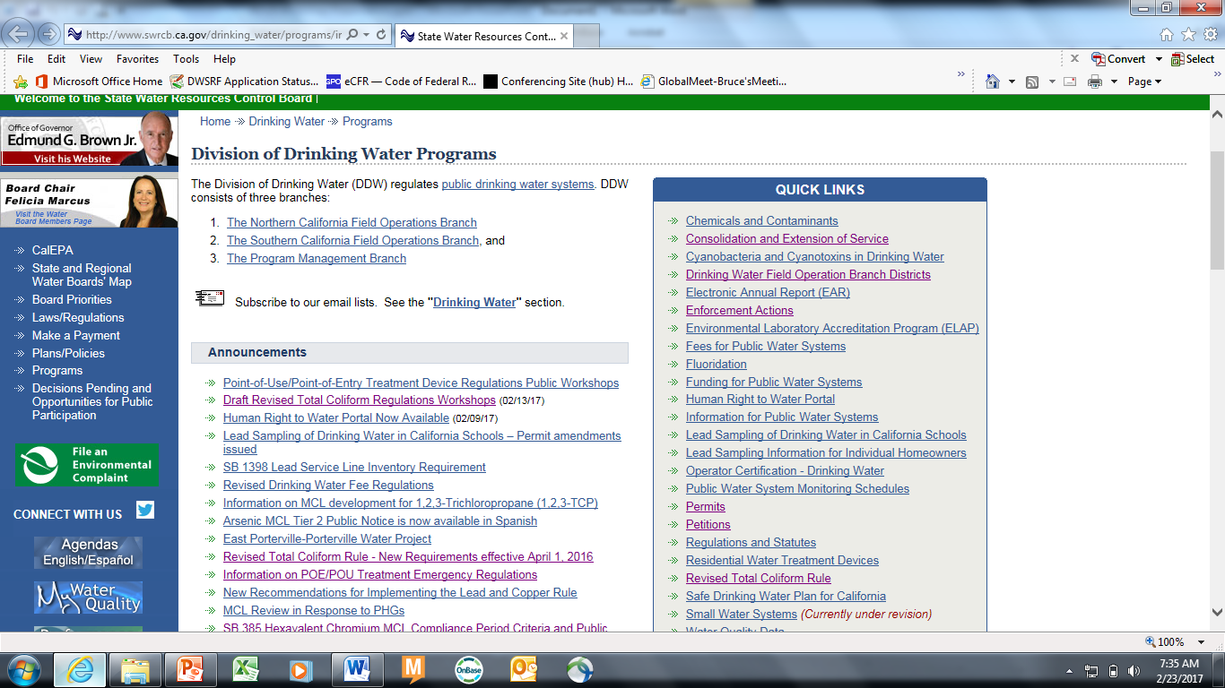

Slide 52
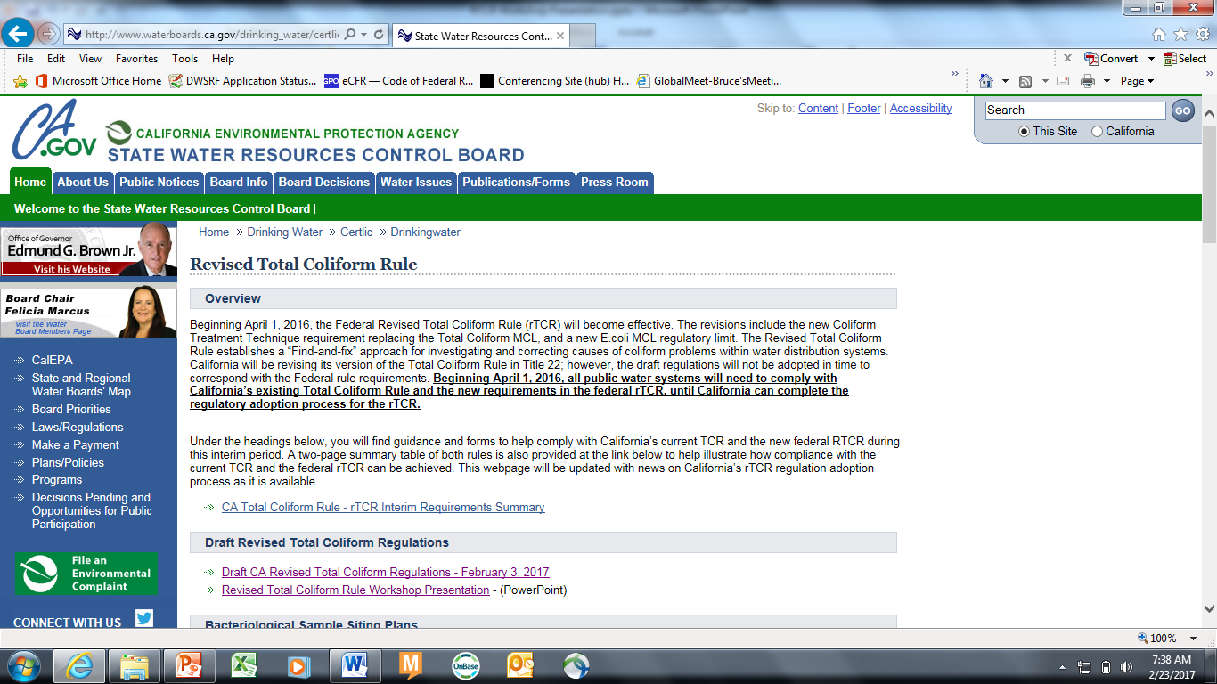

Slide 53
Questions & Comments
RTCR@waterboards.ca.gov

