Slide 1
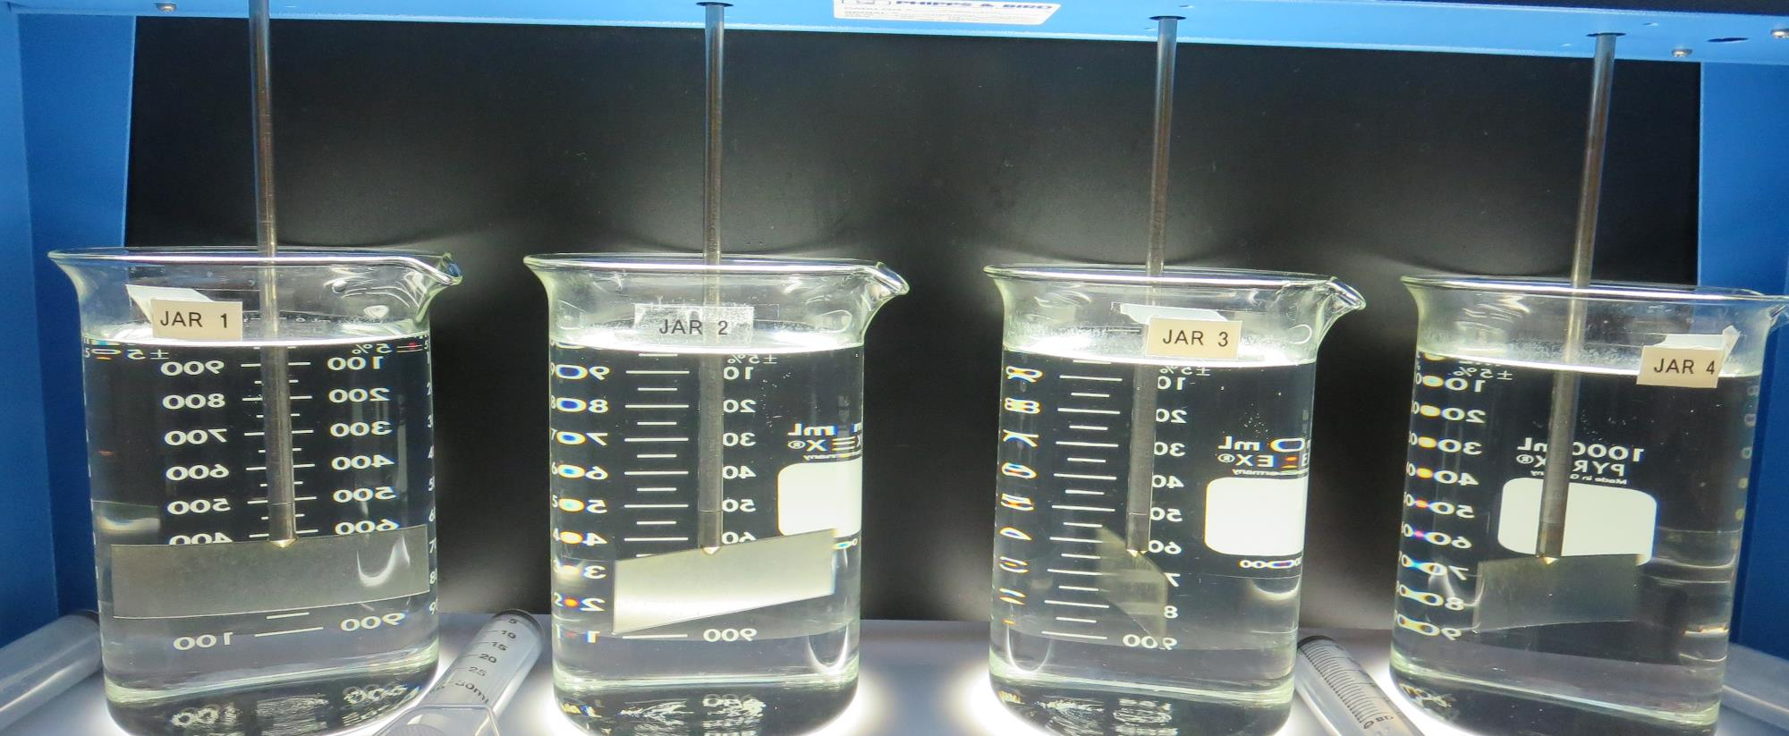
FCSA #34 Millerton New Town CA1000484 Fresno County Jar Test
by Guy Schott, P.E.
May 20, 2021

Slide 2
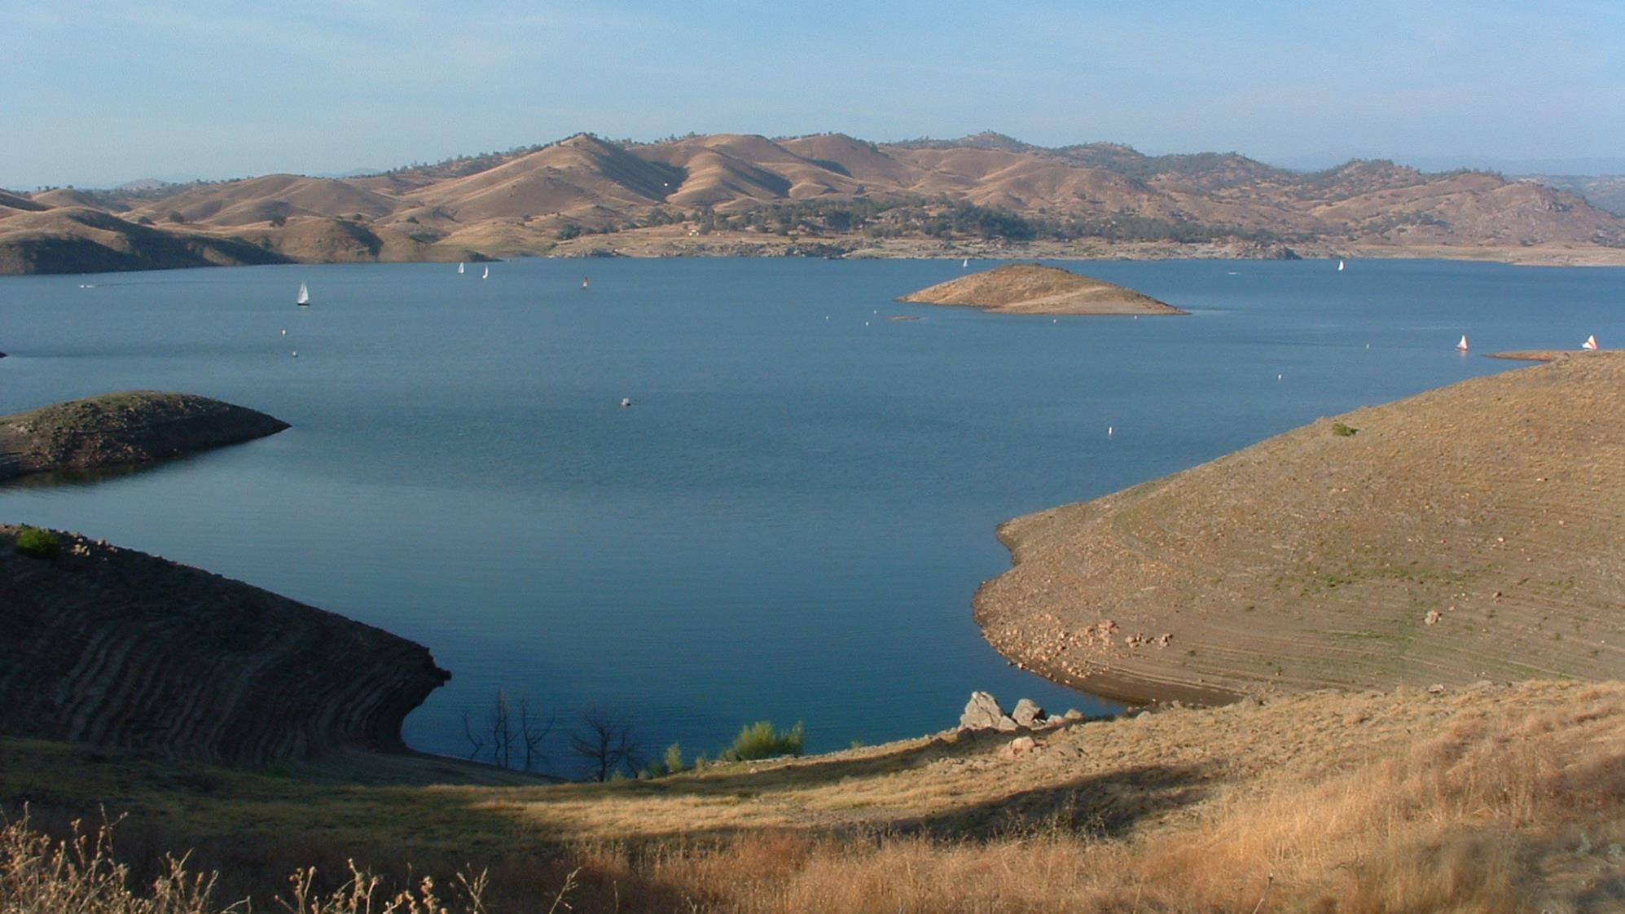
Millerton Lake

Slide 3
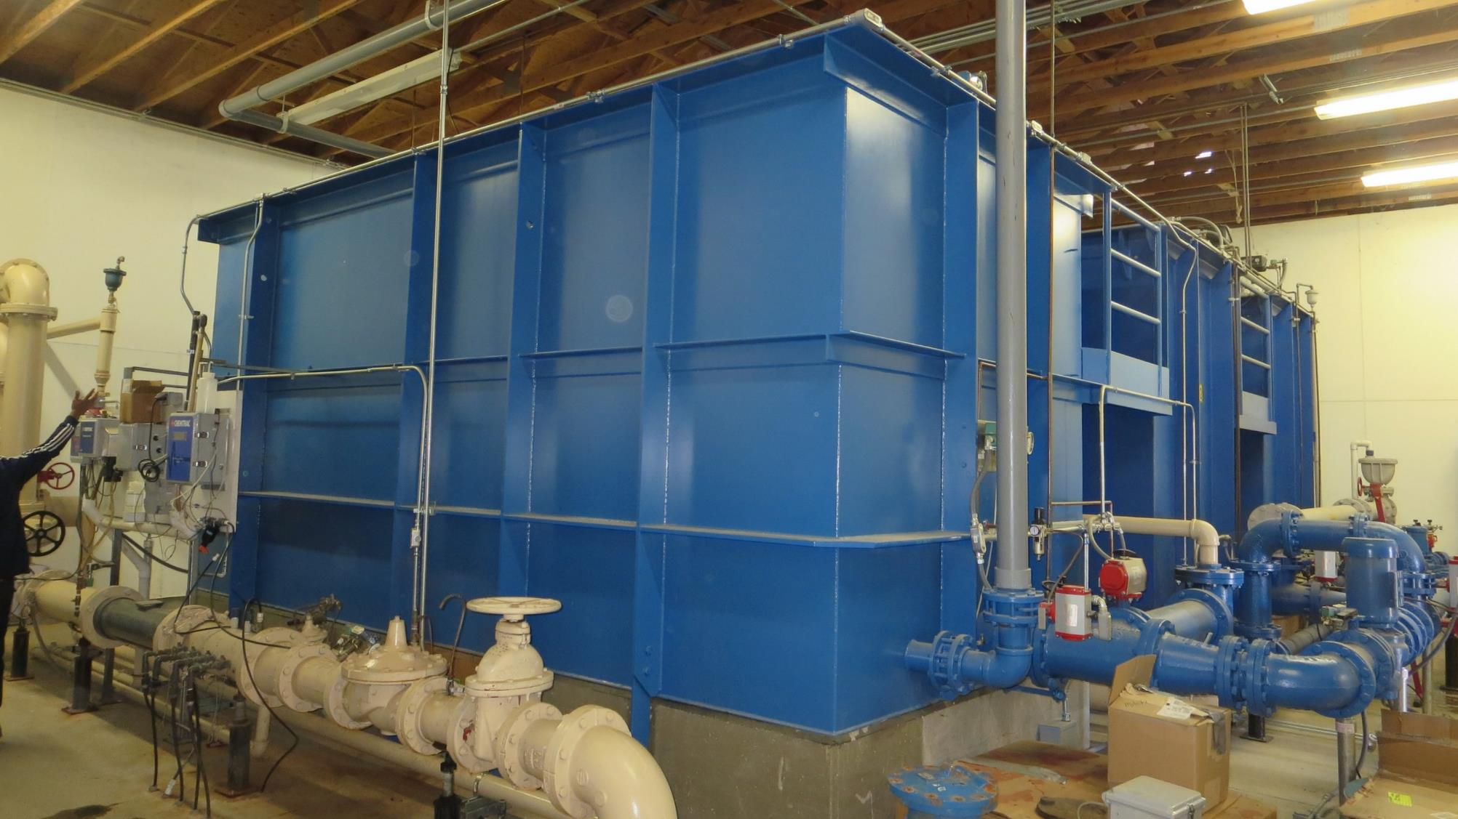
Trident
Trident Filtration System

Slide 4
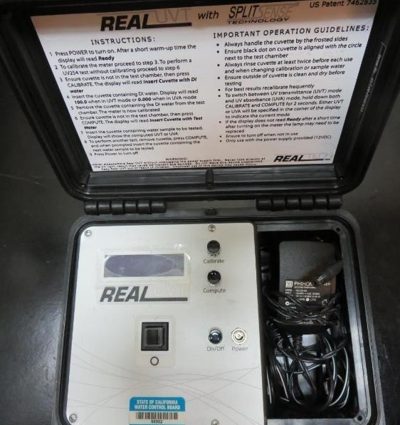
UVT/UVA, pathlength 10 mm
UV transmittance (UVT) is a measurement of the amount of ultraviolet light (254 nm) that passes through a water sample compared to the amount of light that passes through a pure water sample. The measurement is expressed as % UVT.
%UVT = 10^{(-UVA)} x 100%
UV absorbance (UVA) is calculated as a relative measure of the amount of light absorbed by a water sample compared with the amount of light absorbed by a pure water sample.
UVA = -log(%UVT/100)

Slide 5
FCSA #34 Millerton New Town Source & Treated Water Characteristics, May 20, 2021
Source
pH: 7.46
Alkalinity: 13 mg/L as CaCO₃
Turbidity: 0.41 NTU
UVT: 89.0%,
UVA: 0.050/cm
0.4 um Filtered
Turbidity: 0.11 NTU
UVT: 89.9%,
UVA: 0.046/cm
Plant Filtrate Water (pre-chlorination
Turbidity: 0.09 NTU
UVT: 90.4%,
UVA: 0.046/cm
UVA Reduction: 6.52%

Slide 6
Applied Coagulants for Jar Testing (1)
Sterling Water Technologies 8809
40-60% Water (50%)
20-30% Aluminum Chlorohydrate (25%)
~11.8% Al₂O₃
~6.2% Al
83% Basicity
20-30% Polyquaternary amine (25%)
SG = 1.19 – 1.33
NSF limit: 20 mg/L (product)
Product dose 4 mg/L = 1.0 mg/L polyamines active
Pro Pac 9890 (NTU Technologies)
35-45% Aluminum Chlorohydrate
35-45% Water
~18.9% Al₂O₃
~10.5% Al
83% Basicity
20% polyamine (50% water, 50% active polyamines)
SG = 1.25-1.34
NSF limit: 50 mg/L as Product;
Product dose 10 mg/L = 1 mg/L polyamines active

Slide 7
Applied Coagulants for Jar Testing (2)
BWS, Inc.
Greg Nieckarz, Ph.D.
Greg.niekarz@bws.works
541-953-5112
AdvFloc-CTC-00011
Polyaluminum Hydroxy Chlorosulfate
12.55% Al₂O₃
6.64% Al
64.9% Basicity
SG = 1.299
NSF limit: 250 mg/L as Product

Slide 8
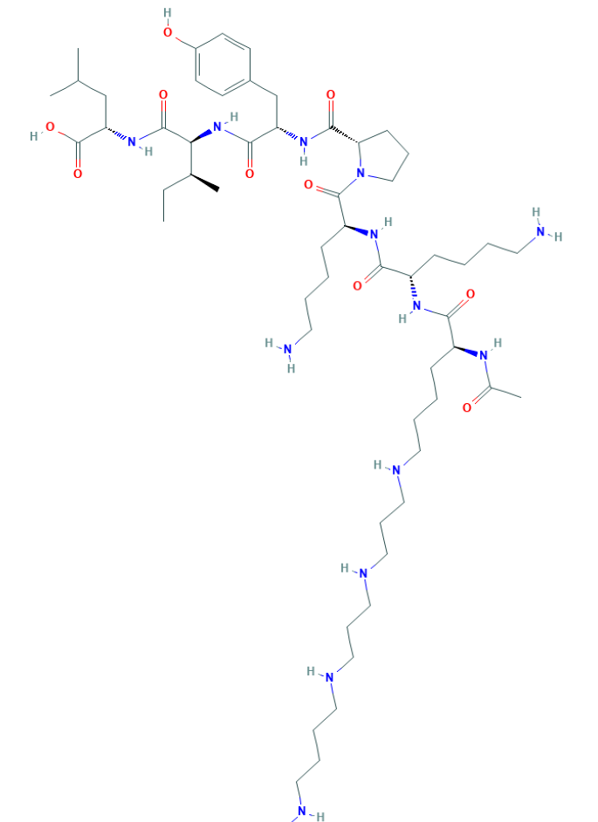
Polyamine C₅₉H₁₀₈N₁₄O₁₀ MW: 1,173.6 g/mol

Slide 9
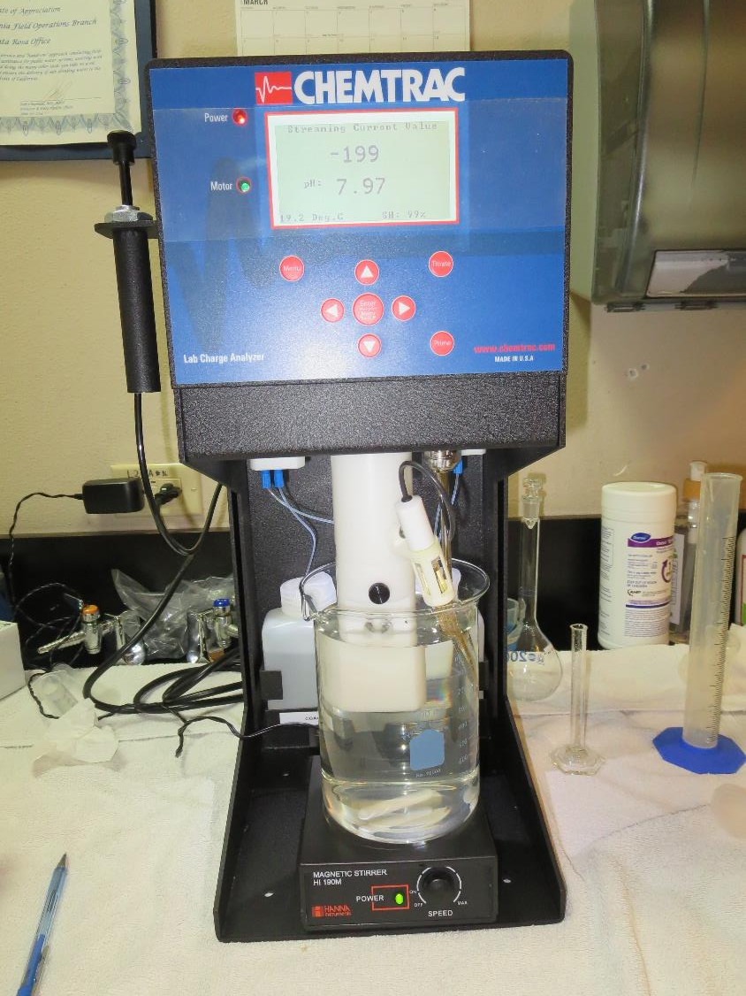
Laboratory Charge Analyzer
LCA: Used to determine coagulant demand of a source water entering the treatment plant.
Source pH: 7.46
LCA #1: SWT 8809: 3.13 mg/L
LCA #2: 9890: 4.85 mg/L
LCA #3: AdvFloc CTC-00011: 25 mg/L

Slide 10
Coagulant Information
Unless stated otherwise, all coagulant doses are reported as Product (100% strength).
Aluminum Sulfate doses are reported as hydrated Al₂(SO₄)₃*14.3H₂0.
Preparation of coagulant stock solutions are generally 1.0 and/or 0.1 percent strength using 100 and/or 200 mL volumetric flasks.
Finnpipette F2 variable volume pipette, capacity 100-1000 micro liters is used for stock solution preparation and coagulant aid jar test dosing.
Finnpipette F2 variable volume pipette, capacity 0.5-5 mL is used for primary coagulant jar test dosing.

Slide 11
FCSA #34 Millerton New Town: Source: Millerton Lake Summary of Plant Coagulant/Dose Jar vs. Optimum Dose and Coagulants
Jar# | CTC-00011 mg/L | SWT 8809 mg/L | Filtrate NTU | Filtrate %UVT | Filtrate UVA/cm | %UVA Reduction
A | 0 | 1.8 | 0.09 | 92.7 | 0.032 | 30.4
vs.
B | 0 | 4.2 | 0.08 | 94.3 | 0.025 | 45.7
C | 15 | 2.8 | 0.04 | 95.9 | 0.017 | 63.0
Note: Jar A – due to poor filterability and floc interference of %UVT/UVA measurements, results are based on water filtered through a 0.6 um absolute Isopore membrane as opposed to a 1.2 um absolute Isopore membrane that is used for the filterability and UVT/UVA analysis.

Slide 12
%UVA Reduction via Source Water Chlorination

Slide 13
Jar Test – Filtrate Water Spiked with 2.2 mg/L NaOCl Plant Coagulant Dose vs. Optimum Dose and Coagulant
7 days:
Blue line: TTHM: 71 ug/L, HAA5: 41 ug/L
Orange line: TTHM: 44 ug/L, HAA5: 29 ug/L

Slide 14
Coagulants
Coagulant | Chemical Dose, mg/L | Alkalinity Consumed mg/L as CaCO₃
SWT 8809 | 10 | 0.6
CTC-00011 | 10 | 1.3
9890 | 10 | 0.9

Slide 15
FCSA #34 Millerton New Town : TTHMs/HAA5s Laboratory Results NaOCl dose after filtration: 2.2 mg/L (Hold Time 6 days)
Jar # | CTC-0001 mg/L | SWT 8809 mg/L | Filtrate %UVT | Filtrate UVA/cm | %UVA Reduction | TTHM ug/L | HAA5 ug/L | Cl2 Residual mg/L
1 | 0 | 1.8 | 92.7 | 0.032 | 30.4 | 71 | 41 | 0.31
2 | 15 | 2.8 | 95.9 | 0.017 | 63.0 | 44 | 29 | 0.82
End of 6 days:
Jar #1: UVT: 95.3%, UVA: 0.020/cm (26.1% UVA additional reduction)
Jar #2: UVT: 97.0%, UVA: 0.013/cm (8.7% UVA additional reduction)

Slide 16
FCSA #34 Millerton New Town; Jar Test 1 - 8 Results Flash Mix 200 RPM (20 sec); Floc Mix 20 RPM (5 min)
Jar# | SWT 8809 mg/L | Filtrate NTU | Filtrate %UVT | Filtrate UVA/cm | %UVA Reduction
J1 | 1.8 | 0.27 | 90.9 | 0.041 | 10.9
J2 | 2.5 | 0.18 | 92.2 | 0.035 | 23.9
J3 | 3.2 | 0.06 | 93.4 | 0.029 | 37.0
J4 | 3.9 | 0.05 | 93.9 | 0.027 | 41.3
J5 | 4.2 | 0.12 | 93.5 | 0.029 | 37.0
J6 | 4.8 | 0.12 | 93.6 | 0.028 | 39.1
J7 | 5.4 | 0.24 | 92.3 | 0.034 | 26.1
J8 | 6.0 | 0.20 | 91.6 | 0.038 | 17.4

Slide 17
FCSA #34 Millerton New Town; Jar Test 9 - 12 Results Flash Mix 200 RPM (20 sec); Floc Mix 20 RPM (5 min)
Jar# | CTC-00011 mg/L | Filtrate NTU | Filtrate %UVT | Filtrate UVA/cm | %UVA Reduction
J9 | 24 | 0.05 | 95.0 | 0.022 | 52.2
J10 | 28 | 0.05 | 95.2 | 0.021 | 54.3
J11 | 32 | 0.05 | 95.4 | 0.020 | 56.5
J12 | 36 | 0.05 | 95.3 | 0.020 | 56.5
J13 | 12 | 0.12 | 93.2 | 0.030 | 34.8
J14 | 16 | 0.04 | 94.6 | 0.024 | 47.8
J15 | 20 | 0.05 | 94.7 | 0.023 | 50.0
J16 | 24 | 0.04 | 95.3 | 0.020 | 56.5

Slide 18
FCSA #34 Millerton New Town; Jar Test 17 - 24 Results Flash Mix 200 RPM (20 sec); Floc Mix 20 RPM (5 min)
Jar# | 9890 mg/L | Filtrate NTU | Filtrate %UVT | Filtrate UVA/cm | %UVA Reduction
J17 | 4.2 | 0.13 | 93.5 | 0.029 | 37.0
J18 | 4.8 | 0.10 | 94.0 | 0.026 | 43.5
J19 | 5.4 | 0.07 | 94.5 | 0.024 | 47.8
J20 | 6.0 | 0.09 | 94.5 | 0.024 | 47.8
J21 | 5.4 | 0.09 | 94.4 | 0.024 | 47.8
J22 | 6.0 | 0.10 | 94.5 | 0.024 | 47.8
J23 | 6.6 | 0.08 | 94.8 | 0.022 | 52.2
J24 | 7.2 | 0.13 | 94.4 | 0.024 | 47.8

Slide 19
FCSA #34 Millerton New Town; Jar Test 25 - 32 Results Flash Mix 200 RPM (20 sec); Floc Mix 20 RPM (5 min)
Jar# | CTC-00011 mg/L | SWT 8809 mg/L | Filtrate NTU | Filtrate %UVT | Filtrate UVA/cm | %UVA Reduction
J25 | 0.0 | 2.5 | 0.23 | 91.0 | 0.041 | 10.9
J26 | 10 | 2.5 | 0.07 | 95.0 | 0.022 | 52.2
J27 | 14 | 2.5 | 0.05 | 95.5 | 0.020 | 56.5
J28 | 18 | 2.5 | 0.05 | 95.6 | 0.019 | 58.7
J29 | 0.0 | 1.8 | 0.28 | 91.4 | 0.038 | 17.4
J30 | 0.0 | 3.8 | 0.16 | 93.5 | 0.029 | 37.0
J31 | 28 | 0.0 | 0.04 | 95.5 | 0.019 | 58.7
J32 | 18 | 2.5 | 0.04 | 95.6 | 0.019 | 58.7

Slide 20
FCSA #34 Millerton New Town; Jar Test 33 - 40 Results Flash Mix 200 RPM (20 sec); Floc Mix 20 RPM (5 min)
Jar# | CTC-00011 mg/L | SWT 8809 mg/L | Filtrate NTU | Filtrate %UVT | Filtrate UVA/cm | %UVA Reduction
J33 | 0 | 2.8 | 0.16 | 93.0 | 0.031 | 32.6
J34 | 0 | 3.2 | 0.13 | 93.3 | 0.030 | 34.8
J35 | 0 | 3.6 | 0.12 | 93.3 | 0.029 | 37.0
J36 | 0 | 4.0 | 0.10 | 94.0 | 0.026 | 43.5
J37 | 12 | 2.8 | 0.05 | 95.7 | 0.019 | 58.7
J38 | 12 | 3.2 | 0.05 | 95.8 | 0.018 | 60.9
J39 | 12 | 3.6 | 0.05 | 95.8 | 0.018 | 60.9
J40 | 12 | 4.0 | 0.07 | 95.7 | 0.019 | 58.7

Slide 21
FCSA #34 Millerton New Town; Jar Test 41 - 48 Results Flash Mix 200 RPM (20 sec); Floc Mix 20 RPM (5 min)
Jar# | CTC-00011 mg/L | SWT 8809 mg/L | Filtrate NTU | Filtrate %UVT | Filtrate UVA/cm | %UVA Reduction
J41 | 0 | 1.8 | 0.19/0.09 | 91.8/92.7 | 0.036/0.032 | 21.7/30.4
J42 | 0 | 3.2 | 0.11 | 93.8 | 0.028 | 39.1
J43 | 0 | 3.7 | 0.08 | 94.1 | 0.026 | 43.5
J44 | 0 | 4.2 | 0.08 | 94.3 | 0.025 | 45.7
J45 | 10 | 1.8 | 0.05 | 95.2 | 0.021 | 54.3
J46 | 15 | 1.8 | 0.05 | 95.4 | 0.020 | 56.5
J47 | 12 | 2.8 | 0.04 | 95.6 | 0.019 | 58.7
J48 | 15 | 2.8 | 0.04 | 95.9 | 0.017 | 63.0
Note: Jar41 – Results based on 1.2 & 0.6 um absolute filters.

Slide 22
Jars 1-4 Test Flash Mix 200 RPM, 20 Sec Floc Mix 20 RPM, 5 min 25 mL sampled end of Floc Applied Coagulant SWT 8809

Slide 23
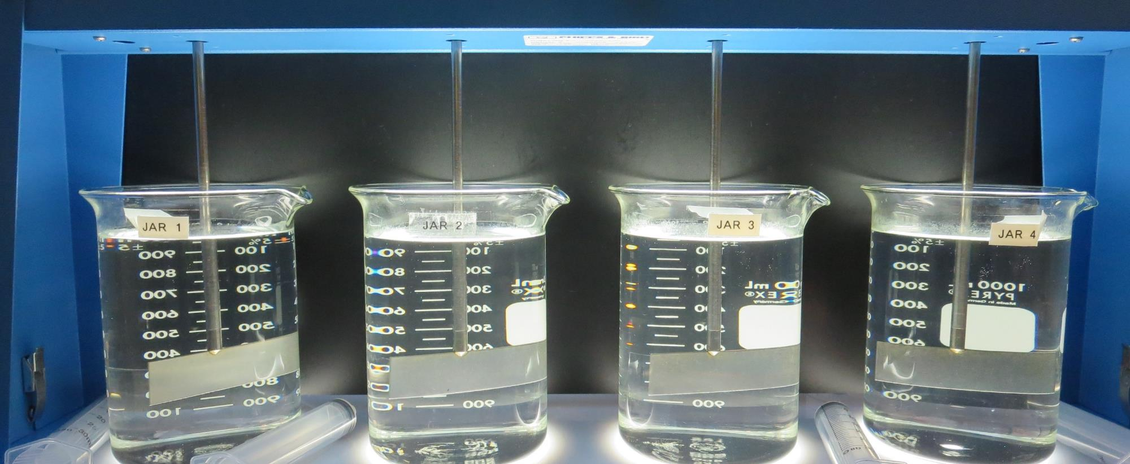
Jars 1-4: End of Floc Duration, 25 mL is syringed for filterability and %UVT/UVA.
1.8 mg/L SWT 8809
Filtrate 0.27 NTU
UVT: 90.9%
UVA: 0.041/cm
UVA Reduction 10.9%
2.5 mg/L SWT 8809
Filtrate 0.18 NTU
UVT: 92.2%
UVA: 0.035/cm
UVA Reduction 23.9%
3.2 mg/L SWT 8809
Filtrate 0.06 NTU
UVT: 93.4%
UVA: 0.029/cm
UVA Reduction 37.0%
3.9 mg/L SWT 8809
Filtrate 0.05 NTU
UVT: 93.9%
UVA: 0.027/cm
UVA Reduction 41.3%

Slide 24
Jars 5-8 Test Flash Mix 200 RPM, 20 Sec Floc Mix 20 RPM, 5 min 25 mL sampled end of Floc Applied Coagulant SWT 8809

Slide 25
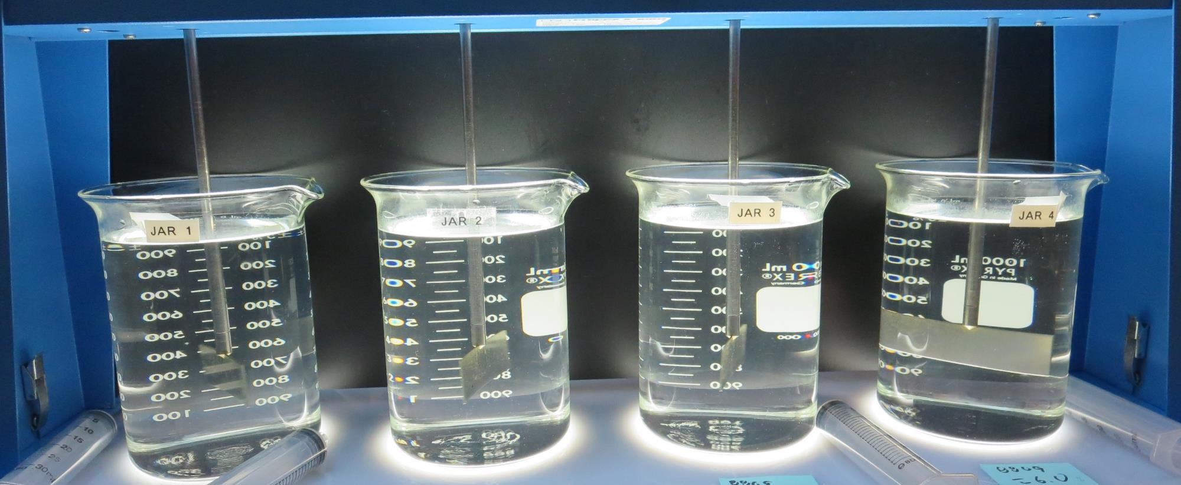
Jars 5-8: End of Floc Duration, 25 mL is syringed for filterability and %UVT/UVA.
4.2 mg/L SWT 8809
Filtrate 0.12 NTU
UVT: 93.5%
UVA: 0.029/cm
UVA Reduction 37.0%
4.8 mg/L SWT 8809
Filtrate 0.12 NTU
UVT: 93.6%
UVA: 0.028/cm
UVA Reduction 39.1%
5.4 mg/L SWT 8809
Filtrate 0.24 NTU
UVT: 92.3%
UVA: 0.034/cm
UVA Reduction 26.1%
6.0 mg/L SWT 8809
Filtrate 0.20 NTU
UVT: 91.6%
UVA: 0.038/cm
UVA Reduction 17.4%

Slide 26
Jars 9-12 Test Flash Mix 200 RPM, 20 Sec Floc Mix 20 RPM, 5 min 25 mL sampled end of Floc Applied Coagulant AdvFloc CTC-00011

Slide 27
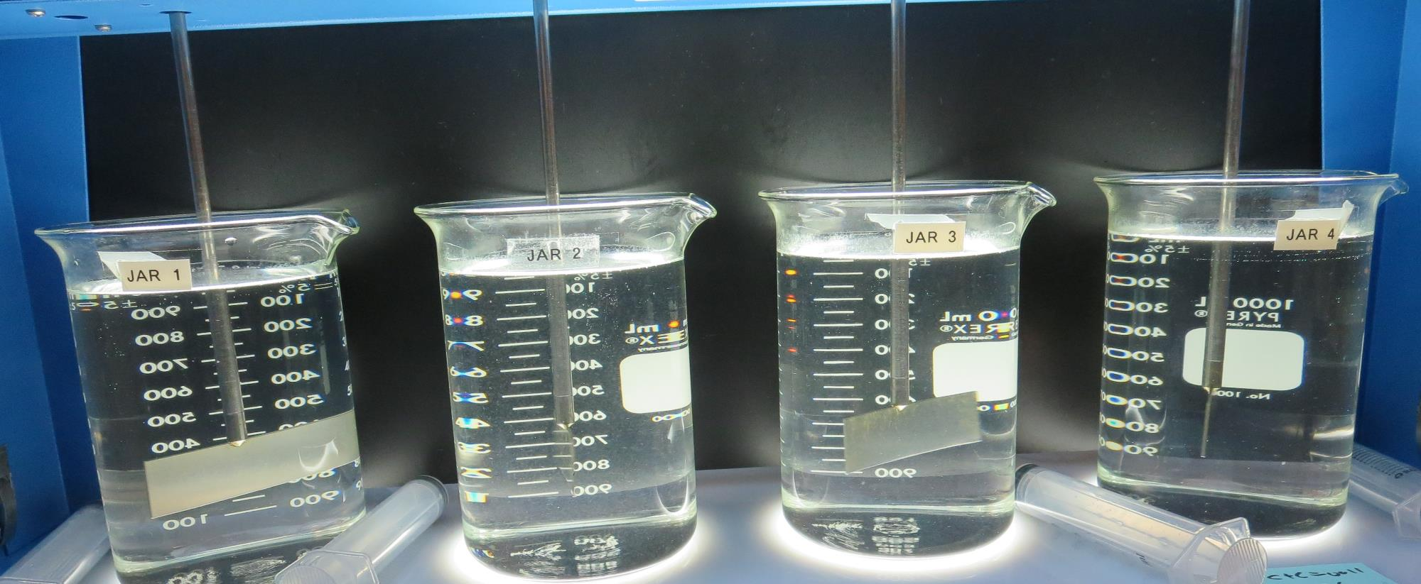
Jars 9-12: End of Floc Duration, 25 mL is syringed for filterability and %UVT/UVA.
24 mg/L CTC-00011
Filtrate 0.05 NTU
UVT: 95.0%
UVA: 0.022/cm
UVA Reduction 52.2%
28 mg/L CTC-00011
Filtrate 0.05 NTU
UVT: 95.2%
UVA: 0.021/cm
UVA Reduction 54.3%
32 mg/L CTC-00011
Filtrate 0.05 NTU
UVT: 95.4%
UVA: 0.020/cm
UVA Reduction 56.5%
36 mg/L CTC-00011
Filtrate 0.05 NTU
UVT: 95.3%
UVA: 0.020/cm
UVA Reduction 56.5%

Slide 28
Jars 13-16 Test Flash Mix 200 RPM, 20 Sec Floc Mix 20 RPM, 5 min 25 mL sampled end of Floc Applied Coagulant AdvFloc CTC-00011

Slide 29
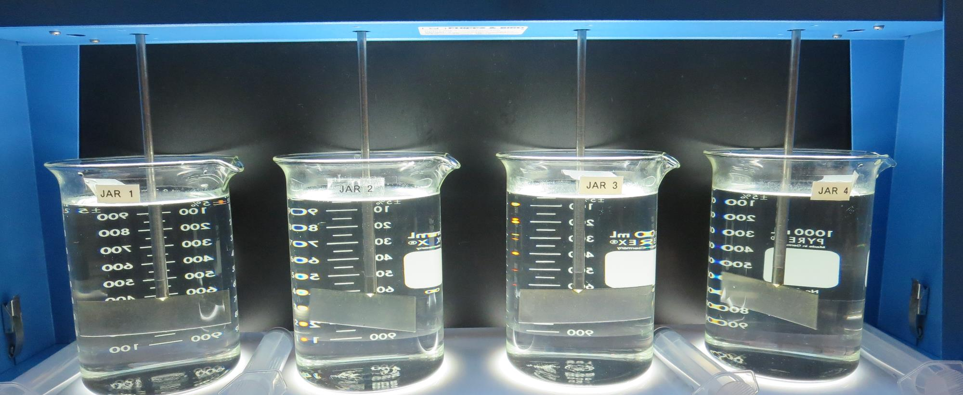
Jars 13-16: End of Floc Duration, 25 mL is syringed for filterability and %UVT/UVA.
12 mg/L CTC-00011
Filtrate 0.12 NTU
UVT: 93.2%
UVA: 0.030/cm
UVA Reduction 34.8%
16 mg/L CTC-00011
Filtrate 0.04 NTU
UVT: 94.6%
UVA: 0.024/cm
UVA Reduction 47.8%
20 mg/L CTC-00011
Filtrate 0.05 NTU
UVT: 94.7%
UVA: 0.023/cm
UVA Reduction 50.0%
24 mg/L CTC-00011
Filtrate 0.04 NTU
UVT: 95.3%
UVA: 0.020/cm
UVA Reduction 56.5%

Slide 30
Jars 17-20 Test Flash Mix 200 RPM, 20 Sec Floc Mix 20 RPM, 5 min 25 mL sampled end of Floc Applied Coagulant 9890

Slide 31
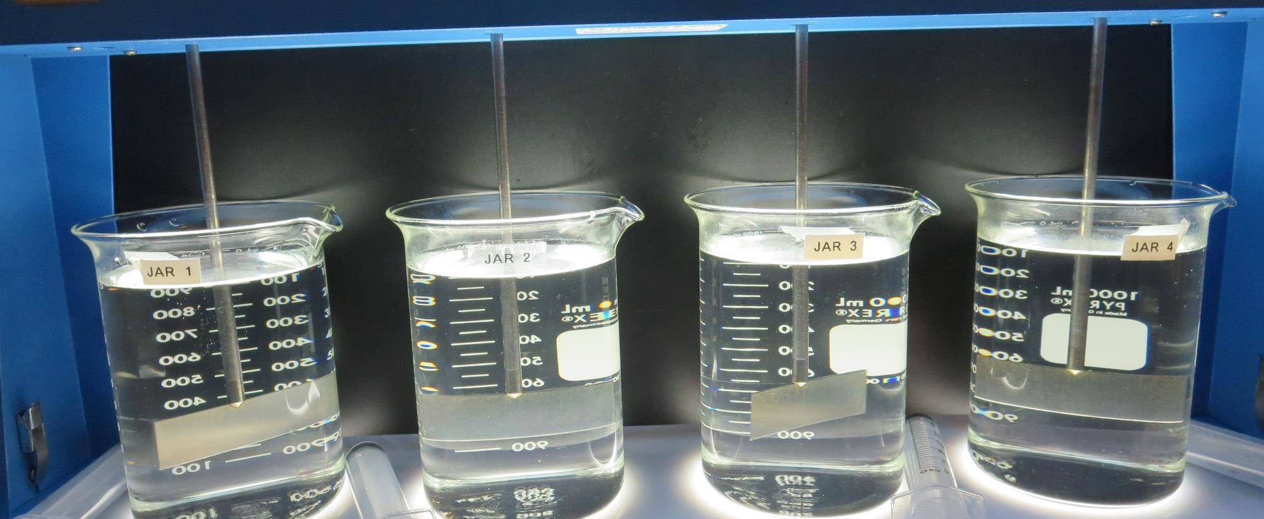
Jars 17-20: End of Floc Duration, 25 mL is syringed for filterability and %UVT/UVA.
4.2 mg/L 9890
Filtrate 0.13 NTU
UVT: 93.5%
UVA: 0.029/cm
UVA Reduction 37.0%
4.8 mg/L 9890
Filtrate 0.10 NTU
UVT: 94.0%
UVA: 0.026/cm
UVA Reduction 43.5%
5.4 mg/L 9890
Filtrate 0.07 NTU
UVT: 94.5%
UVA: 0.024/cm
UVA Reduction 47.8%
6.0 mg/L 9890
Filtrate 0.09 NTU
UVT: 94.5%
UVA: 0.024/cm
UVA Reduction 47.8%

Slide 32
Jars 21-24 Test Flash Mix 200 RPM, 20 Sec Floc Mix 20 RPM, 5 min 25 mL sampled end of Floc Applied Coagulant 9890

Slide 33
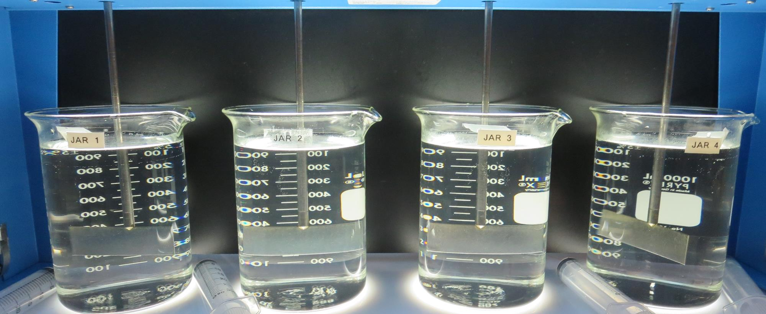
Jars 21-24: End of Floc Duration, 25 mL is syringed for filterability and %UVT/UVA.
5.4 mg/L 9890
Filtrate 0.09 NTU
UVT: 94.4%
UVA: 0.024/cm
UVA Reduction 47.8%
6.0 mg/L 9890
Filtrate 0.10 NTU
UVT: 94.5%
UVA: 0.024/cm
UVA Reduction 47.8%
6.6 mg/L 9890
Filtrate 0.08 NTU
UVT: 94.8%
UVA: 0.022/cm
UVA Reduction 52.2%
7.2 mg/L 9890
Filtrate 0.13 NTU
UVT: 94.4%
UVA: 0.024/cm
UVA Reduction 47.8%

Slide 34
Jars 25-28 Test Flash Mix 200 RPM, 20 Sec Floc Mix 20 RPM, 5 min 25 mL sampled end of Floc Applied Coagulants AdvFloc CTC-00011 SWT 8809

Slide 35
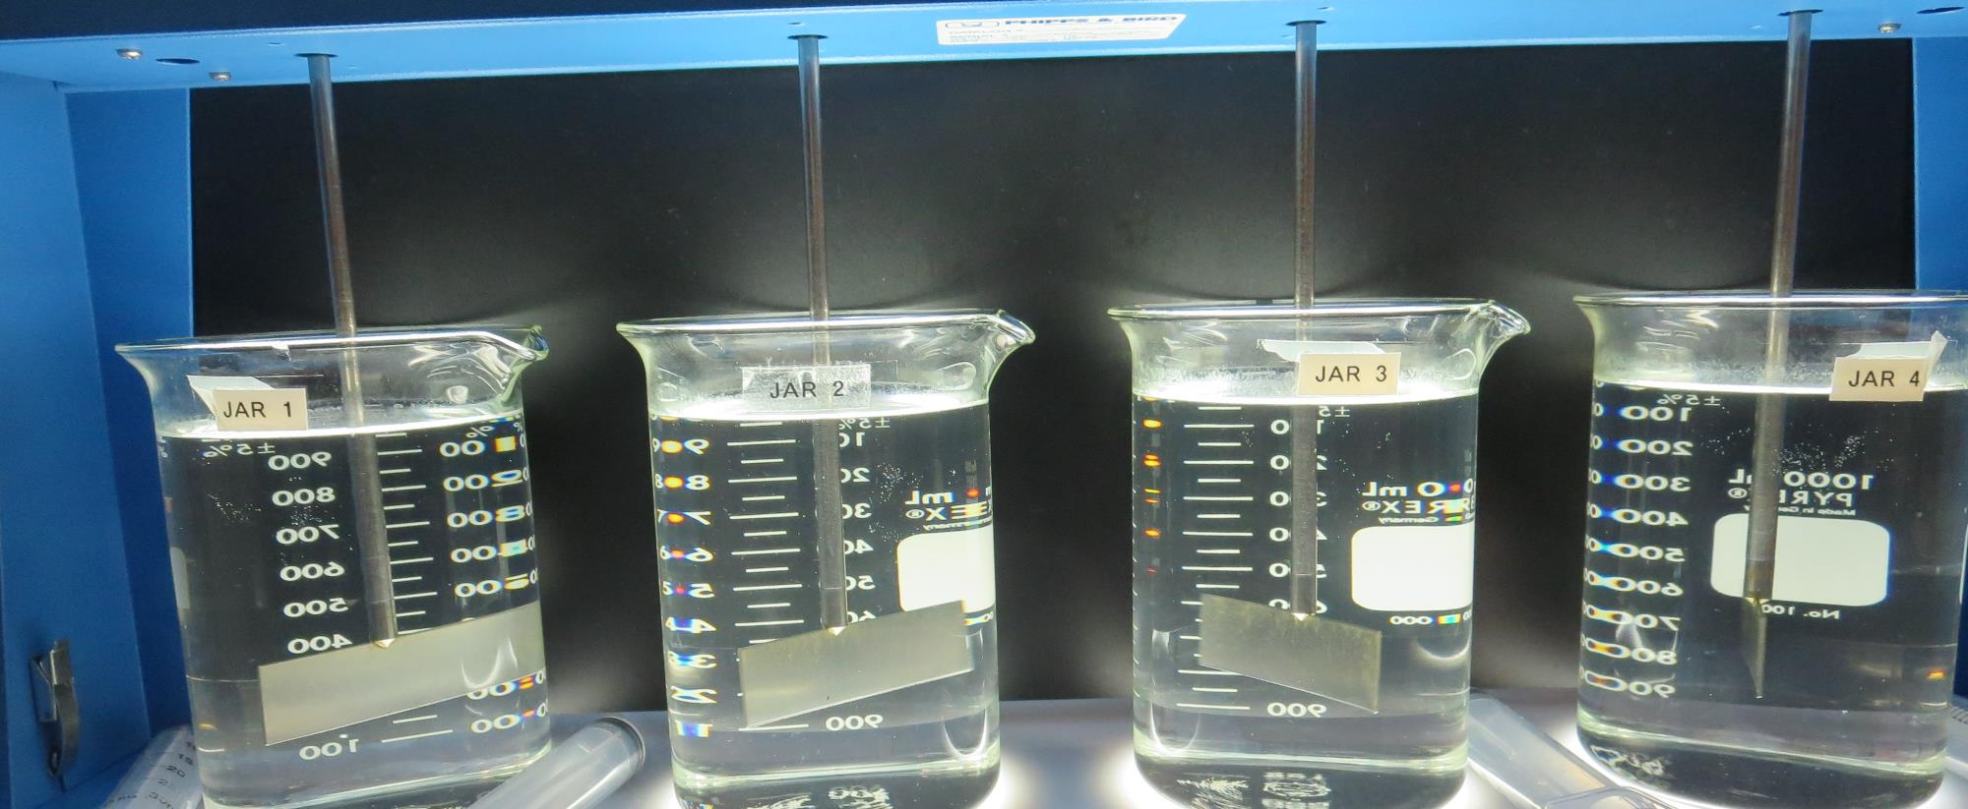
Jars 25-28: End of Floc Duration, 25 mL is syringed for filterability and %UVT/UVA.
0 mg/L CTC-00011
2.5 mg/L SWT 8809
Filtrate 0.23 NTU
UVT: 91.0%
UVA: 0.041/cm
UVA Reduction 10.9%
10 mg/L CTC-00011
2.5 mg/L SWT 8809
Filtrate 0.07 NTU
UVT: 95.0%
UVA: 0.022/cm
UVA Reduction 52.2%
14 mg/L CTC-00011
2.5 mg/L SWT 8809
Filtrate 0.05 NTU
UVT: 95.5%
UVA: 0.020/cm
UVA Reduction 56.5%
18 mg/L CTC-00011
2.5 mg/L SWT 8809
Filtrate 0.05 NTU
UVT: 95.6%
UVA: 0.019/cm
UVA Reduction 58.7%

Slide 36
Jars 29-32 Test Flash Mix 200 RPM, 20 Sec Floc Mix 20 RPM, 5 min 25 mL sampled end of Floc Applied Coagulants AdvFloc CTC-00011 SWT 8809

Slide 37
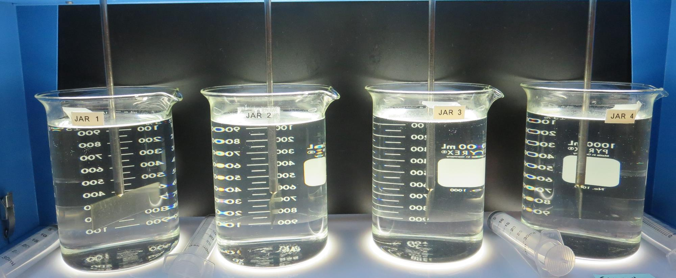
Jars 29-32: End of Floc Duration, 25 mL is syringed for filterability and %UVT/UVA.
0 mg/L CTC-00011
1.8 mg/L SWT 8809
Filtrate 0.28 NTU
UVT: 91.4%
UVA: 0.038/cm
UVA Reduction 17.4%
0 mg/L CTC-00011
3.8 mg/L SWT 8809
Filtrate 0.16 NTU
UVT: 93.5%
UVA: 0.029/cm
UVA Reduction 37.0%
28 mg/L CTC-00011
0 mg/L SWT 8809
Filtrate 0.04 NTU
UVT: 95.5%
UVA: 0.019/cm
UVA Reduction 58.7%
18 mg/L CTC-00011
2.5 mg/L SWT 8809
Filtrate 0.04 NTU
UVT: 95.6%
UVA: 0.019/cm
UVA Reduction 58.7%

Slide 38
Jars 33-36 Test Flash Mix 200 RPM, 20 Sec Floc Mix 20 RPM, 5 min 25 mL sampled end of Floc Applied Coagulant SWT 8809

Slide 39
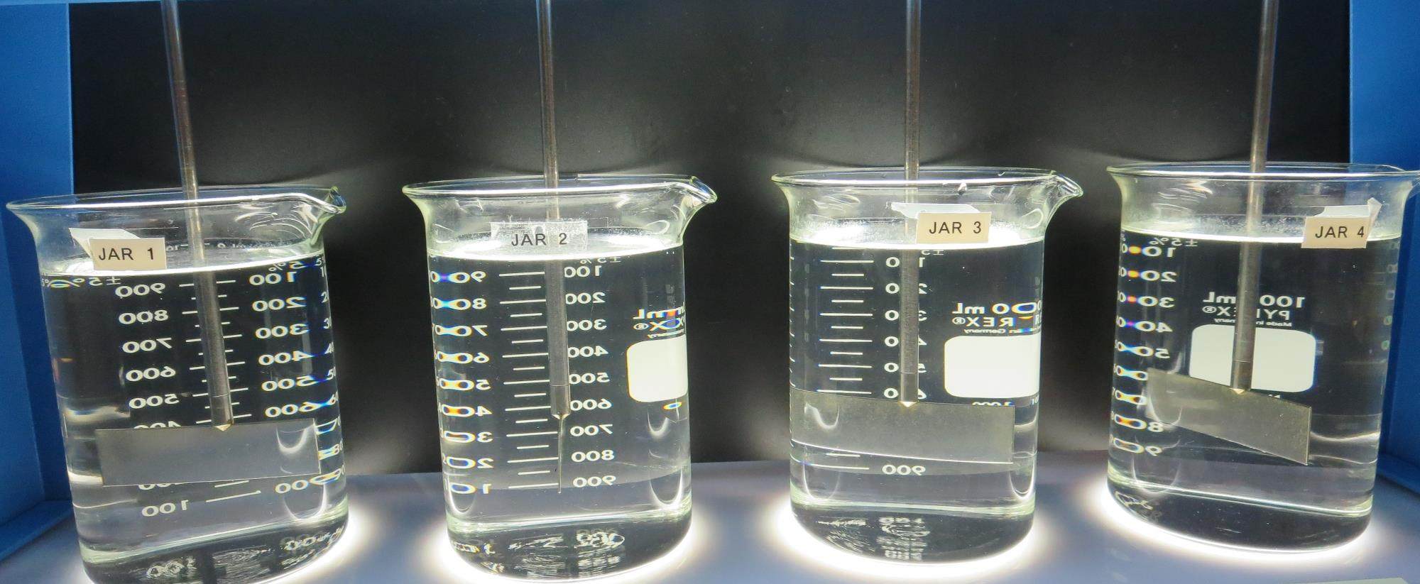
Jars 33-36: End of Floc Duration, 25 mL is syringed for filterability and %UVT/UVA.
2.8 mg/L SWT 8809
Filtrate 0.16 NTU
UVT: 93.0%
UVA: 0.031/cm
UVA Reduction 32.6%
3.2 mg/L SWT 8809
Filtrate 0.13 NTU
UVT: 93.3%
UVA: 0.030/cm
UVA Reduction 34.8%
3.6 mg/L SWT 8809
Filtrate 0.12 NTU
UVT: 93.3%
UVA: 0.029/cm
UVA Reduction 37.0%
4.0 mg/L SWT 8809
Filtrate 0.10 NTU
UVT: 94.0%
UVA: 0.026/cm
UVA Reduction 43.5%

Slide 40
Jars 37-40 Test Flash Mix 200 RPM, 20 Sec Floc Mix 20 RPM, 5 min 25 mL sampled end of Floc Applied Coagulants AdvFloc CTC-00011 SWT 8809

Slide 41
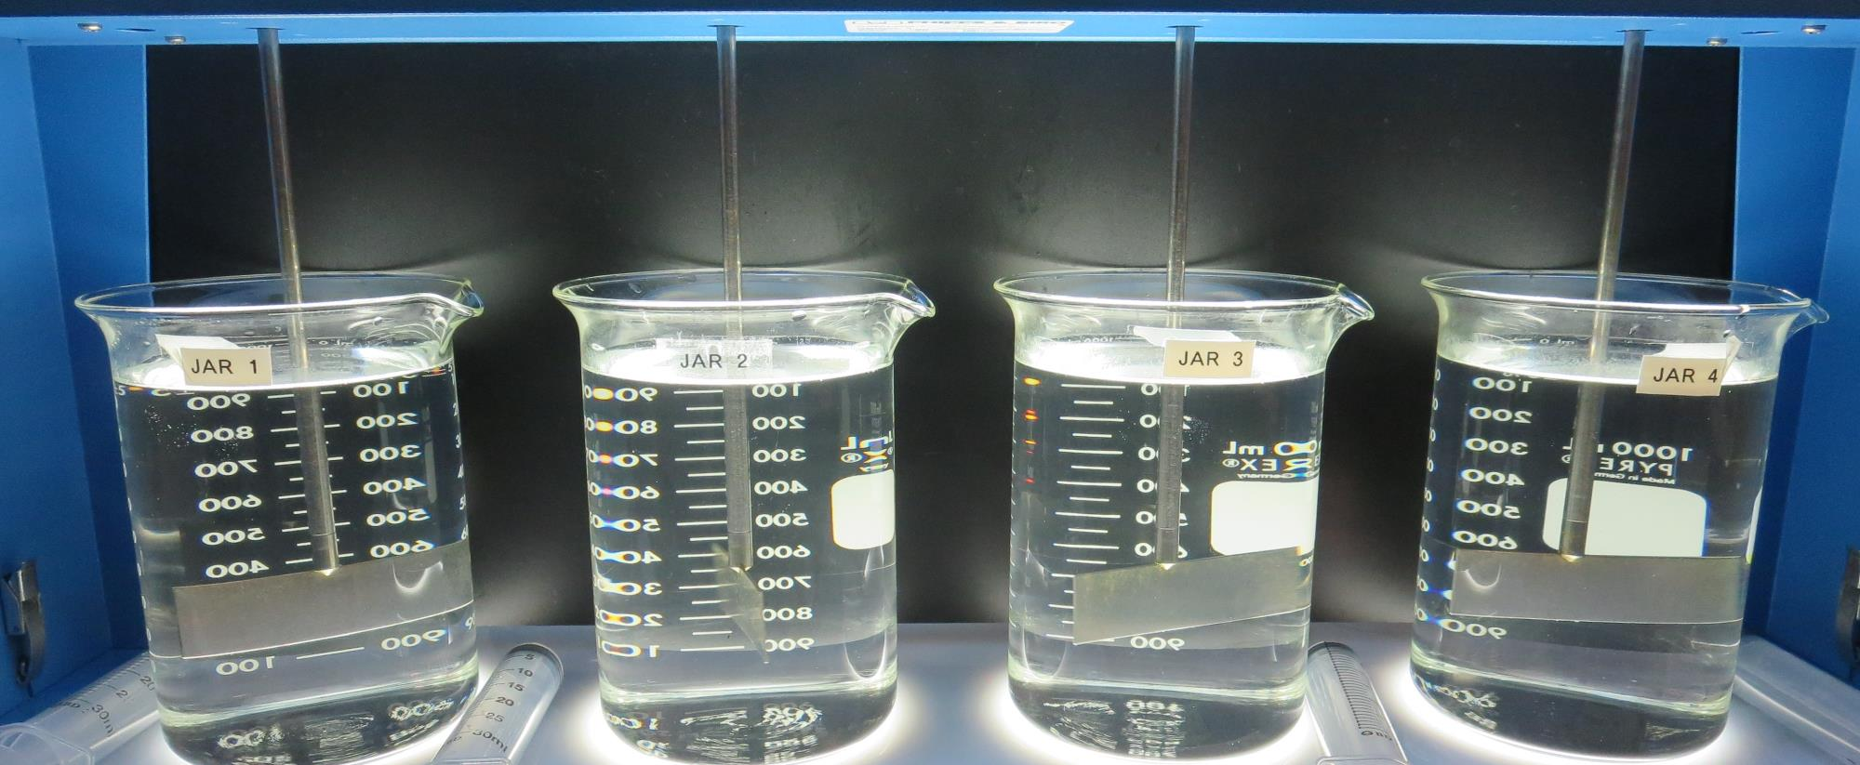
Jars 37-40: End of Floc Duration, 25 mL is syringed for filterability and %UVT/UVA.
12 mg/L CTC-00011
2.8 mg/L SWT 8809
Filtrate 0.05 NTU
UVT: 95.7%
UVA: 0.019/cm
UVA Reduction 57.7%
12 mg/L CTC-00011
3.2 mg/L SWT 8809
Filtrate 0.05 NTU
UVT: 95.8%
UVA: 0.018/cm
UVA Reduction 60.9%
12 mg/L CTC-00011
3.6 mg/L SWT 8809
Filtrate 0.05 NTU
UVT: 95.8%
UVA: 0.018/cm
UVA Reduction 60.9%
12 mg/L CTC-00011
4.0 mg/L SWT 8809
Filtrate 0.07 NTU
UVT: 95.7%
UVA: 0.019/cm
UVA Reduction 58.7%

Slide 42
Jars 41-44 Test Flash Mix 200 RPM, 20 Sec Floc Mix 20 RPM, 5 min 25 mL sampled end of Floc Applied Coagulant SWT 8809

Slide 43
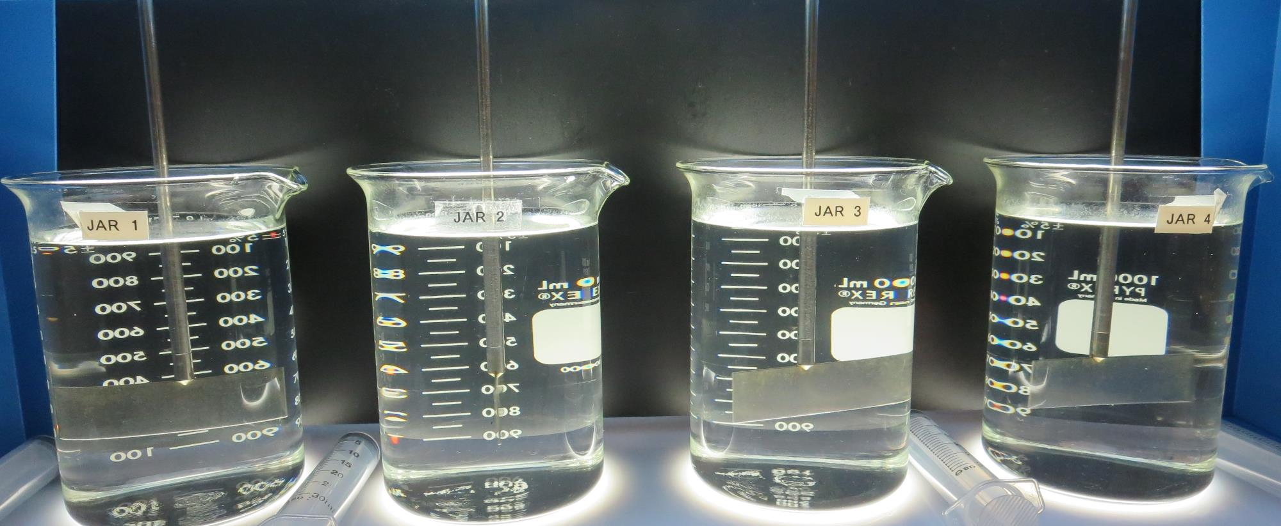
Jars 41-44: End of Floc Duration, 25 mL is syringed for filterability and %UVT/UVA.
1.8 mg/L SWT 8809
**Filtrate 0.09 NTU
UVT: 92.7%
UVA: 0.032/cm
UVA Reduction 30.4%
3.2 mg/L SWT 8809
Filtrate 0.11 NTU
UVT: 93.8%
UVA: 0.028/cm
UVA Reduction 39.1%
3.7 mg/L SWT 8809
Filtrate 0.08 NTU
UVT: 94.1%
UVA: 0.026/cm
UVA Reduction 43.5%
4.2 mg/L SWT 8809
Filtrate 0.08 NTU
UVT: 94.3%
UVA: 0.025/cm
UVA Reduction 45.7%

Slide 44
Jars 45-48 Test Flash Mix 200 RPM, 20 Sec Floc Mix 20 RPM, 5 min 25 mL sampled end of Floc Applied Coagulants AdvFloc CTC-00011 SWT 8809

Slide 45
Jars 45-48: End of Floc Duration, 25 mL is syringed for filterability and %UVT/UVA.
10 mg/L CTC-00011
1.8 mg/L SWT 8809
Filtrate 0.05 NTU
UVT: 95.2%
UVA: 0.021/cm
UVA Reduction 54.3%
15 mg/L CTC-00011
1.8 mg/L SWT 8809
Filtrate 0.05 NTU
UVT: 95.4%
UVA: 0.020/cm
UVA Reduction 56.5%
10 mg/L CTC-00011
2.8 mg/L SWT 8809
Filtrate 0.04 NTU
UVT: 95.6%
UVA: 0.019/cm
UVA Reduction 58.7%
15 mg/L CTC-00011
2.8 mg/L SWT 8809
Filtrate 0.04 NTU
UVT: 95.9%
UVA: 0.017/cm
UVA Reduction 63.0%

Slide 46
Jar Testing for 1-Liter Jars: Procedures for Most Treatment Plants
Fill jars with source water prior to coagulant injection and set paddle speed at 30 rpm
Add chemicals (i.e., NaOCl, primary coagulant, coagulant aid) to each jar
Flash mix for 15-30 seconds (200 rpm)
Slow mix for 5 minutes (20-30 rpm)
Settled for 5 minutes. Syringe 25 mL from each jar taken 1-inch below surface (25 mL/12 sec rate)
Filtered through 1.2 um isopore membrane into cuvette drip rate, 15 mL/(50-90 sec)
Measure filtrate turbidity, chlorine residual and %UVT/UVA
Measure settled water turbidity after 25 minutes of total setting
Record all data

Slide 47
Jar Test Filterability Test Equipment
Turbidity Instrument
Syringe w/Luer-Lock Tip, 30 cc
(part#: 2225800, by Hach)
Swinnex Filter Holder, 25 mm (part#: SX0002500)
Isopore Membrane Filter, 1.2 um absolute
pore size,
Φ= 25 mm , thickness: 24 um,
hydrophilic polycarbonate membrane
(part #: RTTP02500)
Go to Sigma-Aldrich for laboratory supplies http://www.sigmaaldrich.com/united-states.html

Slide 48
Isopore Membrane Information
Categories | Information
trade name | Isopore
filter color | White
chemistry | Polycarbonate (PC)
water flow rate | Avg. 175 mL/min x cm² (typical results @ 10 psi)
media | Isopore®
wettability | Hydrophilic
porosity | 14.7%
pore size | 1.2 µm
bubble point at 23 °C | 1.0 bar, air with water
thickness | 24 µm
filter diameter (ø) | 25 mm
material size | polycarbonate, Hydrophilic, 1.2 µm, 25 mm, white, plain, 100

Slide 49
Isopore Membrane Background Information
The Isopore membrane is a polycarbonate, track-etched screen filter recommended for all analyses in which the sample is viewed on the surface of the membrane. The Isopore membrane is composed of polycarbonate film, which has a smooth, glass-like surface for clearer sample observation. The unique manufacturing process of the membrane ensures a precise pore diameter and a consistent pore size for accurate separation of samples by size. Matched-weight filters are not usually required because of low, constant tar and ash weights. Features & Benefits: Membrane structure retains particles on the surface, simplifying counting and analysis

Slide 50
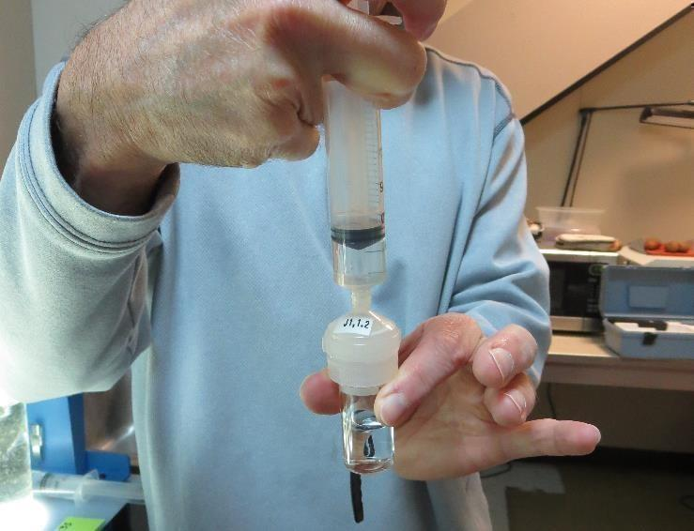
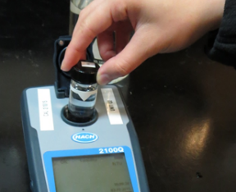
Jar Test - Filterability Test
Syringe ~ 25 mL from jar (after 5-minutes of settling)
Filter-to-waste 3-5 mL
Filter directly into clean cuvette
Measure turbidity
Note: Take several readings before recording final NTU results. Micro bubbles can adhere to glass causing false NTU readings. To remove bubbles, tilt cuvette up to 90 degrees.

Slide 51
Contact
Guy Schott, P.E.
State Water Resources Control Board
Division of Drinking Water
Santa Rosa, CA
Go to Stock Solution/Dose calculations/Jar Test Results for tools to download
www.waterboards.ca.gov/drinking_water/programs/districts/mendocino_district.html
Email: Guy Schott - Guy.Schott@waterboards.ca.gov
Office Number: 707-576-2732

