Slide 1
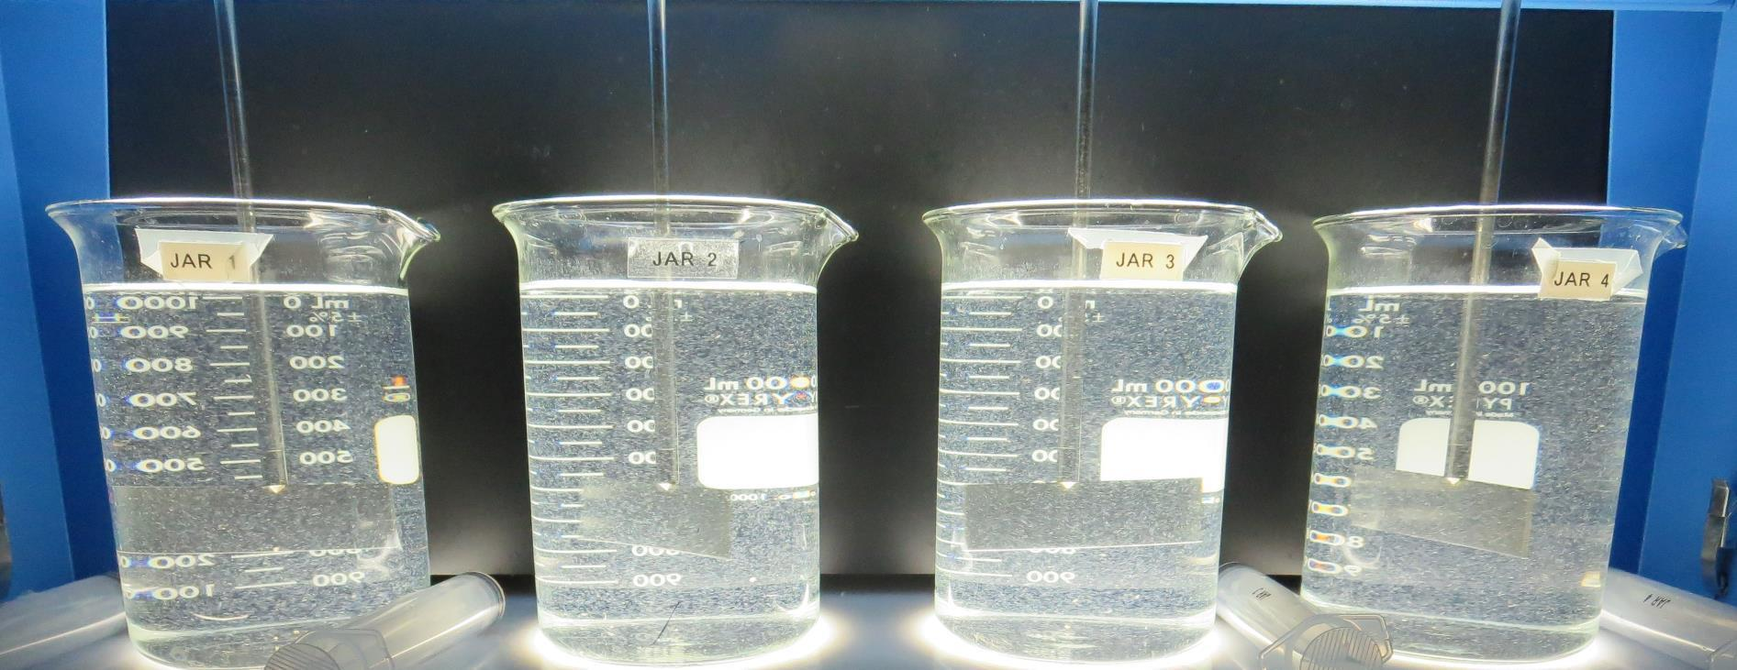
El Centro, City of CA1310004 Imperial County Jar Test
by Guy Schott, P.E.
January 19, 2021

Slide 2
El Centro WTP Source: South Date – Gate 20B

Slide 3
El Centro WTP Water Characteristics January 19, 2021
Source
pH: 8.35-8.40
Alkalinity: 142 mg/L as CaCO₃
Turbidity: 3.28 NTU
UVT: 86.7%,
UVA: 0.062/cm
0.4 um Filtered
Turbidity: 0.18 NTU
UVT: 89.0%,
UVA: 0.050/cm
Plant Coagulant Dose:
Alum: 26 mg/L
308P: 2.5 mg/L

Slide 4
Source Water Dose with 2.0 mg/L NaOCl (note: Sample from 1/12/21)
Time, minutes | %UVT | UVA/cm | %UVA Reduction | Cl₂, mg/L
0 | 87.1 | 0.059 | - | 0
11 | 87.9 | 0.056 | 5.1 | 1.04
22 | 88.3 | 0.053 | 10.2 | 1.00
33 | 88.4 | 0.053 | 10.2 | 0.95
42 | 88.5 | 0.053 | 10.2 | 0.89

Slide 5
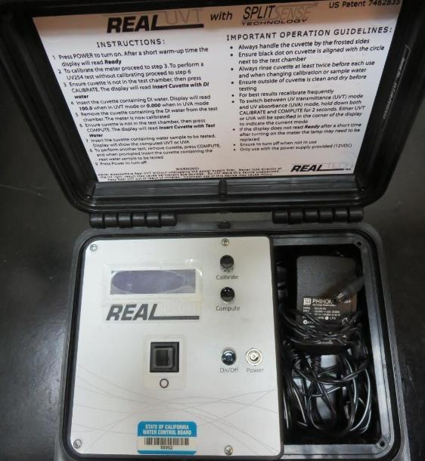
UVT/UVA, pathlength 10 mm
UV transmittance (UVT) is a measurement of the amount of ultraviolet light (commonly at 254 nm due to its germicidal effect) that passes through a water sample compared to the amount of light that passes through a pure water sample. The measurement is expressed as a percentage, % UVT.
%UVT = 10^{(-UVA)} x 100%
UV absorbance (UVA) is calculated as a relative measure of the amount of light absorbed by a water sample compared with the amount of light absorbed by a pure water sample.
UVA = -log(%UVT/100)

Slide 6
Applied Coagulants for Jar Testing (1)
Aluminum Sulfate (Product)
Al₂(SO₄)₃*14.3H₂0 (diluted)
48% Aluminum Sulfate
52% Water
8.2% Al₂O₃
0% Basicity
SG = 1.32
NSF limit: 400 mg/L (product)
As hydrated Al₂(SO₄)₃*14.3H₂0
17% Al₂O₃
Polydyne Incorporated
Clarifloc C-308P
SG = 1.0 – 1.2
pDADMAC (20% active, 80% H₂O)
NSF limit: 50 mg/L (product)
Product dose 5 mg/L = 1 mg/L pDADMAC active

Slide 7
Applied Coagulants for Jar Testing (2)
Pro Pac 9800 (NTU Technologies)
50% Aluminum Chlorohydrate
50% Water
23.62% Al₂O₃
12.5% Al
83% Basicity
SG = 1.25-1.34
NSF limit: 250 mg/L as Product;

Slide 8
Applied Coagulants for Jar Testing (3)
Pro Pac 9810 (NTU Technologies)
45-50% Aluminum Chlorohydrate
45-50% Water
~22.4% Al₂O₃
~11.9% Al
5% polyamine (50% water, 50% active polyamines)
SG = 1.25-1.34
NSF limit: 200 mg/L as Product;
Product dose 40 mg/L = 1 mg/L polyamines active
Pro Pac 917 (NTU Technologies)
40-50% Aluminum Chlorohydrate
40-50% Water
~21.3% Al₂O₃
~11% Al
10% polyamine (50% water, 50% active polyamines)
SG = 1.25-1.34
NSF limit: 100 mg/L as Product;
Product dose 20 mg/L = 1 mg/L polyamines active

Slide 9
Applied Coagulants for Jar Testing (4)
7040 (Garratt-Callahan Company)
10-30% Aluminum Chloride
SG = 1.25-1.31
NSF limit: 70 mg/L as Product;
7049 (Garratt-Callahan Company)
25-50% Aluminum Chloride Hydroxide Sulfate
<50% Polyquaternary Amine
SG = 1.1-1.2
NSF limit: 100 mg/L as Product;

Slide 10
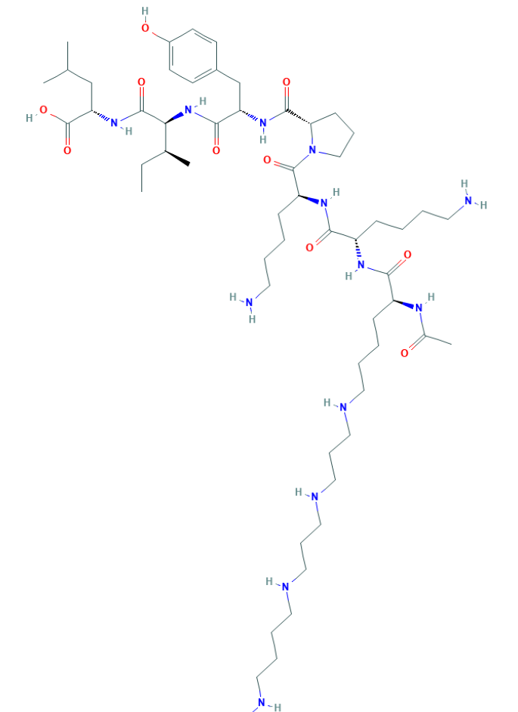
Polyamine C₅₉H₁₀₈N₁₄O₁₀ MW: 1,173.6 g/mol

Slide 11
Diallyldimethylammonium chloride or N-allyl-N,N-dimethylprop-2-en-1-aminium chloride pDADMAC C₈H₁₆ClN MW: 161.67 g/mol
CH₃
CH₂
CH₂
CH
N
+
CH
CH₂
CH₂
CH₃
Cl⁻

Slide 12
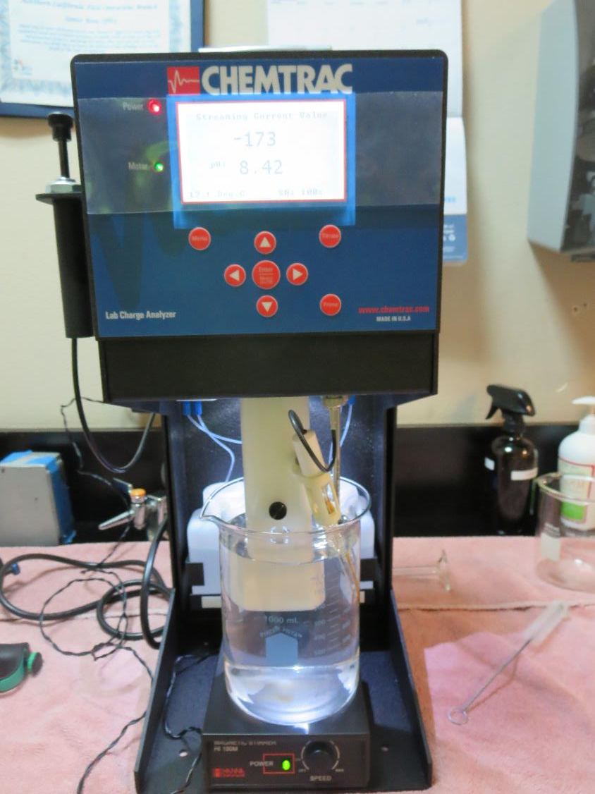
Laboratory Charge Analyzer
LCA: Used to determine coagulant demand of a source water entering the treatment plant.
Source pH: 8.17
LCA #1: Alum: 52 mg/L as hydrated
pH adjusted to 6.6 with acetic acid
LCA #2: NaOCl: 2 mg/L
Alum: 58 mg/L as hyrdrated
pH adjusted to 6.6 with acetic acid
LCA #3: 9800: NaOCl: 2 mg/L
38 mg/L as product
pH adjusted to 7.5 with acetic acid

Slide 13
Coagulant Information
Unless stated otherwise, all coagulant doses are reported as Product (100% strength).
Aluminum Sulfate doses are reported as hydrated Al₂(SO₄)₃*14.3H₂0.
Preparation of coagulant stock solutions are generally 1.0 and/or 0.1 percent strength using 100 and/or 200 mL volumetric flasks.
Finnpipette F2 variable volume pipette, capacity 100-1000 micro liters is used for stock solution preparation and coagulant aid jar test dosing.
Finnpipette F2 variable volume pipette, capacity 0.5-5 mL is used for primary coagulant jar test dosing.

Slide 14
El Centro WTP, Jar Test 1 - 8 Results Flash Mix 200 RPM (30 sec); Floc Mix 30 RPM (5 min)
Jar# | NaOCl mg/L | 9800 mg/L | Filtrate NTU | Filtrate %UVT | Filtrate UVA/cm | %UVA Reduction | Settle NTU 25 min
J1 | 2.0 | 20 | 0.19 | 92.1 | 0.035 | 30 | 3.81
J2 | 2.0 | 23 | 0.21 | 92.1 | 0.035 | 30 | 2.96
J3 | 2.0 | 26 | 0.22 | 92.3 | 0.034 | 32 | 3.00
J4 | 2.0 | 29 | 0.13 | 92.8 | 0.032 | 36 | 3.00
J5 | 2.0 | 32 | 0.19 | 92.5 | 0.033 | 34 | 1.36
J6 | 2.0 | 35 | 0.12 | 92.7 | 0.032 | 36 | 1.34
J7 | 2.0 | 38 | 0.20 | 92.7 | 0.032 | 36 | 1.69
J8 | 2.0 | 41 | 0.20 | 92.7 | 0.032 | 36 | 1.85

Slide 15
El Centro WTP, Jar Test 9 - 16 Results Flash Mix 200 RPM (30 sec); Floc Mix 30 RPM (5 min)
Jar# | NaOCl mg/L | 9810 mg/L | Filtrate NTU | Filtrate %UVT | Filtrate UVA/cm | %UVA Reduction | Settle NTU 25 min
J9 | 2.0 | 32 | 0.08 | 92.8 | 0.032 | 36 | 1.21
J10 | 2.0 | 35 | 0.09 | 93.0 | 0.031 | 38 | 0.99
J11 | 2.0 | 38 | 0.15 | 92.9 | 0.032 | 36 | 1.36
J12 | 2.0 | 41 | 0.15 | 93.1 | 0.030 | 41 | 1.17
J13 | 2.0 | 26 | 0.17 | 93.4 | 0.029 | 42 | 1.34
J14 | 2.0 | 29 | 0.13 | 93.8 | 0.027 | 46 | 1.04
J15 | 2.0 | 32 | 0.13 | 93.8 | 0.027 | 46 | 1.34
J16 | 2.0 | 35 | 0.09 | 93.8 | 0.027 | 46 | 1.15

Slide 16
El Centro WTP, Jar Test 17 - 24 Results Flash Mix 200 RPM (30 sec); Floc Mix 30 RPM (5 min)
Jar# | NaOCl mg/L | 9800 mg/L | C-308P mg/L | Filtrate NTU | Filtrate %UVT | Filtrate UVA/cm | %UVA Reduction | Settle NTU 25 min
J17 | 2.0 | 20 | 1.5 | 0.22 | 92.3 | 0.034 | 32 | 2.77
J18 | 2.0 | 23 | 1.73 | 0.17 | 92.3 | 0.034 | 32 | 2.43
J19 | 2.0 | 26 | 1.95 | 0.19 | 92.6 | 0.033 | 34 | 1.91
J20 | 2.0 | 29 | 2.18 | 0.11 | 92.9 | 0.031 | 38 | 1.87
J21 | 2.0 | 29 | 2.18 | 0.14 | 92.7 | 0.032 | 36 | 1.46
J22 | 2.0 | 32 | 2.4 | 0.15 | 92.8 | 0.032 | 36 | 1.56
J23 | 2.0 | 35 | 2.63 | 0.17 | 92.8 | 0.032 | 36 | 1.57
J24 | 2.0 | 38 | 2.85 | 0.20 | 93.0 | 0.031 | 38 | 1.29

Slide 17
El Centro WTP, Jar Test 25 - 32 Results Flash Mix 200 RPM (30 sec); Floc Mix 30 RPM (5 min)
Jar# | NaOCl mg/L | 917 mg/L | Filtrate NTU | Filtrate %UVT | Filtrate UVA/cm | %UVA Reduction | Settle NTU 25 min
J25 | 2.0 | 26 | 0.09 | 93.8 | 0.027 | 46 | 2.05
J26 | 2.0 | 29 | 0.09 | 93.9 | 0.027 | 46 | 2.28
J27 | 2.0 | 32 | 0.15 | 93.8 | 0.027 | 46 | 1.98
J28 | 2.0 | 35 | 0.10 | 94.0 | 0.026 | 48 | 2.02
J29 | 2.0 | 20 | 0.10 | 93.5 | 0.028 | 44 | 3.07
J30 | 2.0 | 22 | 0.13 | 93.5 | 0.028 | 44 | 2.98
J31 | 2.0 | 24 | 0.13 | 93.5 | 0.029 | 42 | 2.63
J32 | 2.0 | 26 | 0.09 | 93.9 | 0.027 | 46 | 2.52

Slide 18
El Centro WTP, Jar Test 33 - 40 Results Flash Mix 200 RPM (30 sec); Floc Mix 30 RPM (5 min)
Jar# | NaOCl mg/L | 7049 mg/L | Filtrate NTU | Filtrate %UVT | Filtrate UVA/cm | %UVA Reduction | Settle NTU 25 min
J33 | 2.0 | 35 | 0.23 | 93.3 | 0.029 | 42 | 1.62
J34 | 2.0 | 40 | 0.16 | 93.3 | 0.029 | 42 | 1.61
J35 | 2.0 | 45 | 0.16 | 93.3 | 0.029 | 42 | 1.74
J36 | 2.0 | 50 | 0.17 | 93.2 | 0.030 | 40 | 1.58
J37 | 2.0 | 55 | 0.28 | 93.4 | 0.029 | 42 | 0.94
J38 | 2.0 | 60 | 0.11 | 93.4 | 0.029 | 42 | 1.20
J39 | 2.0 | 65 | 0.11 | 93.3 | 0.029 | 42 | 1.15
J40 | 2.0 | 70 | 0.08 | 93.5 | 0.029 | 42 | 1.15

Slide 19
El Centro WTP, Jar Test 41 - 44 Results Flash Mix 200 RPM (30 sec); Floc Mix 30 RPM (5 min)
Jar# | NaOCl mg/L | 7040 mg/L | Filtrate NTU | Filtrate %UVT | Filtrate UVA/cm | %UVA Reduction | Settle NTU 25 min
J41 | 2.0 | 25 | 0.11 | 92.5 | 0.033 | 34 | 2.56
J42 | 2.0 | 30 | 0.10 | 92.3 | 0.034 | 32 | 2.64
J43 | 2.0 | 35 | 0.12 | 92.0 | 0.035 | 30 | 2.48
J44 | 2.0 | 40 | 0.15 | 92.0 | 0.036 | 28 | 1.97

Slide 20
El Centro WTP, Jar Test 45 - 48 Results Flash Mix 200 RPM (30 sec); Floc Mix 30 RPM (5 min)
Jar# | NaOCl mg/L | 917 mg/L | 7049 mg/L | Filtrate NTU | Filtrate %UVT | Filtrate UVA/cm | %UVA Reduction | Settle NTU 25 min
J45 | 2.0 | 26 | 0 | 0.07 | 93.6 | 0.028 | 44 | 2.01
J46 | 2.0 | 29 | 0 | 0.07 | 93.7 | 0.028 | 44 | 2.15
J47 | 2.0 | 0 | 30 | 0.08 | 93.2 | 0.030 | 40 | 2.42
J48 | 2.0 | 0 | 70 | 0.06 | 93.5 | 0.028 | 44 | 1.12

Slide 21
El Centro WTP, Jar Test 49 - 56 Results Flash Mix 200 RPM (30 sec); Floc Mix 30 RPM (5 min)
Jar# | NaOCl mg/L | Alum mg/L | C-308P mg/L | Filtrate NTU | Filtrate %UVT | Filtrate UVA/cm | %UVA Reduction | Settle NTU 25 min
J49 | 2.0 | 12.5 | 2.6 | 0.19 | 91.5 | 0.038 | 24 | 2.20
J50 | 2.0 | 14.4 | 3.0 | 0.16 | 91.7 | 0.037 | 26 | 3.67
J51 | 2.0 | 16.8 | 3.5 | 0.10 | 92.0 | 0.036 | 28 | 3.52
J52 | 2.0 | 19.2 | 4.0 | 0.11 | 92.0 | 0.035 | 30 | 2.91
J53 | 2.0 | 26 | 2.6 | 0.16 | 92.1 | 0.035 | 30 | 2.03
J54 | 2.0 | 30 | 3.0 | 0.11 | 92.4 | 0.034 | 32 | 1.84
J55 | 2.0 | 35 | 3.5 | 0.09 | 92.8 | 0.032 | 36 | 1.36
J56 | 2.0 | 40 | 4.0 | 0.12 | 92.9 | 0.031 | 38 | 1.23

Slide 22
El Centro WTP, Jar Test 57 - 64 Results Flash Mix 200 RPM (30 sec); Floc Mix 30 RPM (5 min)
Jar# | NaOCl mg/L | Alum mg/L | C-308P mg/L | Filtrate NTU | Filtrate %UVT | Filtrate UVA/cm | %UVA Reduction | Settle NTU 25 min
J57 | 2.0 | 45 | 4.5 | 0.14 | 93.0 | 0.031 | 38 | 1.15
J58 | 2.0 | 50 | 5.0 | 0.15 | 93.2 | 0.030 | 40 | 1.13
J59 | 2.0 | 55 | 5.5 | 0.09 | 93.3 | 0.030 | 40 | 1.16
J60 | 2.0 | 60 | 6.0 | 0.12 | 93.3 | 0.029 | 42 | 1.20
J61 | 2.0 | 55 | 0.0 | 0.12 | 93.0 | 0.031 | 38 | 1.10
J62 | 2.0 | 55 | 3.0 | 0.12 | 93.1 | 0.031 | 38 | 1.06
J63 | 2.0 | 55 | 5.5 | 0.12 | 93.2 | 0.030 | 40 | 1.11
J64 | 2.0 | 55 | 8.0 | 0.11 | 93.0 | 0.031 | 38 | 1.10

Slide 23
El Centro WTP, Jar Test 65 - 72 Results Flash Mix 200 RPM (30 sec); Floc Mix 30 RPM (5 min)
Jar # | NaOCl mg/L | Alum mg/L | 9800 mg/L | 9810 mg/L | 917 mg/L | Filtrate NTU | Filtrate %UVT | Filtrate UVA/cm | %UVA Reduct | Settle NTU 25 min
J65 | 2.0 | 26 | 0 | 0 | 0 | 0.09 | 92.1 | 0.035 | 30 | 1.99
J66 | 2.0 | 0 | 20 | 0 | 0 | 0.13 | 92.2 | 0.035 | 30 | 3.76
J67 | 2.0 | 0 | 0 | 29 | 0 | 0.09 | 93.3 | 0.030 | 40 | 1.26
J68 | 2.0 | 0 | 0 | 0 | 26 | 0.12 | 93.2 | 0.030 | 40 | 2.24
J69 | 2.0 | 40 | 0 | 0 | 0 | 0.10 | 92.8 | 0.032 | 36 | 1.10
J70 | 2.0 | 0 | 29 | 0 | 0 | 0.07 | 92.6 | 0.033 | 34 | 2.19
J71 | 2.0 | 0 | 0 | 32 | 0 | 0.12 | 93.0 | 0.031 | 38 | 1.20
J72 | 2.0 | 0 | 0 | 0 | 29 | 0.13 | 93.0 | 0.031 | 38 | 1.70

Slide 24
El Centro WTP, Jar Test 73 - 76 Results Flash Mix 200 RPM (30 sec); Floc Mix 30 RPM (5 min)
Jar # | NaOCl mg/L | Alum mg/L | 9800 mg/L | 9810 mg/L | Filtrate NTU | Filtrate %UVT | Filtrate UVA/cm | %UVA Reduct | Settle NTU 25 min
J73 | 2.0 | 45 | 0 | 0 | 0.11 | 92.8 | 0.032 | 36 | 1.00
J74 | 2.0 | 50 | 0 | 0 | 0.12 | 92.7 | 0.032 | 36 | 0.94
J75 | 2.0 | 0 | 36 | 0 | 0.08 | 92.9 | 0.031 | 38 | 1.28
J76 | 2.0 | 0 | 0 | 36 | 0.08 | 93.3 | 0.029 | 42 | 0.95

Slide 25
Jars 1-4 Test Flash Mix 30 Sec (200 RPM) Floc Mix 5 min (30 RPM) Pre-Oxidant (NaOCl) Applied Coagulant 9800

Slide 26
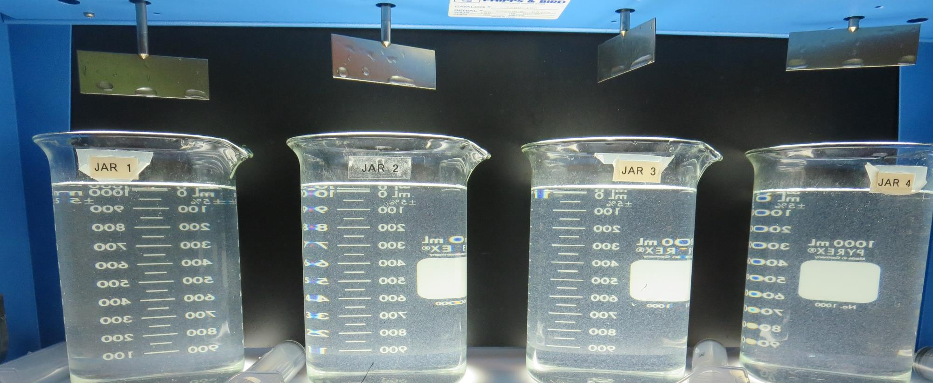
Jars 1-4: End of 5-minute flocculation (30 RPM) duration.
2.0 mg/L NaOCl
20 mg/L 9800
Filtrate 0.19 NTU
UVT: 92.1%
UVA: 0.035/cm
UVA Reduction 30%
Settled: 3.81 NTU
2.0 mg/L NaOCl
23 mg/L 9800
Filtrate 0.21 NTU
UVT: 92.1%
UVA: 0.035/cm
UVA Reduction 30%
Settled: 2.96 NTU
2.0 mg/L NaOCl
26 mg/L 9800
Filtrate 0.22 NTU
UVT: 92.3%
UVA: 0.034/cm
UVA Reduction 32%
Settled: 3.00 NTU
2.0 mg/L NaOCl
29 mg/L 9800
Filtrate 0.13 NTU
UVT: 92.8%
UVA: 0.032/cm
UVA Reduction 36%
Settled: 3.00 NTU

Slide 27
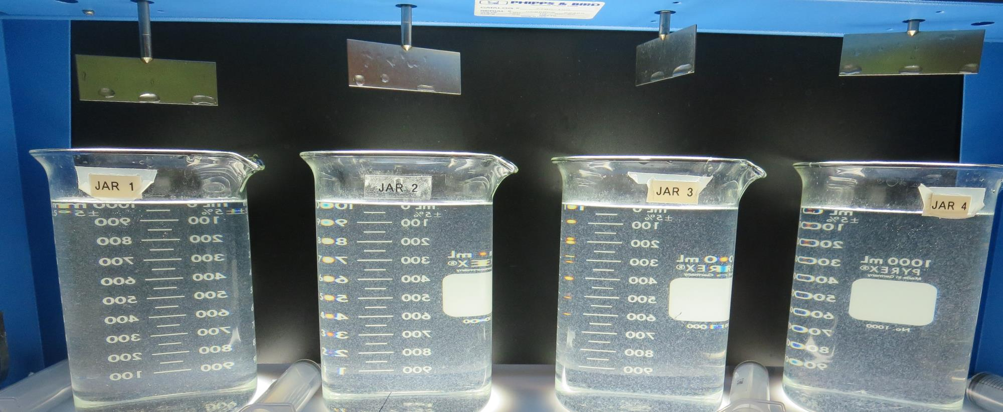
Jars 1-4: After 5 min of settling, 25 mL is syringed for filterability and %UVT/UVA.

Slide 28
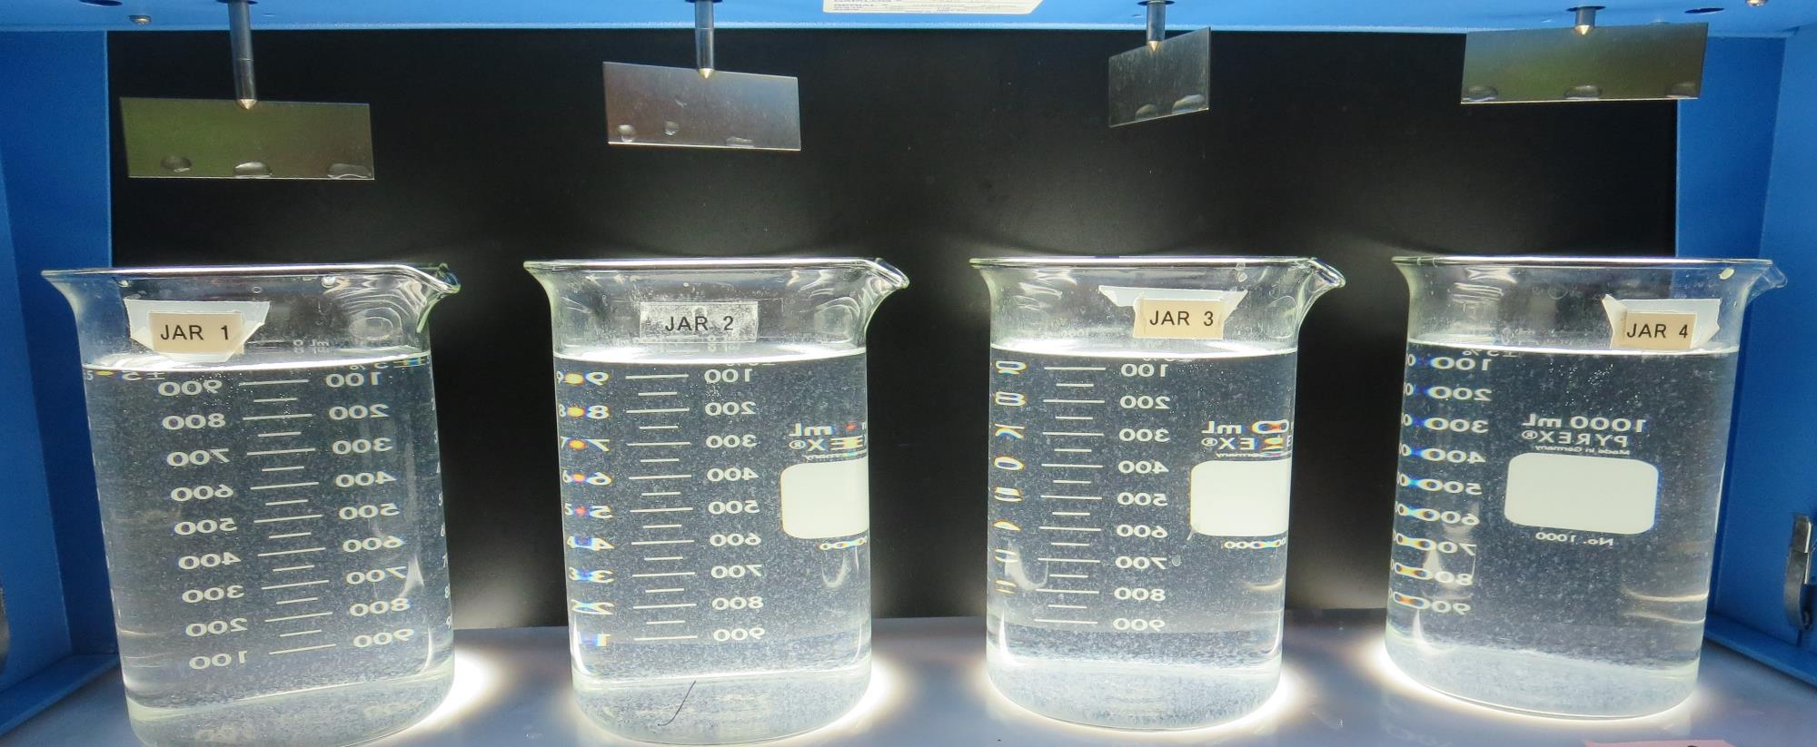
Jars 1-4: After 25-minutes of settling, settled water turbidity is taken.
2.0 mg/L NaOCl
20 mg/L 9800
Filtrate 0.19 NTU
UVT: 92.1%
UVA: 0.035/cm
UVA Reduction 30%
Settled: 3.81 NTU
2.0 mg/L NaOCl
23 mg/L 9800
Filtrate 0.21 NTU
UVT: 92.1%
UVA: 0.035/cm
UVA Reduction 30%
Settled: 2.96 NTU
2.0 mg/L NaOCl
26 mg/L 9800
Filtrate 0.22 NTU
UVT: 92.3%
UVA: 0.034/cm
UVA Reduction 32%
Settled: 3.00 NTU
2.0 mg/L NaOCl
29 mg/L 9800
Filtrate 0.13 NTU
UVT: 92.8%
UVA: 0.032/cm
UVA Reduction 36%
Settled: 3.00 NTU

Slide 29
Jars 5-8 Test Flash Mix 30 Sec (200 RPM) Floc Mix 5 min (30 RPM) Pre-Oxidant (NaOCl) Applied Coagulant 9800

Slide 30
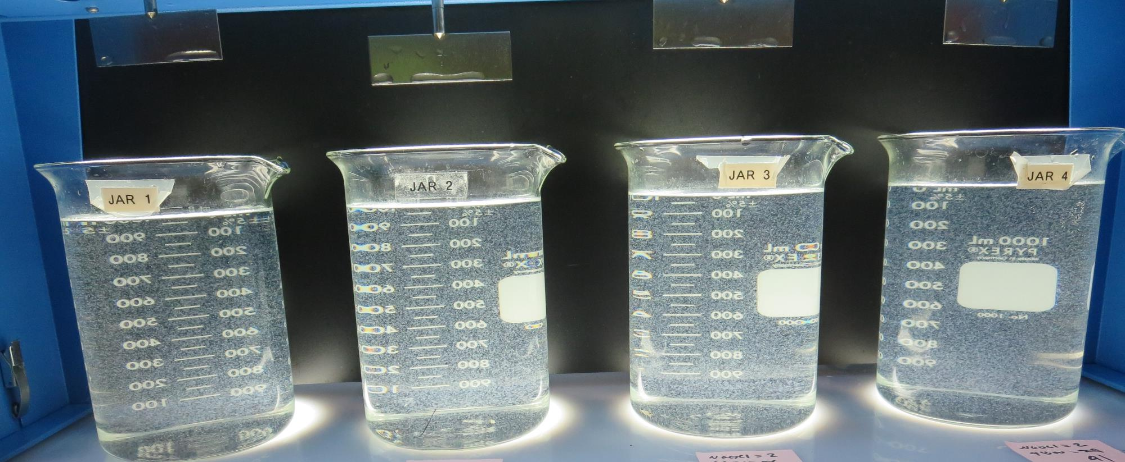
Jars 5-8: End of 5-minute flocculation (30 RPM) duration.
2.0 mg/L NaOCl
32 mg/L 9800
Filtrate 0.19 NTU
UVT: 92.5%
UVA: 0.033/cm
UVA Reduction 34%
Settled: 1.36 NTU
2.0 mg/L NaOCl
35 mg/L 9800
Filtrate 0.12 NTU
UVT: 92.7%
UVA: 0.032/cm
UVA Reduction 36%
Settled: 1.34 NTU
2.0 mg/L NaOCl
38 mg/L 9800
Filtrate 0.20 NTU
UVT: 92.7%
UVA: 0.032/cm
UVA Reduction 36%
Settled: 1.69 NTU
2.0 mg/L NaOCl
41 mg/L 9800
Filtrate 0.20 NTU
UVT: 92.7%
UVA: 0.032/cm
UVA Reduction 36%
Settled: 1.85 NTU

Slide 31
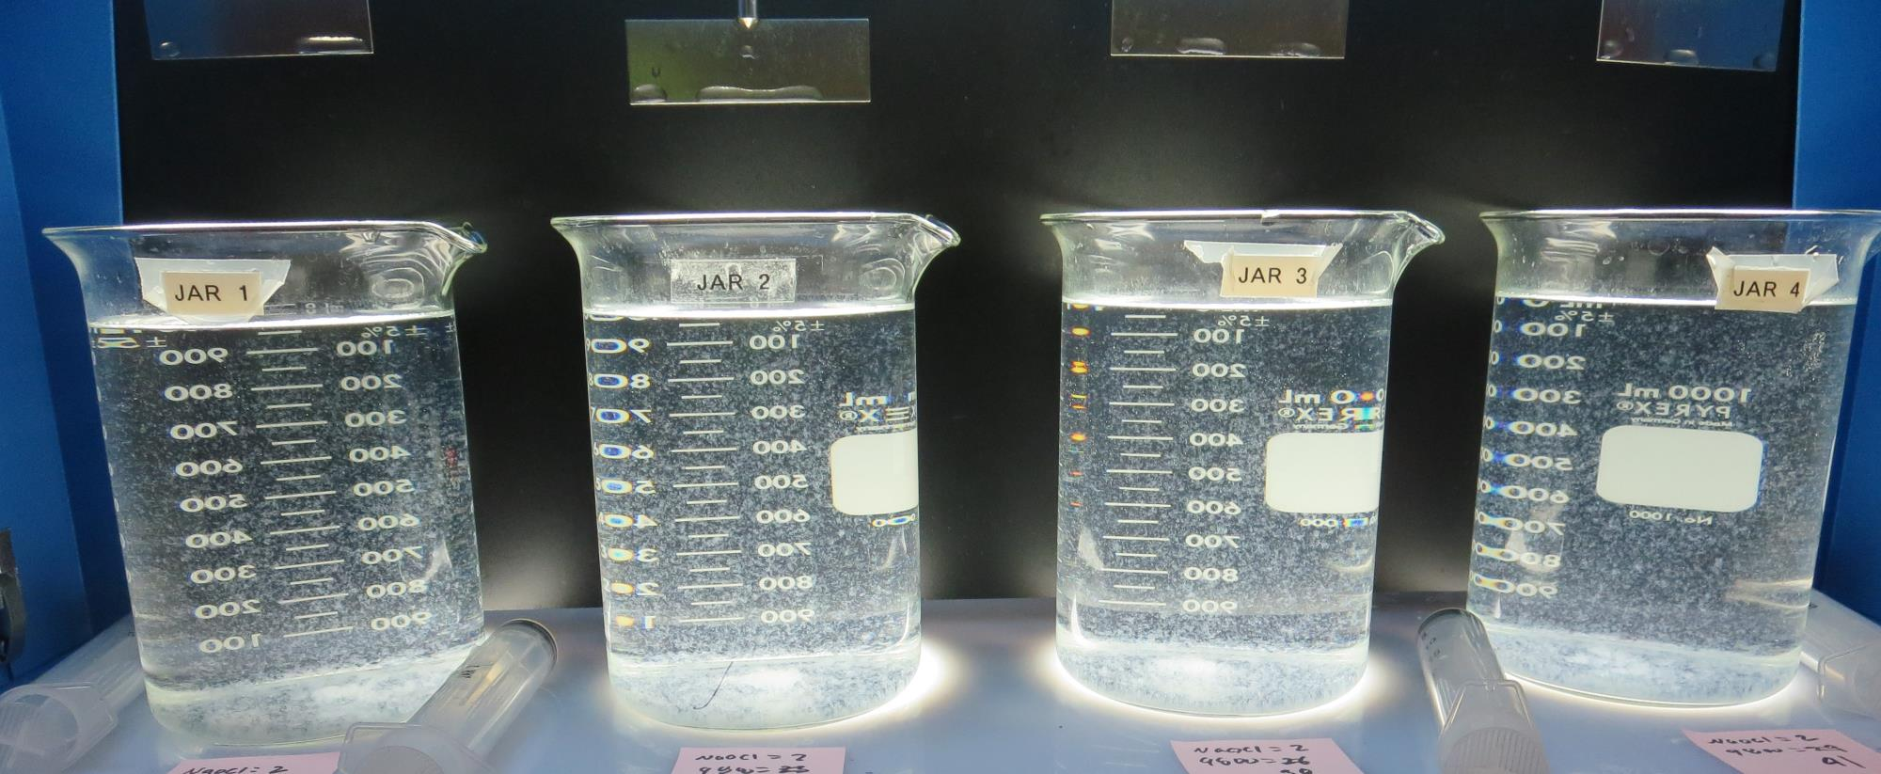
Jars 5-8: After 5 min of settling, 25 mL is syringed for filterability and %UVT/UVA.

Slide 32
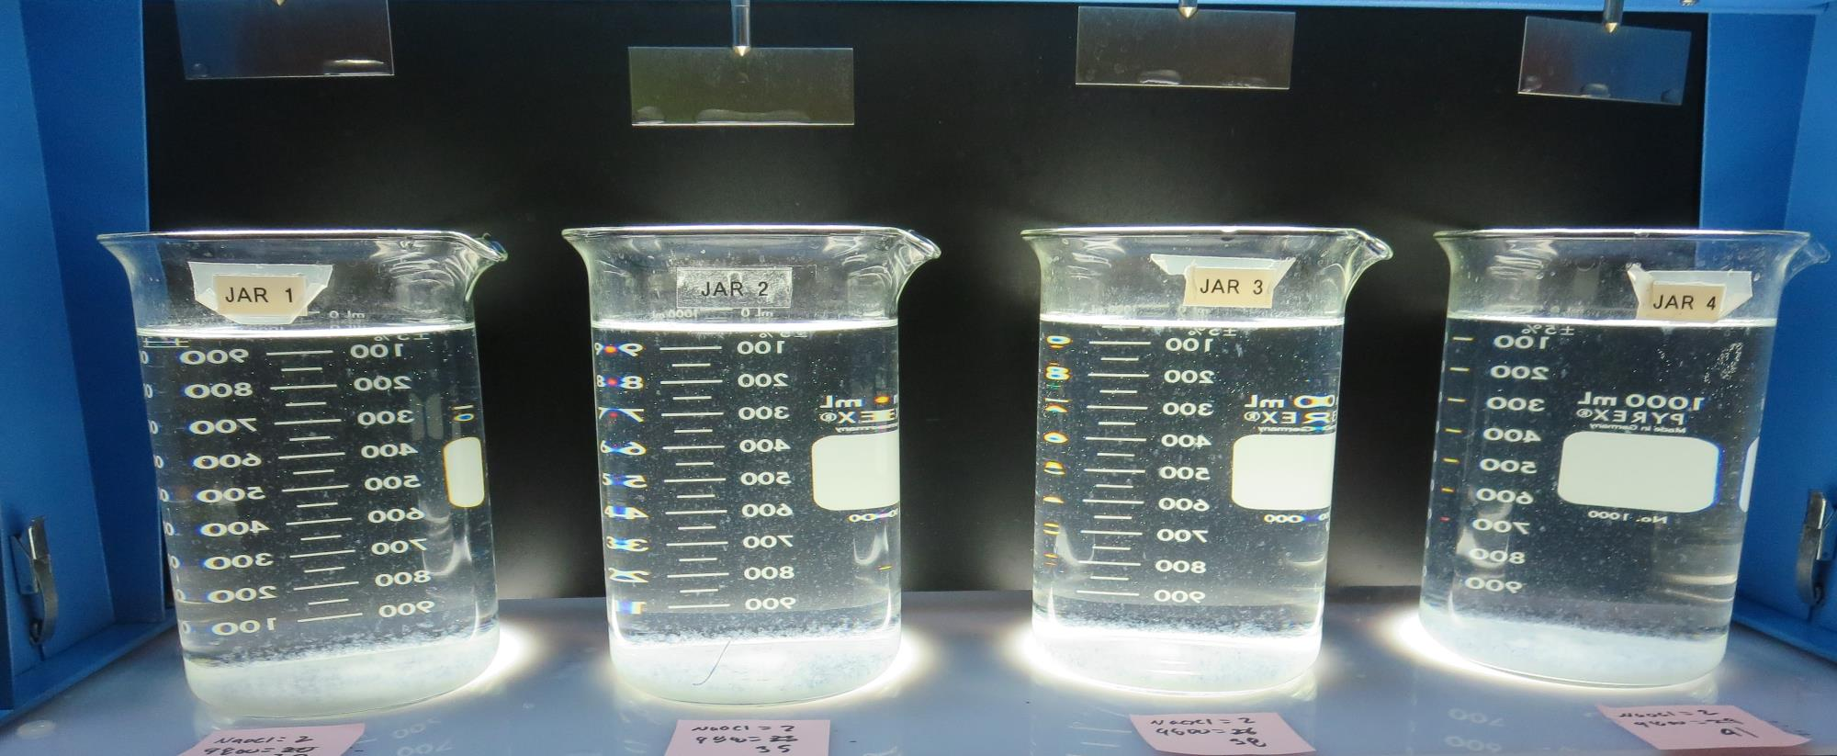
Jars 5-8: After 25-minutes of settling, settled water turbidity is taken.
2.0 mg/L NaOCl
32 mg/L 9800
Filtrate 0.19 NTU
UVT: 92.5%
UVA: 0.033/cm
UVA Reduction 34%
Settled: 1.36 NTU
2.0 mg/L NaOCl
35 mg/L 9800
Filtrate 0.12 NTU
UVT: 92.7%
UVA: 0.032/cm
UVA Reduction 36%
Settled: 1.34 NTU
2.0 mg/L NaOCl
38 mg/L 9800
Filtrate 0.20 NTU
UVT: 92.7%
UVA: 0.032/cm
UVA Reduction 36%
Settled: 1.69 NTU
2.0 mg/L NaOCl
41 mg/L 9800
Filtrate 0.20 NTU
UVT: 92.7%
UVA: 0.032/cm
UVA Reduction 36%
Settled: 1.85 NTU

Slide 33
Jars 9-12 Test Flash Mix 30 Sec (200 RPM) Floc Mix 5 min (30 RPM) Pre-Oxidant (NaOCl) Applied Coagulant 9810

Slide 34
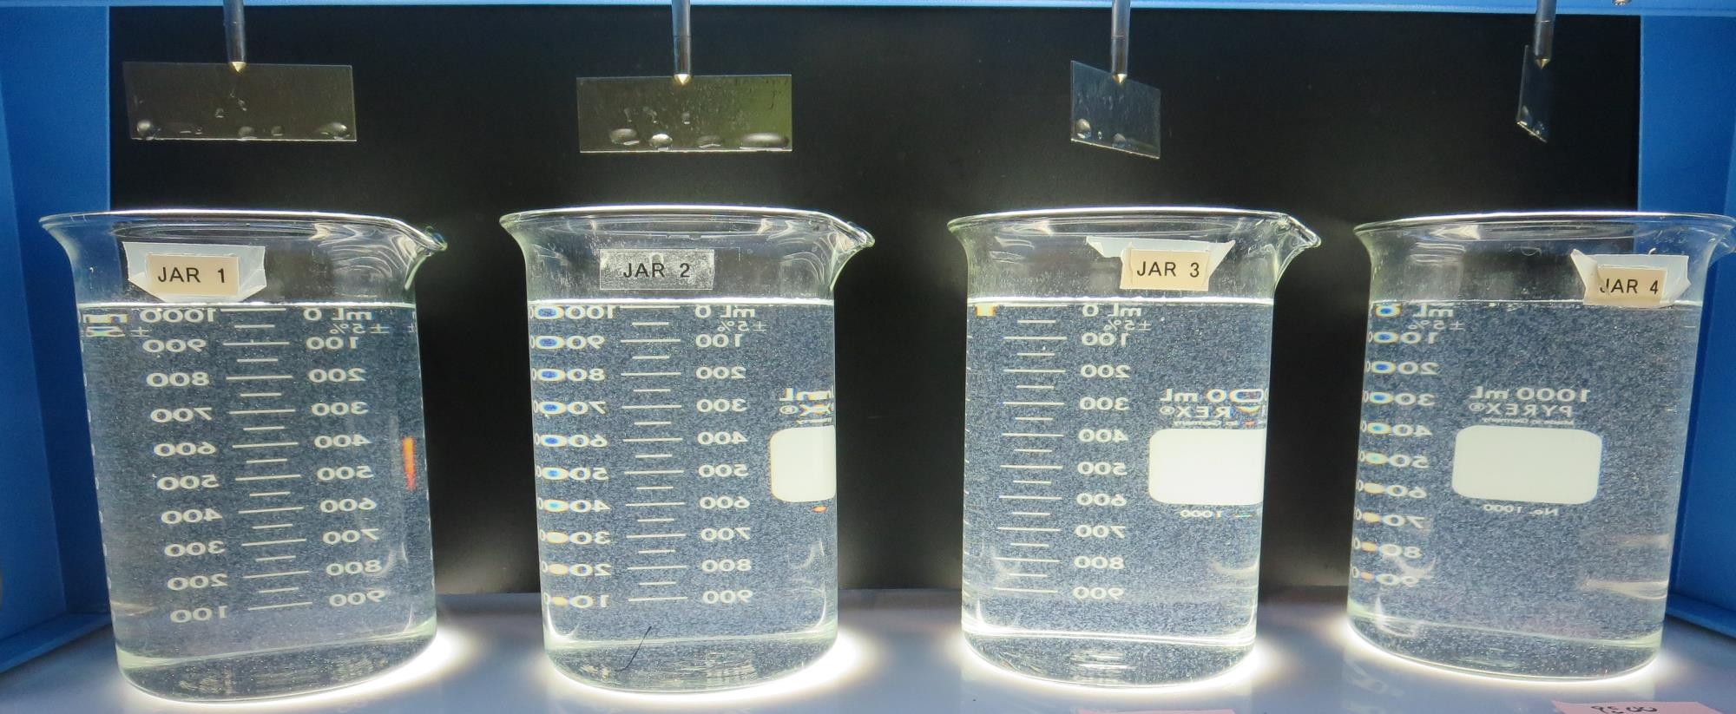
Jars 9-12: End of 5-minute flocculation (30 RPM) duration.
2.0 mg/L NaOCl
32 mg/L 9810
Filtrate 0.08 NTU
UVT: 92.8%
UVA: 0.032/cm
UVA Reduction 36%
Settled: 1.21 NTU
2.0 mg/L NaOCl
35 mg/L 9810
Filtrate 0.09 NTU
UVT: 93.0%
UVA: 0.031/cm
UVA Reduction 38%
Settled: 0.99 NTU
2.0 mg/L NaOCl
38 mg/L 9810
Filtrate 0.15 NTU
UVT: 92.9%
UVA: 0.032/cm
UVA Reduction 36%
Settled: 1.36 NTU
2.0 mg/L NaOCl
41 mg/L 9810
Filtrate 0.15 NTU
UVT: 93.1%
UVA: 0.030/cm
UVA Reduction 40%
Settled: 1.17 NTU

Slide 35
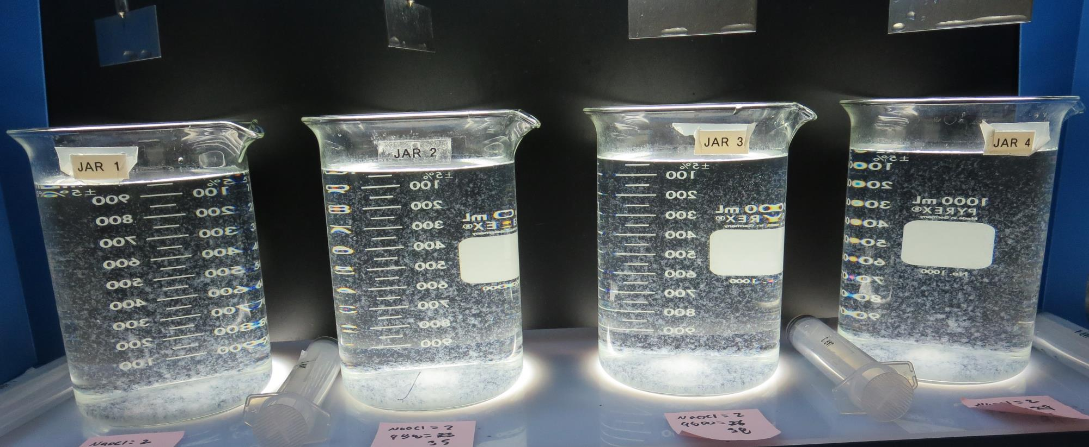
Jars 9-12: After 5 min of settling, 25 mL is syringed for filterability and %UVT/UVA.

Slide 36
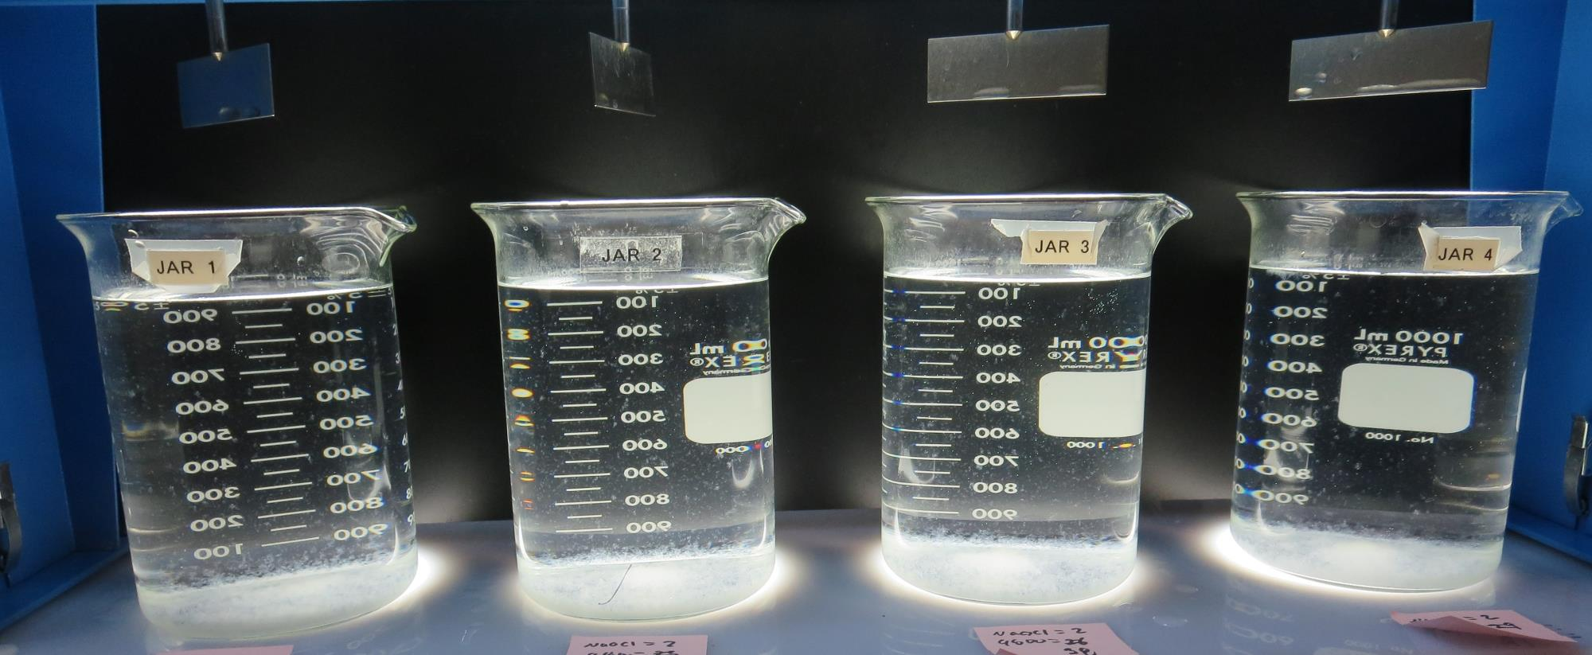
Jars 9-12: After 25-minutes of settling, settled water turbidity is taken.
2.0 mg/L NaOCl
32 mg/L 9810
Filtrate 0.08 NTU
UVT: 92.8%
UVA: 0.032/cm
UVA Reduction 36%
Settled: 1.21 NTU
2.0 mg/L NaOCl
35 mg/L 9810
Filtrate 0.09 NTU
UVT: 93.0%
UVA: 0.031/cm
UVA Reduction 38%
Settled: 0.99 NTU
2.0 mg/L NaOCl
38 mg/L 9810
Filtrate 0.15 NTU
UVT: 92.9%
UVA: 0.032/cm
UVA Reduction 36%
Settled: 1.36 NTU
2.0 mg/L NaOCl
41 mg/L 9810
Filtrate 0.15 NTU
UVT: 93.1%
UVA: 0.030/cm
UVA Reduction 40%
Settled: 1.17 NTU

Slide 37
Jars 13-16 Test Flash Mix 30 Sec (200 RPM) Floc Mix 5 min (30 RPM) Pre-Oxidant (NaOCl) Applied Coagulant 9810

Slide 38
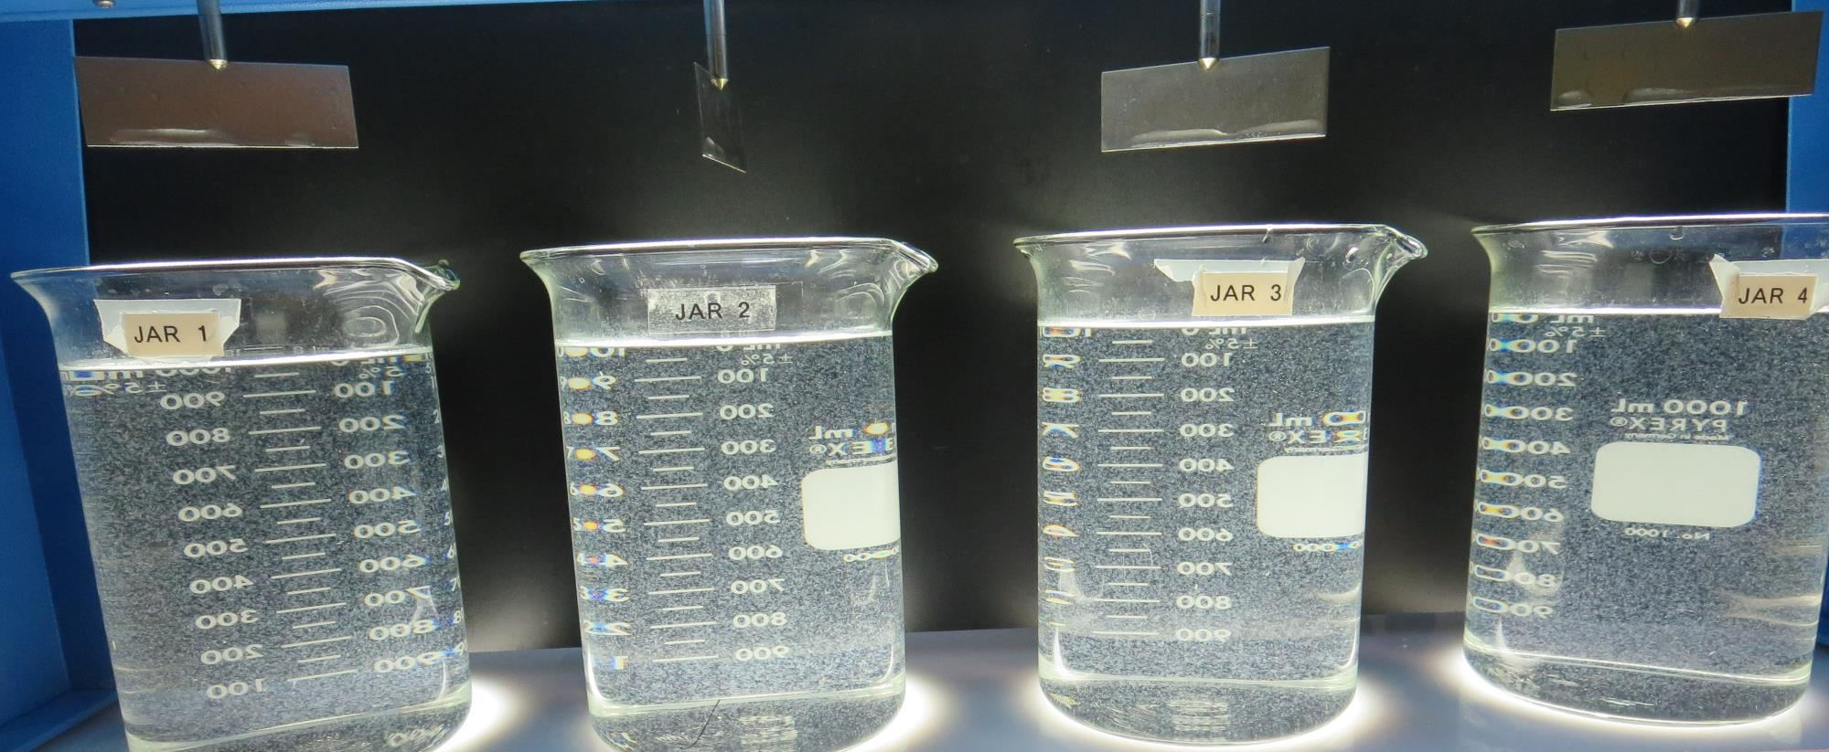
Jars 13-16: End of 5-minute flocculation (30 RPM) duration.
2.0 mg/L NaOCl
26 mg/L 9810
Filtrate 0.17 NTU
UVT: 93.4%
UVA: 0.029/cm
UVA Reduction 42%
Settled: 1.34 NTU
2.0 mg/L NaOCl
29 mg/L 9810
Filtrate 0.13 NTU
UVT: 93.8%
UVA: 0.027/cm
UVA Reduction 46%
Settled: 1.04 NTU
2.0 mg/L NaOCl
32 mg/L 9810
Filtrate 0.13 NTU
UVT: 93.8%
UVA: 0.027/cm
UVA Reduction 46%
Settled: 1.34 NTU
2.0 mg/L NaOCl
35 mg/L 9810
Filtrate 0.09 NTU
UVT: 93.8%
UVA: 0.027/cm
UVA Reduction 46%
Settled: 1.15 NTU

Slide 39
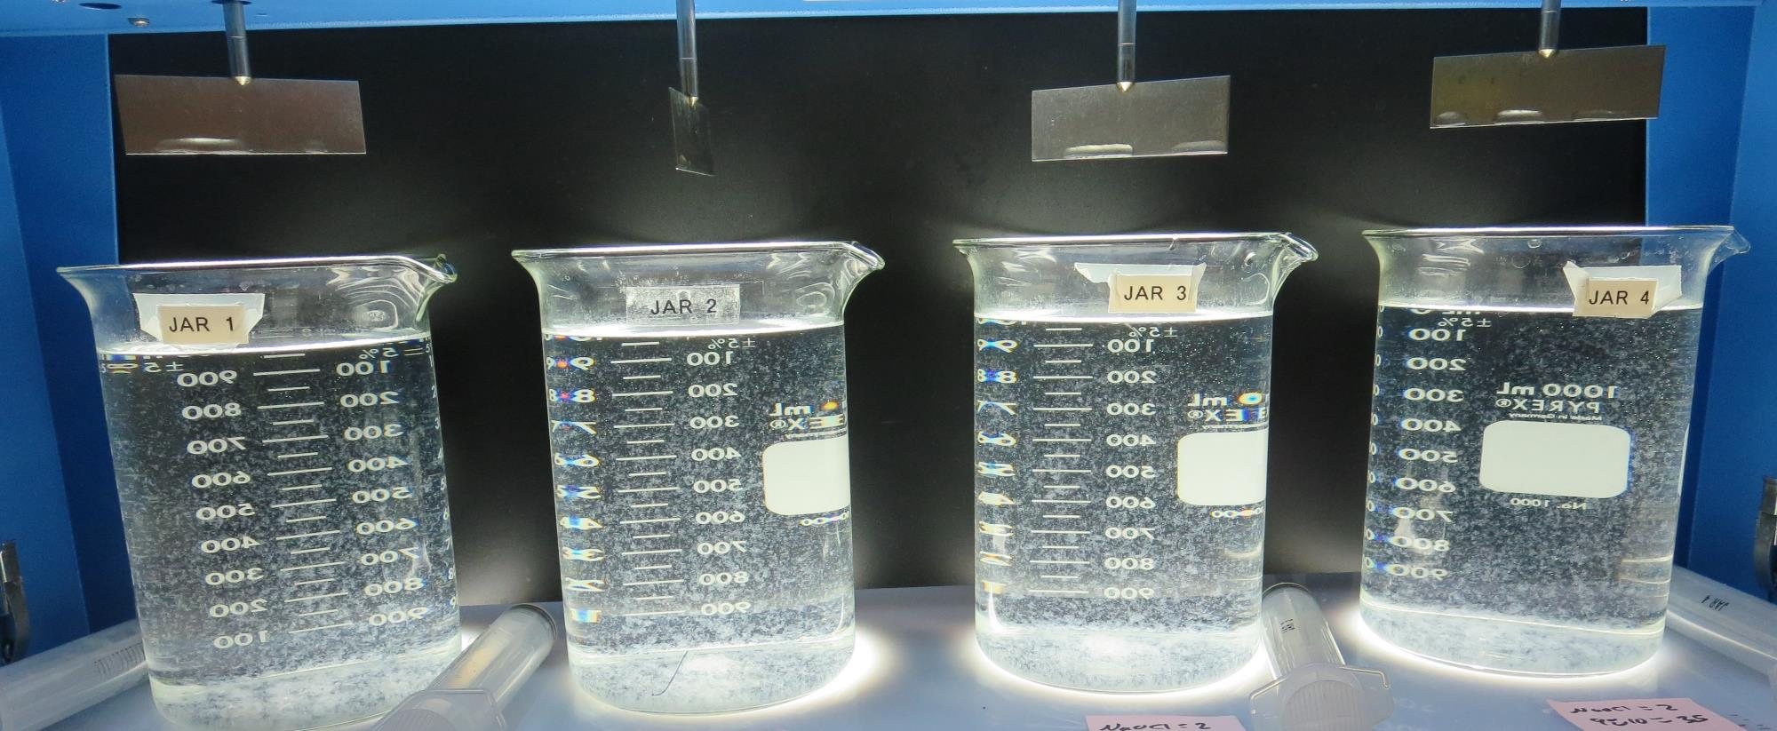
Jars 13-16: After 5 min of settling, 25 mL is syringed for filterability and %UVT/UVA.

Slide 40
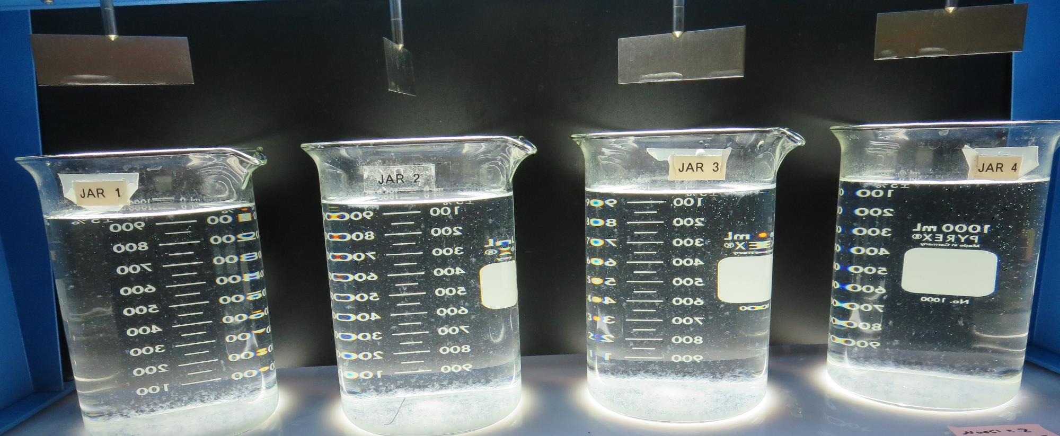
Jars 13-16: After 25-minutes of settling, settled water turbidity is taken.
2.0 mg/L NaOCl
26 mg/L 9810
Filtrate 0.17 NTU
UVT: 93.4%
UVA: 0.029/cm
UVA Reduction 42%
Settled: 1.34 NTU
2.0 mg/L NaOCl
29 mg/L 9810
Filtrate 0.13 NTU
UVT: 93.8%
UVA: 0.027/cm
UVA Reduction 46%
Settled: 1.04 NTU
2.0 mg/L NaOCl
32 mg/L 9810
Filtrate 0.13 NTU
UVT: 93.8%
UVA: 0.027/cm
UVA Reduction 46%
Settled: 1.34 NTU
2.0 mg/L NaOCl
35 mg/L 9810
Filtrate 0.09 NTU
UVT: 93.8%
UVA: 0.027/cm
UVA Reduction 46%
Settled: 1.15 NTU

Slide 41
Jars 17-20 Test Flash Mix 30 Sec (200 RPM) Floc Mix 5 min (30 RPM) Pre-Oxidant (NaOCl) Applied Coagulants 9800/C-308P

Slide 42
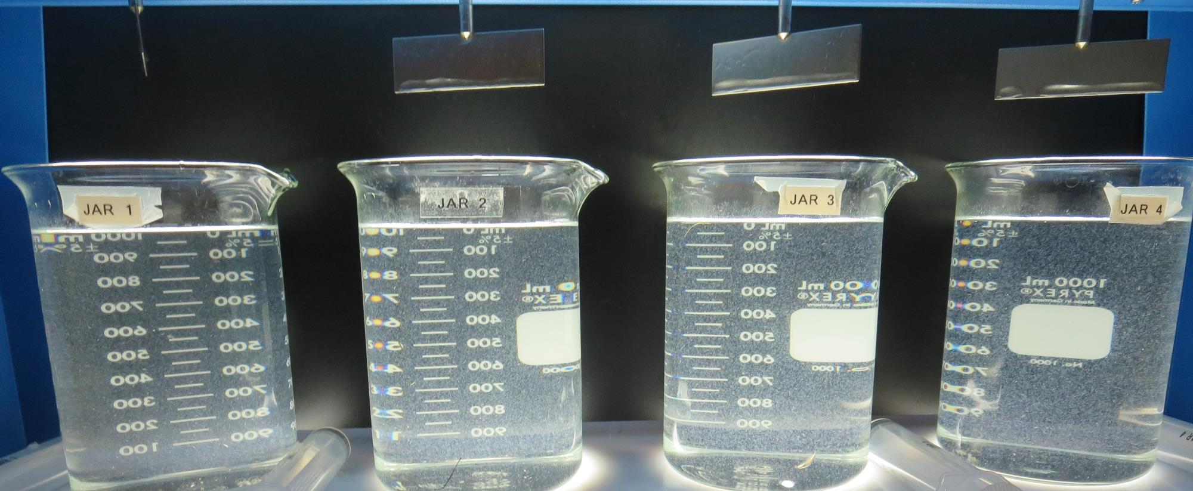
Jars 17-20: End of 5-minute flocculation (30 RPM) duration.
2.0 mg/L NaOCl
20 mg/L 9800
1.5 mg/L C-308P
Filtrate 0.22 NTU
UVT: 92.3%
UVA: 0.034/cm
UVA Reduction 32%
Settled: 2.77 NTU
2.0 mg/L NaOCl
23 mg/L 9800
1.73 mg/L C-308P
Filtrate 0.17 NTU
UVT: 92.3%
UVA: 0.034/cm
UVA Reduction 32%
Settled: 2.43 NTU
2.0 mg/L NaOCl
26 mg/L 9800
1.95 mg/L C-308P
Filtrate 0.19 NTU
UVT: 92.6%
UVA: 0.033/cm
UVA Reduction 34%
Settled: 1.91 NTU
2.0 mg/L NaOCl
29 mg/L 9800
2.18 mg/L C-308P
Filtrate 0.11 NTU
UVT: 92.9%
UVA: 0.031/cm
UVA Reduction 38%
Settled: 1.87 NTU

Slide 43
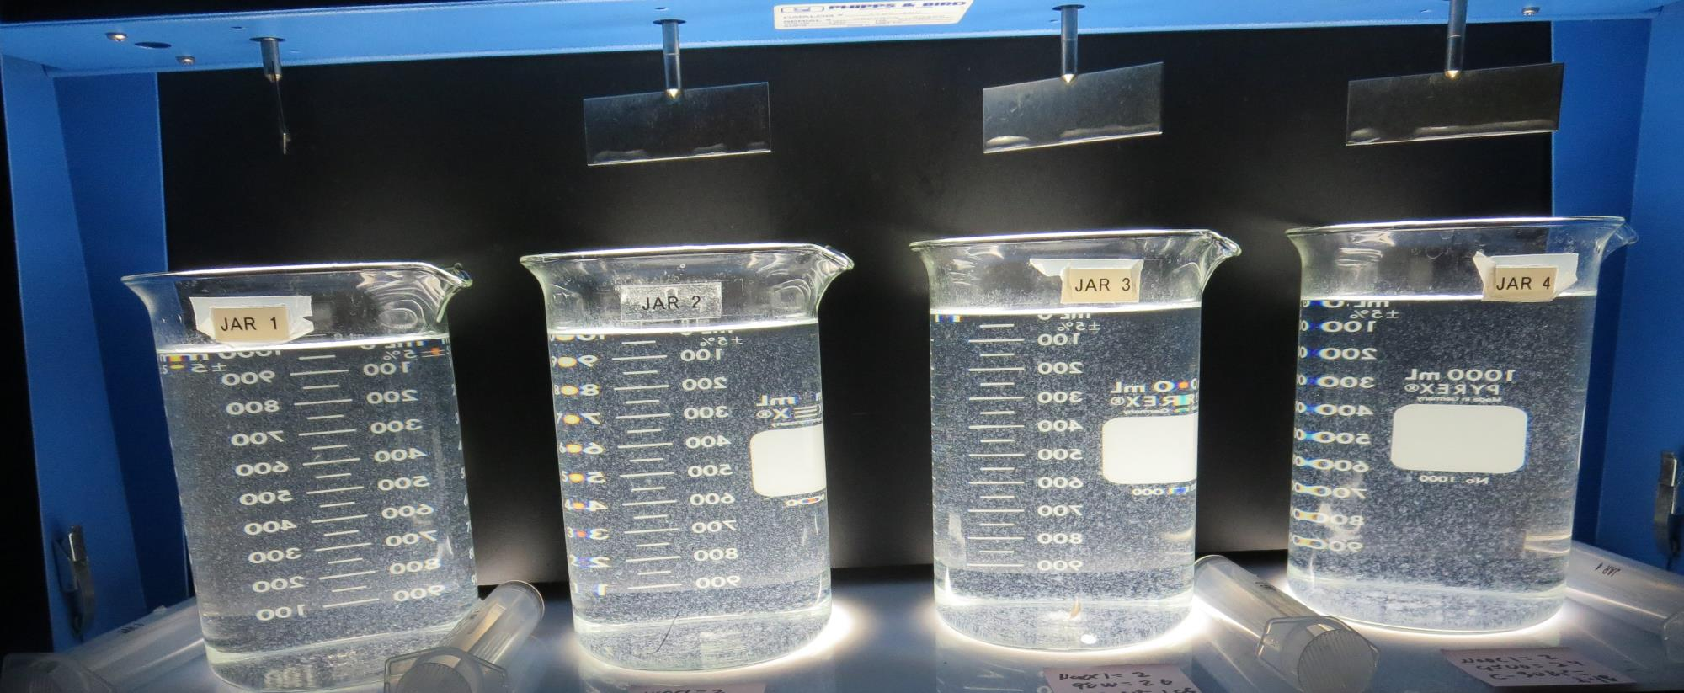
Jars 17-20: After 5 min of settling, 25 mL is syringed for filterability and %UVT/UVA.

Slide 44
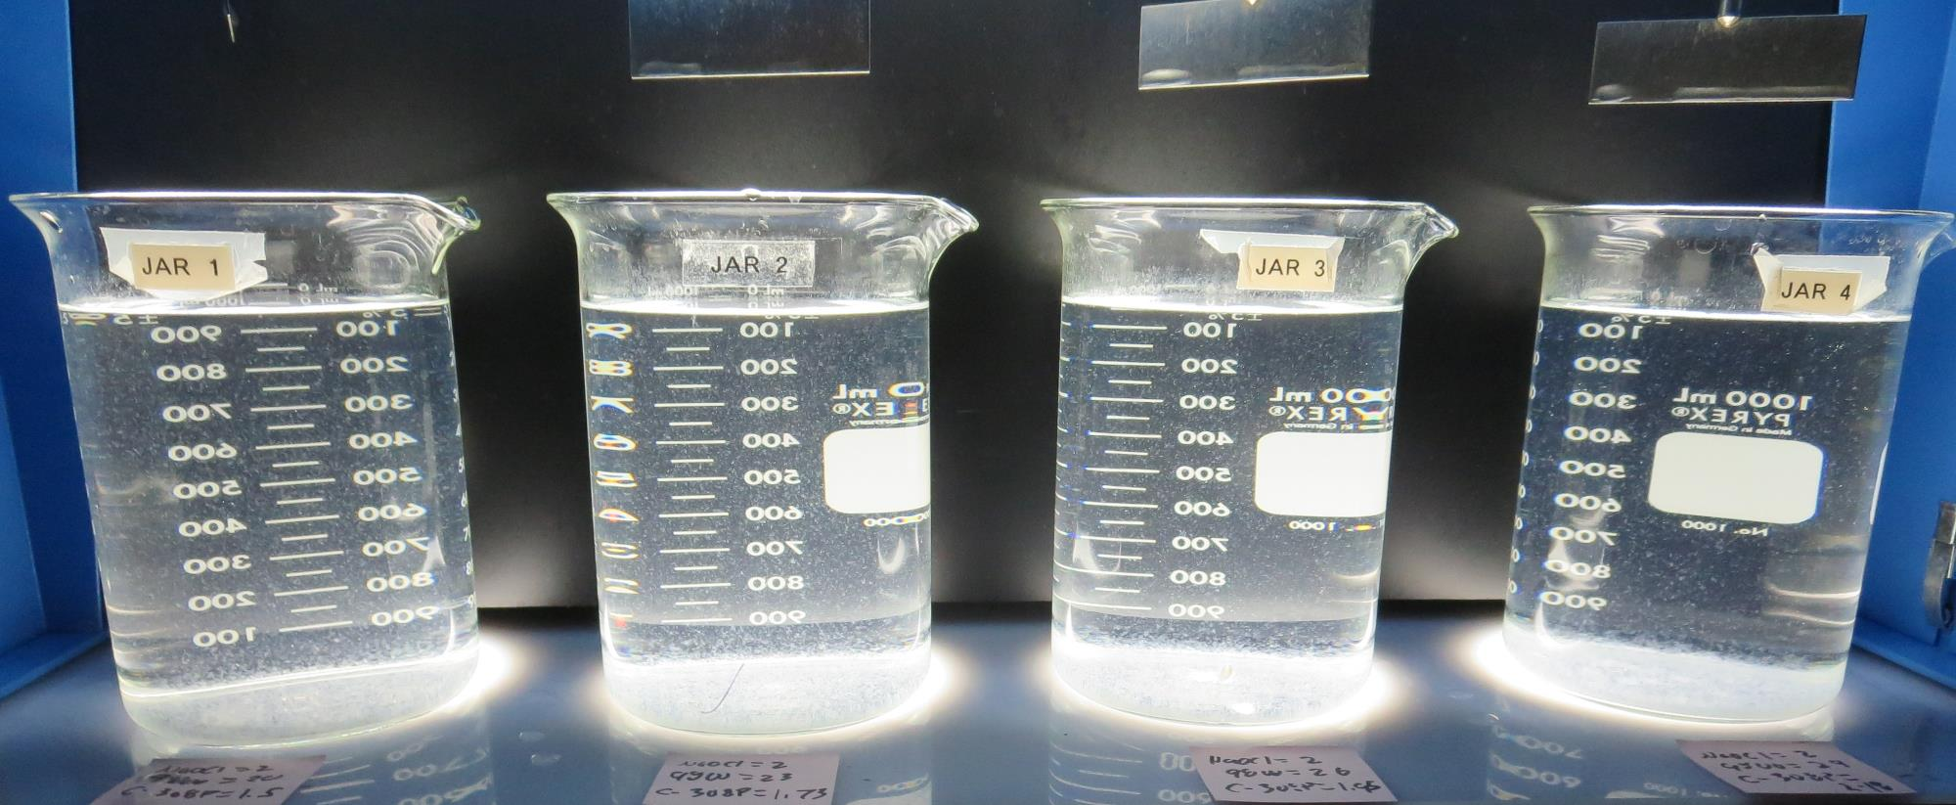
Jars 17-20: After 25-minutes of settling, settled water turbidity is taken.
2.0 mg/L NaOCl
20 mg/L 9800
1.5 mg/L C-308P
Filtrate 0.22 NTU
UVT: 92.3%
UVA: 0.034/cm
UVA Reduction 32%
Settled: 2.77 NTU
2.0 mg/L NaOCl
23 mg/L 9800
1.73 mg/L C-308P
Filtrate 0.17 NTU
UVT: 92.3%
UVA: 0.034/cm
UVA Reduction 32%
Settled: 2.43 NTU
2.0 mg/L NaOCl
26 mg/L 9800
1.95 mg/L C-308P
Filtrate 0.19 NTU
UVT: 92.6%
UVA: 0.033/cm
UVA Reduction 34%
Settled: 1.91 NTU
2.0 mg/L NaOCl
29 mg/L 9800
2.18 mg/L C-308P
Filtrate 0.11 NTU
UVT: 92.9%
UVA: 0.031/cm
UVA Reduction 38%
Settled: 1.87 NTU

Slide 45
Jars 21-24 Test Flash Mix 30 Sec (200 RPM) Floc Mix 5 min (30 RPM) Pre-Oxidant (NaOCl) Applied Coagulants 9800/C-308P

Slide 46
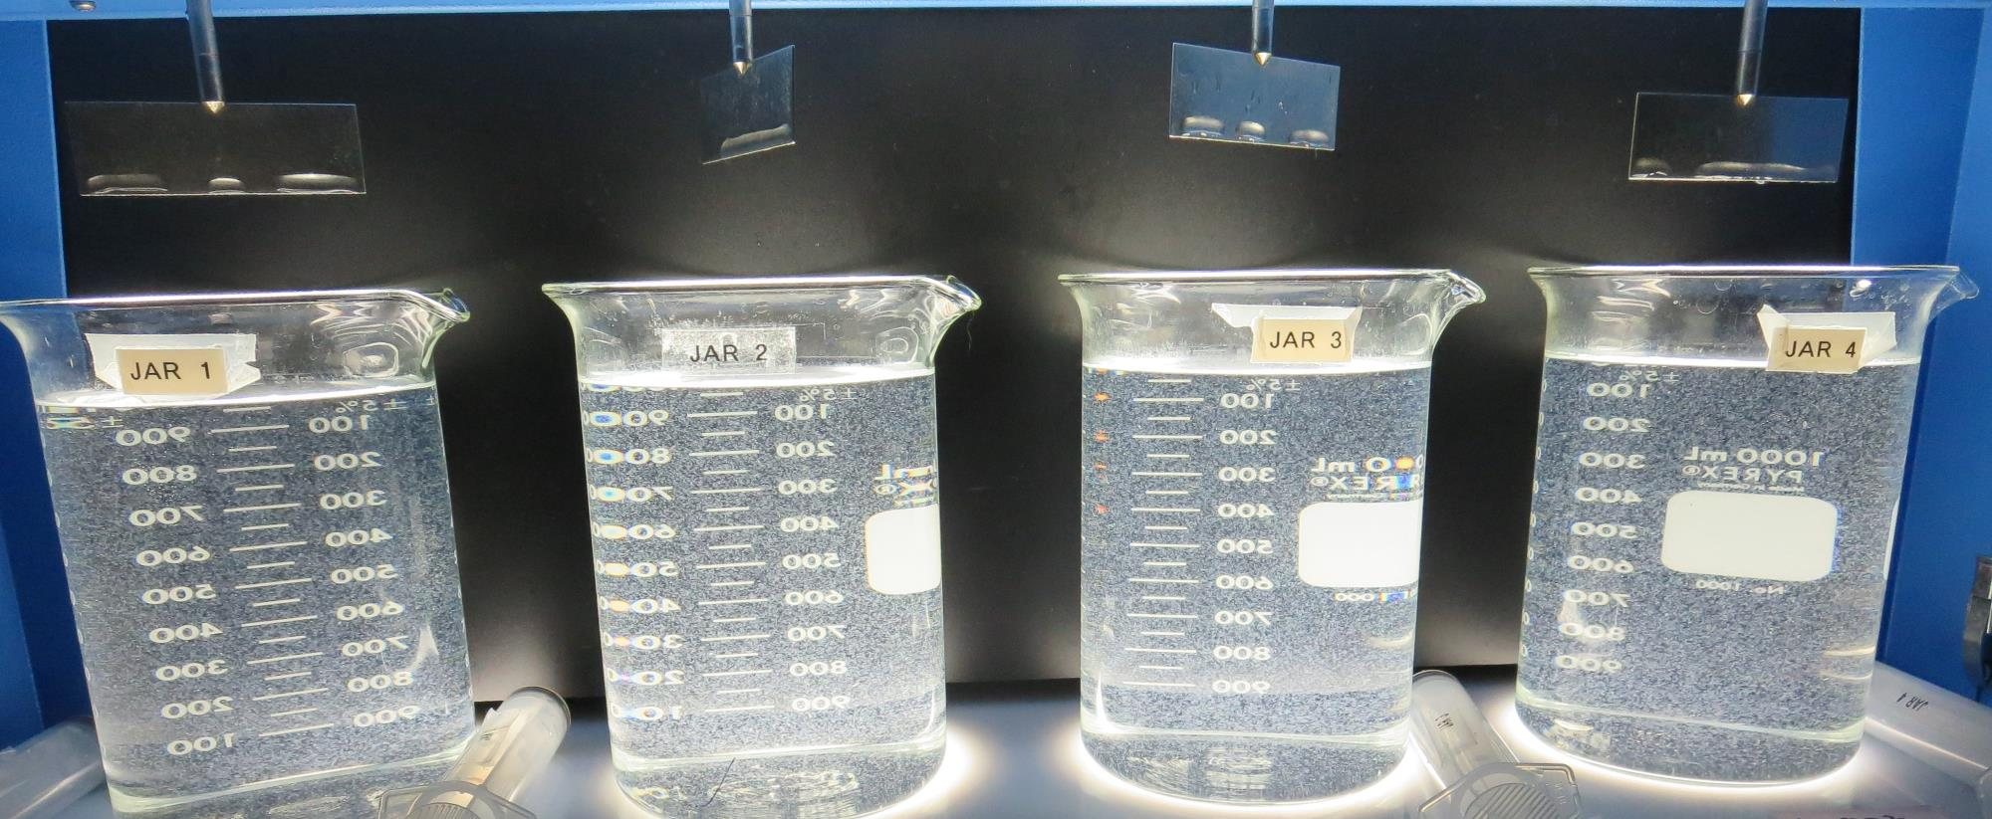
Jars 21-24: End of 5-minute flocculation (30 RPM) duration.
2.0 mg/L NaOCl
29 mg/L 9800
2.18 mg/L C-308P
Filtrate 0.14 NTU
UVT: 92.7%
UVA: 0.032/cm
UVA Reduction 36%
Settled: 1.46 NTU
2.0 mg/L NaOCl
32 mg/L 9800
2.4 mg/L C-308P
Filtrate 0.15 NTU
UVT: 92.8%
UVA: 0.032/cm
UVA Reduction 36%
Settled: 1.56 NTU
2.0 mg/L NaOCl
35 mg/L 9800
2.63 mg/L C-308P
Filtrate 0.17 NTU
UVT: 92.8%
UVA: 0.032/cm
UVA Reduction 36%
Settled: 1.57 NTU
2.0 mg/L NaOCl
38 mg/L 9800
2.85 mg/L C-308P
Filtrate 0.20 NTU
UVT: 93.0%
UVA: 0.031/cm
UVA Reduction 38%
Settled: 1.29 NTU

Slide 47
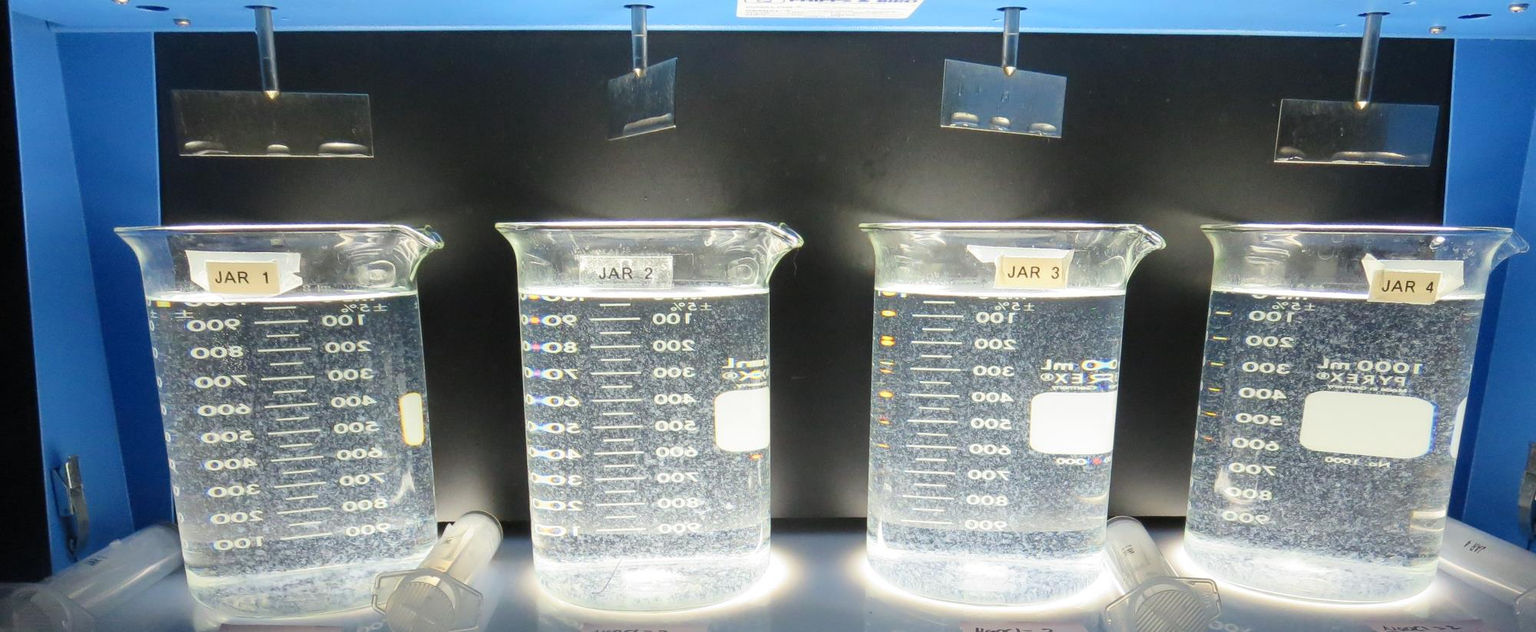
Jars 21-24: After 5 min of settling, 25 mL is syringed for filterability and %UVT/UVA.

Slide 48
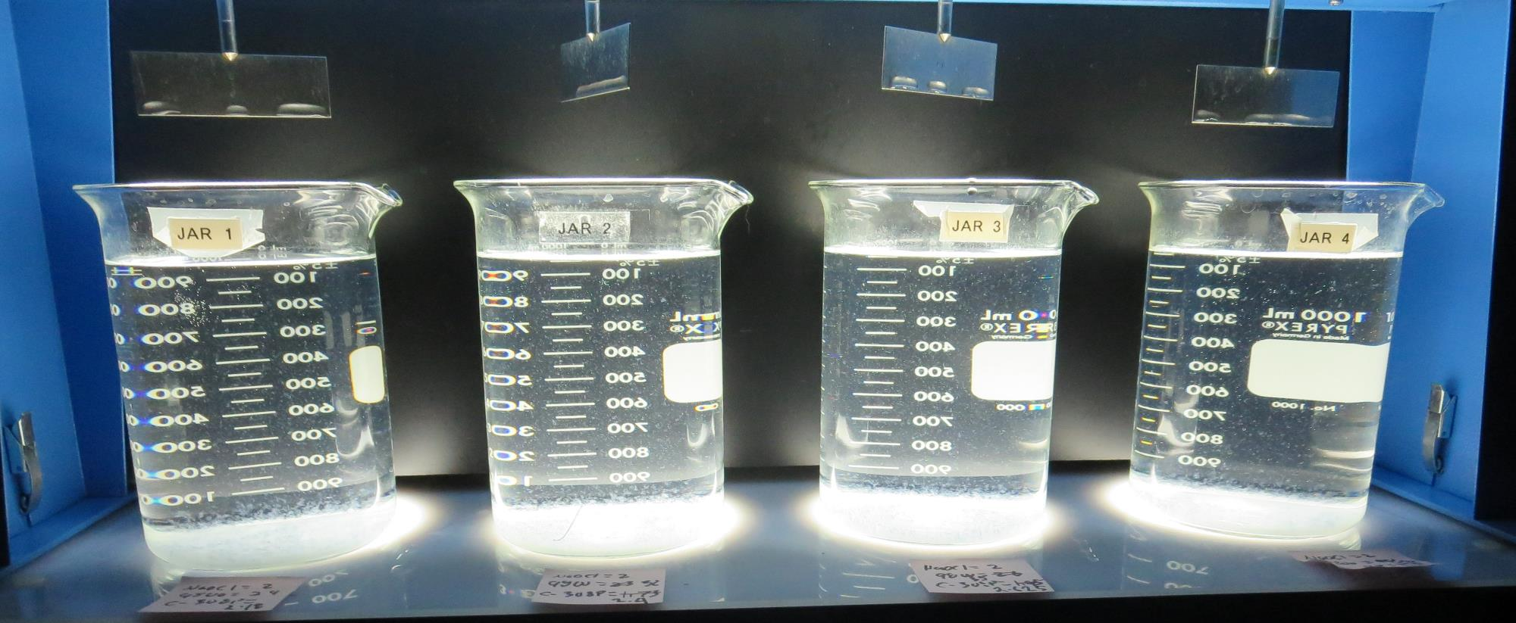
Jars 21-24: After 25-minutes of settling, settled water turbidity is taken.
2.0 mg/L NaOCl
29 mg/L 9800
2.18 mg/L C-308P
Filtrate 0.14 NTU
UVT: 92.7%
UVA: 0.032/cm
UVA Reduction 36%
Settled: 1.46 NTU
2.0 mg/L NaOCl
32 mg/L 9800
2.4 mg/L C-308P
Filtrate 0.15 NTU
UVT: 92.8%
UVA: 0.032/cm
UVA Reduction 36%
Settled: 1.56 NTU
2.0 mg/L NaOCl
35 mg/L 9800
2.63 mg/L C-308P
Filtrate 0.17 NTU
UVT: 92.8%
UVA: 0.032/cm
UVA Reduction 36%
Settled: 1.57 NTU
2.0 mg/L NaOCl
38 mg/L 9800
2.85 mg/L C-308P
Filtrate 0.20 NTU
UVT: 93.0%
UVA: 0.031/cm
UVA Reduction 38%
Settled: 1.29 NTU

Slide 49
Jars 25-28 Test Flash Mix 30 Sec (200 RPM) Floc Mix 5 min (30 RPM) Pre-Oxidant (NaOCl) Applied Coagulant 917

Slide 50
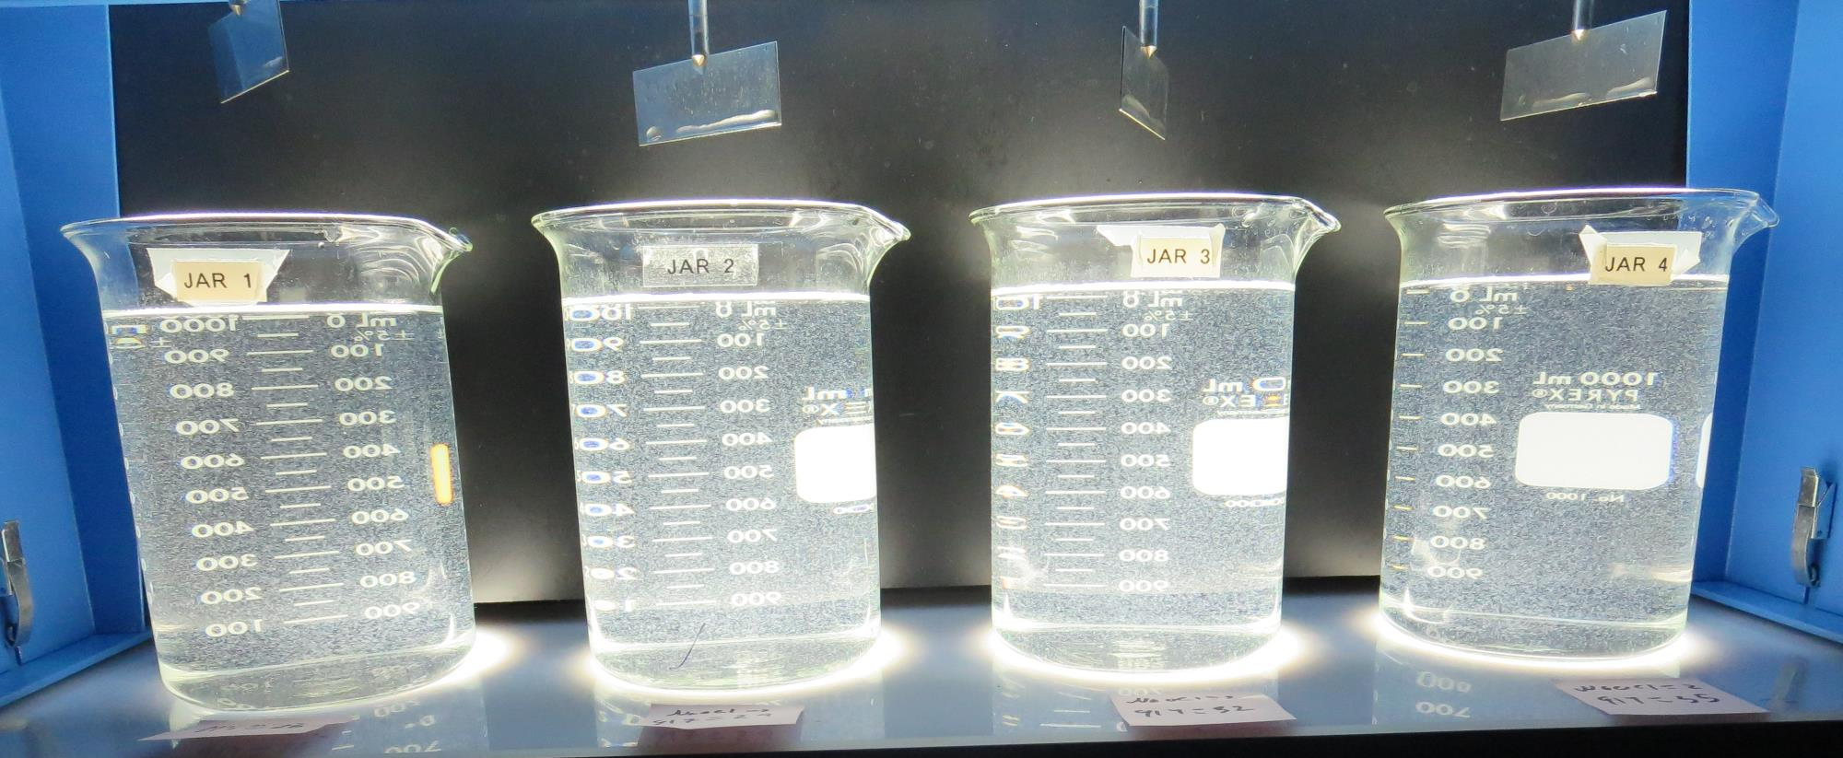
Jars 25-28: End of 5-minute flocculation (30 RPM) duration.
2.0 mg/L NaOCl
26 mg/L 917
Filtrate 0.09 NTU
UVT: 93.8%
UVA: 0.027/cm
UVA Reduction 46%
Settled: 2.05 NTU
2.0 mg/L NaOCl
29 mg/L 917
Filtrate 0.09 NTU
UVT: 93.9%
UVA: 0.027/cm
UVA Reduction 46%
Settled: 2.28 NTU
2.0 mg/L NaOCl
32 mg/L 917
Filtrate 0.09 NTU
UVT: 93.8%
UVA: 0.027/cm
UVA Reduction 46%
Settled: 1.98 NTU
2.0 mg/L NaOCl
35 mg/L 917
Filtrate 0.10 NTU
UVT: 94.0%
UVA: 0.026/cm
UVA Reduction 48%
Settled: 2.02 NTU

Slide 51
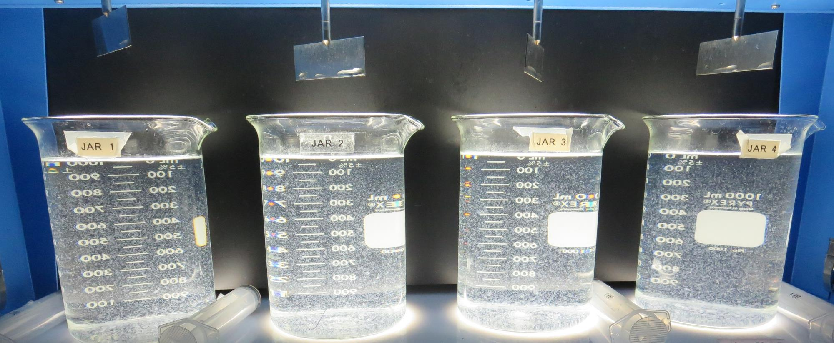
Jars 25-28: After 5 min of settling, 25 mL is syringed for filterability and %UVT/UVA.

Slide 52
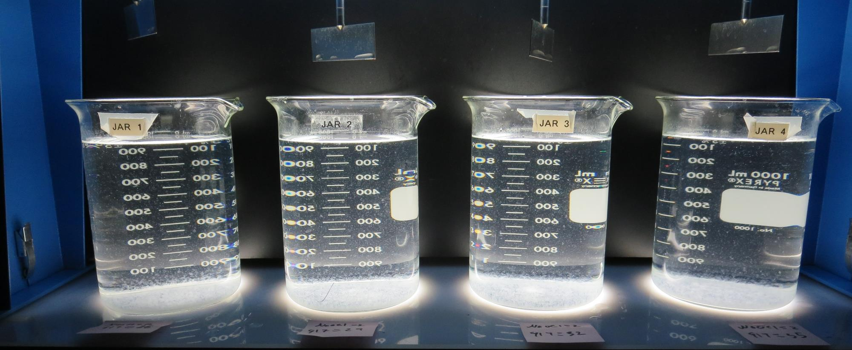
Jars 25-28: After 25-minutes of settling, settled water turbidity is taken.
2.0 mg/L NaOCl
26 mg/L 917
Filtrate 0.09 NTU
UVT: 93.8%
UVA: 0.027/cm
UVA Reduction 46%
Settled: 2.05 NTU
2.0 mg/L NaOCl
29 mg/L 917
Filtrate 0.09 NTU
UVT: 93.9%
UVA: 0.027/cm
UVA Reduction 46%
Settled: 2.28 NTU
2.0 mg/L NaOCl
32 mg/L 917
Filtrate 0.09 NTU
UVT: 93.8%
UVA: 0.027/cm
UVA Reduction 46%
Settled: 1.98 NTU
2.0 mg/L NaOCl
35 mg/L 917
Filtrate 0.10 NTU
UVT: 94.0%
UVA: 0.026/cm
UVA Reduction 48%
Settled: 2.02 NTU

Slide 53
Jars 29-32 Test Flash Mix 30 Sec (200 RPM) Floc Mix 5 min (30 RPM) Pre-Oxidant (NaOCl) Applied Coagulant 917

Slide 54
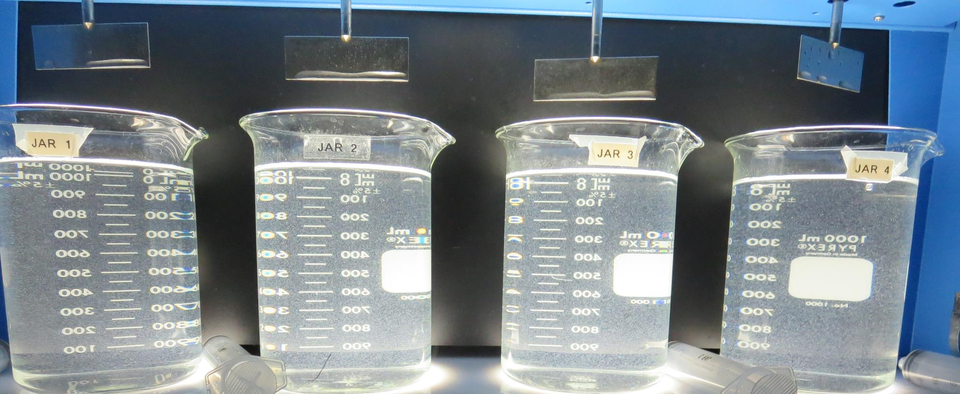
Jars 29-32: End of 5-minute flocculation (30 RPM) duration.
2.0 mg/L NaOCl
20 mg/L 917
Filtrate 0.10 NTU
UVT: 93.5%
UVA: 0.028/cm
UVA Reduction 44%
Settled: 3.07 NTU
2.0 mg/L NaOCl
22 mg/L 917
Filtrate 0.13 NTU
UVT: 93.5%
UVA: 0.028/cm
UVA Reduction 44%
Settled: 2.98 NTU
2.0 mg/L NaOCl
24 mg/L 917
Filtrate 0.13 NTU
UVT: 93.5%
UVA: 0.029/cm
UVA Reduction 42%
Settled: 2.62 NTU
2.0 mg/L NaOCl
26 mg/L 917
Filtrate 0.09 NTU
UVT: 93.9%
UVA: 0.027/cm
UVA Reduction 46%
Settled: 2.52 NTU

Slide 55
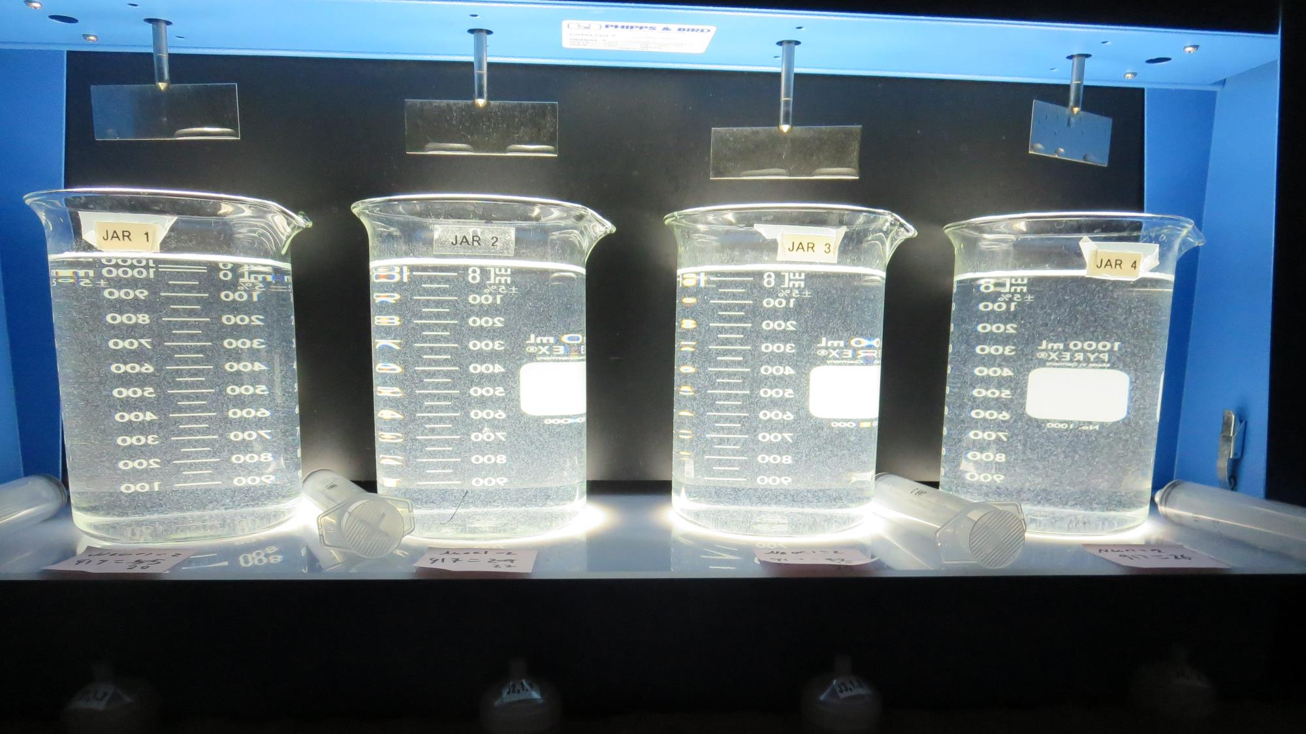
Jars 29-32: After 5 min of settling, 25 mL is syringed for filterability and %UVT/UVA.

Slide 56
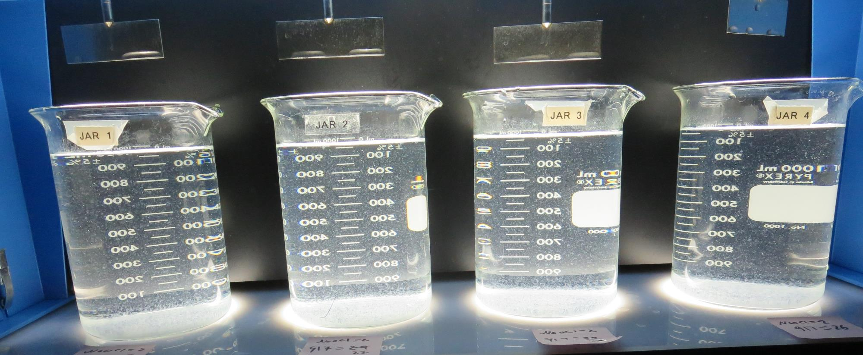
Jars 29-32: After 25-minutes of settling, settled water turbidity is taken.
2.0 mg/L NaOCl
20 mg/L 917
Filtrate 0.10 NTU
UVT: 93.5%
UVA: 0.028/cm
UVA Reduction 44%
Settled: 3.07 NTU
2.0 mg/L NaOCl
22 mg/L 917
Filtrate 0.13 NTU
UVT: 93.5%
UVA: 0.028/cm
UVA Reduction 44%
Settled: 2.98 NTU
2.0 mg/L NaOCl
24 mg/L 917
Filtrate 0.13 NTU
UVT: 93.5%
UVA: 0.029/cm
UVA Reduction 42%
Settled: 2.62 NTU
2.0 mg/L NaOCl
26 mg/L 917
Filtrate 0.09 NTU
UVT: 93.9%
UVA: 0.027/cm
UVA Reduction 46%
Settled: 2.52 NTU

Slide 57
Jars 33-36 Test Flash Mix 30 Sec (200 RPM) Floc Mix 5 min (30 RPM) Pre-Oxidant (NaOCl) Applied Coagulant 7049

Slide 58
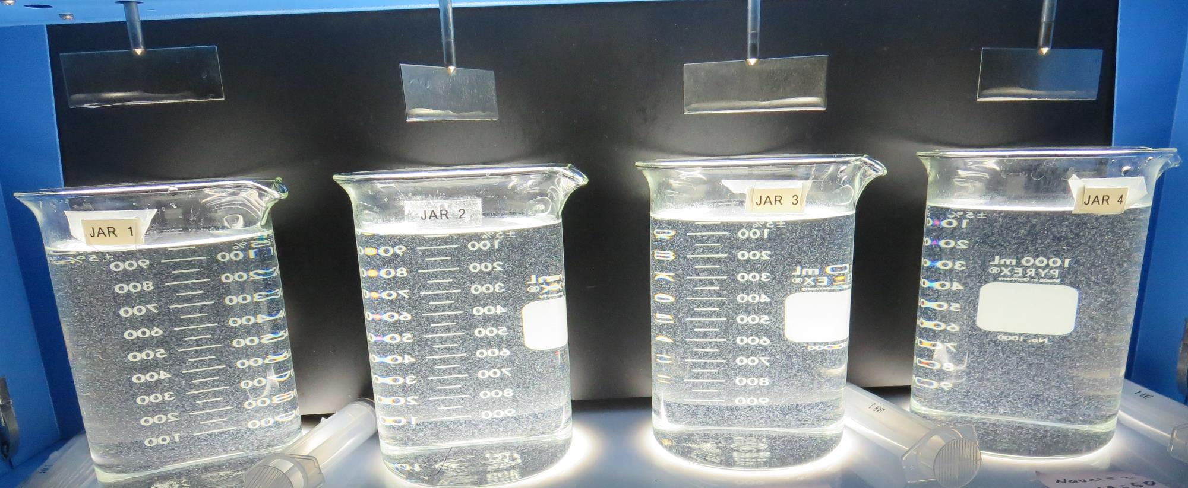
Jars 33-36: End of 5-minute flocculation (30 RPM) duration.
2.0 mg/L NaOCl
35 mg/L 7049
Filtrate 0.23 NTU
UVT: 93.3%
UVA: 0.029/cm
UVA Reduction 42%
Settled: 1.62 NTU
2.0 mg/L NaOCl
40 mg/L 7049
Filtrate 0.16 NTU
UVT: 93.3%
UVA: 0.029/cm
UVA Reduction 42%
Settled: 1.61 NTU
2.0 mg/L NaOCl
45 mg/L 7049
Filtrate 0.16 NTU
UVT: 93.3%
UVA: 0.029/cm
UVA Reduction 42%
Settled: 1.74 NTU
2.0 mg/L NaOCl
50 mg/L 7049
Filtrate 0.17 NTU
UVT: 93.2%
UVA: 0.030/cm
UVA Reduction 40%
Settled: 1.58 NTU

Slide 59
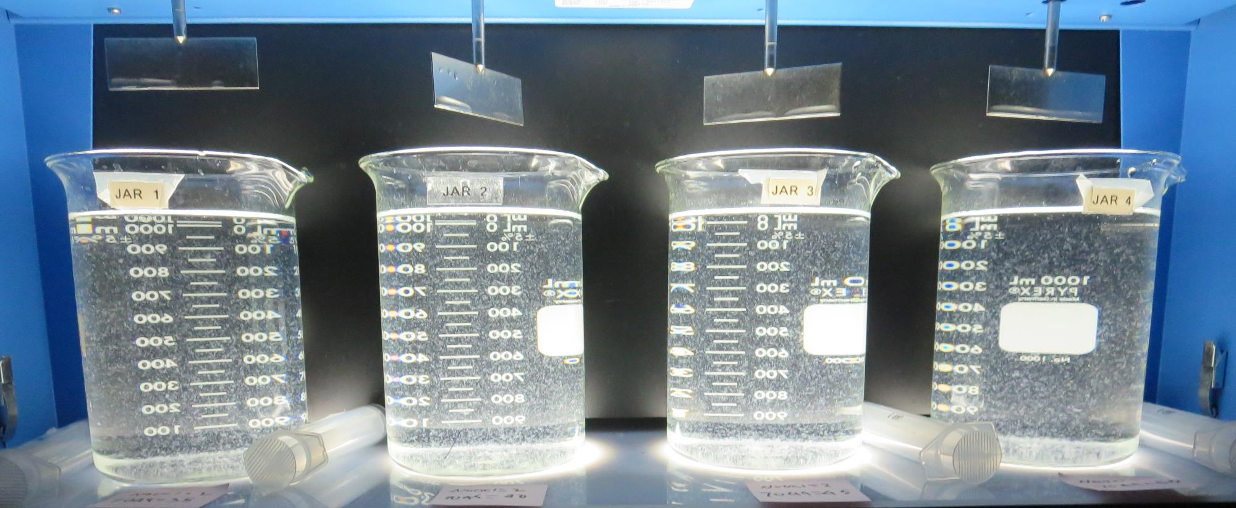
Jars 33-36: After 5 min of settling, 25 mL is syringed for filterability and %UVT/UVA.

Slide 60
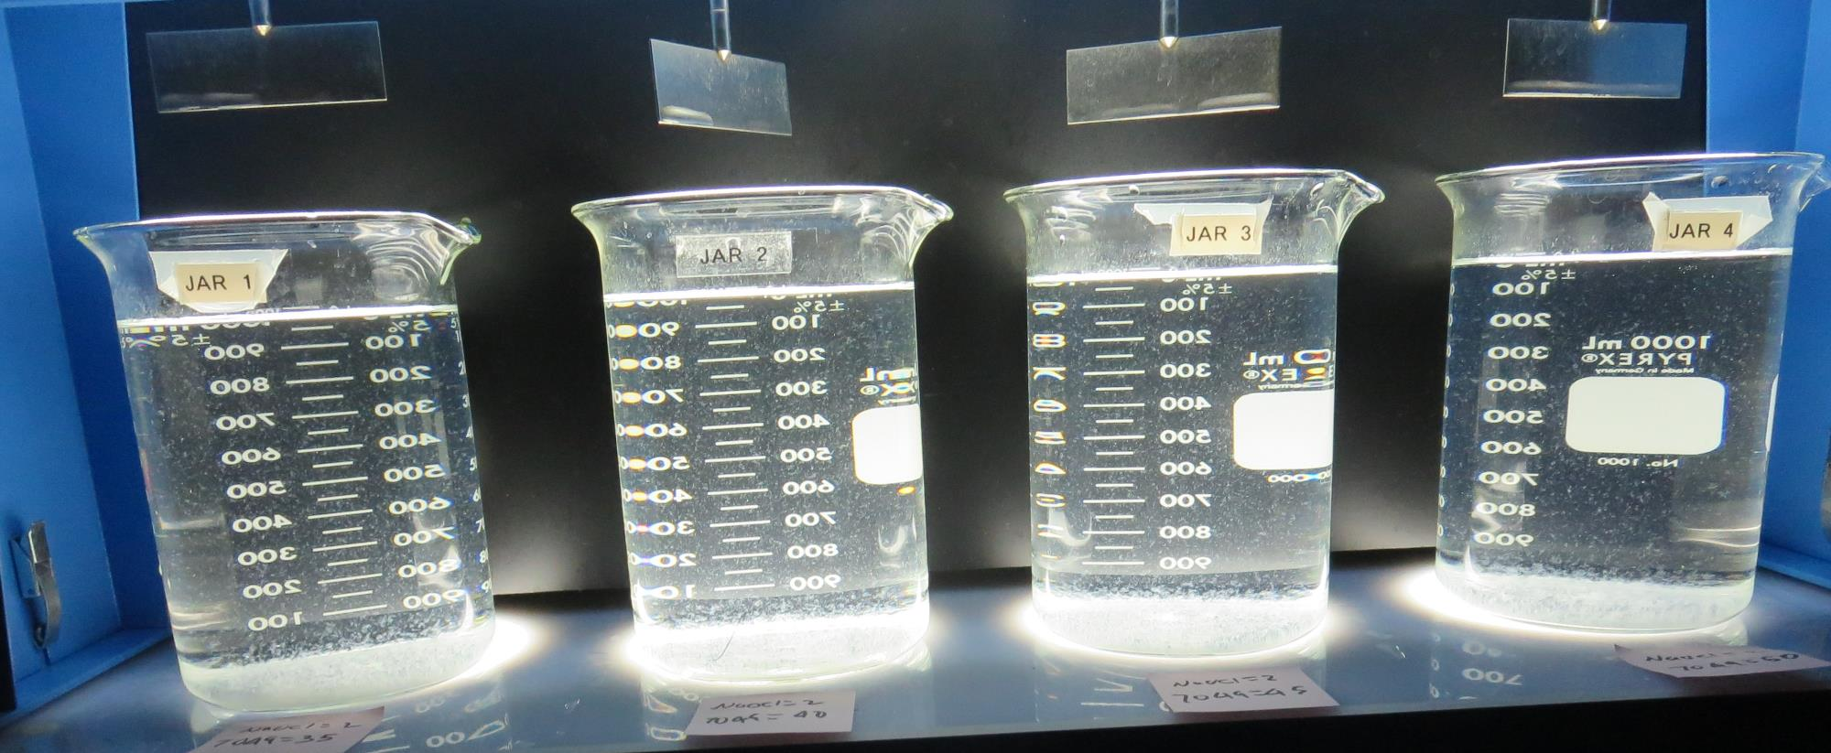
Jars 33-36: After 25-minutes of settling, settled water turbidity is taken.
2.0 mg/L NaOCl
35 mg/L 7049
Filtrate 0.23 NTU
UVT: 93.3%
UVA: 0.029/cm
UVA Reduction 42%
Settled: 1.62 NTU
2.0 mg/L NaOCl
40 mg/L 7049
Filtrate 0.16 NTU
UVT: 93.3%
UVA: 0.029/cm
UVA Reduction 42%
Settled: 1.61 NTU
2.0 mg/L NaOCl
45 mg/L 7049
Filtrate 0.16 NTU
UVT: 93.3%
UVA: 0.029/cm
UVA Reduction 42%
Settled: 1.74 NTU
2.0 mg/L NaOCl
50 mg/L 7049
Filtrate 0.17 NTU
UVT: 93.2%
UVA: 0.030/cm
UVA Reduction 40%
Settled: 1.58 NTU

Slide 61
Jars 37-40 Test Flash Mix 30 Sec (200 RPM) Floc Mix 5 min (30 RPM) Pre-Oxidant (NaOCl) Applied Coagulant 7049

Slide 62
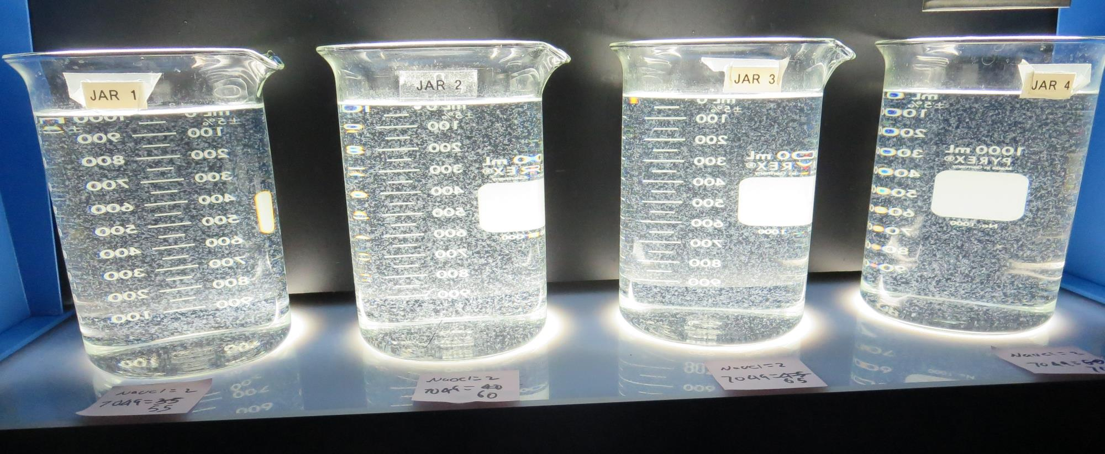
Jars 37-40: End of 5-minute flocculation (30 RPM) duration.
2.0 mg/L NaOCl
55 mg/L 7049
Filtrate 0.28 NTU
UVT: 93.4%
UVA: 0.029/cm
UVA Reduction 42%
Settled: 0.94 NTU
2.0 mg/L NaOCl
60 mg/L 7049
Filtrate 0.11 NTU
UVT: 93.4%
UVA: 0.029/cm
UVA Reduction 42%
Settled: 1.20 NTU
2.0 mg/L NaOCl
65 mg/L 7049
Filtrate 0.11 NTU
UVT: 93.3%
UVA: 0.029/cm
UVA Reduction 42%
Settled: 1.15 NTU
2.0 mg/L NaOCl
70 mg/L 7049
Filtrate 0.08 NTU
UVT: 93.5%
UVA: 0.029/cm
UVA Reduction 42%
Settled: 1.15 NTU

Slide 63
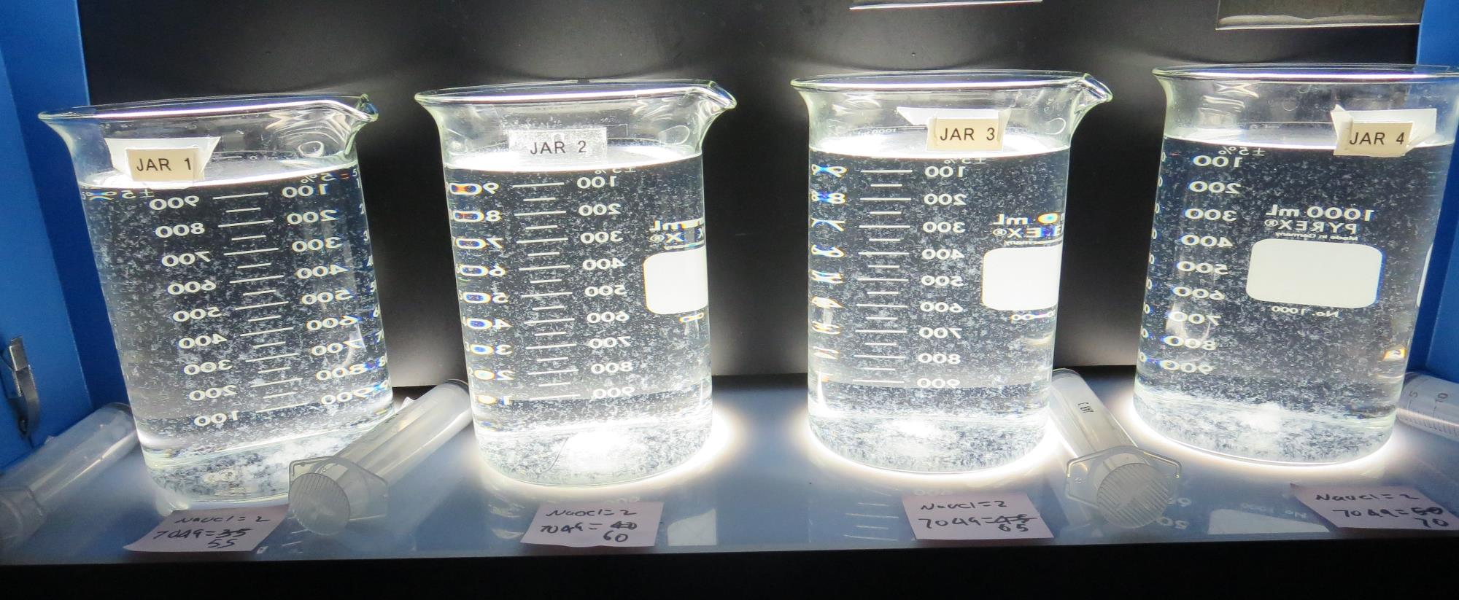
Jars 37-40: After 5 min of settling, 25 mL is syringed for filterability and %UVT/UVA.

Slide 64
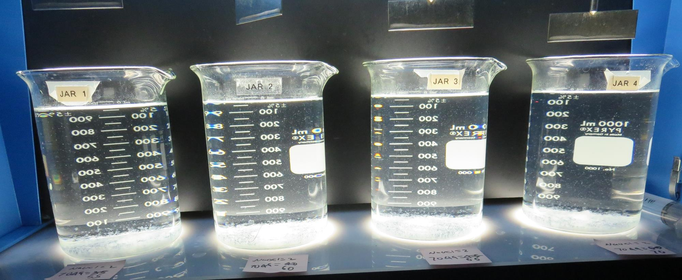
Jars 37-40: After 25-minutes of settling, settled water turbidity is taken.
2.0 mg/L NaOCl
55 mg/L 7049
Filtrate 0.28 NTU
UVT: 93.4%
UVA: 0.029/cm
UVA Reduction 42%
Settled: 0.94 NTU
2.0 mg/L NaOCl
60 mg/L 7049
Filtrate 0.11 NTU
UVT: 93.4%
UVA: 0.029/cm
UVA Reduction 42%
Settled: 1.20 NTU
2.0 mg/L NaOCl
65 mg/L 7049
Filtrate 0.11 NTU
UVT: 93.3%
UVA: 0.029/cm
UVA Reduction 42%
Settled: 1.15 NTU
2.0 mg/L NaOCl
70 mg/L 7049
Filtrate 0.08 NTU
UVT: 93.5%
UVA: 0.029/cm
UVA Reduction 42%
Settled: 1.15 NTU

Slide 65
Jars 41-44 Test Flash Mix 30 Sec (200 RPM) Floc Mix 5 min (30 RPM) Pre-Oxidant (NaOCl) Applied Coagulant 7040

Slide 66
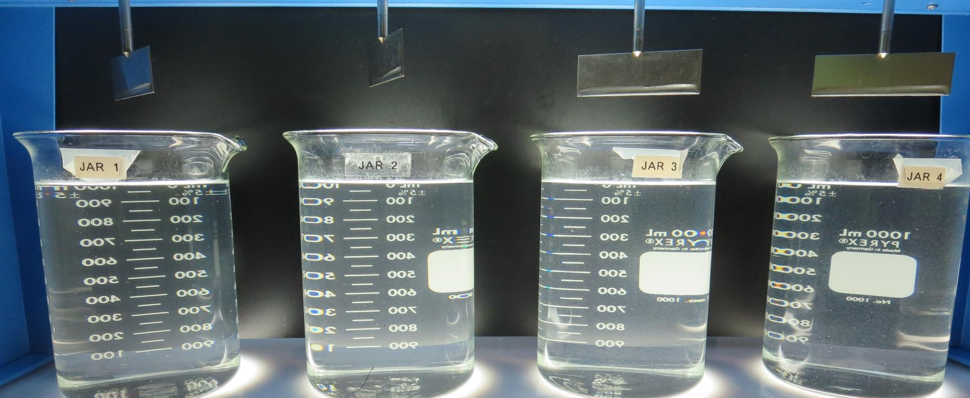
Jars 41-44: End of 5-minute flocculation (30 RPM) duration.
2.0 mg/L NaOCl
25 mg/L 7040
Filtrate 0.11 NTU
UVT: 92.5%
UVA: 0.033/cm
UVA Reduction 34%
Settled: 2.56 NTU
2.0 mg/L NaOCl
30 mg/L 7040
Filtrate 0.10 NTU
UVT: 92.3%
UVA: 0.034/cm
UVA Reduction 32%
Settled: 2.64 NTU
2.0 mg/L NaOCl
35 mg/L 7040
Filtrate 0.12 NTU
UVT: 92.1%
UVA: 0.035/cm
UVA Reduction 30%
Settled: 2.48 NTU
2.0 mg/L NaOCl
40 mg/L 7040
Filtrate 0.15 NTU
UVT: 92.0%
UVA: 0.036/cm
UVA Reduction 28%
Settled: 1.97 NTU

Slide 67
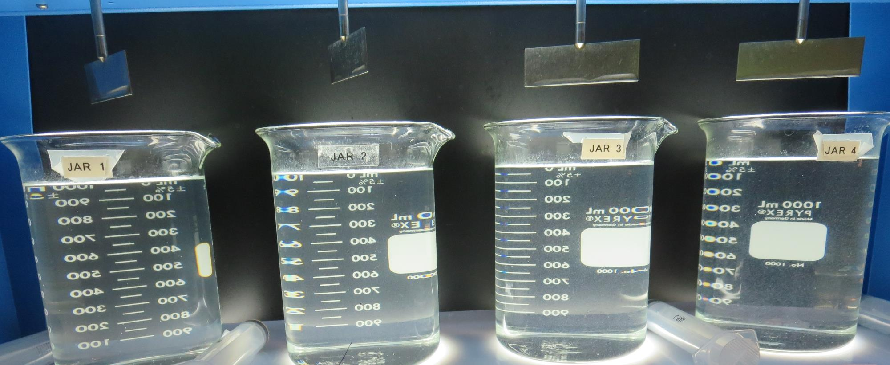
Jars 41-44: After 5 min of settling, 25 mL is syringed for filterability and %UVT/UVA.

Slide 68
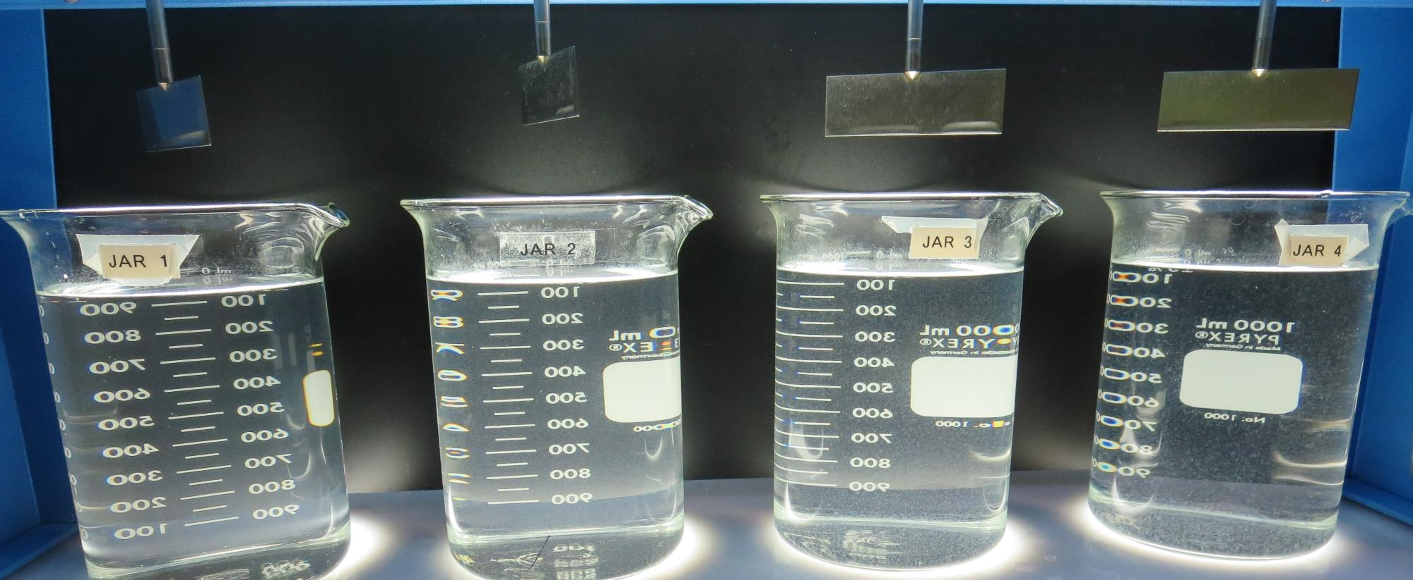
Jars 41-44: After 25-minutes of settling, settled water turbidity is taken.
2.0 mg/L NaOCl
25 mg/L 7040
Filtrate 0.11 NTU
UVT: 92.5%
UVA: 0.033/cm
UVA Reduction 34%
Settled: 2.56 NTU
2.0 mg/L NaOCl
30 mg/L 7040
Filtrate 0.10 NTU
UVT: 92.3%
UVA: 0.034/cm
UVA Reduction 32%
Settled: 2.64 NTU
2.0 mg/L NaOCl
35 mg/L 7040
Filtrate 0.12 NTU
UVT: 92.1%
UVA: 0.035/cm
UVA Reduction 30%
Settled: 2.48 NTU
2.0 mg/L NaOCl
40 mg/L 7040
Filtrate 0.15 NTU
UVT: 92.0%
UVA: 0.036/cm
UVA Reduction 28%
Settled: 1.97 NTU

Slide 69
Jars 45-48 Test Flash Mix 30 Sec (200 RPM) Floc Mix 5 min (30 RPM) Pre-Oxidant (NaOCl) Applied Coagulants 917/7049

Slide 70
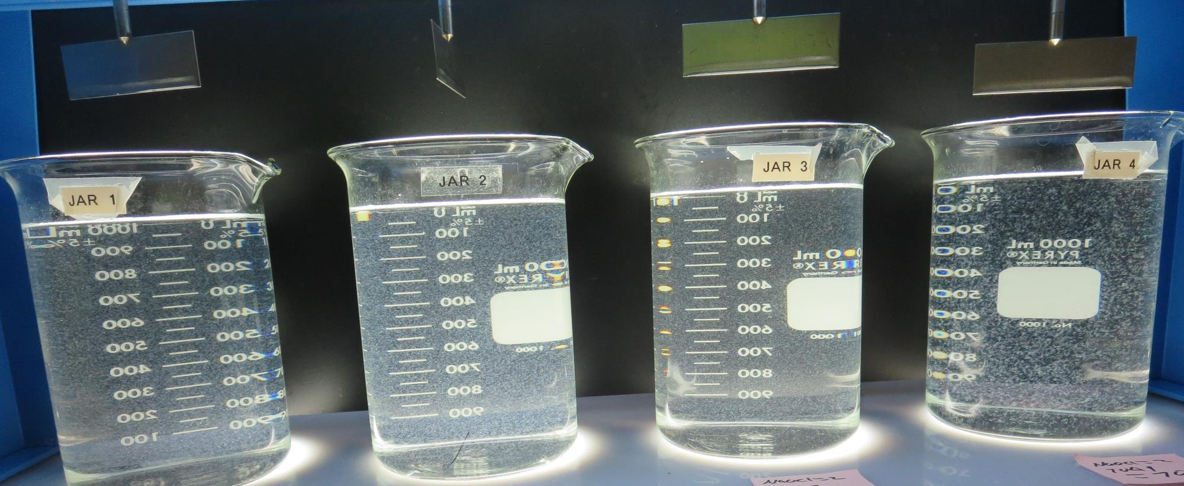
Jars 45-48: End of 5-minute flocculation (30 RPM) duration.
2.0 mg/L NaOCl
26 mg/L 917
Filtrate 0.11 NTU
UVT: 93.6%
UVA: 0.028/cm
UVA Reduction 44%
Settled: 2.01 NTU
2.0 mg/L NaOCl
29 mg/L 917
Filtrate 0.07 NTU
UVT: 93.7%
UVA: 0.028/cm
UVA Reduction 44%
Settled: 2.15 NTU
2.0 mg/L NaOCl
30 mg/L 7049
Filtrate 0.08 NTU
UVT: 93.2%
UVA: 0.030/cm
UVA Reduction 40%
Settled: 2.42 NTU
2.0 mg/L NaOCl
70 mg/L 7049
Filtrate 0.06 NTU
UVT: 93.5%
UVA: 0.028/cm
UVA Reduction 44%
Settled: 1.12 NTU

Slide 71
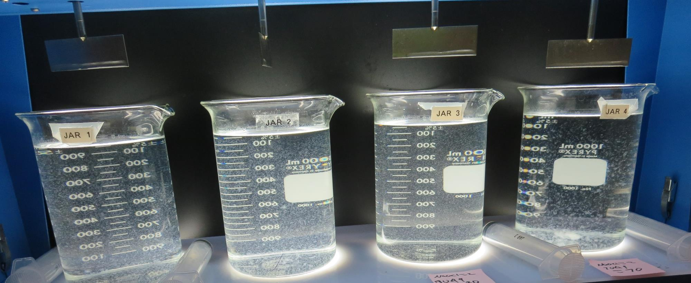
Jars 45-48: After 5 min of settling, 25 mL is syringed for filterability and %UVT/UVA.

Slide 72
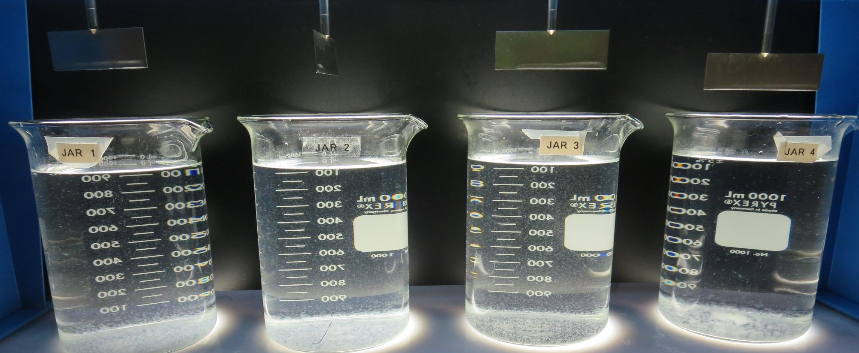
Jars 45-48: After 25-minutes of settling, settled water turbidity is taken.
2.0 mg/L NaOCl
26 mg/L 917
Filtrate 0.11 NTU
UVT: 93.6%
UVA: 0.028/cm
UVA Reduction 44%
Settled: 2.01 NTU
2.0 mg/L NaOCl
29 mg/L 917
Filtrate 0.07 NTU
UVT: 93.7%
UVA: 0.028/cm
UVA Reduction 44%
Settled: 2.15 NTU
2.0 mg/L NaOCl
30 mg/L 7049
Filtrate 0.08 NTU
UVT: 93.2%
UVA: 0.030/cm
UVA Reduction 40%
Settled: 2.42 NTU
2.0 mg/L NaOCl
70 mg/L 7049
Filtrate 0.06 NTU
UVT: 93.5%
UVA: 0.028/cm
UVA Reduction 44%
Settled: 1.12 NTU

Slide 73
Jars 49-52 Test Flash Mix 30 Sec (200 RPM) Floc Mix 5 min (30 RPM) Pre-Oxidant (NaOCl) Applied Coagulants Alum/C-308P

Slide 74
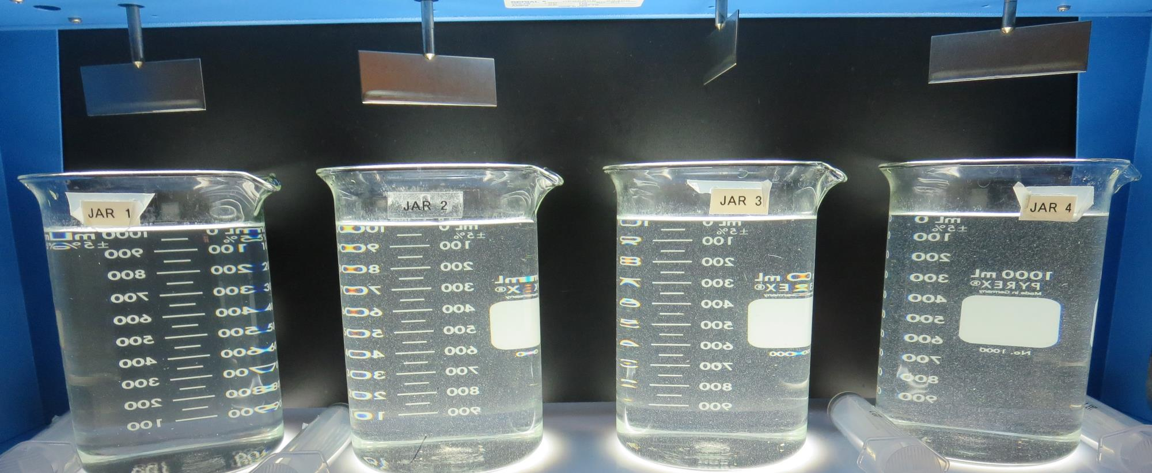
Jars 49-52: End of 5-minute flocculation (30 RPM) duration.
2.0 mg/L NaOCl
12.5 mg/L Alum
2.6 mg/L C-308P
Filtrate 0.19 NTU
UVT: 91.5%
UVA: 0.038/cm
UVA Reduction 24%
Settled: 2.20 NTU
2.0 mg/L NaOCl
14.4 mg/L Alum
3.0 mg/L C-308P
Filtrate 0.16 NTU
UVT: 91.7%
UVA: 0.037/cm
UVA Reduction 26%
Settled: 3.37 NTU
2.0 mg/L NaOCl
16.8 mg/L Alum
3.5 mg/L C-308P
Filtrate 0.10 NTU
UVT: 92.0%
UVA: 0.036/cm
UVA Reduction 28%
Settled: 3.52 NTU
2.0 mg/L NaOCl
19.2 mg/L Alum
4.0 mg/L C-308P
Filtrate 0.11 NTU
UVT: 92.0%
UVA: 0.035/cm
UVA Reduction 30%
Settled: 2.91 NTU

Slide 75
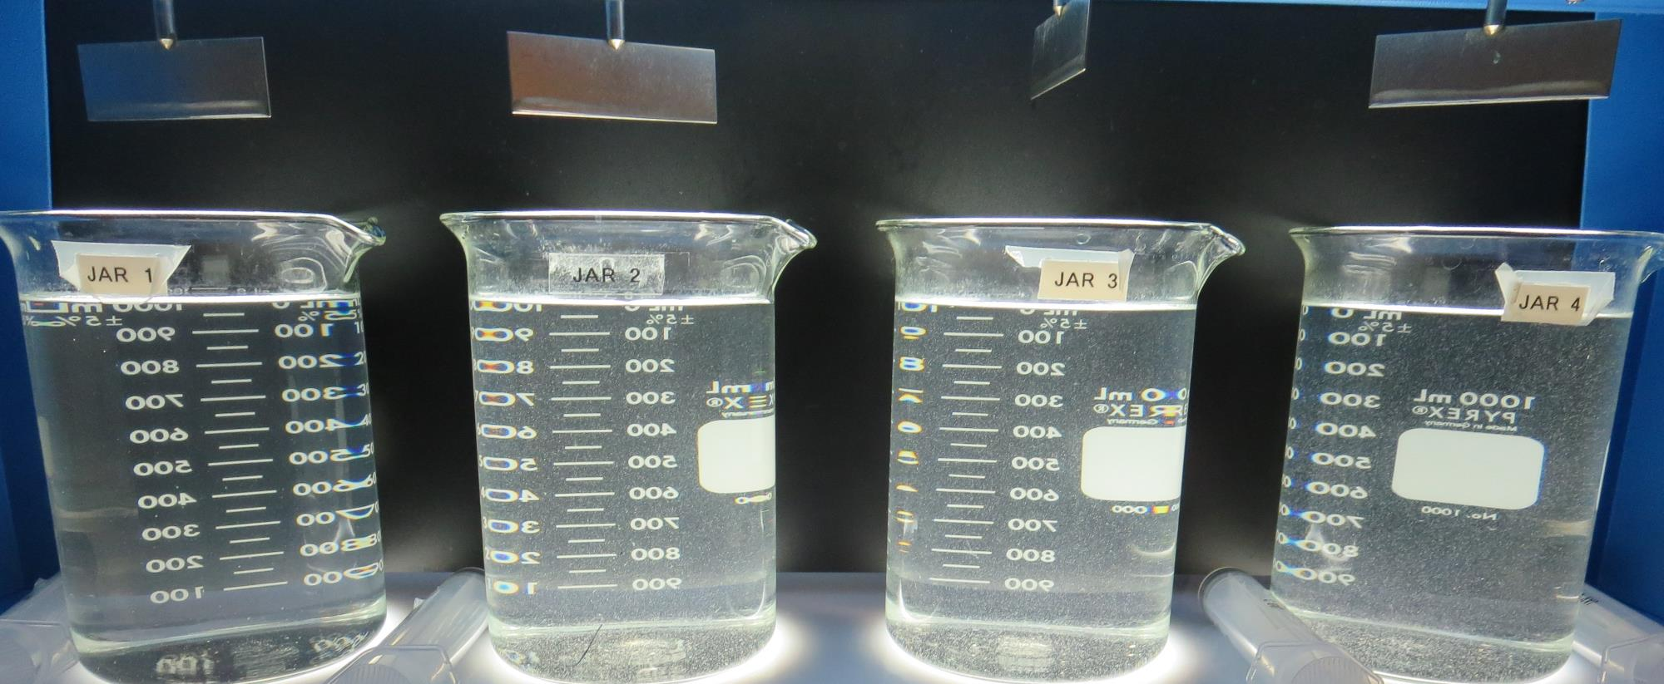
Jars 49-52: After 5 min of settling, 25 mL is syringed for filterability and %UVT/UVA.

Slide 76
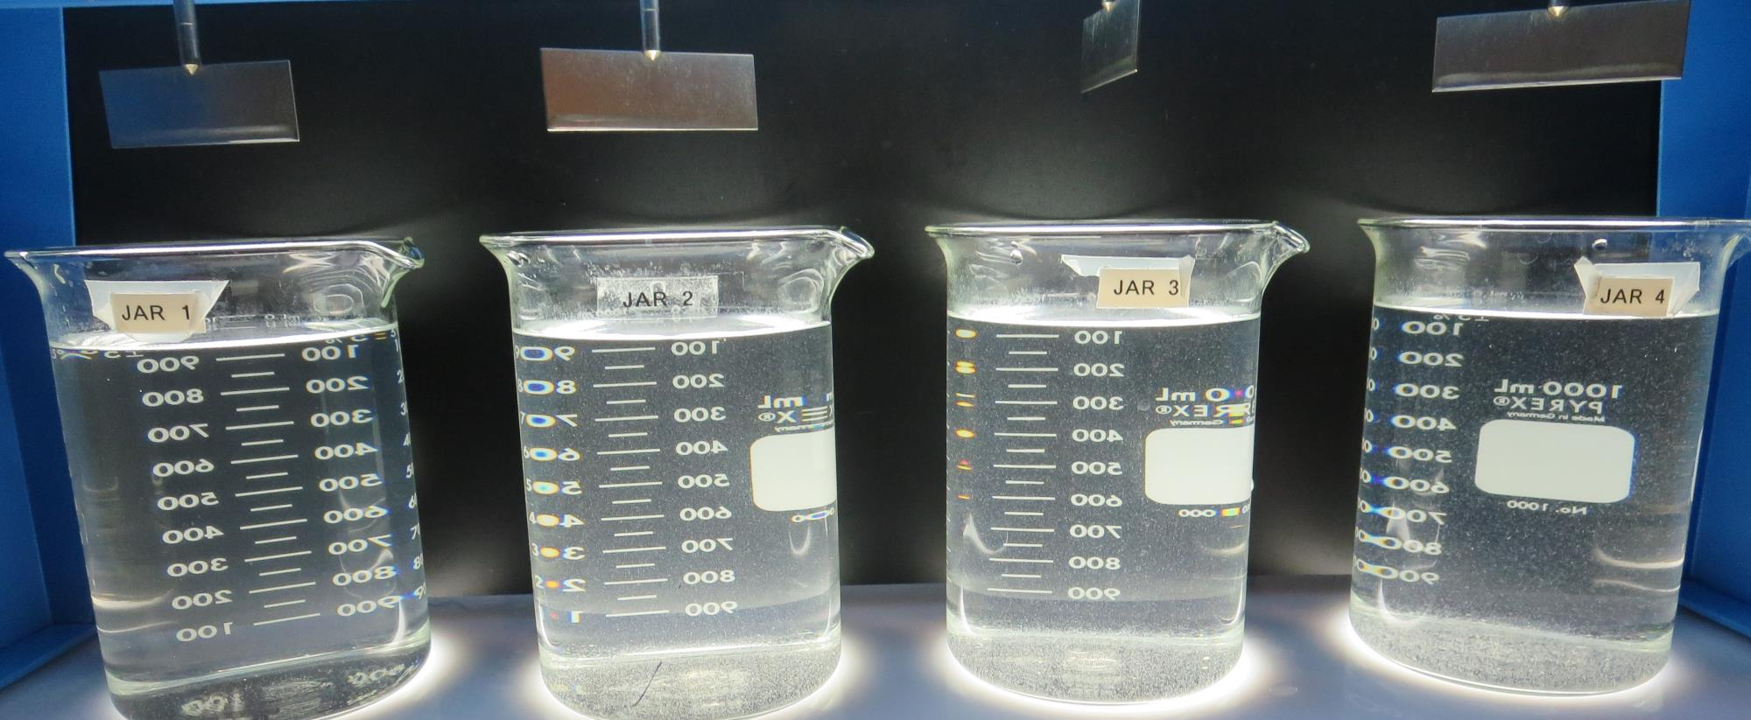
Jars 49-52: After 25-minutes of settling, settled water turbidity is taken.
2.0 mg/L NaOCl
12.5 mg/L Alum
2.6 mg/L C-308P
Filtrate 0.19 NTU
UVT: 91.5%
UVA: 0.038/cm
UVA Reduction 24%
Settled: 2.20 NTU
2.0 mg/L NaOCl
14.4 mg/L Alum
3.0 mg/L C-308P
Filtrate 0.16 NTU
UVT: 91.7%
UVA: 0.037/cm
UVA Reduction 26%
Settled: 3.37 NTU
2.0 mg/L NaOCl
16.8 mg/L Alum
3.5 mg/L C-308P
Filtrate 0.10 NTU
UVT: 92.0%
UVA: 0.036/cm
UVA Reduction 28%
Settled: 3.52 NTU
2.0 mg/L NaOCl
19.2 mg/L Alum
4.0 mg/L C-308P
Filtrate 0.11 NTU
UVT: 92.0%
UVA: 0.035/cm
UVA Reduction 30%
Settled: 2.91 NTU

Slide 77
Jars 53-56 Test Flash Mix 30 Sec (200 RPM) Floc Mix 5 min (30 RPM) Pre-Oxidant (NaOCl) Applied Coagulants Alum/C-308P

Slide 78
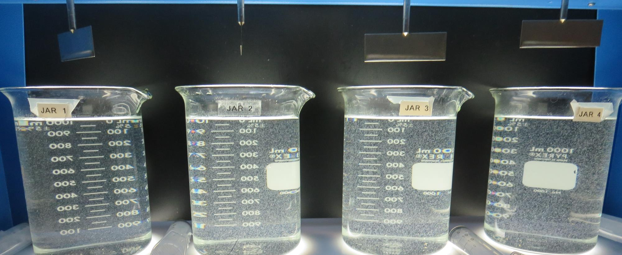
Jars 53-56: End of 5-minute flocculation (30 RPM) duration.
2.0 mg/L NaOCl
26 mg/L Alum
2.6 mg/L C-308P
Filtrate 0.16 NTU
UVT: 92.1%
UVA: 0.035/cm
UVA Reduction 30%
Settled: 2.03 NTU
2.0 mg/L NaOCl
30 mg/L Alum
3.0 mg/L C-308P
Filtrate 0.11 NTU
UVT: 92.4%
UVA: 0.034/cm
UVA Reduction 32%
Settled: 1.87 NTU
2.0 mg/L NaOCl
35 mg/L Alum
3.5 mg/L C-308P
Filtrate 0.09 NTU
UVT: 92.8%
UVA: 0.032/cm
UVA Reduction 36%
Settled: 1.36 NTU
2.0 mg/L NaOCl
40 mg/L Alum
4.0 mg/L C-308P
Filtrate 0.12 NTU
UVT: 92.9%
UVA: 0.031/cm
UVA Reduction 38%
Settled: 1.23 NTU

Slide 79
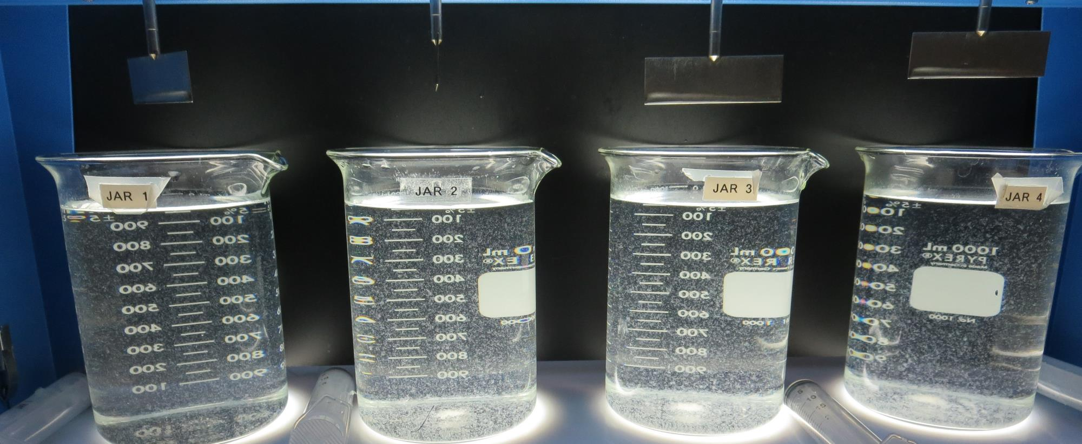
Jars 53-56: After 5 min of settling, 25 mL is syringed for filterability and %UVT/UVA.

Slide 80
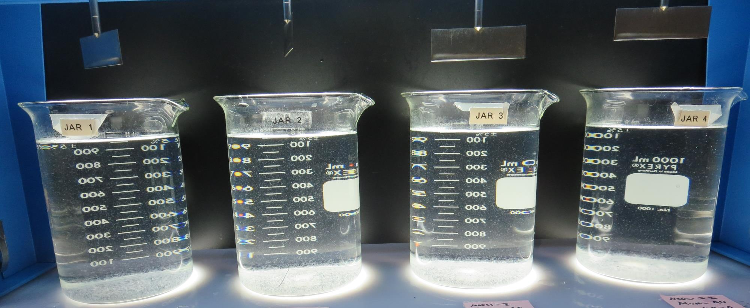
Jars 53-56: After 25-minutes of settling, settled water turbidity is taken.
2.0 mg/L NaOCl
26 mg/L Alum
2.6 mg/L C-308P
Filtrate 0.16 NTU
UVT: 92.1%
UVA: 0.035/cm
UVA Reduction 30%
Settled: 2.03 NTU
2.0 mg/L NaOCl
30 mg/L Alum
3.0 mg/L C-308P
Filtrate 0.11 NTU
UVT: 92.4%
UVA: 0.034/cm
UVA Reduction 32%
Settled: 1.87 NTU
2.0 mg/L NaOCl
35 mg/L Alum
3.5 mg/L C-308P
Filtrate 0.09 NTU
UVT: 92.8%
UVA: 0.032/cm
UVA Reduction 36%
Settled: 1.36 NTU
2.0 mg/L NaOCl
40 mg/L Alum
4.0 mg/L C-308P
Filtrate 0.12 NTU
UVT: 92.9%
UVA: 0.031/cm
UVA Reduction 38%
Settled: 1.23 NTU

Slide 81
Jars 57-60 Test Flash Mix 30 Sec (200 RPM) Floc Mix 5 min (30 RPM) Pre-Oxidant (NaOCl) Applied Coagulants Alum/C-308P

Slide 82
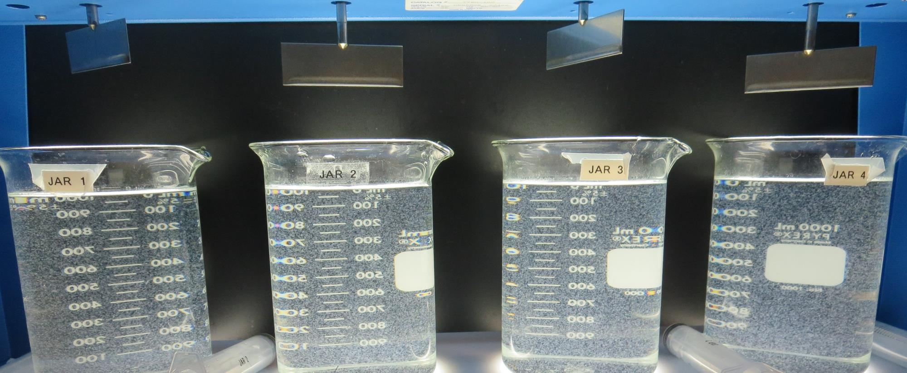
Jars 57-60: End of 5-minute flocculation (30 RPM) duration.
2.0 mg/L NaOCl
45 mg/L Alum
4.5 mg/L C-308P
Filtrate 0.14 NTU
UVT: 93.0%
UVA: 0.031/cm
UVA Reduction 38%
Settled: 1.15 NTU
2.0 mg/L NaOCl
50 mg/L Alum
5.0 mg/L C-308P
Filtrate 0.15 NTU
UVT: 93.2%
UVA: 0.030/cm
UVA Reduction 40%
Settled: 1.13 NTU
2.0 mg/L NaOCl
55 mg/L Alum
5.5 mg/L C-308P
Filtrate 0.09 NTU
UVT: 93.3%
UVA: 0.030/cm
UVA Reduction 40%
Settled: 1.16 NTU
2.0 mg/L NaOCl
60 mg/L Alum
6.0 mg/L C-308P
Filtrate 0.12 NTU
UVT: 93.3%
UVA: 0.029/cm
UVA Reduction 42%
Settled: 1.20 NTU

Slide 83
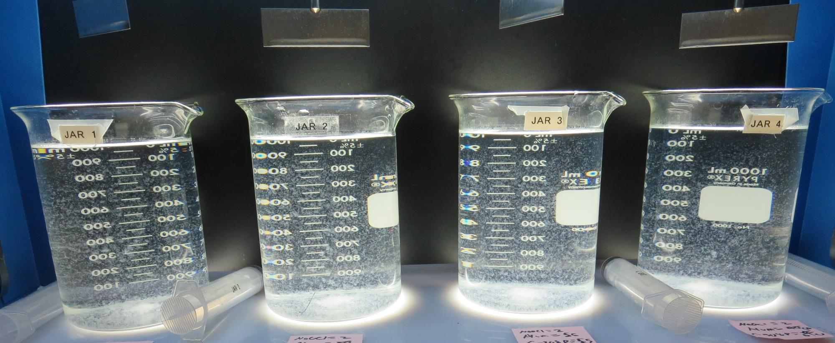
Jars 57-60: After 5 min of settling, 25 mL is syringed for filterability and %UVT/UVA.

Slide 84
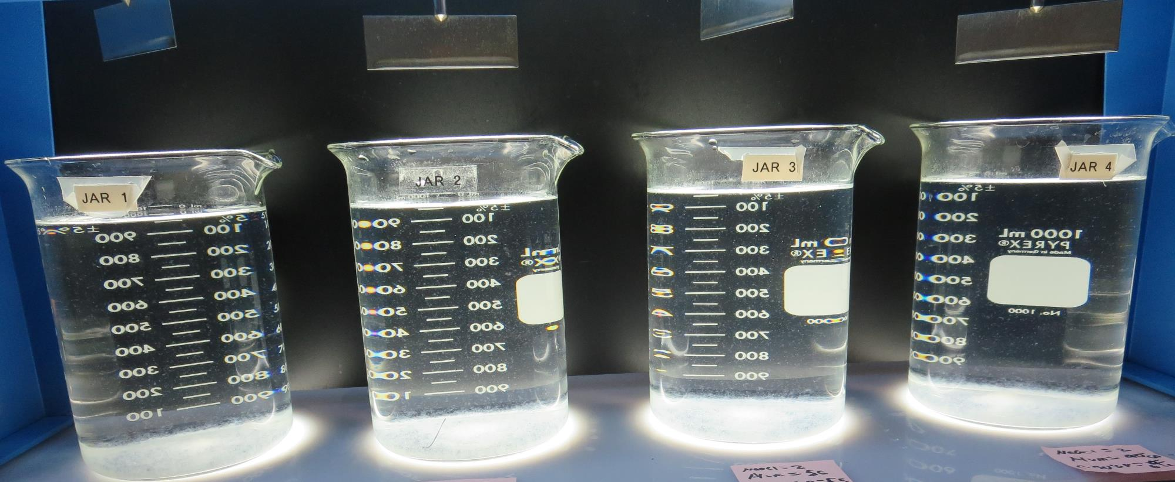
Jars 57-60: After 25-minutes of settling, settled water turbidity is taken.
2.0 mg/L NaOCl
45 mg/L Alum
4.5 mg/L C-308P
Filtrate 0.14 NTU
UVT: 93.0%
UVA: 0.031/cm
UVA Reduction 38%
Settled: 1.15 NTU
2.0 mg/L NaOCl
50 mg/L Alum
5.0 mg/L C-308P
Filtrate 0.15 NTU
UVT: 93.2%
UVA: 0.030/cm
UVA Reduction 40%
Settled: 1.13 NTU
2.0 mg/L NaOCl
55 mg/L Alum
5.5 mg/L C-308P
Filtrate 0.09 NTU
UVT: 93.3%
UVA: 0.030/cm
UVA Reduction 40%
Settled: 1.16 NTU
2.0 mg/L NaOCl
60 mg/L Alum
6.0 mg/L C-308P
Filtrate 0.12 NTU
UVT: 93.3%
UVA: 0.029/cm
UVA Reduction 42%
Settled: 1.20 NTU

Slide 85
Jars 61-64 Test Flash Mix 30 Sec (200 RPM) Floc Mix 5 min (30 RPM) Pre-Oxidant (NaOCl) Applied Coagulants Alum/C-308P

Slide 86
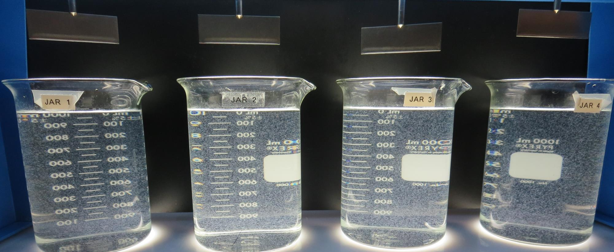
Jars 61-64: End of 5-minute flocculation (30 RPM) duration.
2.0 mg/L NaOCl
55 mg/L Alum
0 mg/L C-308P
Filtrate 0.12 NTU
UVT: 93.0%
UVA: 0.031/cm
UVA Reduction 38%
Settled: 1.10 NTU
2.0 mg/L NaOCl
55 mg/L Alum
5.5 mg/L C-308P
Filtrate 0.12 NTU
UVT: 93.1%
UVA: 0.031/cm
UVA Reduction 38%
Settled: 1.06 NTU
2.0 mg/L NaOCl
55 mg/L Alum
5.5 mg/L C-308P
Filtrate 0.12 NTU
UVT: 93.2%
UVA: 0.030/cm
UVA Reduction 40%
Settled: 1.11 NTU
2.0 mg/L NaOCl
55 mg/L Alum
5.5 mg/L C-308P
Filtrate 0.11 NTU
UVT: 93.0%
UVA: 0.031/cm
UVA Reduction 38%
Settled: 1.10 NTU

Slide 87
Jars 61-64: After 5 min of settling, 25 mL is syringed for filterability and %UVT/UVA.

Slide 88
Jars 61-64: After 25-minutes of settling, settled water turbidity is taken.
2.0 mg/L NaOCl
55 mg/L Alum
0 mg/L C-308P
Filtrate 0.12 NTU
UVT: 93.0%
UVA: 0.031/cm
UVA Reduction 38%
Settled: 1.10 NTU
2.0 mg/L NaOCl
55 mg/L Alum
5.5 mg/L C-308P
Filtrate 0.12 NTU
UVT: 93.1%
UVA: 0.031/cm
UVA Reduction 38%
Settled: 1.06 NTU
2.0 mg/L NaOCl
55 mg/L Alum
5.5 mg/L C-308P
Filtrate 0.12 NTU
UVT: 93.2%
UVA: 0.030/cm
UVA Reduction 40%
Settled: 1.11 NTU
2.0 mg/L NaOCl
55 mg/L Alum
5.5 mg/L C-308P
Filtrate 0.11 NTU
UVT: 93.0%
UVA: 0.031/cm
UVA Reduction 38%
Settled: 1.10 NTU

Slide 89
Jars 65-68 Test Flash Mix 30 Sec (200 RPM) Floc Mix 5 min (30 RPM) Pre-Oxidant (NaOCl) Applied Coagulants Alum/9800/9810/917

Slide 90
Jars 65-68: End of 5-minute flocculation (30 RPM) duration.
2.0 mg/L NaOCl
26 mg/L Alum
Filtrate 0.09 NTU
UVT: 92.1%
UVA: 0.035/cm
UVA Reduction 30%
Settled: 1.99 NTU
2.0 mg/L NaOCl
20 mg/L 9800
Filtrate 0.13 NTU
UVT: 92.2%
UVA: 0.035/cm
UVA Reduction 30%
Settled: 3.76 NTU
2.0 mg/L NaOCl
29 mg/L 9810
Filtrate 0.09 NTU
UVT: 93.3%
UVA: 0.030/cm
UVA Reduction 40%
Settled: 1.26 NTU
2.0 mg/L NaOCl
26 mg/L 917
Filtrate 0.12 NTU
UVT: 93.2%
UVA: 0.030/cm
UVA Reduction 40%
Settled: 2.24 NTU

Slide 91
Jars 65-68: After 5 min of settling, 25 mL is syringed for filterability and %UVT/UVA.

Slide 92
Jars 65-68: After 25-minutes of settling, settled water turbidity is taken.
2.0 mg/L NaOCl
26 mg/L Alum
Filtrate 0.09 NTU
UVT: 92.1%
UVA: 0.035/cm
UVA Reduction 30%
Settled: 1.99 NTU
2.0 mg/L NaOCl
20 mg/L 9800
Filtrate 0.13 NTU
UVT: 92.2%
UVA: 0.035/cm
UVA Reduction 30%
Settled: 3.76 NTU
2.0 mg/L NaOCl
29 mg/L 9810
Filtrate 0.09 NTU
UVT: 93.3%
UVA: 0.030/cm
UVA Reduction 40%
Settled: 1.26 NTU
2.0 mg/L NaOCl
26 mg/L 917
Filtrate 0.12 NTU
UVT: 93.2%
UVA: 0.030/cm
UVA Reduction 40%
Settled: 2.24 NTU

Slide 93
Jars 69-72 Test Flash Mix 30 Sec (200 RPM) Floc Mix 5 min (30 RPM) Pre-Oxidant (NaOCl) Applied Coagulants Alum/9800/9810/917

Slide 94
Jars 69-72: End of 5-minute flocculation (30 RPM) duration.
2.0 mg/L NaOCl
40 mg/L Alum
Filtrate 0.10 NTU
UVT: 92.8%
UVA: 0.032/cm
UVA Reduction 36%
Settled: 1.10 NTU
2.0 mg/L NaOCl
29 mg/L 9800
Filtrate 0.07 NTU
UVT: 92.6%
UVA: 0.033/cm
UVA Reduction 34%
Settled: 2.19 NTU
2.0 mg/L NaOCl
32 mg/L 9810
Filtrate 0.12 NTU
UVT: 93.0%
UVA: 0.031/cm
UVA Reduction 38%
Settled: 1.20 NTU
2.0 mg/L NaOCl
29 mg/L 917
Filtrate 0.13 NTU
UVT: 93.0%
UVA: 0.031/cm
UVA Reduction 38%
Settled: 1.70 NTU

Slide 95
Jars 69-72: After 5 min of settling, 25 mL is syringed for filterability and %UVT/UVA.

Slide 96
Jars 69-72: After 25-minutes of settling, settled water turbidity is taken.
2.0 mg/L NaOCl
40 mg/L Alum
Filtrate 0.10 NTU
UVT: 92.8%
UVA: 0.032/cm
UVA Reduction 36%
Settled: 1.10 NTU
2.0 mg/L NaOCl
29 mg/L 9800
Filtrate 0.07 NTU
UVT: 92.6%
UVA: 0.033/cm
UVA Reduction 34%
Settled: 2.19 NTU
2.0 mg/L NaOCl
32 mg/L 9810
Filtrate 0.12 NTU
UVT: 93.0%
UVA: 0.031/cm
UVA Reduction 38%
Settled: 1.20 NTU
2.0 mg/L NaOCl
29 mg/L 917
Filtrate 0.13 NTU
UVT: 93.0%
UVA: 0.031/cm
UVA Reduction 38%
Settled: 1.70 NTU

Slide 97
Jars 73-76 Test Flash Mix 30 Sec (200 RPM) Floc Mix 5 min (30 RPM) Pre-Oxidant (NaOCl) Applied Coagulants Alum/9800/9810

Slide 98
Jars 73-76: End of 5-minute flocculation (30 RPM) duration.
2.0 mg/L NaOCl
45 mg/L Alum
Filtrate 0.11 NTU
UVT: 92.8%
UVA: 0.032/cm
UVA Reduction 36%
Settled: 1.00 NTU
2.0 mg/L NaOCl
50 mg/L Alum
Filtrate 0.12 NTU
UVT: 92.7%
UVA: 0.032/cm
UVA Reduction 36%
Settled: 0.94 NTU
2.0 mg/L NaOCl
36 mg/L 9800
Filtrate 0.08 NTU
UVT: 93.0%
UVA: 0.031/cm
UVA Reduction 38%
Settled: 1.28 NTU
2.0 mg/L NaOCl
36 mg/L 9810
Filtrate 0.08 NTU
UVT: 93.3%
UVA: 0.029/cm
UVA Reduction 42%
Settled: 0.95 NTU

Slide 99
Jars 73-76: After 5 min of settling, 25 mL is syringed for filterability and %UVT/UVA.

Slide 100
Jars 73-76: After 25-minutes of settling, settled water turbidity is taken.
2.0 mg/L NaOCl
45 mg/L Alum
Filtrate 0.11 NTU
UVT: 92.8%
UVA: 0.032/cm
UVA Reduction 36%
Settled: 1.00 NTU
2.0 mg/L NaOCl
50 mg/L Alum
Filtrate 0.12 NTU
UVT: 92.7%
UVA: 0.032/cm
UVA Reduction 36%
Settled: 0.94 NTU
2.0 mg/L NaOCl
36 mg/L 9800
Filtrate 0.08 NTU
UVT: 93.0%
UVA: 0.031/cm
UVA Reduction 38%
Settled: 1.28 NTU
2.0 mg/L NaOCl
36 mg/L 9810
Filtrate 0.08 NTU
UVT: 93.3%
UVA: 0.029/cm
UVA Reduction 42%
Settled: 0.95 NTU

Slide 101
Jar Testing for 1-Liter Jars: Procedures for Most Treatment Plants
Fill jars with source water prior to coagulant injection and set paddle speed at 30 rpm
Add chemicals (i.e., NaOCl, primary coagulant, coagulant aid) to each jar
Flash mix for 15-30 seconds (200 rpm)
Slow mix for 5 minutes (20-30 rpm)
Settled for 5 minutes. Syringe 25 mL from each jar taken 1-inch below surface (25 mL/12 sec rate)
Filtered through 1.2 um isopore membrane into cuvette drip rate, 15 mL/(50-90 sec)
Measure filtrate turbidity, chlorine residual and %UVT/UVA
Measure settled water turbidity after 25 minutes of total setting
Record all data

Slide 102
Jar Test Filterability Test Equipment
Turbidity Instrument
Syringe w/Luer-Lock Tip, 30 cc
(part#: 2225800, by Hach)
Swinnex Filter Holder, 25 mm (part#: SX0002500)
Isopore Membrane Filter, 1.2 um absolute
pore size,
Φ= 25 mm , thickness: 24 um,
hydrophilic polycarbonate membrane
(part #: RTTP02500)
Go to Sigma-Aldrich for laboratory supplies http://www.sigmaaldrich.com/united-states.html

Slide 103
Isopore Membrane Information
Categories | Information
trade name | Isopore
filter color | White
chemistry | Polycarbonate (PC)
water flow rate | Avg. 175 mL/min x cm² (typical results @ 10 psi)
media | Isopore®
wettability | Hydrophilic
porosity | 14.7%
pore size | 1.2 µm
bubble point at 23 °C | 1.0 bar, air with water
thickness | 24 µm
filter diameter (ø) | 25 mm
material size | polycarbonate, Hydrophilic, 1.2 µm, 25 mm, white, plain, 100

Slide 104
Isopore Membrane Background Information
The Isopore membrane is a polycarbonate, track-etched screen filter recommended for all analyses in which the sample is viewed on the surface of the membrane. The Isopore membrane is composed of polycarbonate film, which has a smooth, glass-like surface for clearer sample observation. The unique manufacturing process of the membrane ensures a precise pore diameter and a consistent pore size for accurate separation of samples by size. Matched-weight filters are not usually required because of low, constant tar and ash weights. Features & Benefits: Membrane structure retains particles on the surface, simplifying counting and analysis

Slide 105
Jar Test - Filterability Test
Syringe ~ 25 mL from jar (after 5-minutes of settling)
Filter-to-waste 3-5 mL
Filter directly into clean cuvette
Measure turbidity
Note: Take several readings before recording final NTU results. Micro bubbles can adhere to glass causing false NTU readings. To remove bubbles, tilt cuvette up to 90 degrees.

Slide 106
Contact
Guy Schott, P.E.
State Water Resources Control Board
Division of Drinking Water
Santa Rosa, CA
Go to Stock Solution/Dose calculations/Jar Test Results for tools to download
www.waterboards.ca.gov/drinking_water/programs/districts/mendocino_district.html
Email: Guy Schott - Guy.Schott@waterboards.ca.gov
Office Number: 707-576-2732

