Slide 1
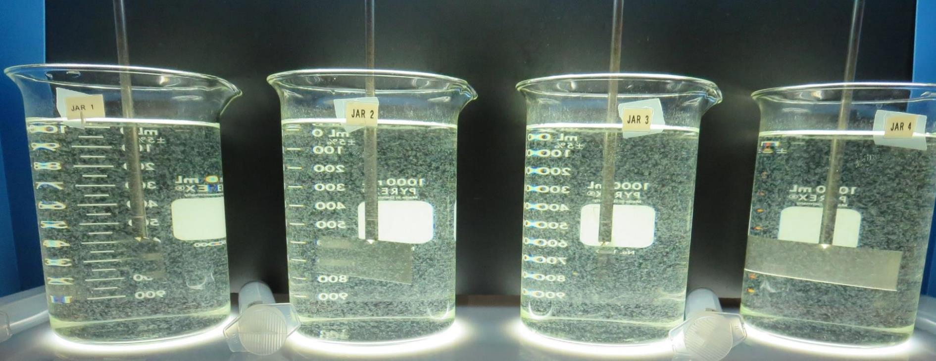
Clear Water Mutual Water Company
CA1700546
Lake County
Jar Test
by Guy Schott, P.E
October 9, 2019

Slide 2
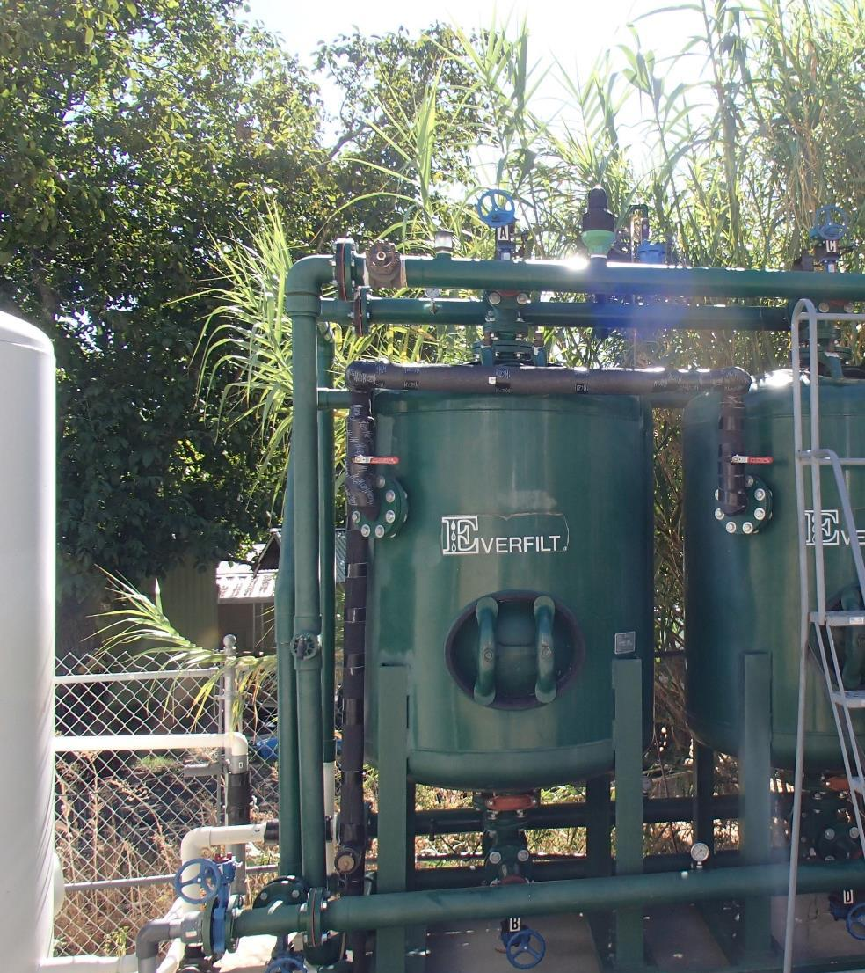
Conventional Water Treatment

Slide 3
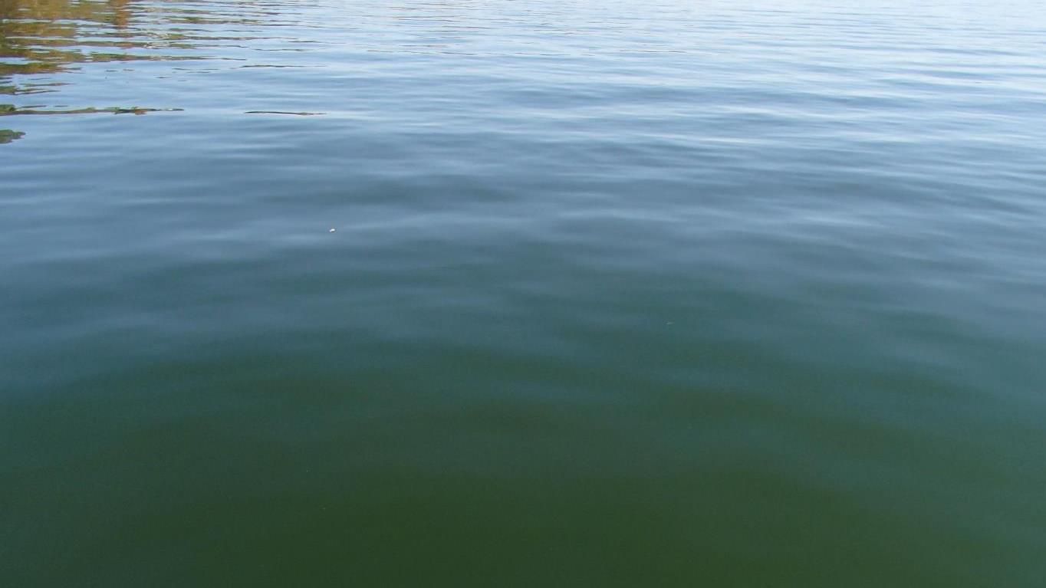
Clear Water MWC Water Characteristics
October 8, 2019
Source
Turbidity: 3.95 NTU
pH: 7.94
UVT: 78.7%, UVA: 0.104/cm
0.4 um Filtered
UVT: 81.2%, UVA: 0.090/cm

Slide 4
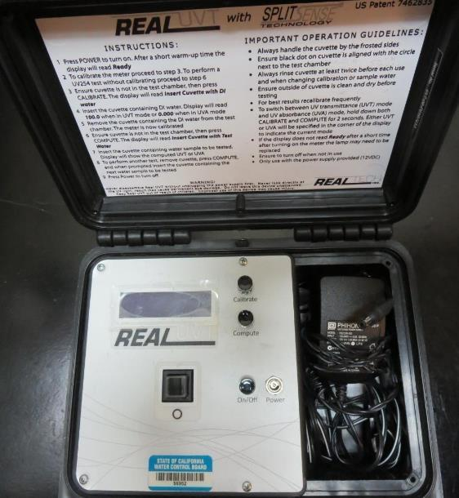
UVT/UVA, pathlength 10 mm
UV transmittance (UVT) is a measurement of the amount of ultraviolet light (commonly at 254 nm due to its germicidal effect) that passes through a water sample compared to the amount of light that passes through a pure water sample. The measurement is expressed as a percentage, % UVT.
%UVT = 10^{(-UVA)} x 100%
UV absorbance (UVA) is calculated as a relative measure of the amount of light absorbed by a water sample compared with the amount of light absorbed by a pure water sample.
UVA = -log(%UVT/100)

Slide 5
Applied Coagulants for Jar Testing Set 1
Pro Pac 9800 (NTU Technologies)
50% Aluminum Chlorohydrate
50% Water
23.62% Al₂O₃
12.5% Al
83% Basicity
SG = 1.25-1.34
NSF limit: 250 mg/L as Product
10 mg/L as 9800 = Reduction 1.18 mg/L as CaCO₃
7066 (Garratt Callahan)
10 – 30% Poly Aluminum Hydroxychloride Sulfate
50% Basicity
SG = 1.2
NSF limit: 450 mg/L as Product

Slide 6
Applied Coagulants for Jar Testing Set 2
Pro Pac 9890 (NTU Technologies)
35-45% Aluminum Chlorohydrate
20% polyamine (50% water, 50% active polyamines)
35-45% Water
~18.9% Al₂O₃
~10.5% Al
83% Basicity
SG = 1.25-1.34
NSF limit: 50 mg/L as Product;
Product dose 10 mg/L = 1 mg/L polyamines active
Pro Pac 917 (NTU Technologies)
40-50% Aluminum Chlorohydrate (ACH)
40-50% Water
10% polyamine (50% water, 50% active polyamines)
SG = 1.25 - 1.34
NSF limit: 100 mg/L as Product;
Product dose 20 mg/L = 1 mg/L polyamines active

Slide 7
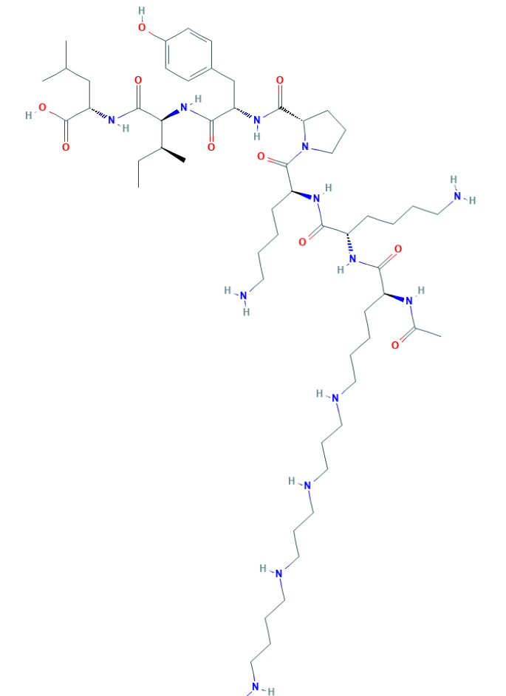
Polyamine
C₅₉H₁₀₈N₁₄O₁₀
MW: 1,173.6 g/mol

Slide 8
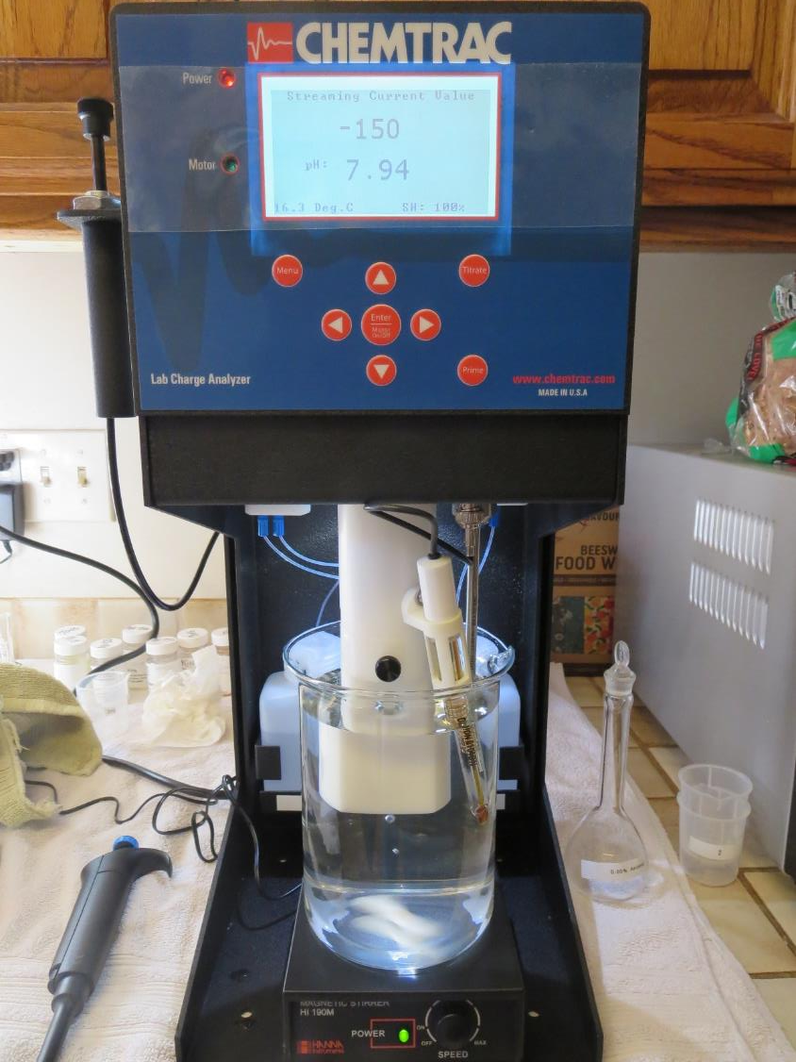
Laboratory Charge Analyzer
LCA: Used to determine coagulant demand of a source water entering the treatment plant.
Source pH: 7.94
LCA #1:
7032 (ACH): 28 mg/L as product
pH adjusted to 7.5 with acidic acid
LCA #2:
7032 (ACH): 29.6 mg/L as product (no pH adjustment)
Final pH: 7.77

Slide 9
Laboratory Charge Analyzer - Continue
LCA #3:
Added 1.0 mg/L NaOCl
7032 (ACH): 26.6 mg/L as product
pH adjusted to 7.5 with acidic acid
LCA #4:
917: 19 mg/L as product
pH adjusted to 7.5 with acidic acid

Slide 10
Coagulant Information
Unless stated otherwise, all coagulant doses are reported as Product (100% strength).
Preparation of coagulant stock solutions are generally 1.0 and/or 0.1 percent strength using 100 and/or 200 mL volumetric flasks.
Finnpipette F2 variable volume pipette, capacity 100-1000 micro liters is used for stock solution preparation and coagulant aid jar test dosing.
Finnpipette F2 variable volume pipette, capacity 0.5-5 mL is used for primary coagulant jar test dosing.

Slide 11
Source: Clear Lake; Jar Test 1 - 8 Results
Flash Mix 200 RPM (60 sec); Floc Mix 30 RPM (5 min)
Jar# | 9800 mg/L | Filtrate NTU | Filtrate %UVT | Filtrate UVA/cm | %UVA Reduction | Settle NTU 25 min
J1 | 26 | 0.12 | 86.7 | 0.062 | 31.1 | 0.45
J2 | 28 | 0.13 | 86.5 | 0.063 | 30.0 | 0.40
J3 | 30 | 0.13 | 86.5 | 0.063 | 30.0 | 0.45
J4 | 32 | 0.10 | 86.8 | 0.061 | 32.2 | 0.46
J5 | 32 | 0.12 | 87.5 | 0.058 | 35.6 | 0.29
J6 | 34 | 0.12 | 87.2 | 0.059 | 34.4 | 0.57
J7 | 36 | 0.10 | 87.4 | 0.058 | 35.6 | 0.43
J8 | 38 | 0.09 | 87.7 | 0.057 | 36.7 | 0.40

Slide 12
Source: Clear Lake; Jar Test 9 - 16 Results
Flash Mix 200 RPM (60 sec); Floc Mix 30 RPM (5 min)
Jar# | 917 mg/L | Filtrate NTU | Filtrate %UVT | Filtrate UVA/cm | %UVA Reduction | Settle NTU 25 min
J9 | 19 | 0.11 | 89.5 | 0.048 | 46.7 | 0.34
J10 | 21 | 0.10 | 89.7 | 0.047 | 47.8 | 0.35
J11 | 23 | 0.08 | 90.0 | 0.046 | 48.9 | 0.39
J12 | 25 | 0.09 | 90.2 | 0.045 | 50.0 | 0.27
J13 | 25 | 0.08 | 89.6 | 0.048 | 46.7 | 0.32
J14 | 27 | 0.09 | 89.5 | 0.048 | 46.7 | 0.40
J15 | 29 | 0.07 | 89.2 | 0.050 | 44.4 | 0.39
J16 | 31 | 0.09 | 89.4 | 0.049 | 45.6 | 0.29

Slide 13
Source: Clear Lake; Jar Test 17 - 24 Results
Flash Mix 200 RPM (60 sec); Floc Mix 30 RPM (5 min)
Jar# | 7066 mg/L | Filtrate NTU | Filtrate %UVT | Filtrate UVA/cm | %UVA Reduction | Settle NTU 25 min
J17 | 70 | 0.12 | 87.3 | 0.059 | 34.4 | 0.34
J18 | 80 | 0.12 | 87.2 | 0.059 | 34.4 | 0.27
J19 | 90 | 0.11 | 87.8 | 0.057 | 36.7 | 0.37
J20 | 100 | 0.09 | 88.2 | 0.055 | 38.9 | 0.25
J21 | 110 | 0.10 | 88.0 | 0.056 | 37.8 | 0.31
J22 | 120 | 0.10 | 88.4 | 0.054 | 40.0 | 0.21
J23 | 130 | 0.09 | 88.6 | 0.053 | 41.1 | 0.33
J24 | 140 | 0.07 | 88.9 | 0.051 | 43.3 | 0.15

Slide 14
Source: Clear Lake; Jar Test 25 - 32 Results
Flash Mix 200 RPM (60 sec); Floc Mix 30 RPM (5 min)
Jar# | 9890 mg/L | Filtrate NTU | Filtrate %UVT | Filtrate UVA/cm | %UVA Reduction | Settle NTU 25 min
J25 | 18 | 0.06 | 89.8 | 0.047 | 47.8 | 0.24
J26 | 20 | 0.06 | 89.5 | 0.048 | 46.7 | 0.26
J27 | 22 | 0.06 | 89.5 | 0.048 | 46.7 | 0.22
J28 | 24 | 0.06 | 89.8 | 0.047 | 47.8 | 0.22
J29 | 16 | 0.06 | 89.0 | 0.051 | 43.3 | 0.38
J30 | 17 | 0.07 | 88.9 | 0.051 | 43.3 | 0.31
J31 | 18 | 0.06 | 89.1 | 0.050 | 44.4 | 0.39
J32 | 19 | 0.07 | 89.0 | 0.051 | 43.3 | 0.21

Slide 15
Source: Clear Lake; Jar Test 33 - 40 Results
Flash Mix 200 RPM (see below); Floc Mix 30 RPM (5 min)
Jar# | 200 RPM Flash Mix, Sec | NaOCl mg/L | 9890 mg/L | Filtrate NTU | Filtrate %UVT | Filtrate UVA/cm | %UVA Reduction | Settle NTU 25 min
J33 | 0 | 0 | 18 | 0.06 | 89.4 | 0.049 | 45.6 | 0.28
J34 | 15 | 0 | 18 | 0.06 | 89.2 | 0.050 | 44.4 | 0.34
J35 | 30 | 0 | 18 | 0.07 | 89.3 | 0.049 | 45.6 | 0.36
J36 | 60 | 0 | 18 | 0.07 | 89.2 | 0.050 | 44.4 | 0.26
J37 | 60 | 0 | 18 | 0.06 | 89.3 | 0.049 | 45.6 | 0.19
J38 | 60 | 1.0 | 18 | 0.06 | 88.7 | 0.052 | 42.2 | 0.26
J39 | 60 | 1.5 | 18 | 0.07 | 89.0 | 0.051 | 43.3 | 0.38
J40 | 60 | 2.0 | 18 | 0.06 | 89.6 | 0.048 | 46.6 | 0.31

Slide 16
Jars 1-4 Test
Flash Mix 60 Sec (200 RPM)
Floc Mix 5 min (30 RPM)
Applied Coagulant
9800

Slide 17
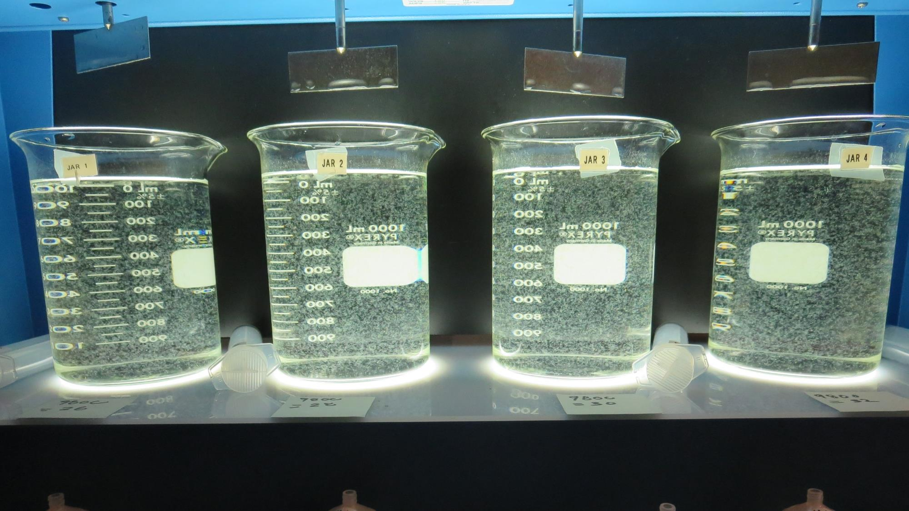
Jars 1-4: End of 5-minute flocculation (30 RPM) duration.
26 mg/L 9800
Filtrate: 0.12 NTU
UVT: 86.7%
UVA: 0.062/cm
UVA Reduction: 31.1%
Settled: 0.45 NTU
28 mg/L 9800
Filtrate: 0.13 NTU
UVT: 86.5%
UVA: 0.063/cm
UVA Reduction: 30.0%
Settled: 0.40 NTU
30 mg/L 9800
Filtrate: 0.13 NTU
UVT: 86.5%
UVA: 0.063/cm
UVA Reduction: 30.0%
Settled: 0.45 NTU
32 mg/L 9800
Filtrate: 0.10 NTU
UVT: 86.8%
UVA: 0.061/cm
UVA Reduction: 32.2%
Settled: 0.46 NTU

Slide 18
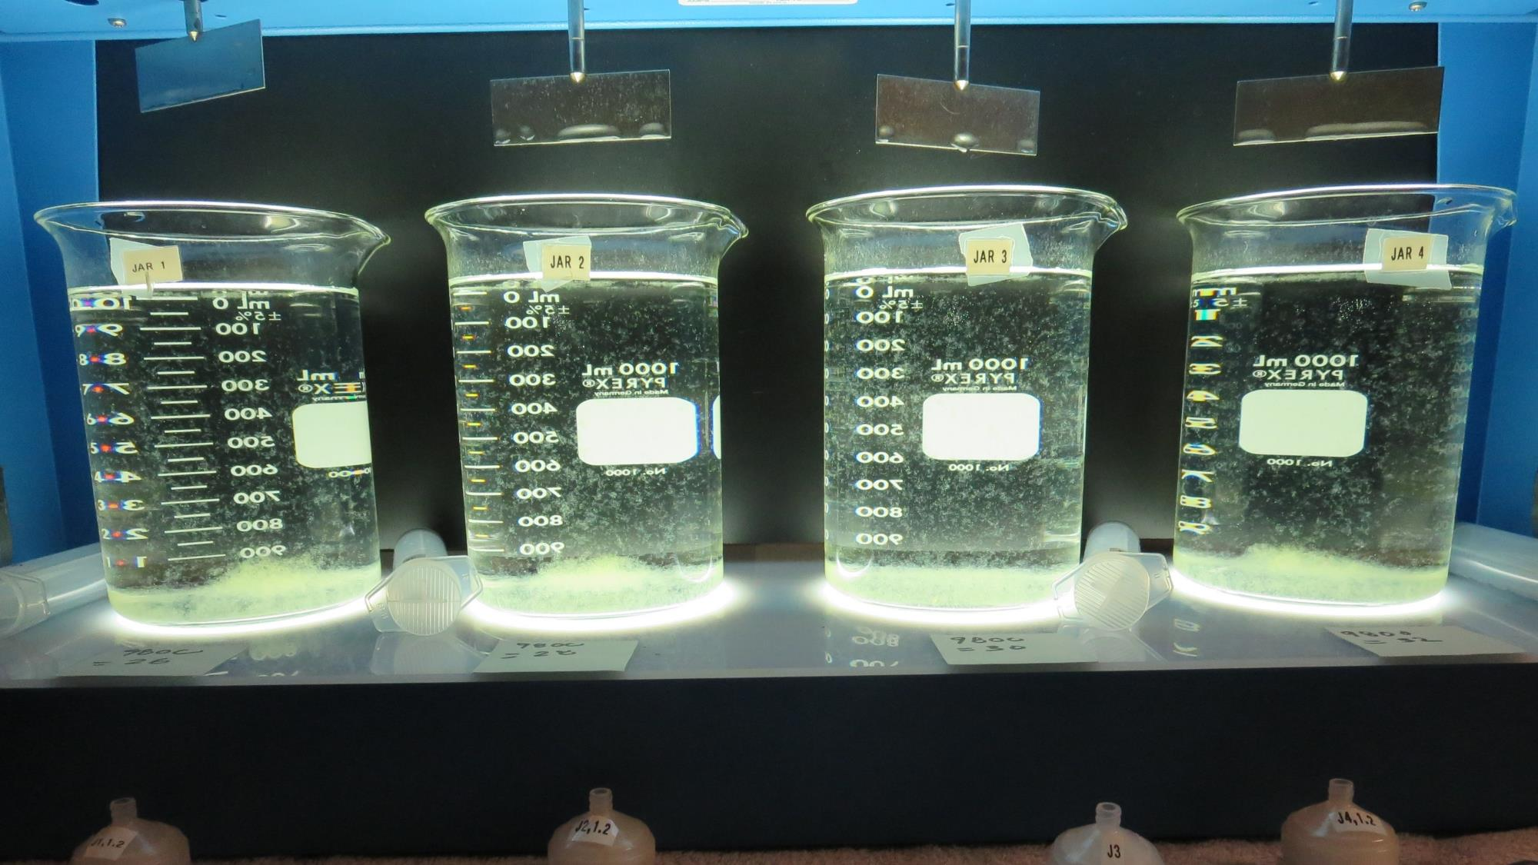
Jars 1-4: After 5 min of settling, 25 mL is syringed for filterability and %UVT/UVA.

Slide 19
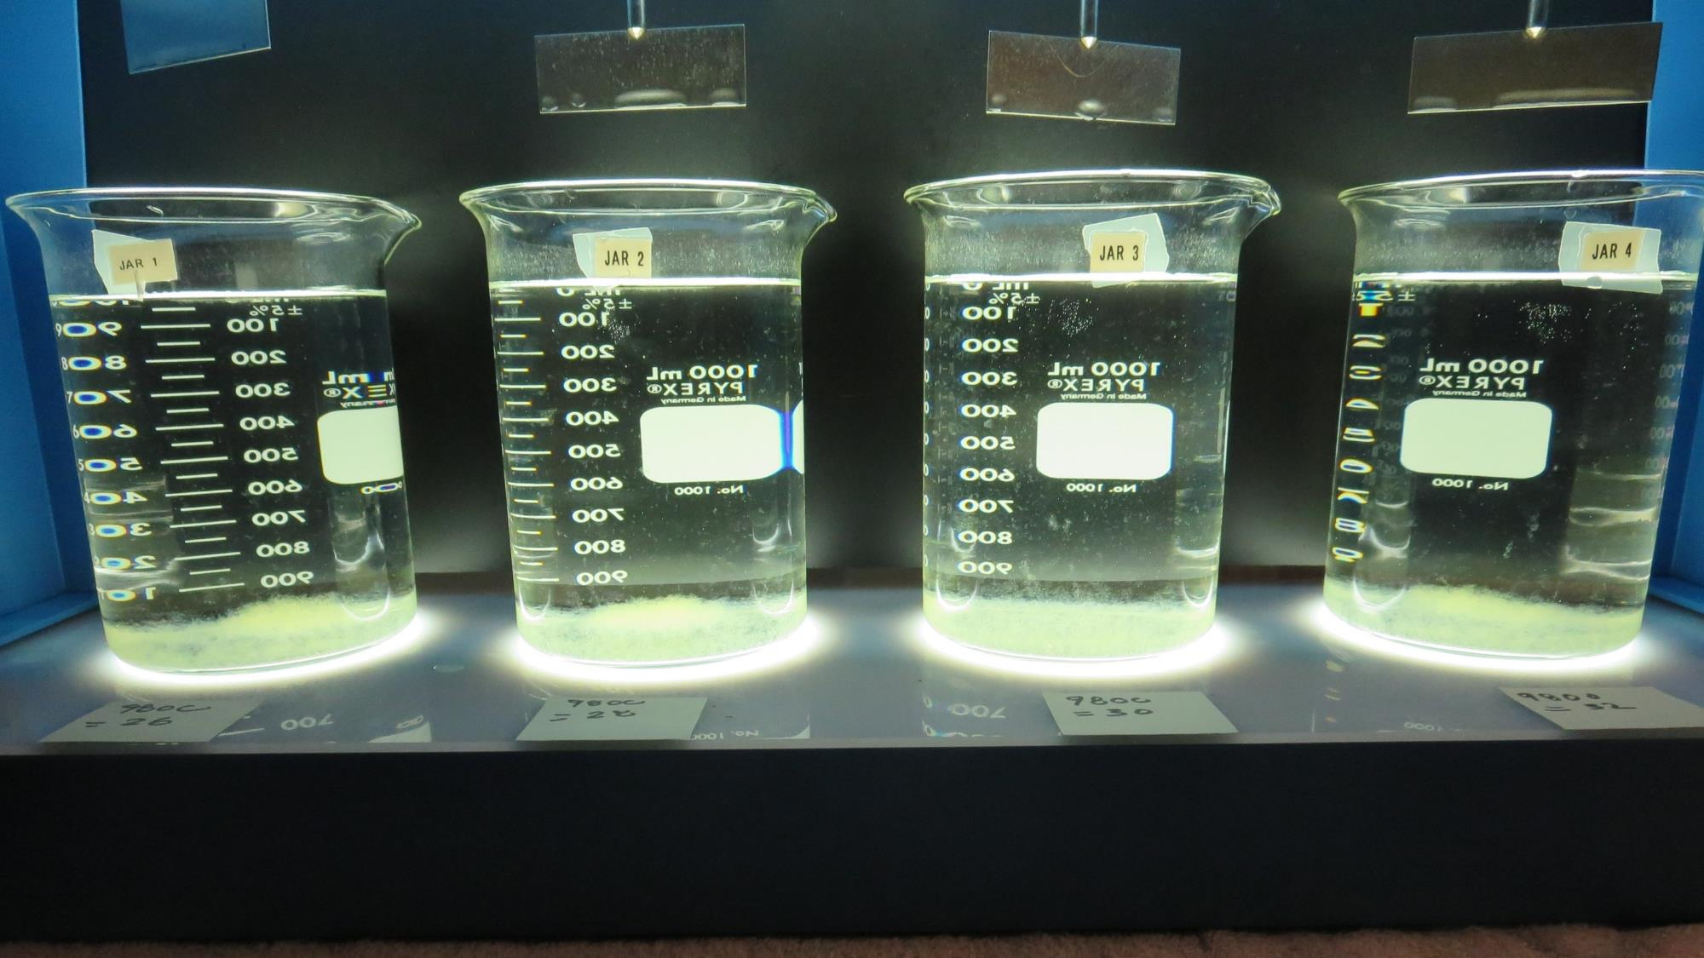
Jars 1-4: After 25-minutes of settling, settled water turbidity is taken.
26 mg/L 9800
Filtrate: 0.12 NTU
UVT: 86.7%
UVA: 0.062/cm
UVA Reduction: 31.1%
Settled: 0.45 NTU
28 mg/L 9800
Filtrate: 0.13 NTU
UVT: 86.5%
UVA: 0.063/cm
UVA Reduction: 30.0%
Settled: 0.40 NTU
30 mg/L 9800
Filtrate: 0.13 NTU
UVT: 86.5%
UVA: 0.063/cm
UVA Reduction: 30.0%
Settled: 0.45 NTU
32 mg/L 9800
Filtrate: 0.10 NTU
UVT: 86.8%
UVA: 0.061/cm
UVA Reduction: 32.2%
Settled: 0.46 NTU

Slide 20
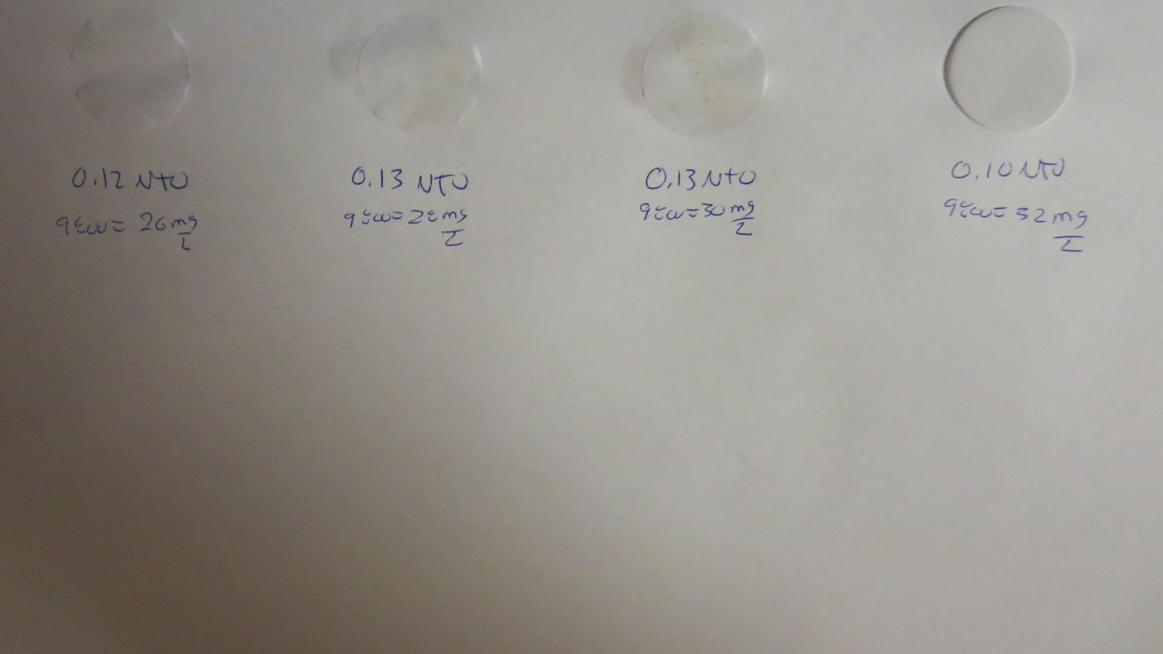
Visual of Filterability of Jars 1-4
26 mg/L 9800
Filtrate 0.12 NTU
UVT: 86.7%
UVA: 0.062/cm
Settled: 0.45 NTU
28 mg/L 9800
Filtrate 0.13 NTU
UVT: 86.5%
UVA: 0.063/cm
Settled: 0.40 NTU
30 mg/L 9800
Filtrate 0.13 NTU
UVT: 86.5%
UVA: 0.063/cm
Settled: 0.45 NTU
32 mg/L 9800
Filtrate 0.10 NTU
UVT: 86.8%
UVA: 0.061/cm
Settled: 0.46 NTU

Slide 21
Jars 5-8 Test
Flash Mix 60 Sec (200 RPM)
Floc Mix 5 min (30 RPM)
Applied Coagulant
9800

Slide 22
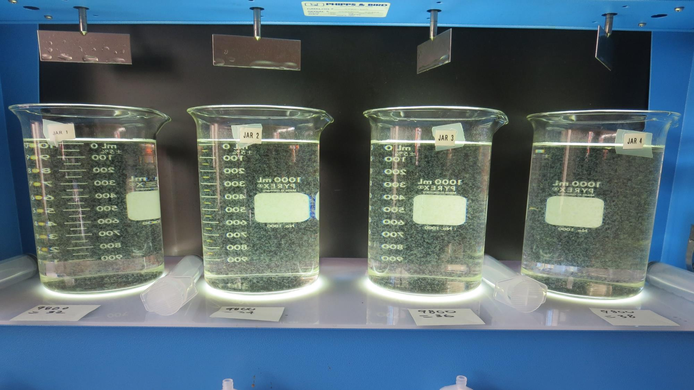
Jars 5-8: End of 5-minute flocculation (30 RPM) duration.
32 mg/L 9800
Filtrate: 0.12 NTU
UVT: 86.5%
UVA: 0.058/cm
UVA Reduction: 35.6%
Settled: 0.29 NTU
34 mg/L 9800
Filtrate: 0.12 NTU
UVT: 87.2%
UVA: 0.059/cm
UVA Reduction: 34.4%
Settled: 0.57 NTU
36 mg/L 9800
Filtrate: 0.10 NTU
UVT: 87.4%
UVA: 0.058/cm
UVA Reduction: 35.6%
Settled: 0.43 NTU
38 mg/L 9800
Filtrate: 0.09 NTU
UVT: 87.7%
UVA: 0.057/cm
UVA Reduction: 36.7
Settled: 0.40 NTU

Slide 23
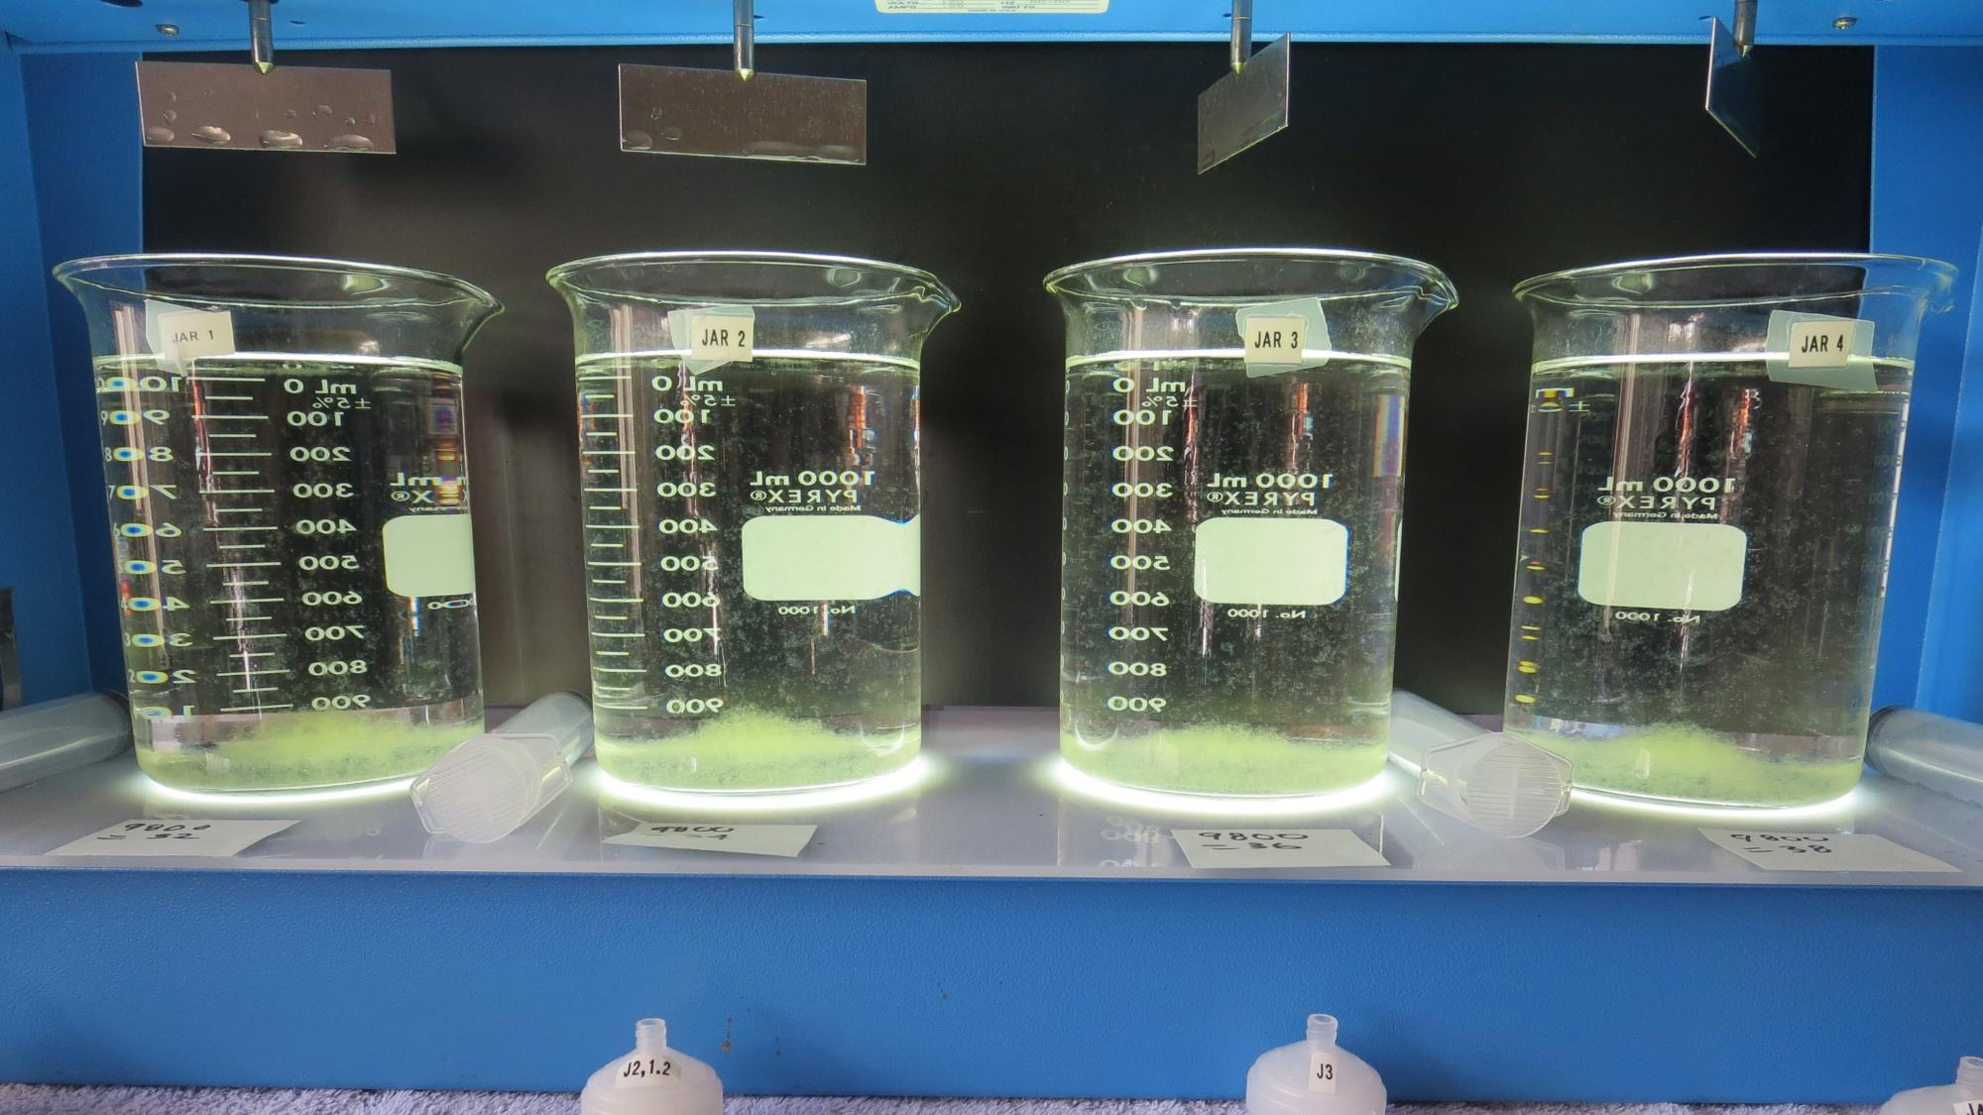
Jars 5-8: After 5 min of settling, 25 mL is syringed for filterability and %UVT/UVA.

Slide 24
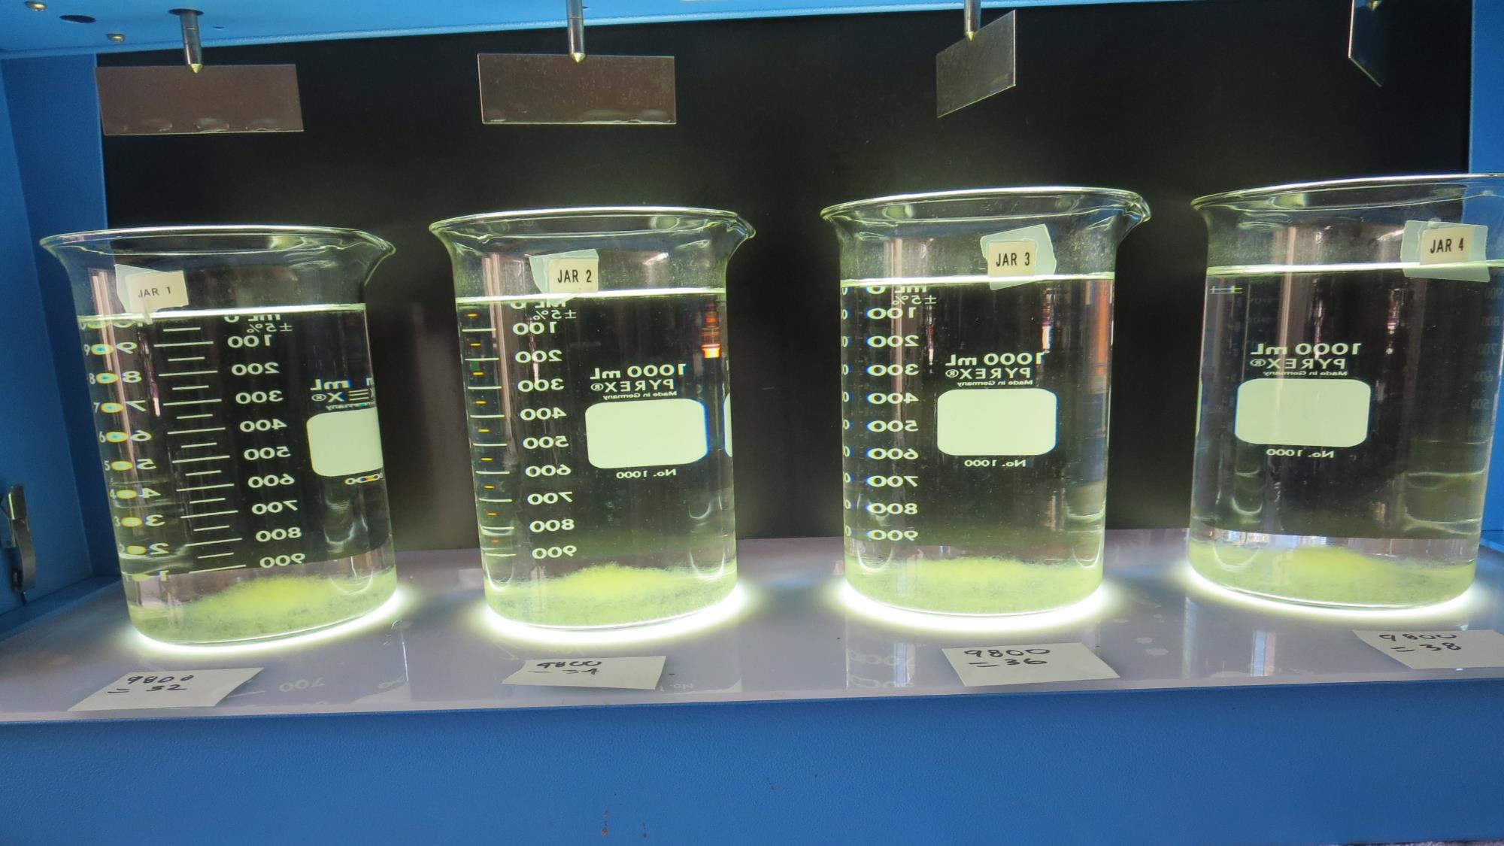
Jars 5-8: After 25-minutes of settling, settled water turbidity is taken.
32 mg/L 9800
Filtrate: 0.12 NTU
UVT: 86.5%
UVA: 0.058/cm
UVA Reduction: 35.6%
Settled: 0.29 NTU
34 mg/L 9800
Filtrate: 0.12 NTU
UVT: 87.2%
UVA: 0.059/cm
UVA Reduction: 34.4%
Settled: 0.57 NTU
36 mg/L 9800
Filtrate: 0.10 NTU
UVT: 87.4%
UVA: 0.058/cm
UVA Reduction: 35.6%
Settled: 0.43 NTU
38 mg/L 9800
Filtrate: 0.09 NTU
UVT: 87.7%
UVA: 0.057/cm
UVA Reduction: 36.7
Settled: 0.40 NTU

Slide 25
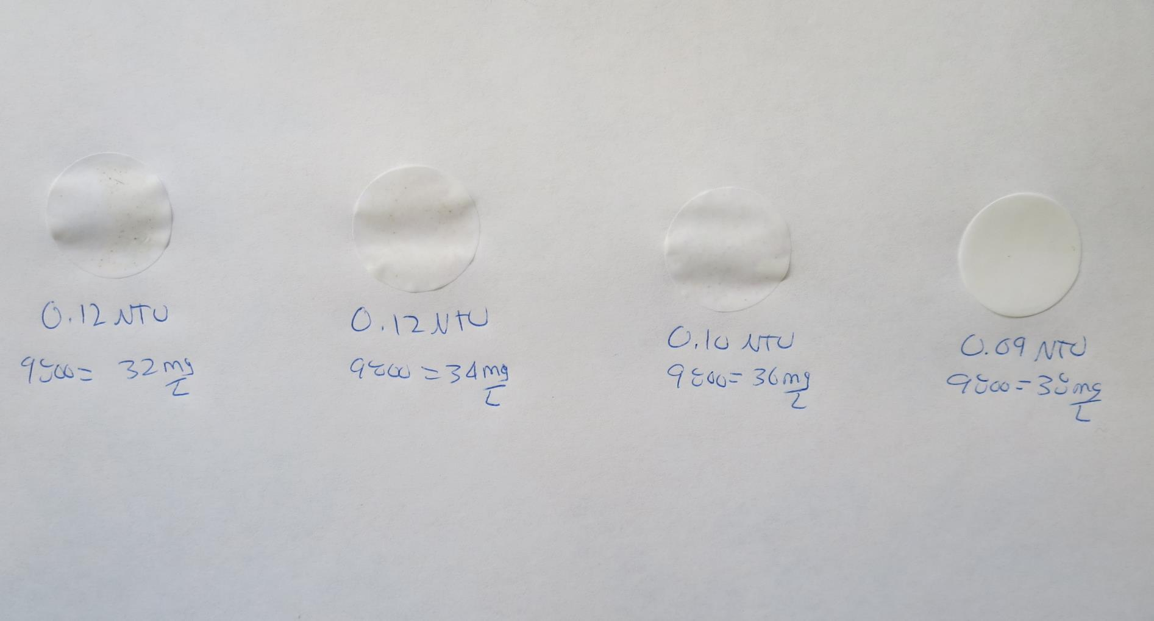
Visual of Filterability of Jars 5-8
32 mg/L 9800
Filtrate 0.12 NTU
UVT: 86.5%
UVA: 0.058/cm
Settled: 0.29 NTU
34 mg/L 9800
Filtrate 0.12 NTU
UVT: 87.2%
UVA: 0.059/cm
Settled: 0.57 NTU
36 mg/L 9800
Filtrate 0.10 NTU
UVT: 87.4%
UVA: 0.058/cm
Settled: 0.43 NTU
38 mg/L 9800
Filtrate 0.09 NTU
UVT: 87.7%
UVA: 0.057/cm
Settled: 0.40 NTU

Slide 26
Jars 9-12 Test
Flash Mix 60 Sec (200 RPM)
Floc Mix 5 min (30 RPM)
Applied Coagulant
9817

Slide 27
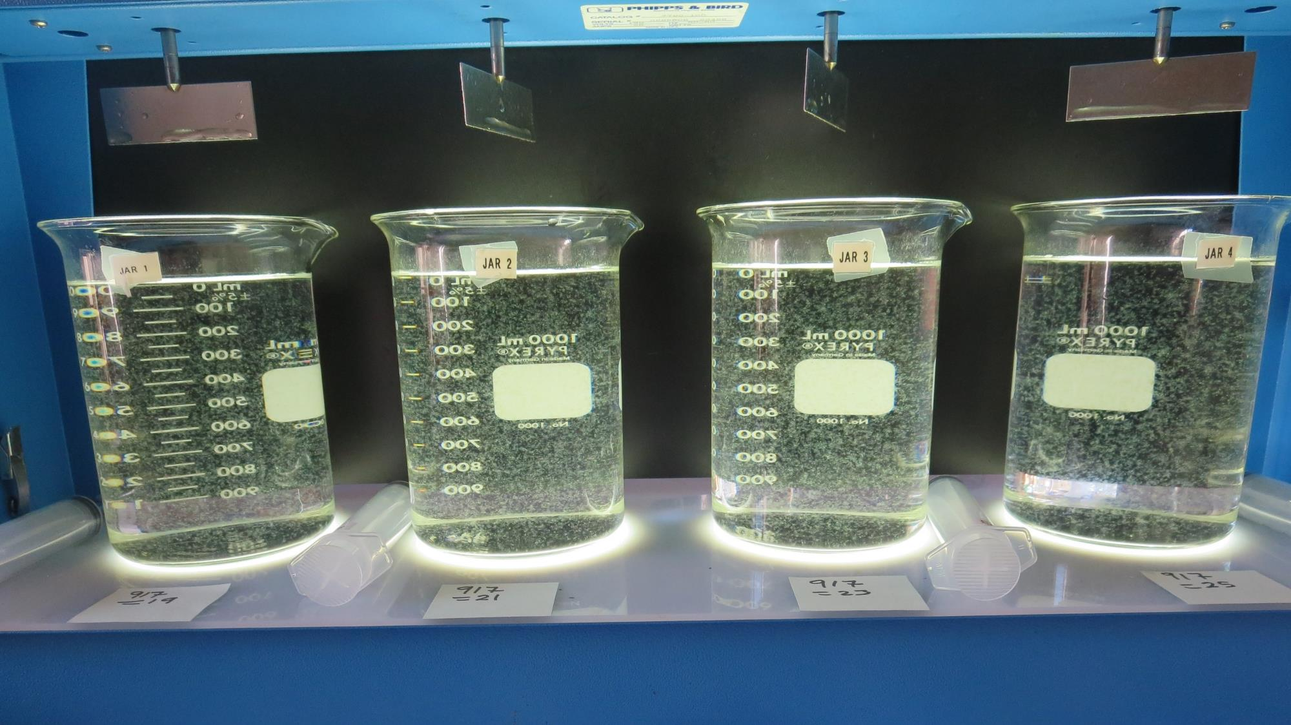
Jars 9-12: End of 5-minute flocculation (30 RPM) duration.
19 mg/L 917
Filtrate: 0.11 NTU
UVT: 89.5%
UVA: 0.048/cm
UVA Reduction: 46.7%
Settled: 0.34 NTU
21 mg/L 917
Filtrate: 0.10 NTU
UVT: 89.7%
UVA: 0.047/cm
UVA Reduction: 47.8%
Settled: 0.35 NTU
23 mg/L 917
Filtrate: 0.08 NTU
UVT: 90.0%
UVA: 0.046/cm
UVA Reduction: 48.9%
Settled: 0.39 NTU
25 mg/L 917
Filtrate 0.09 NTU
UVT: 90.2%
UVA: 0.045/cm
UVA Reduction: 50.0%
Settled: 0.27 NTU

Slide 28
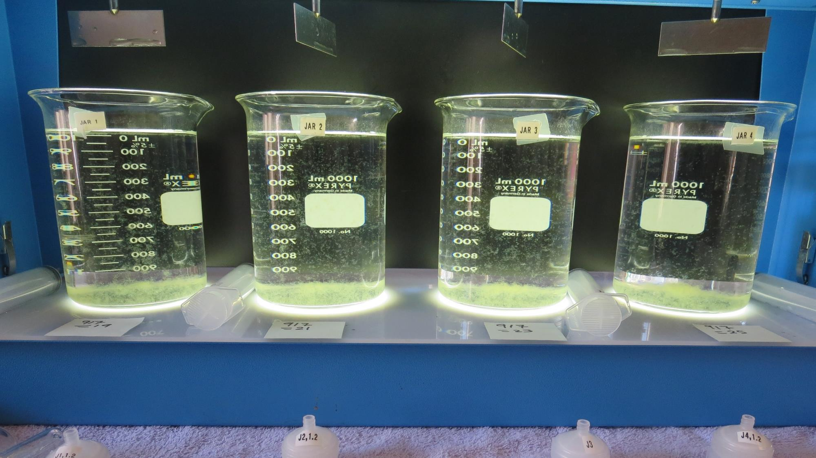
Jars 9-12: After 5 min of settling, 25 mL is syringed for filterability and %UVT/UVA.

Slide 29
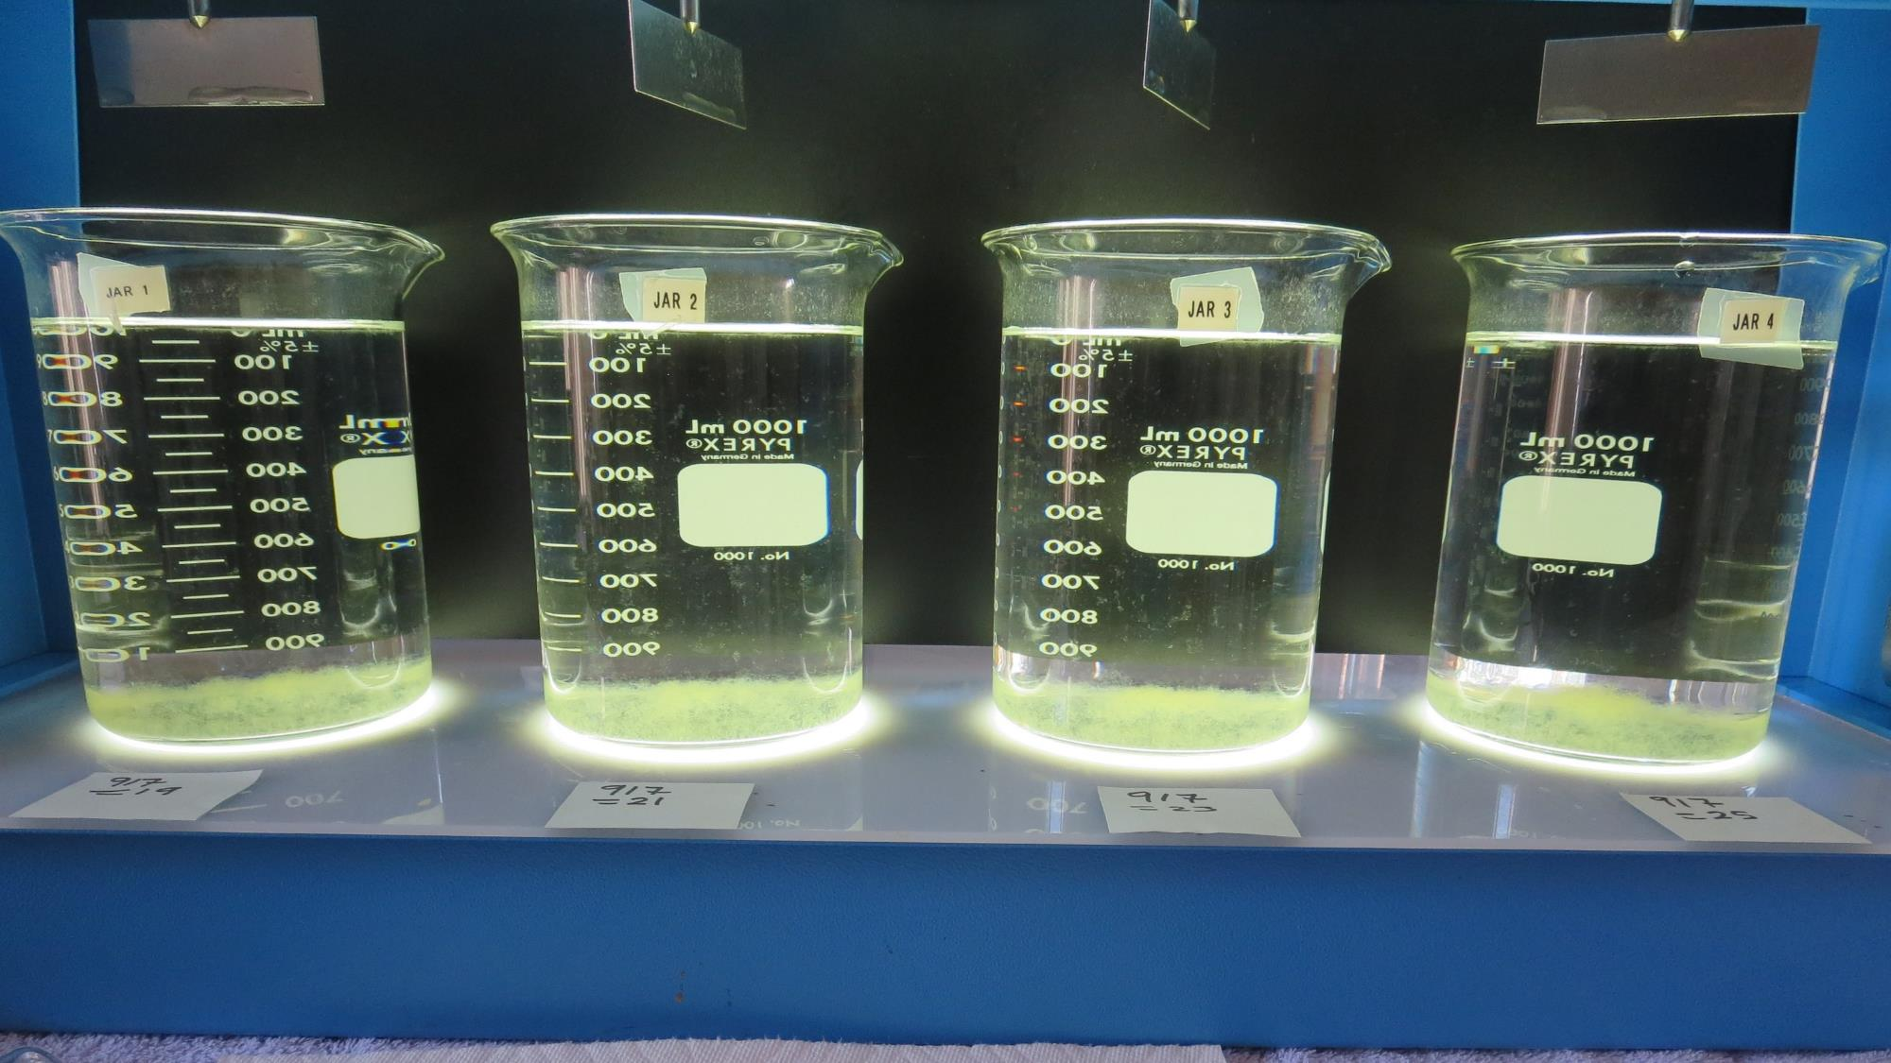
Jars 9-12: After 25-minutes of settling, settled water turbidity is taken.
19 mg/L 917
Filtrate: 0.11 NTU
UVT: 89.5%
UVA: 0.048/cm
UVA Reduction: 46.7%
Settled: 0.34 NTU
21 mg/L 917
Filtrate: 0.10 NTU
UVT: 89.7%
UVA: 0.047/cm
UVA Reduction: 47.8%
Settled: 0.35 NTU
23 mg/L 917
Filtrate: 0.08 NTU
UVT: 90.0%
UVA: 0.046/cm
UVA Reduction: 48.9%
Settled: 0.39 NTU
25 mg/L 917
Filtrate 0.09 NTU
UVT: 90.2%
UVA: 0.045/cm
UVA Reduction: 50.0%
Settled: 0.27 NTU

Slide 30
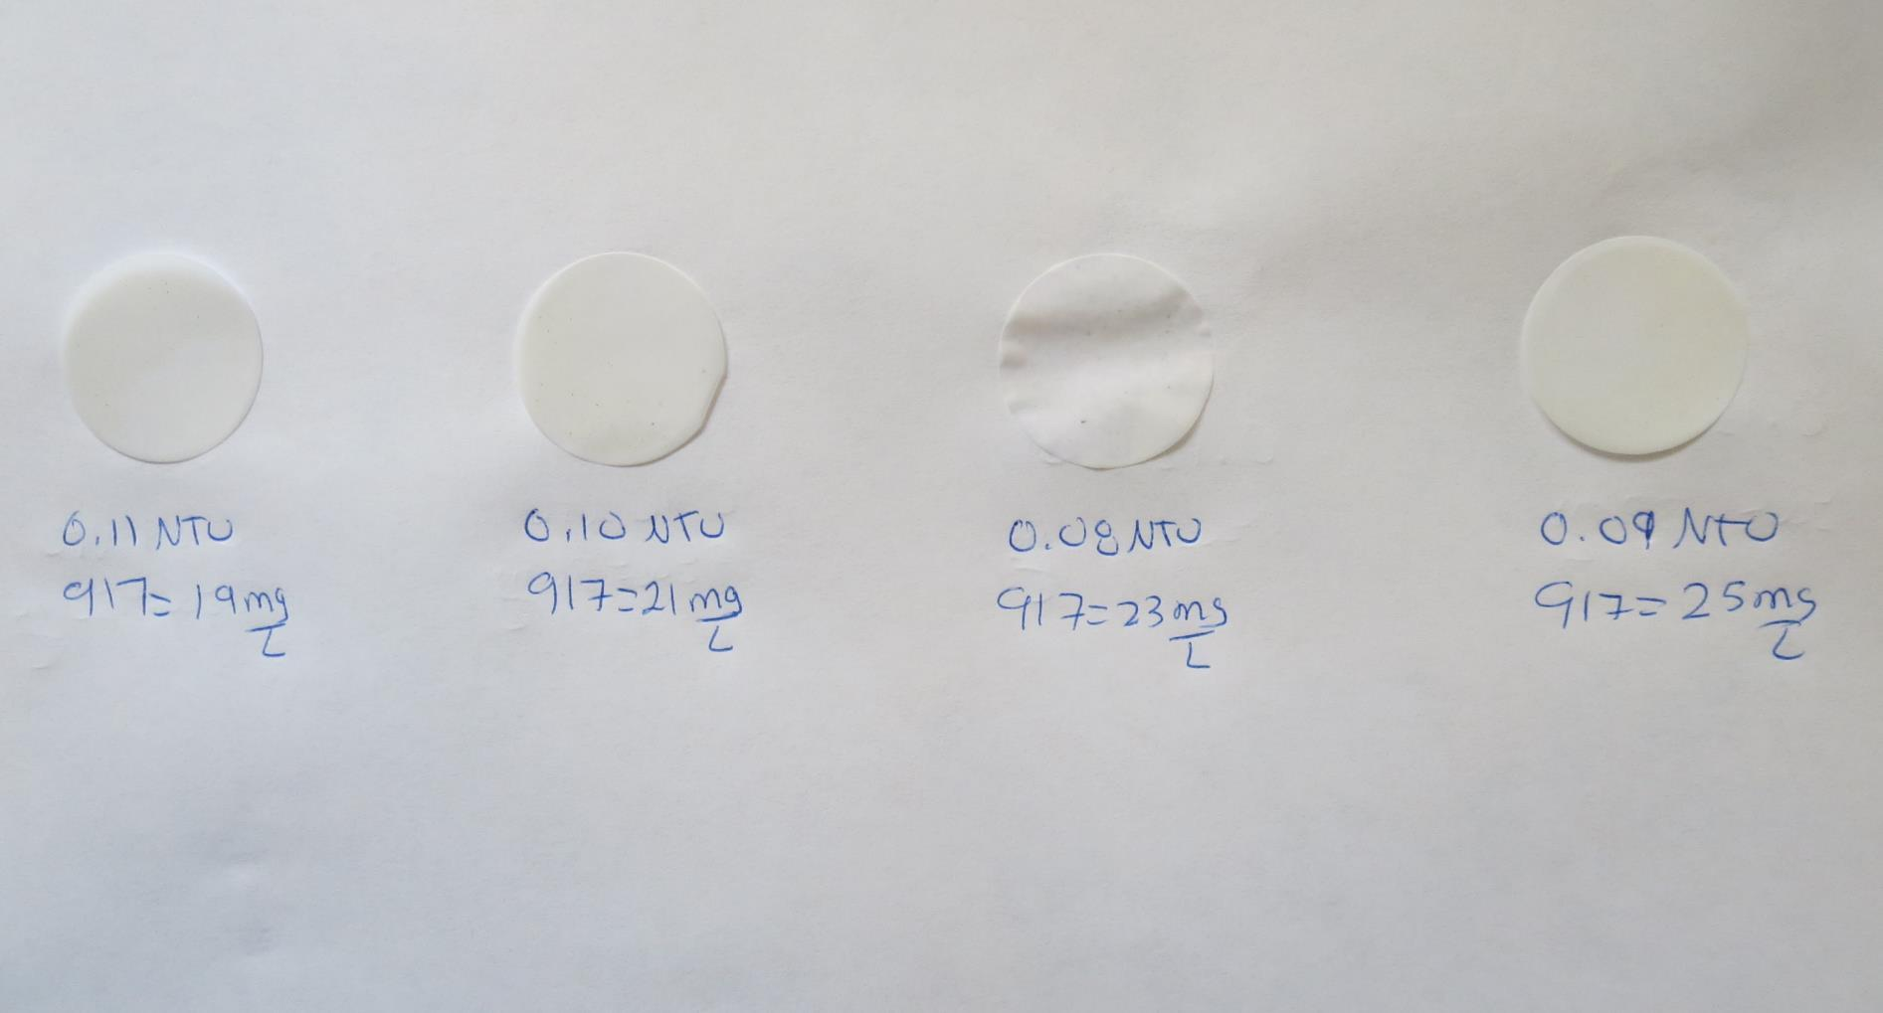
Visual of Filterability of Jars 9-12
19 mg/L 917
Filtrate 0.11 NTU
UVT: 89.5%
UVA: 0.048/cm
Settled: 0.34 NTU
21 mg/L 917
Filtrate 0.10 NTU
UVT: 89.7%
UVA: 0.047/cm
Settled: 0.35 NTU
23 mg/L 917
Filtrate 0.08 NTU
UVT: 90.0%
UVA: 0.046/cm
Settled: 0.39 NTU
25 mg/L 917
Filtrate 0.09 NTU
UVT: 90.2%
UVA: 0.045/cm
Settled: 0.27 NTU

Slide 31
Jars 13-16 Test
Flash Mix 60 Sec (200 RPM)
Floc Mix 5 min (30 RPM)
Applied Coagulant
9817

Slide 32
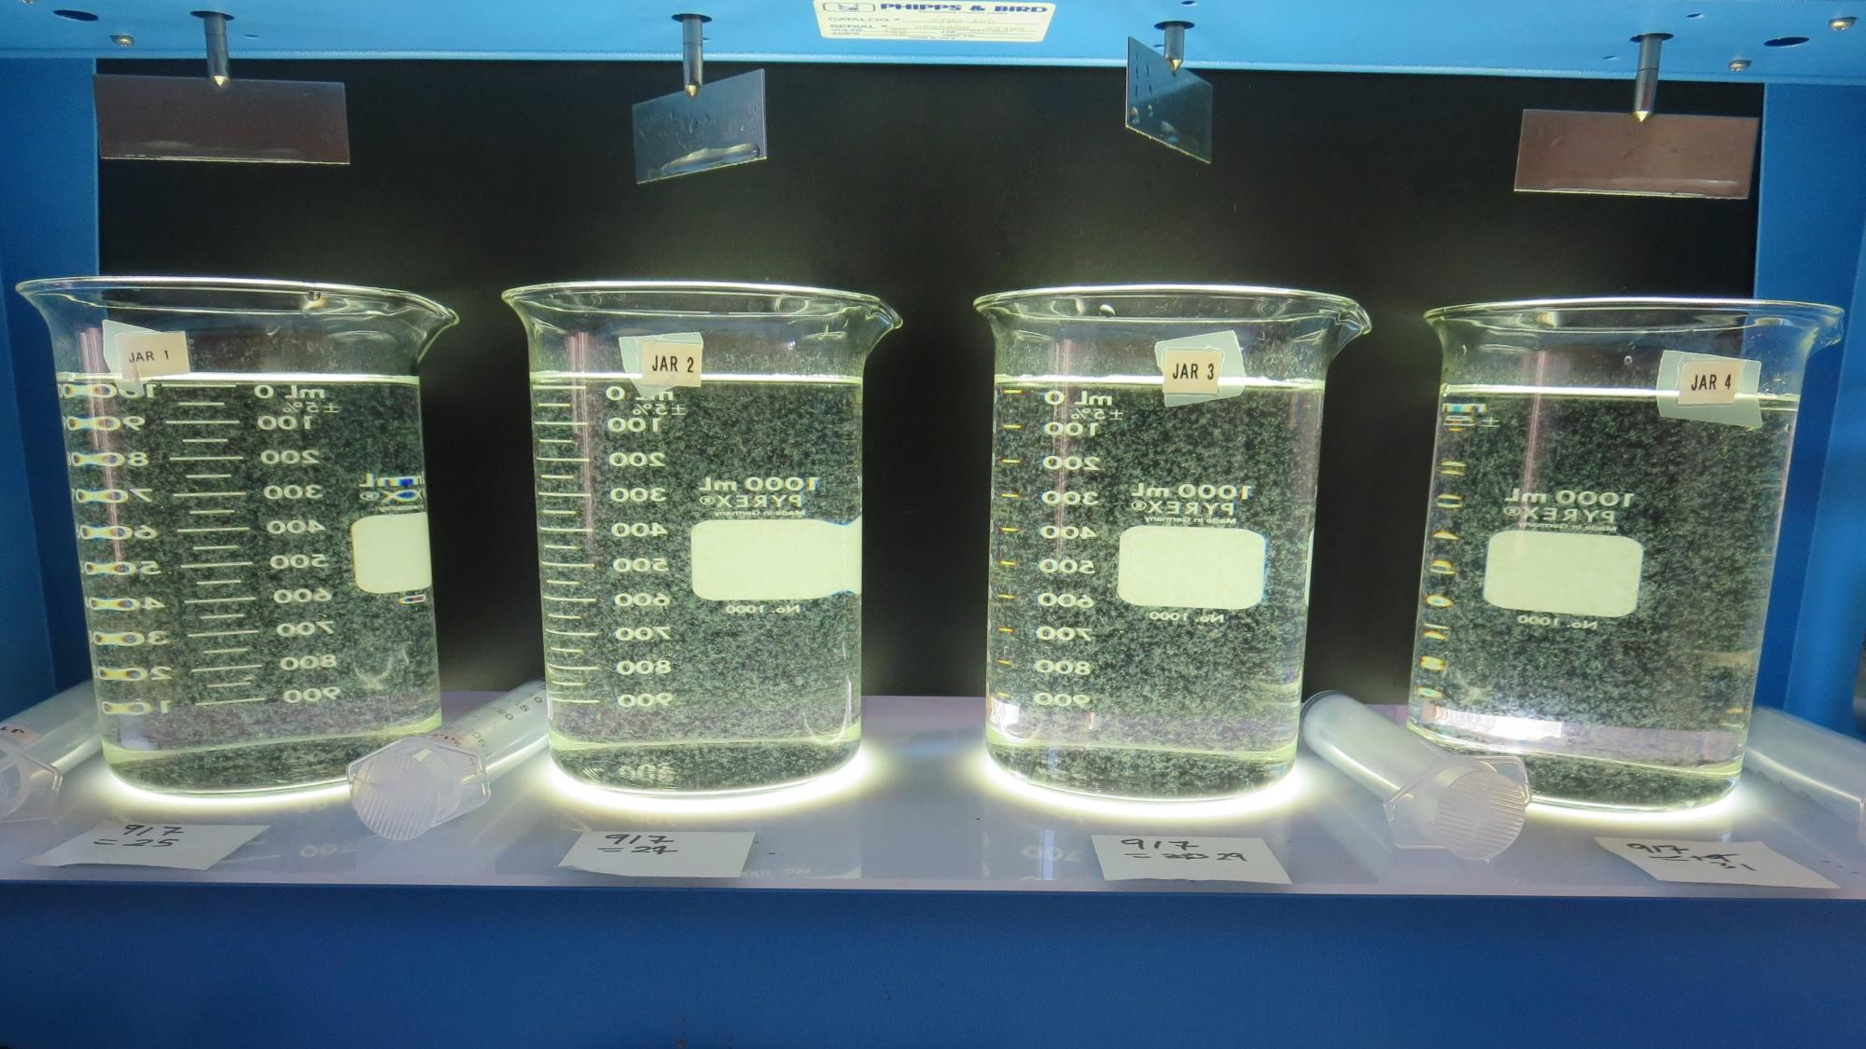
Jars 13-16: End of 5-minute flocculation (30 RPM) duration.
25 mg/L 917
Filtrate: 0.08 NTU
UVT: 89.6%
UVA: 0.048/cm
UVA Reduction: 46.7%
Settled: 0.32 NTU
27 mg/L 917
Filtrate: 0.09 NTU
UVT: 89.5%
UVA: 0.048/cm
UVA Reduction: 46.7%
Settled: 0.40 NTU
29 mg/L 917
Filtrate: 0.07 NTU
UVT: 89.2%
UVA: 0.050/cm
UVA Reduction: 44.4%
Settled: 0.39 NTU
31 mg/L 917
Filtrate: 0.09 NTU
UVT: 89.4%
UVA: 0.049/cm
UVA Reduction: 45.6%
Settled: 0.29 NTU

Slide 33
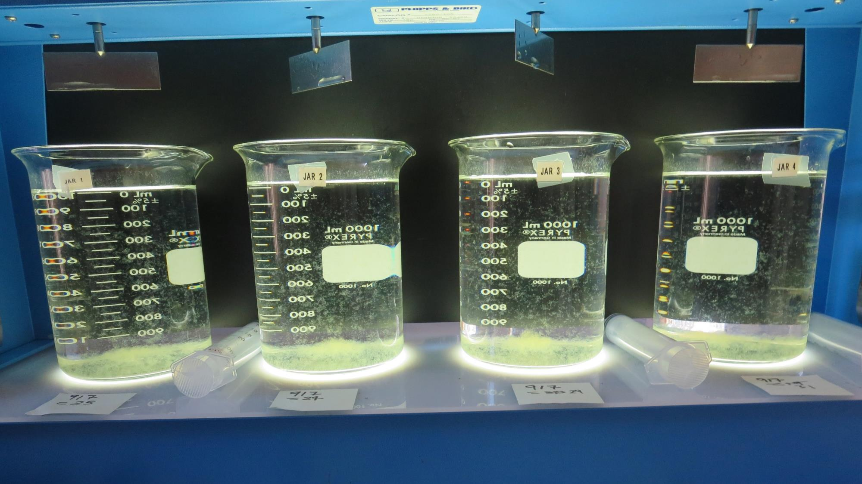
Jars 13-16: After 5 min of settling, 25 mL is syringed for filterability and %UVT/UVA.

Slide 34
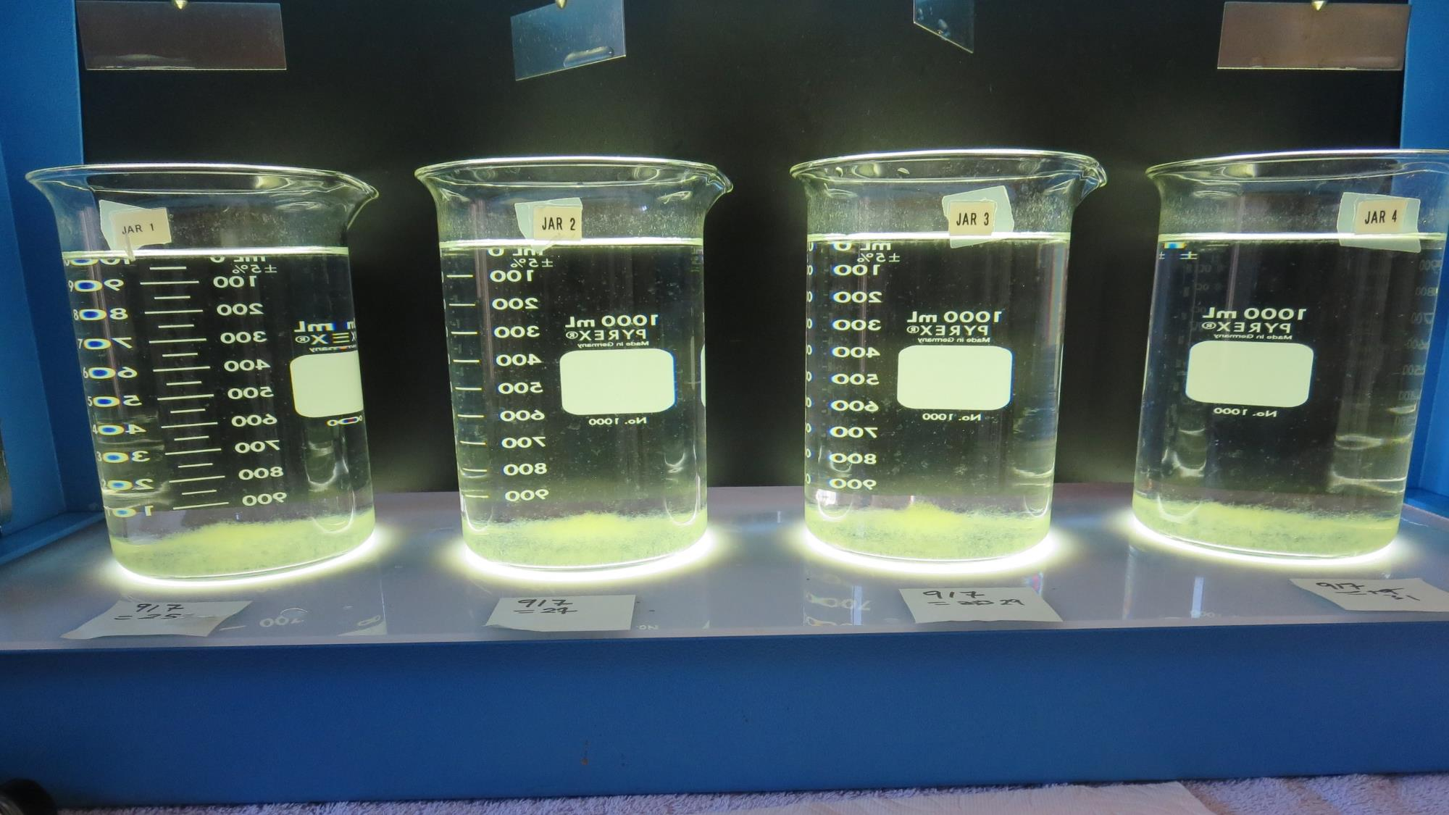
Jars 13-16: After 25-minutes of settling, settled water turbidity is taken.
25 mg/L 917
Filtrate: 0.08 NTU
UVT: 89.6%
UVA: 0.048/cm
UVA Reduction: 46.7%
Settled: 0.32 NTU
27 mg/L 917
Filtrate: 0.09 NTU
UVT: 89.5%
UVA: 0.048/cm
UVA Reduction: 46.7%
Settled: 0.40 NTU
29 mg/L 917
Filtrate: 0.07 NTU
UVT: 89.2%
UVA: 0.050/cm
UVA Reduction: 44.4%
Settled: 0.39 NTU
31 mg/L 917
Filtrate: 0.09 NTU
UVT: 89.4%
UVA: 0.049/cm
UVA Reduction: 45.6%
Settled: 0.29 NTU

Slide 35
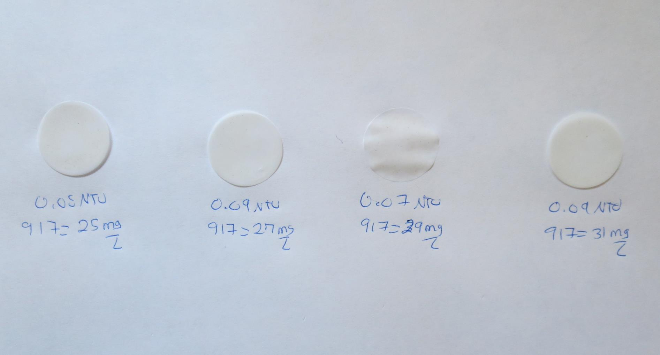
Visual of Filterability of Jars 13-16
25 mg/L 917
Filtrate 0.08 NTU
UVT: 89.6%
UVA: 0.048/cm
Settled: 0.32 NTU
27 mg/L 917
Filtrate 0.09 NTU
UVT: 89.5%
UVA: 0.048/cm
Settled: 0.40 NTU
29 mg/L 917
Filtrate 0.07 NTU
UVT: 89.2%
UVA: 0.050/cm
Settled: 0.39 NTU
31 mg/L 917
Filtrate 0.09 NTU
UVT: 89.4%
UVA: 0.049/cm
Settled: 0.29 NTU

Slide 36
Jars 17-20 Test
Flash Mix 60 Sec (200 RPM)
Floc Mix 5 min (30 RPM)
Applied Coagulant
7066

Slide 37
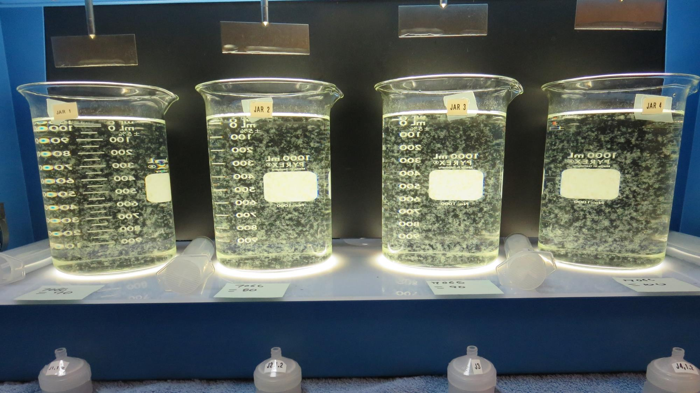
Jars 17-20: End of 5-minute flocculation (30 RPM) duration.
70 mg/L 7076
Filtrate: 0.12 NTU
UVT: 87.3%
UVA: 0.059/cm
UVA Reduction: 34.4%
Settled: 0.34 NTU
80 mg/L 7076
Filtrate: 0.12 NTU
UVT: 87.2%
UVA: 0.059/cm
UVA Reduction: 34.4%
Settled: 0.27 NTU
90 mg/L 7076
Filtrate: 0.11 NTU
UVT: 87.8%
UVA: 0.057/cm
UVA Reduction: 36.7%
Settled: 0.37 NTU
100 mg/L 7076
Filtrate: 0.09 NTU
UVT: 88.2%
UVA: 0.055/cm
UVA Reduction: 38.9%
Settled: 0.25 NTU

Slide 38
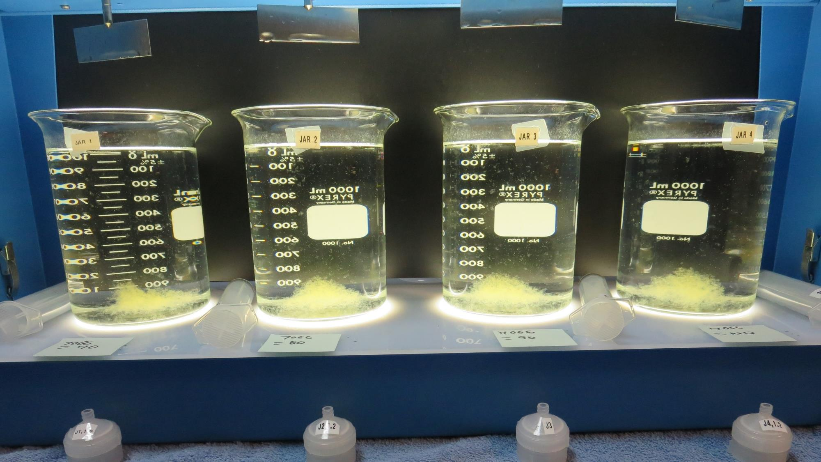
Jars 17-20: After 5 min of settling, 25 mL is syringed for filterability and %UVT/UVA.

Slide 39
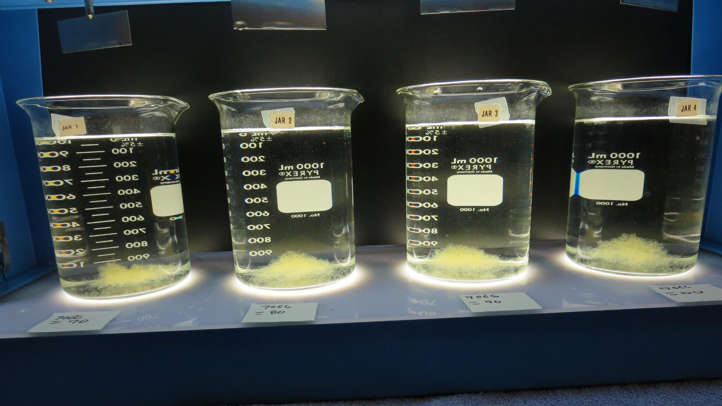
Jars 17-20: After 25-minutes of settling, settled water turbidity is taken.
70 mg/L 7076
Filtrate: 0.12 NTU
UVT: 87.3%
UVA: 0.059/cm
UVA Reduction: 34.4%
Settled: 0.34 NTU
80 mg/L 7076
Filtrate: 0.12 NTU
UVT: 87.2%
UVA: 0.059/cm
UVA Reduction: 34.4%
Settled: 0.27 NTU
90 mg/L 7076
Filtrate: 0.11 NTU
UVT: 87.8%
UVA: 0.057/cm
UVA Reduction: 36.7%
Settled: 0.37 NTU
100 mg/L 7076
Filtrate: 0.09 NTU
UVT: 88.2%
UVA: 0.055/cm
UVA Reduction: 38.9%
Settled: 0.25 NTU

Slide 40
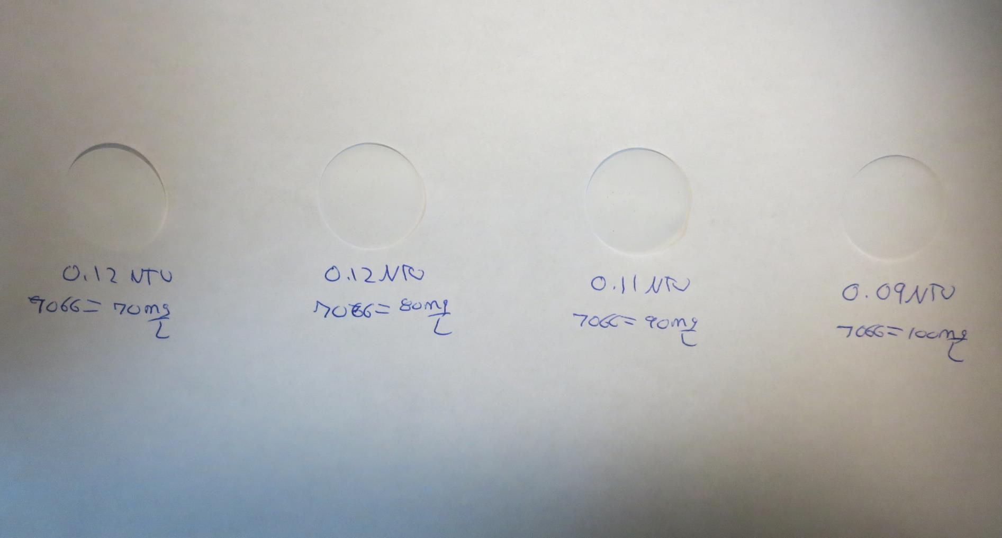
Visual of Filterability of Jars 17-20
70 mg/L 7076
Filtrate 0.12 NTU
UVT: 87.3%
UVA: 0.059/cm
Settled: 0.34 NTU
80 mg/L 7076
Filtrate 0.12 NTU
UVT: 87.2%
UVA: 0.059/cm
Settled: 0.27 NTU
90 mg/L 7076
Filtrate 0.11 NTU
UVT: 87.8%
UVA: 0.057/cm
Settled: 0.37 NTU
100 mg/L 7076
Filtrate 0.09 NTU
UVT: 88.2%
UVA: 0.055/cm
Settled: 0.25 NTU

Slide 41
Jars 21-24 Test
Flash Mix 60 Sec (200 RPM)
Floc Mix 5 min (30 RPM)
Applied Coagulant
7066

Slide 42
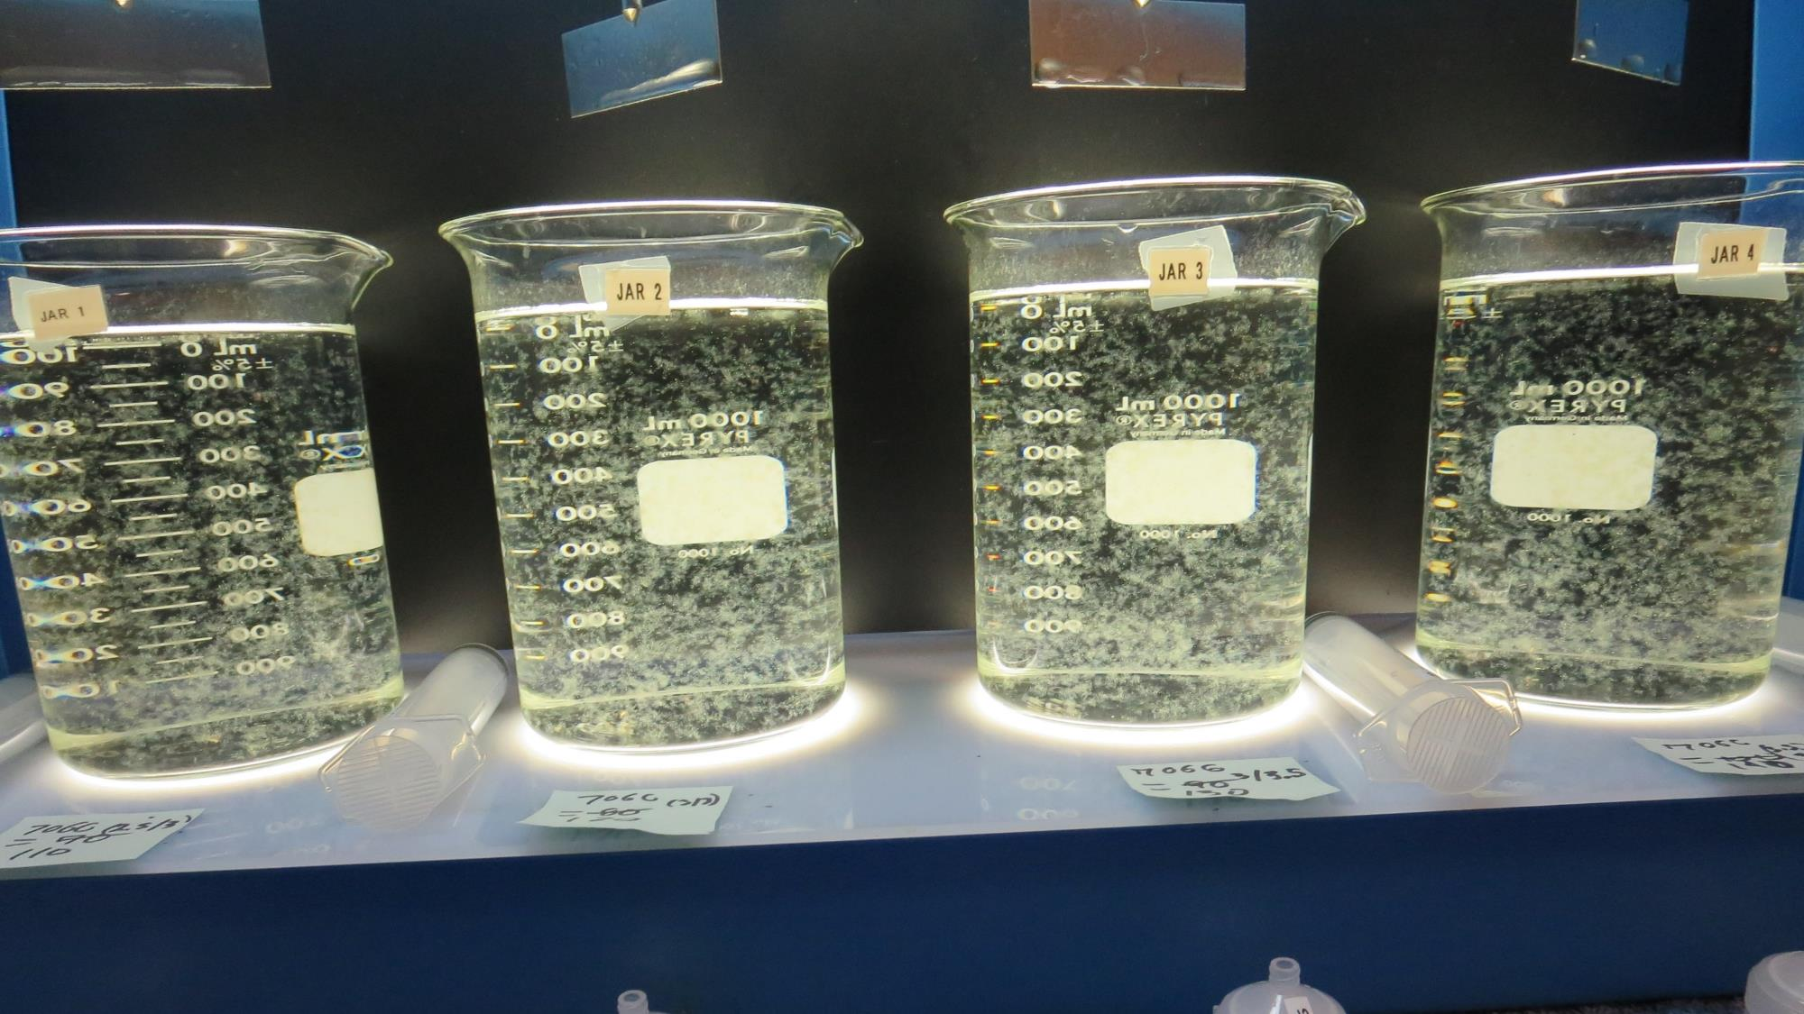
Jars21-24: End of 5-minute flocculation (30 RPM) duration.
110 mg/L 7076
Filtrate: 0.10 NTU
UVT: 88.0%
UVA: 0.056/cm
UVA Reduction: 37.8%
Settled: 0.31 NTU
120 mg/L 7076
Filtrate: 0.10 NTU
UVT: 88.4%
UVA: 0.054/cm
UVA Reduction: 40.0%
Settled: 0.21 NTU
130 mg/L 7076
Filtrate: 0.09 NTU
UVT: 88.6%
UVA: 0.054/cm
UVA Reduction: 41.1%
Settled: 0.33 NTU
140 mg/L 7076
Filtrate: 0.07 NTU
UVT: 88.9%
UVA: 0.051/cm
UVA Reduction: 43.3%
Settled: 0.15 NTU

Slide 43
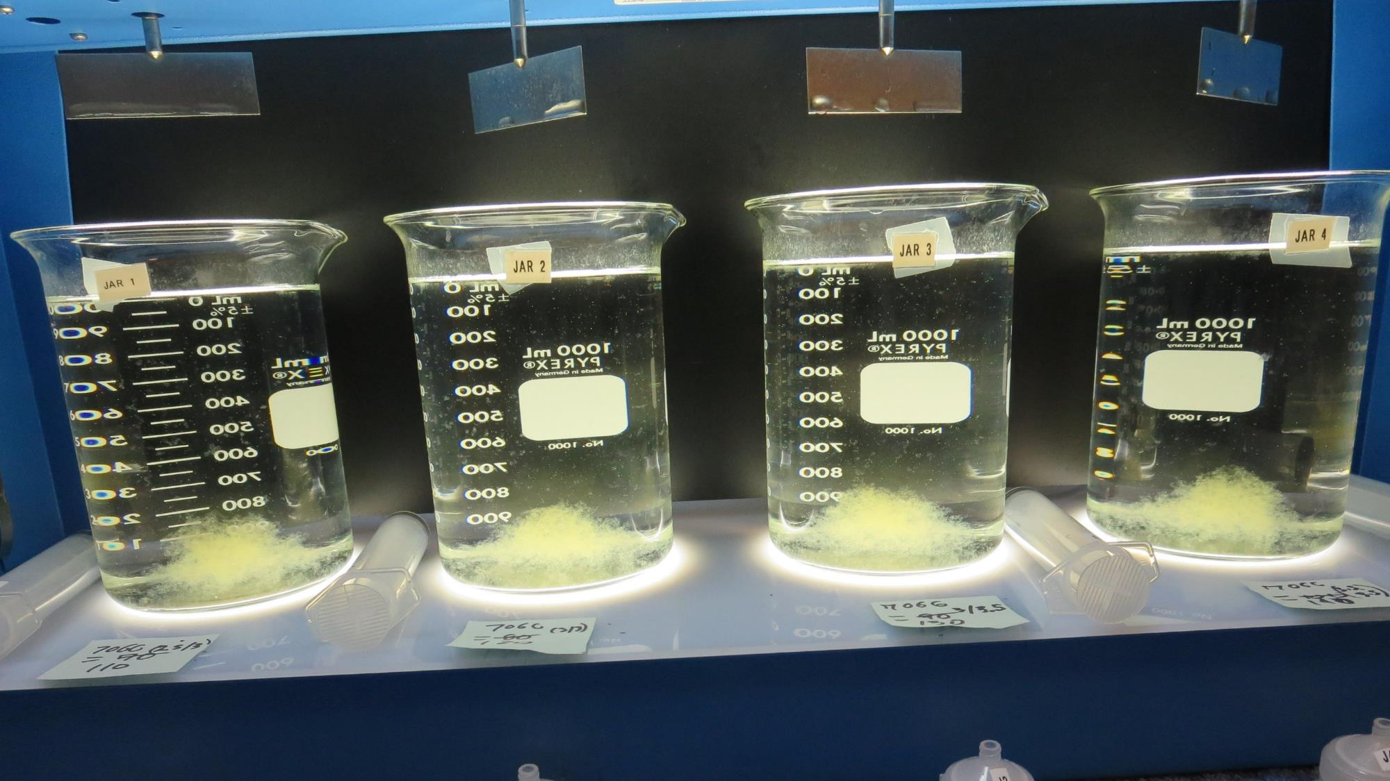
Jars 21-24: After 5 min of settling, 25 mL is syringed for filterability and %UVT/UVA.

Slide 44
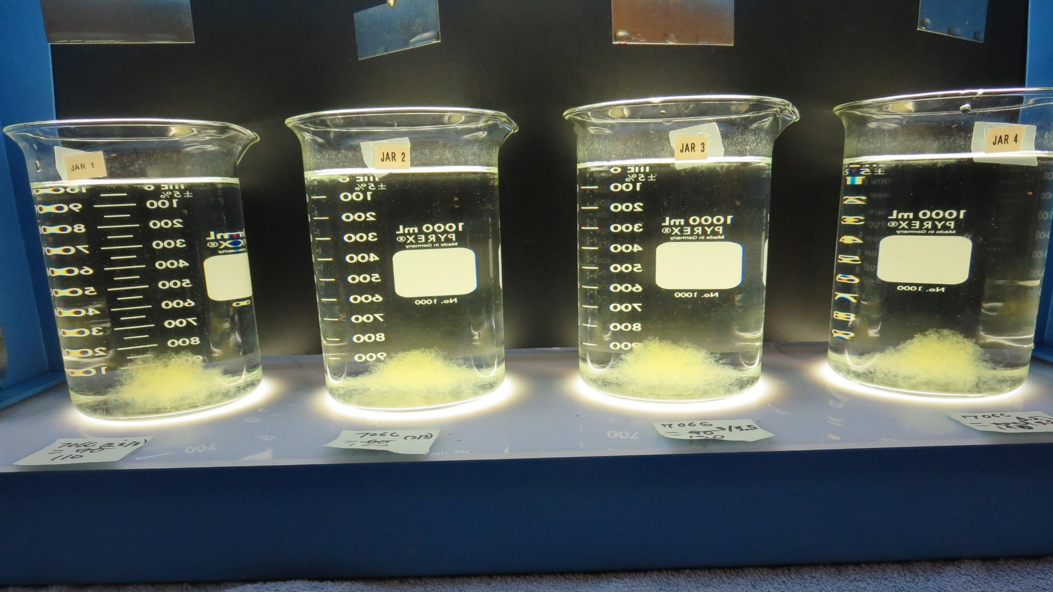
Jars 21-24: After 25-minutes of settling, settled water turbidity is taken.
110 mg/L 7076
Filtrate: 0.10 NTU
UVT: 88.0%
UVA: 0.056/cm
UVA Reduction: 37.8%
Settled: 0.31 NTU
120 mg/L 7076
Filtrate: 0.10 NTU
UVT: 88.4%
UVA: 0.054/cm
UVA Reduction: 40.0%
Settled: 0.21 NTU
130 mg/L 7076
Filtrate: 0.09 NTU
UVT: 88.6%
UVA: 0.054/cm
UVA Reduction: 41.1%
Settled: 0.33 NTU
140 mg/L 7076
Filtrate: 0.07 NTU
UVT: 88.9%
UVA: 0.051/cm
UVA Reduction: 43.3%
Settled: 0.15 NTU

Slide 45
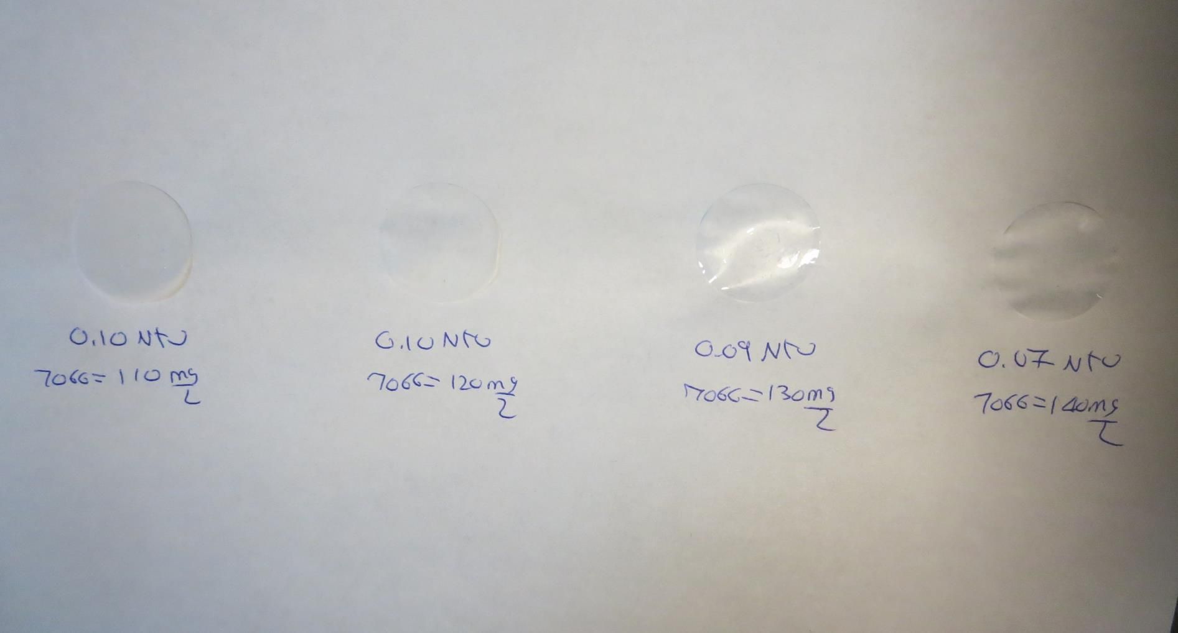
Visual of Filterability of Jars 21-24
110 mg/L 7076
Filtrate 0.10 NTU
UVT: 88.0%
UVA: 0.056/cm
Settled: 0.31 NTU
120 mg/L 7076
Filtrate 0.10 NTU
UVT: 88.4%
UVA: 0.054/cm
Settled: 0.21 NTU
130 mg/L 7076
Filtrate 0.09 NTU
UVT: 88.6%
UVA: 0.054/cm
Settled: 0.33 NTU
140 mg/L 7076
Filtrate 0.07 NTU
UVT: 88.9%
UVA: 0.051/cm
Settled: 0.15 NTU

Slide 46
Jars 25-28 Test
Flash Mix 60 Sec (200 RPM)
Floc Mix 5 min (30 RPM)
Applied Coagulant
9890

Slide 47
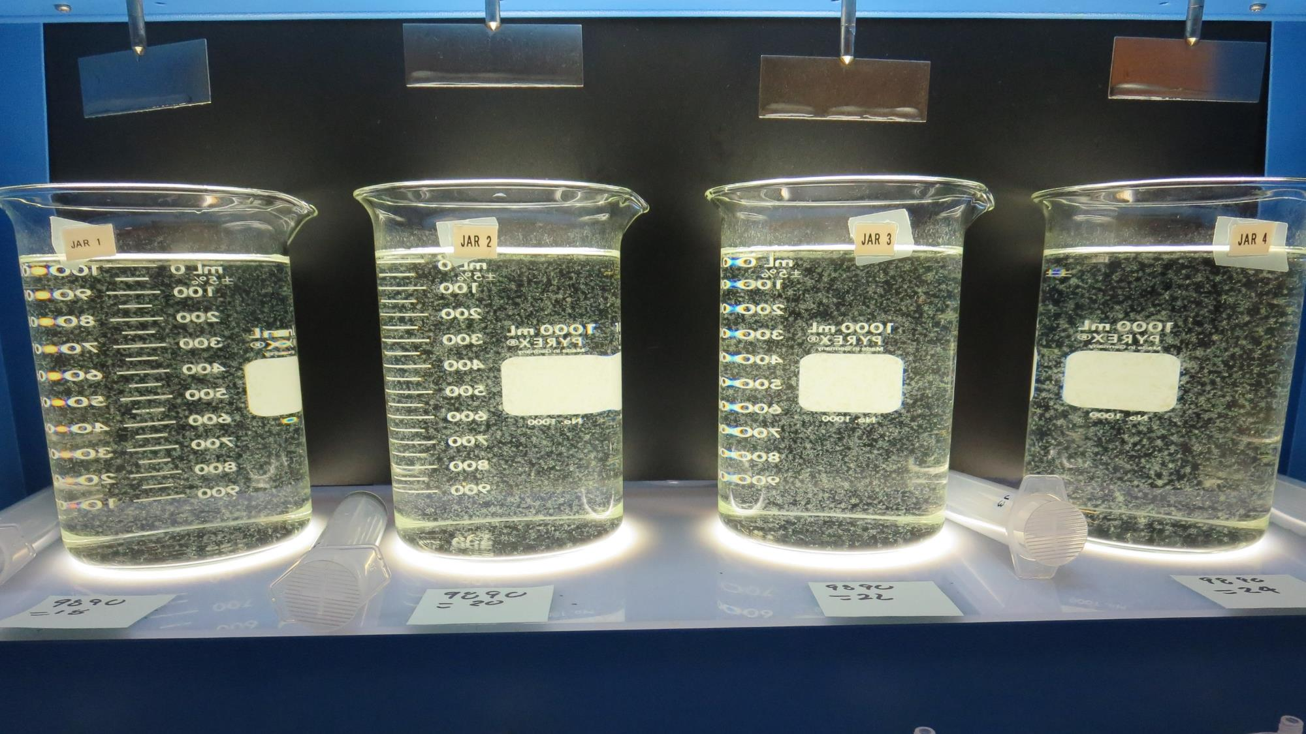
Jars 25-28: End of 5-minute flocculation (30 RPM) duration.
18 mg/L 9890
Filtrate: 0.06 NTU
UVT: 89.8%
UVA: 0.047/cm
UVA Reduction: 47.8%
Settled: 0.24 NTU
20 mg/L 9890
Filtrate: 0.06 NTU
UVT: 89.5%
UVA: 0.048/cm
UVA Reduction: 46.7%
Settled: 0.26 NTU
22 mg/L 9890
Filtrate: 0.06 NTU
UVT: 89.5%
UVA: 0.048/cm
UVA Reduction: 46.7%
Settled: 0.22 NTU
24 mg/L 9890
Filtrate: 0.06 NTU
UVT: 89.8%
UVA: 0.047/cm
UVA Reduction: 47.8%
Settled: 0.22 NTU

Slide 48
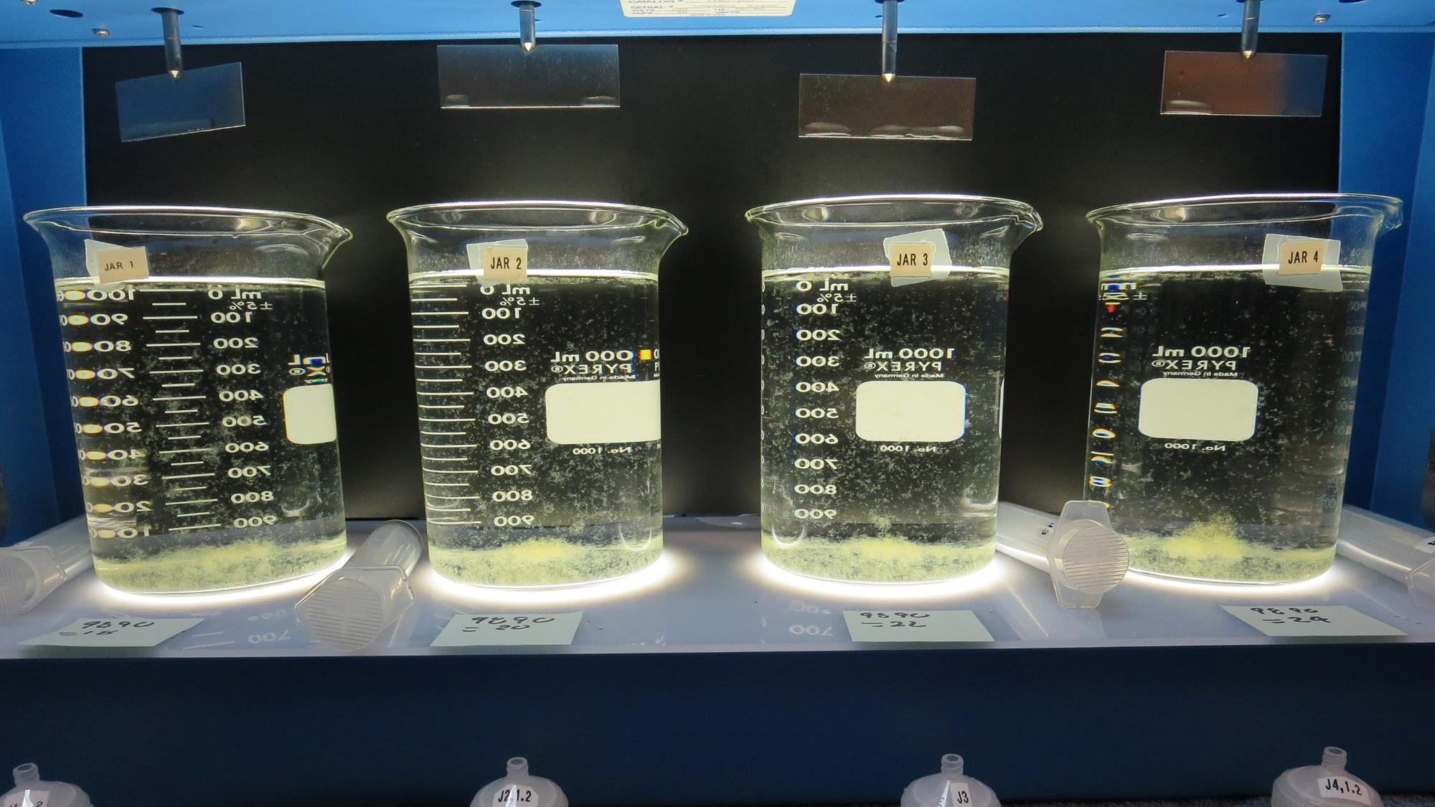
Jars 25-28: After 5 min of settling, 25 mL is syringed for filterability and %UVT/UVA.

Slide 49
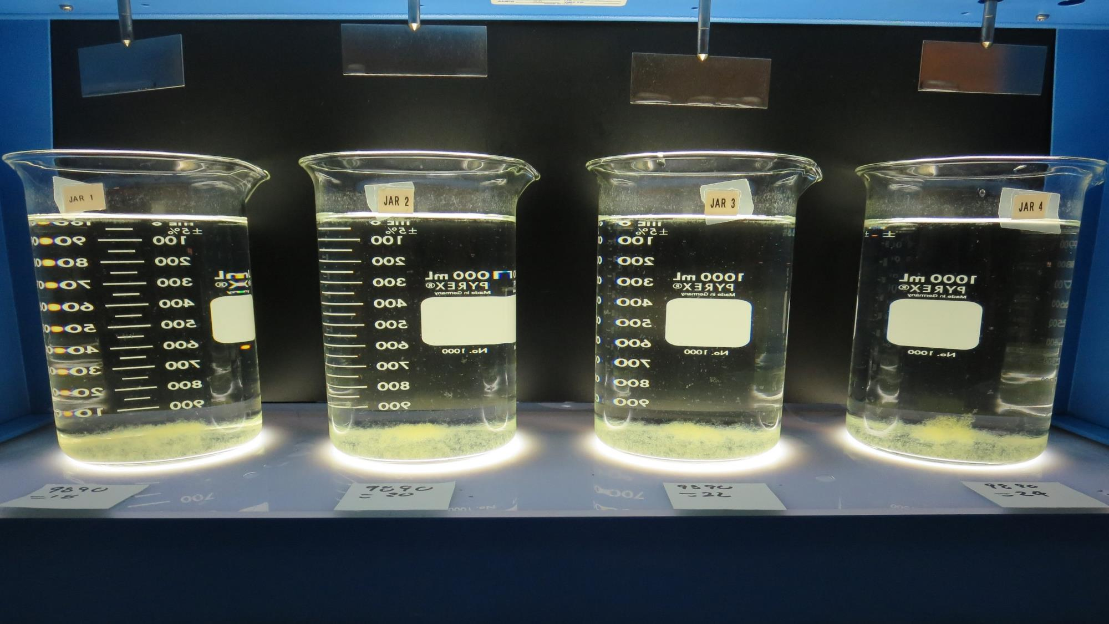
Jars 25-28: After 25-minutes of settling, settled water turbidity is taken.
18 mg/L 9890
Filtrate: 0.06 NTU
UVT: 89.8%
UVA: 0.047/cm
UVA Reduction: 47.8%
Settled: 0.24 NTU
20 mg/L 9890
Filtrate: 0.06 NTU
UVT: 89.5%
UVA: 0.048/cm
UVA Reduction: 46.7%
Settled: 0.26 NTU
22 mg/L 9890
Filtrate: 0.06 NTU
UVT: 89.5%
UVA: 0.048/cm
UVA Reduction: 46.7%
Settled: 0.22 NTU
24 mg/L 9890
Filtrate: 0.06 NTU
UVT: 89.8%
UVA: 0.047/cm
UVA Reduction: 47.8%
Settled: 0.22 NTU

Slide 50
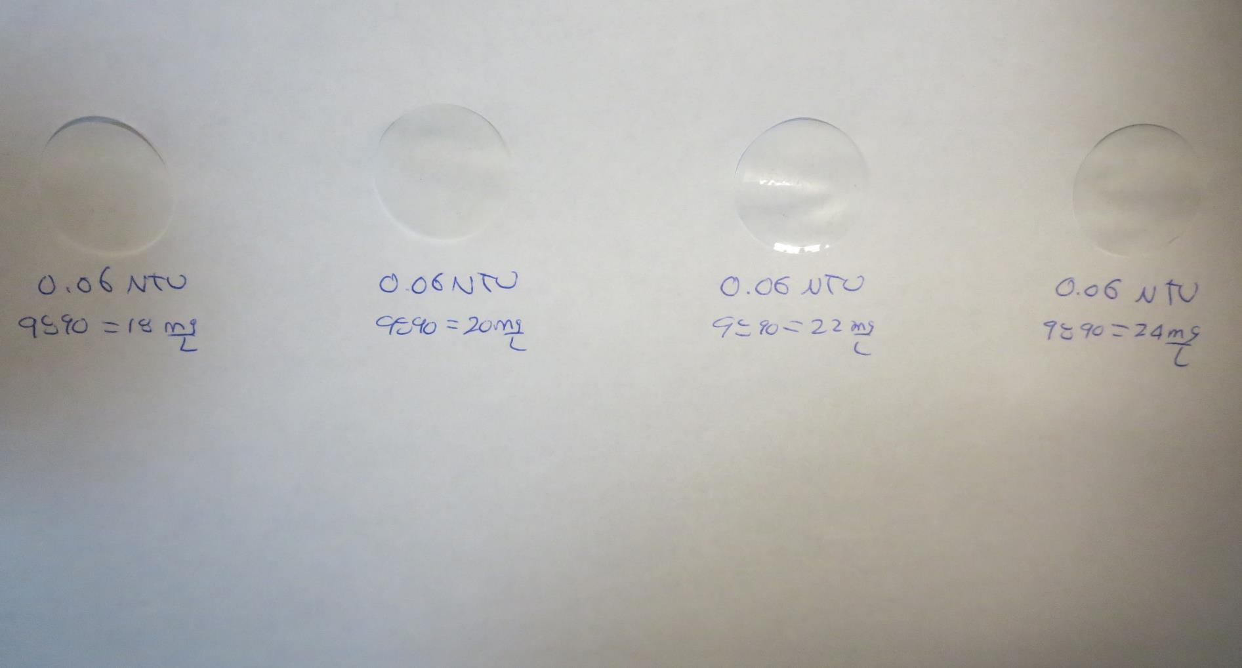
Visual of Filterability of Jars 25-28
18 mg/L 9890
Filtrate 0.06 NTU
UVT: 89.8%
UVA: 0.047/cm
Settled: 0.24 NTU
20 mg/L 9890
Filtrate 0.06 NTU
UVT: 89.5%
UVA: 0.048/cm
Settled: 0.26 NTU
22 mg/L 9890
Filtrate 0.06 NTU
UVT: 89.5%
UVA: 0.048/cm
Settled: 0.22 NTU
24 mg/L 9890
Filtrate 0.06 NTU
UVT: 89.8%
UVA: 0.047/cm
Settled: 0.22 NTU

Slide 51
Jars 29-32 Test
Flash Mix 60 Sec (200 RPM)
Floc Mix 5 min (30 RPM)
Applied Coagulant
9890

Slide 52
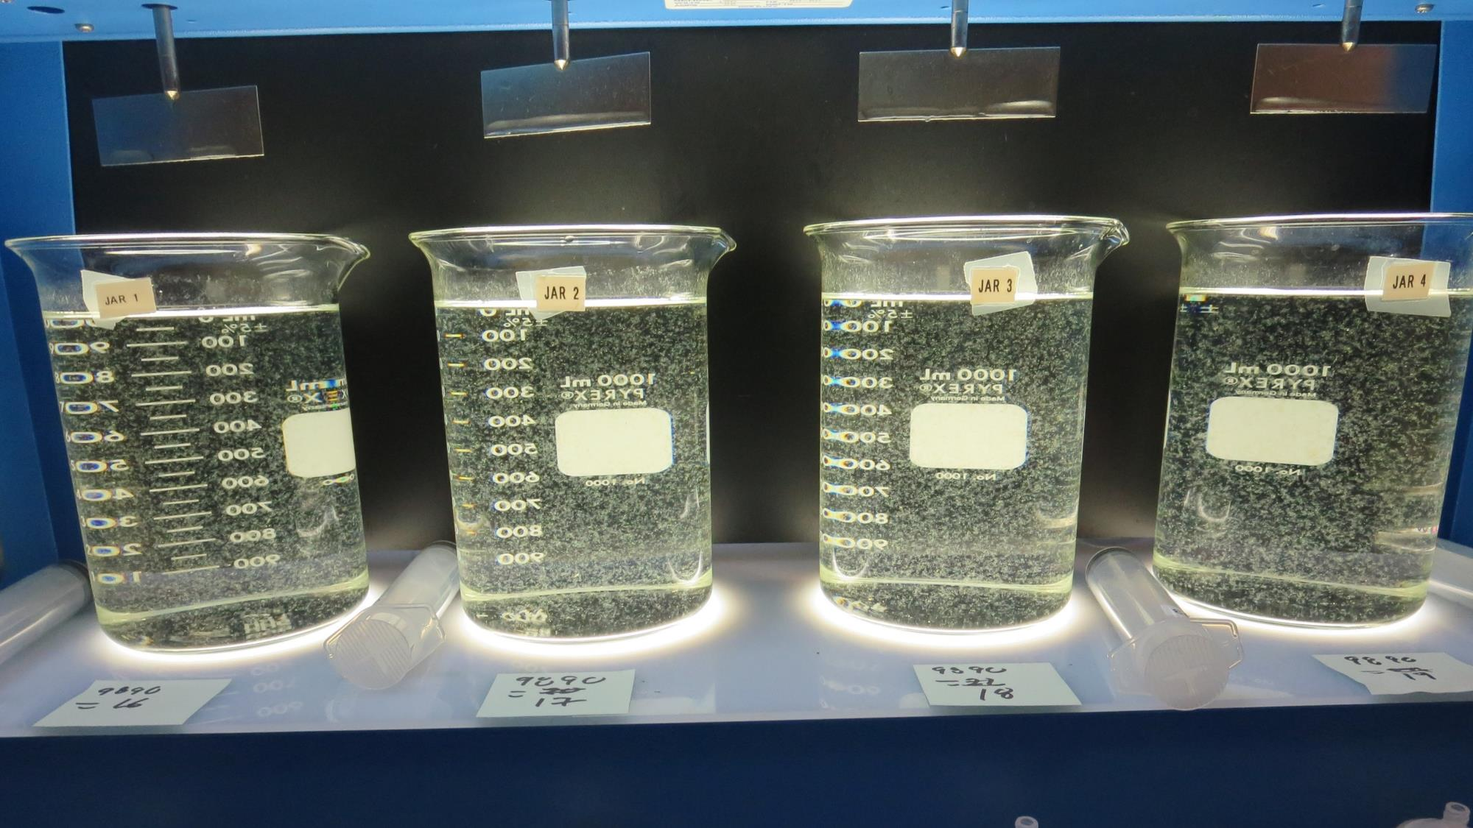
Jars 29-32: End of 5-minute flocculation (30 RPM) duration.
16 mg/L 9890
Filtrate: 0.06 NTU
UVT: 89.0%
UVA: 0.051/cm
UVA Reduction: 43.3%
Settled: 0.38 NTU
17 mg/L 9890
Filtrate: 0.07 NTU
UVT: 89.9%
UVA: 0.051/cm
UVA Reduction: 43.3%
Settled: 0.31 NTU
18 mg/L 9890
Filtrate: 0.06 NTU
UVT: 89.1%
UVA: 0.050/cm
UVA Reduction: 44.4%
Settled: 0.39 NTU
19 mg/L 9890
Filtrate: 0.07 NTU
UVT: 89.0%
UVA: 0.051/cm
UVA Reduction: 43.3%
Settled: 0.21 NTU

Slide 53
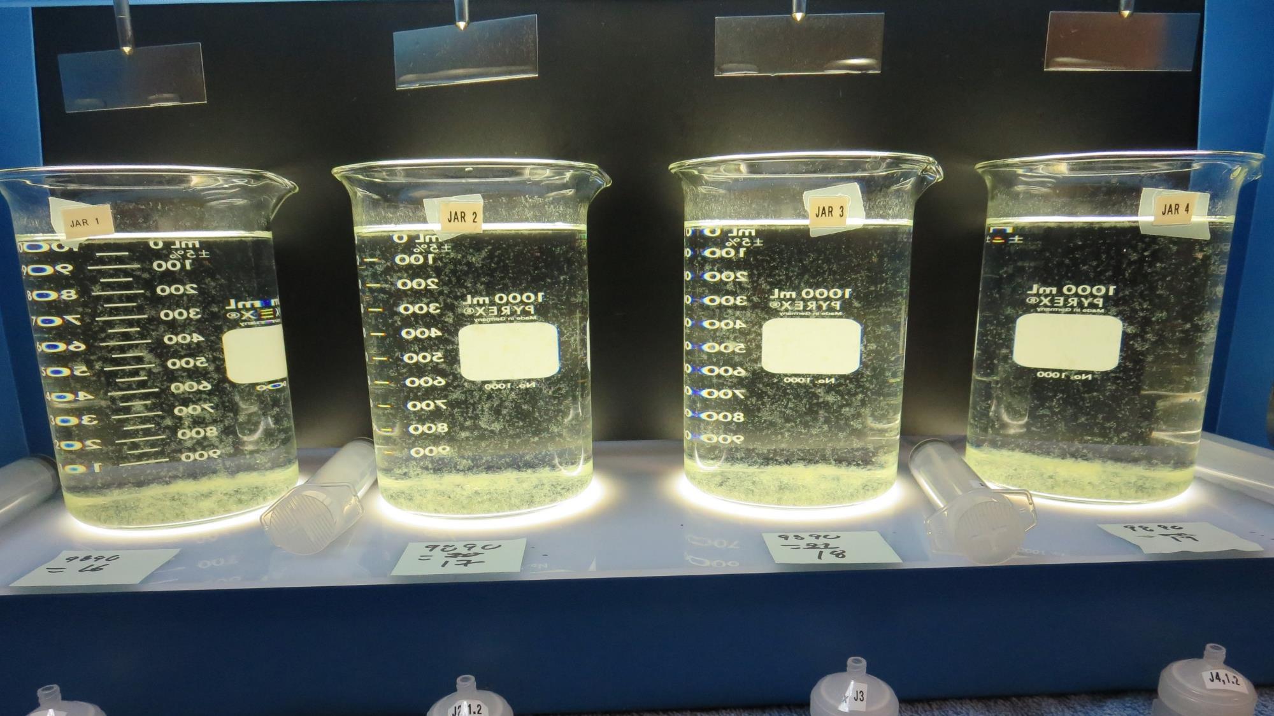
Jars 29-32: After 5 min of settling, 25 mL is syringed for filterability and %UVT/UVA.

Slide 54
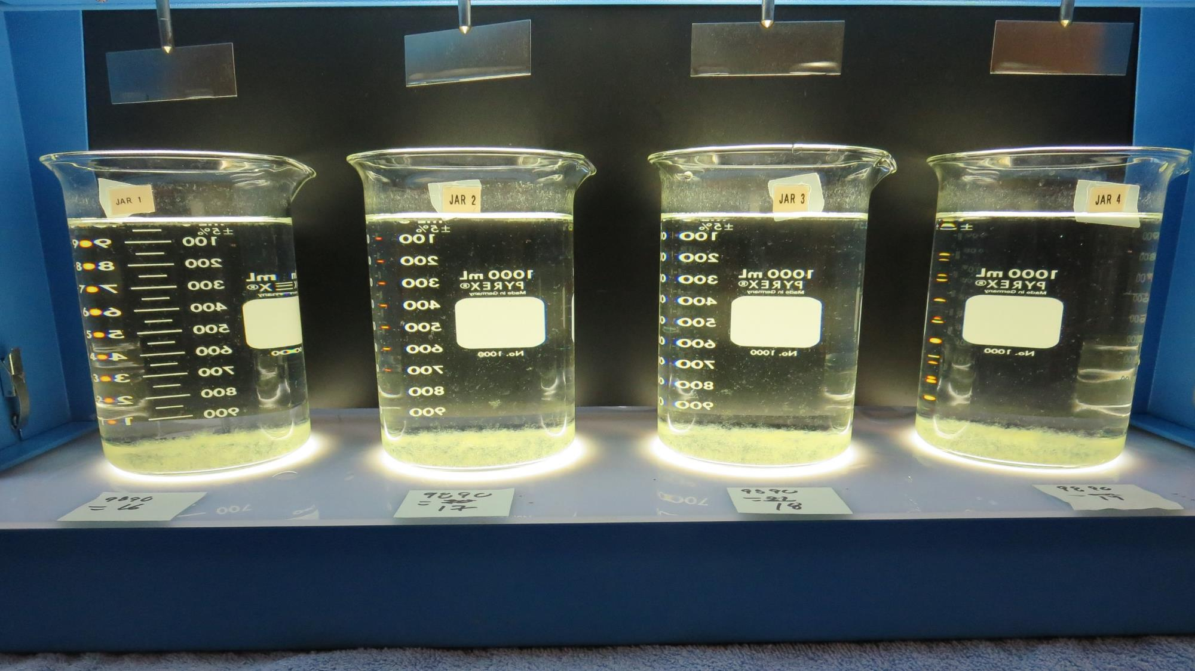
Jars 29-32: After 25-minutes of settling, settled water turbidity is taken.
16 mg/L 9890
Filtrate: 0.06 NTU
UVT: 89.0%
UVA: 0.051/cm
UVA Reduction: 43.3%
Settled: 0.38 NTU
17 mg/L 9890
Filtrate: 0.07 NTU
UVT: 89.9%
UVA: 0.051/cm
UVA Reduction: 43.3%
Settled: 0.31 NTU
18 mg/L 9890
Filtrate: 0.06 NTU
UVT: 89.1%
UVA: 0.050/cm
UVA Reduction: 44.4%
Settled: 0.39 NTU
19 mg/L 9890
Filtrate: 0.07 NTU
UVT: 89.0%
UVA: 0.051/cm
UVA Reduction: 43.3%
Settled: 0.21 NTU

Slide 55
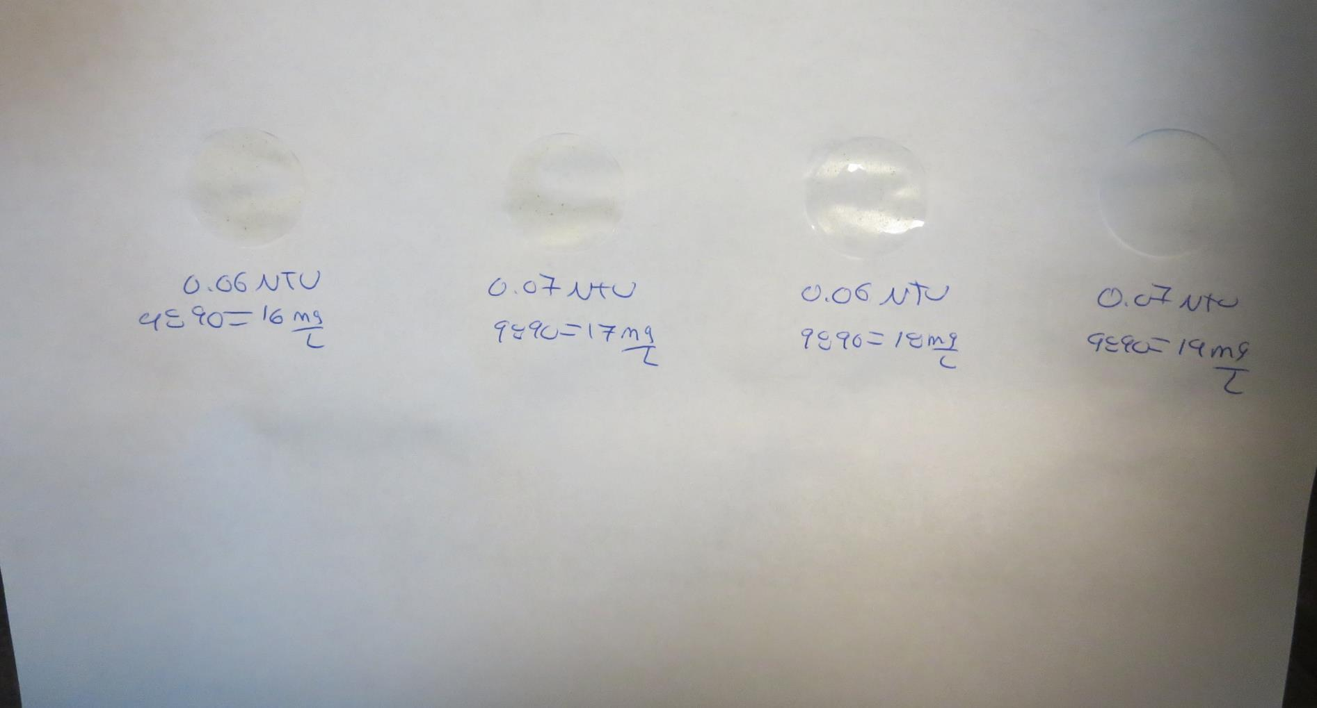
Visual of Filterability of Jars 29-32
16 mg/L 9890
Filtrate 0.06 NTU
UVT: 89.0%
UVA: 0.051/cm
Settled: 0.38 NTU
17 mg/L 9890
Filtrate 0.07 NTU
UVT: 89.9%
UVA: 0.051/cm
Settled: 0.31 NTU
18 mg/L 9890
Filtrate 0.06 NTU
UVT: 89.1%
UVA: 0.050/cm
Settled: 0.39 NTU
19mg/L 9890
Filtrate 0.07 NTU
UVT: 89.0%
UVA: 0.051/cm
Settled: 0.21 NTU

Slide 56
Jars 33-36 Test
Flash Mix 0/15/30/60 Sec
200 RPM)
Floc Mix 5 min (30 RPM)
Applied Coagulant
9890

Slide 57
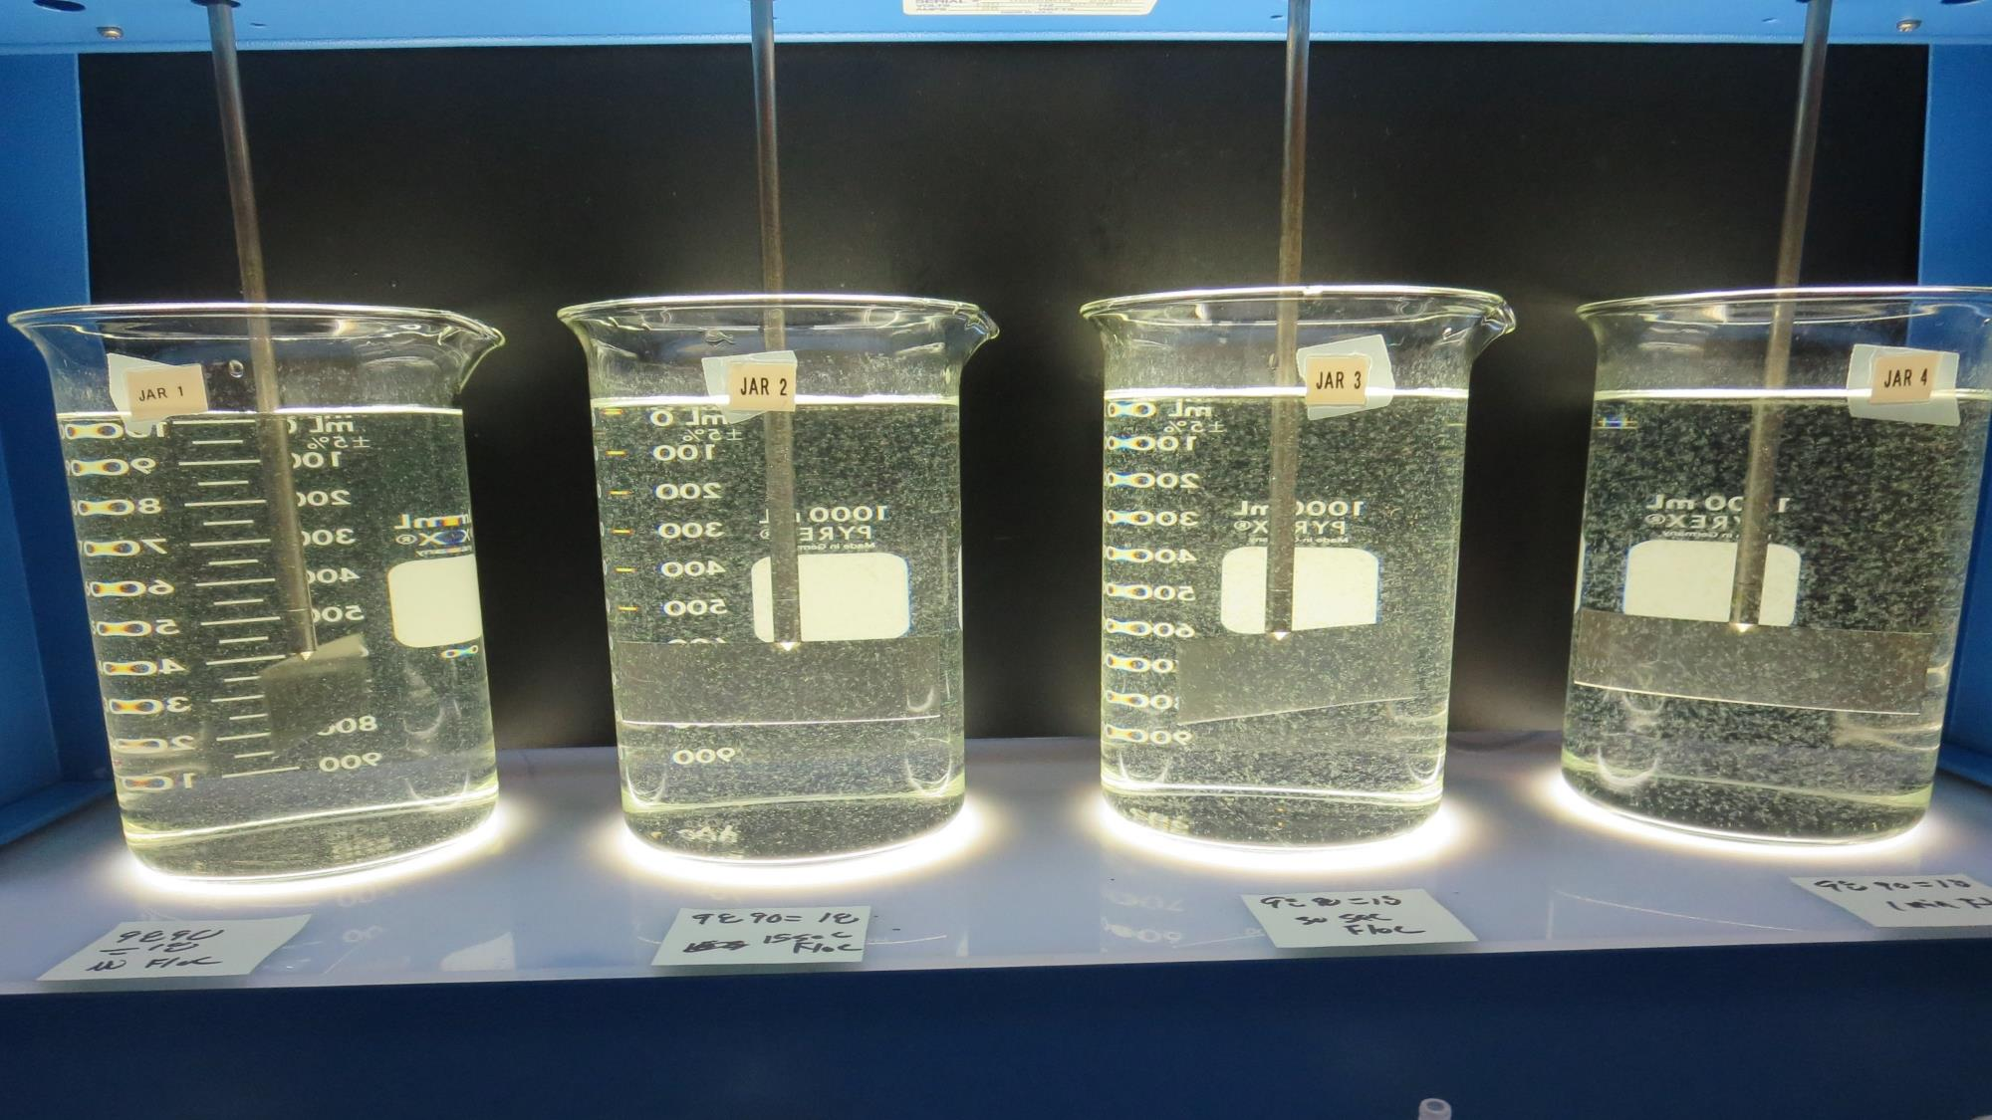
Jars 33-36: 2-minutes into flocculation (30 RPM) duration.
0 seconds Flash mix
18 mg/L 9890
Filtrate: 0.06 NTU
UVT: 89.4%
UVA: 0.049/cm
UVA Reduction: 45.6%
Settled: 0.28 NTU
15 seconds Flash mix
18 mg/L 9890
Filtrate: 0.06 NTU
UVT: 89.2%
UVA: 0.050/cm
UVA Reduction: 44.4%
Settled: 0.34 NTU
30 seconds Flash mix
18 mg/L 9890
Filtrate: 0.07 NTU
UVT: 89.3%
UVA: 0.049/cm
UVA Reduction: 45.6%
Settled: 0.36 NTU
60 seconds Flash mix
18 mg/L 9890
Filtrate: 0.07 NTU
UVT: 89.2%
UVA: 0.050/cm
UVA Reduction: 44.4%
Settled: 0.26 NTU

Slide 58
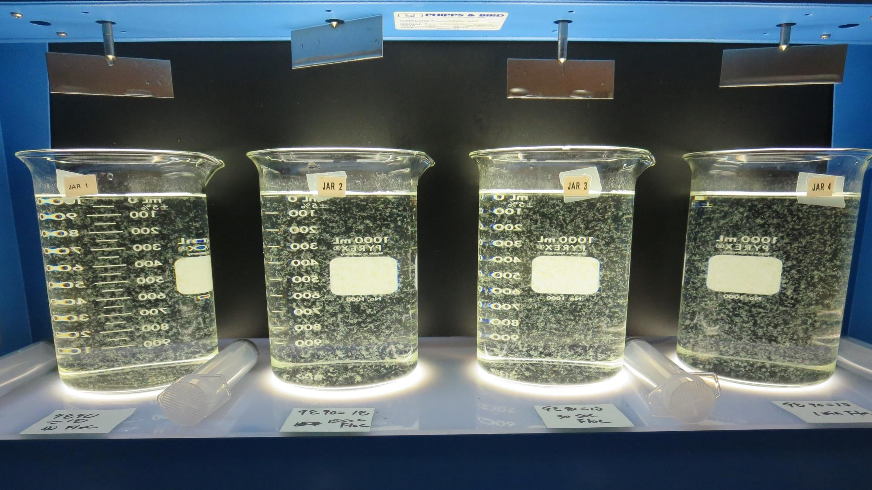
Jars 33-36: End of 5-minute flocculation (30 RPM) duration.
0 seconds Flash mix
18 mg/L 9890
Filtrate: 0.06 NTU
UVT: 89.4%
UVA: 0.049/cm
UVA Reduction: 45.6%
Settled: 0.28 NTU
15 seconds Flash mix
18 mg/L 9890
Filtrate: 0.06 NTU
UVT: 89.2%
UVA: 0.050/cm
UVA Reduction: 44.4%
Settled: 0.34 NTU
30 seconds Flash mix
18 mg/L 9890
Filtrate: 0.07 NTU
UVT: 89.3%
UVA: 0.049/cm
UVA Reduction: 45.6%
Settled: 0.36 NTU
60 seconds Flash mix
18 mg/L 9890
Filtrate: 0.07 NTU
UVT: 89.2%
UVA: 0.050/cm
UVA Reduction: 44.4%
Settled: 0.26 NTU

Slide 59
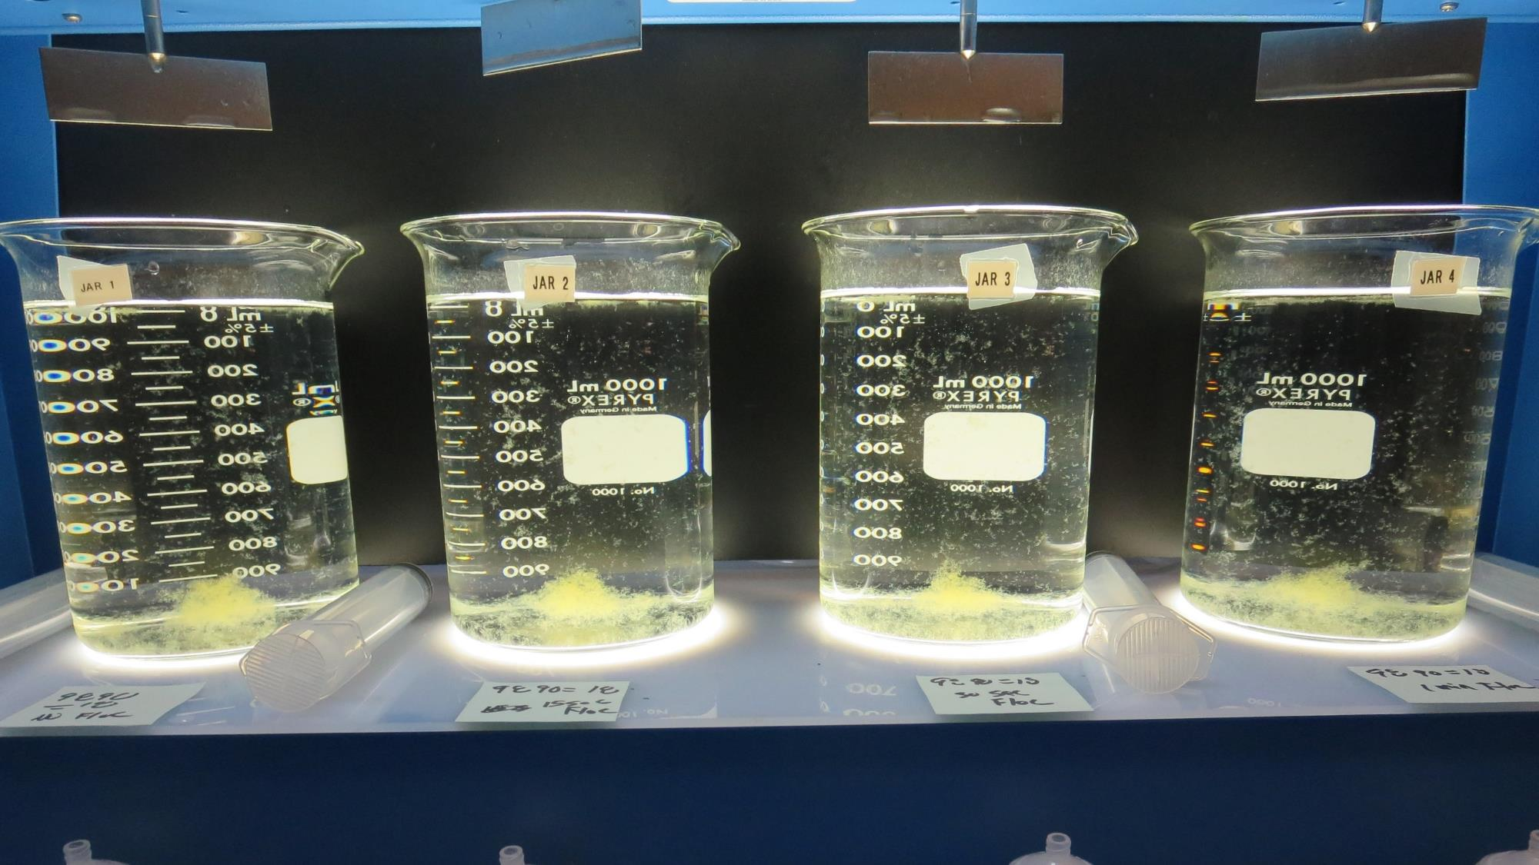
Jars 33-36: After 5 min of settling, 25 mL is syringed for filterability and %UVT/UVA.

Slide 60
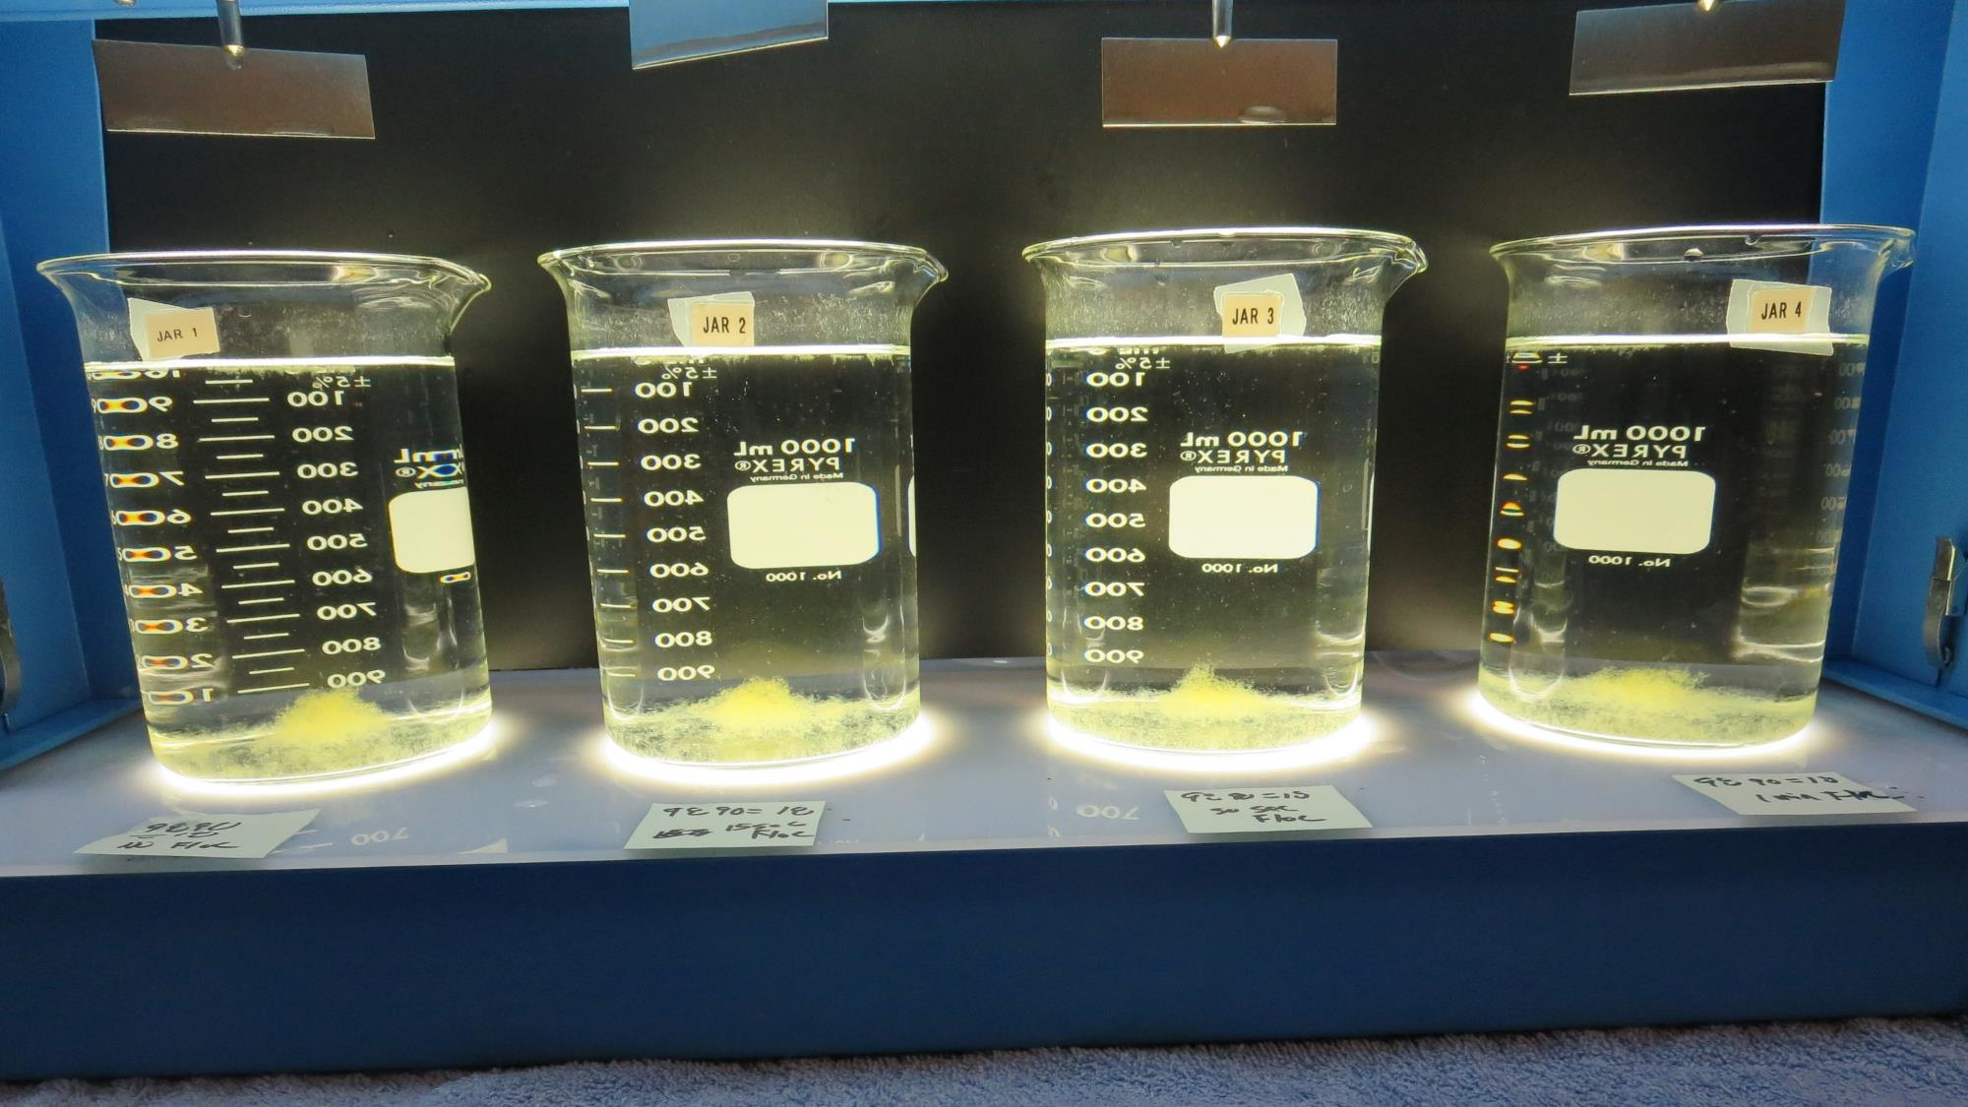
Jars 33-36: After 25-minutes of settling, settled water turbidity is taken.
0 seconds Flash mix
18 mg/L 9890
Filtrate: 0.06 NTU
UVT: 89.4%
UVA: 0.049/cm
UVA Reduction: 45.6%
Settled: 0.28 NTU
15 seconds Flash mix
18 mg/L 9890
Filtrate: 0.06 NTU
UVT: 89.2%
UVA: 0.050/cm
UVA Reduction: 44.4%
Settled: 0.34 NTU
30 seconds Flash mix
18 mg/L 9890
Filtrate: 0.07 NTU
UVT: 89.3%
UVA: 0.049/cm
UVA Reduction: 45.6%
Settled: 0.36 NTU
60 seconds Flash mix
18 mg/L 9890
Filtrate: 0.07 NTU
UVT: 89.2%
UVA: 0.050/cm
UVA Reduction: 44.4%
Settled: 0.26 NTU

Slide 61
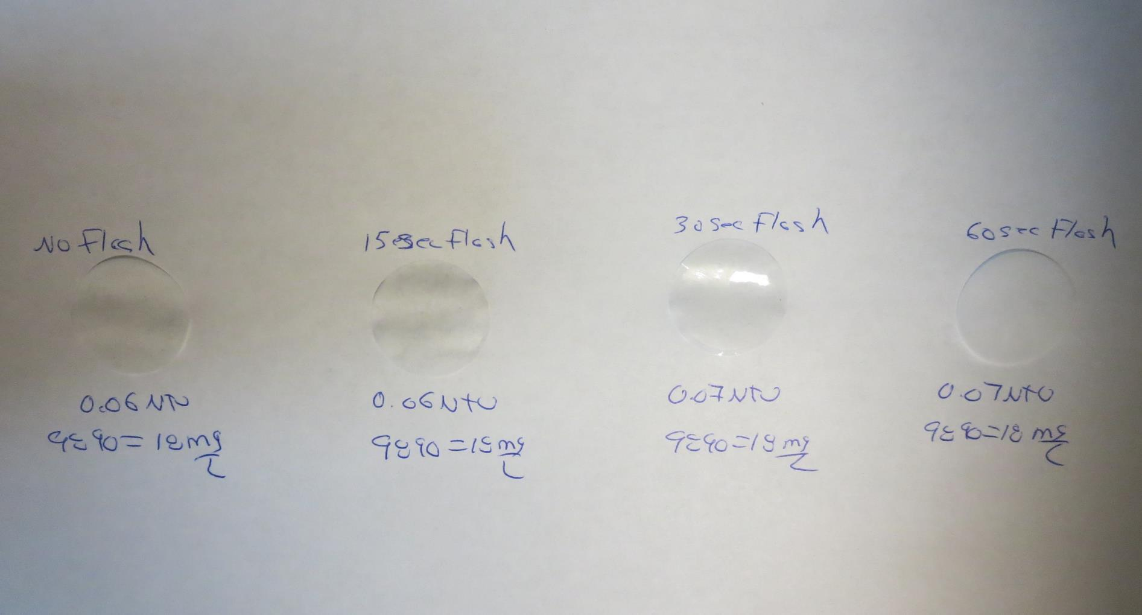
Visual of Filterability of Jars 33-36
0 seconds Flash mix
18 mg/L 9890
Filtrate 0.06 NTU
UVT: 89.4%
UVA: 0.049/cm
Settled: 0.28 NTU
15 seconds Flash mix
18 mg/L 9890
Filtrate 0.06 NTU
UVT: 89.2%
UVA: 0.050/cm
Settled: 0.34 NTU
30 seconds Flash mix
18 mg/L 9890
Filtrate 0.07 NTU
UVT: 89.3%
UVA: 0.049/cm
Settled: 0.36 NTU
60 seconds Flash mix
18 mg/L 9890
Filtrate 0.07 NTU
UVT: 89.2%
UVA: 0.050/cm
Settled: 0.26 NTU

Slide 62
Jars 36-40 Test
Flash Mix 60 Sec (200 RPM)
Floc Mix 5 min (30 RPM)
Applied Coagulant
9890 with NaOCl

Slide 63
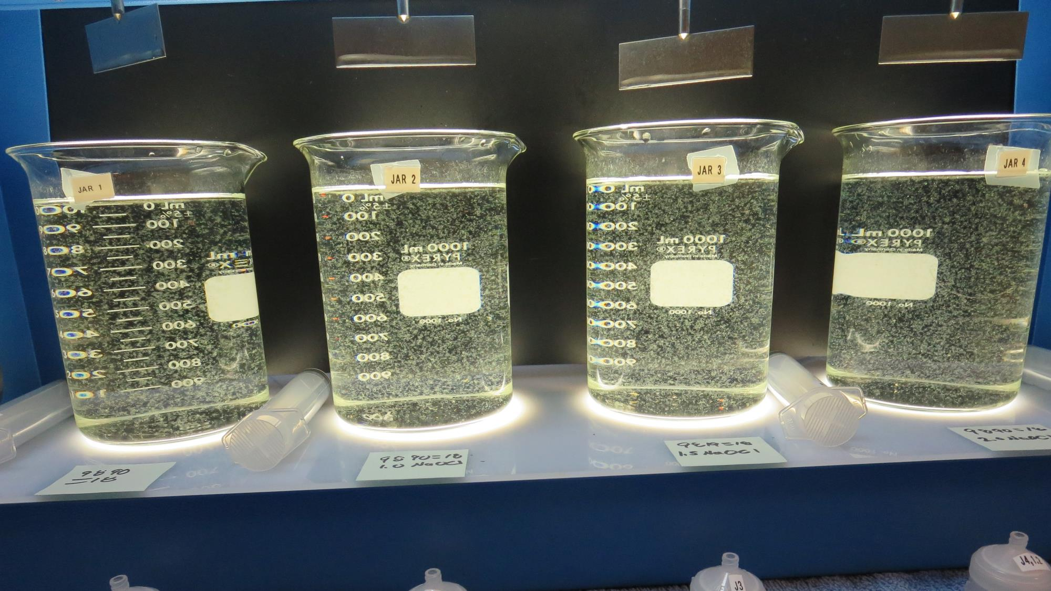
Jars 36-40: End of 5-minute flocculation (30 RPM) duration.
0 mg/L NaOCl
18 mg/L 9890
Filtrate: 0.06 NTU
UVT: 89.3%
UVA: 0.049/cm
UVA Reduction: 45.6%
Settled: 0.19 NTU
1.0 mg/L NaOCl
18 mg/L 9890
Filtrate: 0.06 NTU
UVT: 88.7%
UVA: 0.052/cm
UVA Reduction: 42.2%
Settled: 0.26 NTU
1.5 mg/L NaOCl
18 mg/L 9890
Filtrate: 0.07 NTU
UVT: 89.0%
UVA: 0.051/cm
UVA Reduction: 43.3%
Settled: 0.38 NTU
2.0 mg/L NaOCl
18 mg/L 9890
Filtrate 0.06 NTU
UVT: 89.6%
UVA: 0.048/cm
UVA Reduction: 46.6%
Settled: 0.31 NTU

Slide 64
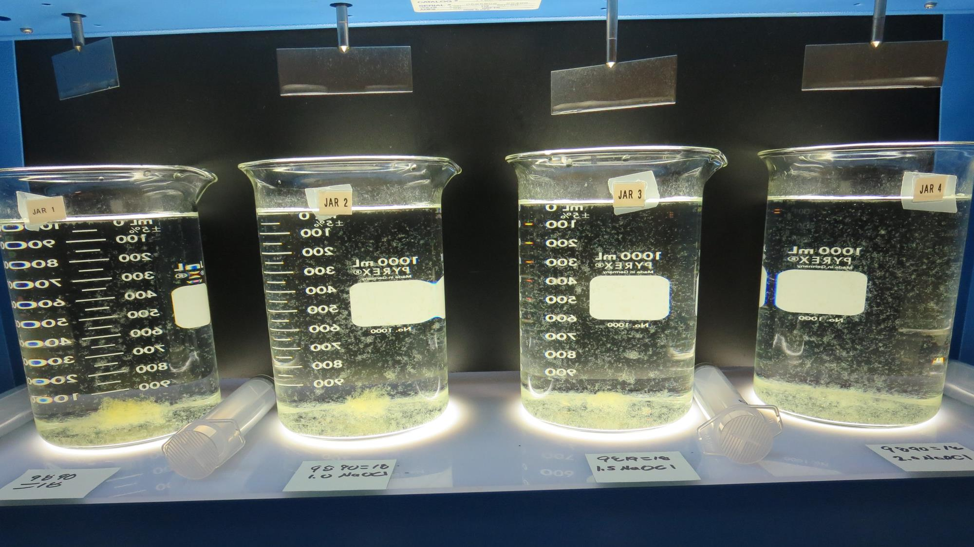
Jars 37-40: After 5 min of settling, 25 mL is syringed for filterability and %UVT/UVA.

Slide 65
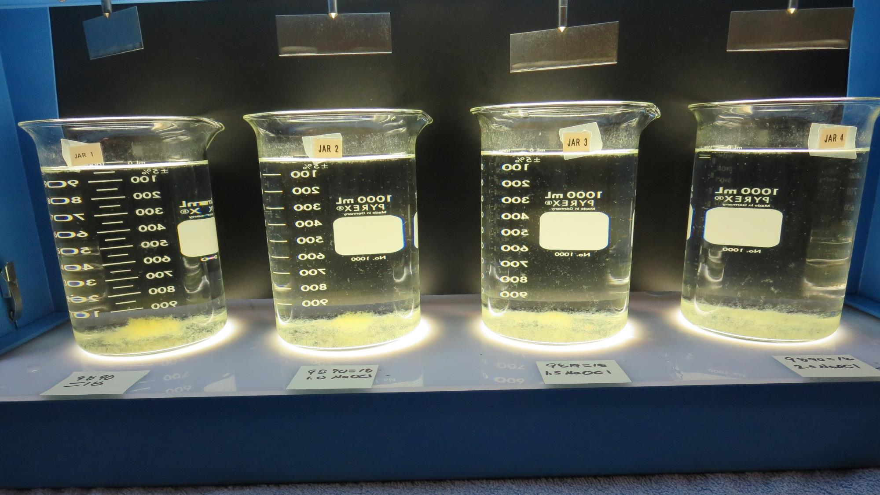
Jars 37-40: After 25-minutes of settling, settled water turbidity is taken.
0 mg/L NaOCl
18 mg/L 9890
Filtrate: 0.06 NTU
UVT: 89.3%
UVA: 0.049/cm
UVA Reduction: 45.6%
Settled: 0.19 NTU
1.0 mg/L NaOCl
18 mg/L 9890
Filtrate: 0.06 NTU
UVT: 88.7%
UVA: 0.052/cm
UVA Reduction: 42.2%
Settled: 0.26 NTU
1.5 mg/L NaOCl
18 mg/L 9890
Filtrate: 0.07 NTU
UVT: 89.0%
UVA: 0.051/cm
UVA Reduction: 43.3%
Settled: 0.38 NTU
2.0 mg/L NaOCl
18 mg/L 9890
Filtrate 0.06 NTU
UVT: 89.6%
UVA: 0.048/cm
UVA Reduction: 46.6%
Settled: 0.31 NTU

Slide 66
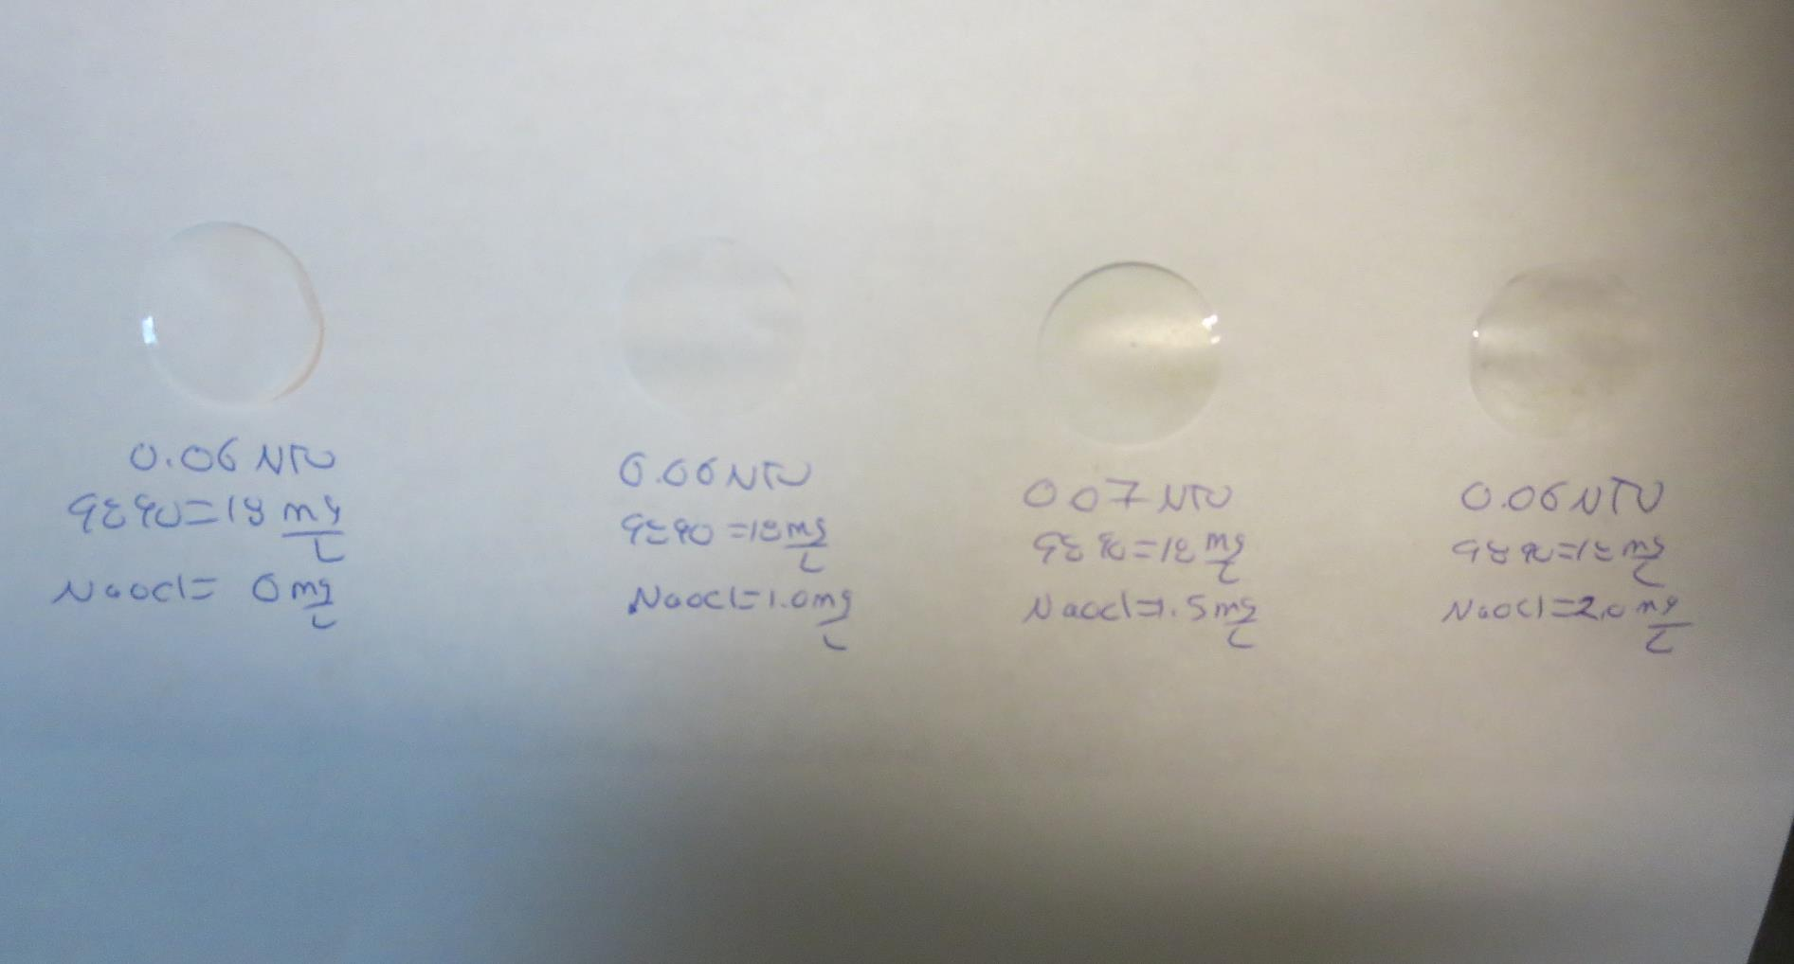
Visual of Filterability of Jars 37-40
0 mg/L NaOCl
18 mg/L 9890
Filtrate 0.06 NTU
UVT: 89.3%
UVA: 0.049/cm
Settled: 0.19 NTU
1.0 mg/L NaOCl
18 mg/L 9890
Filtrate 0.06 NTU
UVT: 88.7%
UVA: 0.052/cm
Settled: 0.26 NTU
1.5 mg/L NaOCl
18 mg/L 9890
Filtrate 0.07 NTU
UVT: 89.0%
UVA: 0.051/cm
Settled: 0.38 NTU
2.0 mg/L NaOCl
18 mg/L 9890
Filtrate 0.06 NTU
UVT: 89.6%
UVA: 0.048/cm
Settled: 0.31 NTU

Slide 67
Jar Testing for 1-Liter Jars:
Procedures for Most Treatment Plants
Fill jars with source water prior to coagulant injection and set paddle speed at 30 rpm
Add chemicals (i.e., NaOCl, primary coagulant, coagulant aid) to each jar
Flash mix for 15-60 seconds (200 rpm)
Slow mix for 5 minutes (20-30 rpm)
Settled for 5 minutes. Syringe 25 mL from each jar taken 1-inch below surface (25 mL/12 sec rate)
Filtered through 1.2 um isopore membrane into cuvette drip rate, 15 mL/(50-90 sec)
Measure filtrate turbidity, chlorine residual and %UVT/UVA
Measure settled water turbidity after 25 minutes of total setting
Record all data

Slide 68

Jar Test
Filterability Test Equipment
Turbidity Instrument
Syringe w/Luer-Lock Tip, 30 cc
(part#: 2225800, by Hach)
Swinnex Filter Holder, 25 mm (part#: SX0002500)
Isopore Membrane Filter, 1.2 um absolute
pore size,
Φ= 25 mm , thickness: 24 um,
hydrophilic polycarbonate membrane
(part #: RTTP02500)
Go to Sigma-Aldrich for laboratory supplies http://www.sigmaaldrich.com/united-states.html

Slide 69
Isopore Membrane Information
Categories | Information
trade name | Isopore
filter color | White
chemistry | Polycarbonate (PC)
water flow rate | Avg. 175 mL/min x cm² (typical results @ 10 psi)
media | Isopore®
wettability | Hydrophilic
porosity | 14.7%
pore size | 1.2 µm
bubble point at 23 °C | 1.0 bar, air with water
thickness | 24 µm
filter diameter (ø) | 25 mm
material size | polycarbonate, Hydrophilic, 1.2 µm, 25 mm, white, plain, 100

Slide 70
Isopore Membrane Background Information
The Isopore membrane is a polycarbonate, track-etched screen filter recommended for all analyses in which the sample is viewed on the surface of the membrane. The Isopore membrane is composed of polycarbonate film, which has a smooth, glass-like surface for clearer sample observation. The unique manufacturing process of the membrane ensures a precise pore diameter and a consistent pore size for accurate separation of samples by size. Matched-weight filters are not usually required because of low, constant tar and ash weights.
Features & Benefits:
Membrane structure retains particles on the surface, simplifying counting and analysis

Slide 71
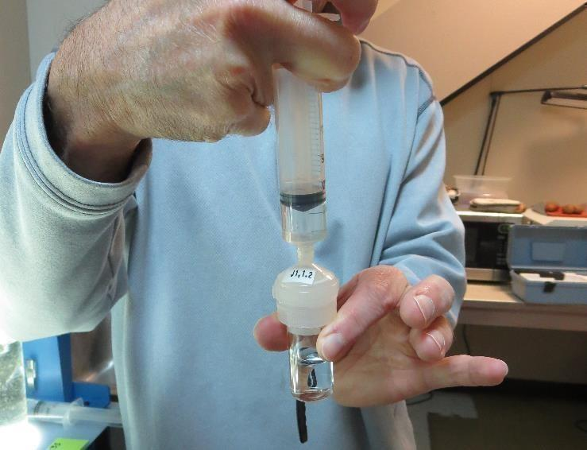

Jar Test - Filterability Test
Syringe ~ 25 mL from jar (after 5-minutes of settling)
Filter-to-waste 3-5 mL
Filter directly into clean cuvette
Measure turbidity
Note: Take several readings before recording final NTU results. Micro bubbles can adhere to glass causing false NTU readings. To remove bubbles, tilt cuvette up to 90 degrees.

Slide 72

Contact
Guy Schott, P.E.
State Water Resources Control Board
Division of Drinking Water
Santa Rosa, CA
Go to Stock Solution/Dose calculations/Jar Test Results for tools to download
www.waterboards.ca.gov/drinking_water/programs/districts/mendocino_district.html
Email: Guy Schott - Guy.Schott@waterboards.ca.gov
Office Number: 707-576-2732

