Slide 1
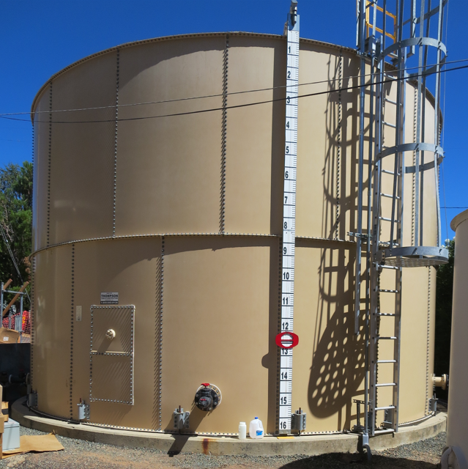
Clearwell
Clear Water MWC
CA1700546
Tracer Studies
Clearwell
September 5 & 18, 2024
Performed by:
Guy Schott, P.E
Alexis Ortiz-Vasquez

Slide 2
Clear Water Mutual Water Company
Clearwell Tracer Study Operations

Slide 3
Summary of Tracer Procedures
Two tracer studies at different exit flows were conducted on a 54,000-gallon bolted steel tank (clearwell). Liquid fluoride was used as the tracer that was injected near the chlorine injection point upstream of the clearwell.
Sampling were conducted at two stations
  Station 1: Inlet to clearwell to determine fluoride dose (mg/L)
  Station 2: Downstream of clearwell and flow meter near high lift pumps
Clearwell entry flow was 44 gpm for both tests
Clearwell exit flows were at 82.7 gpm (test 1) and 66.7 gpm (test 2)

Slide 4
Tracer Test Result Summary –
54,000-Gallon Clearwell
Modified Step-Dose – Test 1
Test Date: 9/5/24
Clearwell avg operating volume: 45,260-gallons
Entry flow: 44 gpm
Exit flow: 82.7 gpm
HRT: 546 minutes
t₁₀: 21.6 minutes
Baffling Factor (t₁₀/HRT): 0.040
Modified Step-Dose – Test 2
Test Date: 9/18/24
Clearwell avg operating volume: 48,968-gallons
Entry flow: 44 gpm
Exit flow: 66.7 gpm
HRT: 734 minutes
t₁₀: 30.0 minutes
Baffling Factor (t₁₀/HRT): 0.041

Slide 5
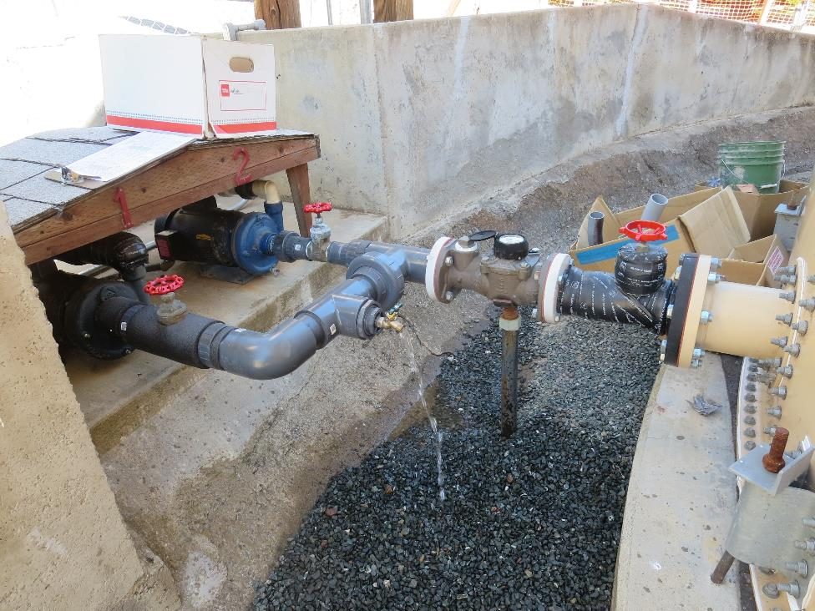
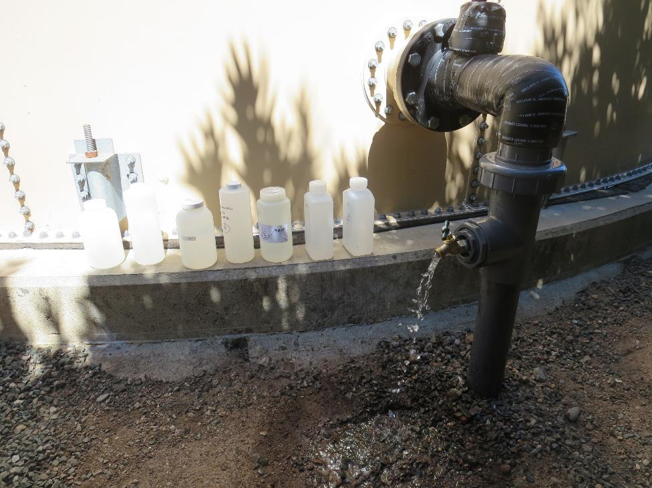
Clearwell Inlet/Outlet Sampling Taps
Outlet Sampling Tap
Inlet Sampling Tap

Slide 6
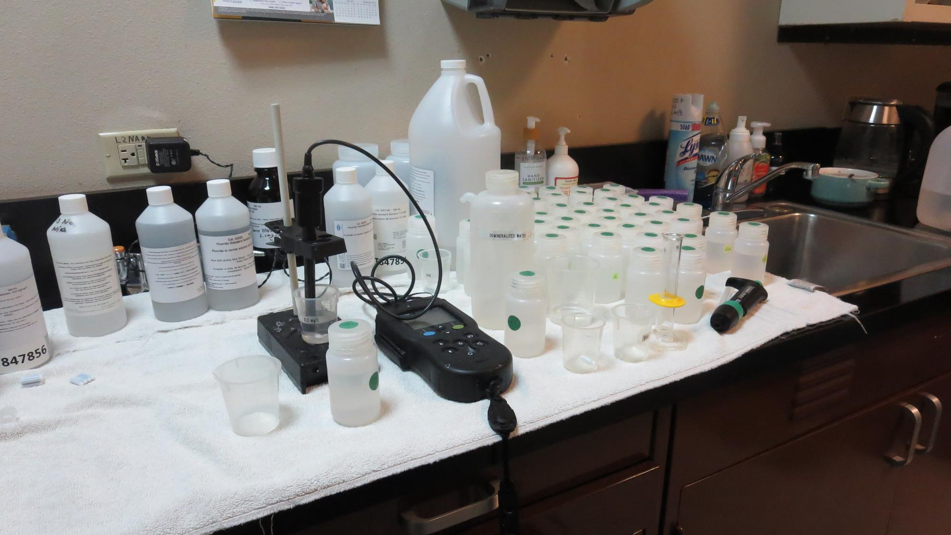
Laboratory
Fluoride Analysis

Slide 7
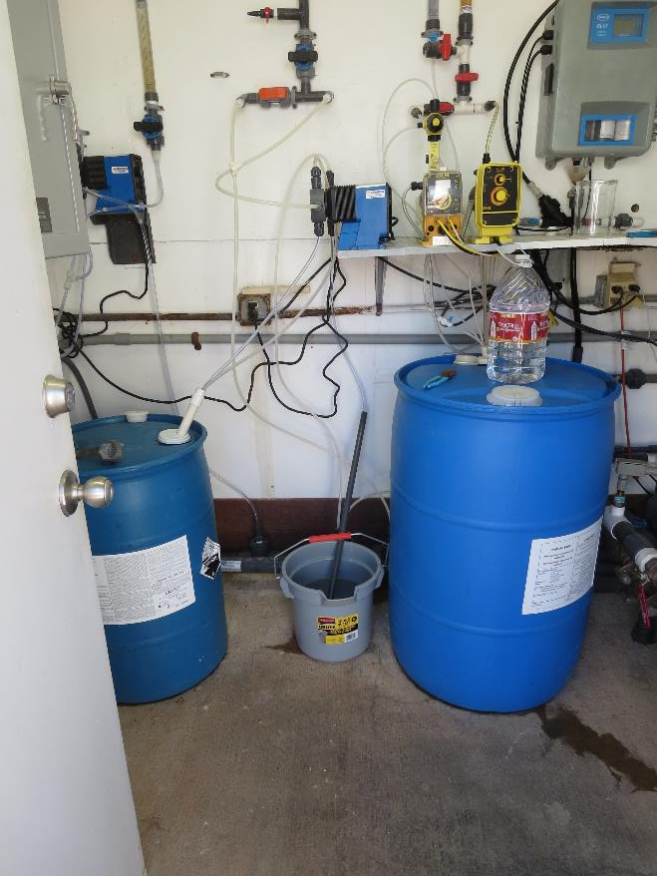
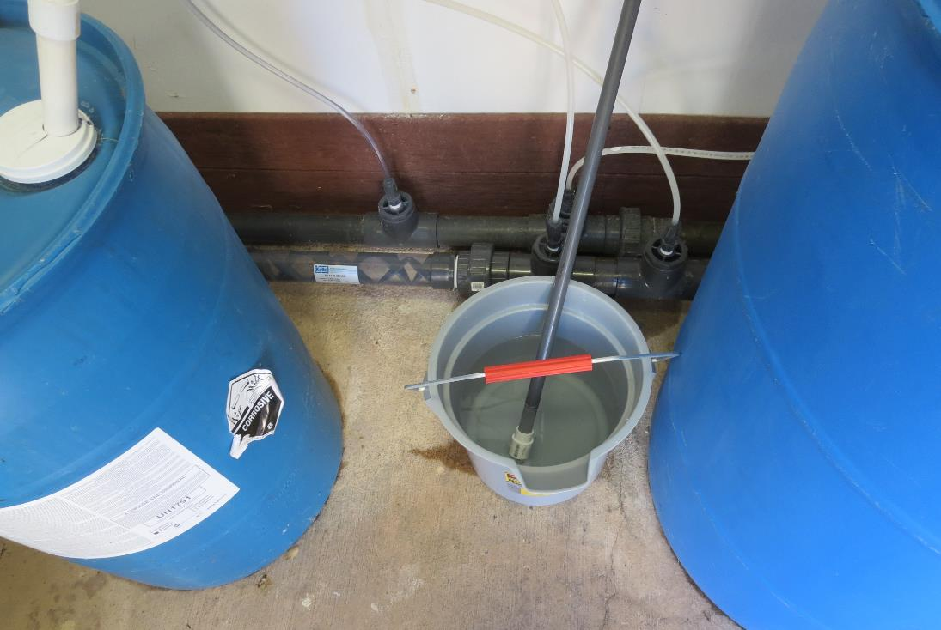
Tracer: H₂SiF₆, Fluoride (F) Injection
Static
Mixer
Solution
of Fluoride
Solution
of Fluoride

Slide 8
Test 1: Tracer Fluoride Dose, Inlet to Clearwell
Elapsed Time minutes | *Tracer Fluoride Dose mg/L
7 | 0.82
14 | 0.94
21 | 0.96
*Excludes background fluoride of 0.131 mg/L

Slide 9
Test 2: Tracer Fluoride Dose, Inlet to Clearwell
Elapsed Time minutes | *Tracer Fluoride Dose mg/L
5.5 | 1.68
10.5 | 1.77
16.5 | 1.76
23.5 | 1.80
27.5 | 1.81
35 | 1.82
*Excludes background fluoride of 0.147 mg/L

Slide 10
Tracer Test 1 – Tabulated Results

Slide 11
Tracer Test 2 – Tabulated Results

Slide 12
Test 1
Dose: 0.909 mg/L (inlet monitoring)
0.0909 mg/L at t₁₀ (outlet monitoring)
T₁₀: 21.63 min
HRT: 546 min
BF: 0.040 (T₁₀/HRT)

Slide 13
Test 1
BF: 0.040

Slide 14
Test 2
Dose: 1.77 mg/L (inlet monitoring)
0.177 mg/L at t₁₀ (outlet monitoring)
T₁₀: 30.0 min
HRT: 734 min
BF: 0.041 (T₁₀/HRT)

Slide 15
Test 2
BF: 0.041

Slide 16
Purpose of a Tracer Study
To determine the hydraulic efficiency or disinfectant exposure time of water through one or more reactors.
The addition of known quantities of a nonreactive chemical (tracer) is added in the form of a pulse (slug) or step-input.
The time of travel or disinfectant exposure time through the reactor is related to:
  Flow rate
  Reactor water volume
  Water Depth
  Reactor configuration
  Hydraulic mixing

Slide 17
Disinfection Exposure Time of Fluid in Vessel for Determining Ct₁₀
C” is the disinfectant residual (mg/L) at the point of inactivation compliance.
The disinfection exposure time of water used for Ct₁₀ calculation is the time (t₁₀) it takes for the first 10 percent of the water entering the reactor to exit the reactor.
To determine this, a marker (nonreactive tracer) is introduced into the water and is monitored leaving the reactor.
Example: 1.9 mg/L of tracer is continuously dose during testing; t₁₀ is that time when 0.19 mg/L of tracer concentration (10% of dose) has exited the reactor.

Slide 18
Ct₁₀ Value
Log inactivation is based on the Delivered Dose, “Ct₁₀”
  “C” is the disinfectant residual (mg/L)
  “t₁₀” is the exposure or contact time (minutes)
  Multiply them:
C • t₁₀ = mg/L • min (delivered dose to pathogens)
The calculated Ct₁₀ value is looked up in EPA Ct tables to determine the log inactivation based on specific monitoring parameters (pH, disinfectant residual and temperature).

Slide 19
Baffling Factor (BF)
Baffling factor or short-circuiting factor:
  Determined from tracer study or estimated
  BF = t₁₀/ HRT from tracer study
  HRT (hydraulic residence time) = reactor volume divided by reactor flow
Once the BF is determined, then it is applied to the operations of the reactor for determining the disinfectant exposure time.
Example:
  Total Clearwell operating volume: 46,000 gallons
  Exit flow: 82 gpm (0. 118 MGD)
  BF: 0.040, from tracer study
  Calculated contact or disinfection exposure time:
    46,000 gal ÷ 82 gpm × 0.040 = 22.4 minutes = t₁₀

Slide 20
Test Method
Modified Step-Dose Method
It is a continue feed of tracer at constant rate and inlet plant flow throughout the duration of the test. The “Step-Dose” test has a duration of 3-4 HRT to achieve reactor outlet steady-state tracer concentration. The time “t₁₀” is determined when 10% of the tracer dose concentration has exist the reactor. The “Modified Step-Dose” test allows the test to be completed in less than 1 HRT by physical measurements of the tracer inlet flow and/or channel basin concentration.

Slide 21
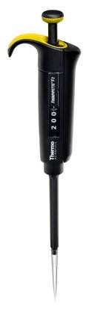
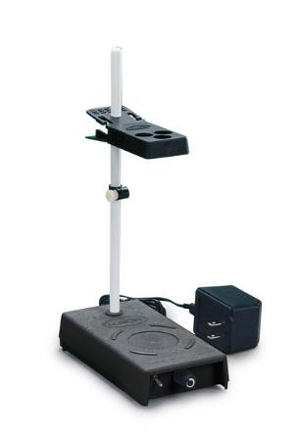
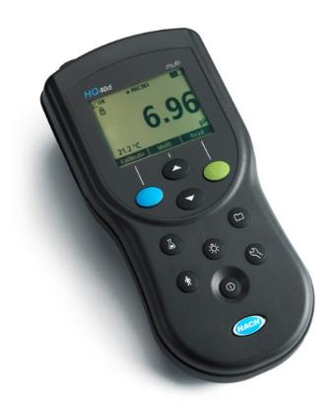
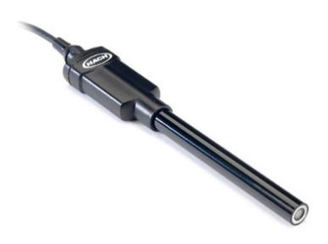
Method of Analysis and Equipment
Intellical™ ISEF121 Fluoride (F⁻) Ion Selective Electrode (ISE)
HQ40d Portable ISE Multi-Parameter Meter
Fluoride Ionic Strength Adjustor (ISA)
Fluoride Standards (0.2 & 2.0 mg/L)
25 mL graduated cylinder
Finnpipette F2 variable volume pipette, capacity 0.5 - 5 mL
Electrode stirrer stand
50 mL beakers
Stir Bar, Magnetic, Polygon

Slide 22

Contact
Guy Schott, P.E.
State Water Resources Control Board
Division of Drinking Water
Santa Rosa, CA
Go to Tracer Test Results for review
www.waterboards.ca.gov/drinking_water/programs/districts/mendocino_district.html
Email: Guy Schott - Guy.Schott@waterboards.ca.gov
Office Number: 707-576-2732

