Slide 1
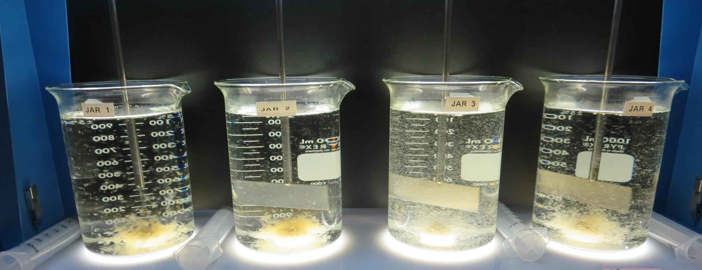
Clearlake Oaks CWD CA1710001 Lake County Jar Test
by Guy Schott, P.E.
September 7, 2022

Slide 2
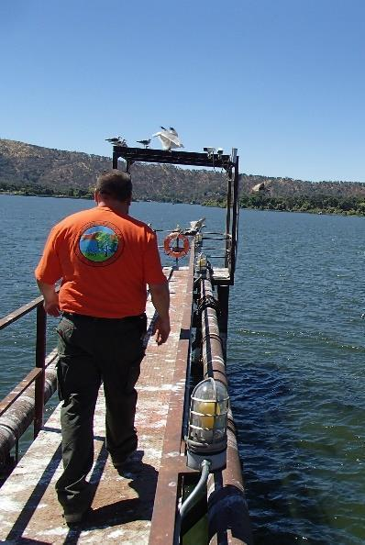
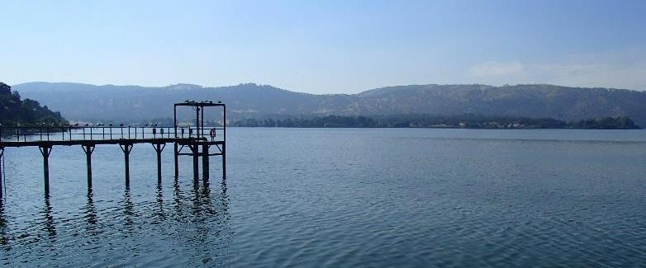
Clearlake Oaks CWD Source Water: Clear Lake Conventional Treatment

Slide 3
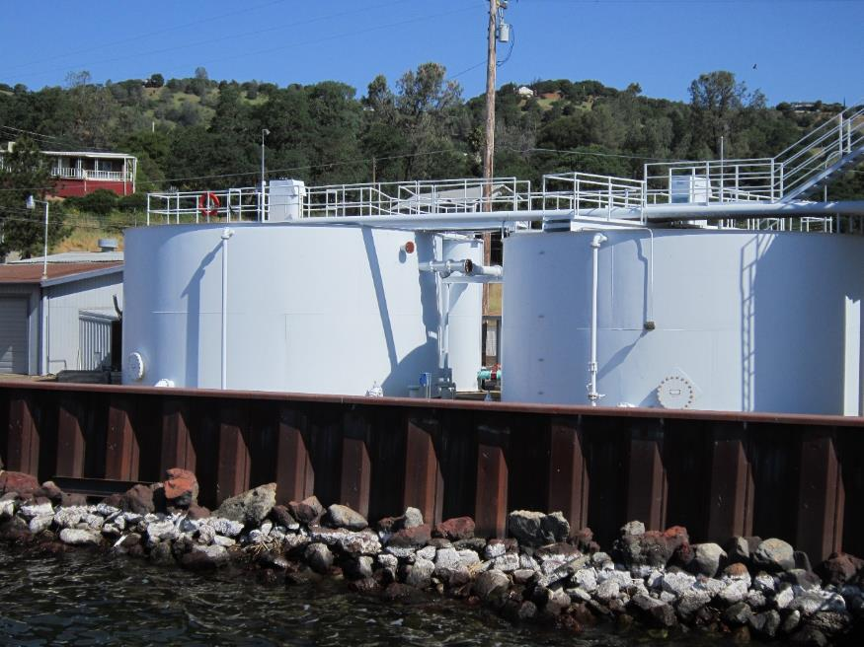
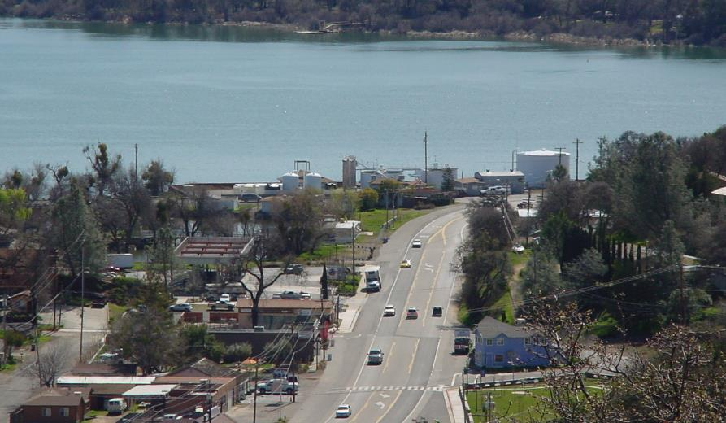
Conventional Treatment Plant

Slide 4
Clearlake Oaks CWD.: Source Water Characteristics September 7, 2022
Source (at Pier) – no ozone was applied
pH: 8.76
Turbidity: 13.4 NTU
UVT: 75.8%
UVA: 0.120/cm
0.4 um Filtered
Turbidity: 0.45 NTU
UVT: 81.6%
UVA: 0.087/cm

Slide 5
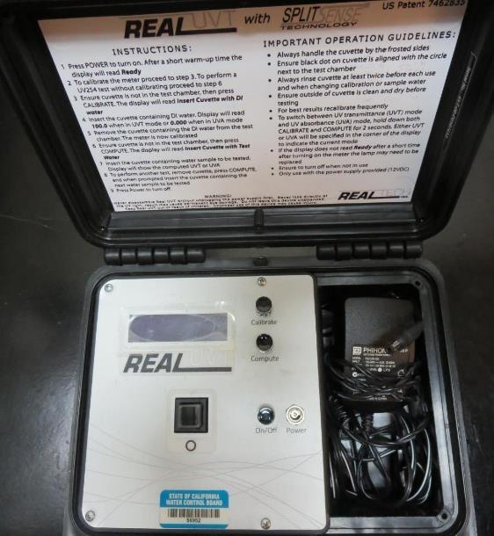
UVT/UVA, pathlength 10 mm
UV transmittance (UVT) is a measurement of the amount of ultraviolet light (commonly at 254 nm due to its germicidal effect) that passes through a water sample compared to the amount of light that passes through a pure water sample. The measurement is expressed as a percentage, % UVT.
%UVT = 10^{(-UVA)} x 100%
UV absorbance (UVA) is calculated as a relative measure of the amount of light absorbed by a water sample compared with the amount of light absorbed by a pure water sample.
UVA = -log(%UVT/100)

Slide 6
Applied Coagulants for Jar Testing (1)
Pro Pac 9800 (NTU Technologies)
50% Aluminum Chlorohydrate
50% Water
23.62% Al₂O₃
12.5% Al
83% Basicity
SG = 1.25-1.34
NSF limit: 250 mg/L as Product
10 mg/L as 9800 = Reduction 1.18 mg/L as CaCO₃
Pro Pac 9890 (NTU Technologies)
35-45% Aluminum Chlorohydrate
20% polyamine (50% water, 50% active polyamines)
35-45% Water
~18.9% Al₂O₃
~10.5% Al
83% Basicity
SG = 1.25-1.34
NSF limit: 50 mg/L as Product;
Product dose 10 mg/L = 1 mg/L polyamines active

Slide 7
Applied Coagulants for Jar Testing (2)
7% Acid Alum
36.48% Alum
3.25% Al
6.2% Al₂O₃
7% H₂SO₄
SG = 1.30
NSF limit: 450 mg/L as Product
Chemtrade
10 mg/L as Alum = Reduction 6.99 mg/L as CaCO₃ with H₂SO₄
NTU Technologies
CD313P Acrylamide Polymer (dry)
(NTU Technologies)
Cationic dry polymer
NSF limit: 1 mg/L as Product
Veolia Water Solutions
HYDREX 3523
Acrylamide Polymer (dry)
Anionic polymer
NSF limit: 1 mg/L as Product

Slide 8
Coagulant Information
Unless stated otherwise, all coagulant doses are reported as Product (100% strength). Ferric Chloride is reported as FeCl₃.
Preparation of coagulant stock solutions are generally 1.0 and/or 0.1 percent strength using 100 and/or 200 mL volumetric flasks.
Finnpipette F2 variable volume pipette, capacity 100-1000 micro liters is used for stock solution preparation and coagulant aid jar test dosing.
Finnpipette F2 variable volume pipette, capacity 0.5-5 mL is used for primary coagulant jar test dosing.

Slide 9
Source: Clear Lake : Jar Test 1-4 Results Flash 20 sec (200 RPM), Floc1 2 min (110 RPM), Floc2 3 min (60 RPM)
Jar # | 9800 mg/L | Ballast Sand @ Floc1 | AD313P mg/L @ Floc2 | Filtrate NTU | Filtrate %UVT | Filtrate UVA/cm | %UVA Reduction | Settle NTU 5 min
J1 | 70 | ½ tsp | 0 | 0.12 | 86.3 | 0.063 | 27.6 | 2.49
J2 | 70 | ½ tsp | 0.1 | 0.22 | 86.5 | 0.062 | 28.7 | 1.90
J3 | 70 | ½ tsp | 0.2 | 0.20 | 86.5 | 0.062 | 28.7 | 1.58
J4 | 70 | ½ tsp | 0.3 | 0.15 | 86.4 | 0.063 | 27.6 | 1.31

Slide 10
Source: Clear Lake : Jar Test 5-8 Results Flash 2 min (200 RPM), Floc1 2 min (110 RPM), Floc2 3 min (60 RPM)
Jar # | 9800 mg/L | Ballast Sand | 3523 mg/L | Filtrate NTU | Filtrate %UVT | Filtrate UVA/cm | %UVA Reduction | Settle NTU 5 min
J5 | 28 | 1 tsp | 0.3 | 0.41 | 84.7 | 0.072 | 17.2 | 8.7
J6 | 32 | 1 tsp | 0.3 | 0.45 | 84.6 | 0.072 | 17.2 | 7.3
J7 | 36 | 1 tsp | 0.3 | 0.44 | 84.7 | 0.072 | 17.2 | 8.2
J8 | 40 | 1 tsp | 0.3 | 0.41 | 85.1 | 0.070 | 19.5 | 6.5

Slide 11
Source: Clear Lake : Jar Test 9-16 Results Flash 2 min (200 RPM), Floc1 2 min (110 RPM), Floc2 2 min (60 RPM)
Jar # | 9800 mg/L | Ballast Sand | 3523 mg/L | Filtrate NTU | Filtrate %UVT | Filtrate UVA/cm | %UVA Reduction | Settle NTU 5 min
J9 | 45 | 1 tsp | 0.3 | 0.29 | 85.6 | 0.067 | 23.0 | 7.5
J10 | 50 | 1 tsp | 0.3 | 0.27 | 85.5 | 0.068 | 21.8 | 7.6
J11 | 55 | 1 tsp | 0.3 | 0.21 | 85.9 | 0.066 | 24.1 | 9.7
J12 | 60 | 1 tsp | 0.3 | 0.12 | 86.7 | 0.061 | 29.9 | 9.2
J13 | 65 | 1 tsp | 0.3 | 0.19 | 86.4 | 0.063 | 27.6 | 9.2
J14 | 65 | 1 tsp | 0.6 | 0.17 | 86.7 | 0.061 | 29.9 | 6.6
J15 | 65 | 1.5 tsp | 0.3 | 0.13 | 86.7 | 0.061 | 29.9 | 5.1
J16 | 65 | 1.5 tsp | 0.6 | 0.10 | 86.7 | 0.061 | 29.9 | 6.4

Slide 12
Source: Clear Lake : Jar Test 17-20 Results Flash 2 min (200 RPM), Floc1 2 min (110 RPM), Floc2 2 min (60 RPM)
Jar # | 9800 mg/L | 9890 mg/L | Ballast Sand | 3523 mg/L | Filtrate NTU | Filtrate %UVT | Filtrate UVA/cm | %UVA Reduction | Settle NTU 5 min
J17 | 70 | 0 | 1 tsp | 0.3 | 0.16 | 86.6 | 0.062 | 28.7 | 4.8
J18 | 70 | 2 | 1 tsp | 0.3 | 0.16 | 86.6 | 0.062 | 28.7 | 5.8
J19 | 70 | 4 | 1 tsp | 0.3 | 0.14 | 86.9 | 0.060 | 31.0 | 6.7
J20 | 70 | 6 | 1 tsp | 0.3 | 0.10 | 86.4 | 0.061 | 29.9 | 4.3

Slide 13
Source: Clear Lake : Jar Test 21-25 Results Flash 2 min (200 RPM), Floc1 2 min (110 RPM), Floc2 2 min (60 RPM)
Jar # | Alum Dry mg/L | H₂SO₄ mg/L | Ballast Sand | 3523 mg/L | Filtrate NTU | Filtrate %UVT | Filtrate UVA/cm | %UVA Reduction | Settle NTU 5 min
J21 | 80 | 15.4 | 1 tsp | 0.3 | 0.25 | 85.5 | 0.067 | 23.0 | 5.7
J22 | 90 | 17.3 | 1 tsp | 0.3 | 0.23 | 86.1 | 0.064 | 26.4 | 9.6
J23 | 100 | 19.2 | 1 tsp | 0.3 | 0.20 | 86.5 | 0.062 | 28.7 | 5.9
J24 | 110 | 21.1 | 1 tsp | 0.3 | 0.16 | 87.0 | 0.060 | 31.0 | 4.3
J25 | 140 | 26.9 | 1 tsp | 0.4 | 0.18 | 88.0 | 0.055 | 36.8 | 6.4

Slide 14
Source: Clear Lake : Jar Test 26-28 Results Flash 2 min (200 RPM), Floc1 2 min (110 RPM), Floc2 2 min (60 RPM)
Jar # | CTC-0011 mg/L | Ballast Sand | 3523 mg/L | Filtrate NTU | Filtrate %UVT | Filtrate UVA/cm | %UVA Reduction | Settle NTU 5 min
J26 | 160 | 1 tsp | 0.4 | 0.26 | 85.7 | 0.067 | 23.0 | 11.6
J27 | 180 | 1 tsp | 0.4 | 0.56 | 85.8 | 0.066 | 24.1 | 7.3
J28 | 200 | 1 tsp | 0.4 | 0.13 | 87.4 | 0.058 | 33.3 | 4.6

Slide 15
Source: Clear Lake : Jar Test 29-36 Results Flash 2 min (200 RPM), Floc1 2 min (110 RPM), Floc2 2 min (60 RPM)
Jar # | 9800 mg/L | 9890 mg/L | Ballast Sand | 3523 mg/L | Filtrate NTU | Filtrate %UVT | Filtrate UVA/cm | %UVA Reduction | Settle NTU 5 min
J29 | 80 | 0 | 0 tsp | 0 | 0.07 | 86.3 | 0.064 | 26.4 | 0.86
J30 | 100 | 6 | 0 tsp | 0 | 0.06 | 87.3 | 0.058 | 33.3 | 0.71
J31 | 80 | 6 | 0 tsp | 0 | 0.10 | 86.9 | 0.060 | 31.0 | 1.11
J32 | 100 | 6 | 0 tsp | 0 | 0.09 | 87.2 | 0.059 | 32.2 | 1.77
J33 | 110 | 6 | 1 tsp | 0.3 | 0.09 | 86.9 | 0.060 | 31.0 | 3.56
J34 | 120 | 6 | 1 tsp | 0.3 | 0.10 | 87.5 | 0.057 | 34.5 | 2.88
J35 | 130 | 6 | 1 tsp | 0.3 | 0.08 | 87.8 | 0.056 | 35.6 | 3.44
J36 | 130 | 0 | 1 tsp | 0.3 | 0.09 | 87.8 | 0.056 | 35.6 | 0.62

Slide 16
Jar Testing – Procedures for Actiflo, 1-Liter Jars
Fill jars with source water prior to coagulant injection and set paddle speed at 30 rpm
Add chemicals (i.e., NaOCl, primary coagulant, coagulant aid) to each jar
Start flash mix and hold for 2 minutes (200 rpm)
Add ballast sand and acrylamide polymer during flash mixing
Reduce paddled speed to 110 RPM for 2 minutes
Reduce paddle speed to 60 RPM for 2 minutes
Raise paddles out of water and settled for 1 minute
Syringe 25 mL from each jar taken 1-inch below surface (25 mL/12 sec rate)
Filtered through 1.2 um isopore membrane into cuvette (drip rate, 15 mL/90 sec)
Measure filtrate turbidity, chlorine residual and %UVT or UVA
Measure settled water turbidity after 5 minutes of total setting
Record all data

Slide 17
Jar Test Filterability Test Equipment
Turbidity Instrument
Syringe w/Luer-Lock Tip, 30 cc
(part#: 2225800, by Hach)
Swinnex Filter Holder, 25 mm (part#: SX0002500)
Isopore Membrane Filter, 1.2 um absolute
pore size,
Φ= 25 mm , thickness: 24 um,
hydrophilic polycarbonate membrane
(part #: RTTP02500)
Go to Sigma-Aldrich for laboratory supplies http://www.sigmaaldrich.com/united-states.html

Slide 18
Isopore Membrane Information
Categories | Information
trade name | Isopore
filter color | White
chemistry | Polycarbonate (PC)
water flow rate | Avg. 175 mL/min x cm² (typical results @ 10 psi)
media | Isopore®
wettability | Hydrophilic
porosity | 14.7%
pore size | 1.2 µm
bubble point at 23 °C | 1.0 bar, air with water
thickness | 24 µm
filter diameter (ø) | 25 mm
material size | polycarbonate, Hydrophilic, 1.2 µm, 25 mm, white, plain, 100

Slide 19
Isopore Membrane Background Information
The Isopore membrane is a polycarbonate, track-etched screen filter recommended for all analyses in which the sample is viewed on the surface of the membrane. The Isopore membrane is composed of polycarbonate film, which has a smooth, glass-like surface for clearer sample observation. The unique manufacturing process of the membrane ensures a precise pore diameter and a consistent pore size for accurate separation of samples by size. Matched-weight filters are not usually required because of low, constant tar and ash weights. Features & Benefits: Membrane structure retains particles on the surface, simplifying counting and analysis

Slide 20
Jar Test - Filterability Test
Syringe ~ 25 mL from jar (after 5-minutes of settling)
Filter-to-waste 3-5 mL
Filter directly into clean cuvette
Measure turbidity
Note: Take several readings before recording final NTU results. Micro bubbles can adhere to glass causing false NTU readings. To remove bubbles, tilt cuvette up to 90 degrees.

Slide 21
Contact
Guy Schott, P.E.
State Water Resources Control Board
Division of Drinking Water
Santa Rosa, CA
Go to Stock Solution/Dose calculations/Jar Test Results for tools to download
www.waterboards.ca.gov/drinking_water/programs/districts/mendocino_district.html
Email: Guy Schott - Guy.Schott@waterboards.ca.gov
Office Number: 707-576-2732

