Slide 1
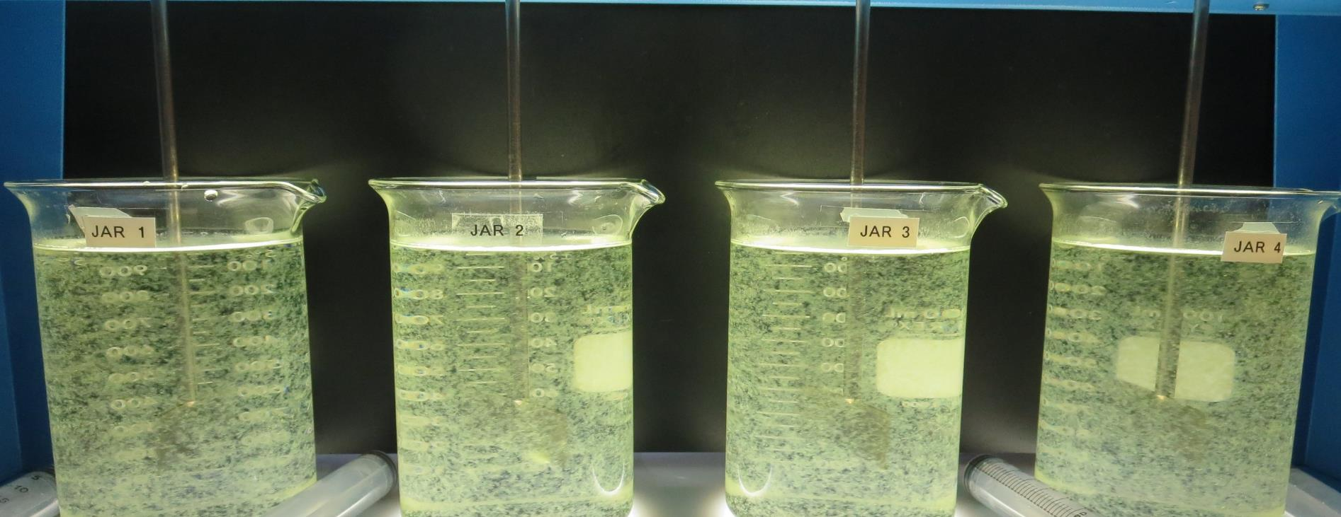
Clearlake Oaks CWD CA1710001 Lake County Jar Test
by Guy Schott, P.E.
July 20, 2021

Slide 2
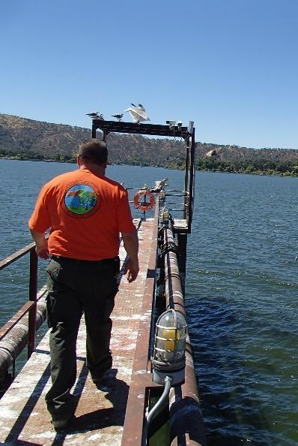
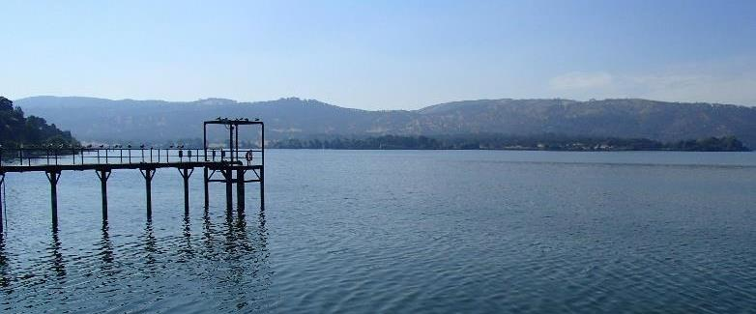
Clearlake Oaks CWD Source Water: Clear Lake Conventional Treatment

Slide 3
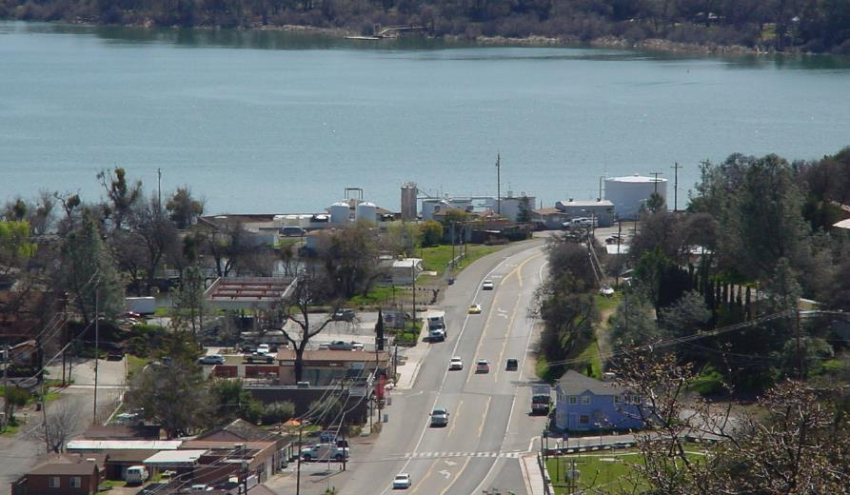
Conventional Treatment Plant

Slide 4
Clearlake Oaks CWD.: Source Water Characteristics July 20, 2021
Source
Post Ozone Sample
Turbidity: 10.5 NTU
UVT: 74.0%
UVA: 0.130/cm
0.4 um Filtered
Turbidity: 0.6 NTU
UVT: 84.0%
UVA: 0.074/cm

Slide 5
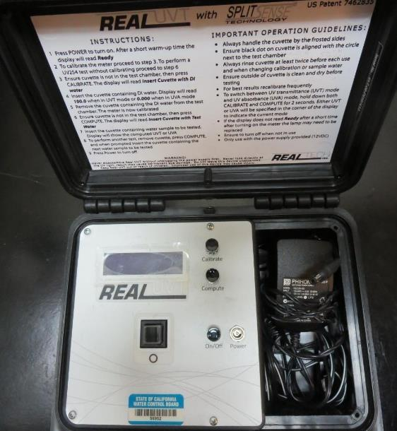
UVT/UVA, pathlength 10 mm
UV transmittance (UVT) is a measurement of the amount of ultraviolet light (commonly at 254 nm due to its germicidal effect) that passes through a water sample compared to the amount of light that passes through a pure water sample. The measurement is expressed as a percentage, % UVT.
%UVT = 10^{(-UVA)} x 100%
UV absorbance (UVA) is calculated as a relative measure of the amount of light absorbed by a water sample compared with the amount of light absorbed by a pure water sample.
UVA = -log(%UVT/100)

Slide 6
Applied Coagulants for Jar Testing (1)
Pro Pac 9800 (NTU Technologies)
50% Aluminum Chlorohydrate
50% Water
23.62% Al₂O₃
12.5% Al
83% Basicity
SG = 1.25-1.34
NSF limit: 250 mg/L as Product
10 mg/L as 9800 = Reduction 1.18 mg/L as CaCO₃
Pro Pac 9890 (NTU Technologies)
35-45% Aluminum Chlorohydrate
20% polyamine (50% water, 50% active polyamines)
35-45% Water
~18.9% Al₂O₃
~10.5% Al
83% Basicity
SG = 1.25-1.34
NSF limit: 50 mg/L as Product;
Product dose 10 mg/L = 1 mg/L polyamines active

Slide 7
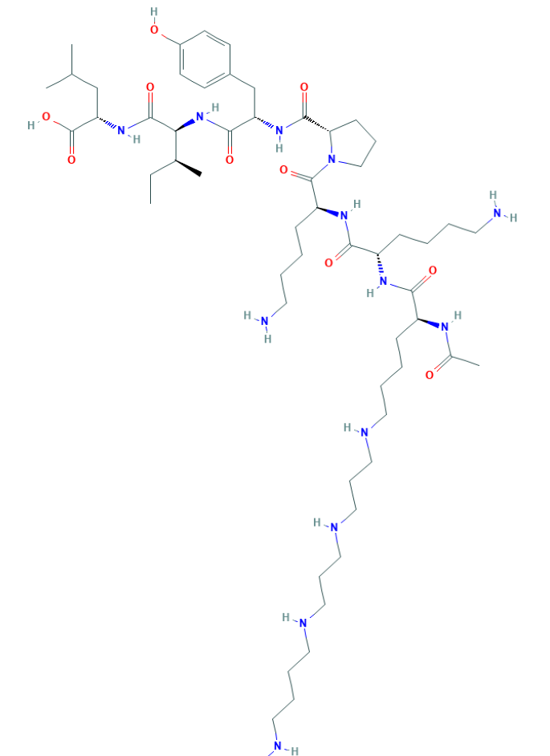
Polyamine C₅₉H₁₀₈N₁₄O₁₀ MW: 1,173.6 g/mol

Slide 8
Coagulant Information
Unless stated otherwise, all coagulant doses are reported as Product (100% strength). Alum Sulfate is reported as Alum.
Preparation of coagulant stock solutions are generally 1.0 and/or 0.1 percent strength using 100 and/or 200 mL volumetric flasks.
Finnpipette F2 variable volume pipette, capacity 100-1000 micro liters is used for stock solution preparation and coagulant aid jar test dosing.
Finnpipette F2 variable volume pipette, capacity 0.5-5 mL is used for primary coagulant jar test dosing.

Slide 9
Source: Clear Lake, Post Ozone; Jar Test 1 - 8 Results Flash Mix 200 RPM (30 sec); Floc Mix 30 RPM (5 min)
Jar# | 9800 mg/L | 9890 mg/L | Filtrate NTU | Filtrate %UVT | Filtrate UVA/cm | %UVA Reduction | Settle NTU 25 min
J1 | 50 | 15 | 0.11 | 90.2 | 0.044 | 40.5 | 0.36
J2 | 55 | 15 | 0.06 | 90.4 | 0.043 | 41.9 | 0.37
J3 | 60 | 15 | 0.06 | 90.6 | 0.042 | 43.2 | 0.36
J4 | 65 | 15 | 0.07 | 91.1 | 0.040 | 45.9 | 0.32
J5 | 60 | 8 | 0.05 | 90.8 | 0.041 | 44.6 | 0.48
J6 | 65 | 8 | 0.07 | 90.6 | 0.042 | 43.2 | 0.39
J7 | 70 | 8 | 0.05 | 90.8 | 0.041 | 44.6 | 0.37
J8 | 75 | 8 | 0.06 | 90.7 | 0.042 | 43.2 | 0.35

Slide 10
Source: Clear Lake, Post Ozone; Jar Test 9 - 16 Results Flash Mix 200 RPM (30 sec); Floc Mix 30 RPM (5 min)
Jar# | 9800 mg/L | 9890 mg/L | Filtrate NTU | Filtrate %UVT | Filtrate UVA/cm | %UVA Reduction | Settle NTU 25 min
J9 | 60 | 4 | 0.06 | 90.4 | 0.043 | 41.9 | 0.51
J10 | 65 | 4 | 0.06 | 90.5 | 0.043 | 41.9 | 0.33
J11 | 70 | 4 | 0.06 | 90.8 | 0.041 | 44.6 | 0.38
J12 | 75 | 4 | 0.06 | 90.9 | 0.041 | 44.6 | 0.34
J13 | 60 | 0 | 0.17 | 89.8 | 0.046 | 37.8 | 0.65
J14 | 65 | 0 | 0.10 | 90.2 | 0.044 | 40.5 | 0.40
J15 | 70 | 0 | 0.10 | 90.2 | 0.044 | 40.5 | 0.48
J16 | 75 | 0 | 0.07 | 90.5 | 0.043 | 41.9 | 0.77

Slide 11
Jars 1-4 Test Flash Mix 30 Sec (200 RPM) Floc Mix 5 min (30 RPM) Post Ozone Applied Coagulants 9800/9890

Slide 12
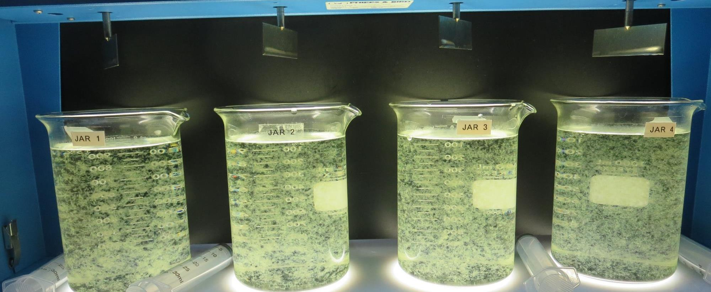
Jars 1-4: End of 5-minute flocculation (30 RPM) duration.
50 mg/L 9800
15 mg/L 9890
Filtrate 0.11 NTU
UVT: 90.2%
UVA: 0.044/cm
UVA Reduction: 40.5%
Settled: 0.36 NTU
55 mg/L 9800
15 mg/L 9890
Filtrate 0.06 NTU
UVT: 90.4%
UVA: 0.043/cm
UVA Reduction: 41.9%
Settled: 0.37 NTU
60 mg/L 9800
15 mg/L 9890
Filtrate 0.06 NTU
UVT: 90.6%
UVA: 0.042/cm
UVA Reduction: 41.9%
Settled: 0.36 NTU
65 mg/L 9800
15 mg/L 9890
Filtrate 0.07 NTU
UVT: 91.1%
UVA: 0.040/cm
UVA Reduction: 45.9%
Settled: 0.32 NTU

Slide 13
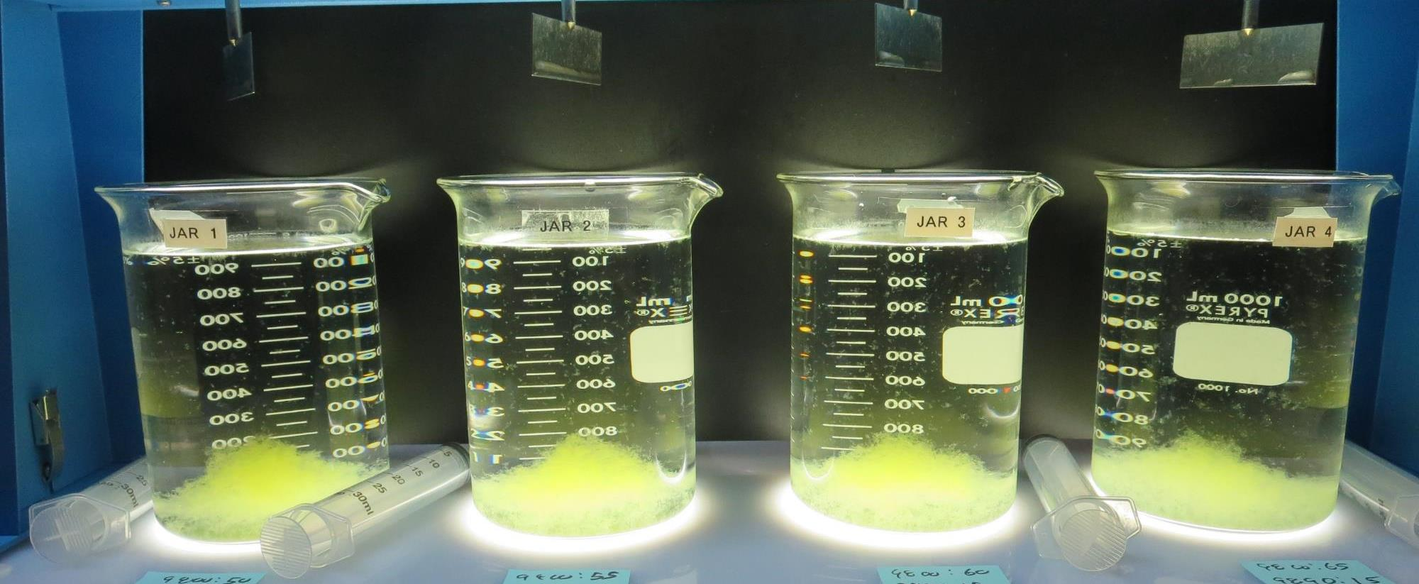
Jars 1-4: After 5 min of settling, 25 mL is syringed for filterability and %UVT/UVA.

Slide 14
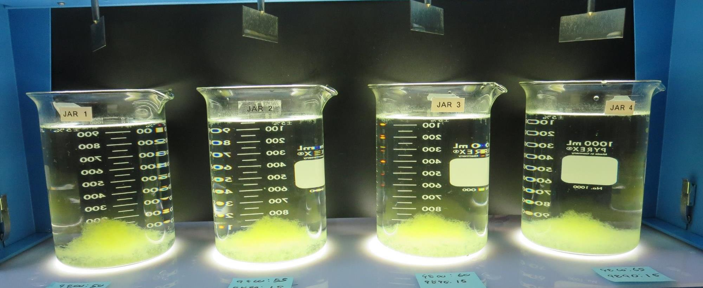
Jars 1-4: After 25-minutes of settling, settled water turbidity is taken.
50 mg/L 9800
15 mg/L 9890
Filtrate 0.11 NTU
UVT: 90.2%
UVA: 0.044/cm
UVA Reduction: 40.5%
Settled: 0.36 NTU
55 mg/L 9800
15 mg/L 9890
Filtrate 0.06 NTU
UVT: 90.4%
UVA: 0.043/cm
UVA Reduction: 41.9%
Settled: 0.37 NTU
60 mg/L 9800
15 mg/L 9890
Filtrate 0.06 NTU
UVT: 90.6%
UVA: 0.042/cm
UVA Reduction: 41.9%
Settled: 0.36 NTU
65 mg/L 9800
15 mg/L 9890
Filtrate 0.07 NTU
UVT: 91.1%
UVA: 0.040/cm
UVA Reduction: 45.9%
Settled: 0.32 NTU

Slide 15
Jars 5-8 Test Flash Mix 30 Sec (200 RPM) Floc Mix 5 min (30 RPM) Post Ozone Applied Coagulants 9800/9890

Slide 16
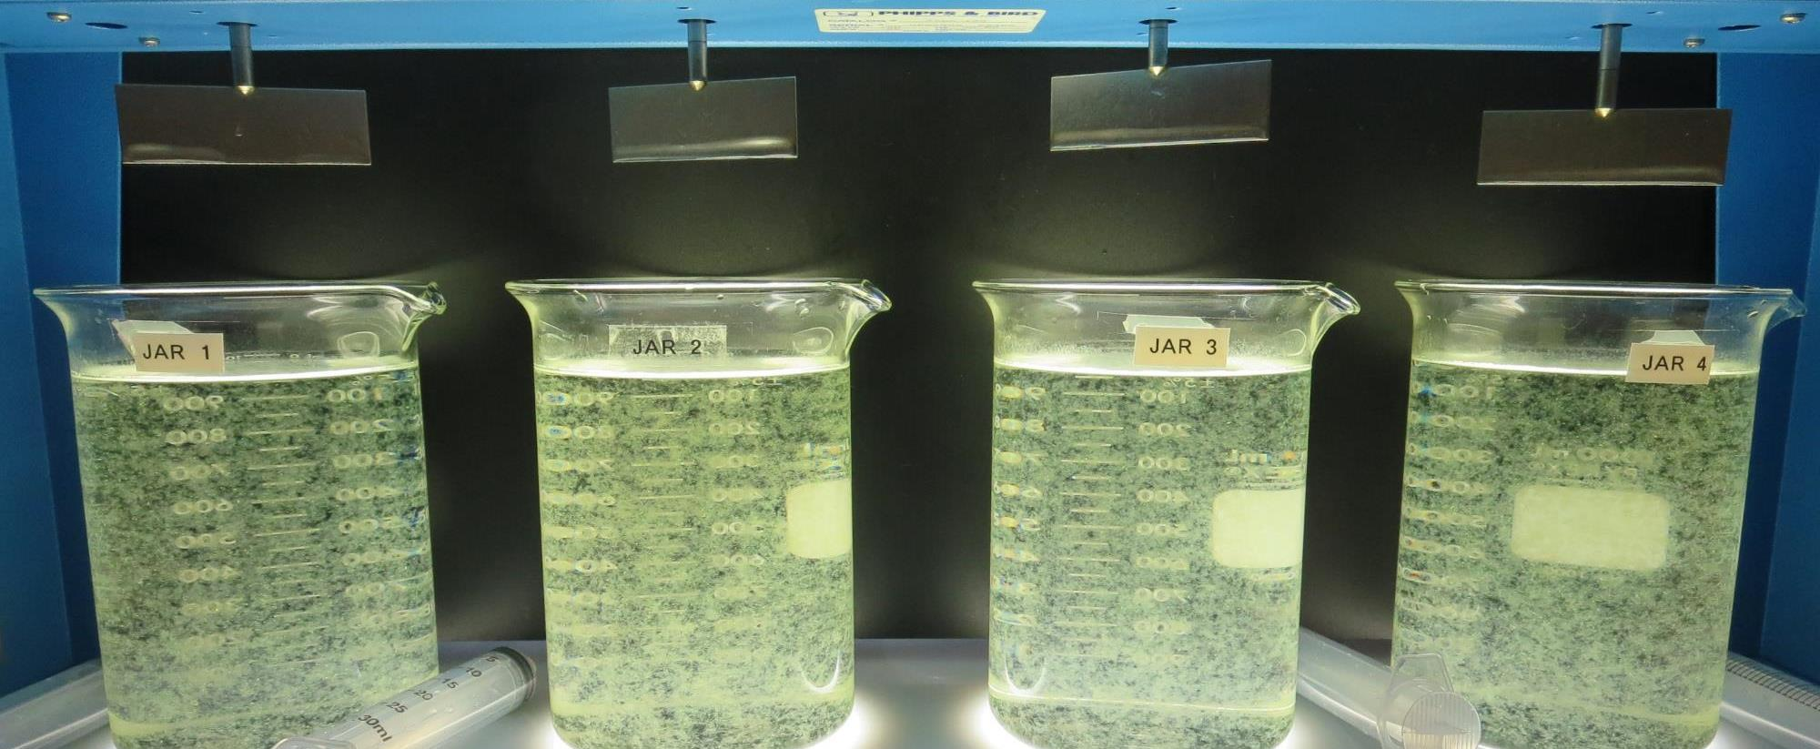
Jars 5-8: End of 5-minute flocculation (30 RPM) duration.
60 mg/L 9800
8 mg/L 9890
Filtrate 0.05 NTU
UVT: 90.8%
UVA: 0.041/cm
UVA Reduction: 44.6%
Settled: 0.48 NTU
65 mg/L 9800
8 mg/L 9890
Filtrate 0.07 NTU
UVT: 90.6%
UVA: 0.042/cm
UVA Reduction: 43.2%
Settled: 0.39 NTU
70 mg/L 9800
8 mg/L 9890
Filtrate 0.05 NTU
UVT: 90.8%
UVA: 0.041/cm
UVA Reduction: 44.6%
Settled: 0.37 NTU
75 mg/L 9800
8 mg/L 9890
Filtrate 0.06 NTU
UVT: 90.7%
UVA: 0.042/cm
UVA Reduction: 43.2%
Settled: 0.35 NTU

Slide 17
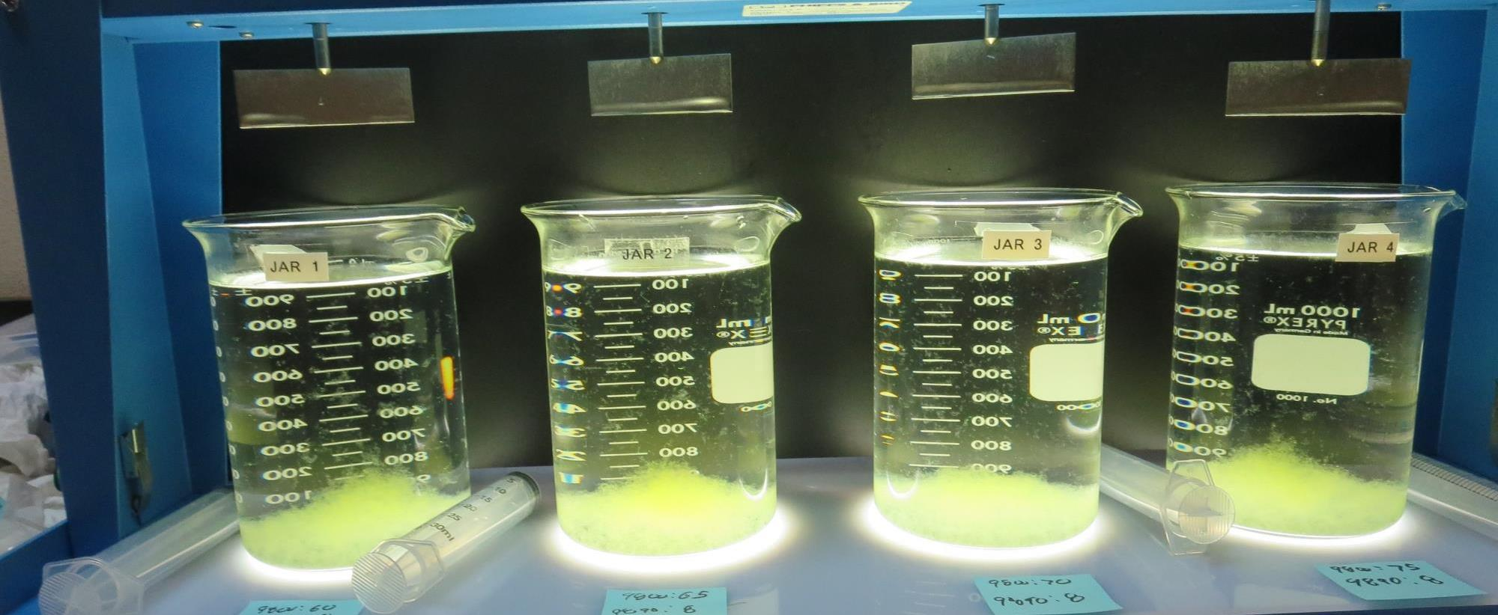
Jars 5-8: After 5 min of settling, 25 mL is syringed for filterability and %UVT/UVA.

Slide 18
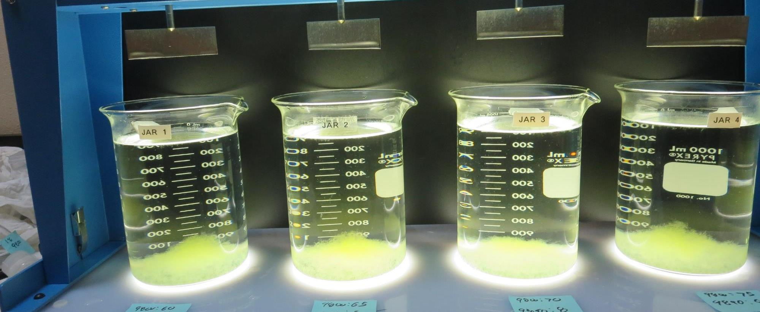
Jars 5-8: After 25-minutes of settling, settled water turbidity is taken.
60 mg/L 9800
8 mg/L 9890
Filtrate 0.05 NTU
UVT: 90.8%
UVA: 0.041/cm
UVA Reduction: 44.6%
Settled: 0.48 NTU
65 mg/L 9800
8 mg/L 9890
Filtrate 0.07 NTU
UVT: 90.6%
UVA: 0.042/cm
UVA Reduction: 43.2%
Settled: 0.39 NTU
70 mg/L 9800
8 mg/L 9890
Filtrate 0.05 NTU
UVT: 90.8%
UVA: 0.041/cm
UVA Reduction: 44.6%
Settled: 0.37 NTU
75 mg/L 9800
8 mg/L 9890
Filtrate 0.06 NTU
UVT: 90.7%
UVA: 0.042/cm
UVA Reduction: 43.2%
Settled: 0.35 NTU

Slide 19
Jars 9-12 Test Flash Mix 30 Sec (200 RPM) Floc Mix 5 min (30 RPM) Post Ozone Applied Coagulants 9800/9890

Slide 20
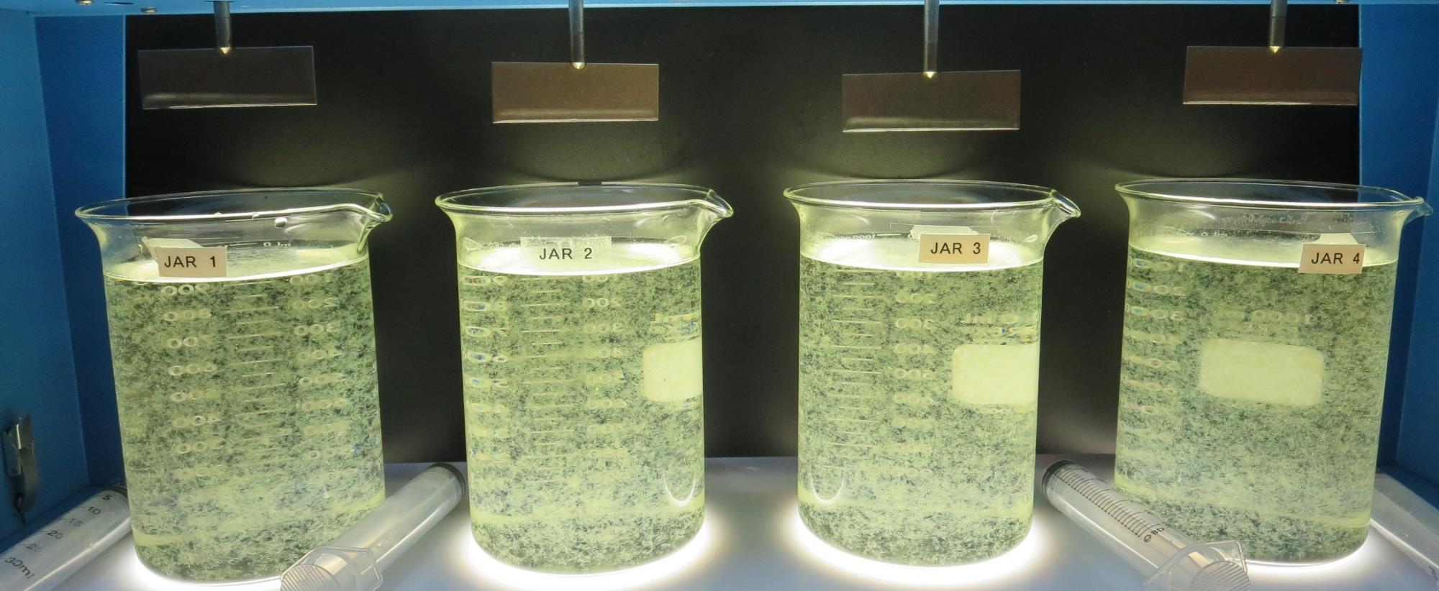
Jars 9-12: End of 5-minute flocculation (30 RPM) duration.
60 mg/L 9800
4 mg/L 9890
Filtrate 0.06 NTU
UVT: 90.4%
UVA: 0.043/cm
UVA Reduction: 41.9%
Settled: 0.51 NTU
65 mg/L 9800
4 mg/L 9890
Filtrate 0.06 NTU
UVT: 90.5%
UVA: 0.043/cm
UVA Reduction: 41.9%
Settled: 0.33 NTU
70 mg/L 9800
4 mg/L 9890
Filtrate 0.06 NTU
UVT: 90.8%
UVA: 0.041/cm
UVA Reduction: 44.6%
Settled: 0.38 NTU
75 mg/L 9800
4 mg/L 9890
Filtrate 0.06 NTU
UVT: 90.9%
UVA: 0.041/cm
UVA Reduction: 44.6%
Settled: 0.34 NTU

Slide 21
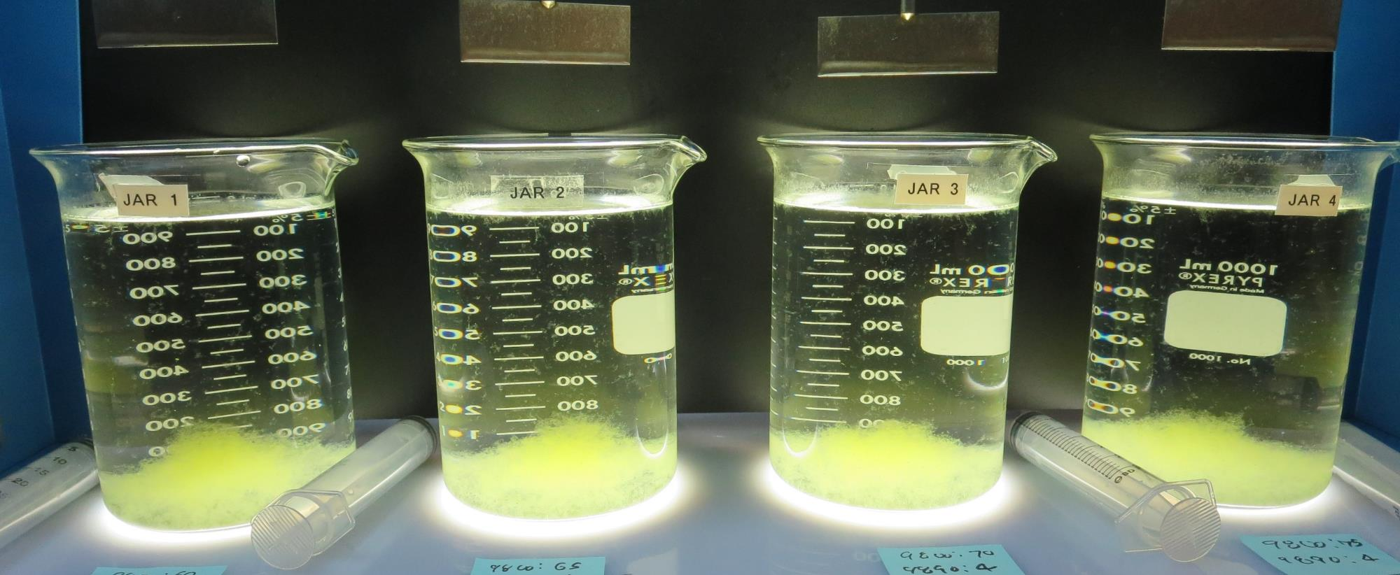
Jars 9-12: After 5 min of settling, 25 mL is syringed for filterability and %UVT/UVA.

Slide 22
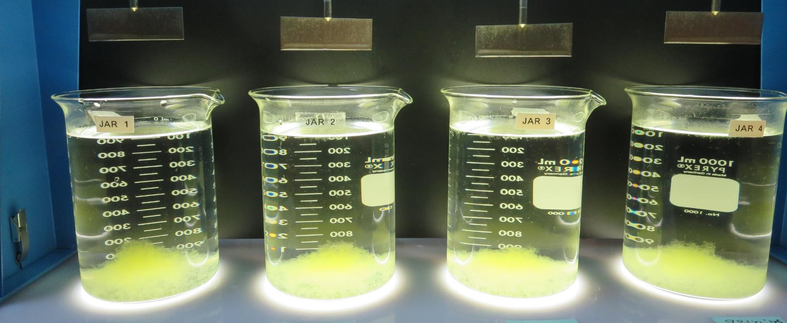
Jars 9-12: After 25-minutes of settling, settled water turbidity is taken.
60 mg/L 9800
4 mg/L 9890
Filtrate 0.06 NTU
UVT: 90.4%
UVA: 0.043/cm
UVA Reduction: 41.9%
Settled: 0.51 NTU
65 mg/L 9800
4 mg/L 9890
Filtrate 0.06 NTU
UVT: 90.5%
UVA: 0.043/cm
UVA Reduction: 41.9%
Settled: 0.33 NTU
70 mg/L 9800
4 mg/L 9890
Filtrate 0.06 NTU
UVT: 90.8%
UVA: 0.041/cm
UVA Reduction: 44.6%
Settled: 0.38 NTU
75 mg/L 9800
4 mg/L 9890
Filtrate 0.06 NTU
UVT: 90.9%
UVA: 0.041/cm
UVA Reduction: 44.6%
Settled: 0.34 NTU

Slide 23
Jars 13-16 Test Flash Mix 30 Sec (200 RPM) Floc Mix 5 min (30 RPM) Post Ozone Applied Coagulant 9800

Slide 24
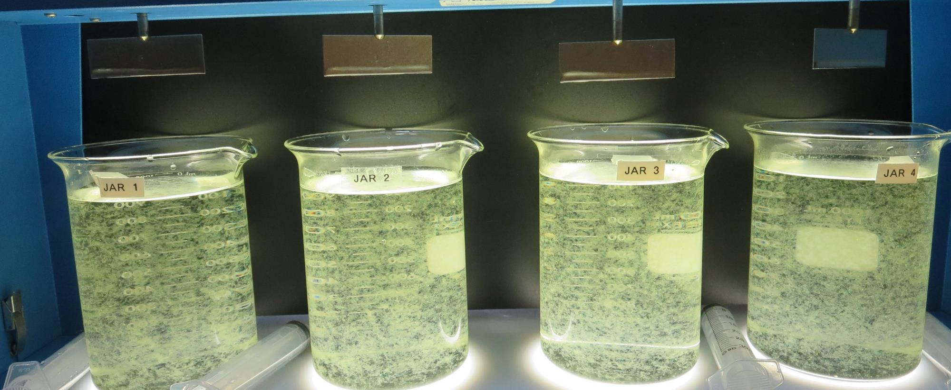
Jars 13-16: End of 5-minute flocculation (30 RPM) duration.
60 mg/L 9800
Filtrate 0.17 NTU
UVT: 89.8%
UVA: 0.046/cm
UVA Reduction: 37.8%
Settled: 0.65 NTU
65 mg/L 9800
Filtrate 0.10 NTU
UVT: 90.2%
UVA: 0.044/cm
UVA Reduction: 40.5%
Settled: 0.40 NTU
70 mg/L 9800
Filtrate 0.10 NTU
UVT: 90.2%
UVA: 0.044/cm
UVA Reduction: 40.5%
Settled: 0.48 NTU
75 mg/L 9800
Filtrate 0.07 NTU
UVT: 90.5%
UVA: 0.043/cm
UVA Reduction: 41.9%
Settled: 0.77 NTU

Slide 25
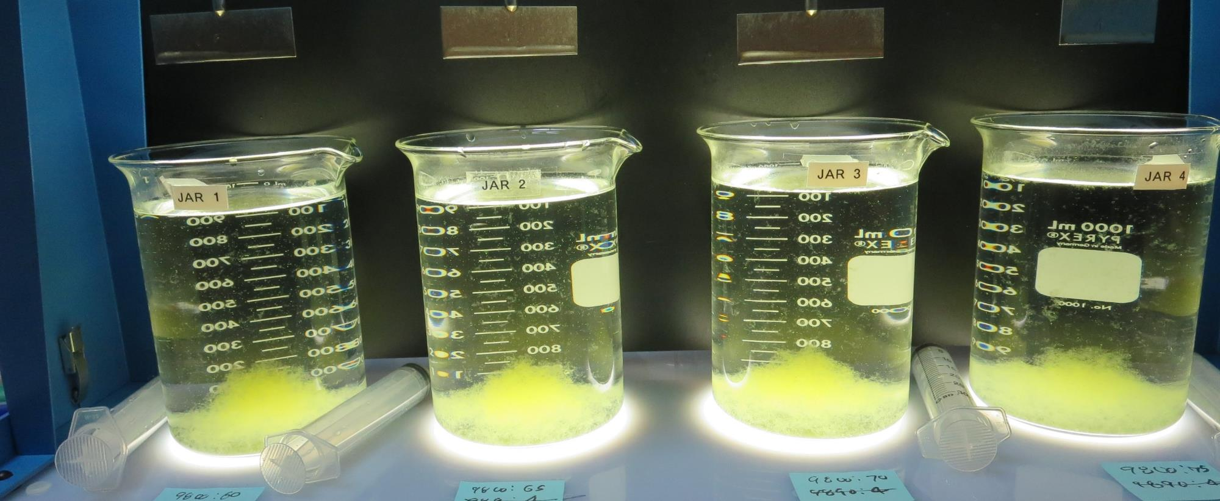
Jars 13-16: After 5 min of settling, 25 mL is syringed for filterability and %UVT/UVA.

Slide 26
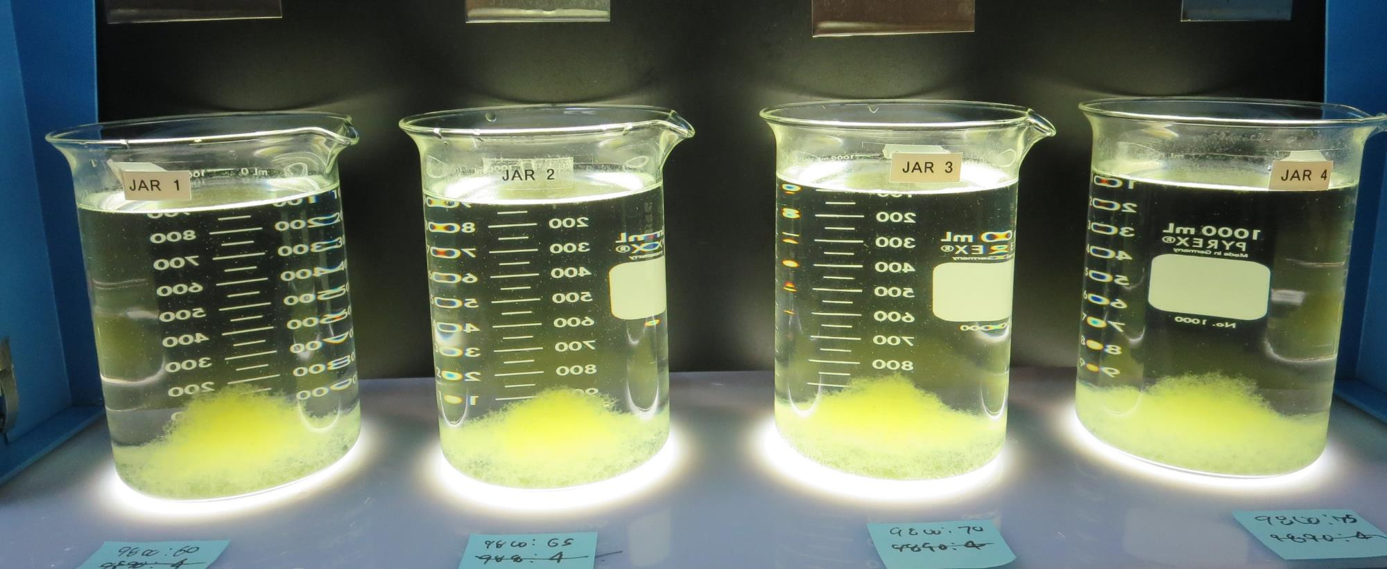
Jars 13-16: After 25-minutes of settling, settled water turbidity is taken.
60 mg/L 9800
Filtrate 0.17 NTU
UVT: 89.8%
UVA: 0.046/cm
UVA Reduction: 37.8%
Settled: 0.65 NTU
65 mg/L 9800
Filtrate 0.10 NTU
UVT: 90.2%
UVA: 0.044/cm
UVA Reduction: 40.5%
Settled: 0.40 NTU
70 mg/L 9800
Filtrate 0.10 NTU
UVT: 90.2%
UVA: 0.044/cm
UVA Reduction: 40.5%
Settled: 0.48 NTU
75 mg/L 9800
Filtrate 0.07 NTU
UVT: 90.5%
UVA: 0.043/cm
UVA Reduction: 41.9%
Settled: 0.77 NTU

Slide 27
Jar Testing for 1-Liter Jars: Procedures for Most Treatment Plants
Fill jars with source water prior to coagulant injection and set paddle speed at 30 rpm
Add chemicals (i.e., NaOCl, primary coagulant, coagulant aid) to each jar
Flash mix for 15-30 seconds (200 rpm)
Slow mix for 5 minutes (20-30 rpm)
Settled for 5 minutes. Syringe 25 mL from each jar taken 1-inch below surface (25 mL/12 sec rate)
Filtered through 1.2 um isopore membrane into cuvette drip rate, 15 mL/(50-90 sec)
Measure filtrate turbidity, chlorine residual and %UVT/UVA
Measure settled water turbidity after 25 minutes of total setting
Record all data

Slide 28
Jar Test Filterability Test Equipment
Turbidity Instrument
Syringe w/Luer-Lock Tip, 30 cc
(part#: 2225800, by Hach)
Swinnex Filter Holder, 25 mm (part#: SX0002500)
Isopore Membrane Filter, 1.2 um absolute
pore size,
Φ= 25 mm , thickness: 24 um,
hydrophilic polycarbonate membrane
(part #: RTTP02500)
Go to Sigma-Aldrich for laboratory supplies http://www.sigmaaldrich.com/united-states.html

Slide 29
Isopore Membrane Information
Categories | Information
trade name | Isopore
filter color | White
chemistry | Polycarbonate (PC)
water flow rate | Avg. 175 mL/min x cm² (typical results @ 10 psi)
media | Isopore®
wettability | Hydrophilic
porosity | 14.7%
pore size | 1.2 µm
bubble point at 23 °C | 1.0 bar, air with water
thickness | 24 µm
filter diameter (ø) | 25 mm
material size | polycarbonate, Hydrophilic, 1.2 µm, 25 mm, white, plain, 100

Slide 30
Isopore Membrane Background Information
The Isopore membrane is a polycarbonate, track-etched screen filter recommended for all analyses in which the sample is viewed on the surface of the membrane. The Isopore membrane is composed of polycarbonate film, which has a smooth, glass-like surface for clearer sample observation. The unique manufacturing process of the membrane ensures a precise pore diameter and a consistent pore size for accurate separation of samples by size. Matched-weight filters are not usually required because of low, constant tar and ash weights. Features & Benefits: Membrane structure retains particles on the surface, simplifying counting and analysis

Slide 31
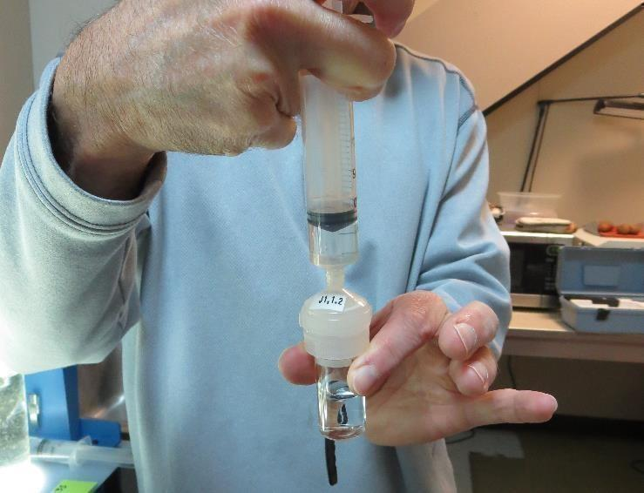
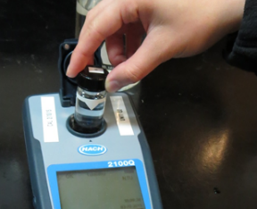
Jar Test - Filterability Test
Syringe ~ 25 mL from jar (after 5-minutes of settling)
Filter-to-waste 3-5 mL
Filter directly into clean cuvette
Measure turbidity
Note: Take several readings before recording final NTU results. Micro bubbles can adhere to glass causing false NTU readings. To remove bubbles, tilt cuvette up to 90 degrees.

Slide 32
Contact
Guy Schott, P.E.
State Water Resources Control Board
Division of Drinking Water
Santa Rosa, CA
Go to Stock Solution/Dose calculations/Jar Test Results for tools to download
www.waterboards.ca.gov/drinking_water/programs/districts/mendocino_district.html
Email: Guy Schott - Guy.Schott@waterboards.ca.gov
Office Number: 707-576-2732

