Slide 1
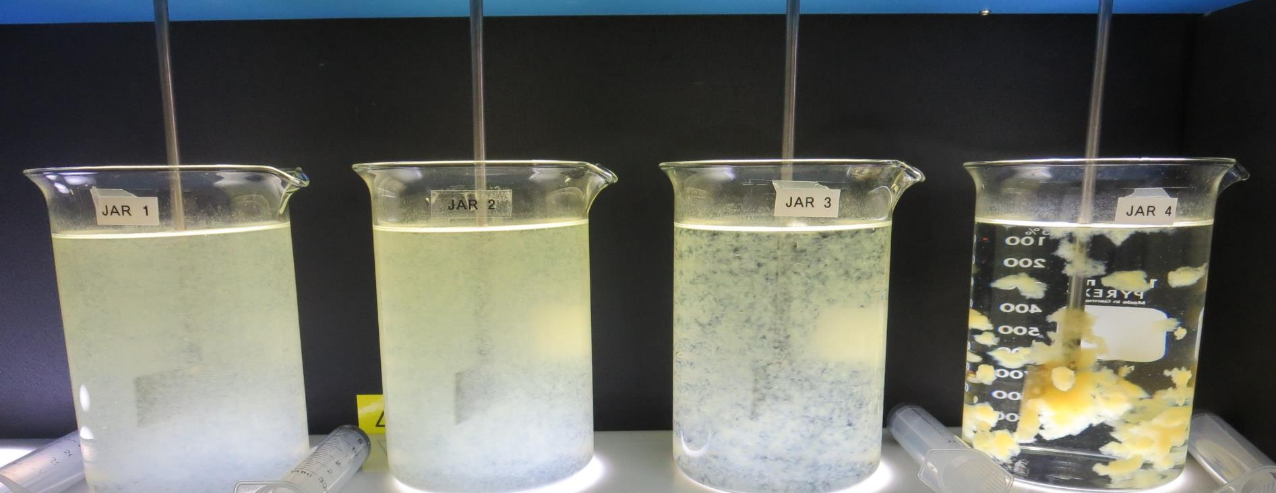
Konocti County Water District CA1710006, Lake County, Jar Test
by Guy Schott, P.E. September 13, 2021

Slide 2
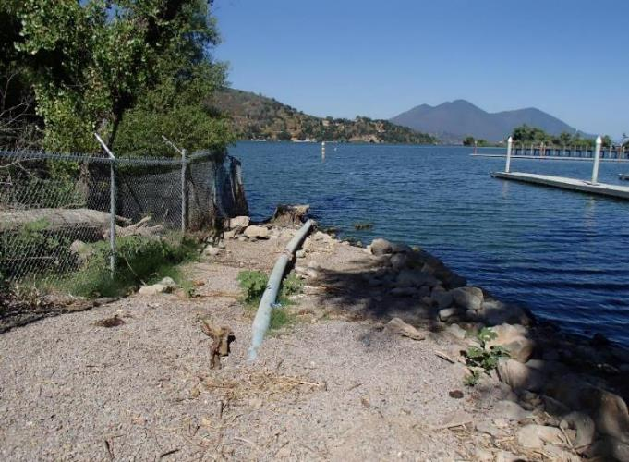
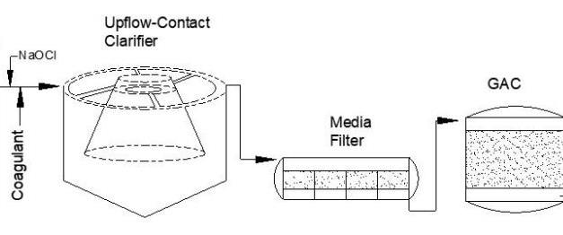
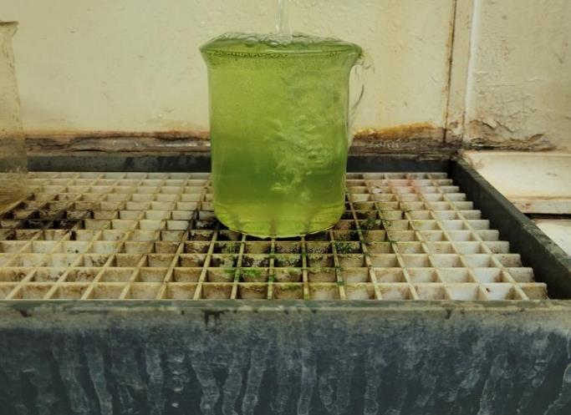
Konocti County Water District Source Water: Clear Lake Conventional Treatment

Slide 3
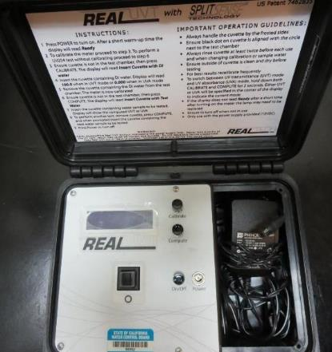
UVT/UVA, pathlength 10 mm
UV transmittance (UVT) is a measurement of the amount of ultraviolet light (254 nm) that passes through a water sample compared to the amount of light that passes through a pure water sample. The measurement is expressed as % UVT.
%UVT = 10^{(-UVA)} x 100%
UV absorbance (UVA) is calculated as a relative measure of the amount of light absorbed by a water sample compared with the amount of light absorbed by a pure water sample.
UVA = -log(%UVT/100)

Slide 4
Konocti CWD Source & Treated Water Characteristics, June 3, 2021
Source (post KMnO4 & Cl2)
pH: 9.13
Turbidity: 34 NTU
UVT: 47.8%,
UVA: 0.154/cm
0.4 um Filtered
Turbidity: 2.2 NTU
UVT: 70.1%,
UVA: 0.154/cm
Plant Filtrate Water
~0.40 NTU

Slide 5
Applied Coagulants for Jar Testing (1)
Pro Pac 9800 (NTU Technologies)
50% Aluminum Chlorohydrate
50% Water
23.62% Al₂O₃
12.5% Al
83% Basicity
SG = 1.25-1.34
NSF limit: 250 mg/L as Product
10 mg/L as 9800 = Reduction 1.18 mg/L as CaCO₃
Pro Pac 9890 (NTU Technologies)
35-45% Aluminum Chlorohydrate
20% polyamine (50% water, 50% active polyamines)
35-45% Water
~18.9% Al₂O₃
~10.5% Al
83% Basicity
SG = 1.25-1.34
NSF limit: 50 mg/L as Product;
Product dose 10 mg/L = 1 mg/L polyamines active

Slide 6
Applied Coagulants for Jar Testing (2)
Brenntag (559-485-4150)
Solenis
Praestol 186K
SG = 1.0 – 1.2
Viscosity: 60-180 centipoise
MW: 150,00 g/moles
pDADMAC (20% active, 80% H₂O)
NSF limit: 50 mg/L (product)
Product dose 5 mg/L = 1 mg/L pDADMAC active

Slide 7
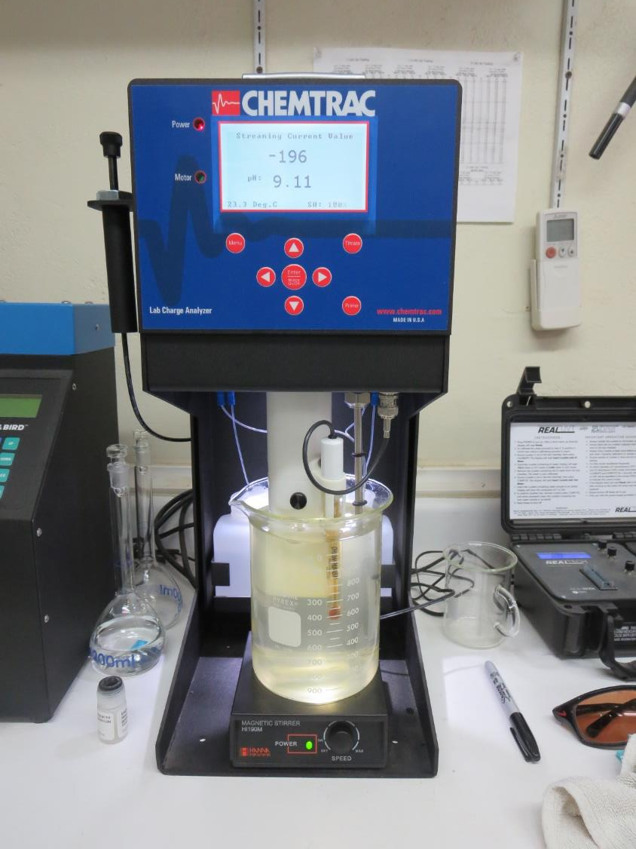
Laboratory Charge Analyzer
LCA: Used to determine coagulant demand of a source water entering the treatment plant.
pH adjusted to 7.70 with acetic acid
Source pH: 9.13
LCA #2: 9800: 123 mg/L as product
LCA #2:
186K: 10 mg/L as product (manually added)
9800: 95 mg/L as product
LCA #3:
9890: 15 mg/L as product (manually added)
9800: 92 mg/L as product

Slide 8
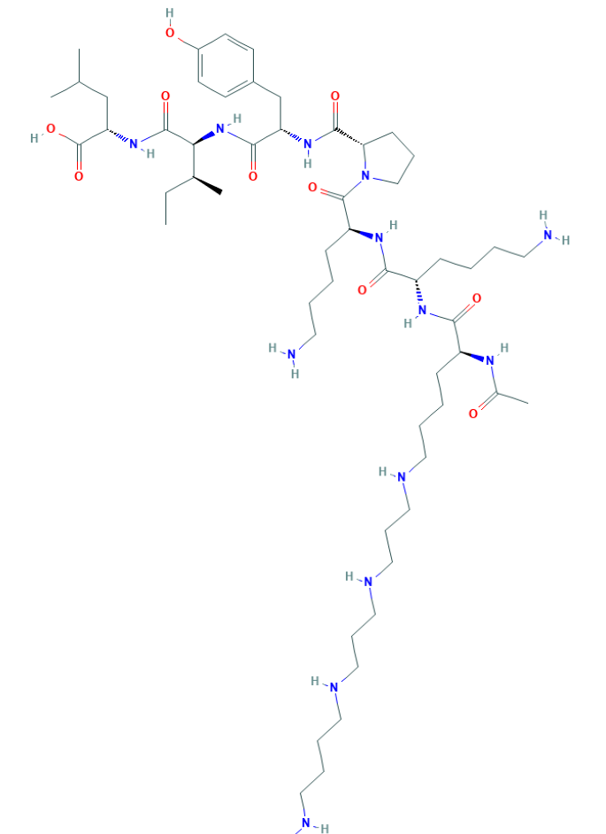
Polyamine C₅₉H₁₀₈N₁₄O₁₀ MW: 1,173.6 g/mol

Slide 9
Diallyldimethylammonium chloride or N-allyl-N,N-dimethylprop-2-en-1-aminium chloride pDADMAC C₈H₁₆ClN MW: 161.67 g/mol
CH₃
CH₂
CH₂
CH
N
+
CH
CH₂
CH₂
CH₃
Cl⁻

Slide 10
Coagulant Information
Unless stated otherwise, all coagulant doses are reported as Product (100% strength).
Aluminum Sulfate doses are reported as hydrated Al₂(SO₄)₃*14.3H₂0.
Preparation of coagulant stock solutions are generally 1.0 and/or 0.1 percent strength using 100 and/or 200 mL volumetric flasks.
Finnpipette F2 variable volume pipette, capacity 100-1000 micro liters is used for stock solution preparation and coagulant aid jar test dosing.
Finnpipette F2 variable volume pipette, capacity 0.5-5 mL is used for primary coagulant jar test dosing.

Slide 11
Konocti CWD; Jar Test 1 - 8 Results Flash Mix 200 RPM (20 sec); Floc Mix 30 RPM (5 min)
Jar# | HCl mg/L | 9800 mg/L | 9890 mg/L | 186K mg/L | Filtrate NTU | Filtrate %UVT | Filtrate UVA/cm | %UVA Reduction | Settle NTU 25 min
J1 | 8 | 90 | 15 | 0 | 0.18 | 85.8 | 0.067 | 56.9 | 0.91
J2 | 8 | 100 | 15 | 0 | 0.19 | 85.5 | 0.068 | 55.9 | 1.27
J3 | 8 | 110 | 15 | 0 | 0.10 | 86.2 | 0.065 | 58.0 | 0.40
J4 | 8 | 120 | 15 | 0 | 0.09 | 86.3 | 0.064 | 58.6 | 0.44
J5 | 8 | 120 | 15 | 0 | 0.29 | 85.8 | 0.066 | 57.0 | 1.31
J6 | 8 | 130 | 15 | 0 | 0.19 | 86.0 | 0.065 | 57.6 | 1.25
J7 | 8 | 140 | 15 | 0 | 0.08 | 86.8 | 0.062 | 60.0 | 1.10
J8 | 8 | 120 | 0 | 10 | 0.06 | 86.0 | 0.066 | 57.5 | 0.47

Slide 12
Jars 1-4 Test Flash Mix 20 Sec (200 RPM) Floc Mix 5 min (30 RPM) Post-Oxidation KMnO₄ HCl + Applied Coagulants 9800/9890

Slide 13
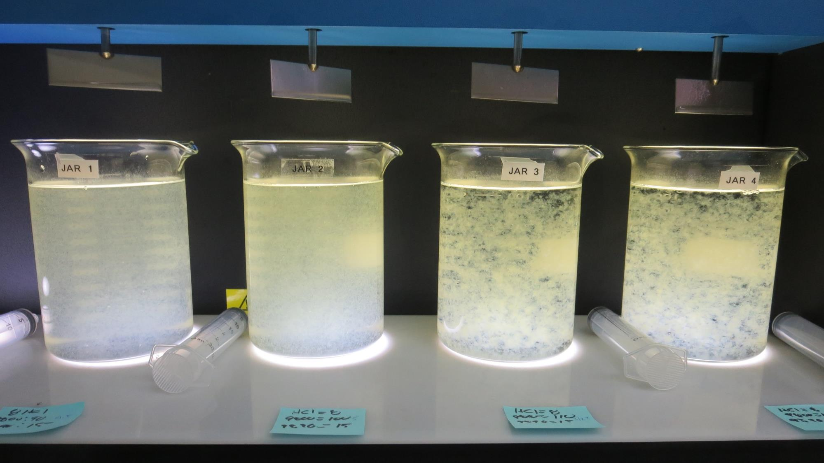
Jars 1-4: End of 5-minute flocculation (30 RPM) duration.
8 mg/L HCl
90 mg/L 9800
15 mg/L 9890
Filtrate 0.18 NTU
UVT: 85.8%
UVA: 0.067/cm
UVA Reduction: 56.9%
Settled: 0.91 NTU
8 mg/L HCl
100 mg/L 9800
15 mg/L 9890
Filtrate 0.19 NTU
UVT: 85.5%
UVA: 0.068/cm
UVA Reduction: 55.9%
Settled: 1.2 NTU
8 mg/L HCl
110 mg/L 9800
15 mg/L 9890
Filtrate 0.10 NTU
UVT: 86.2%
UVA: 0.065/cm
UVA Reduction: 58.0%
Settled: 0.40 NTU
8 mg/L HCl
120 mg/L 9800
15 mg/L 9890
Filtrate 0.09 NTU
UVT: 86.3%
UVA: 0.064/cm
UVA Reduction: 58.6%
Settled: 0.44 NTU

Slide 14
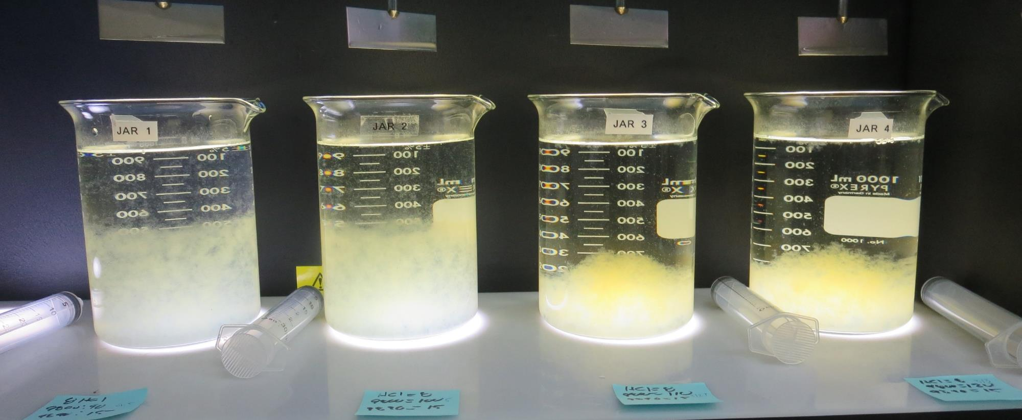
Jars 1-4: After 5 min of settling, 25 mL is syringed for filterability and %UVT/UVA.

Slide 15
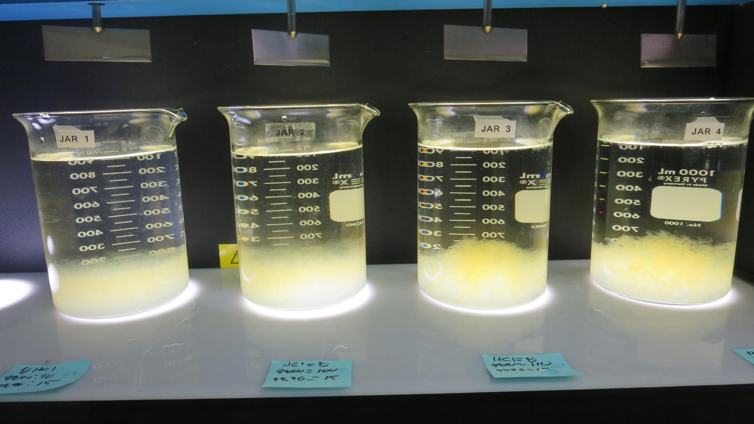
Jars 1-4: After 25-minutes of settling, settled water turbidity is taken.
8 mg/L HCl
90 mg/L 9800
15 mg/L 9890
Filtrate 0.18 NTU
UVT: 85.8%
UVA: 0.067/cm
UVA Reduction: 56.9%
Settled: 0.91 NTU
8 mg/L HCl
100 mg/L 9800
15 mg/L 9890
Filtrate 0.19 NTU
UVT: 85.5%
UVA: 0.068/cm
UVA Reduction: 55.9%
Settled: 1.2 NTU
8 mg/L HCl
110 mg/L 9800
15 mg/L 9890
Filtrate 0.10 NTU
UVT: 86.2%
UVA: 0.065/cm
UVA Reduction: 58.0%
Settled: 0.40 NTU
8 mg/L HCl
120 mg/L 9800
15 mg/L 9890
Filtrate 0.09 NTU
UVT: 86.3%
UVA: 0.064/cm
UVA Reduction: 58.6%
Settled: 0.44 NTU

Slide 16
Jars 5-8 Test Flash Mix 20 Sec (200 RPM) Floc Mix 5 min (30 RPM) Post-Oxidation KMnO₄ HCl + Applied Coagulants 9800/9890/186KH

Slide 17
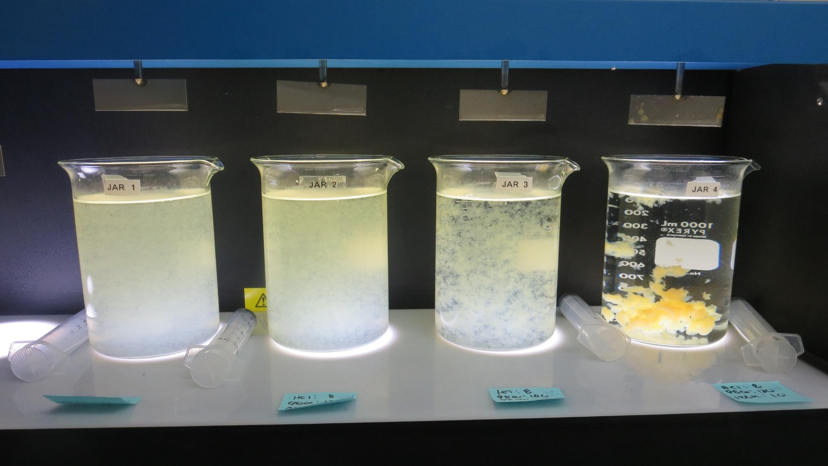
Jars 5-8: End of 5-minute flocculation (30 RPM) duration.
8 mg/L HCl
120 mg/L 9800
15 mg/L 9890
Filtrate 0.29 NTU
UVT: 85.8%
UVA: 0.066/cm
UVA Reduction: 57.0%
Settled: 1.3 NTU
8 mg/L HCl
130 mg/L 9800
15 mg/L 9890
Filtrate 0.19 NTU
UVT: 86.0%
UVA: 0.065/cm
UVA Reduction: 57.6%
Settled: 1.3 NTU
8 mg/L HCl
140 mg/L 9800
15 mg/L 9890
Filtrate 0.08 NTU
UVT: 86.8%
UVA: 0.062/cm
UVA Reduction: 60.0%
Settled: 1.1 NTU
8 mg/L HCl
120 mg/L 9800
10 mg/L 186KH
Filtrate 0.06 NTU
UVT: 86.0%
UVA: 0.066/cm
UVA Reduction: 57.5%
Settled: 0.47NTU

Slide 18
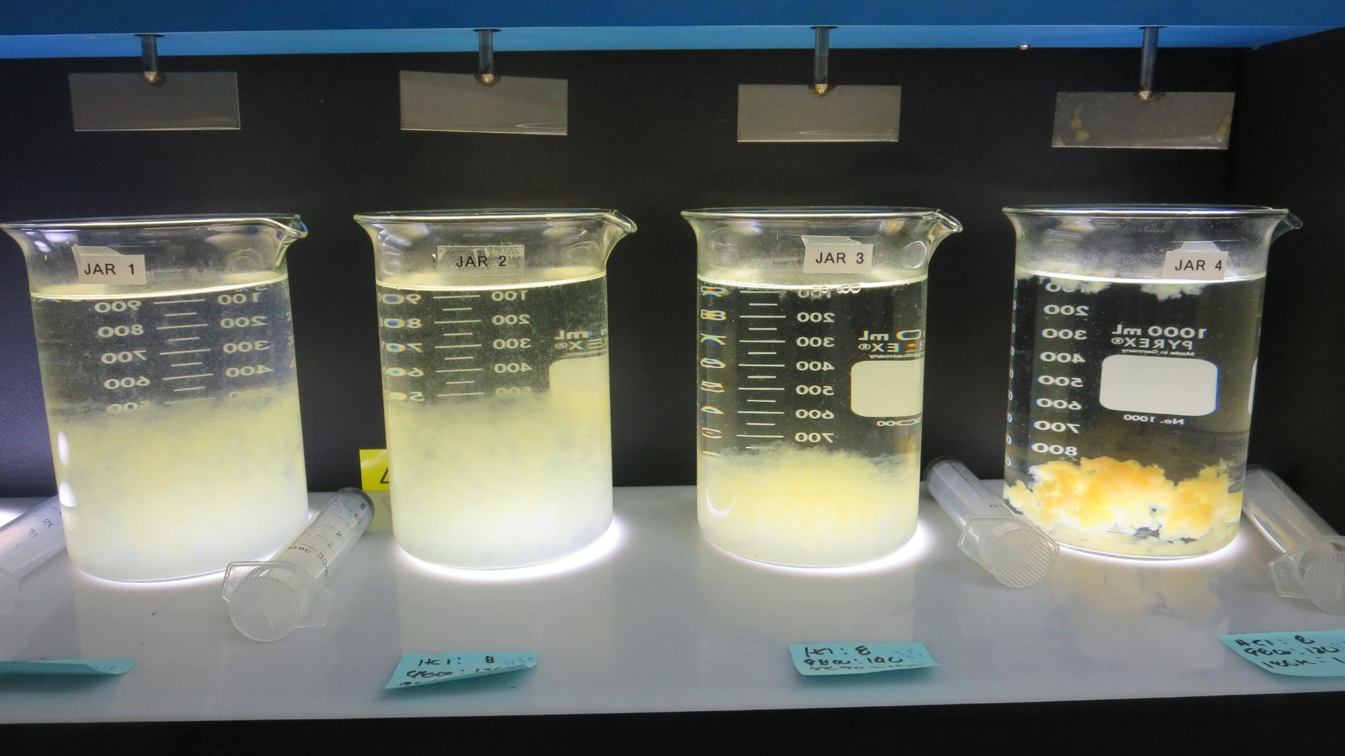
Jars 5-8: After 5 min of settling, 25 mL is syringed for filterability and %UVT/UVA.

Slide 19
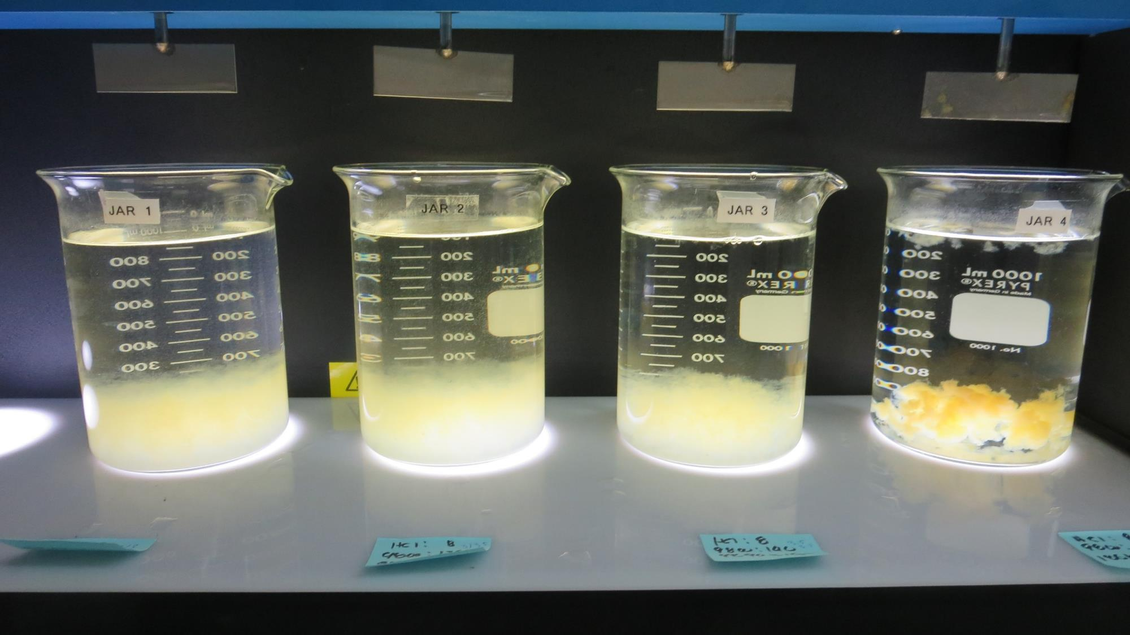
Jars 5-8: After 25-minutes of settling, settled water turbidity is taken.
8 mg/L HCl
120 mg/L 9800
15 mg/L 9890
Filtrate 0.29 NTU
UVT: 85.8%
UVA: 0.066/cm
UVA Reduction: 57.0%
Settled: 1.3 NTU
8 mg/L HCl
130 mg/L 9800
15 mg/L 9890
Filtrate 0.19 NTU
UVT: 86.0%
UVA: 0.065/cm
UVA Reduction: 57.6%
Settled: 1.3 NTU
8 mg/L HCl
140 mg/L 9800
15 mg/L 9890
Filtrate 0.08 NTU
UVT: 86.8%
UVA: 0.062/cm
UVA Reduction: 60.0%
Settled: 1.1 NTU
8 mg/L HCl
120 mg/L 9800
10 mg/L 186KH
Filtrate 0.06 NTU
UVT: 86.0%
UVA: 0.066/cm
UVA Reduction: 57.5%
Settled: 0.47NTU

Slide 20
Jar Testing for 1-Liter Jars: Procedures for Most Treatment Plants
Fill jars with source water prior to coagulant injection and set paddle speed at 30 rpm
Add chemicals (i.e., NaOCl, primary coagulant, coagulant aid) to each jar
Flash mix for 15-30 seconds (200 rpm)
Slow mix for 5 minutes (20-30 rpm)
Settled for 5 minutes. Syringe 25 mL from each jar taken 1-inch below surface (25 mL/12 sec rate)
Filtered through 1.2 um isopore membrane into cuvette drip rate, 15 mL/(50-90 sec)
Measure filtrate turbidity, chlorine residual and %UVT/UVA
Measure settled water turbidity after 25 minutes of total setting
Record all data

Slide 21
Jar Test Filterability Test Equipment
Turbidity Instrument
Syringe w/Luer-Lock Tip, 30 cc
(part#: 2225800, by Hach)
Swinnex Filter Holder, 25 mm (part#: SX0002500)
Isopore Membrane Filter, 1.2 um absolute
pore size,
Φ= 25 mm , thickness: 24 um,
hydrophilic polycarbonate membrane
(part #: RTTP02500)
Go to Sigma-Aldrich for laboratory supplies http://www.sigmaaldrich.com/united-states.html

Slide 22
Isopore Membrane Information
Categories | Information
trade name | Isopore
filter color | White
chemistry | Polycarbonate (PC)
water flow rate | Avg. 175 mL/min x cm² (typical results @ 10 psi)
media | Isopore®
wettability | Hydrophilic
porosity | 14.7%
pore size | 1.2 µm
bubble point at 23 °C | 1.0 bar, air with water
thickness | 24 µm
filter diameter (ø) | 25 mm
material size | polycarbonate, Hydrophilic, 1.2 µm, 25 mm, white, plain, 100

Slide 23
Isopore Membrane Background Information
The Isopore membrane is a polycarbonate, track-etched screen filter recommended for all analyses in which the sample is viewed on the surface of the membrane. The Isopore membrane is composed of polycarbonate film, which has a smooth, glass-like surface for clearer sample observation. The unique manufacturing process of the membrane ensures a precise pore diameter and a consistent pore size for accurate separation of samples by size. Matched-weight filters are not usually required because of low, constant tar and ash weights. Features & Benefits: Membrane structure retains particles on the surface, simplifying counting and analysis

Slide 24
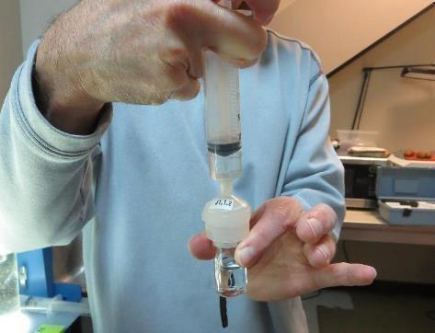
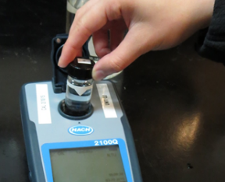
Jar Test - Filterability Test
Syringe ~ 25 mL from jar (after 5-minutes of settling)
Filter-to-waste 3-5 mL
Filter directly into clean cuvette
Measure turbidity
Note: Take several readings before recording final NTU results. Micro bubbles can adhere to glass causing false NTU readings. To remove bubbles, tilt cuvette up to 90 degrees.

Slide 25
Contact
Guy Schott, P.E.
State Water Resources Control Board
Division of Drinking Water
Santa Rosa, CA
Go to Stock Solution/Dose calculations/Jar Test Results for tools to download
www.waterboards.ca.gov/drinking_water/programs/districts/mendocino_district.html
Email: Guy Schott - Guy.Schott@waterboards.ca.gov
Office Number: 707-576-2732

