Slide 1
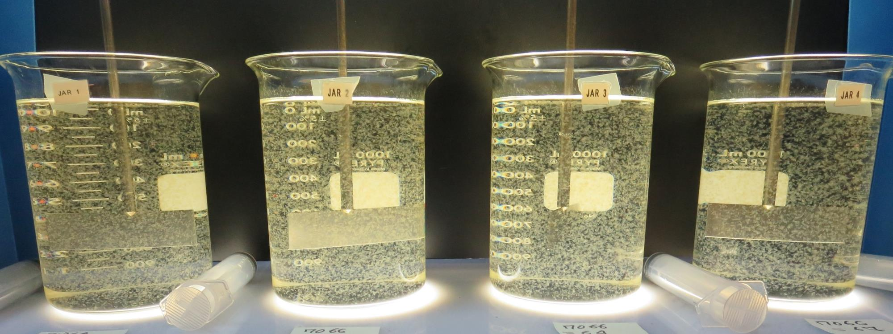
Surfwood Mutual Water Corporation
CA2300590
Mendocino County
Jar Test
by Guy Schott, P.E
September 19, 2019

Slide 2
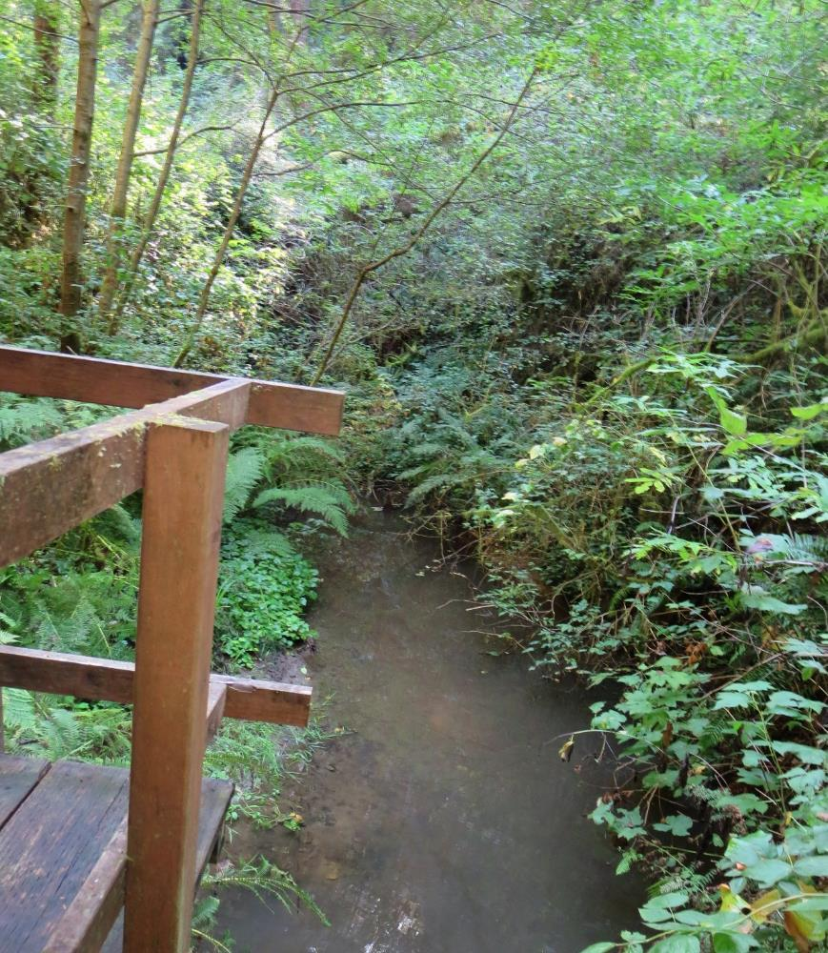
Source Water: Jack Peter’s Creek
Roughing Filter followed by Multi-Media Filtration
Source Water Characteristics
Turbidity: 6.2 NTU
pH: 7.20
UVT: 65.3%, UVA: 0.185/cm
0.4 um Filtered
UVT: 70.1%, UVA: 0.154/cm
Treated Water Train 1 (7066 coagulant 61 mg/L)
Turbidity: 0.05 NTU
UVT: 97.2%, UVA: 0.012/cm
UVA Reduction: 92.2%

Slide 3
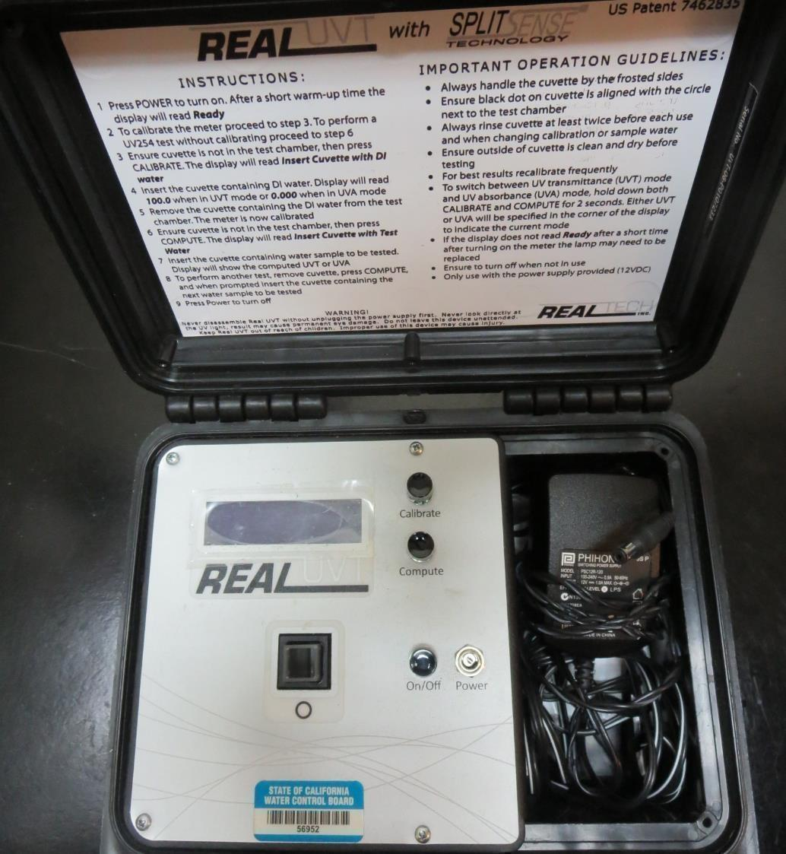
UVT/UVA, pathlength: 10 mm
UV transmittance (UVT) is a measurement of the amount of ultraviolet light (commonly at 254 nm due to its germicidal effect) that passes through a water sample compared to the amount of light that passes through a pure water sample. The measurement is expressed as a percentage, % UVT.
%UVT = 10^{(-UVA)} x 100%
UV absorbance (UVA) is calculated as a relative measure of the amount of light absorbed by a water sample compared with the amount of light absorbed by a pure water sample.
UVA = -log(%UVT/100)

Slide 4
Coagulant Used for Jar Testing
7066 (Garratt Callahan)
10 – 30% Poly Aluminum Hydroxychloride Sulfate
SG = 1.2

Slide 5
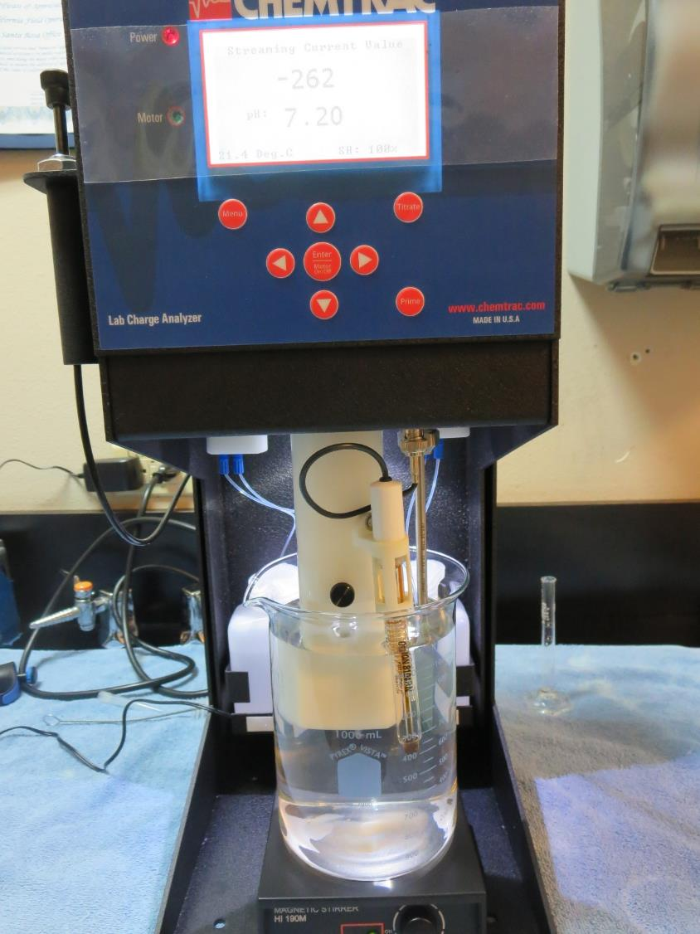
Laboratory Charge Analyzer
LCA: Used to determine coagulant demand of a source water entering the treatment plant.
Source pH: 7.20
LCA #1:
7066: 58.6 mg/L as product (no pH adjustment)
Final pH: 6.49

Slide 6
Coagulant Information
Unless stated otherwise, all coagulant doses are reported as Product (100% strength).
Preparation of coagulant stock solutions are generally 1.0 or 0.1 percent strength using 100 and/or 200 mL volumetric flasks.
Finnpipette F2 variable volume pipette, capacity 100-1000 micro liters is used for stock solution preparation and coagulant aid jar test dosing.
Finnpipette F2 variable volume pipette, capacity 0.5-5 mL is used for primary coagulant jar test dosing.

Slide 7
Filterability and %UVT/UVA Analysis
All jars except jars 21-24, 25 mL were sampled immediately at the end of flocculation duration for filterability and %UVT/UVA. Jars 21-24, 25 mL were sampled after 5 minutes of settling.

Slide 8
Surfwood MWC: Jar Test 1-8 Results
Jar 1-8, 25 mL sampled at end of floc duration.
Jar # | 200 RPM Flash Mix sec | RPM Floc Duration 5 min | 7066 mg/L | Filtrate NTU | Filtrate %UVT | Filtrate UVA/cm | %UVA Reduction | Settle NTU 25 min
J1 | 60 | 30 | 58 | 0.13 | 95.3 | 0.021 | 86.4 | 0.56
J2 | 60 | 30 | 61 | 0.07 | 96.3 | 0.016 | 89.6 | 0.57
J3 | 60 | 30 | 64 | 0.07 | 96.2 | 0.017 | 89.0 | 0.82
J4 | 60 | 30 | 67 | 0.08 | 96.2 | 0.017 | 89.0 | 0.59
J5 | 60 | 20 | 58 | n/a | n/a | n/a | - | 0.59
J6 | 60 | 20 | 61 | 0.09 | 96.0 | 0.018 | 88.3 | 0.49
J7 | 60 | 20 | 64 | 0.08 | 96.2 | 0.017 | 89.0 | 1.63
J8 | 60 | 20 | 67 | 0.09 | 96.1 | 0.017 | 89.0 | 0.63

Slide 9
Surfwood MWC: Jar Test 9-16 Results
Jar 9-16, 25 mL sampled at end of floc duration.
Jar # | 200 RPM Flash Mix sec | RPM Floc Duration 5 min | 7066 mg/L | Filtrate NTU | Filtrate %UVT | Filtrate UVA/cm | %UVA Reduction | Settle NTU 25 min
J9 | 60 | 10 | 58 | 0.13 | 95.3 | 0.021 | 86.4 | 0.97
J10 | 60 | 10 | 61 | 0.09 | 96.0 | 0.018 | 88.3 | 0.77
J11 | 60 | 10 | 64 | 0.13 | 96.0 | 0.018 | 88.3 | 1.37
J12 | 60 | 10 | 67 | 0.09 | 96.1 | 0.017 | 89.0 | 0.82
J13 | 60 | 40 | 58 | 0.08 | 95.6 | 0.020 | 87.0 | 0.84
J14 | 60 | 40 | 61 | 0.13 | 95.2 | 0.021 | 86.4 | 0.79
J15 | 60 | 40 | 64 | 0.13 | 95.2 | 0.021 | 86.4 | 1.07
J16 | 60 | 40 | 67 | 0.11 | 95.7 | 0.019 | 87.7 | 0.51

Slide 10
Surfwood MWC: Jar Test 17-20 Results
Jar 17-20, 25 mL sampled at end of floc duration.
Jar # | 200 RPM Flash Mix sec | RPM Floc Duration 5 min | 7066 mg/L | Filtrate NTU | Filtrate %UVT | Filtrate UVA/cm | %UVA Reduction | Settle NTU 25 min
J17 | 60 | 30 | 58 | 0.13 | 95.0 | 0.022 | 85.7 | 0.83
J18 | 60 | 30 | 61 | 0.13 | 95.2 | 0.021 | 86.4 | 0.58
J19 | 60 | 30 | 64 | 0.13 | 95.3 | 0.021 | 86.4 | 0.58
J20 | 60 | 30 | 67 | 0.11 | 95.6 | 0.020 | 87.0 | 0.39

Slide 11
Surfwood MWC: Jar Test 21-24 Results
Jar 21-24, 25 mL sampled after 5 min of settling.
Jar # | 200 RPM Flash Mix sec | RPM Floc Duration 5 min | 7066 mg/L | Filtrate NTU | Filtrate %UVT | Filtrate UVA/cm | %UVA Reduction | Settle NTU 25 min
J21 | 60 | 30 | 58 | 0.22 | 93.6 | 0.029 | 81.2 | 0.72
J22 | 60 | 30 | 61 | 0.19 | 94.2 | 0.026 | 83.1 | 0.70
J23 | 60 | 30 | 64 | 0.08 | 95.6 | 0.020 | 87.0 | 0.78
J24 | 60 | 30 | 67 | 0.11 | 95.6 | 0.020 | 87.0 | 0.49

Slide 12
Surfwood MWC: Jar Test 25-32 Results
Jar 25-32, 25 mL sampled at end of floc duration.
Jar # | 200 RPM Flash Mix sec | RPM -Floc Duration 5 min | 7066 mg/L | Filtrate NTU | Filtrate %UVT | Filtrate UVA/cm | %UVA Reduction | Settle NTU 25 min
J25 | 15 | 30 | 58 | 0.11 | 95.6 | 0.020 | 87.0 | 0.87
J26 | 15 | 30 | 61 | 0.08 | 96.2 | 0.017 | 89.0 | 0.79
J27 | 15 | 30 | 64 | n/a | n/a | n/a | n/a | 0.90
J28 | 15 | 30 | 67 | 0.06 | 96.6 | 0.015 | 90.3 | 0.78
J29 | 0 | 30 | 58 | 0.09 | 95.8 | 0.019 | 87.7 | 0.95
J30 | 0 | 30 | 61 | 0.16 | 95.0 | 0.022 | 85.7 | 1.02
J31 | 0 | 30 | 64 | 0.07 | 96.4 | 0.016 | 89.6 | 1.08
J32 | 0 | 30 | 67 | 0.06 | 96.7 | 0.015 | 90.3 | 0.84

Slide 13
Jars 1-4 Test
Flash Mix 60 Sec (200 RPM)
Floc Mix 5 min (30 RPM)
25 mL sampled end of Floc
Applied Coagulant
7066

Slide 14
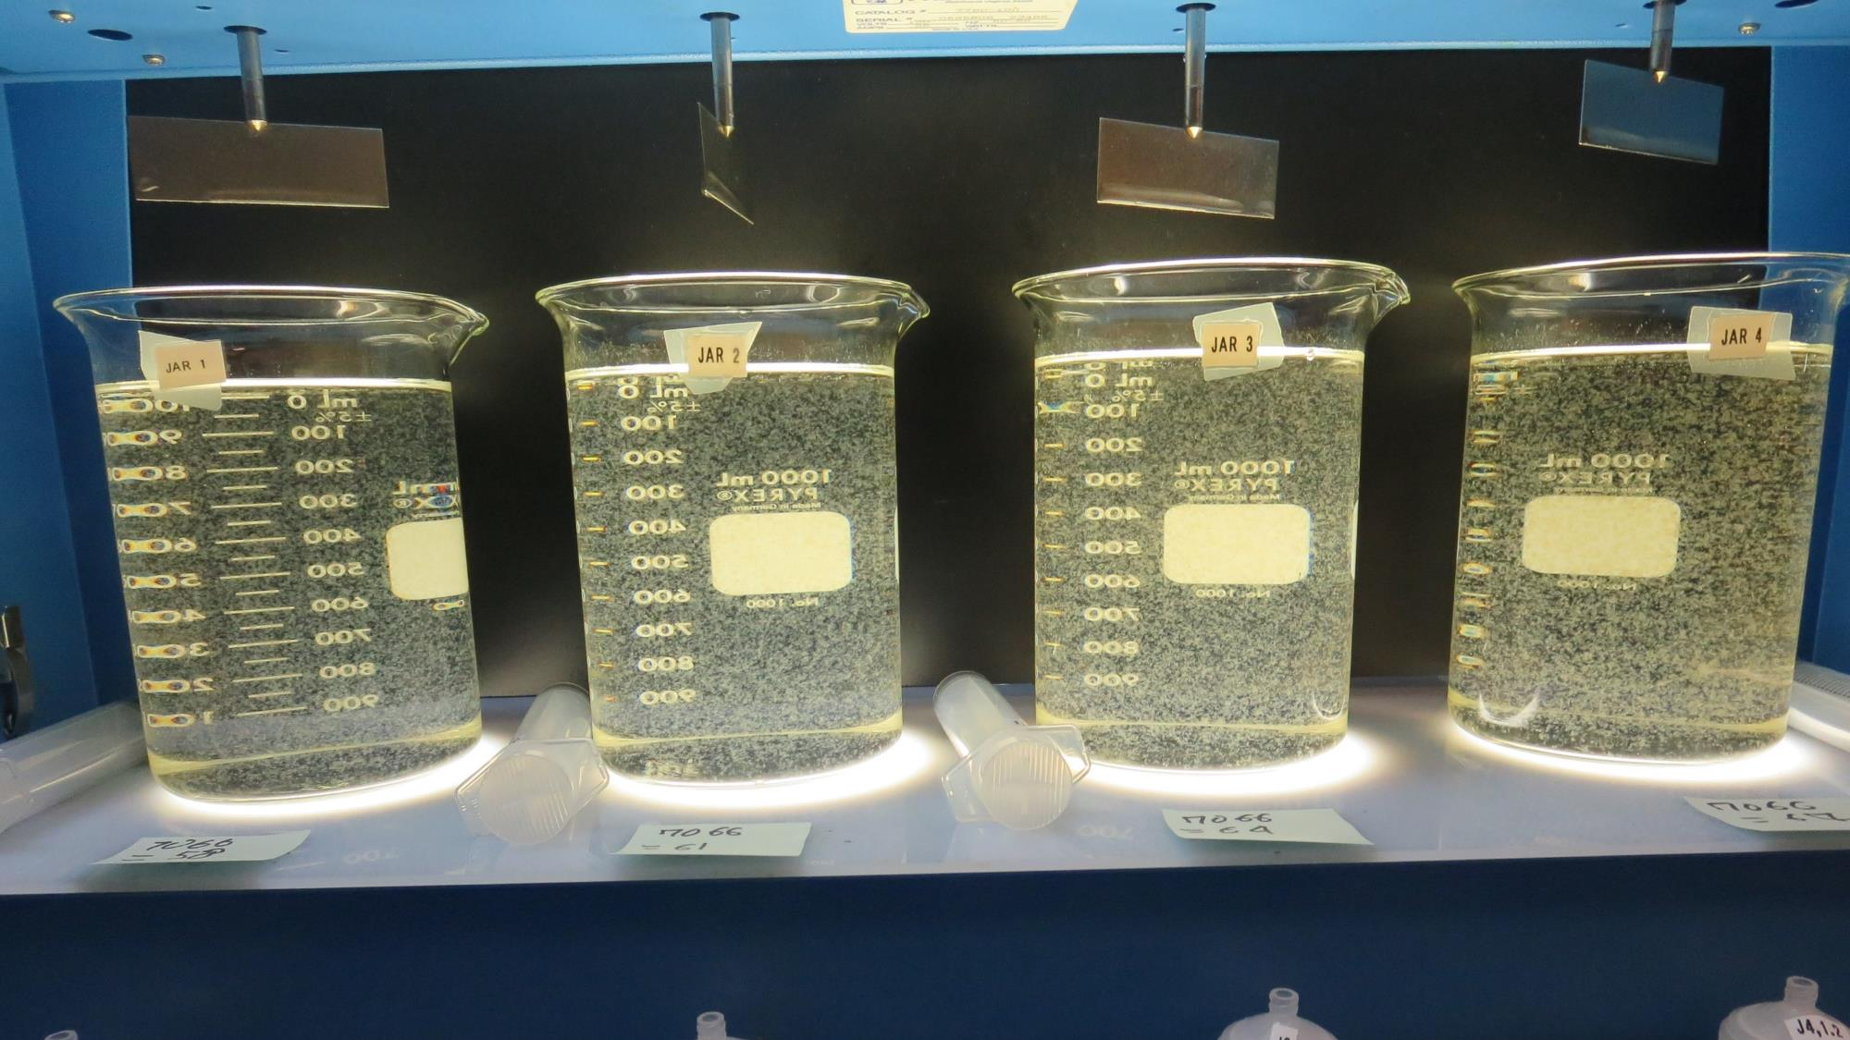
Jars 1-4: At End of Floc Duration, 25 mL is syringed for filterability and %UVT/UVA.
58 mg/L 7066
Filtrate 0.13 NTU
UVT: 95.3%
UVA: 0.021/cm
UVA Reduction: 86.4%
Settled: 0.56 NTU
61 mg/L 7066
Filtrate 0.07 NTU
UVT: 96.3%
UVA: 0.016/cm
UVA Reduction: 89.6%
Settled: 0.57 NTU
64 mg/L 7066
Filtrate 0.07 NTU
UVT: 96.2%
UVA: 0.017/cm
UVA Reduction: 89%
Settled: 0.82 NTU
67 mg/L 7066
Filtrate 0.08 NTU
UVT: 96.2%
UVA: 0.017/cm
UVA Reduction: 89%
Settled: 0.59 NTU

Slide 15
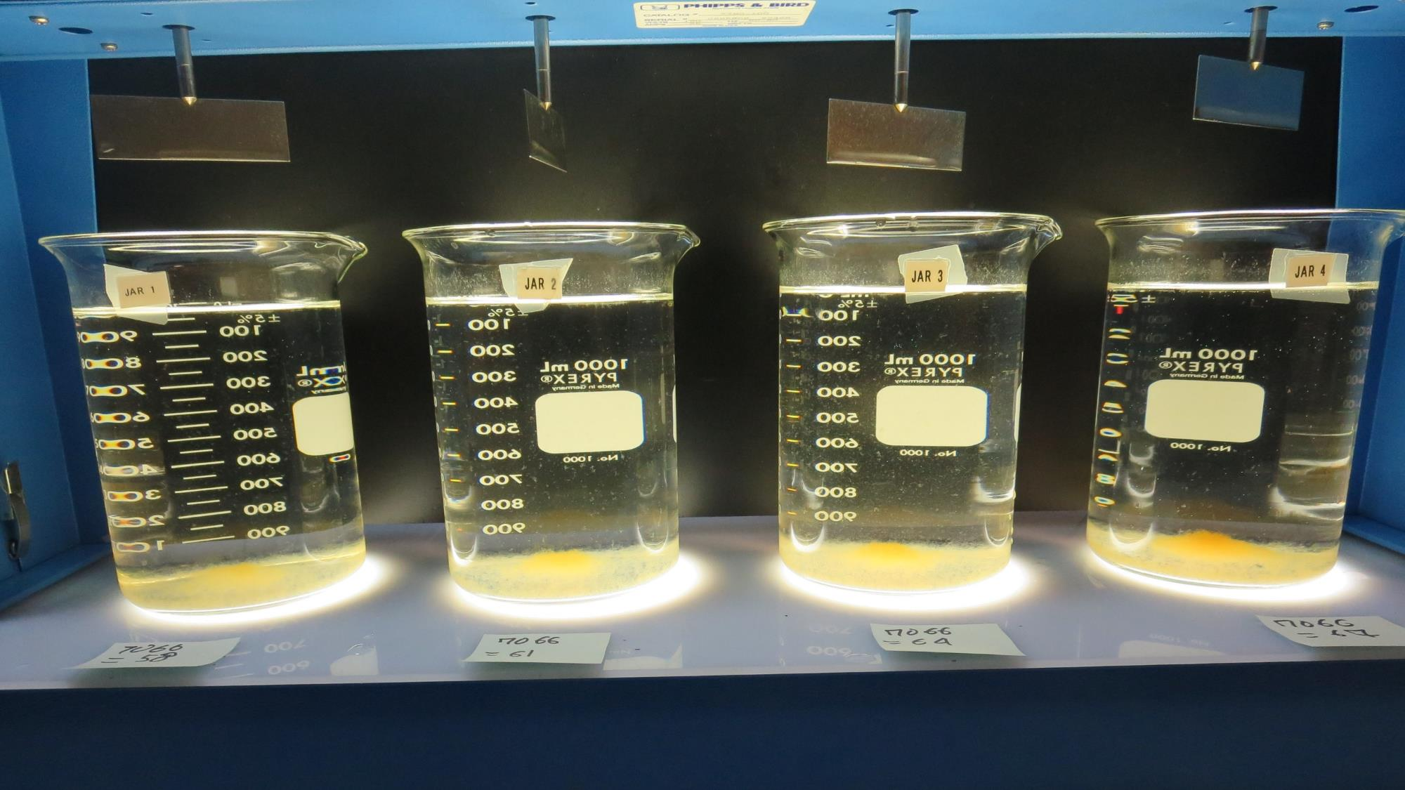
Jars 1-4: After 25-minutes of settling, settled water turbidity is taken.

Slide 16
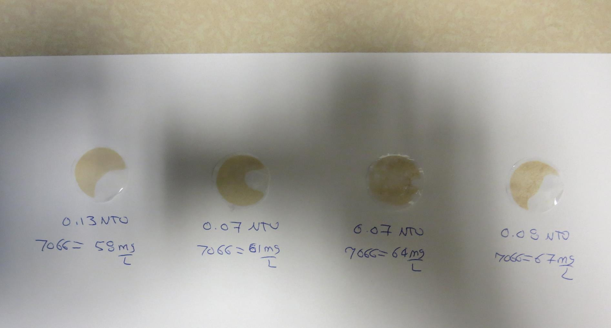
Visual of Filterability of Jars 1-4
58 mg/L 7066
Filtrate 0.13 NTU
UVT: 95.3%
UVA: 0.021/cm
Settled: 0.56 NTU
61 mg/L 7066
Filtrate 0.07 NTU
UVT: 96.3%
UVA: 0.016/cm
Settled: 0.57 NTU
64 mg/L 7066
Filtrate 0.07 NTU
UVT: 96.2%
UVA: 0.017/cm
Settled: 0.82 NTU
67 mg/L 7066
Filtrate 0.08 NTU
UVT: 96.2%
UVA: 0.017/cm
Settled: 0.59 NTU

Slide 17
Jars 5-8 Test
Flash Mix 60 Sec (200 RPM)
Floc Mix 5 min (20 RPM)
25 mL sampled end of Floc
Applied Coagulant
7066

Slide 18
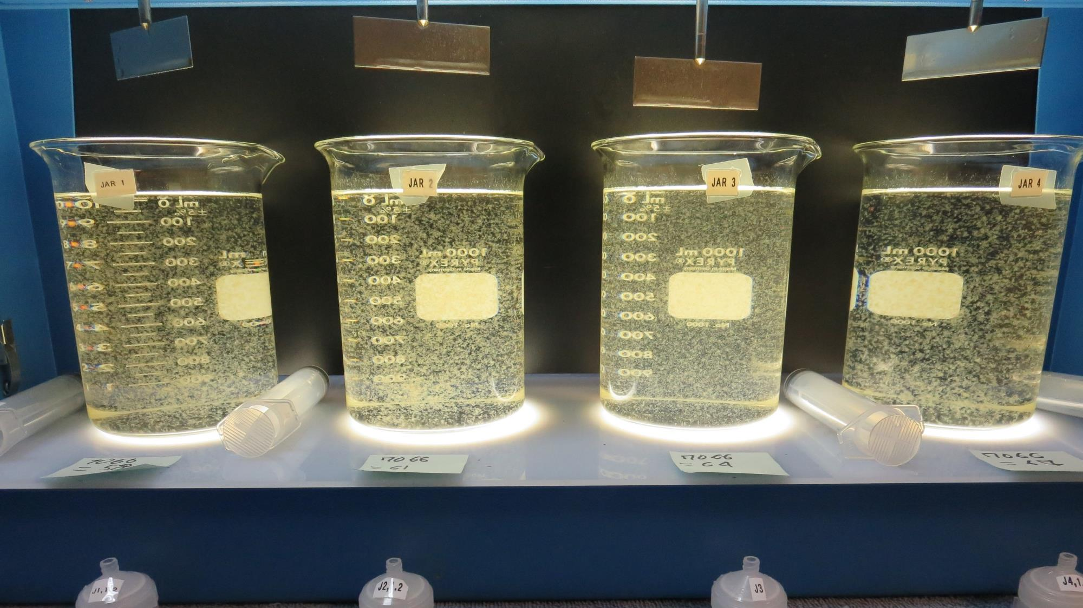
Jars 5-8: At End of Floc Duration, 25 mL is syringed for filterability and %UVT/UVA.
58 mg/L 7066
Filtrate x NTU
UVT: x%
UVA: x/cm
Settled: 0.59 NTU
61 mg/L 7066
Filtrate 0.09 NTU
UVT: 96.0%
UVA: 0.018/cm
UVA Reduction: 88.3%
Settled: 0.49 NTU
64 mg/L 7066
Filtrate 0.08 NTU
UVT: 96.2%
UVA: 0.017/cm
UVA Reduction: 89%
Settled: 1.6 NTU
67 mg/L 7066
Filtrate 0.09 NTU
UVT: 96.1%
UVA: 0.017/cm
UVA Reduction: 89%
Settled: 0.63 NTU

Slide 19
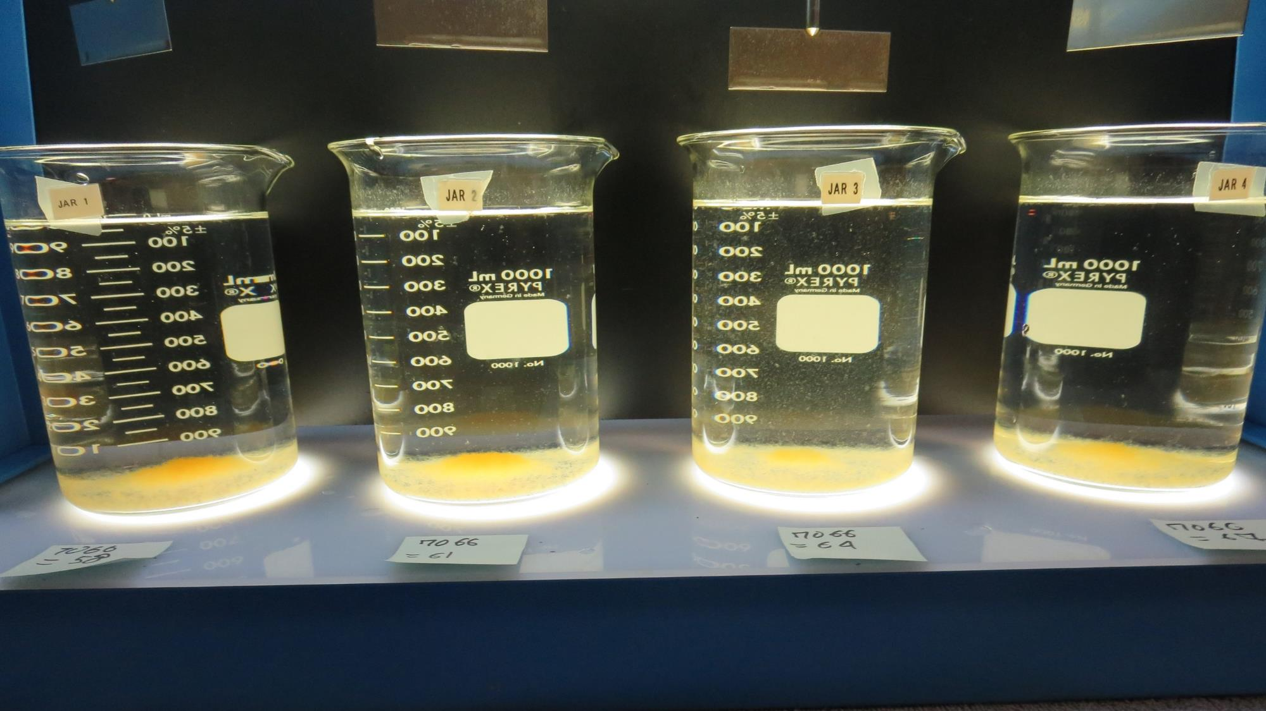
Jars 5-8: After 25-minutes of settling, settled water turbidity is taken.

Slide 20
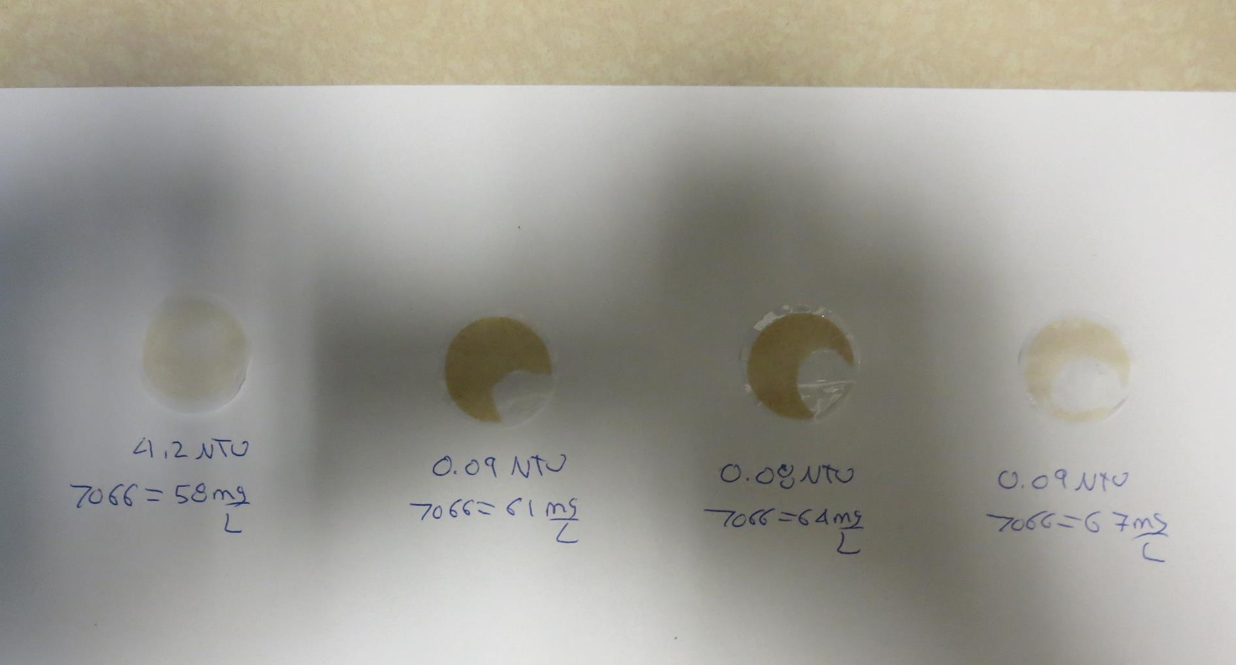
Visual of Filterability of Jars 5-8
58 mg/L 7066
Filtrate x NTU
UVT: x%
UVA: x/cm
Settled: 0.59 NTU
61 mg/L 7066
Filtrate 0.09 NTU
UVT: 96.0%
UVA: 0.018/cm
Settled: 0.49 NTU
64 mg/L 7066
Filtrate 0.08 NTU
UVT: 96.2%
UVA: 0.017/cm
Settled: 1.6 NTU
67 mg/L 7066
Filtrate 0.09 NTU
UVT: 96.1%
UVA: 0.017/cm
Settled: 0.63 NTU

Slide 21
Jars 9-12 Test
Flash Mix 60 Sec (200 RPM)
Floc Mix 5 min (10 RPM)
25 mL sampled end of Floc
Applied Coagulant
7066

Slide 22
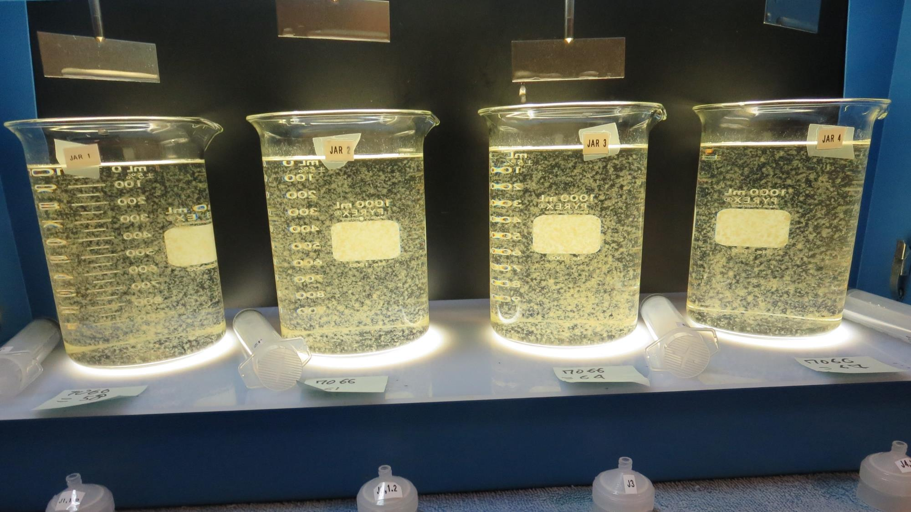
Jars 9-12: At End of Floc Duration, 25 mL is syringed for filterability and %UVT/UVA.
58 mg/L 7066
Filtrate 0.13 NTU
UVT: 95.3%
UVA: 0.021/cm
UVA Reduction: 86.4%
Settled: 0.97 NTU
61 mg/L 7066
Filtrate 0.09 NTU
UVT: 96.0%
UVA: 0.018/cm
UVA Reduction: 88.3%
Settled: 0.77 NTU
64 mg/L 7066
Filtrate 0.13 NTU
UVT: 96.0%
UVA: 0.018/cm
UVA Reduction: 88.3%
Settled: 1.37 NTU
67 mg/L 7066
Filtrate 0.09 NTU
UVT: 96.1%
UVA: 0.017/cm
UVA Reduction: 89%
Settled: 0.82 NTU

Slide 23
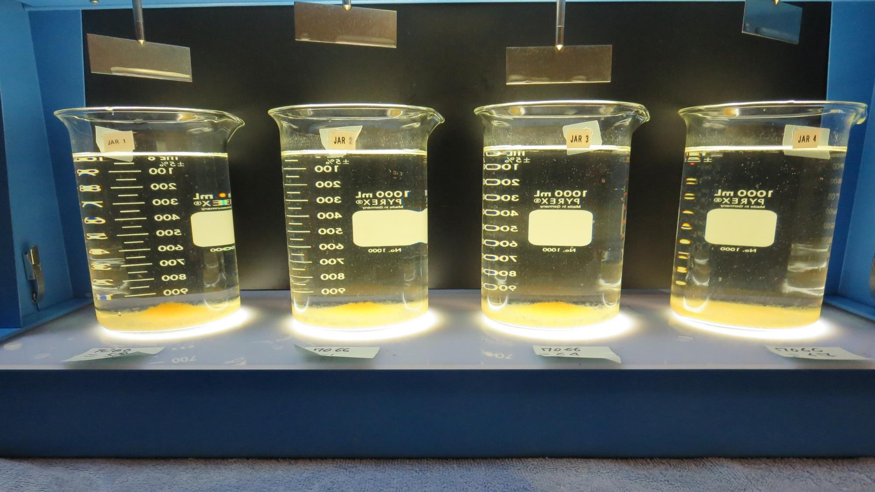
Jars 9-12: After 25-minutes of settling, settled water turbidity is taken.

Slide 24
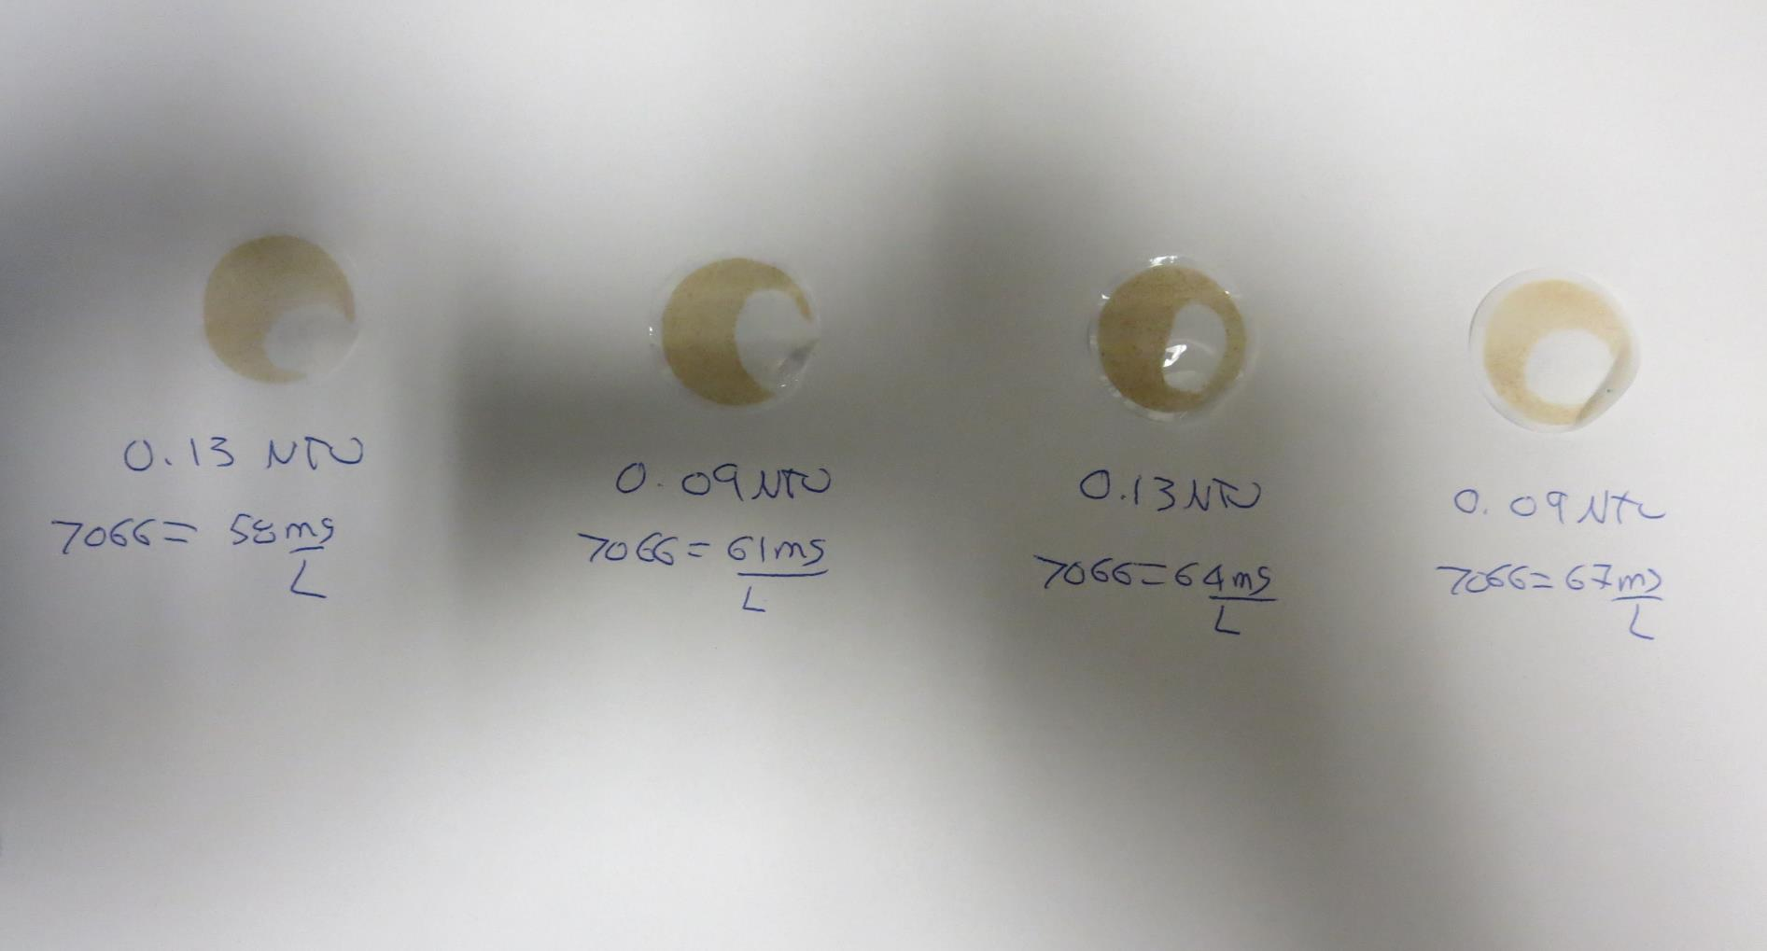
Visual of Filterability of Jars 9-12
58 mg/L 7066
Filtrate 0.13 NTU
UVT: 95.3%
UVA: 0.021/cm
Settled: 0.97 NTU
61 mg/L 7066
Filtrate 0.09 NTU
UVT: 96.0%
UVA: 0.018/cm
Settled: 0.77 NTU
64 mg/L 7066
Filtrate 0.13 NTU
UVT: 96.0%
UVA: 0.018/cm
Settled: 1.37 NTU
67 mg/L 7066
Filtrate 0.09 NTU
UVT: 96.1%
UVA: 0.017/cm
Settled: 0.82 NTU

Slide 25
Jars 13-16 Test
Flash Mix 60 Sec (200 RPM)
Floc Mix 5 min (40 RPM)
25 mL sampled end of Floc
Applied Coagulant
7066

Slide 26
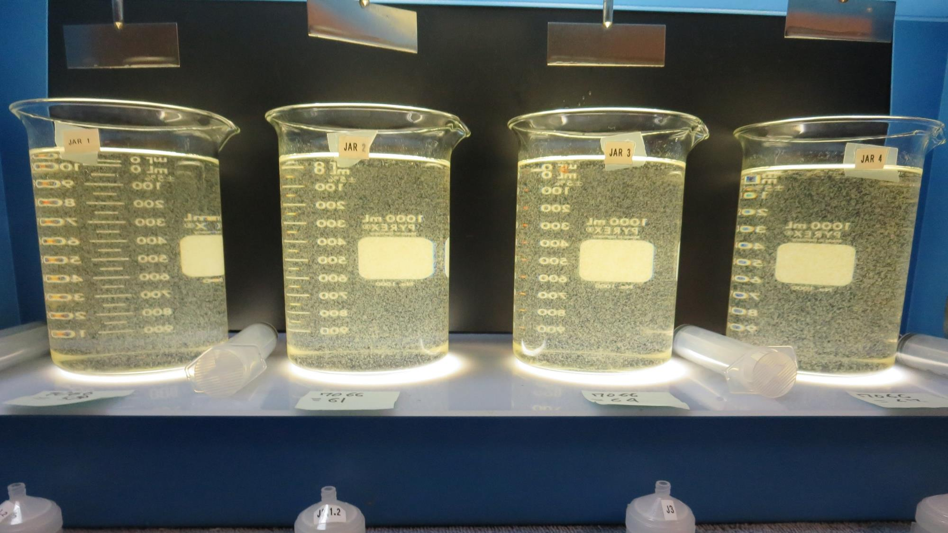
Jars 13-16: At End of Floc Duration, 25 mL is syringed for filterability and %UVT/UVA.
58 mg/L 7066
Filtrate 0.08 NTU
UVT: 95.6%
UVA: 0.020/cm
UVA Reduction: 87%
Settled: 0.84 NTU
61 mg/L 7066
Filtrate 0.13 NTU
UVT: 95.2%
UVA: 0.021/cm
UVA Reduction: 86.4%
Settled: 0.79 NTU
64 mg/L 7066
Filtrate 0.13 NTU
UVT: 95.2%
UVA: 0.021/cm
UVA Reduction: 86.4%
Settled: 1.07 NTU
67 mg/L 7066
Filtrate 0.11 NTU
UVT: 95.7%
UVA: 0.019/cm
UVA Reduction: 87.7%
Settled: 0.51 NTU

Slide 27
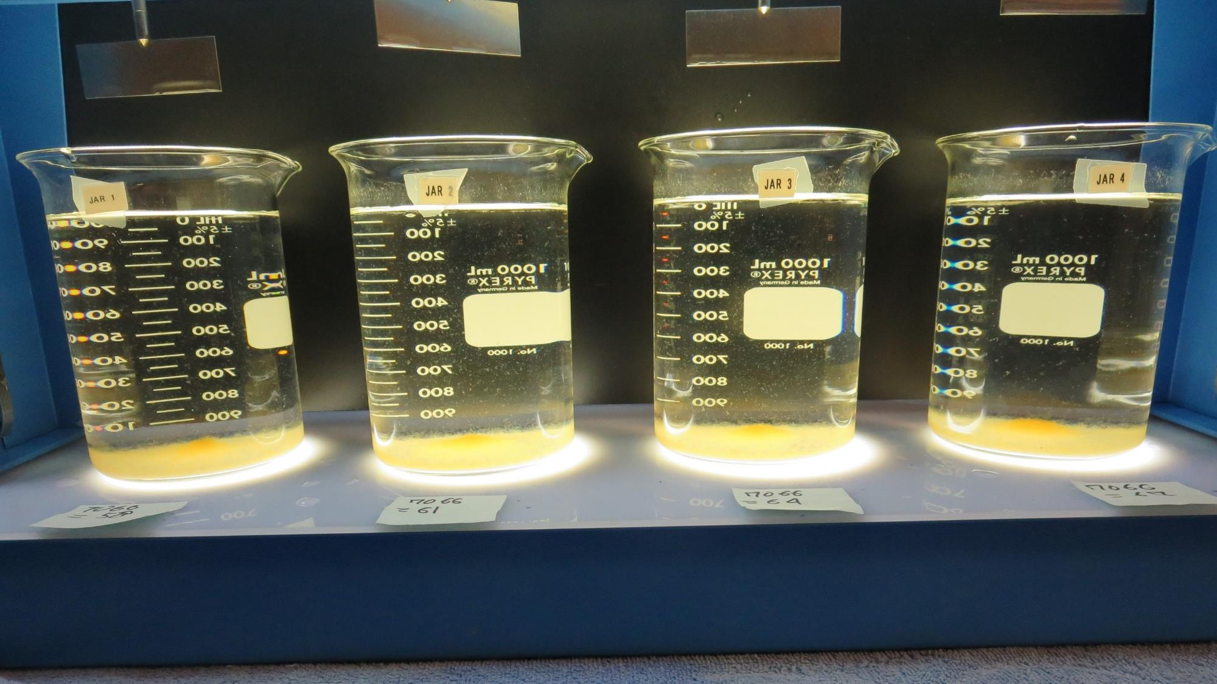
Jars 13-16: After 25-minutes of settling, settled water turbidity is taken.

Slide 28
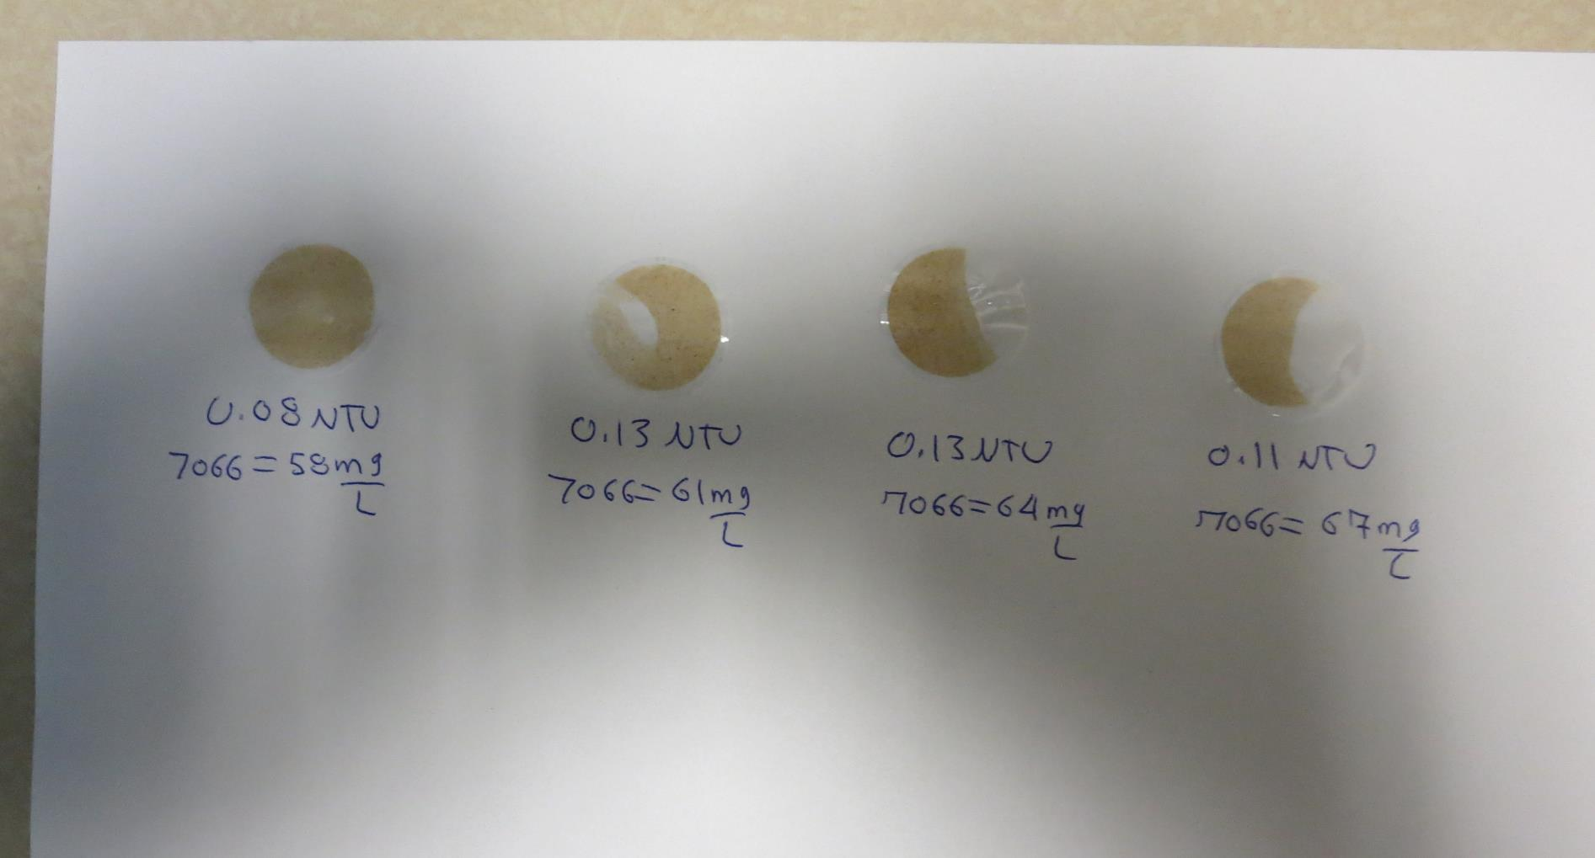
Visual of Filterability of Jars 13-16
58 mg/L 7066
Filtrate 0.08 NTU
UVT: 95.6%
UVA: 0.020/cm
Settled: 0.84 NTU
61 mg/L 7066
Filtrate 0.13 NTU
UVT: 95.2%
UVA: 0.021/cm
Settled: 0.79 NTU
61 mg/L 7066
Filtrate 0.13 NTU
UVT: 95.2%
UVA: 0.021/cm
Settled: 0.79 NTU
67 mg/L 7066
Filtrate 0.11 NTU
UVT: 95.7%
UVA: 0.019/cm
Settled: 0.51 NTU

Slide 29
Jars 17-20 Test
Flash Mix 60 Sec (200 RPM)
Floc Mix 5 min (30 RPM)
25 mL sampled end of Floc
Applied Coagulant
7066

Slide 30
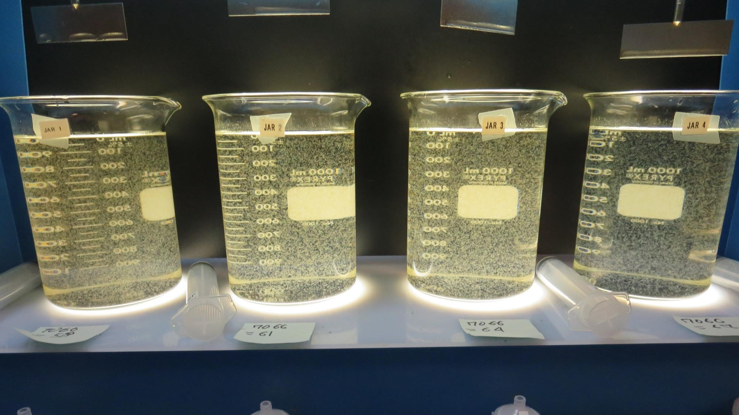
Jars 17-20: At End of Floc Duration, 25 mL is syringed for filterability and %UVT/UVA.
58 mg/L 7066
Filtrate 0.13 NTU
UVT: 95.0%
UVA: 0.022/cm
UVA Reduction: 85.7%
Settled: 0.84 NTU
61 mg/L 7066
Filtrate 0.13 NTU
UVT: 95.2%
UVA: 0.021/cm
UVA Reduction: 86.4%
Settled: 0.54 NTU
64 mg/L 7066
Filtrate 0.13 NTU
UVT: 95.3%
UVA: 0.021/cm
UVA Reduction: 86.4%
Settled: 0.58 NTU
67 mg/L 7066
Filtrate 0.11 NTU
UVT: 95.6%
UVA: 0.020/cm
UVA Reduction: 87%
Settled: 0.39 NTU

Slide 31
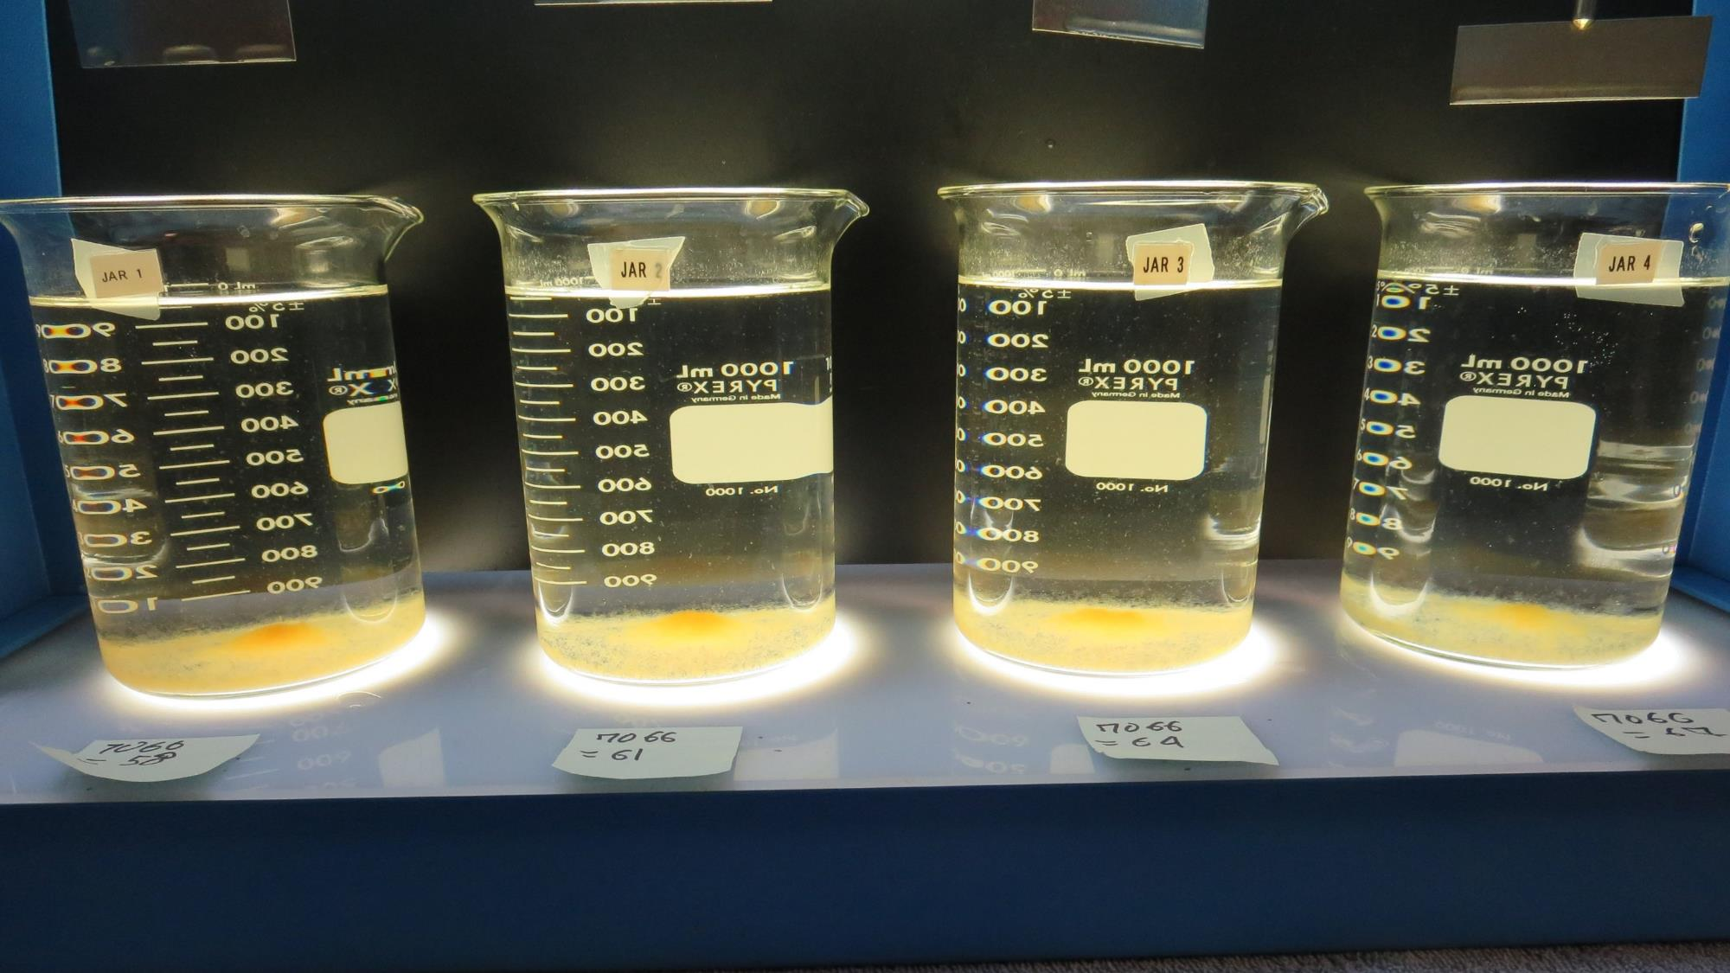
Jars 17-20: After 25-minutes of settling, settled water turbidity is taken.

Slide 32
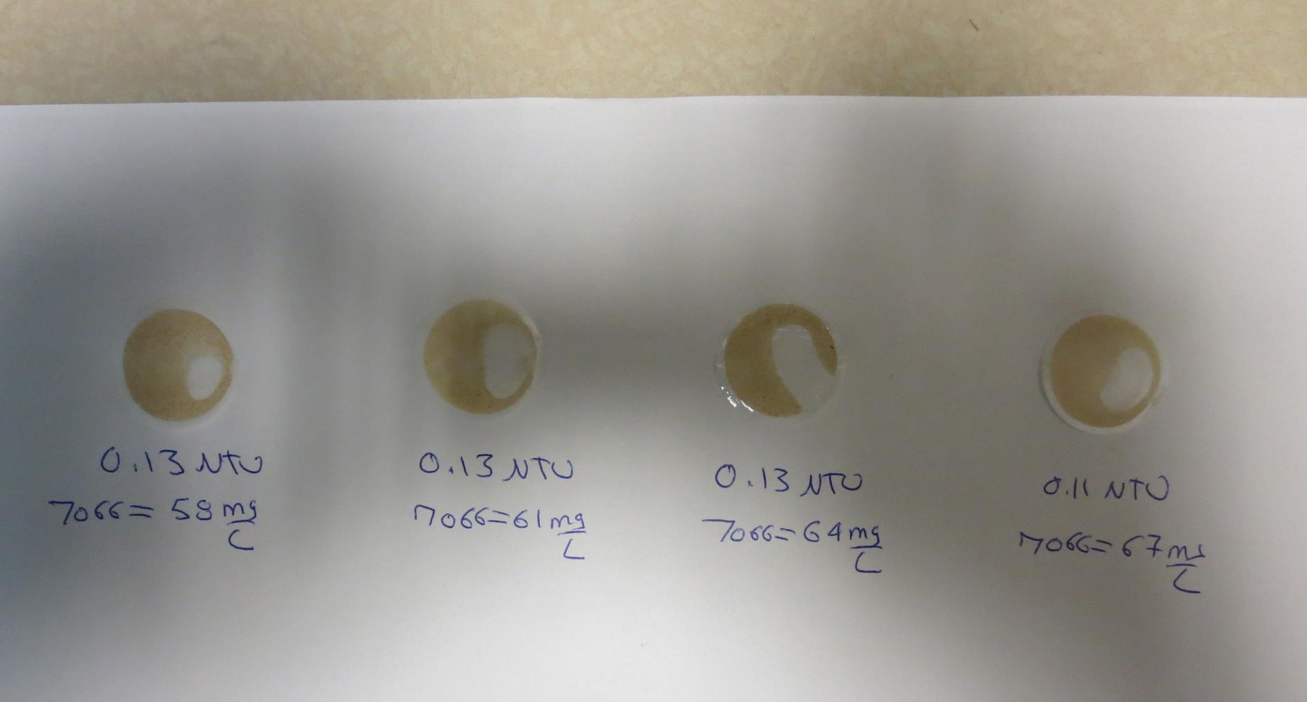
Visual of Filterability of Jars 17-20
58 mg/L 7066
Filtrate 0.13 NTU
UVT: 95.0%
UVA: 0.022/cm
Settled: 0.84 NTU
61 mg/L 7066
Filtrate 0.13 NTU
UVT: 95.2%
UVA: 0.021/cm
Settled: 0.54 NTU
64 mg/L 7066
Filtrate 0.13 NTU
UVT: 95.3%
UVA: 0.021/cm
Settled: 0.58 NTU
67 mg/L 7066
Filtrate 0.11 NTU
UVT: 95.6%
UVA: 0.020/cm
Settled: 0.39 NTU

Slide 33
Jars 21-24 Test
Flash Mix 60 Sec (200 RPM)
Floc Mix 5 min (30 RPM)
Applied Coagulant
7066

Slide 34
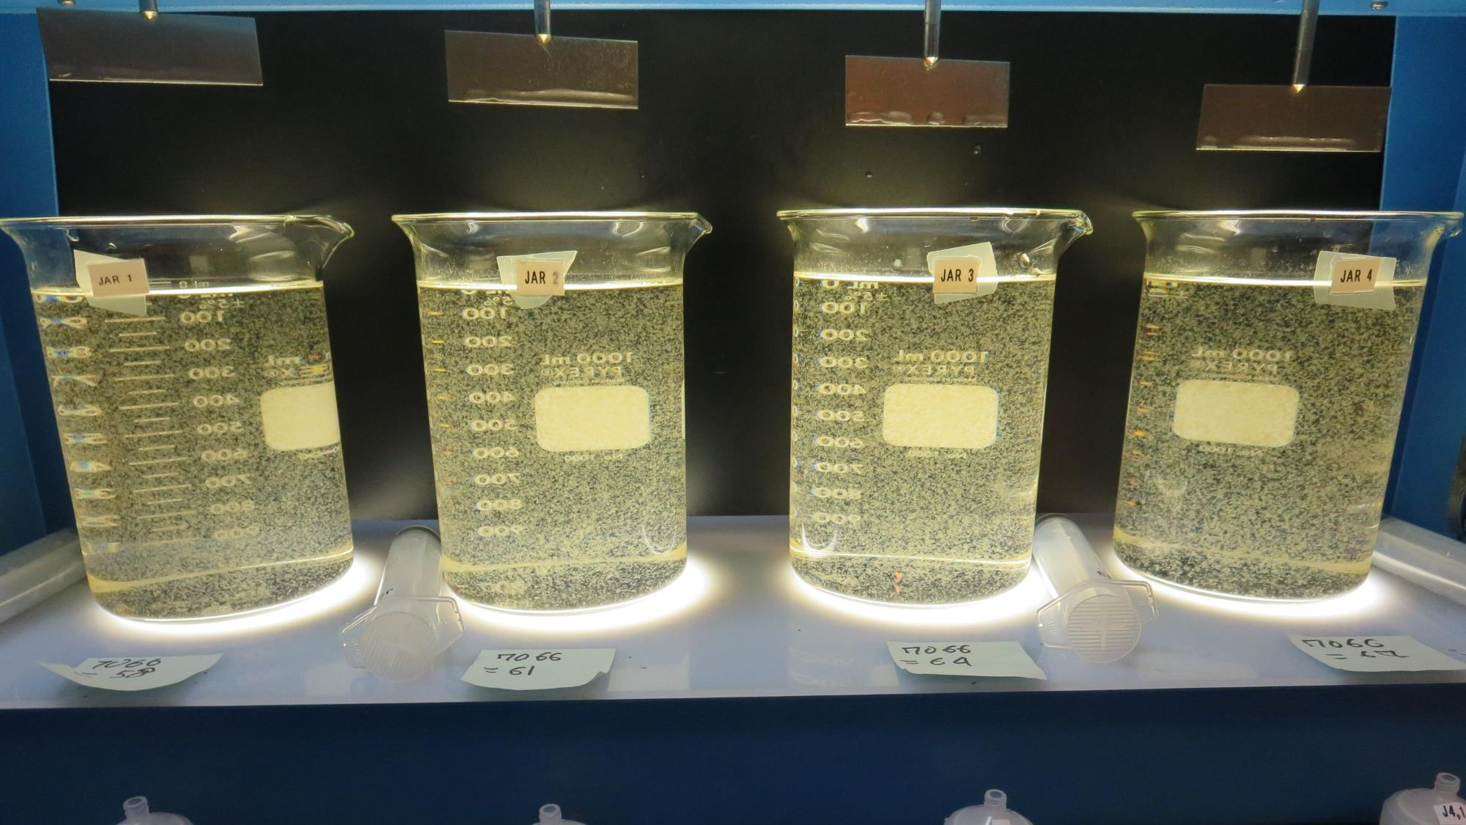
Jars 21-24: End of 5-minute flocculation (30 RPM) duration.
58 mg/L 7066
Filtrate 0.22 NTU
UVT: 93.6%
UVA: 0.029/cm
UVA Reduction: 81.2%
Settled: 0.72 NTU
61 mg/L 7066
Filtrate 0.19 NTU
UVT: 94.2%
UVA: 0.026/cm
UVA Reduction: 83.1%
Settled: 0.70 NTU
64 mg/L 7066
Filtrate 0.08 NTU
UVT: 95.6%
UVA: 0.020/cm
UVA Reduction: 87%
Settled: 0.78 NTU
67 mg/L 7066
Filtrate 0.11 NTU
UVT: 95.6%
UVA: 0.020/cm
UVA Reduction: 87%
Settled: 0.49 NTU

Slide 35
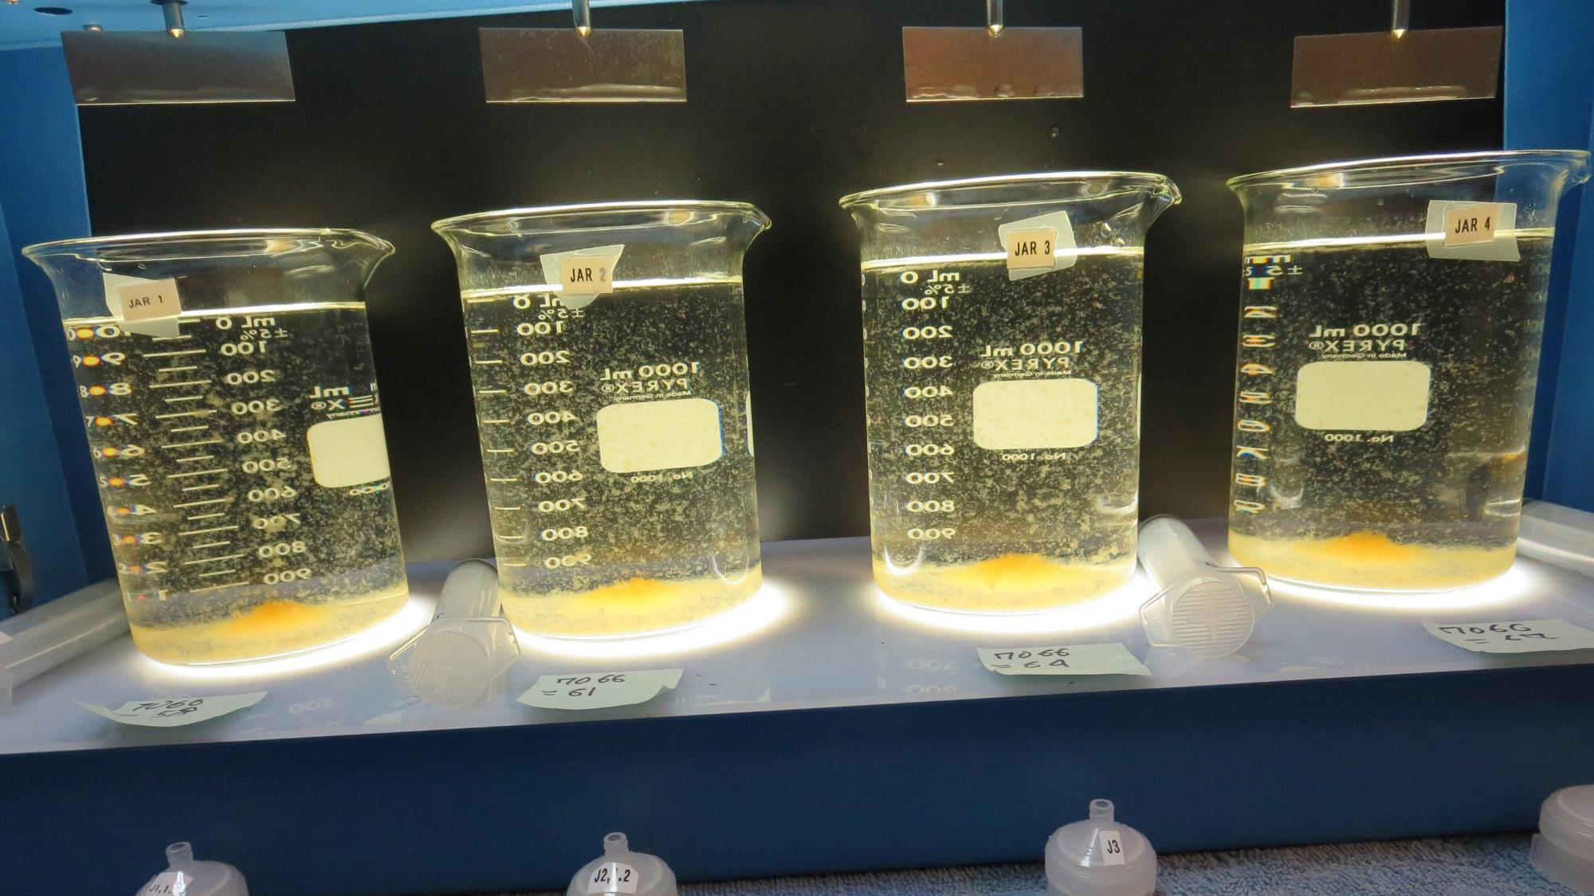
Jars 21-24: After 5-minutes of settling, 25 mL is syringed for filterability and %UVT/UVA.

Slide 36
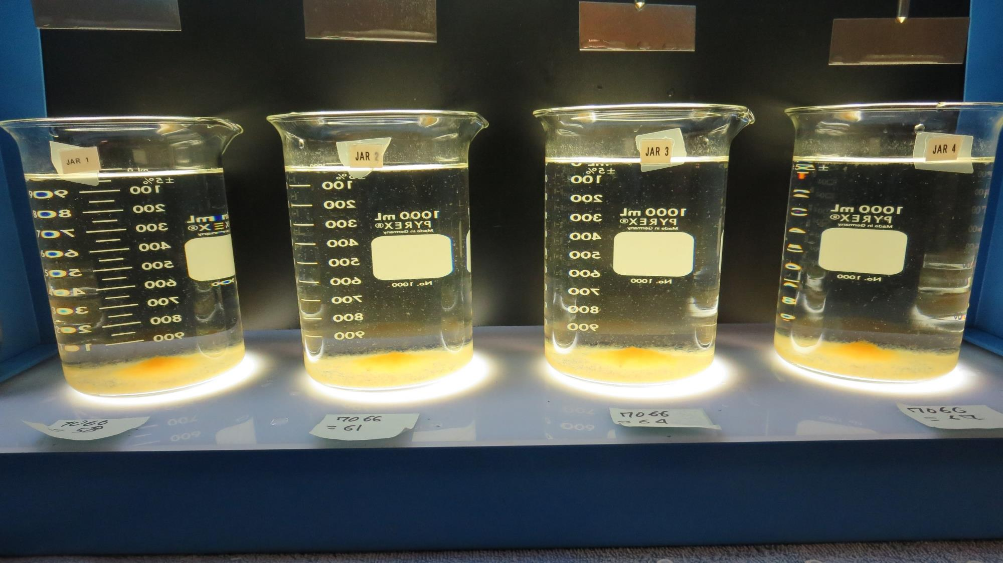
Jars 21-24: After 25-minutes of settling, settled water turbidity is taken.
58 mg/L 7066
Filtrate 0.22 NTU
UVT: 93.6%
UVA: 0.029/cm
UVA Reduction: 81.2%
Settled: 0.72 NTU
61 mg/L 7066
Filtrate 0.19 NTU
UVT: 94.2%
UVA: 0.026/cm
UVA Reduction: 83.1%
Settled: 0.70 NTU
64 mg/L 7066
Filtrate 0.08 NTU
UVT: 95.6%
UVA: 0.020/cm
UVA Reduction: 87%
Settled: 0.78 NTU
67 mg/L 7066
Filtrate 0.11 NTU
UVT: 95.6%
UVA: 0.020/cm
UVA Reduction: 87%
Settled: 0.49 NTU

Slide 37
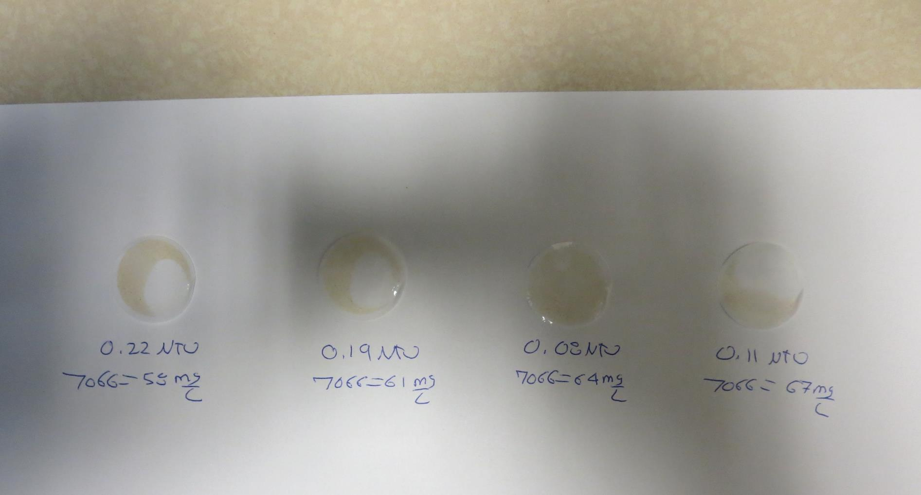
Visual of Filterability of Jars 21-24
58 mg/L 7066
Filtrate 0.22 NTU
UVT: 93.6%
UVA: 0.029/cm
Settled: 0.72 NTU
61 mg/L 7066
Filtrate 0.19 NTU
UVT: 94.2%
UVA: 0.026/cm
Settled: 0.70 NTU
64 mg/L 7066
Filtrate 0.08 NTU
UVT: 95.6%
UVA: 0.020/cm
Settled: 0.78 NTU
67 mg/L 7066
Filtrate 0.11 NTU
UVT: 95.6%
UVA: 0.020/cm
Settled: 0.49 NTU

Slide 38
Jars 25-28 Test
Flash Mix 15 Sec (200 RPM)
Floc Mix 5 min (30 RPM)
25 mL sampled end of Floc
Applied Coagulant
7066

Slide 39
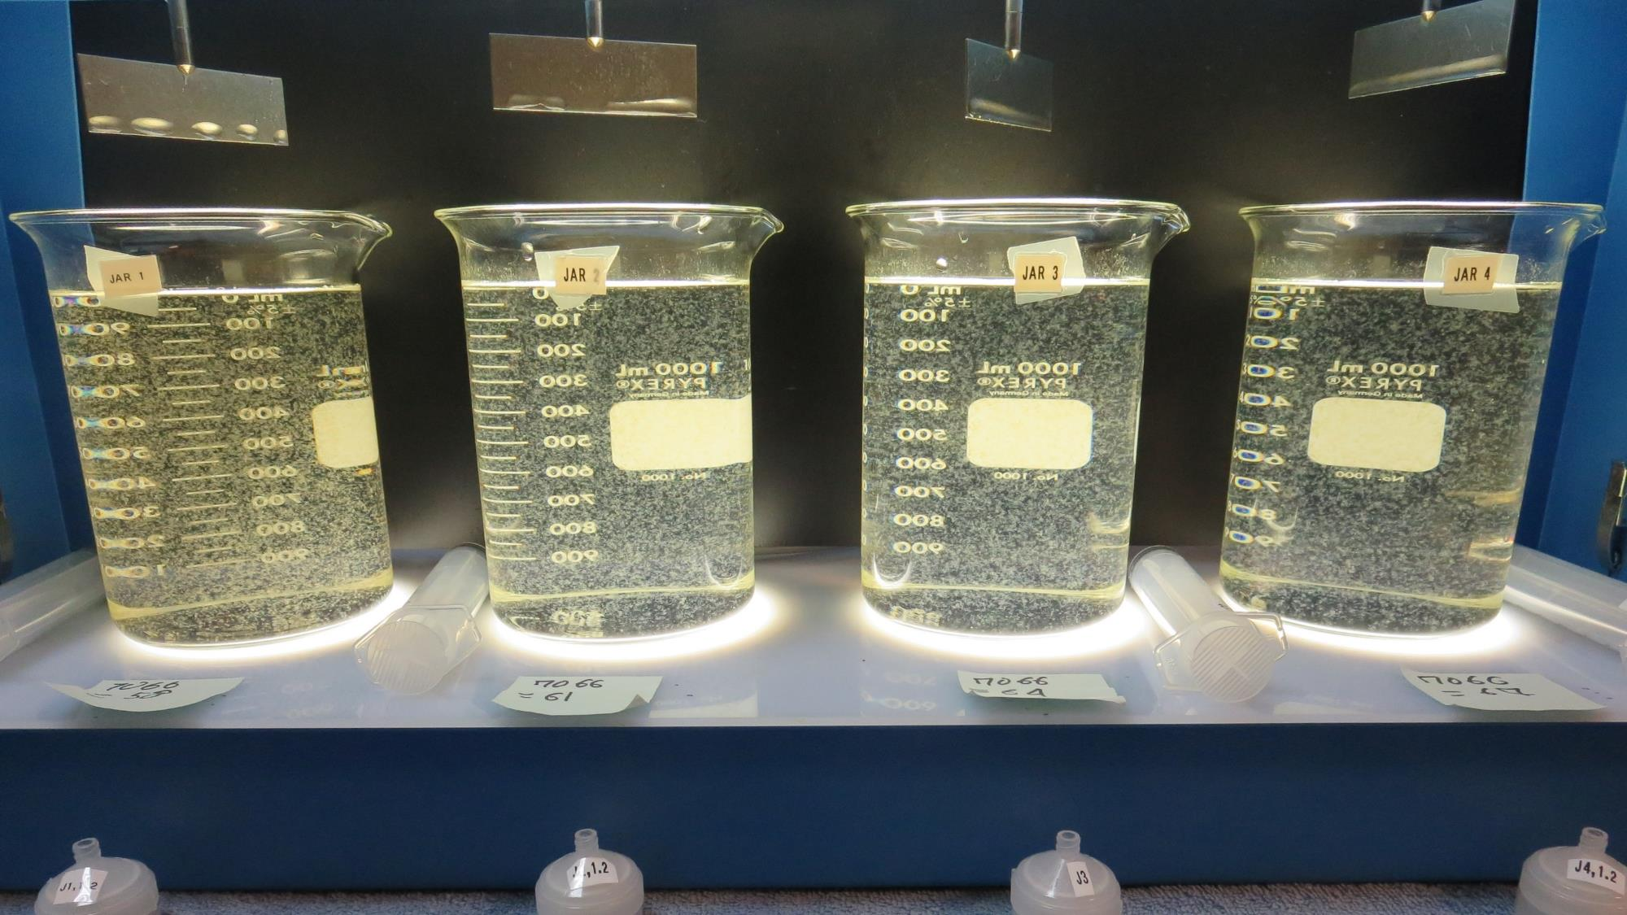
Jars 25-28: At End of Floc Duration, 25 mL is syringed for filterability and %UVT/UVA.
58 mg/L 7066
Filtrate 0.11 NTU
UVT: 95.6%
UVA: 0.020/cm
UVA Reduction: 87%
Settled: 0.87 NTU
61 mg/L 7066
Filtrate 0.08 NTU
UVT: 96.2%
UVA: 0.017/cm
UVA Reduction: 89%
Settled: 0.79 NTU
64 mg/L 7066
Filtrate x NTU
UVT: x%
UVA: x/cm
Settled: 0.90 NTU
67 mg/L 7066
Filtrate 0.06 NTU
UVT: 96.6%
UVA: 0.015/cm
UVA Reduction: 90.3%
Settled: 0.78 NTU

Slide 40
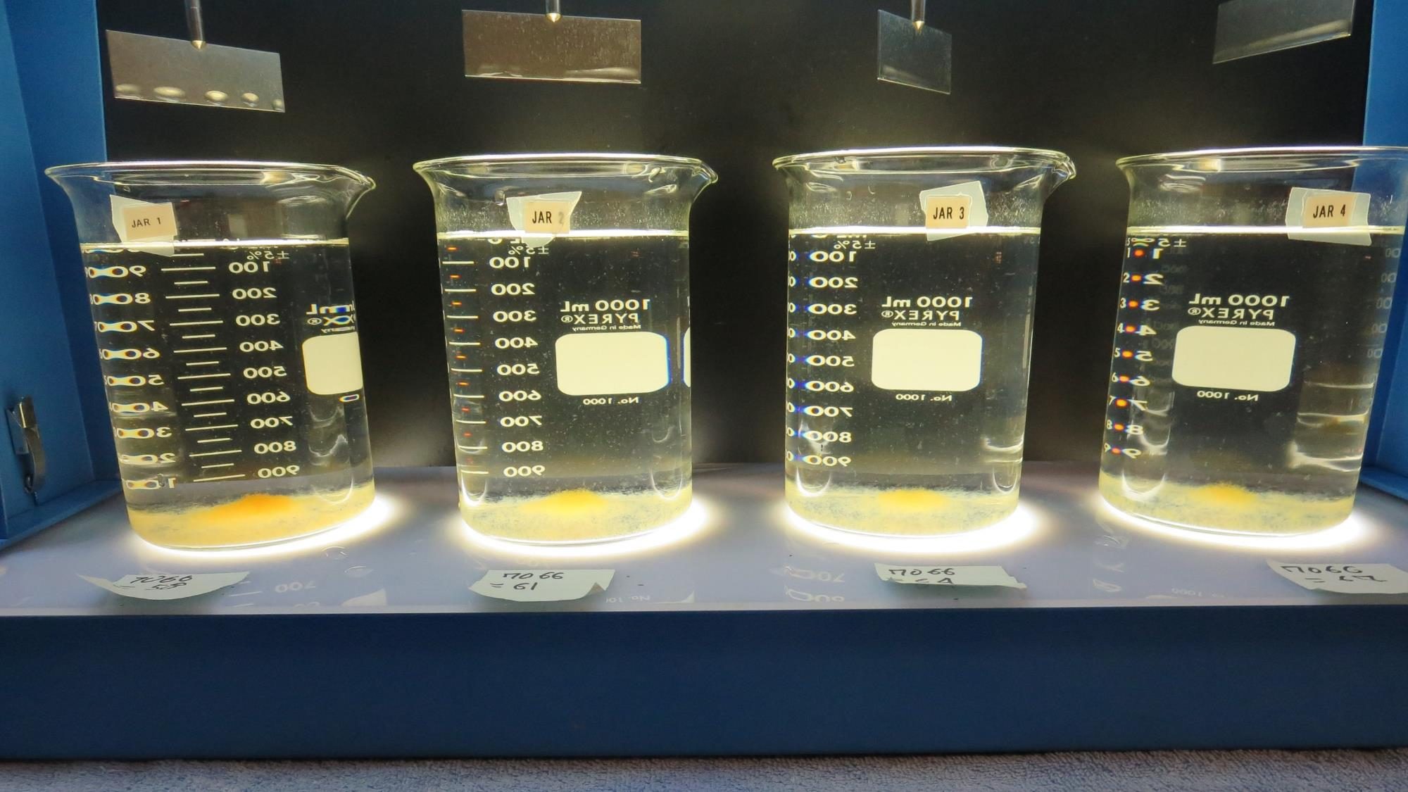
Jars 25-28: After 25-minutes of settling, settled water turbidity is taken.

Slide 41
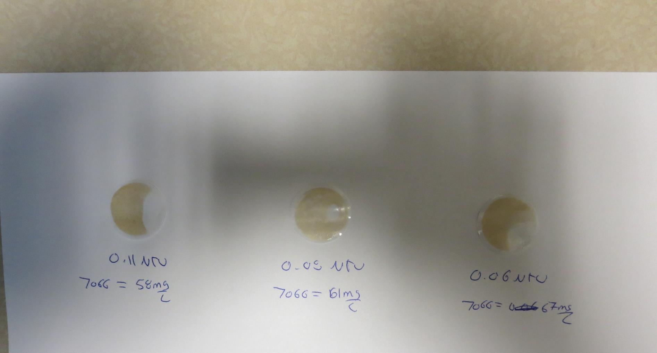
Visual of Filterability of Jars 25-28
58 mg/L 7066
Filtrate 0.11 NTU
UVT: 95.6%
UVA: 0.020/cm
Settled: 0.87 NTU
61 mg/L 7066
Filtrate 0.08 NTU
UVT: 96.2%
UVA: 0.017/cm
Settled: 0.79 NTU
67 mg/L 7066
Filtrate 0.06 NTU
UVT: 96.6%
UVA: 0.015/cm
Settled: 0.78 NTU

Slide 42
Jars 29-32 Test
Flash Mix 0 Sec (200 RPM)
Floc Mix 5 min (30 RPM)
25 mL sampled end of Floc
Applied Coagulant
7066

Slide 43
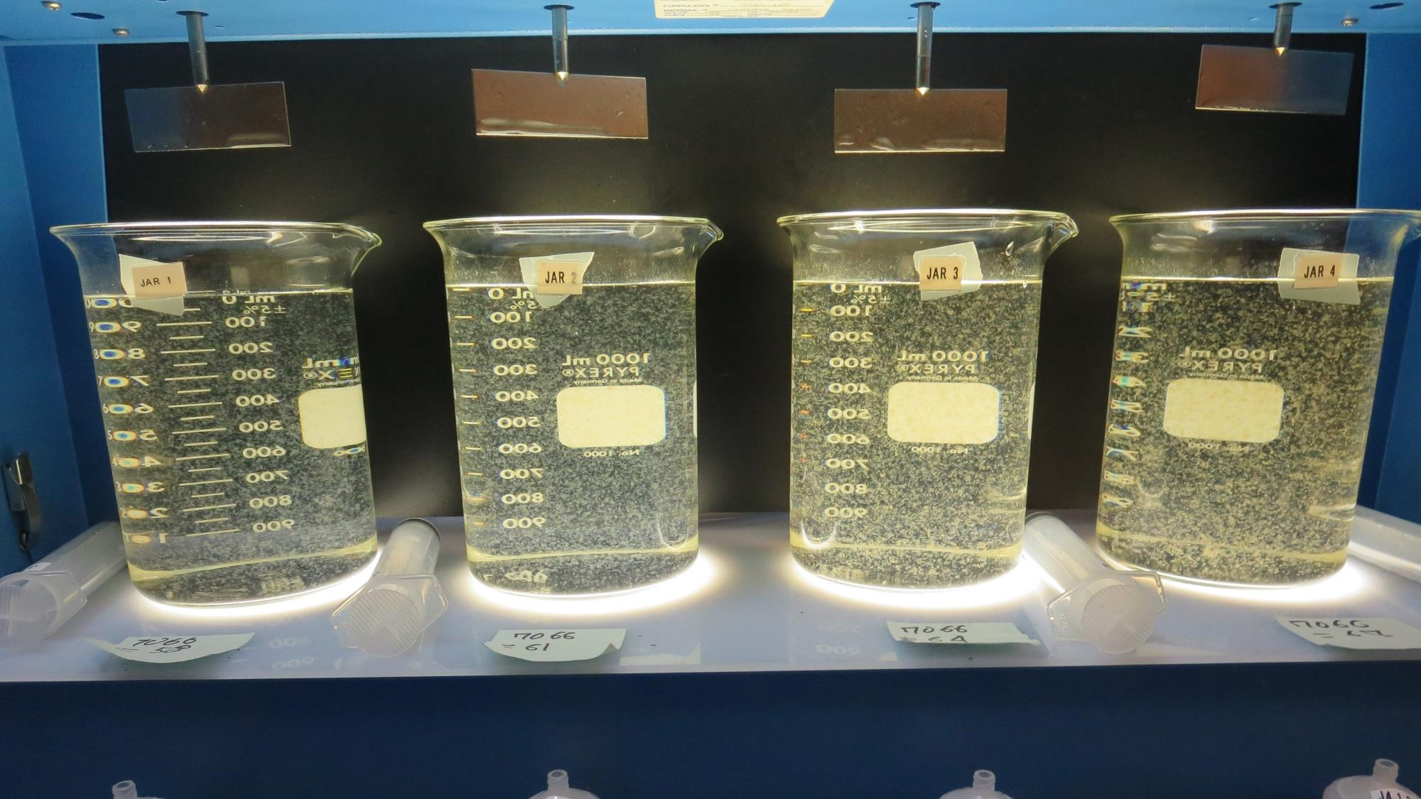
Jars 29-32: At End of Floc Duration, 25 mL is syringed for filterability and %UVT/UVA.
58 mg/L 7066
Filtrate 0.09 NTU
UVT: 95.8%
UVA: 0.019/cm
UVA Reduction: 87.7%
Settled: 0.95 NTU
61 mg/L 7066
Filtrate 0.16 NTU
UVT: 95.0%
UVA: 0.022/cm
UVA Reduction: 85.7%
Settled: 1.02 NTU
61 mg/L 7066
Filtrate 0.07 NTU
UVT: 96.4%
UVA: 0.016/cm
UVA Reduction: 89.6%
Settled: 1.08 NTU
64 mg/L 7066
Filtrate 0.06 NTU
UVT: 96.7%
UVA: 0.015/cm
UVA Reduction: 90.3%
Settled: 0.84 NTU

Slide 44
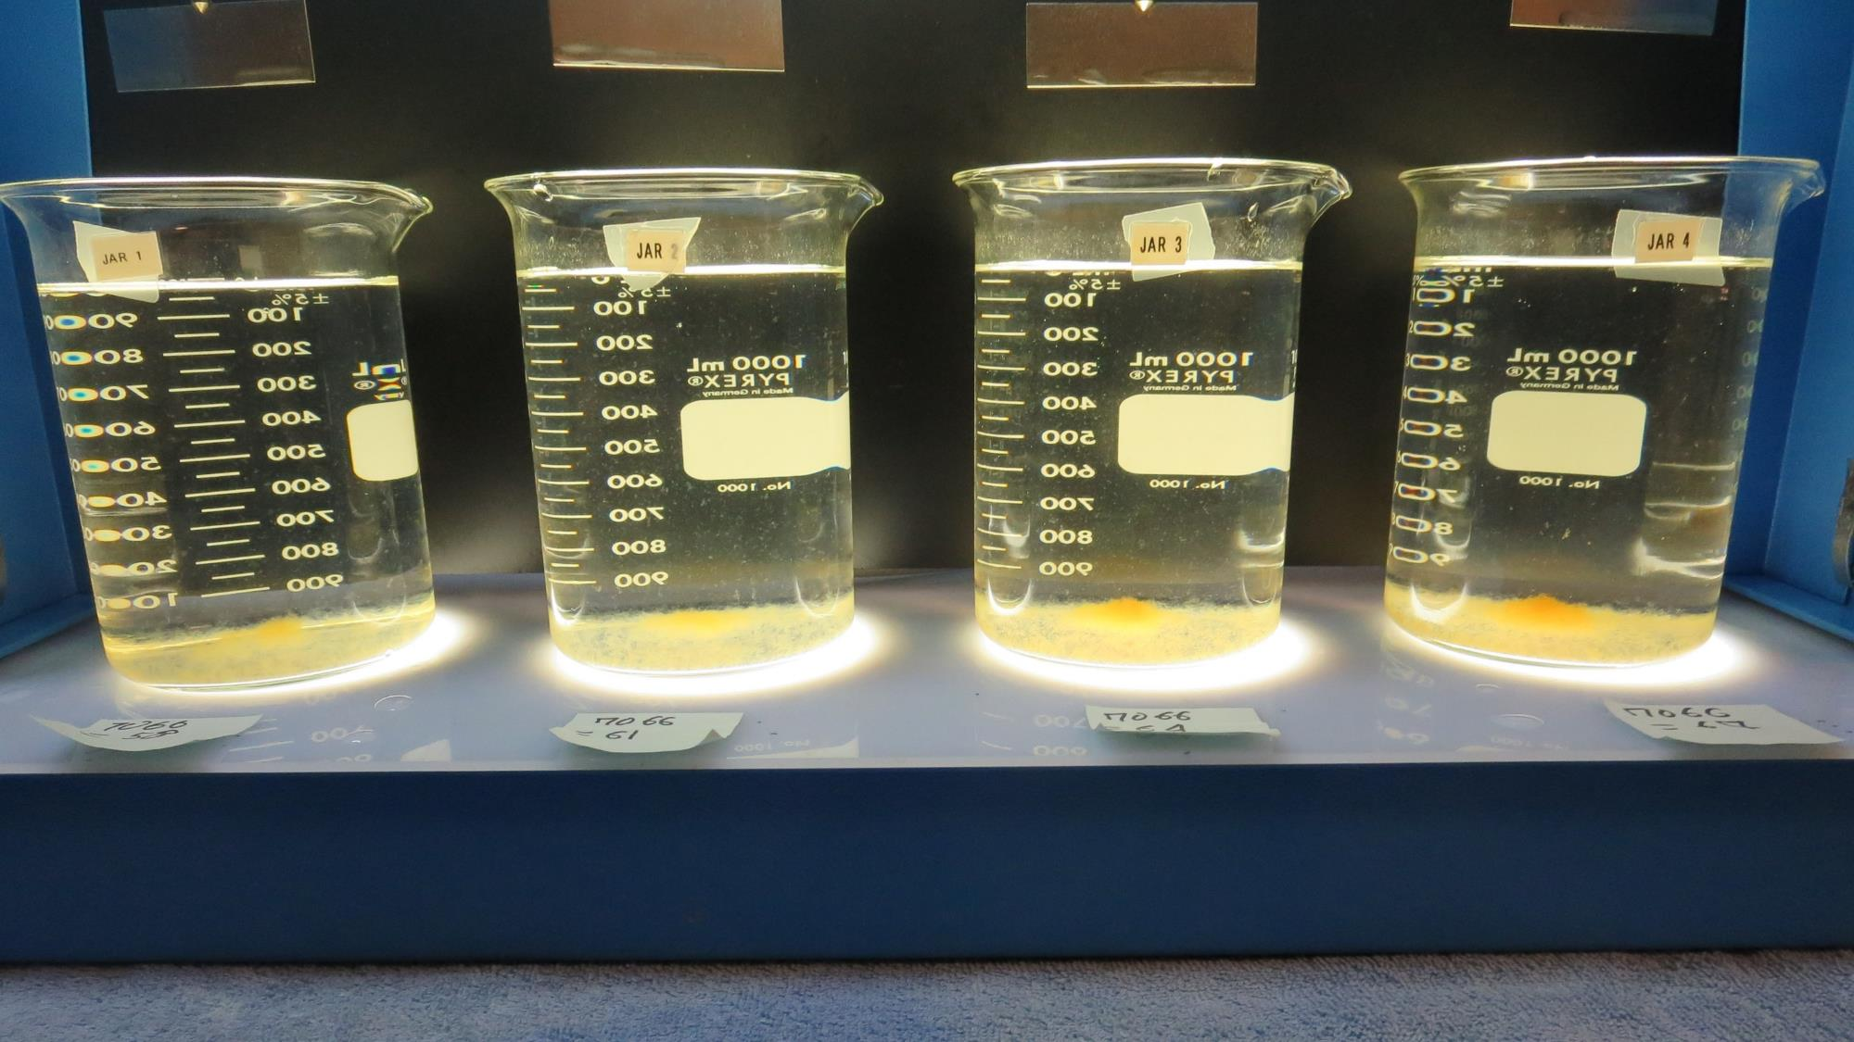
Jars 29-32: After 25-minutes of settling, settled water turbidity is taken.

Slide 45
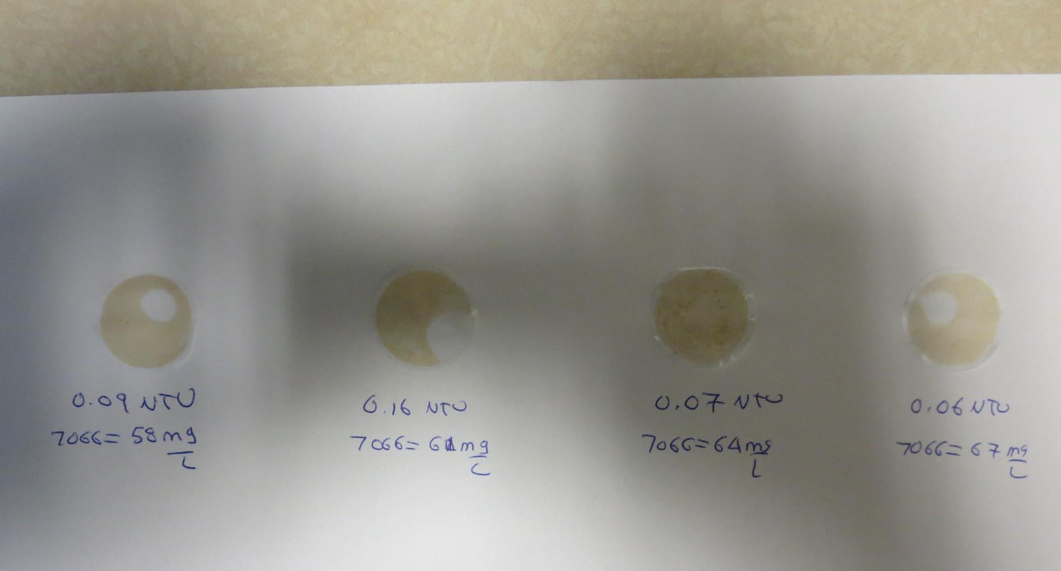
Visual of Filterability of Jars 29-32
58 mg/L 7066
Filtrate 0.09 NTU
UVT: 95.8%
UVA: 0.019/cm
Settled: 0.95 NTU
61 mg/L 7066
Filtrate 0.16 NTU
UVT: 95.0%
UVA: 0.022/cm
Settled: 1.02 NTU
61 mg/L 7066
Filtrate 0.07 NTU
UVT: 96.4%
UVA: 0.016/cm
Settled: 1.08 NTU
64 mg/L 7066
Filtrate 0.06 NTU
UVT: 96.7%
UVA: 0.015/cm
Settled: 0.84 NTU

Slide 46
Jar Testing for 1-Liter Jars:
Procedures for Most Treatment Plants
Fill jars with source water prior to coagulant injection and set paddle speed at 30 rpm
Add chemicals (i.e., NaOCl, primary coagulant, coagulant aid) to each jar
Flash mix for 15-60 seconds (200 rpm)
Slow mix for 5 minutes (20-30 rpm)
Settled for 5 minutes. Syringe 25 mL from each jar taken 1-inch below surface (25 mL/12 sec rate). For this study, sample was taken immediately at the end of flocculation process.
Filtered through 1.2 um isopore membrane into cuvette drip rate, 15 mL/(50-90 sec)
Measure filtrate turbidity, chlorine residual and %UVT/UVA
Measure settled water turbidity after 25 minutes of total setting
Record all data

Slide 47

Jar Test
Filterability Test Equipment
Turbidity Instrument
Syringe w/Luer-Lock Tip, 30 cc
(part#: 2225800, by Hach)
Swinnex Filter Holder, 25 mm (part#: SX0002500)
Isopore Membrane Filter, 1.2 um absolute
pore size,
Φ= 25 mm , thickness: 24 um,
hydrophilic polycarbonate membrane
(part #: RTTP02500)
Go to Sigma-Aldrich for laboratory supplies http://www.sigmaaldrich.com/united-states.html

Slide 48
Isopore Membrane Information
Categories | Information
trade name | Isopore
filter color | White
chemistry | Polycarbonate (PC)
water flow rate | Avg. 175 mL/min x cm² (typical results @ 10 psi)
media | Isopore®
wettability | Hydrophilic
porosity | 14.7%
pore size | 1.2 µm
bubble point at 23 °C | 1.0 bar, air with water
thickness | 24 µm
filter diameter (ø) | 25 mm
material size | polycarbonate, Hydrophilic, 1.2 µm, 25 mm, white, plain, 100

Slide 49
Isopore Membrane Background Information
The Isopore membrane is a polycarbonate, track-etched screen filter recommended for all analyses in which the sample is viewed on the surface of the membrane. The Isopore membrane is composed of polycarbonate film, which has a smooth, glass-like surface for clearer sample observation. The unique manufacturing process of the membrane ensures a precise pore diameter and a consistent pore size for accurate separation of samples by size. Matched-weight filters are not usually required because of low, constant tar and ash weights.
Features & Benefits:
Membrane structure retains particles on the surface, simplifying counting and analysis

Slide 50
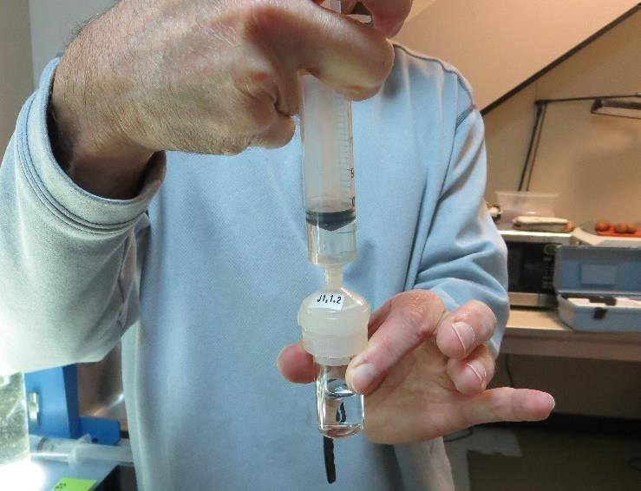

Jar Test - Filterability Test
Syringe ~ 25 mL from jar (after 5-minutes of settling)
Filter-to-waste 3-5 mL
Filter directly into clean cuvette
Measure turbidity
Note: Take several readings before recording final NTU results. Micro bubbles can adhere to glass causing false NTU readings. To remove bubbles, tilt cuvette up to 90 degrees.

Slide 51

Contact
Guy Schott, P.E.
State Water Resources Control Board
Division of Drinking Water
Santa Rosa, CA
Go to Stock Solution/Dose calculations/Jar Test Results for tools to download
www.waterboards.ca.gov/drinking_water/programs/districts/mendocino_district.html
Email: Guy Schott - Guy.Schott@waterboards.ca.gov
Office Number: 707-576-2732

