Slide 1
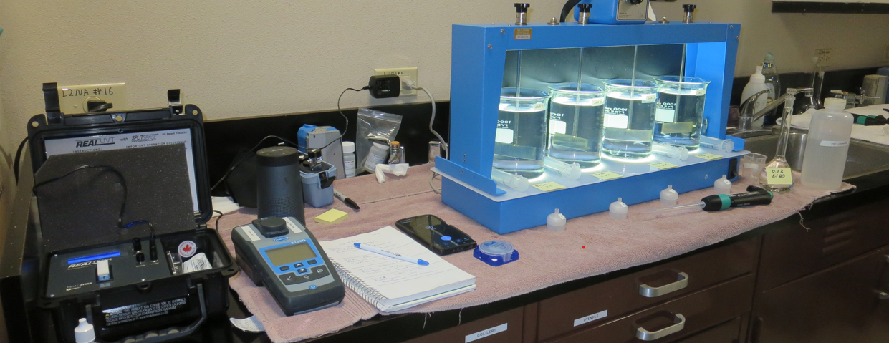
Westport County Water District CA2300730 Mendocino County Jar Test
by Guy Schott, P.E.
May 5, 2025

Slide 2
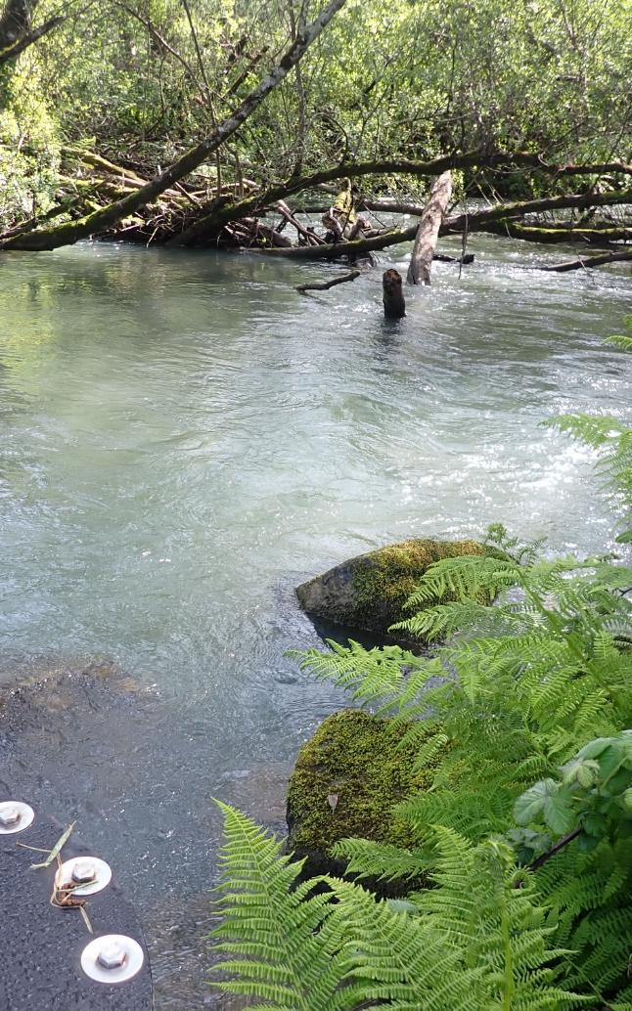
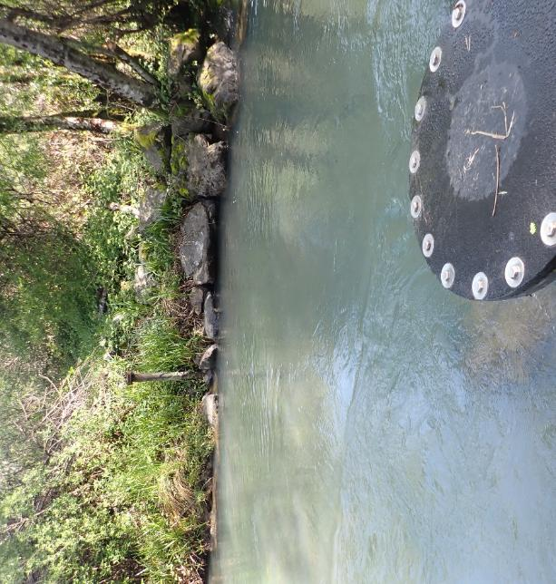
Westport CWD May 5, 2025
Wage Creek

Slide 3
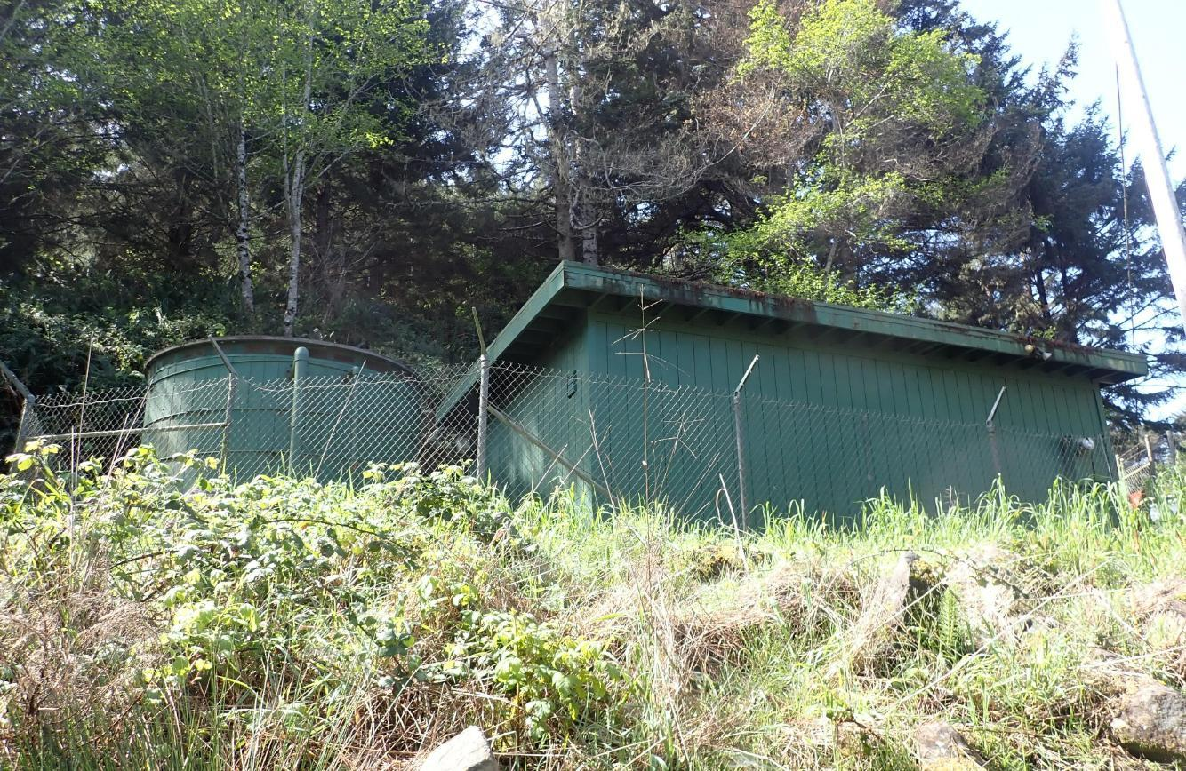
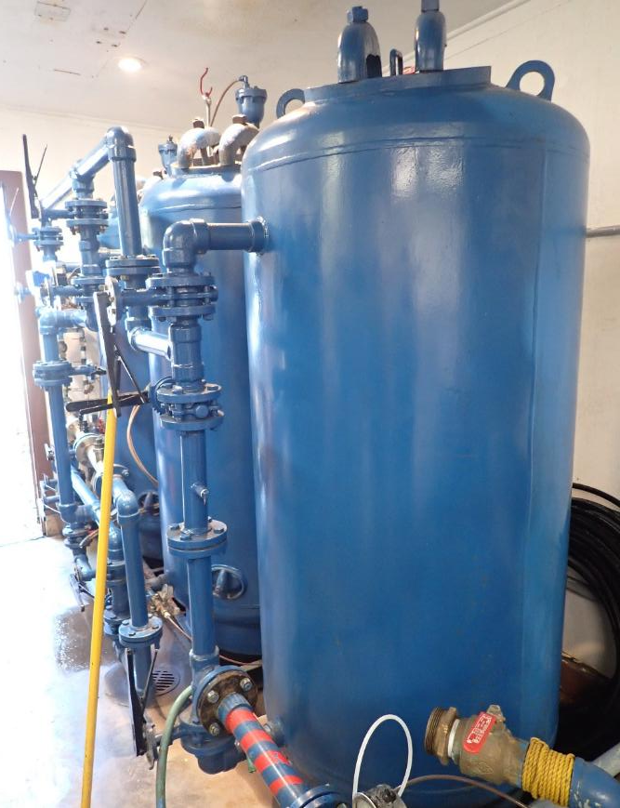
Westport CWS – Direct Filtration

Slide 4
Westport County Water District – May 5, 2025
Source – Wage Creek
Post Filtration
pH: 7.00
Fe: 0.259 mg/L
Mn: 100 ug/L
Alkalinity: 62 mg/L as CaCO₃
Turbidity: 1.08 NTU
UVT: 92.65%,
UVA: 0.0332/cm
0.4 um Filtered
Turbidity: 0.25 NTU
UVT: 93.32%,
UVA: 0.030/cm
Fe: 0.0 mg/L
Mn: 37 ug/L
Turbidity: 0.14 NTU
UVT: 97.04%,
UVA: 0.0131/cm
UVA Reduction: 56.3%

Slide 5
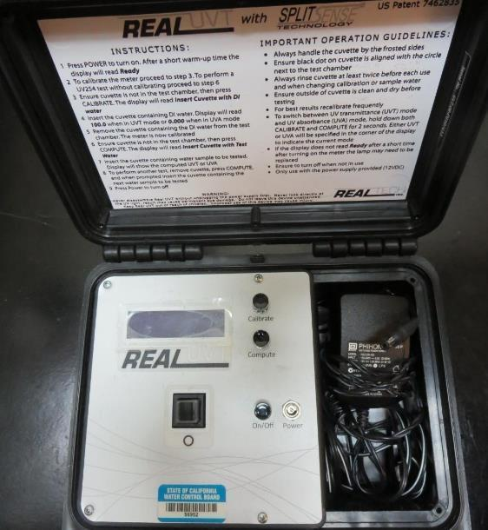
UVT/UVA, pathlength 10 mm
UV transmittance (UVT) is a measurement of the amount of ultraviolet light (commonly at 254 nm due to its germicidal effect) that passes through a water sample compared to the amount of light that passes through a pure water sample. The measurement is expressed as a percentage, % UVT.
%UVT = 10^{(-UVA)} x 100%
UV absorbance (UVA) is calculated as a relative measure of the amount of light absorbed by a water sample compared with the amount of light absorbed by a pure water sample.
UVA = -log(%UVT/100)

Slide 6
Applied Coagulants for Jar Testing
NALCO 8186
10 - 30% Aluminum Chloride Hydroxide (ACH)
Polyamine (%?)
SG = 1.14 – 1.23
NSF limit: 100 mg/L as Product

Slide 7
Coagulant Information
Unless stated otherwise, all coagulant doses are reported as Product (100% strength).
Preparation of coagulant stock solutions are generally 2.0, 1.0 or 0.1 percent strength using 100 and/or 200 mL volumetric flasks.
Finnpipette F2 variable volume pipette, capacity 100-1000 micro liters is used for stock solution preparation and coagulant aid jar test dosing.
Finnpipette F2 variable volume pipette, capacity 0.5-5 mL is used for primary coagulant jar test dosing.

Slide 8
Filtrate and %UVT/UVA Analysis
For this study, all jars were samples for Filtrate and %UVT/UVA analysis immediately at the end of the flocculation period.

Slide 9
Westport CWD; Jar Test 1 - 8 Results Flash Mix 200 RPM (20 sec); Floc Mix 20 RPM (5 min)
Jar# | NALCO 8186 mg/L | Filtrate NTU | Filtrate %UVT | Filtrate UVA/cm | %UVA Reduction
J1 | 2.30 | 0.16 | 96.42 | 0.0159 | 47.0
J2 | 2.77 | 0.36 | 94.49 | 0.0247 | 17.7
J3 | 3.23 | 0.23 | 95.31 | 0.0209 | 30.3
J4 | 3.69 | 0.25 | 94.84 | 0.0230 | 23.3
J5 | 0.92 | 0.08 | 97.46 | 0.0112 | 62.7
J6 | 1.38 | 0.04 | 97.82 | 0.0096 | 68.0
J7 | 1.84 | 0.04 | 98.07 | 0.0085 | 71.7
J8 | 2.30 | 0.12 | 97.05 | 0.0130 | 56.7

Slide 10
Westport CWD; Jar Test 9 - 16 Results Flash Mix 200 RPM (20 sec); Floc Mix 20 RPM (5 min)
Jar# | NaOCl mg/L | NALCO 8186 mg/L | Filtrate NTU | Filtrate %UVT | Filtrate UVA/cm | %UVA Reduction | Cl₂ mg/L | Mn ug/L
J9 | 0 | 1.15 | 0.15 | 97.18 | 0.0125 | 58.3 | - | -
J10 | 0 | 1.38 | 0.05 | 97.93 | 0.0091 | 69.7 | - | -
J11 | 0 | 1.61 | 0.04 | 98.12 | 0.0083 | 72.3 | - | -
J12 | 0 | 1.84 | 0.03 | 98.26 | 0.0076 | 74.7 | - | -
J13 | 0 | 1.61 | 0.04 | 98.02 | 0.0087 | 71.0 | - | -
J14 | 0 | 1.84 | 0.04 | 98.14 | 0.0082 | 72.7 | - | 94
J15 | 2.0 | 1.61 | 0.03 | 97.69 | 0.0102 | 66.0 | 2.0 | -
J16 | 2.0 | 1.84 | 0.03 | 97.90 | 0.0092 | 69.3 | 2.0 | 98

Slide 11
Westport CWD; Jar Test 17 - 20 Results Flash Mix 200 RPM (20 sec); Floc Mix 20 RPM (5 min)
Jar# | NaOCl mg/L | NALCO 8186 mg/L | Filtrate NTU | Filtrate %UVT | Filtrate UVA/cm | %UVA Reduction | Fe ug/L
J17 | 0 | 1.60 | 0.10 | 96.62 | 0.0150 | 50.0 | 23
J18 | 0 | 1.85 | 0.04 | 97.16 | 0.0125 | 58.3 | 5
J19 | 2.0 | 1.60 | 0.03 | 96.77 | 0.0143 | 52.3 | 0
J20 | 2.0 | 1.85 | 0.04 | 96.89 | 0.0138 | 54.0 | 0

Slide 12
Jars 1-4 Test Flash Mix 20 Sec (200 RPM) Floc Mix 5 min (20 RPM) 25 mL sampled end of Floc Applied Coagulant NALCO 8186

Slide 13
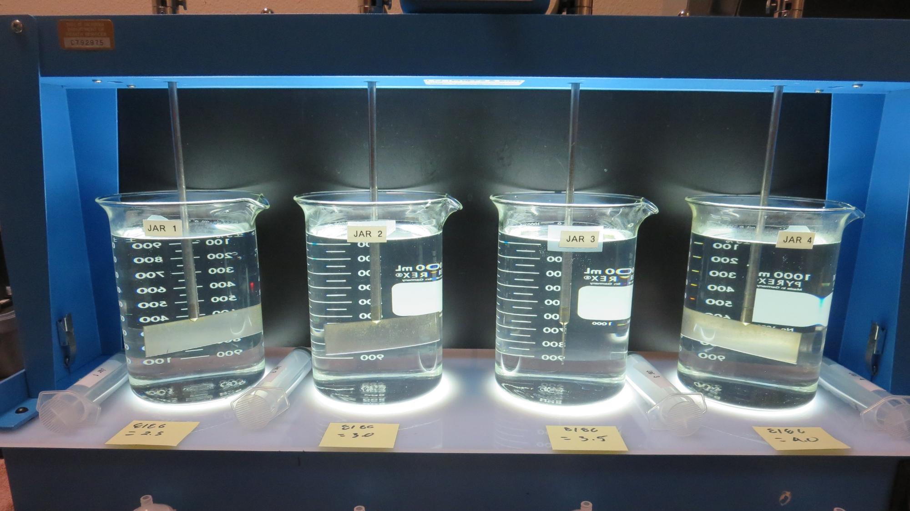
Jars 1-4: End of Floc Duration, 25 mL is syringed for filterability and %UVT/UVA.
NALCO 8186: 2.30 mg/L
Filtrate: 0.16 NTU
UVT: 97.1%
UVA: 0.0159/cm
UVA Reduction: 47.0%
NALCO 8186: 2.77 mg/L
Filtrate: 0.36 NTU
UVT: 94.49%
UVA: 0.0247/cm
UVA Reduction: 17.7%
NALCO 8186: 3.23 mg/L
Filtrate: 0.23 NTU
UVT: 94.49%
UVA: 0.0209/cm
UVA Reduction: 30.3%
NALCO 8186: 3.69 mg/L
Filtrate: 0.25 NTU
UVT: 94.84%
UVA: 0.0230/cm
UVA Reduction: 23.3%

Slide 14
Jars 5-8 Test Flash Mix 20 Sec (200 RPM) Floc Mix 5 min (20 RPM) 25 mL sampled end of Floc Applied Coagulant NALCO 8186

Slide 15
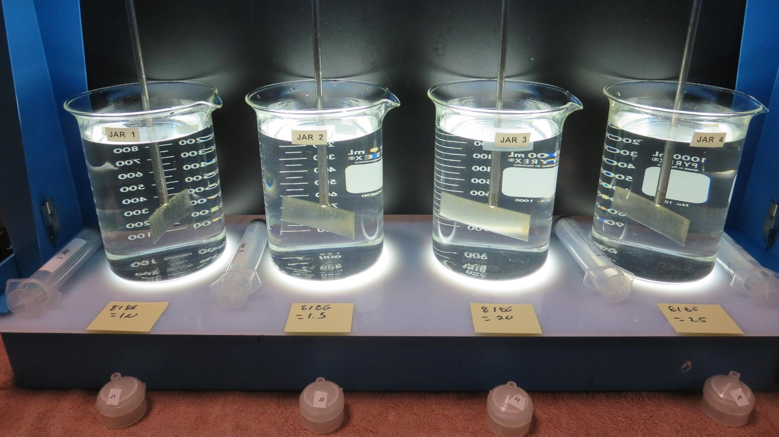
Jars 5-8: End of Floc Duration, 25 mL is syringed for filterability and %UVT/UVA.
NALCO 8186: 0.92 mg/L
Filtrate: 0.08 NTU
UVT: 97.46%
UVA: 0.0112/cm
UVA Reduction: 62.7%
NALCO 8186: 1.38 mg/L
Filtrate: 0.04 NTU
UVT: 97.82
UVA: 0.0096/cm
UVA Reduction: 68.0%
NALCO 8186: 1.84 mg/L
Filtrate: 0.04 NTU
UVT: 98.07
UVA: 0.0085/cm
UVA Reduction: 71.7%
NALCO 8186: 2.30 mg/L
Filtrate: 0.12 NTU
UVT: 98.07
UVA: 0.0085/cm
UVA Reduction: 71.7%

Slide 16
Jars 9-12 Test Flash Mix 20 Sec (200 RPM) Floc Mix 5 min (20 RPM) 25 mL sampled end of Floc Applied Coagulant NALCO 8186

Slide 17
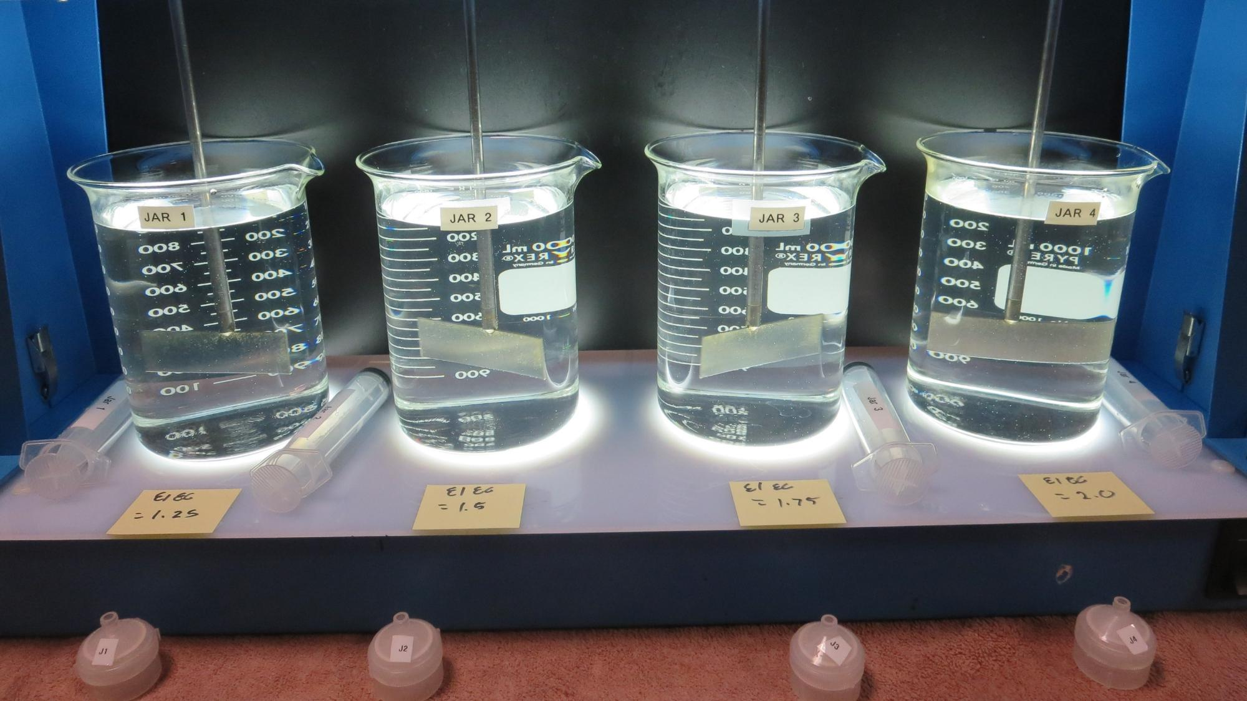
Jars 9-12: End of Floc Duration, 25 mL is syringed for filterability and %UVT/UVA.
NALCO 8186: 1.15 mg/L
Filtrate: 0.15 NTU
UVT: 97.18%
UVA: 0.0125/cm
UVA Reduction: 58.3%
NALCO 8186: 1.38 mg/L
Filtrate: 0.05 NTU
UVT: 97.93%
UVA: 0.0091/cm
UVA Reduction: 69.7%
NALCO 8186: 1.61 mg/L
Filtrate: 0.04 NTU
UVT: 98.12%
UVA: 0.0083/cm
UVA Reduction: 72.3%
NALCO 8186: 1.84 mg/L
Filtrate: 0.03 NTU
UVT: 98.23%
UVA: 0.0076/cm
UVA Reduction: 74.7%

Slide 18
Jars 13-16 Test Flash Mix 20 Sec (200 RPM) Floc Mix 5 min (20 RPM) 25 mL sampled end of Floc Applied Coagulant NALCO 8186

Slide 19
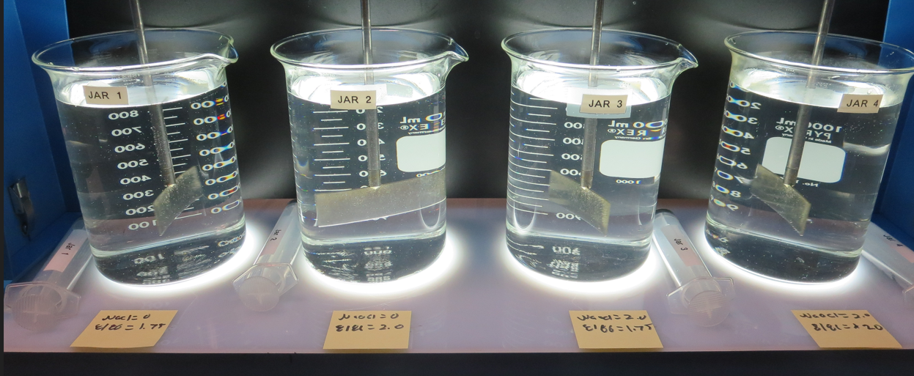
Jars 13-16: End of Floc Duration, 25 mL is syringed for filterability and %UVT/UVA.
NaOCl: 0 mg/L
NALCO 8186: 1.61 mg/L
Filtrate: 0.04 NTU
UVT: 98.02%
UVA: 0.0087/cm
UVA Reduction: 71.0%
NaOCl: 0 mg/L
NALCO 8186: 1.84 mg/L
Filtrate: 0.04 NTU
UVT: 98.14%
UVA: 0.0082/cm
UVA Reduction: 72.7%
NaOCl: 2.0 mg/L
NALCO 8186: 1.61 mg/L
Filtrate: 0.03 NTU
UVT: 97.69%
UVA: 0.0102/cm
UVA Reduction: 66.0%
NaOCl: 2.0 mg/L
NALCO 8186: 1.84 mg/L
Filtrate: 0.03 NTU
UVT: 97.90%
UVA: 0.0092/cm
UVA Reduction: 69.3%

Slide 20
Jars 17-20 Test Flash Mix 20 Sec (200 RPM) Floc Mix 5 min (20 RPM) 25 mL sampled end of Floc Applied Coagulant NALCO 8186

Slide 21
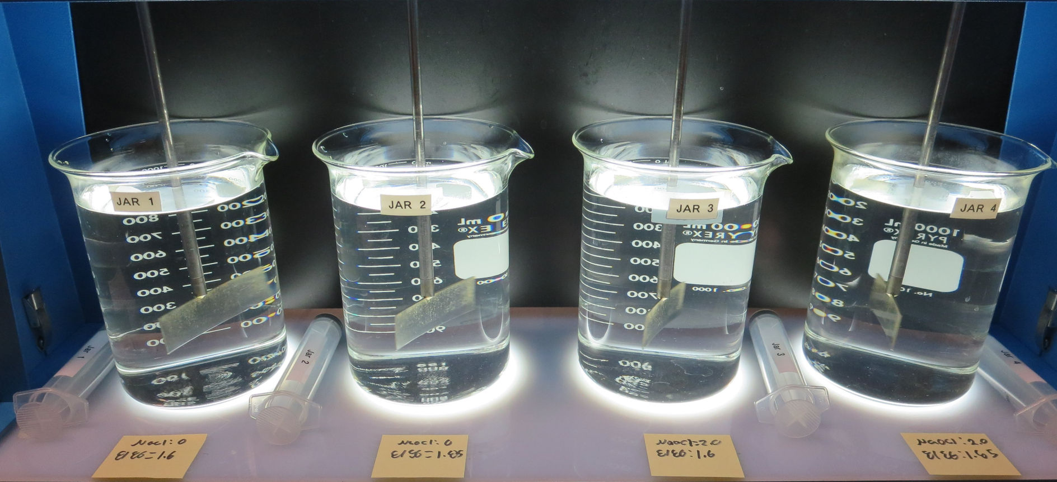
Jars 17-20: End of Floc Duration, 25 mL is syringed for filterability and %UVT/UVA. Note: jar tested 12 days after collection.
NaOCl: 0 mg/L
NALCO 8186: 1.60 mg/L
Filtrate: 0.10 NTU
UVT: 96.62%
UVA: 0.0150/cm
UVA Reduction: 50.0%
NaOCl: 0 mg/L
NALCO 8186: 1.85 mg/L
Filtrate: 0.04 NTU
UVT: 97.16%
UVA: 0.0125/cm
UVA Reduction: 58.3%
NaOCl: 2.0 mg/L
NALCO 8186: 1.60 mg/L
Filtrate: 0.03 NTU
UVT: 96.77%
UVA: 0.0143/cm
UVA Reduction: 52.3%
NaOCl: 2.0 mg/L
NALCO 8186: 1.85 mg/L
Filtrate: 0.04 NTU
UVT: 96.89%
UVA: 0.0138/cm
UVA Reduction: 54.0%

Slide 22
Jar Testing for 1-Liter Jars: Procedures for Most Treatment Plants
Fill jars with source water prior to coagulant injection and set paddle speed at 20-30 rpm
Add chemicals (i.e., NaOCl, primary coagulant, coagulant aid) to each jar
Flash mix for 15-30 seconds (200 rpm)
Slow mix for 5 minutes (20-30 rpm)
Settled for 5 minutes. Syringe 25 mL from each jar taken 1-inch below surface (25 mL/12 sec rate). For this study, samples were taken immediately at the end of flocculation process.
Filtered through 1.2 um isopore membrane into cuvette drip rate, 15 mL/(50-90 sec)
Measure filtrate turbidity, chlorine residual and %UVT/UVA
Measure settled water turbidity after 25 minutes of total setting
Record all data

Slide 23
Jar Test Filterability Test Equipment
Turbidity Instrument
Syringe w/Luer-Lock Tip, 30 cc
(part#: 2225800, by Hach)
Swinnex Filter Holder, 25 mm (part#: SX0002500)
Isopore Membrane Filter, 1.2 um absolute
pore size,
Φ= 25 mm , thickness: 24 um,
hydrophilic polycarbonate membrane
(part #: RTTP02500)
Go to Sigma-Aldrich for laboratory supplies http://www.sigmaaldrich.com/united-states.html

Slide 24
Isopore Membrane Information
Categories | Information
trade name | Isopore
filter color | White
chemistry | Polycarbonate (PC)
water flow rate | Avg. 175 mL/min x cm² (typical results @ 10 psi)
media | Isopore®
wettability | Hydrophilic
porosity | 14.7%
pore size | 1.2 µm
bubble point at 23 °C | 1.0 bar, air with water
thickness | 24 µm
filter diameter (ø) | 25 mm
material size | polycarbonate, Hydrophilic, 1.2 µm, 25 mm, white, plain, 100

Slide 25
Isopore Membrane Background Information
The Isopore membrane is a polycarbonate, track-etched screen filter recommended for all analyses in which the sample is viewed on the surface of the membrane. The Isopore membrane is composed of polycarbonate film, which has a smooth, glass-like surface for clearer sample observation. The unique manufacturing process of the membrane ensures a precise pore diameter and a consistent pore size for accurate separation of samples by size. Matched-weight filters are not usually required because of low, constant tar and ash weights. Features & Benefits: Membrane structure retains particles on the surface, simplifying counting and analysis

Slide 26
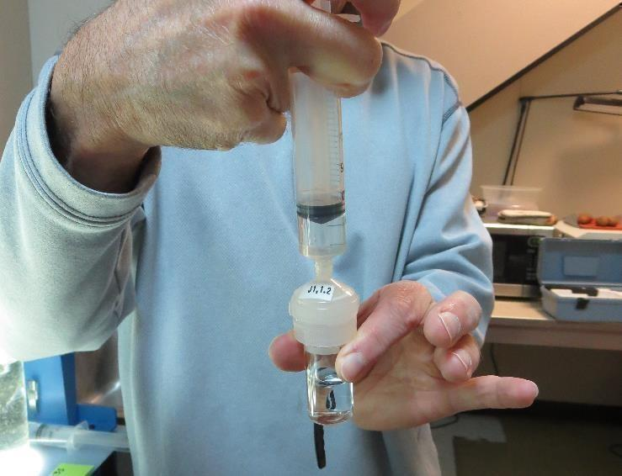
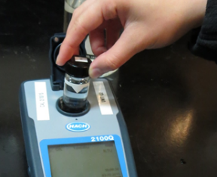
Jar Test - Filterability Test
Syringe ~ 25 mL from jar (after 5-minutes of settling)
Filter-to-waste 3-5 mL
Filter directly into clean cuvette
Measure turbidity
Note: Take several readings before recording final NTU results. Micro bubbles can adhere to glass causing false NTU readings. To remove bubbles, tilt cuvette up to 90 degrees.

Slide 27
Contact
Guy Schott, P.E.
State Water Resources Control Board
Division of Drinking Water
Santa Rosa, CA
Go to Jar Test Results/Procedures for tools to download
www.waterboards.ca.gov/drinking_water/programs/districts/mendocino_district.html
Jar Testing Done Right video training https://youtu.be/aGByyxhelkI
Email: Guy Schott - Guy.Schott@waterboards.ca.gov
Office Number: 707-576-2732

