Slide 1
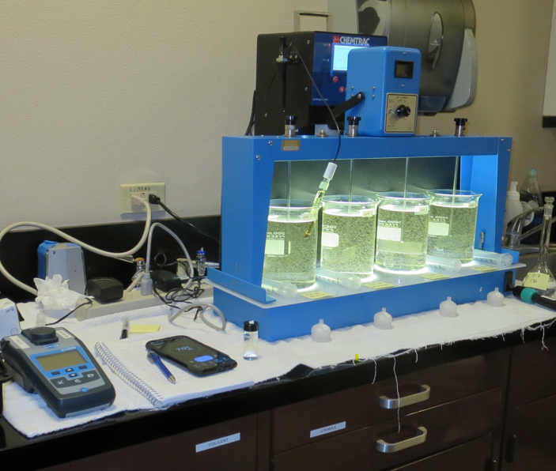
City of St. Helena CA2810004 Napa County Jar Test
by Guy Schott, P.E.
August 28-29, 2024

Slide 2
Source Water: Bell Canyon Reservoir
Source Water Characteristics
Turbidity: 3.8 NTU
UVT: 70.2%
UVA: 0.153
0.4 um Filtered
Turbidity: 0.45 NTU
UVT: 77%
UVA: 0.113

Slide 3
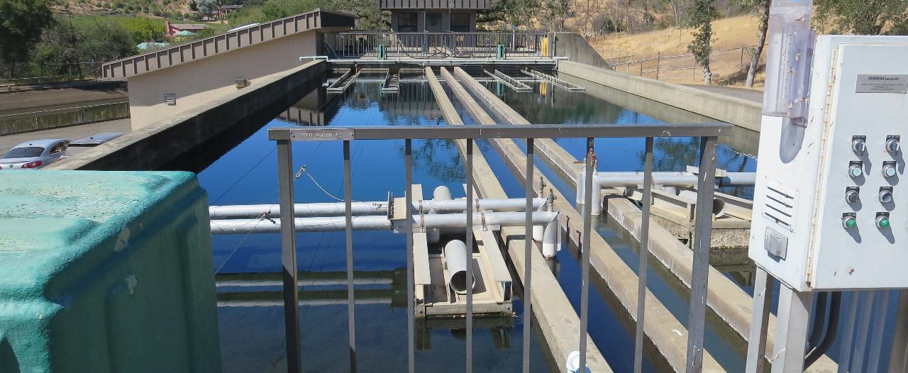
Flocculation/Sedimentation Basins

Slide 4
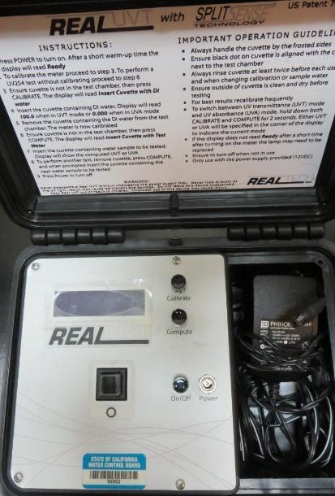
UVT/UVA, pathlength 10 mm
UV transmittance (UVT) is a measurement of the amount of ultraviolet light (commonly at 254 nm due to its germicidal effect) that passes through a water sample compared to the amount of light that passes through a pure water sample. The measurement is expressed as a percentage, % UVT.
%UVT = 10^{(-UVA)} x 100%
UV absorbance (UVA) is calculated as a relative measure of the amount of light absorbed by a water sample compared with the amount of light absorbed by a pure water sample.
UVA = -log(%UVT/100)

Slide 5
Applied Coagulants for Jar Testing (1)
Aluminum Sulfate (Product)
Al₂(SO₄)₃*14.3H₂0 (Liquid)
48% Aluminum Sulfate
52% Water
8.2% Al₂O₃
4.3% Al
0% Basicity
SG = 1.32
NSF max use: 400 mg/L (product)
As hydrated Al₂(SO₄)₃*14.3H₂0
17% Al₂O₃
NALCLEAR 8170 PULV (Nalco)
Flocculant
Dry
Polyacrylamide
NSF max use: 1 mg/L

Slide 6
Applied Coagulants for Jar Testing (2)
Pro Pac 917 (NTU Technologies)
10% polyamine (50% water, 50% active polyamines)
45% Aluminum Chlorohydrate (ACH)
~21.3% Al₂O₃
~11.3% Al
45% Water
83% Basicity
SG = 1.25-1.34
NSF limit: 100 mg/L as Product
961 (NTU Technologies)
32% Polyaluminum Hydroxychlorosulfate
2% pDADMAC
66% Water
SG = 1.2-1.24
NSF limit: 255 mg/L as Product
Product dose 10 mg/L = 0.1-0.2 mg/L pDADMAC

Slide 7
Coagulant Information
Unless stated otherwise, all coagulant doses are reported as Product (100% strength). Aluminum sulfate is reported as Alum.
Preparation of coagulant stock solutions are generally 1.0 and/or 0.1 percent strength using 100 and/or 200 mL volumetric flasks.
Finnpipette F2 variable volume pipette, capacity 100-1000 micro liters is used for stock solution preparation and coagulant aid jar test dosing.
Finnpipette F2 variable volume pipette, capacity 0.5-5 mL is used for primary coagulant jar test dosing.

Slide 8
City of St. Helena : Jar Test 1-8 Results Flash Mix 200 RPM (20 sec); Floc Mix 30 RPM (5 min)
Jar # | NaOCl mg/L | 917 mg/L | Filtrate NTU | Filtrate %UVT | Filtrate UVA/cm | %UVA Reduction | Settle NTU 25 min
J1 | 0 | 22 | 0.06 | 89.1 | 0.0501 | 55.7 | 0.44
J2 | 0 | 26 | 0.09 | 89.9 | 0.0463 | 59.0 | 0.38
J3 | 0 | 30 | 0.08 | 89.9 | 0.0461 | 59.2 | 0.59
J4 | 0 | 34 | 0.07 | 90.5 | 0.0436 | 61.4 | 1.11
J5 | 2.0 | 22 | 0.06 | 91.6 | 0.037 | 67.3 | 0.38
J6 | 2.0 | 26 | 0.05 | 91.6 | 0.037 | 67.3 | 0.36
J7 | 2.0 | 30 | 0.04 | 91.9 | 0.036 | 68.1 | 0.54
J8 | 2.0 | 34 | 0.06 | 92.8 | 0.032 | 71.7 | 0.61
Source water jar testing was taken after Post NaMnO₄

Slide 9
City of St. Helena : Jar Test 9-16 Results Flash Mix 200 RPM (20 sec); Floc Mix 30 RPM (5 min)
Jar # | NaOCl mg/L | 917 mg/L | Filtrate NTU | Filtrate %UVT | Filtrate UVA/cm | %UVA Reduction | Settle NTU 25 min
J9 | 2.0 | 35 | 0.06 | 92.1 | 0.035 | 69.0 | 0.42
J10 | 2.0 | 40 | 0.11 | 92.8 | 0.034 | 69.9 | 0.72
J11 | 2.0 | 45 | 0.09 | 91.6 | 0.038 | 66.4 | 0.98
J12 | 2.0 | 45 | 0.07 | 91.9 | 0.036 | 68.1 | 1.22
J13 | 2.0 | 50 | 0.09 | 92.5 | 0.033 | 70.8 | -
J14 | 2.0 | 55 | 0.08 | 92.6 | 0.033 | 70.8 | -
J15 | 2.0 | 60 | 0.06 | 92.6 | 0.033 | 70.8 | -
J16 | 2.0 | 65 | 0.13 | 92.4 | 0.034 | 69.9 | -
Source water jar testing was taken after Post NaMnO₄

Slide 10
City of St. Helena : Jar Test 17-20 Results Flash Mix 200 RPM (20 sec); Floc Mix 30 RPM (5 min)
Jar # | NaOCl mg/L | 917 mg/L | Filtrate NTU | Filtrate %UVT | Filtrate UVA/cm | %UVA Reduction | Settle NTU 25 min
J17 | 2.0 | 60 | 0.09 | 90.9 | 0.041 | 63.7 | -
J18 | 2.0 | 65 | 0.05 | 92.9 | 0.031 | 66.7 | -
J19 | 2.0 | 70 | 0.15 | 91.3 | 0.039 | 65.5 | -
J20 | 2.0 | 75 | 0.29 | 89.3 | 0.048 | 57.5 | 4.9
Source water jar testing was taken after Post NaMnO₄

Slide 11
City of St. Helena: Jar Test 21-28 Results Flash Mix 200 RPM (20 sec); Floc Mix 30 RPM (5 min)
Jar # | NaOCl mg/L | Alum mg/L | Filtrate NTU | Filtrate %UVT | Filtrate UVA/cm | %UVA Reduction | Settle NTU 25 min
J21 | 0 | 40 | 0.05 | 89.68 | 0.0473 | 58.14 | -
J22 | 0 | 45 | 0.05 | 90.21 | 0.0448 | 60.35 | -
J23 | 0 | 50 | 0.07 | 90.28 | 0.0444 | 60.71 | -
J24 | 0 | 55 | 0.08 | 91.06 | 0.0398 | 64.78 | -
J25 | 2.0 | 45 | 0.08 | 90.46 | 0.0436 | 61.42 | -
J26 | 2.0 | 50 | 0.07 | 91.07 | 0.0406 | 64.07 | -
J27 | 2.0 | 55 | 0.05 | 91.24 | 0.0399 | 64.69 | -
J28 | 2.0 | 60 | 0.04 | 91.71 | 0.0376 | 66.73 | 0.34

Slide 12
City of St. Helena: Jar Test 29-32 Results Flash Mix 200 RPM (20 sec); Floc Mix 30 RPM (5 min)
Jar # | NaOH mg/L | Alum mg/L | 8170 mg/L | Filtrate NTU | Filtrate %UVT | Filtrate UVA/cm | %UVA Reduction | Settle NTU 25 min
J29 | 0 | 60 | 0 | 0.05 | 91.07 | 0.0406 | 64.07 | 0.30
J30 | 0 | 90 | 0.3 | 0.07 | 90.94 | 0.0413 | 63.45 | 0.40
J31 | 2.0 | 60 | 0.3 | 0.05 | 91.65 | 0.0379 | 66.45 | 0.42
J32 | 2.0 | 60 | 0 | 0.05 | 91.88 | 0.0368 | 67.43 | 0.27

Slide 13
City of St. Helena: Jar Test 33-36 Results Flash Mix 200 RPM (20 sec); Floc Mix 30 RPM (5 min)
Jar # | 961 mg/L | Filtrate NTU | Filtrate %UVT | Filtrate UVA/cm | %UVA Reduction | Settle NTU 25 min
J33 | 70 | 0.06 | 89.82 | 0.0466 | 58.76 | 0.24
J34 | 80 | 0.07 | 90.30 | 0.0444 | 60.71 | 0.26
J35 | 90 | 0.11 | 90.67 | 0.0426 | 62.30 | 0.29
J36 | 100 | 0.06 | 90.81 | 0.0419 | 62.93 | 0.30

Slide 14
Jar Testing for 1-Liter Jars: Procedures for Most Treatment Plants
Fill jars with source water prior to coagulant injection and set paddle speed at 30 rpm
Add chemicals (i.e., NaOCl, primary coagulant, coagulant aid) to each jar
Flash mix for 15-60 seconds (200 rpm)
Slow mix for 5 minutes (20-30 rpm)
Settled for 5 minutes. Syringe 25 mL from each jar taken 1-inch below surface (25 mL/12 sec rate)
Filtered through 1.2 um isopore membrane into cuvette drip rate, 15 mL/(50-90 sec)
Measure filtrate turbidity, chlorine residual and %UVT/UVA
Measure settled water turbidity after 25 minutes of total setting
Record all data

Slide 15
Jar Test Filterability Test Equipment
Turbidity Instrument
Syringe w/Luer-Lock Tip, 30 cc
(part#: 2225800, by Hach)
Swinnex Filter Holder, 25 mm (part#: SX0002500)
Isopore Membrane Filter, 1.2 um absolute
pore size,
Φ= 25 mm , thickness: 24 um,
hydrophilic polycarbonate membrane
(part #: RTTP02500)
Go to Sigma-Aldrich for laboratory supplies http://www.sigmaaldrich.com/united-states.html

Slide 16
Isopore Membrane Information
Categories | Information
trade name | Isopore
filter color | White
chemistry | Polycarbonate (PC)
water flow rate | Avg. 175 mL/min x cm² (typical results @ 10 psi)
media | Isopore®
wettability | Hydrophilic
porosity | 14.7%
pore size | 1.2 µm
bubble point at 23 °C | 1.0 bar, air with water
thickness | 24 µm
filter diameter (ø) | 25 mm
material size | polycarbonate, Hydrophilic, 1.2 µm, 25 mm, white, plain, 100

Slide 17
Isopore Membrane Background Information
The Isopore membrane is a polycarbonate, track-etched screen filter recommended for all analyses in which the sample is viewed on the surface of the membrane. The Isopore membrane is composed of polycarbonate film, which has a smooth, glass-like surface for clearer sample observation. The unique manufacturing process of the membrane ensures a precise pore diameter and a consistent pore size for accurate separation of samples by size. Matched-weight filters are not usually required because of low, constant tar and ash weights. Features & Benefits: Membrane structure retains particles on the surface, simplifying counting and analysis

Slide 18
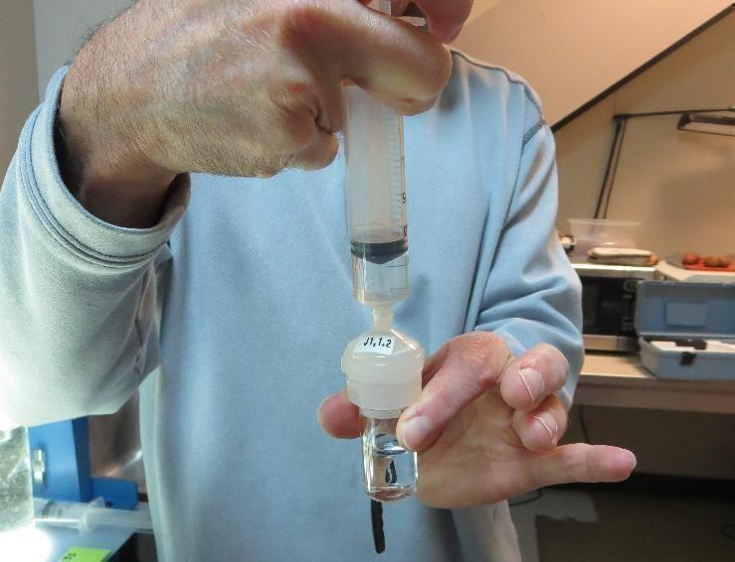
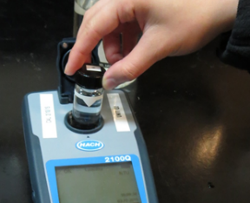
Jar Test - Filterability Test
Syringe ~ 25 mL from jar (after 5-minutes of settling)
Filter-to-waste 3-5 mL
Filter directly into clean cuvette
Measure turbidity
Note: Take several readings before recording final NTU results. Micro bubbles can adhere to glass causing false NTU readings. To remove bubbles, tilt cuvette up to 90 degrees.

Slide 19
Contact
Guy Schott, P.E.
State Water Resources Control Board
Division of Drinking Water
Santa Rosa, CA
Go to Stock Solution/Dose calculations/Jar Test Results for tools to download
www.waterboards.ca.gov/drinking_water/programs/districts/mendocino_district.html
Jar Testing Done Right training video: https://www.youtube.com/watch?v=aGByyxhelkI
Email: Guy Schott - Guy.Schott@waterboards.ca.gov
Office Number: 707-576-2732

