Slide 1
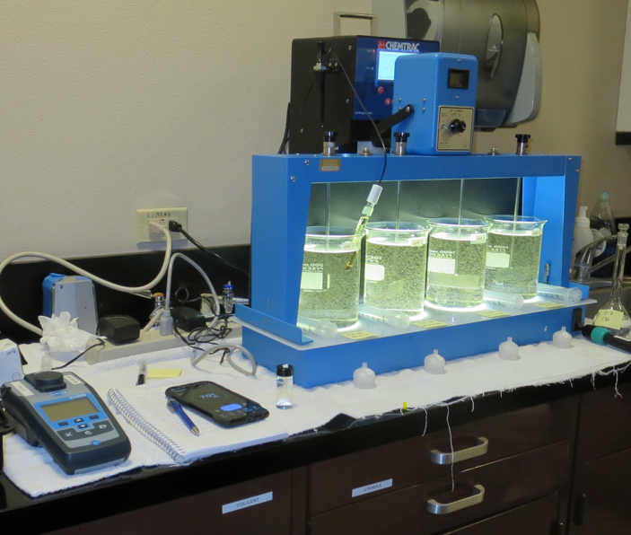
City of St. Helena CA2810004 Napa County Jar Test
by Guy Schott, P.E.
September 14, 2024

Slide 2
Source Water: Bell Canyon Reservoir
Source Water Characteristics
Turbidity: 8.94 NTU
pH: 7.21
UVT: 69.21%
UVA: 0.1599/cm
0.4 um Filtered
UVT: 73.46%
UVA: 0.1340/cm

Slide 3
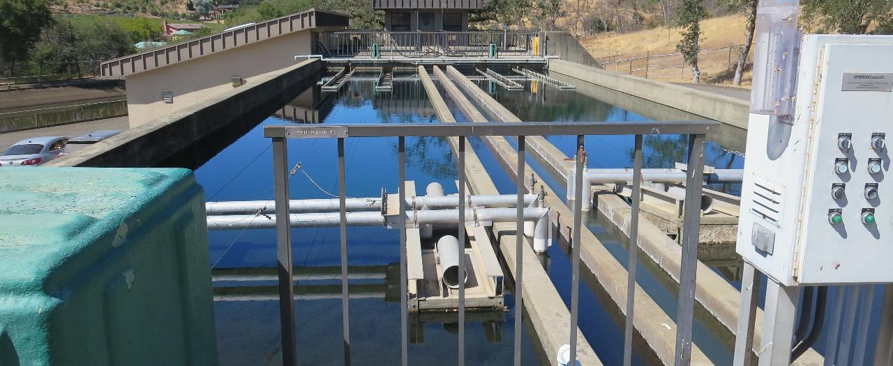
Flocculation/Sedimentation Basins

Slide 4
Bell Canyon Reservoir Source & Treated Water Characteristics, September 5, 2024
Source – Bell Canyon Reservoir
pH: 7.29
Alkalinity: 33.4 mg/L as CaCO₃
Turbidity: 3.52 NTU
UVT: 66.54%,
UVA: 0.177/cm
0.4 um Filtered
Turbidity: 1.11 NTU
UVT: 68.60%,
UVA: 0.1637/cm
Filter 1 Water
pH: 6.50
Alkalinity: 12.6 mg/L as CaCO₃
0.12 NTU
UVT: 91.25%,
UVA: 0.0398/cm
Clearwell Water
pH: 7.51
Alkalinity: 28.2 mg/L as CaCO₃
0.63 NTU
UVT: 91.83%,
UVA: 0.0370/cm

Slide 5
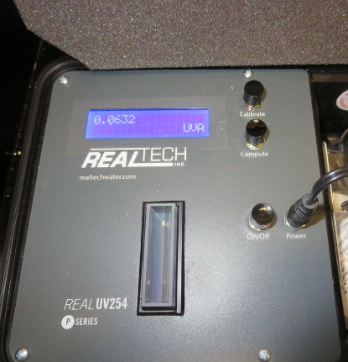
UVT/UVA, pathlength 40 mm
UV transmittance (UVT) is a measurement of the amount of ultraviolet light (commonly at 254 nm due to its germicidal effect) that passes through a water sample compared to the amount of light that passes through a pure water sample. The measurement is expressed as a percentage, % UVT.
%UVT = 10^{(-UVA)} x 100%
UV absorbance (UVA) is calculated as a relative measure of the amount of light absorbed by a water sample compared with the amount of light absorbed by a pure water sample.
UVA = -log(%UVT/100)

Slide 6
Applied Coagulants for Jar Testing (1)
Aluminum Sulfate (Product)
Al₂(SO₄)₃*14.3H₂0 (Liquid)
47.47% Aluminum Sulfate
52% Water
8.08% Al₂O₃
0% Basicity
SG = 1.325
NSF max use: 400 mg/L (product)
As hydrated Al₂(SO₄)₃*14.3H₂0
17% Al₂O₃
Ferric Chloride
42.4% Ferric Chloride
47.6% Water
SG = 1.44
NSF limit: 250 mg/L as Product

Slide 7
Applied Coagulants for Jar Testing (2)
Pro Pac 917 (NTU Technologies, Inc.)
10% polyamine (50% water, 50% active polyamines)
45% Aluminum Chlorohydrate (ACH)
~21.3% Al₂O₃
~11.3% Al
45% Water
83% Basicity
SG = 1.25-1.34
NSF limit: 100 mg/L as Product
NTU Technologies
Pro Pac 9810
45-50% Aluminum Chlorohydrate
45-50% Water
~22.4% Al₂O₃
~11.9% Al
83% Basicity
5% polyamine (50% water, 50% active polyamines)
SG = 1.25-1.34
NSF Max Use: 200 mg/L as Product;

Slide 8
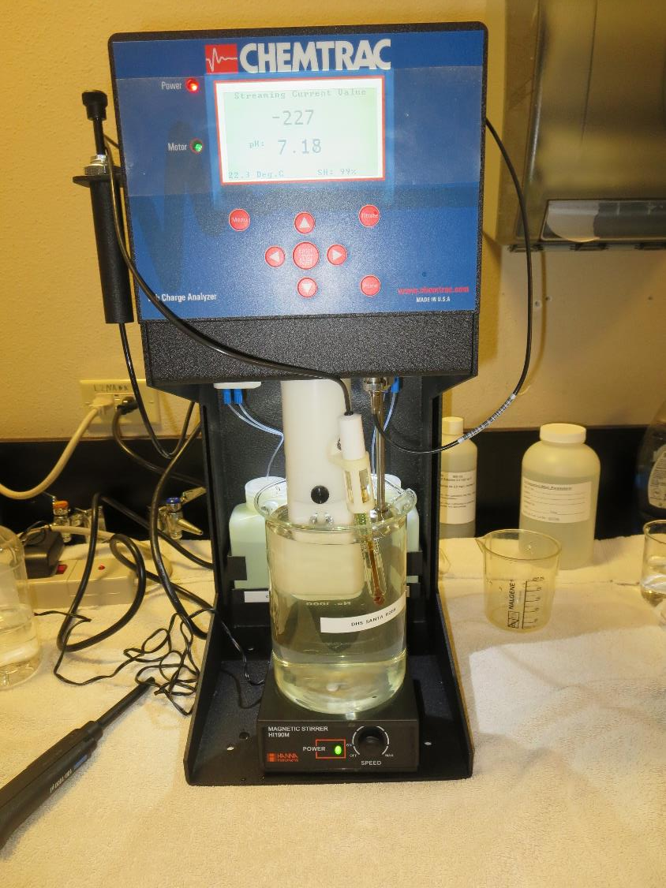
Laboratory Charge Analyzer
LCA: Used to determine coagulant demand of a source water entering the treatment plant.
Source pH: 7.29
LCA #1
FeSO₄: 61 mg/L
No pH adjustment.
LCA #2:
FeCl₃: 40.6 mg/L
No pH adjustment

Slide 9
Coagulant Information
Unless stated otherwise, all coagulant doses are reported as Product (100% strength). Aluminum sulfate is reported as Alum.
Preparation of coagulant stock solutions are generally 1.0 and/or 0.1 percent strength using 100 and/or 200 mL volumetric flasks.
Finnpipette F2 variable volume pipette, capacity 100-1000 micro liters is used for stock solution preparation and coagulant aid jar test dosing.
Finnpipette F2 variable volume pipette, capacity 0.5-5 mL is used for primary coagulant jar test dosing.

Slide 10
City of St. Helena : Jar Test 1-4 Results Flash Mix 200 RPM (20 sec); Floc Mix 30 RPM (9 min)
Jar # | Alum mg/L | FeCl₃ mg/L | Filtrate NTU | Filtrate %UVT | Filtrate UVA/cm | %UVA Reduction | Settle NTU 25 min | pH
J1 | 50 | - | 0.05 | 89.07 | 0.0503 | 69.3 | 0.26 | 6.10
J2 | - | 36 | 0.16 | 85.84 | 0.0663 | 59.5 | 2.23 | 6.28
J3 | - | 40 | 0.40 | 82.90 | 0.0815 | 50.2 | 2.21 | 6.21
J4 | - | 44 | 0.27 | 86.47 | 0.0632 | 61.4 | 1.88 | 6.11
Source water jar testing was taken after Post NaMnO₄

Slide 11
City of St. Helena : Jar Test 5-8 Results Flash Mix 200 RPM (20 sec); Floc Mix 30 RPM (8 min)
Jar # | FeSO₄ mg/L | Filtrate NTU | Filtrate %UVT | Filtrate UVA/cm | %UVA Reduction | Settle NTU 25 min | pH
J5 | 50 | 0.08 | 90.41 | 0.0438 | 73.2 | 0.51 | 6.00
J6 | 55 | 0.12 | 90.15 | 0.0451 | 72.4 | 0.98 | 5.85
J7 | 60 | 0.13 | 90.82 | 0.0419 | 74.4 | 0.87 | 5.68
J8 | 65 | 0.09 | 91.71 | 0.0376 | 77.0 | 0.57 | 5.52
Source water jar testing was taken after Post NaMnO₄

Slide 12
City of St. Helena : Jar Test 9-12 Results Flash Mix 200 RPM (20 sec); Floc Mix 30 RPM (9 min)
Jar # | FeCl₃ mg/L | FeSO₄ mg/L | Filtrate NTU | Filtrate %UVT | Filtrate UVA/cm | %UVA Reduction | Settle NTU 25 min | pH | Fe mg/L
J9 | 25 | - | 0.30 | 86.82 | 0.0614 | 62.5 | 1.04 | 6.28 | 0.000
J10 | 30 | - | 0.13 | 88.31 | 0.0540 | 67.0 | 0.57 | 6.09 | 0.033
J11 | - | 40 | 0.38 | 87.09 | 0.0601 | 63.3 | 2.06 | 6.22 | 0.032
J12 | - | 45 | 0.09 | 88.95 | 0.0509 | 68.9 | 0.52 | 6.10 | 0.051
Source water jar testing was taken after Post NaMnO₄

Slide 13
City of St. Helena : Jar Test 13-16 Results Flash Mix 200 RPM (20 sec); Floc Mix 30 RPM (8 min)
Jar # | Alum mg/L | FeSO₄ mg/L | Zeta Floc 20 mg/L | Filtrate NTU | Filtrate %UVT | Filtrate UVA/cm | %UVA Reduction | Settle NTU 25 min | pH
J13 | 50 | - | - | 0.06 | 88.83 | 0.0515 | 68.5 | 0.28 | 6.15
J14 | - | 60 | 1.0 | 0.05 | 91.54 | 0.0384 | 76.5 | 0.43 | 5.71
J15 | - | 65 | 1.0 | 0.05 | 92.22 | 0.0352 | 78.5 | 0.44 | 5.51
J16 | - | 70 | 1.0 | 0.05 | 92.64 | 0.0332 | 79.7 | 0.36 | 5.20
J17 | 50 | - | - | 0.05 | 89.11 | 0.0501 | 69.4 | 0.34 | 6.17
J18 | - | 70 | 1.0 | 0.04 | 93.03 | 0.0314 | 80.8 | 0.41 | 5.23
Jar 18 post filtrate Fe: 0.060 mg/L
Source water jar testing was taken after Post NaMnO₄

Slide 14
Jars 1-4 Test Flash Mix 20 Sec (200 RPM) Floc Mix 9 min (30 RPM) Post NaMnO₄ Applied Coagulants Alum/FeCl₃

Slide 15
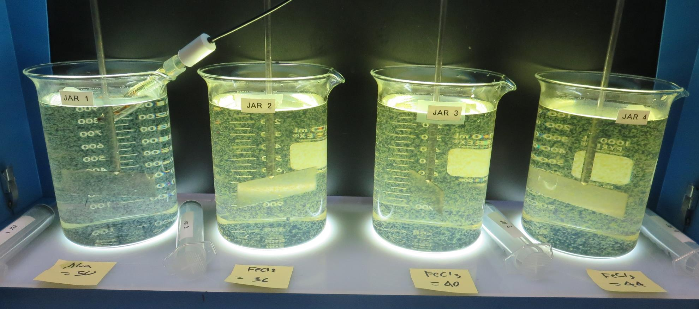
Jars 1-4: End of 7-minute flocculation (30 RPM) duration.
50 mg/L Alum
Filtrate: 0.05 NTU
UVT: 89.07%
UVA: 0.0503/cm
UVA Reduction: 69.3%
Settled: 0.26 NTU
pH: 6.10
50 mg/L FeCl₃
Filtrate: 0.16 NTU
UVT: 88.84%
UVA: 0.0663/cm
UVA Reduction: 59.5%
Settled: 0.23 NTU
pH: 6.28
40 mg/L FeCl₃
Filtrate: 0.40 NTU
UVT: 88.84%
UVA: 0.0815/cm
UVA Reduction: 50.2%
Settled: 2.21 NTU
pH: 6.21
44 mg/L FeCl₃
Filtrate: 0.27 NTU
UVT: 88.47%
UVA: 0.0632/cm
UVA Reduction: 61.4%
Settled: 1.88 NTU
pH: 6.11

Slide 16
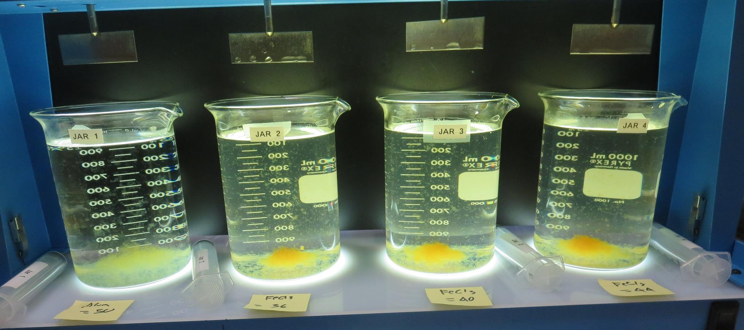
Jars 1-4: After 5 min of settling, 25 mL is syringed for filterability and %UVT/UVA

Slide 17
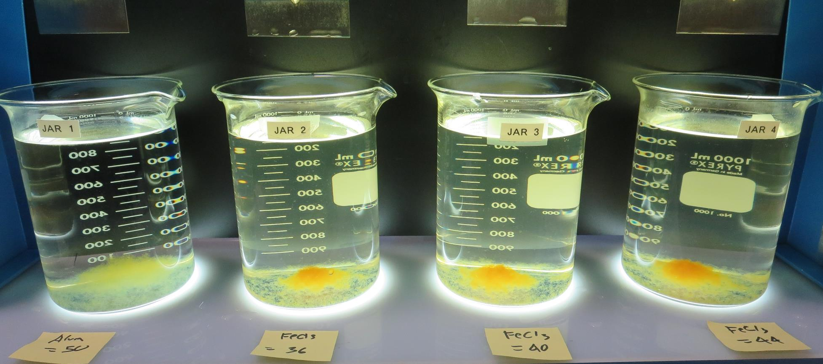
Jars 1-4: After 25-minutes of settling, settled water turbidity is taken.
50 mg/L Alum
Filtrate: 0.05 NTU
UVT: 89.07%
UVA: 0.0503/cm
UVA Reduction: 69.3%
Settled: 0.26 NTU
pH: 6.10
50 mg/L FeCl₃
Filtrate: 0.16 NTU
UVT: 88.84%
UVA: 0.0663/cm
UVA Reduction: 59.5%
Settled: 0.23 NTU
pH: 6.28
40 mg/L FeCl₃
Filtrate: 0.40 NTU
UVT: 88.84%
UVA: 0.0815/cm
UVA Reduction: 50.2%
Settled: 2.21 NTU
pH: 6.21
44 mg/L FeCl₃
Filtrate: 0.27 NTU
UVT: 88.47%
UVA: 0.0632/cm
UVA Reduction: 61.4%
Settled: 1.88 NTU
pH: 6.11

Slide 18
Jars 5-8 Test Flash Mix 20 Sec (200 RPM) Floc Mix 8 min (30 RPM) Post NaMnO₄ Applied Coagulant FeSO₄

Slide 19
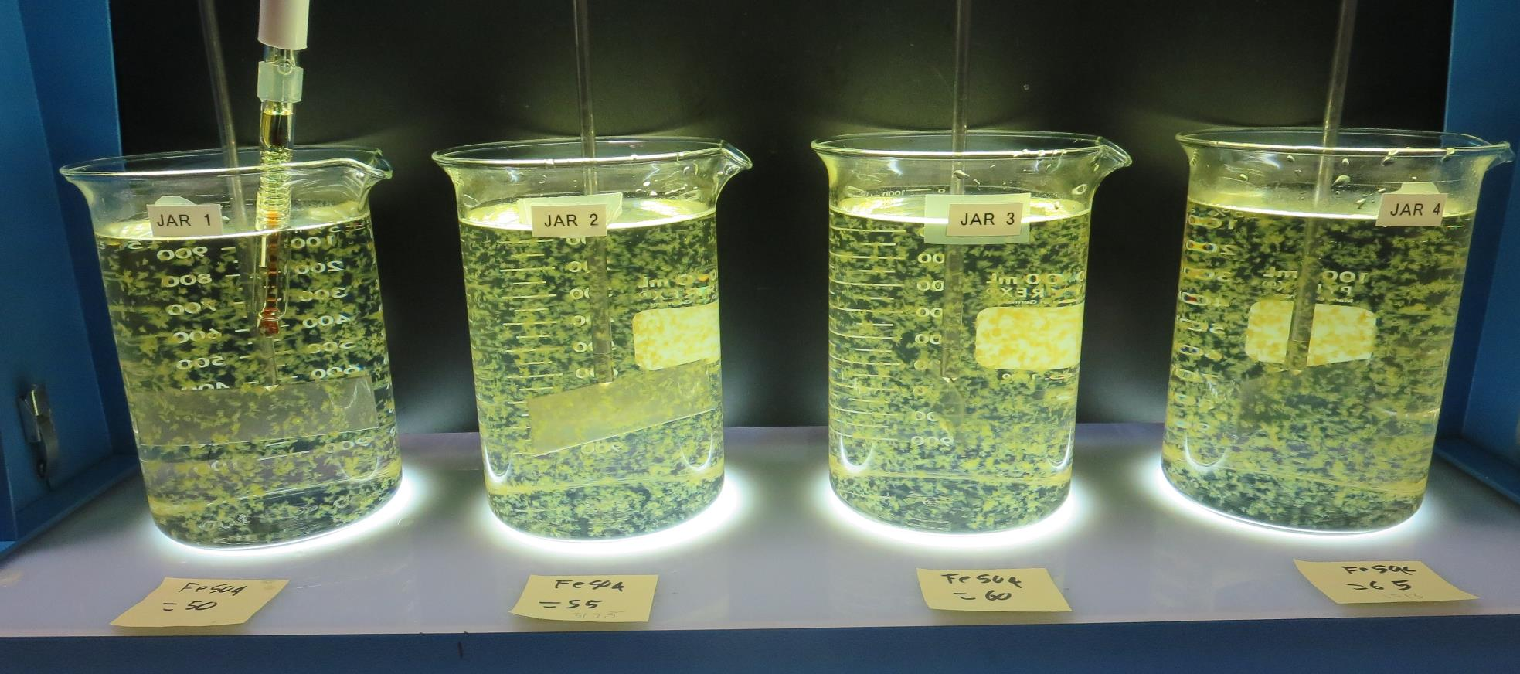
Jars 5-8: End of 8-minute flocculation (30 RPM) duration.
50 mg/L FeSO₄
Filtrate: 0.08 NTU
UVT: 90.41%
UVA: 0.0438/cm
UVA Reduction: 73.4%
Settled: 0.51 NTU
pH: 6.00
55 mg/L FeSO₄
Filtrate: 0.12 NTU
UVT: 90.15%
UVA: 0.0451/cm
UVA Reduction: 72.4%
Settled: 0.98 NTU
pH: 5.85
60 mg/L FeSO₄
Filtrate: 0.13 NTU
UVT: 90.82%
UVA: 0.0419/cm
UVA Reduction: 74.4%
Settled: 0.87 NTU
pH: 5.68
65 mg/L FeSO₄
Filtrate: 0.09 NTU
UVT: 91.71%
UVA: 0.0376/cm
UVA Reduction: 77.0%
Settled: 0.57 NTU
pH: 5.52

Slide 20
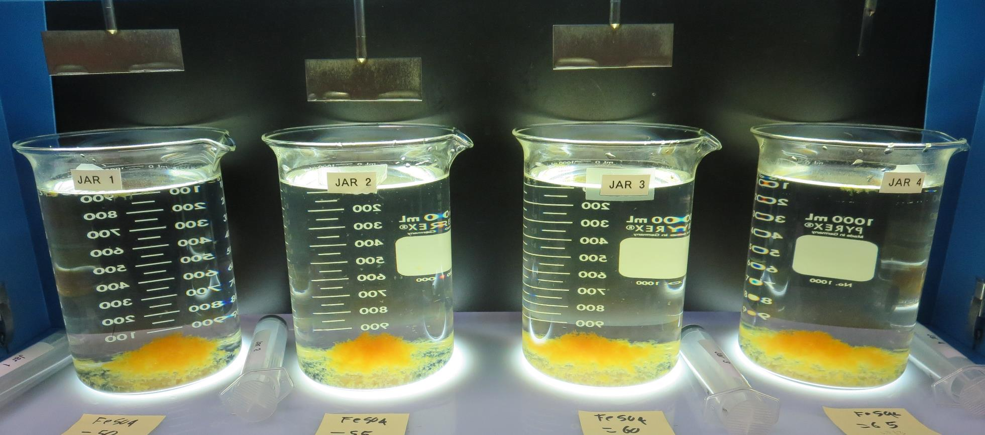
Jars 5-8: After 5 min of settling, 25 mL is syringed for filterability and %UVT/UVA

Slide 21
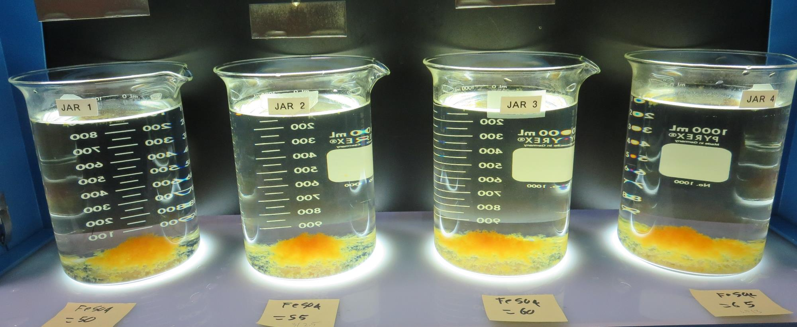
Jars 5-8: After 25-minutes of settling, settled water turbidity is taken.
50 mg/L FeSO₄
Filtrate: 0.08 NTU
UVT: 90.41%
UVA: 0.0438/cm
UVA Reduction: 73.4%
Settled: 0.51 NTU
pH: 6.00
55 mg/L FeSO₄
Filtrate: 0.12 NTU
UVT: 90.15%
UVA: 0.0451/cm
UVA Reduction: 72.4%
Settled: 0.98 NTU
pH: 5.85
60 mg/L FeSO₄
Filtrate: 0.13 NTU
UVT: 90.82%
UVA: 0.0419/cm
UVA Reduction: 74.4%
Settled: 0.87 NTU
pH: 5.68
65 mg/L FeSO₄
Filtrate: 0.09 NTU
UVT: 91.71%
UVA: 0.0376/cm
UVA Reduction: 77.0%
Settled: 0.57 NTU
pH: 5.52

Slide 22
Jars 9-12 Test Flash Mix 20 Sec (200 RPM) Floc Mix 9 min (30 RPM) Post NaMnO₄ Applied Coagulants FeCl₃/FeSO₄

Slide 23
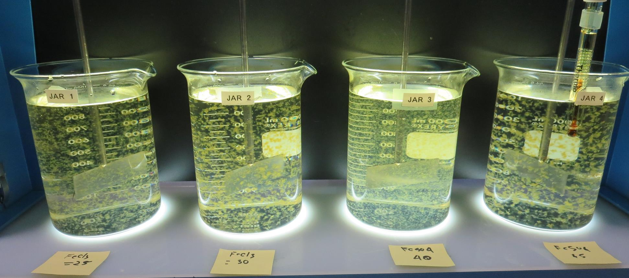
Jars 9-12: End of 9-minute flocculation (30 RPM) duration.
25 mg/L FeCl₃
Filtrate: 0.30 NTU
UVT: 86.82%
UVA: 0.0614/cm
UVA Reduction: 62.5%
Settled: 1.04 NTU
pH: 6.28, Fe: 0.0 mg/L
30 mg/L FeCl₃
Filtrate: 0.13 NTU
UVT: 88.31%
UVA: 0.0540/cm
UVA Reduction: 67.0%
Settled: 0.57 NTU
pH: 6.09, Fe: 0.033 mg/L
40 mg/L FeSO₄
Filtrate: 0.38 NTU
UVT: 87.09%
UVA: 0.0601/cm
UVA Reduction: 63.3%
Settled: 2.06 NTU
pH: 6.22, Fe: 0.032 mg/L
45 mg/L FeSO₄
Filtrate: 0.09 NTU
UVT: 88.9%
UVA: 0.0509/cm
UVA Reduction: 68.9%
Settled: 0.52 NTU
pH: 6.10, Fe: 0.051 mg/L

Slide 24
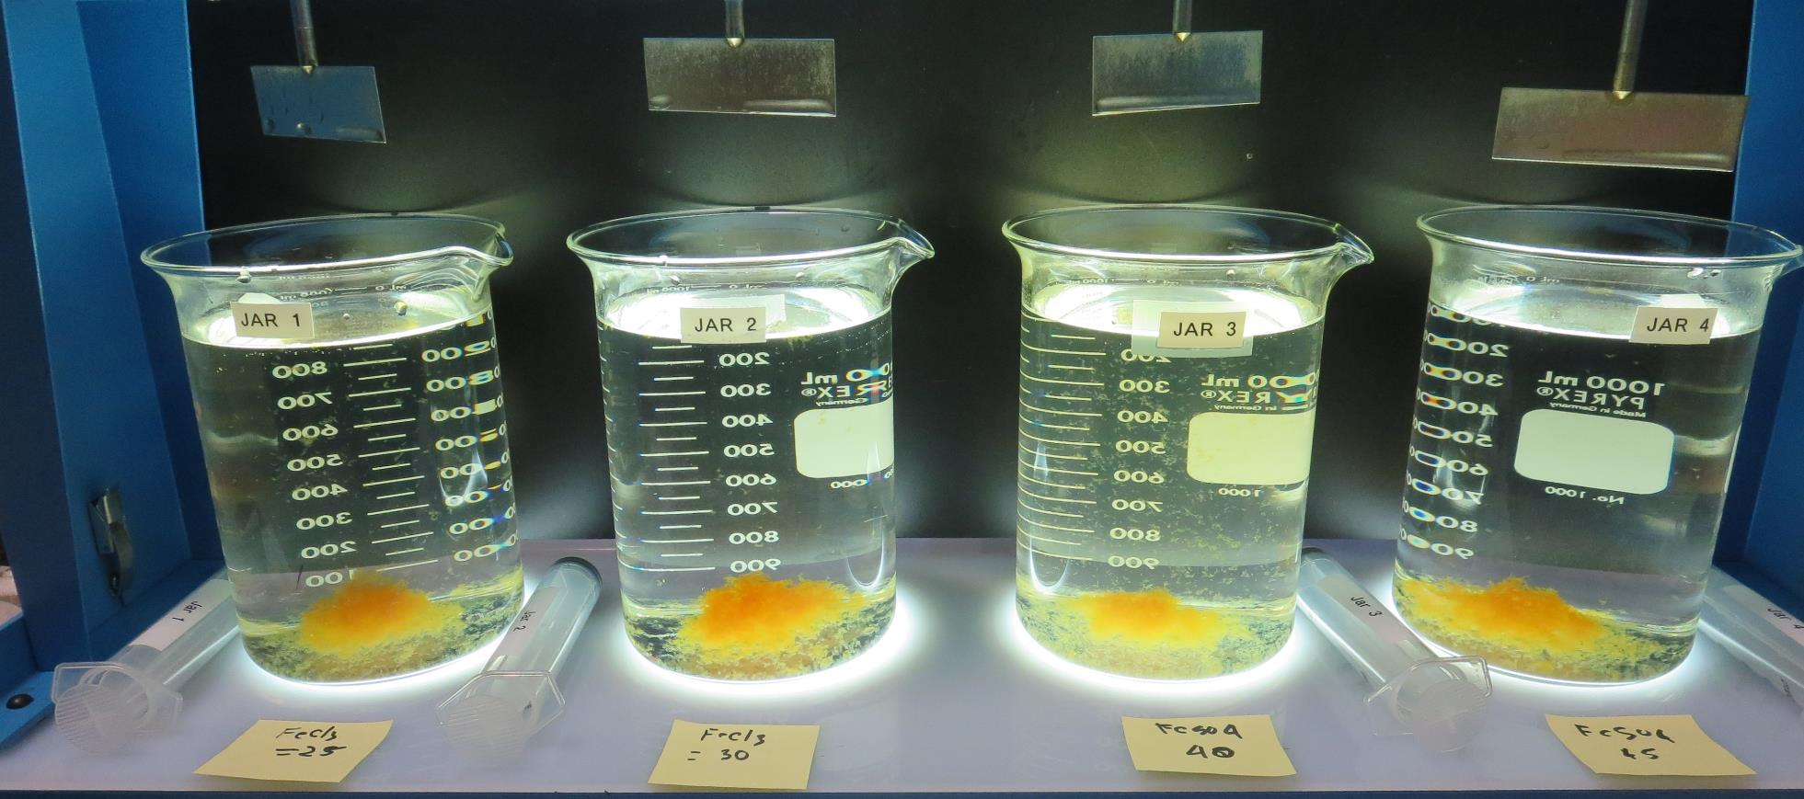
Jars 9-12: After 5 min of settling, 25 mL is syringed for filterability and %UVT/UVA

Slide 25
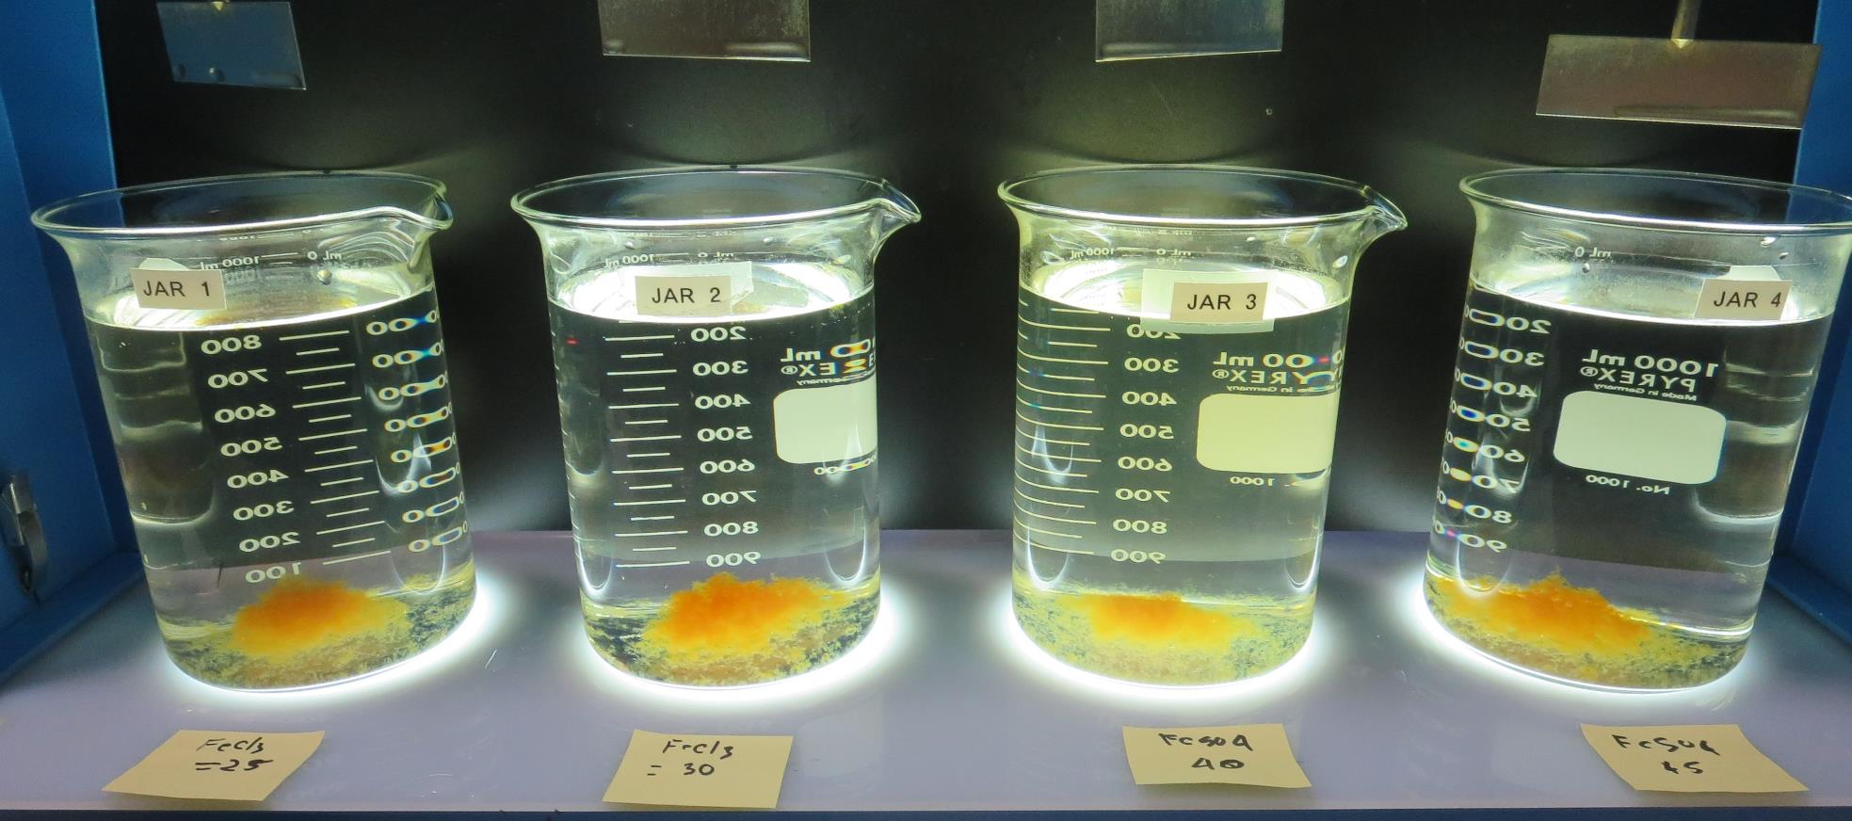
Jars 9-12: After 25-minutes of settling, settled water turbidity is taken.
25 mg/L FeCl₃
Filtrate: 0.30 NTU
UVT: 86.82%
UVA: 0.0614/cm
UVA Reduction: 62.5%
Settled: 1.04 NTU
pH: 6.28, Fe: 0.0 mg/L
30 mg/L FeCl₃
Filtrate: 0.13 NTU
UVT: 88.31%
UVA: 0.0540/cm
UVA Reduction: 67.0%
Settled: 0.57 NTU
pH: 6.09, Fe: 0.033 mg/L
40 mg/L FeSO₄
Filtrate: 0.38 NTU
UVT: 87.09%
UVA: 0.0601/cm
UVA Reduction: 63.3%
Settled: 2.06 NTU
pH: 6.22, Fe: 0.032 mg/L
45 mg/L FeSO₄
Filtrate: 0.09 NTU
UVT: 88.9%
UVA: 0.0509/cm
UVA Reduction: 68.9%
Settled: 0.52 NTU
pH: 6.10, Fe: 0.051 mg/L

Slide 26
Jars 13-16 Test Flash Mix 30 Sec (200 RPM) Floc Mix 8 min (30 RPM) Post NaMnO₄ Applied Coagulants Alum/FeSO₄

Slide 27
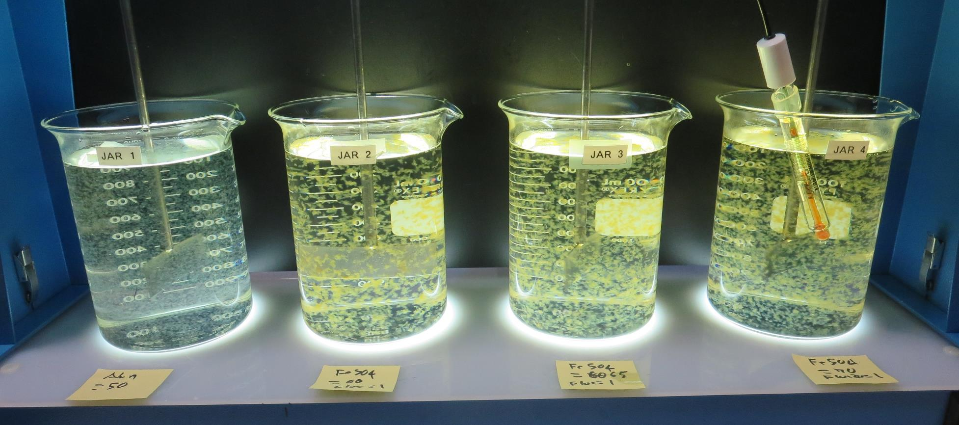
Jars 13-16: End of 8-minute flocculation (30 RPM) duration.
50 mg/L Alum
Filtrate: 0.06 NTU
UVT: 88.83%
UVA: 0.0515/cm
UVA Reduction: 69.5%
Settled: 0.28 NTU
pH: 6.15
60 mg/L FeSO₄
1.0 mg/L ZetaFloc 20
Filtrate: 0.05 NTU
UVT: 91.54%
UVA: 0.0384/cm
UVA Reduction: 76.5%
Settled: 0.43 NTU
pH: 5.71
65 mg/L FeSO₄
1.0 mg/L ZetaFloc 20
Filtrate: 0.05 NTU
UVT: 92.22%
UVA: 0.0352/cm
UVA Reduction: 78.5%
Settled: 0.44 NTU
pH: 5.51
70 mg/L FeSO₄
1.0 mg/L ZetaFloc 20
Filtrate: 0.05 NTU
UVT: 92.64%
UVA: 0.0332/cm
UVA Reduction: 79.7%
Settled: 0.36 NTU
pH: 5.20

Slide 28
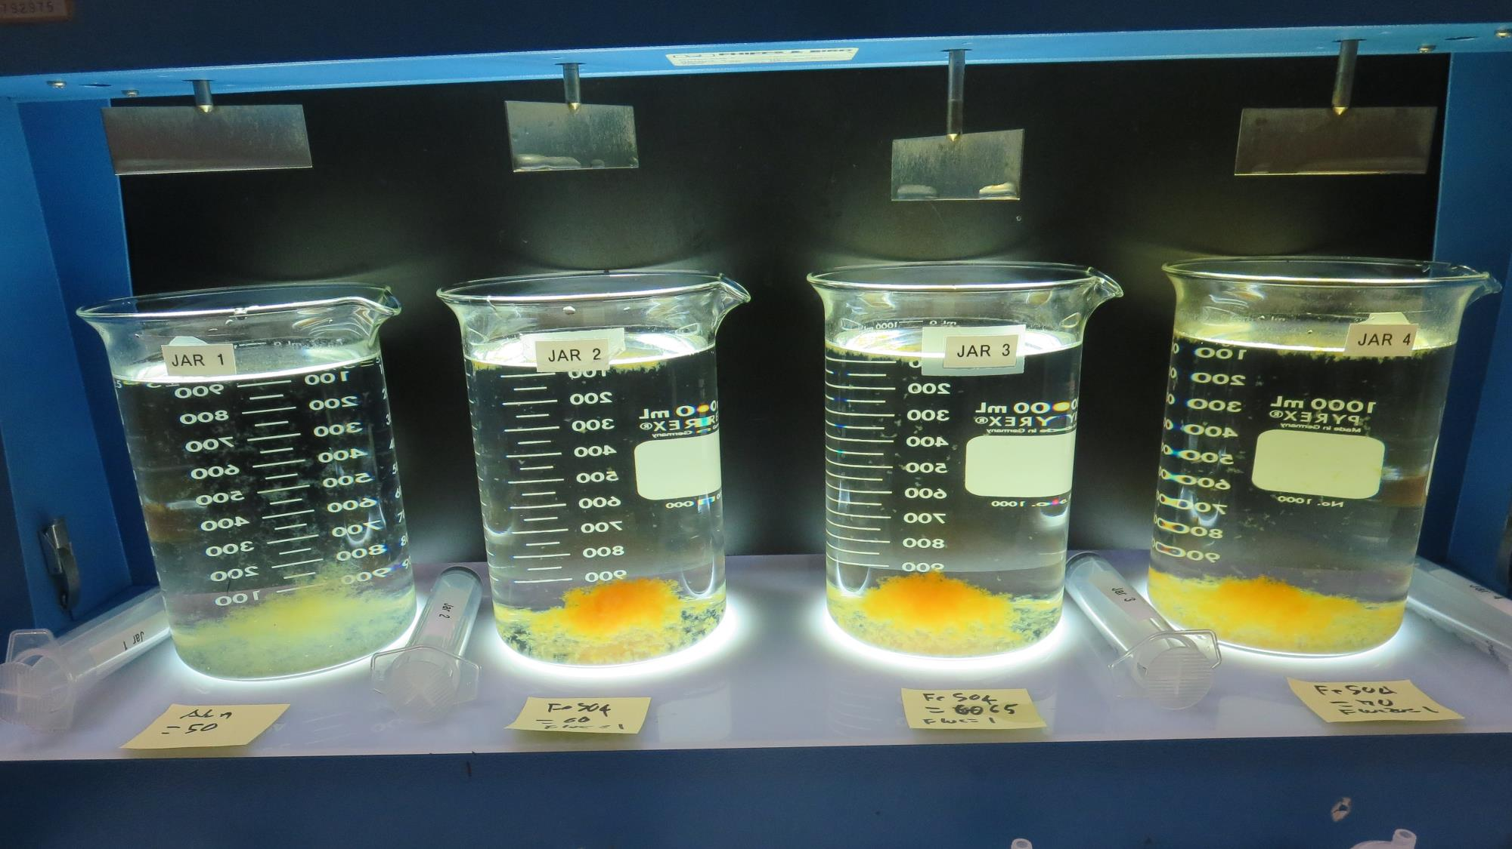
Jars 13-16: After 5 min of settling, 25 mL is syringed for filterability and %UVT/UVA

Slide 29
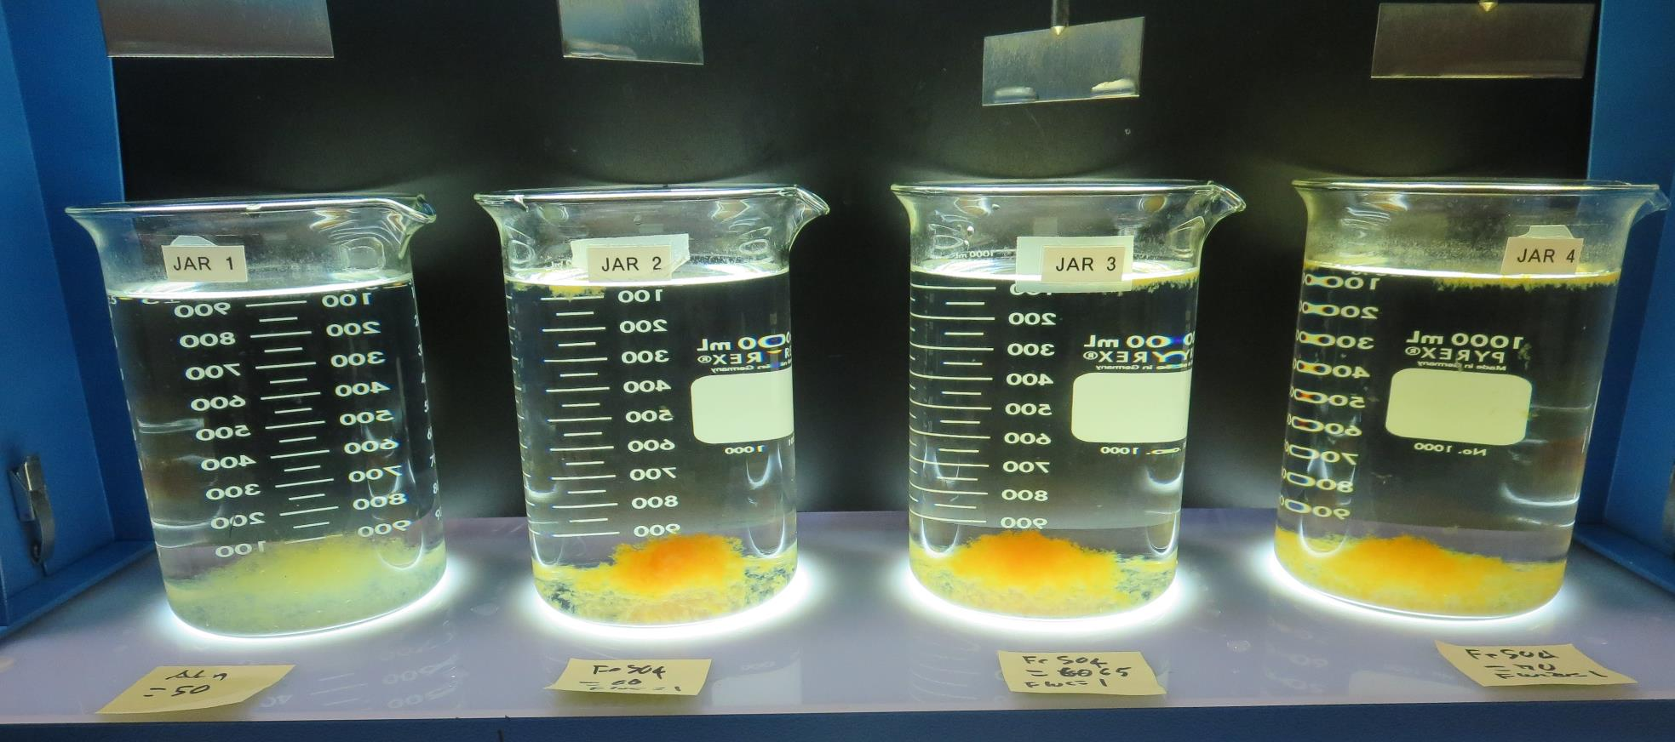
Jars 13-16: After 25-minutes of settling, settled water turbidity is taken.
50 mg/L Alum
Filtrate: 0.06 NTU
UVT: 88.83%
UVA: 0.0515/cm
UVA Reduction: 69.5%
Settled: 0.28 NTU
pH: 6.15
60 mg/L FeSO₄
1.0 mg/L ZetaFloc 20
Filtrate: 0.05 NTU
UVT: 91.54%
UVA: 0.0384/cm
UVA Reduction: 76.5%
Settled: 0.43 NTU
pH: 5.71
65 mg/L FeSO₄
1.0 mg/L ZetaFloc 20
Filtrate: 0.05 NTU
UVT: 92.22%
UVA: 0.0352/cm
UVA Reduction: 78.5%
Settled: 0.44 NTU
pH: 5.51
70 mg/L FeSO₄
1.0 mg/L ZetaFloc 20
Filtrate: 0.05 NTU
UVT: 92.64%
UVA: 0.0332/cm
UVA Reduction: 79.7%
Settled: 0.36 NTU
pH: 5.20

Slide 30
Jars 17-8 Test Flash Mix 30 Sec (200 RPM) Floc Mix 7 min (30 RPM) Post NaMnO₄ Applied Coagulants Alum/FeSO₄

Slide 31
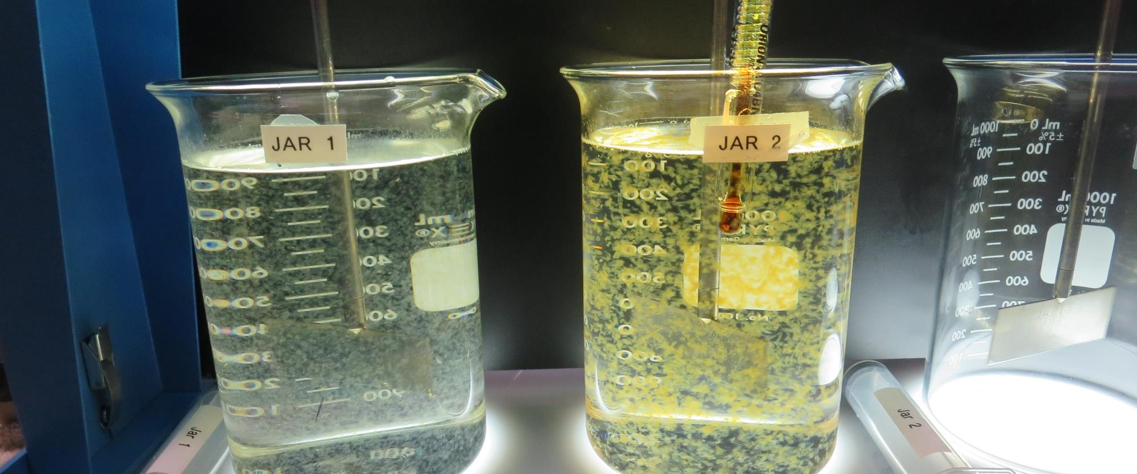
Jars 17-18: End of 8-minute flocculation (30 RPM) duration.
50 mg/L Alum
Filtrate: 0.05 NTU
UVT: 89.97%
UVA: 0.0501/cm
UVA Reduction: 69.4%
Settled: 0.34 NTU
pH: 6.17
70 mg/L FeSO₄
1.0 mg/L ZetaFloc 20
Filtrate: 0.04 NTU
UVT: 92.99%
UVA: 0.0316/cm
UVA Reduction: 80.8%
Settled: 0.41 NTU
pH: 5.23, Fe: 0.06 mg/L

Slide 32
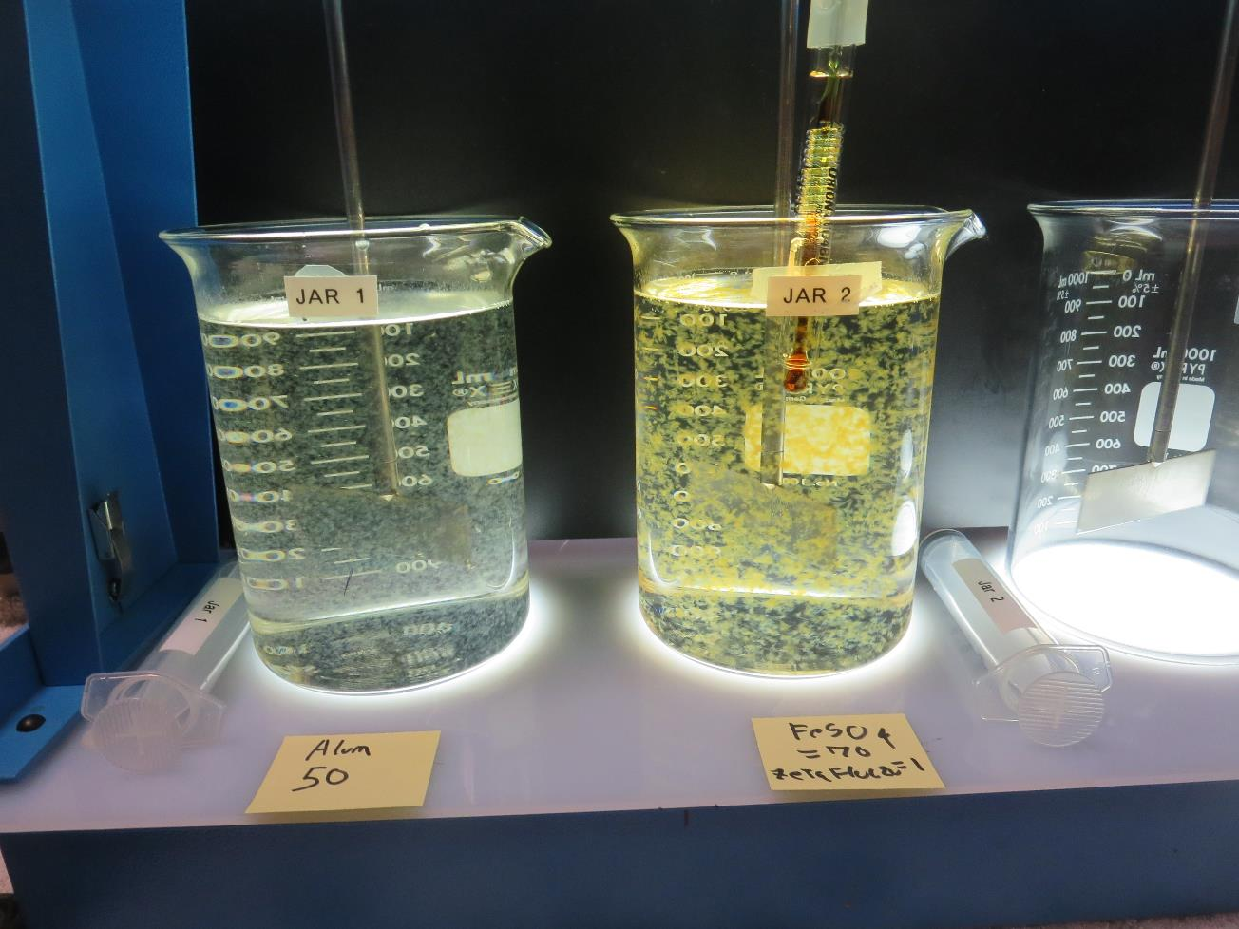
Jars 17-18: After 5 min of settling, 25 mL is syringed for filterability and %UVT/UVA

Slide 33
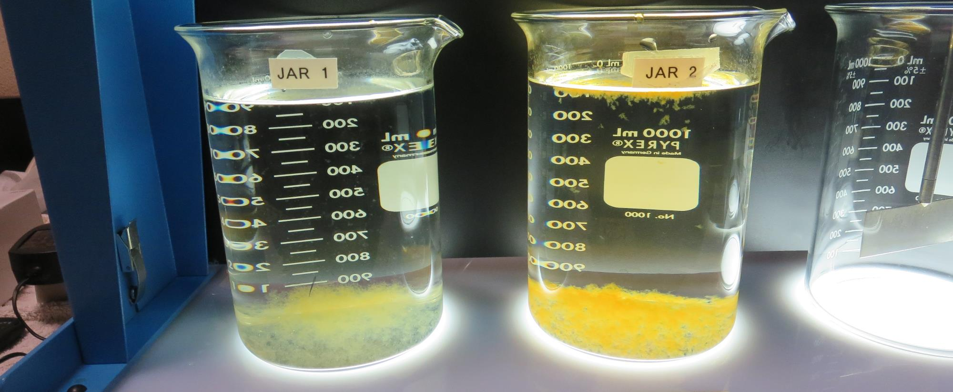
Jars 17-18: After 25-minutes of settling, settled water turbidity is taken.
50 mg/L Alum
Filtrate: 0.05 NTU
UVT: 89.97%
UVA: 0.0501/cm
UVA Reduction: 69.4%
Settled: 0.34 NTU
pH: 6.17
70 mg/L FeSO₄
1.0 mg/L ZetaFloc 20
Filtrate: 0.04 NTU
UVT: 92.99%
UVA: 0.0316/cm
UVA Reduction: 80.8%
Settled: 0.41 NTU
pH: 5.23, Fe: 0.06 mg/L

Slide 34
Jar Testing for 1-Liter Jars: Procedures for Most Treatment Plants
Fill jars with source water prior to coagulant injection and set paddle speed at 30 rpm
Add chemicals (i.e., NaOCl, primary coagulant, coagulant aid) to each jar
Flash mix for 15-60 seconds (200 rpm)
Slow mix for 5 minutes (20-30 rpm)
Settled for 5 minutes. Syringe 25 mL from each jar taken 1-inch below surface (25 mL/12 sec rate)
Filtered through 1.2 um isopore membrane into cuvette drip rate, 15 mL/(50-90 sec)
Measure filtrate turbidity, chlorine residual and %UVT/UVA
Measure settled water turbidity after 25 minutes of total setting
Record all data

Slide 35
Jar Test Filterability Test Equipment
Turbidity Instrument
Syringe w/Luer-Lock Tip, 30 cc
(part#: 2225800, by Hach)
Swinnex Filter Holder, 25 mm (part#: SX0002500)
Isopore Membrane Filter, 1.2 um absolute
pore size,
Φ= 25 mm , thickness: 24 um,
hydrophilic polycarbonate membrane
(part #: RTTP02500)
Go to Sigma-Aldrich for laboratory supplies http://www.sigmaaldrich.com/united-states.html

Slide 36
Isopore Membrane Information
Categories | Information
trade name | Isopore
filter color | White
chemistry | Polycarbonate (PC)
water flow rate | Avg. 175 mL/min x cm² (typical results @ 10 psi)
media | Isopore®
wettability | Hydrophilic
porosity | 14.7%
pore size | 1.2 µm
bubble point at 23 °C | 1.0 bar, air with water
thickness | 24 µm
filter diameter (ø) | 25 mm
material size | polycarbonate, Hydrophilic, 1.2 µm, 25 mm, white, plain, 100

Slide 37
Isopore Membrane Background Information
The Isopore membrane is a polycarbonate, track-etched screen filter recommended for all analyses in which the sample is viewed on the surface of the membrane. The Isopore membrane is composed of polycarbonate film, which has a smooth, glass-like surface for clearer sample observation. The unique manufacturing process of the membrane ensures a precise pore diameter and a consistent pore size for accurate separation of samples by size. Matched-weight filters are not usually required because of low, constant tar and ash weights. Features & Benefits: Membrane structure retains particles on the surface, simplifying counting and analysis

Slide 38
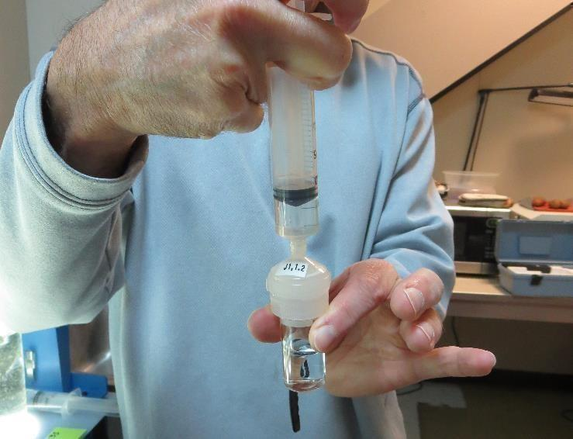
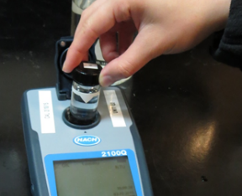
Jar Test - Filterability Test
Syringe ~ 25 mL from jar (after 5-minutes of settling)
Filter-to-waste 3-5 mL
Filter directly into clean cuvette
Measure turbidity
Note: Take several readings before recording final NTU results. Micro bubbles can adhere to glass causing false NTU readings. To remove bubbles, tilt cuvette up to 90 degrees.

Slide 39
Contact
Guy Schott, P.E.
State Water Resources Control Board
Division of Drinking Water
Santa Rosa, CA
Go to Stock Solution/Dose calculations/Jar Test Results for tools to download
www.waterboards.ca.gov/drinking_water/programs/districts/mendocino_district.html
Jar Testing Done Right training video: https://www.youtube.com/watch?v=aGByyxhelkI
Email: Guy Schott - Guy.Schott@waterboards.ca.gov
Office Number: 707-576-2732

