Slide 1
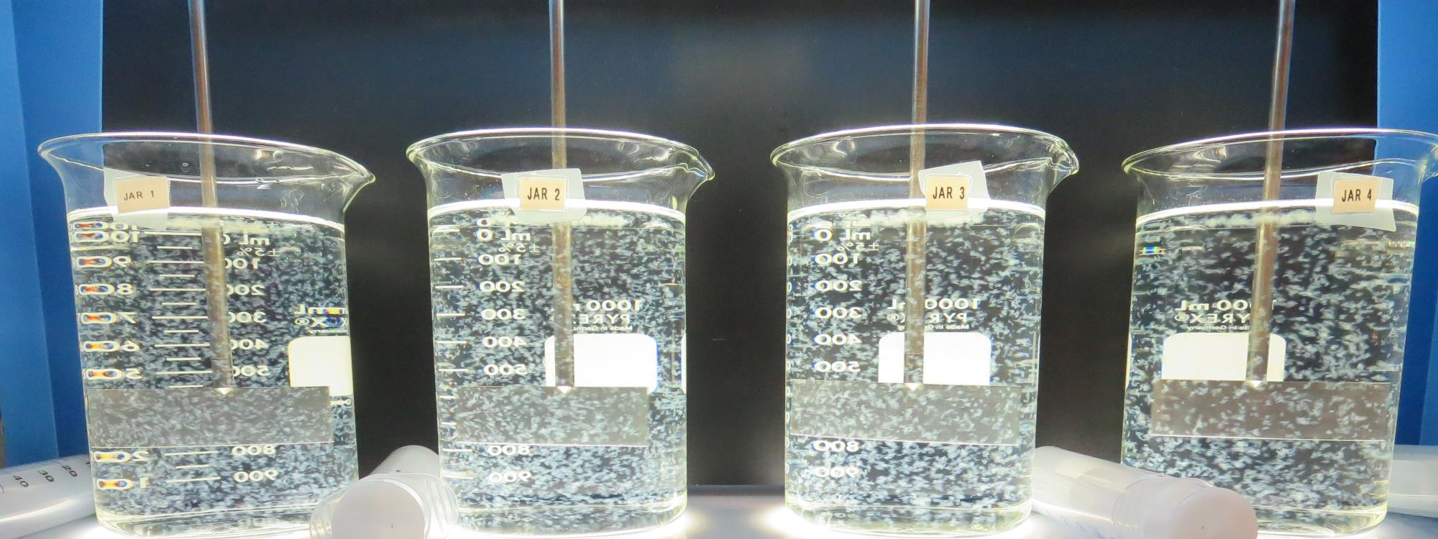
Veterans Home Roberts Filtration Treatment Plant CA2810008 Napa County Jar Test
by Guy Schott, P.E.
April 30, 2019

Slide 2
Rector Reservoir Water Characteristics April 30, 2019
Source
Turbidity: 4.1 NTU
UVT: 77.4%
UVA: 0.111/cm
0.4 um Filtered
UVT: 79.0%
UVA: 0.102/cm

Slide 3
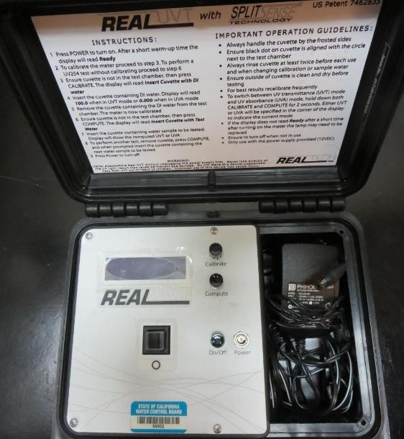
UVT/UVA
UV transmittance (UVT) is a measurement of the amount of ultraviolet light (commonly at 254 nm due to its germicidal effect) that passes through a water sample compared to the amount of light that passes through a pure water sample. The measurement is expressed as a percentage, % UVT.
%UVT = 10^{(-UVA)} x 100%
UV absorbance (UVA) is calculated as a relative measure of the amount of light absorbed by a water sample compared with the amount of light absorbed by a pure water sample.
UVA = -log(%UVT/100)

Slide 4
Applied Coagulants for Jar Testing
AH-710 (Garratt Callahan)
ACH/1,2-Ethanediamine, Polymer w/(Chloromethlyl) Oxirane & N-Methylmethanamine (Epichlorohydrin Dimethylamine Copolymer)
SG-1.31
7066 (Garratt Callahan)
10 – 30% Poly Aluminum Hydroxychloride Sulfate
50% Basicity
SG = 1.2

Slide 5
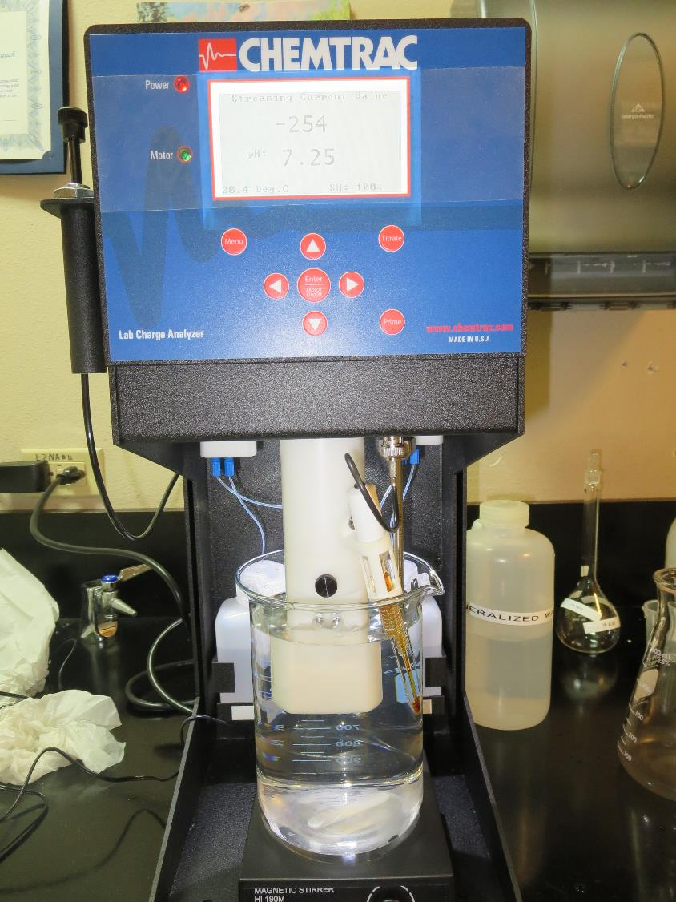
Laboratory Charge Analyzer
LCA: Used to determine coagulant demand of a source water entering the treatment plant.
Source pH: 7.25
LCA #1: 7066: 44 mg/L as product
pH adjusted to 6.6 w/acetic acid

Slide 6
Coagulant Information
Unless stated otherwise, all coagulant doses are reported as Product (100% strength). Aluminum sulfate is reported as Alum.
Preparation of coagulant stock solutions are generally 1.0 and/or 0.1 percent strength using 100 and/or 200 mL volumetric flasks.
Finnpipette F2 variable volume pipette, capacity 100-1000 micro liters is used for stock solution preparation and coagulant aid jar test dosing.
Finnpipette F2 variable volume pipette, capacity 0.5-5 mL is used for primary coagulant jar test dosing.

Slide 7
Veterans Home: Jar Test 1-8 Results
Jar # | 200 RPM Flash Mix seconds | 30 RPM Floc Duration minutes | 7066 mg/L | Filtrate NTU | Filtrate %UVT | Filtrate UVA/cm | Settle NTU 25 min
J1 | 60 | 10 | 65 | 0.06 | 94.5 | 0.025 | 0.53
J2 | 60 | 10 | 70 | 0.07 | 94.8 | 0.023 | 0.56
J3 | 60 | 10 | 75 | 0.06 | 94.9 | 0.023 | 0.70
J4 | 60 | 10 | 80 | 0.06 | 95.3 | 0.021 | 0.55
J5 | 60 | 10 | 45 | 0.18 | 92.9 | 0.032 | 0.77
J6 | 60 | 10 | 50 | 0.08 | 93.8 | 0.028 | 0.81
J7 | 60 | 10 | 55 | 0.07 | 94.5 | 0.025 | 0.80
J8 | 60 | 10 | 60 | 0.05 | 94.9 | 0.023 | 0.66

Slide 8
Veterans Home: Jar Test 9-12 Results Flash Mix 60 sec (200 RPM), Floc 10 min (30 RPM) *25 mL taken at end of floc duration.
Jar # | 7066 mg/L | *Filtrate NTU | *Filtrate %UVT | *Filtrate UVA/cm | Filtrate NTU | Filtrate %UVT | Filtrate UVA/cm | Settle NTU 25 min
J9 | 45 | 0.06 | 93.6 | 0.029 | 0.22 | 93.0 | 0.032 | 0.72
J10 | 50 | 0.15 | 93.6 | 0.029 | 0.15 | 93.5 | 0.029 | 0.75
J11 | 55 | 0.08 | 94.4 | 0.025 | 0.07 | 94.0 | 0.027 | 0.71
J12 | 60 | 0.06 | 94.3 | 0.025 | 0.09 | 94.0 | 0.027 | 0.61

Slide 9
Veterans Home: Jar Test 13-20 Results
Jar # | 200 RPM Flash Mix seconds | 30 RPM Floc Duration minutes | AH-710 mg/L | 7066 mg/L | Filtrate NTU | Filtrate %UVT | Filtrate UVA/cm | Settle NTU 25 min
J13 | 60 | 10 | 9 | 0 | 0.65 | 91.1 | 0.040 | 3.4
J14 | 60 | 10 | 10 | 0 | 0.77 | 91.1 | 0.040 | 3.0
J15 | 60 | 10 | 9 | 4.5 | 0.12 | 92.7 | 0.033 | 2.2
J16 | 60 | 10 | 10 | 5.0 | 0.34 | 92.9 | 0.032 | 2.1
J17 | 60 | 10 | 9 | 6.75 | 0.16 | 93.1 | 0.031 | 1.5
J18 | 60 | 10 | 9 | 9 | 0.09 | 93.3 | 0.030 | 1.4
J19 | 60 | 10 | 10 | 7.5 | 0.10 | 94.0 | 0.027 | 1.6
J20 | 60 | 10 | 10 | 10 | 0.32 | 93.5 | 0.029 | 1.4

Slide 10
Veterans Home: Jar Test 21-28 Results
Jar # | 200 RPM Flash Mix seconds | 30 RPM Floc Duration minutes | AH-710 mg/L | 7066 mg/L | Filtrate NTU | Filtrate %UVT | Filtrate UVA/cm | Settle NTU 25 min
J21 | 60 | 10 | 8 | 12 | 0.11 | 93.5 | 0.029 | 1.2
J22 | 60 | 10 | 8 | 16 | 0.21 | 93.9 | 0.027 | 1.1
J23 | 60 | 10 | 9 | 13.5 | 0.19 | 93.8 | 0.028 | 1.0
J24 | 60 | 10 | 9 | 18 | 0.13 | 93.8 | 0.028 | 0.8
J25 | 60 | 10 | 2.5 | 25 | 0.53 | 91.7 | 0.038 | 1.5
J26 | 60 | 10 | 3 | 30 | 0.14 | 93.1 | 0.031 | 1.0
J27 | 60 | 10 | - | 25 | 1.0 | 89.5 | 0.048 | 3.2
J28 | 60 | 10 | - | 30 | 0.24 | 91.8 | 0.037 | 1.5

Slide 11
Veterans Home: Jar Test 29-32 Results
Jar # | 200 RPM Flash Mix seconds | 30 RPM Floc Duration minutes | 7066 mg/L | Filtrate NTU | Filtrate %UVT | Filtrate UVA/cm | Settle NTU 25 min
J29 | 60 | 10 | 50 | 0.08 | 93.7 | 0.028 | 0.54
J30 | 60 | 10 | 55 | 0.14 | 93.5 | 0.029 | 0.57
J31 | 60 | 10 | 60 | 0.10 | 94.0 | 0.027 | 0.58
J32 | 60 | 10 | 65 | 0.14 | 94.0 | 0.027 | 0.54

Slide 12
Jars 1-4 Test Flash Mix 60 Sec (200 RPM) Floc Mix 10 min (30 RPM) Applied Coagulant 7066

Slide 13
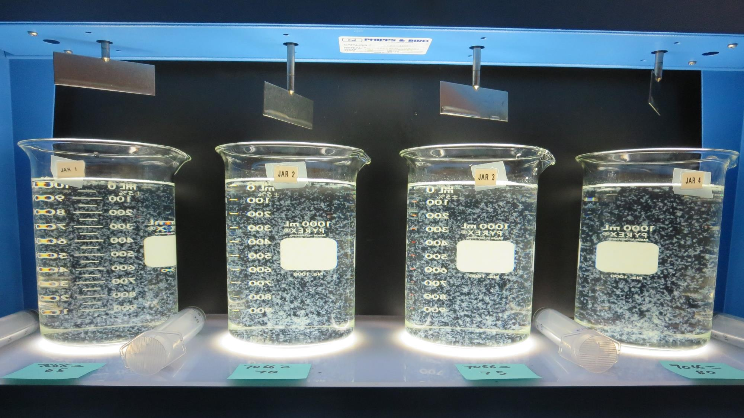
Jars 1-4: End of 10-minute flocculation (30 RPM) duration.
65 mg/L 7066
Filtrate: 0.06 NTU
UVT: 94.5%
UVA: 0.025/cm
Settled: 0.53 NTU
70 mg/L 7066
Filtrate: 0.07 NTU
UVT: 94.8%
UVA: 0.023/cm
Settled: 0.56 NTU
75 mg/L 7066
Filtrate: 0.06 NTU
UVT: 94.9%
UVA: 0.023/cm
Settled: 0.70 NTU
80 mg/L 7066
Filtrate: 0.06 NTU
UVT: 95.3%
UVA: 0.021/cm
Settled: 0.55 NTU

Slide 14
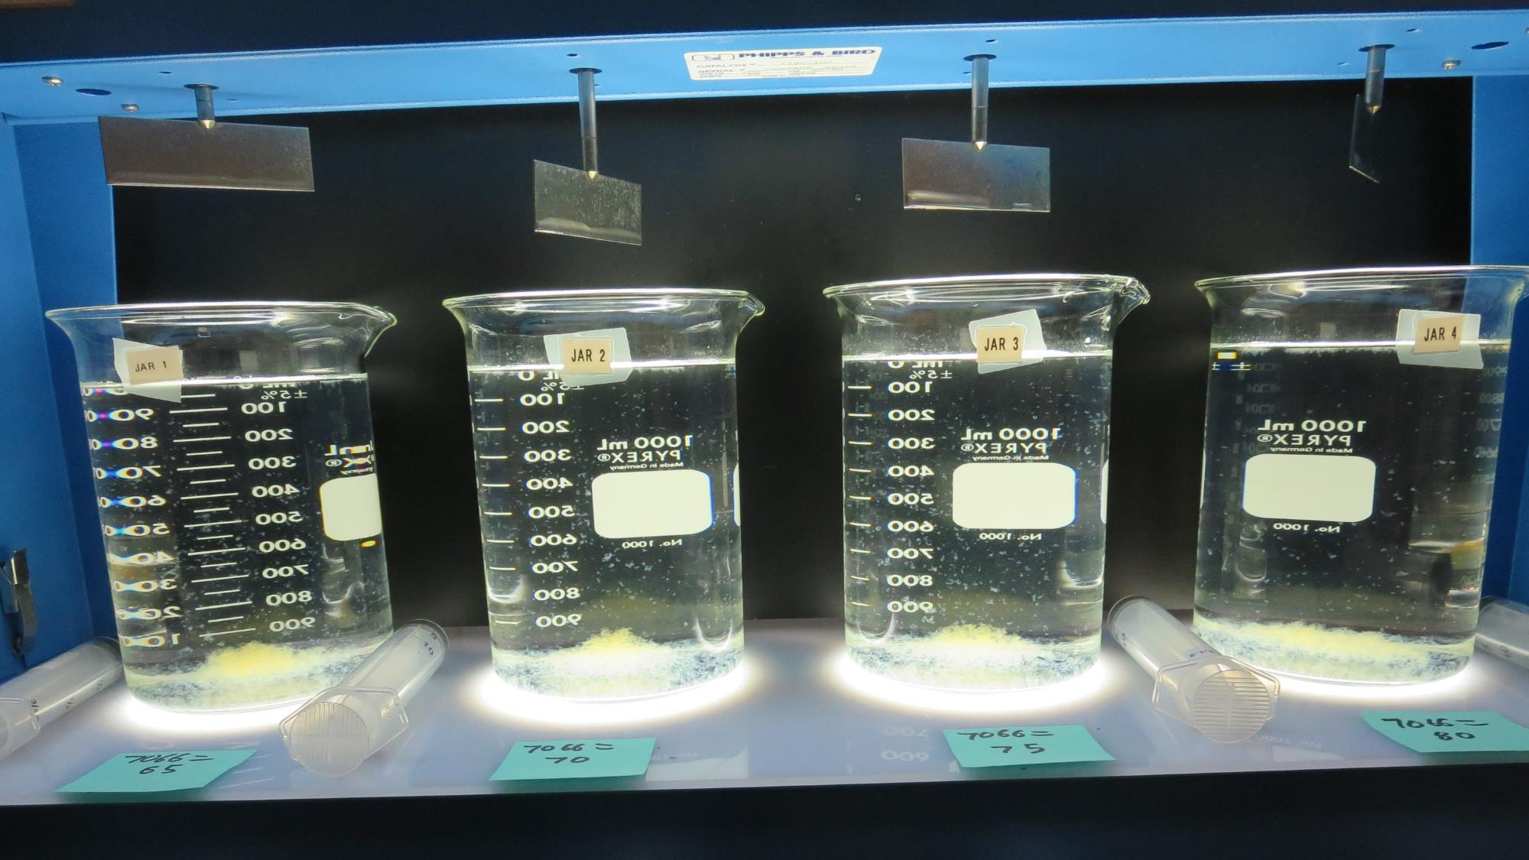
Jars 1-4: After 5 min of settling, 25 mL is syringed for filterability and %UVT/UVA

Slide 15
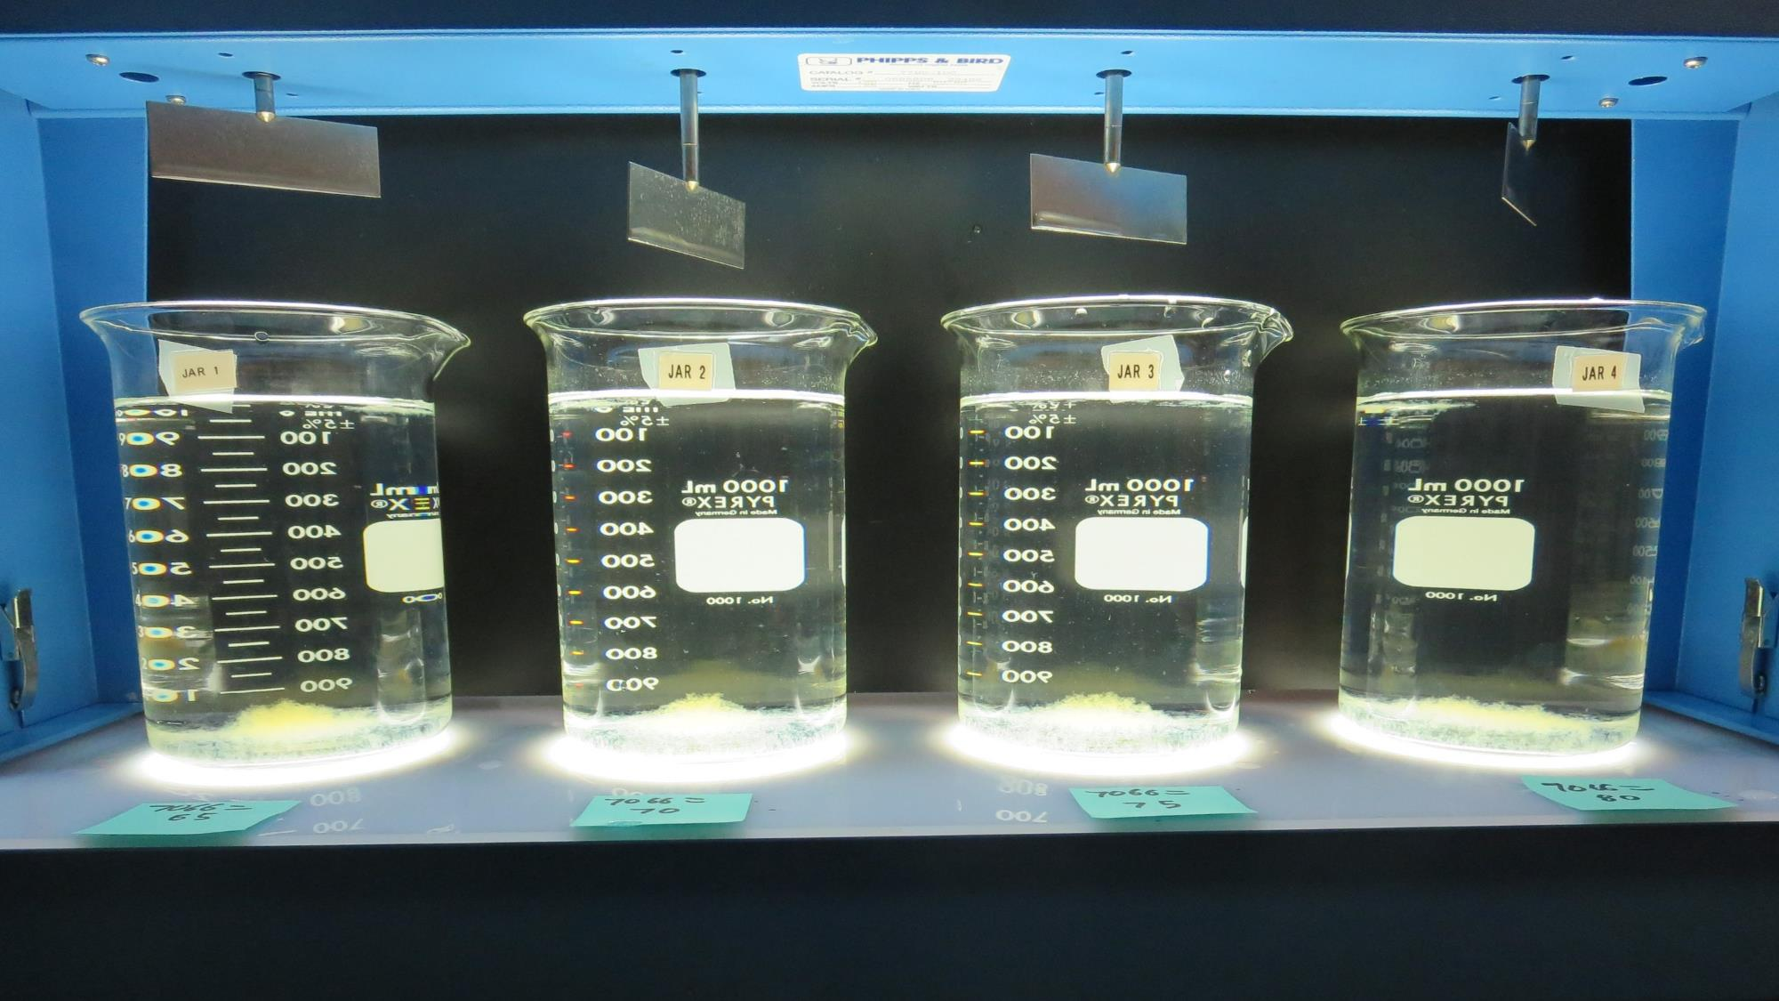
Jars 1-4: After 25-minutes of settling, settled water turbidity is taken.
65 mg/L 7066
Filtrate: 0.06 NTU
UVT: 94.5%
UVA: 0.025/cm
Settled: 0.53 NTU
65 mg/L 7066
Filtrate: 0.06 NTU
UVT: 94.5%
UVA: 0.025/cm
Settled: 0.53 NTU
75 mg/L 7066
Filtrate: 0.06 NTU
UVT: 94.9%
UVA: 0.023/cm
Settled: 0.70 NTU
80 mg/L 7066
Filtrate: 0.06 NTU
UVT: 95.3%
UVA: 0.021/cm
Settled: 0.55 NTU

Slide 16
Jars 5-8 Test Flash Mix 60 Sec (200 RPM) Floc Mix 10 min (30 RPM) Applied Coagulant 7066

Slide 17
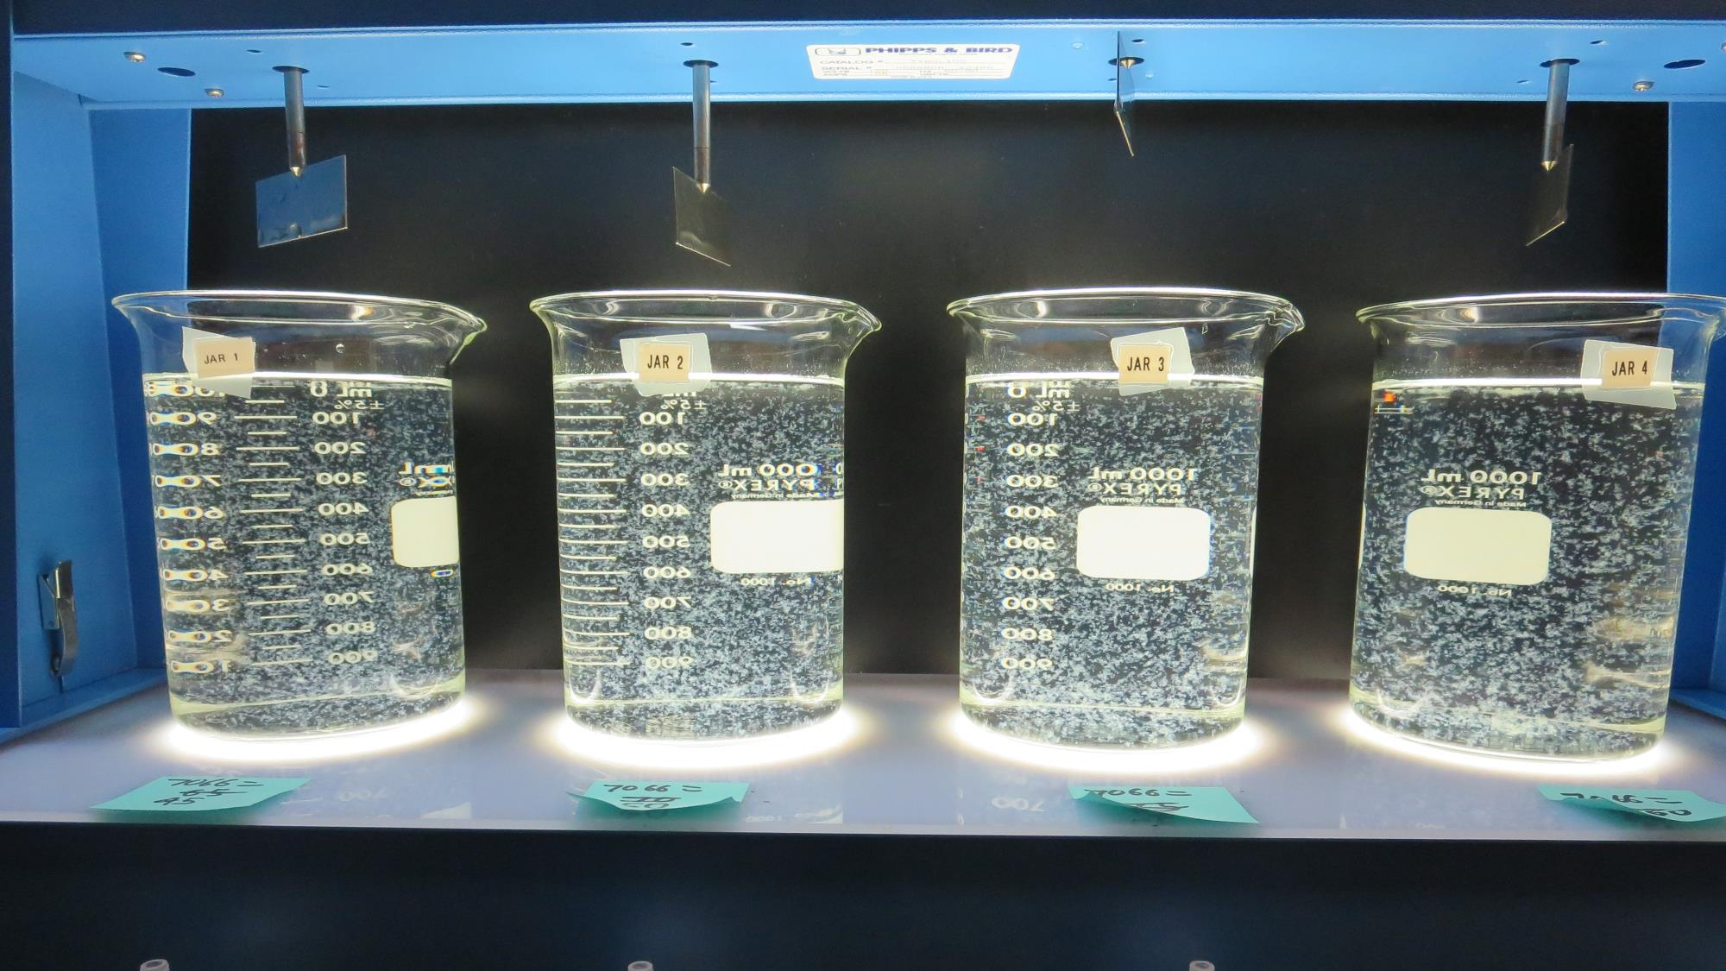
Jars 5-8: End of 10-minute flocculation (30 RPM) duration.
45 mg/L 7066
Filtrate: 0.18 NTU
UVT: 92.9%
UVA: 0.032/cm
Settled: 0.77 NTU
50 mg/L 7066
Filtrate: 0.08 NTU
UVT: 93.8%
UVA: 0.028/cm
Settled: 0.81 NTU
55 mg/L 7066
Filtrate: 0.07 NTU
UVT: 94.5%
UVA: 0.025/cm
Settled: 0.80 NTU
60 mg/L 7066
Filtrate: 0.05 NTU
UVT: 94.9%
UVA: 0.023/cm
Settled: 0.66 NTU

Slide 18
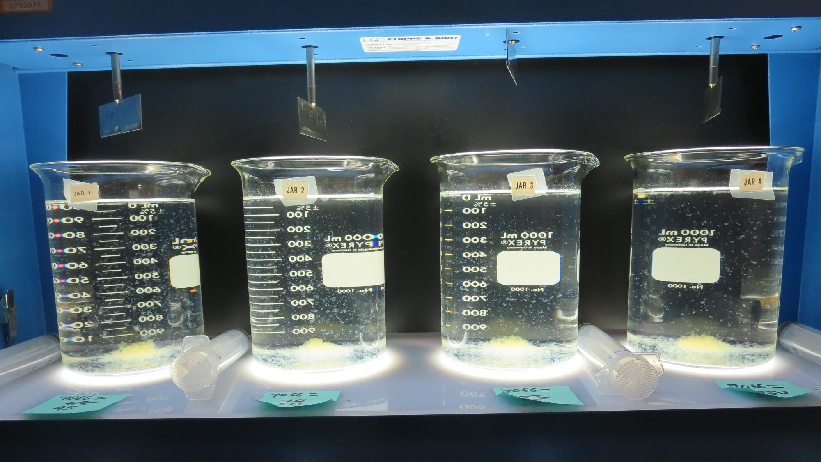
Jars 5-8: After 5 min of settling, 25 mL is syringed for filterability and %UVT/UVA

Slide 19
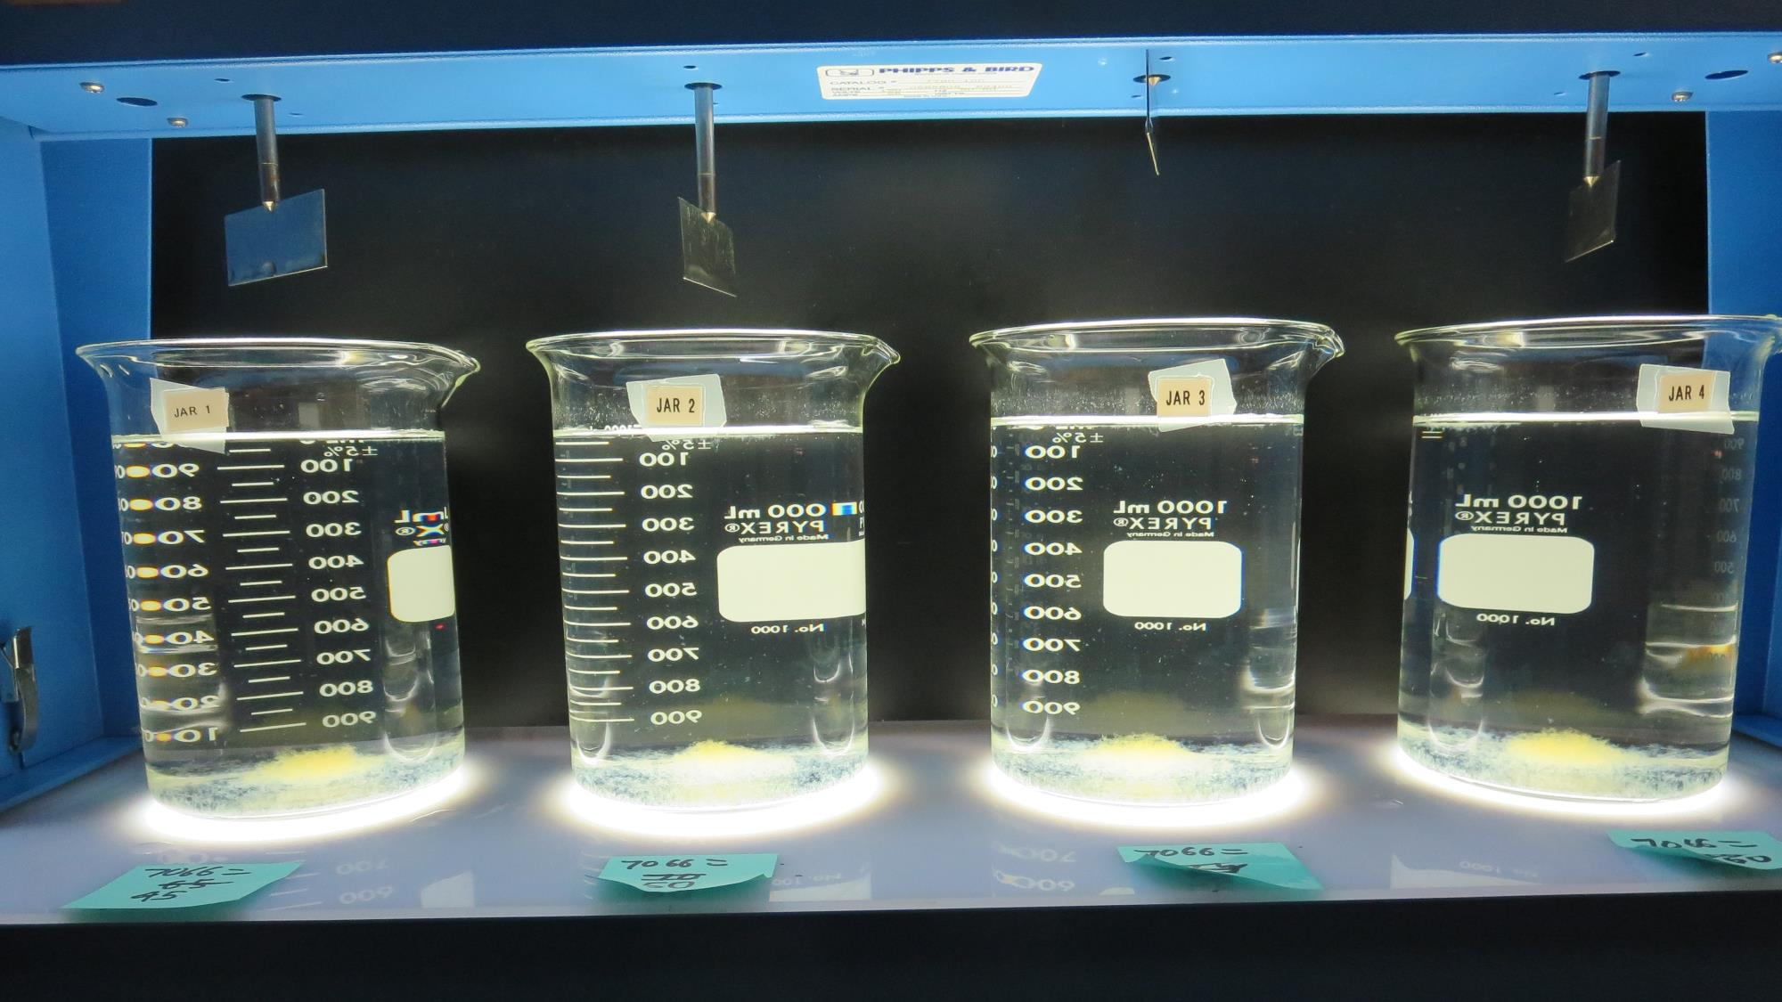
Jars 5-8: After 25-minutes of settling, settled water turbidity is taken.
45 mg/L 7066
Filtrate: 0.18 NTU
UVT: 92.9%
UVA: 0.032/cm
Settled: 0.77 NTU
50 mg/L 7066
Filtrate: 0.08 NTU
UVT: 93.8%
UVA: 0.028/cm
Settled: 0.81 NTU
55 mg/L 7066
Filtrate: 0.07 NTU
UVT: 94.5%
UVA: 0.025/cm
Settled: 0.80 NTU
60 mg/L 7066
Filtrate: 0.05 NTU
UVT: 94.9%
UVA: 0.023/cm
Settled: 0.66 NTU

Slide 20
Jars 9-12 Test Flash Mix 60 Sec (200 RPM) Floc Mix 10 min (30 RPM) Applied Coagulant 7066

Slide 21
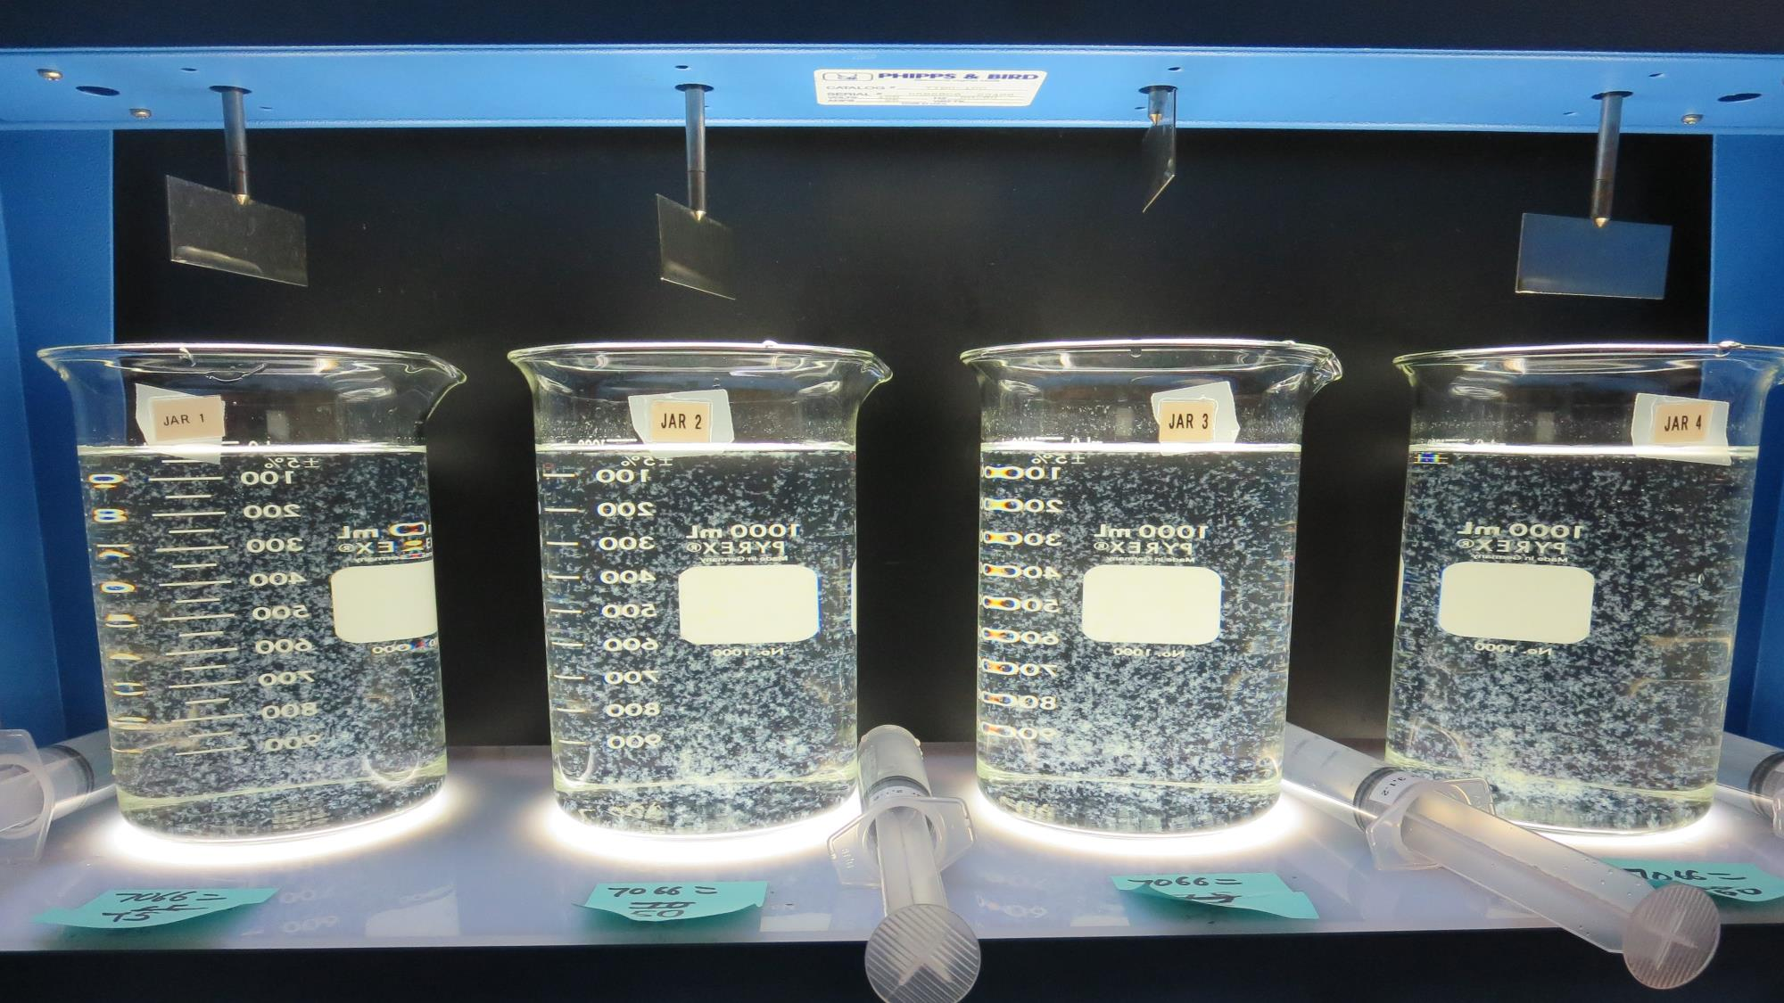
Jars 9-12: End of 10-minute flocculation (30 RPM) duration.
45 mg/L 7066
Filtrate: 0.22 NTU
UVT: 93.0%
UVA: 0.032/cm
Settled: 0.72 NTU
50 mg/L 7066
Filtrate: 0.18 NTU
UVT: 93.5%
UVA: 0.029/cm
Settled: 0.75 NTU
55 mg/L 7066
Filtrate: 0.07 NTU
UVT: 94.0%
UVA: 0.027/cm
Settled: 0.71 NTU
60 mg/L 7066
Filtrate: 0.09 NTU
UVT: 94.0%
UVA: 0.027/cm
Settled: 0.61 NTU

Slide 22
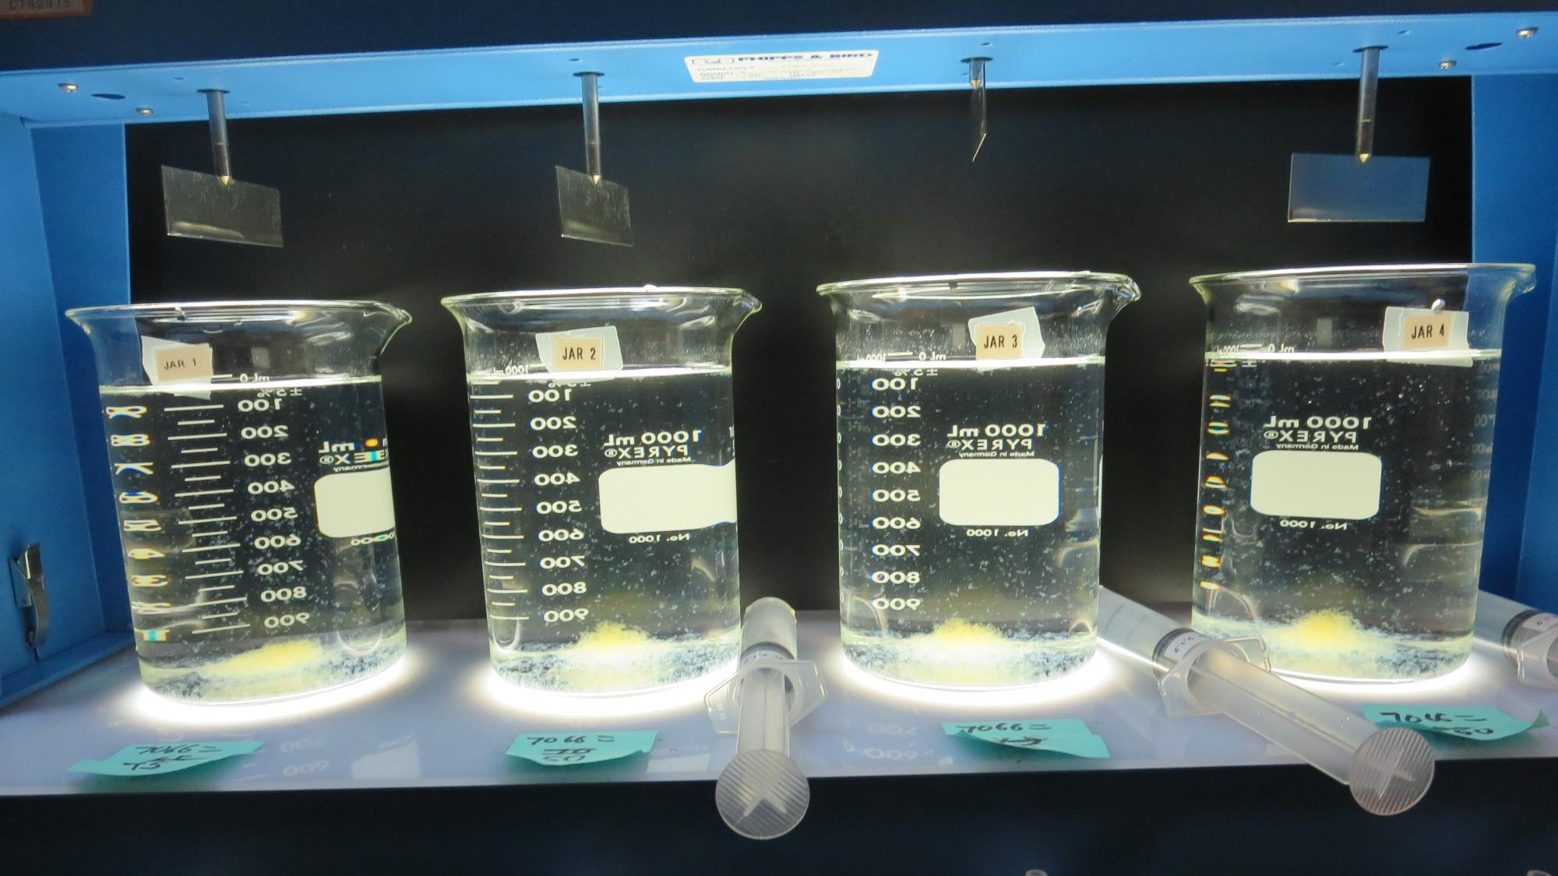
Jars 9-12: After 5 min of settling, 25 mL is syringed for filterability and %UVT/UVA

Slide 23
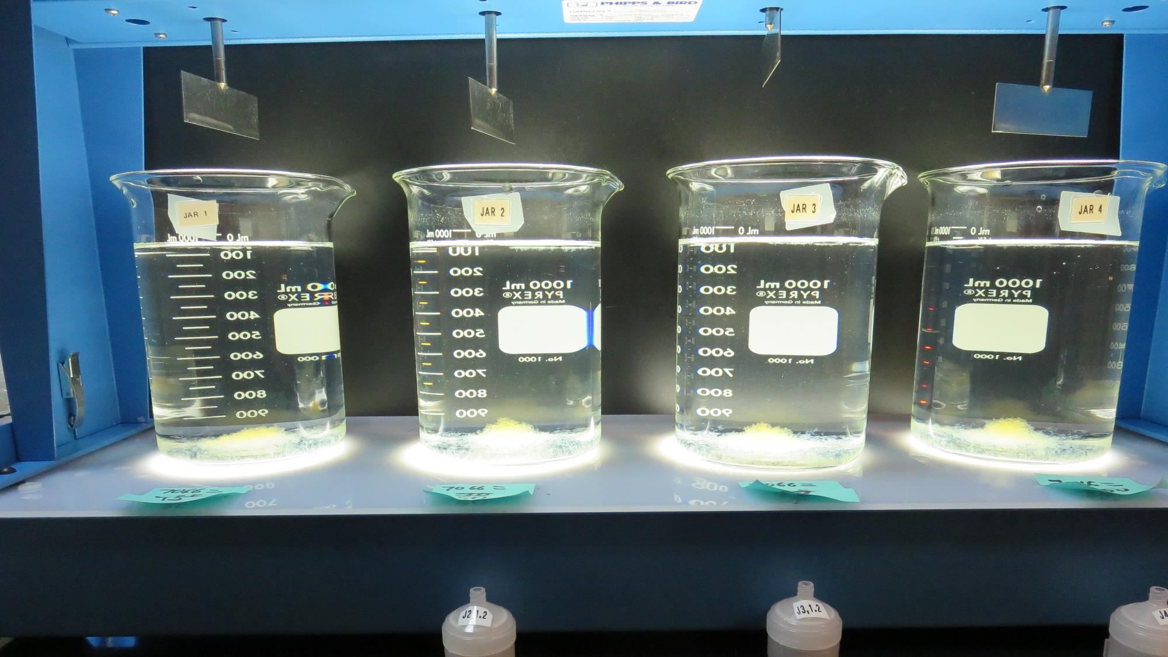
Jars 9-12: After 25-minutes of settling, settled water turbidity is taken.
45 mg/L 7066
Filtrate: 0.22 NTU
UVT: 93.0%
UVA: 0.032/cm
Settled: 0.72 NTU
50 mg/L 7066
Filtrate: 0.18 NTU
UVT: 93.5%
UVA: 0.029/cm
Settled: 0.75 NTU
55 mg/L 7066
Filtrate: 0.07 NTU
UVT: 94.0%
UVA: 0.027/cm
Settled: 0.71 NTU
60 mg/L 7066
Filtrate: 0.09 NTU
UVT: 94.0%
UVA: 0.027/cm
Settled: 0.61 NTU

Slide 24
Jars 13-16 Test Flash Mix 60 Sec (200 RPM) Floc Mix 10 min (30 RPM) Applied Coagulants AH-710 7066

Slide 25
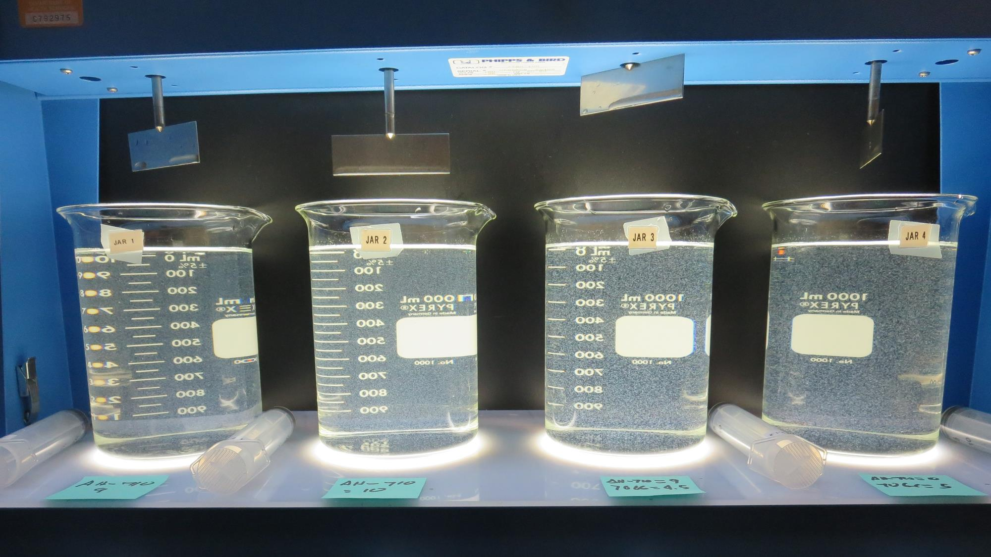
Jars 13-16: End of 10-minute flocculation (30 RPM) duration.
9.0 mg/L AH-710
0 mg/L 7066
Filtrate: 0.65 NTU
UVT: 91.1%
UVA: 0.040/cm
Settled: 3.4 NTU
10 mg/L AH-710
0 mg/L 7066
Filtrate: 0.77 NTU
UVT: 91.1%
UVA: 0.040/cm
Settled: 3.0 NTU
9.0 mg/L AH-710
4.5 mg/L 7066
Filtrate: 0.12 NTU
UVT: 92.7%
UVA: 0.033/cm
Settled: 2.2 NTU
10 mg/L AH-710
5.0 mg/L 7066
Filtrate: 0.34 NTU
UVT: 92.9%
UVA: 0.032/cm
Settled: 2.1 NTU

Slide 26
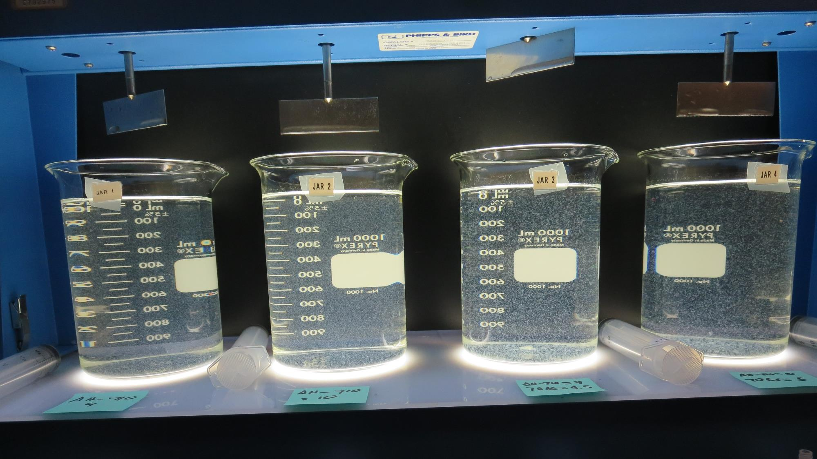
Jars 13-16: After 5 min of settling, 25 mL is syringed for filterability and %UVT/UVA

Slide 27
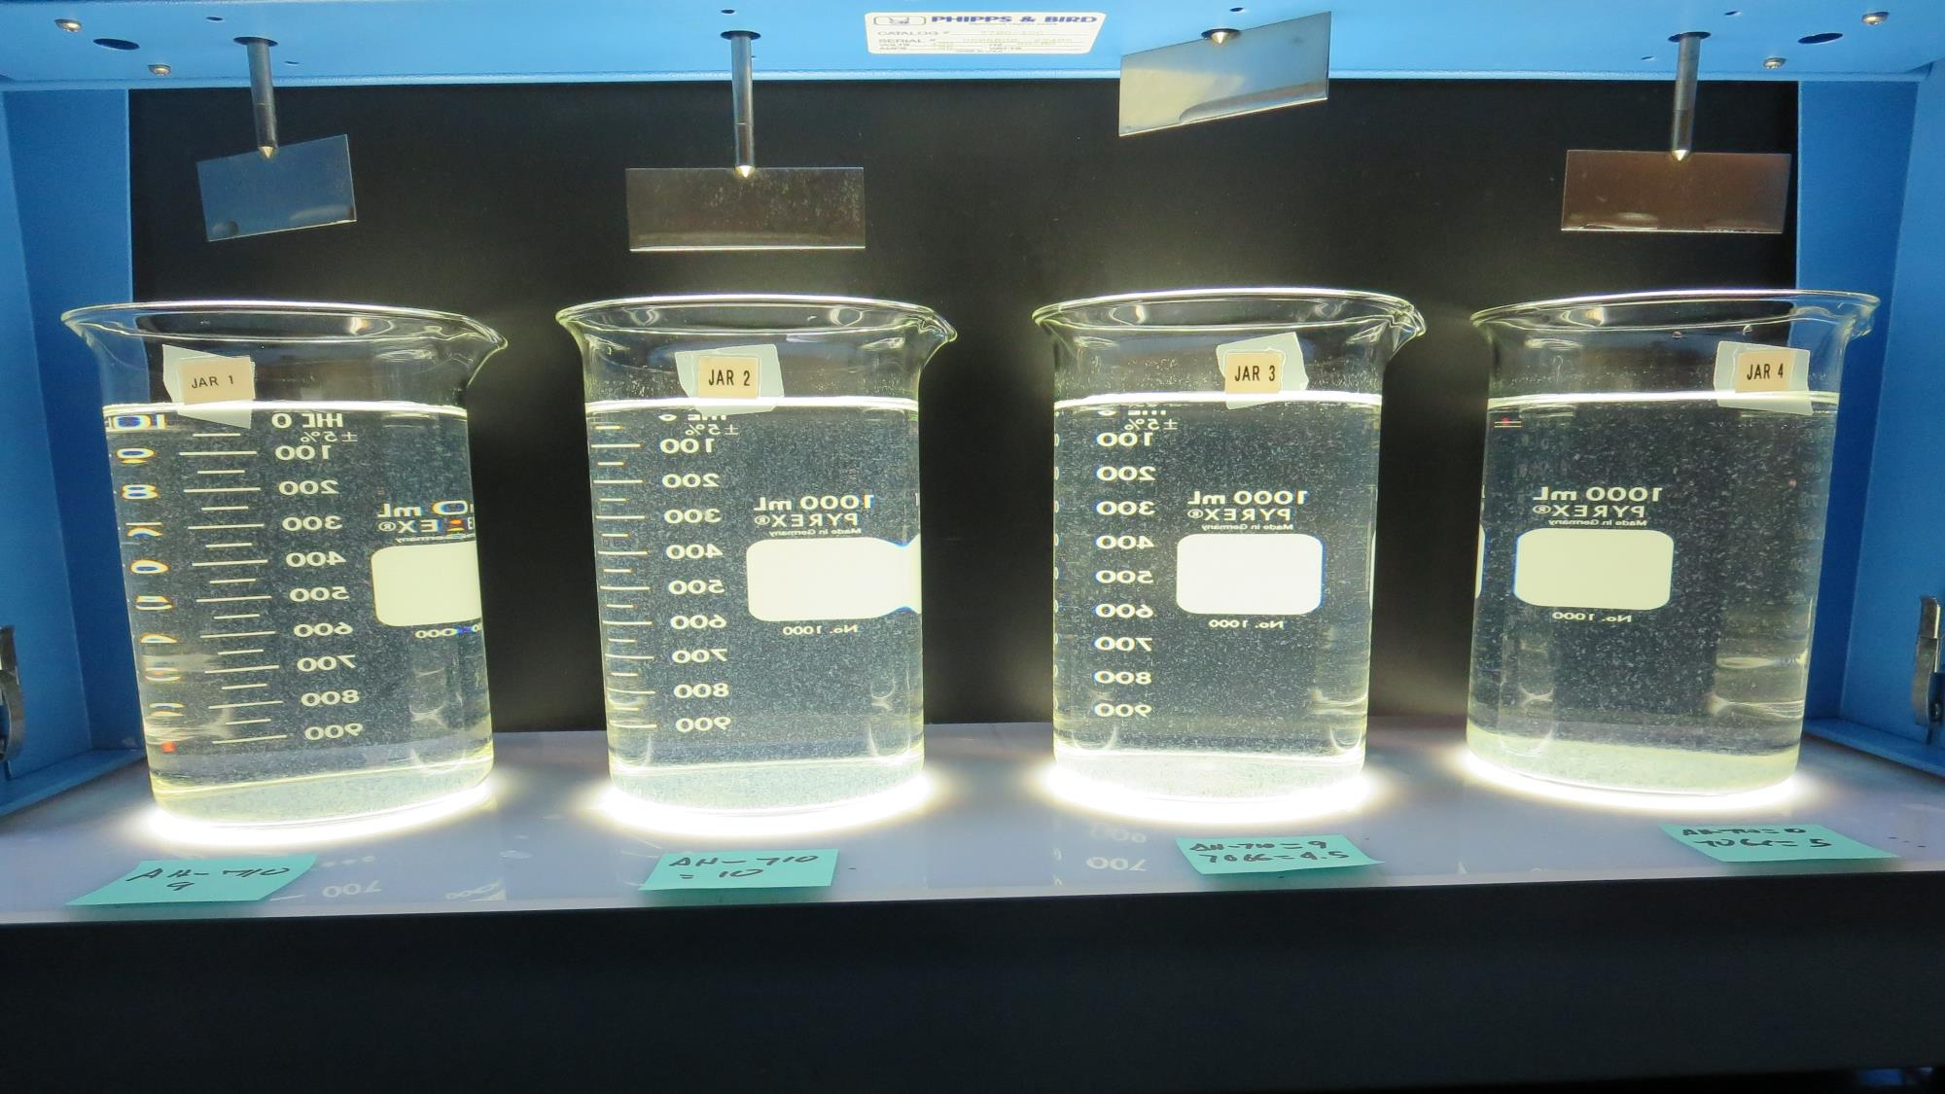
Jars 13-16: After 25-minutes of settling, settled water turbidity is taken.
9.0 mg/L AH-710
0 mg/L 7066
Filtrate: 0.65 NTU
UVT: 91.1%
UVA: 0.040/cm
Settled: 3.4 NTU
10 mg/L AH-710
0 mg/L 7066
Filtrate: 0.77 NTU
UVT: 91.1%
UVA: 0.040/cm
Settled: 3.0 NTU
9.0 mg/L AH-710
4.5 mg/L 7066
Filtrate: 0.12 NTU
UVT: 92.7%
UVA: 0.033/cm
Settled: 2.2 NTU
10 mg/L AH-710
5.0 mg/L 7066
Filtrate: 0.34 NTU
UVT: 92.9%
UVA: 0.032/cm
Settled: 2.1 NTU

Slide 28
Jars 17-20 Test Flash Mix 60 Sec (200 RPM) Floc Mix 10 min (30 RPM) Applied Coagulants AH-710 7066

Slide 29
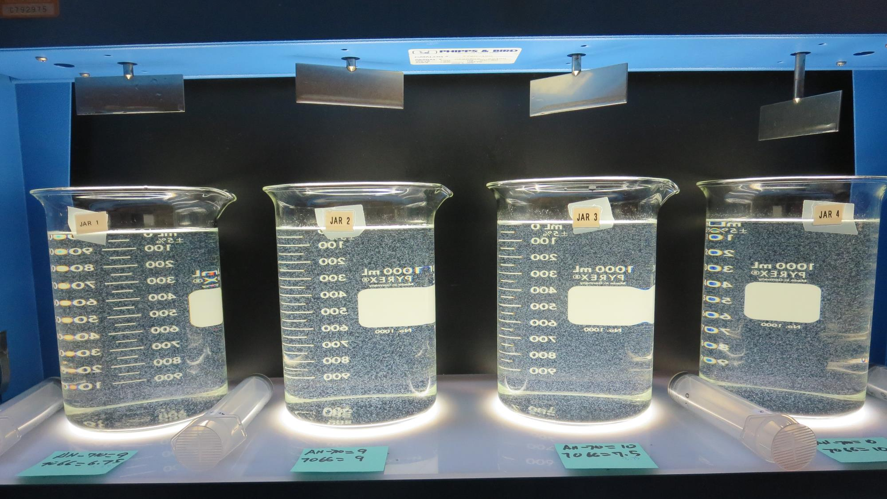
Jars 17-20: End of 10-minute flocculation (30 RPM) duration.
9.0 mg/L AH-710
6.75 mg/L 7066
Filtrate: 0.16 NTU
UVT: 93.1%
UVA: 0.031/cm
Settled: 1.5 NTU
9.0 mg/L AH-710
9.0 mg/L 7066
Filtrate: 0.09 NTU
UVT: 93.3%
UVA: 0.030/cm
Settled: 1.4 NTU
10 mg/L AH-710
7.5 mg/L 7066
Filtrate: 0.10 NTU
UVT: 94.0%
UVA: 0.027/cm
Settled: 1.6 NTU
10 mg/L AH-710
10 mg/L 7066
Filtrate: 0.32 NTU
UVT: 93.5%
UVA: 0.029/cm
Settled: 1.4 NTU

Slide 30
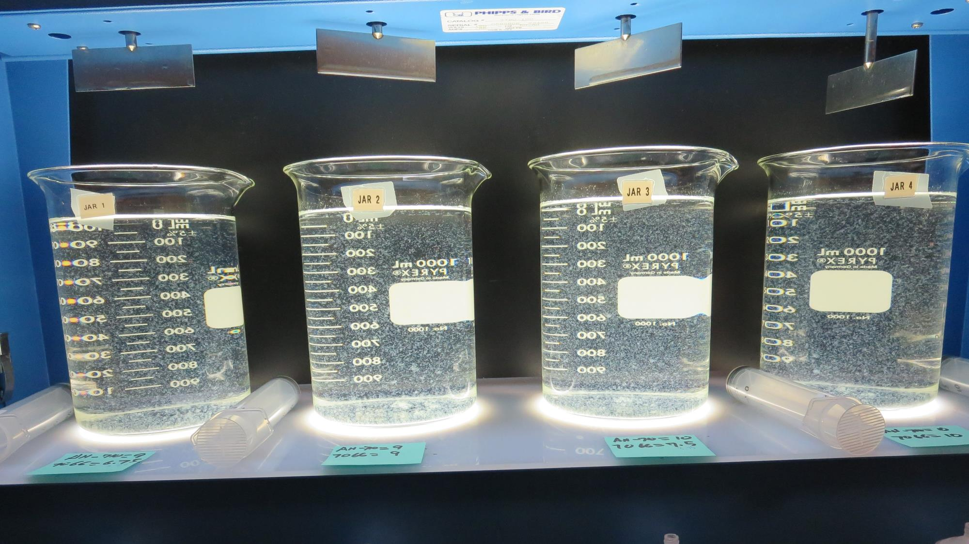
Jars 17-20: After 5 min of settling, 25 mL is syringed for filterability and %UVT/UVA

Slide 31
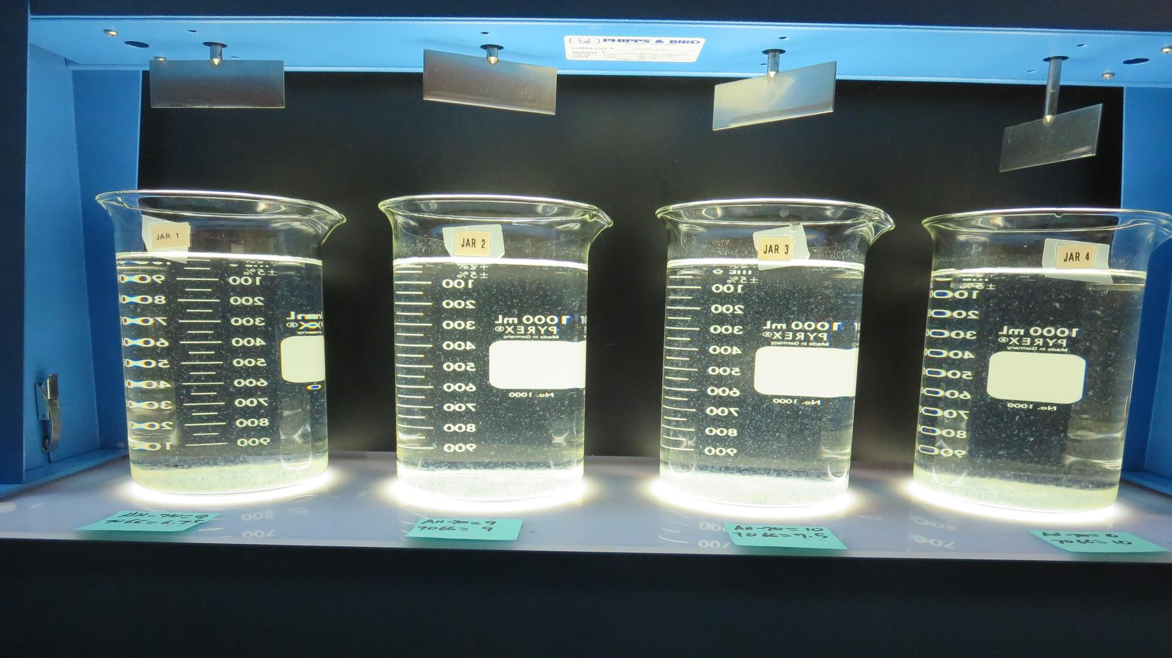
Jars 17-20: After 25-minutes of settling, settled water turbidity is taken.
9.0 mg/L AH-710
6.75 mg/L 7066
Filtrate: 0.16 NTU
UVT: 93.1%
UVA: 0.031/cm
Settled: 1.5 NTU
9.0 mg/L AH-710
9.0 mg/L 7066
Filtrate: 0.09 NTU
UVT: 93.3%
UVA: 0.030/cm
Settled: 1.4 NTU
10 mg/L AH-710
7.5 mg/L 7066
Filtrate: 0.10 NTU
UVT: 94.0%
UVA: 0.027/cm
Settled: 1.6 NTU
10 mg/L AH-710
10 mg/L 7066
Filtrate: 0.32 NTU
UVT: 93.5%
UVA: 0.029/cm
Settled: 1.4 NTU

Slide 32
Jars 21-24 Test Flash Mix 60 Sec (200 RPM) Floc Mix 10 min (30 RPM) Applied Coagulants AH-710 7066

Slide 33
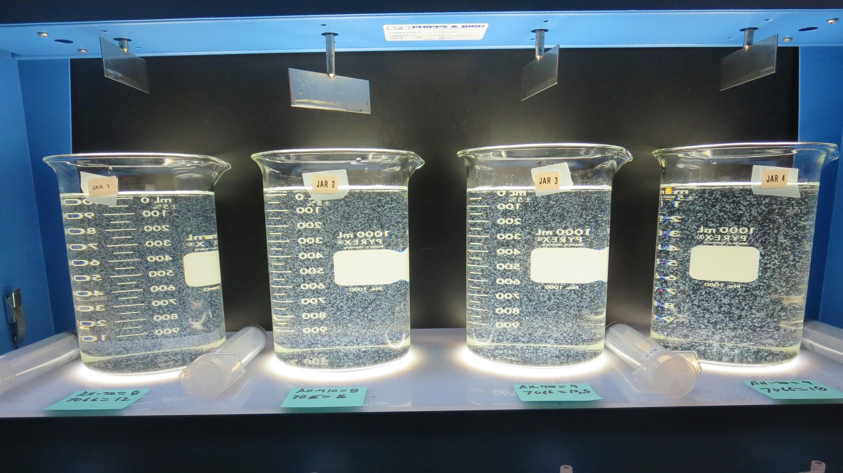
Jars 21-24: End of 10-minute flocculation (30 RPM) duration.
8.0 mg/L AH-710
12 mg/L 7066
Filtrate: 0.11 NTU
UVT: 93.5%
UVA: 0.029/cm
Settled: 1.2 NTU
8.0 mg/L AH-710
16 mg/L 7066
Filtrate: 0.21 NTU
UVT: 93.9%
UVA: 0.027/cm
Settled: 1.1 NTU
9.0 mg/L AH-710
13.5 mg/L 7066
Filtrate: 0.19 NTU
UVT: 93.8%
UVA: 0.028/cm
Settled: 1.0 NTU
9.0 mg/L AH-710
18 mg/L 7066
Filtrate: 0.13 NTU
UVT: 93.8%
UVA: 0.028/cm
Settled: 0.8 NTU

Slide 34
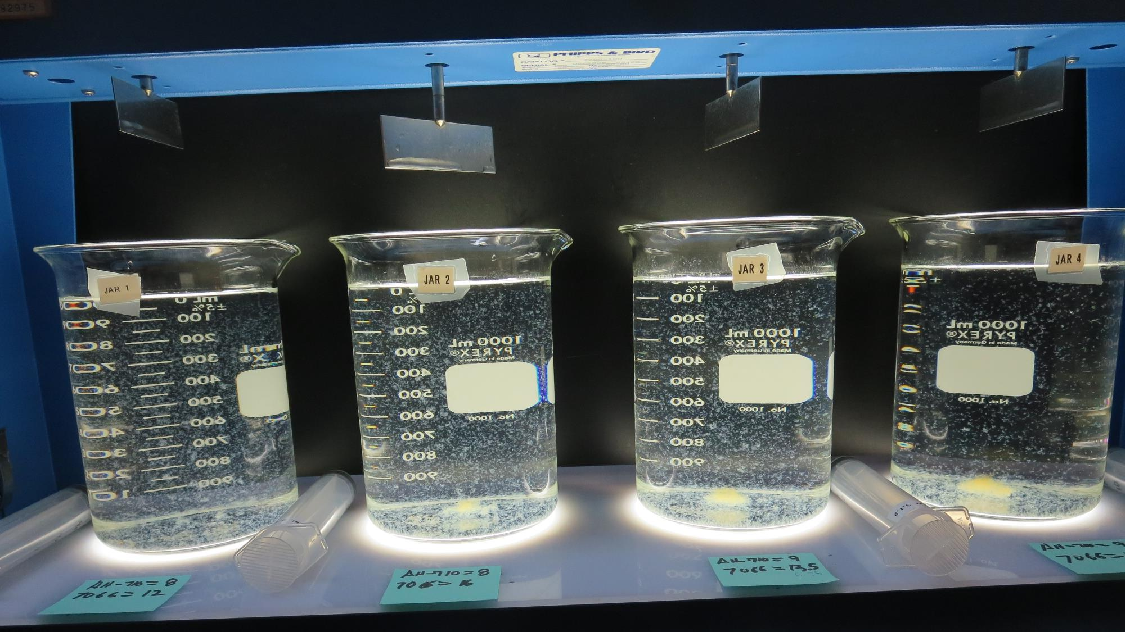
Jars 21-24: After 5 min of settling, 25 mL is syringed for filterability and %UVT/UVA

Slide 35
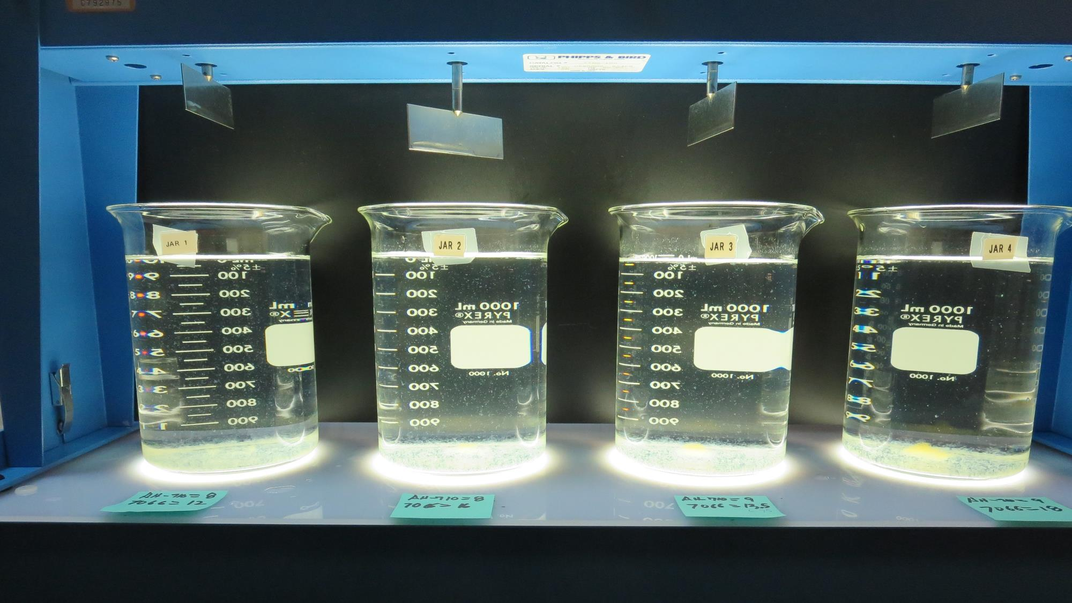
Jars 21-24: After 25-minutes of settling, settled water turbidity is taken.
8.0 mg/L AH-710
12 mg/L 7066
Filtrate: 0.11 NTU
UVT: 93.5%
UVA: 0.029/cm
Settled: 1.2 NTU
8.0 mg/L AH-710
16 mg/L 7066
Filtrate: 0.21 NTU
UVT: 93.9%
UVA: 0.027/cm
Settled: 1.1 NTU
9.0 mg/L AH-710
13.5 mg/L 7066
Filtrate: 0.19 NTU
UVT: 93.8%
UVA: 0.028/cm
Settled: 1.0 NTU
9.0 mg/L AH-710
18 mg/L 7066
Filtrate: 0.13 NTU
UVT: 93.8%
UVA: 0.028/cm
Settled: 0.8 NTU

Slide 36
Jars 25-28 Test Flash Mix 60 Sec (200 RPM) Floc Mix 10 min (30 RPM) Applied Coagulants AH-710 7066

Slide 37
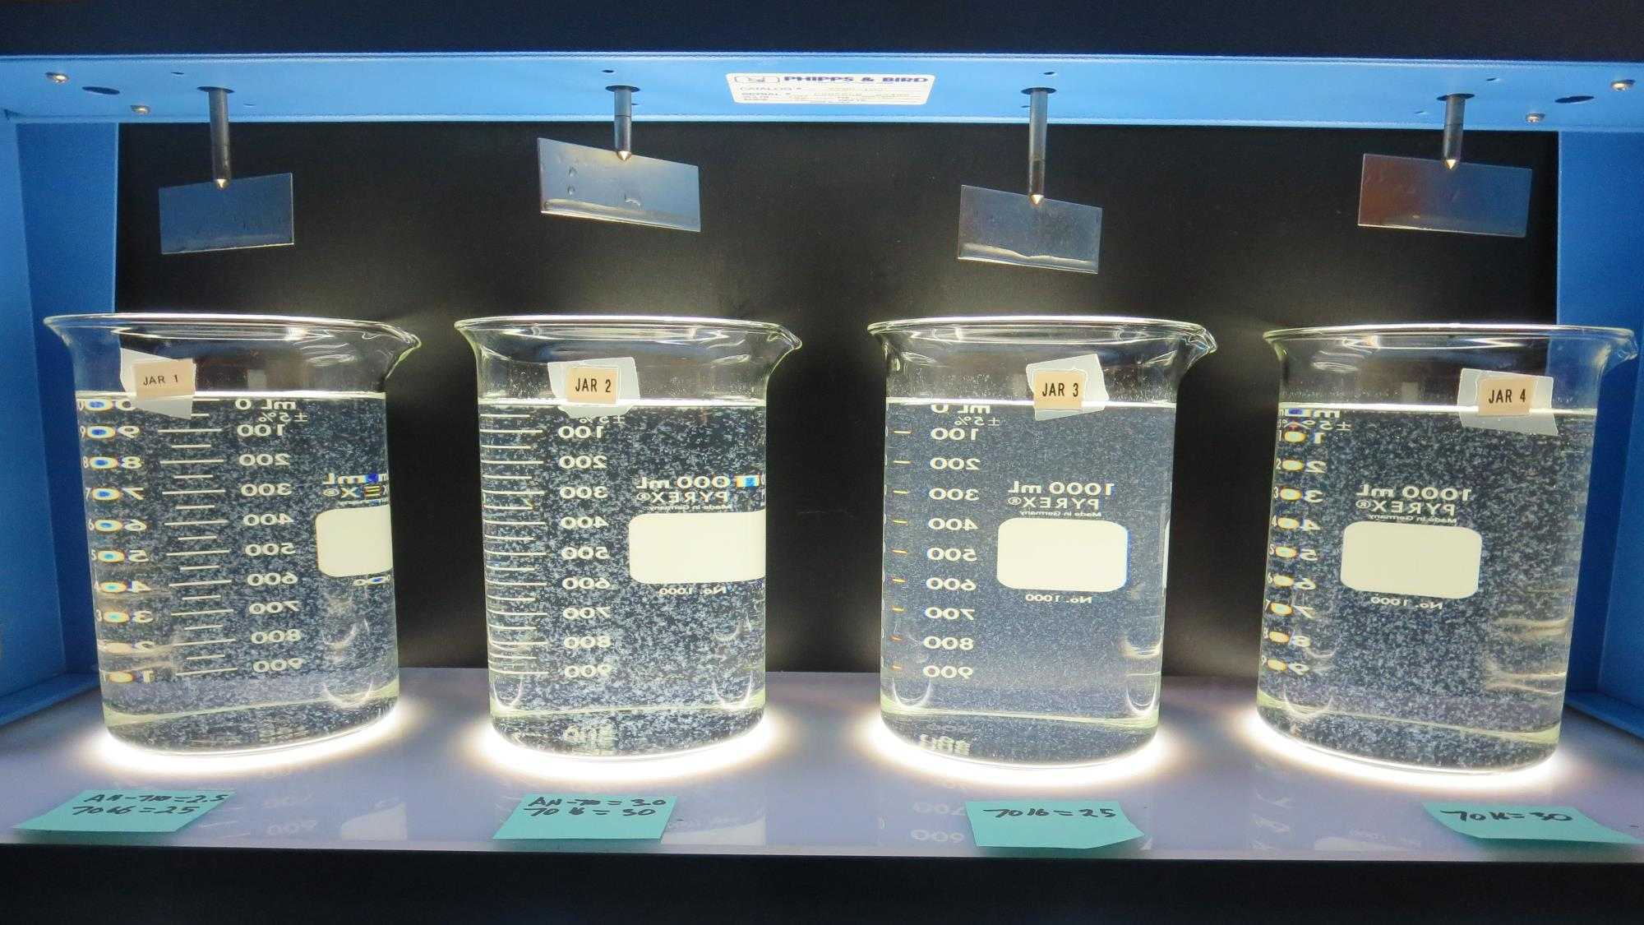
Jars 25-28: End of 10-minute flocculation (30 RPM) duration.
2.5 mg/L AH-710
25 mg/L 7066
Filtrate: 0.53 NTU
UVT: 91.7%
UVA: 0.038/cm
Settled: 1.5 NTU
3.0 mg/L AH-710
30 mg/L 7066
Filtrate: 0.14 NTU
UVT: 93.1%
UVA: 0.031/cm
Settled: 1.0 NTU
0 mg/L AH-710
25 mg/L 7066
Filtrate: 1.0 NTU
UVT: 89.5%
UVA: 0.048/cm
Settled: 3.2 NTU
0 mg/L AH-710
30 mg/L 7066
Filtrate: 0.24 NTU
UVT: 91.8%
UVA: 0.037/cm
Settled: 1.5 NTU

Slide 38
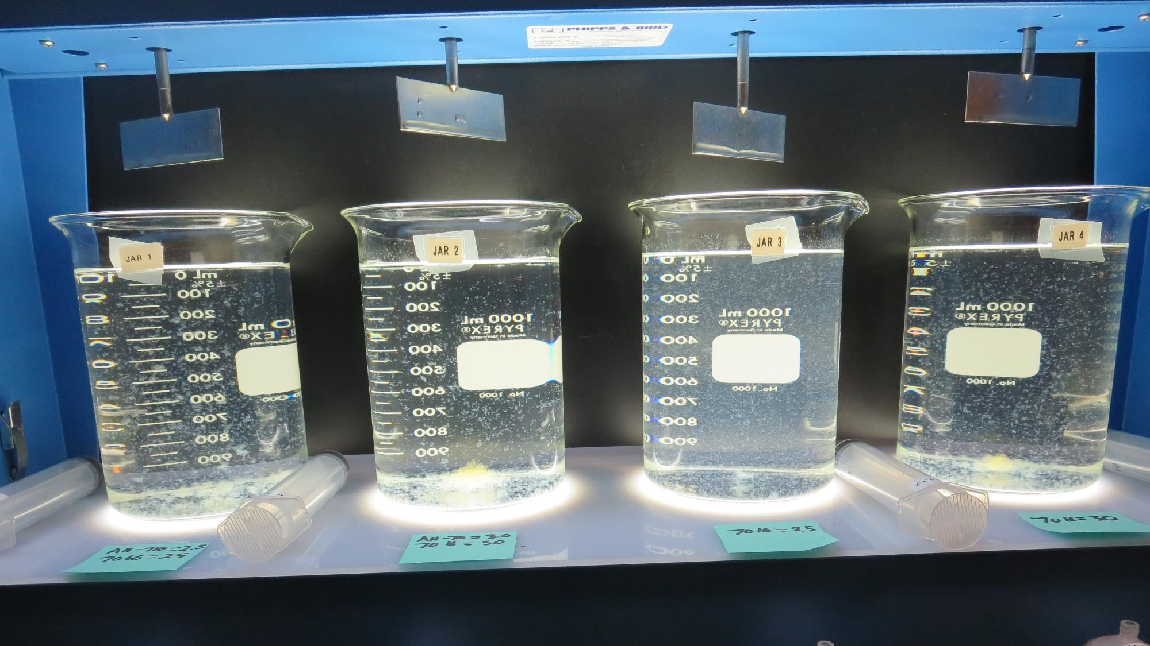
Jars 25-28: After 5 min of settling, 25 mL is syringed for filterability and %UVT/UVA

Slide 39
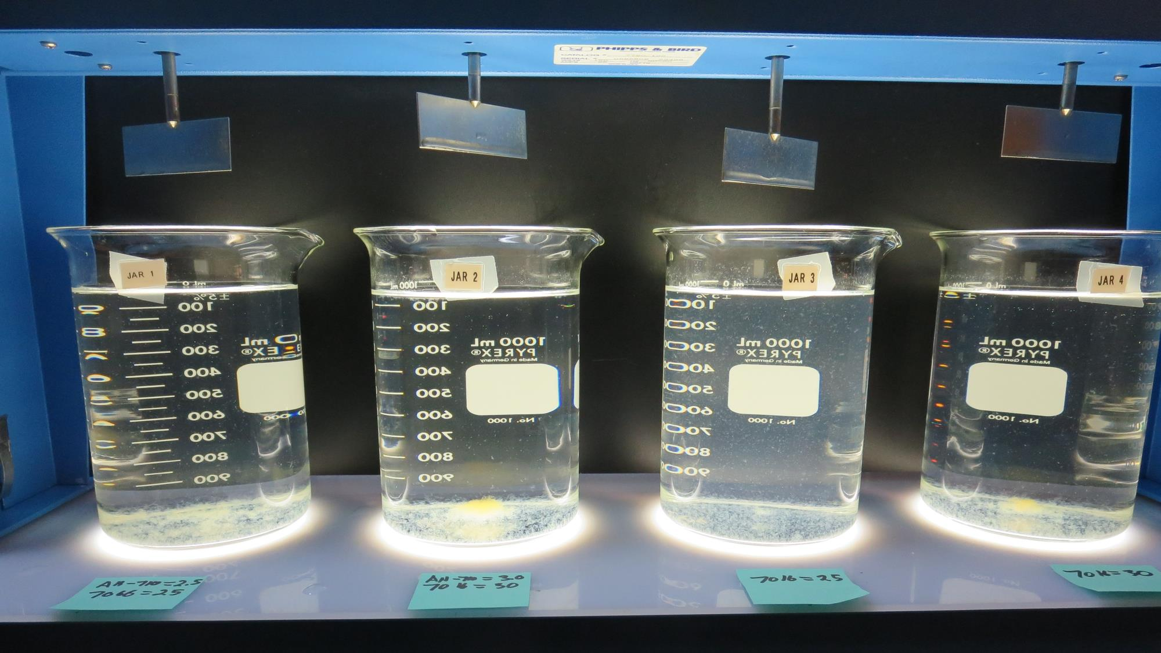
Jars 25-28: After 25-minutes of settling, settled water turbidity is taken.
2.5 mg/L AH-710
25 mg/L 7066
Filtrate: 0.53 NTU
UVT: 91.7%
UVA: 0.038/cm
Settled: 1.5 NTU
3.0 mg/L AH-710
30 mg/L 7066
Filtrate: 0.14 NTU
UVT: 93.1%
UVA: 0.031/cm
Settled: 1.0 NTU
0 mg/L AH-710
25 mg/L 7066
Filtrate: 1.0 NTU
UVT: 89.5%
UVA: 0.048/cm
Settled: 3.2 NTU
0 mg/L AH-710
30 mg/L 7066
Filtrate: 0.24 NTU
UVT: 91.8%
UVA: 0.037/cm
Settled: 1.5 NTU

Slide 40
Jars 29-32 Test Flash Mix 60 Sec (200 RPM) Floc Mix 10 min (30 RPM) Applied Coagulants AH-710 7066

Slide 41
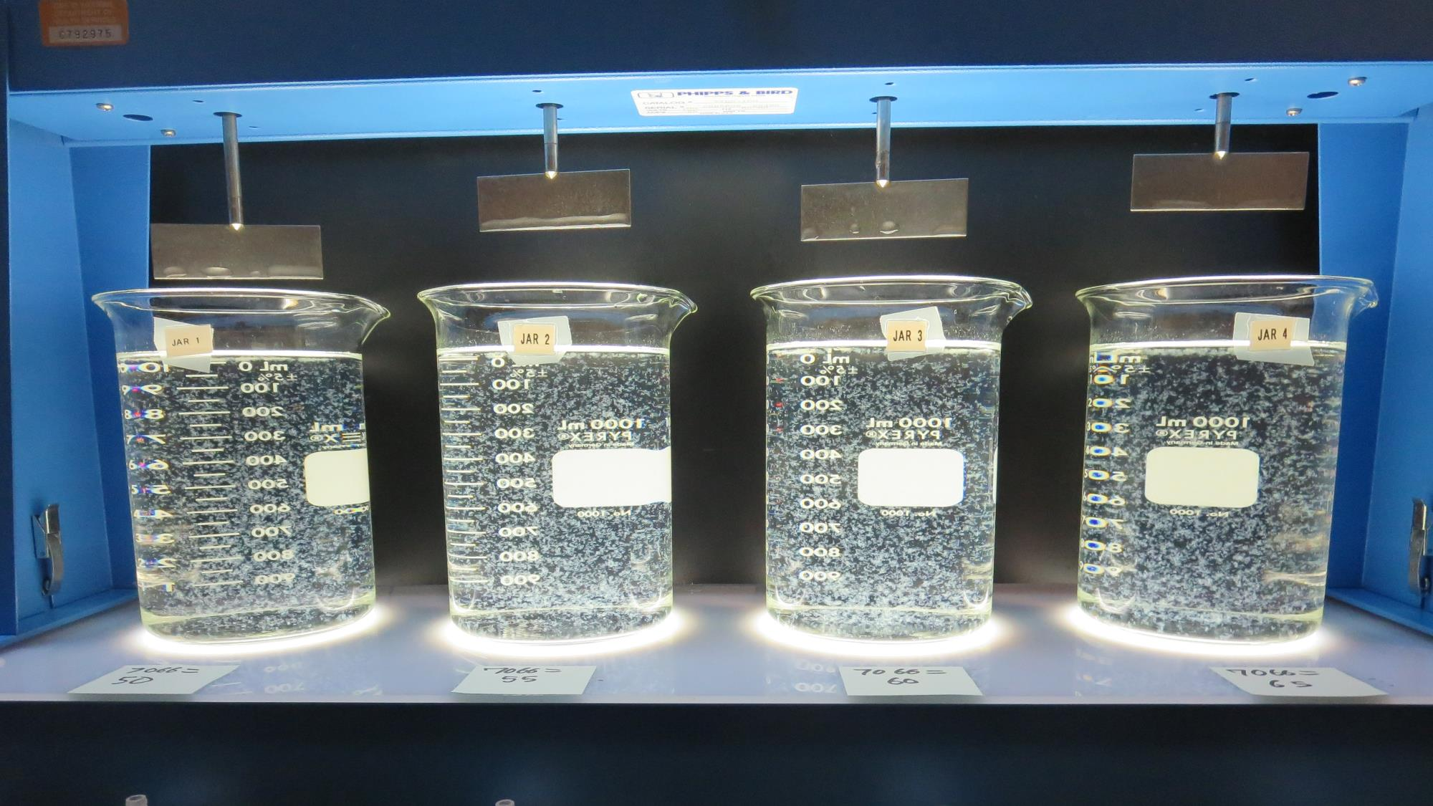
Jars 29-32: End of 10-minute flocculation (30 RPM) duration.
50 mg/L 7066
Filtrate: 0.08 NTU
UVT: 93.7%
UVA: 0.028/cm
Settled: 0.54 NTU
55 mg/L 7066
Filtrate: 0.14 NTU
UVT: 93.5%
UVA: 0.029/cm
Settled: 0.57 NTU
60 mg/L 7066
Filtrate: 0.10 NTU
UVT: 94.0%
UVA: 0.027/cm
Settled: 0.58 NTU
65 mg/L 7066
Filtrate: 0.14 NTU
UVT: 94.0%
UVA: 0.027/cm
Settled: 0.54 NTU

Slide 42
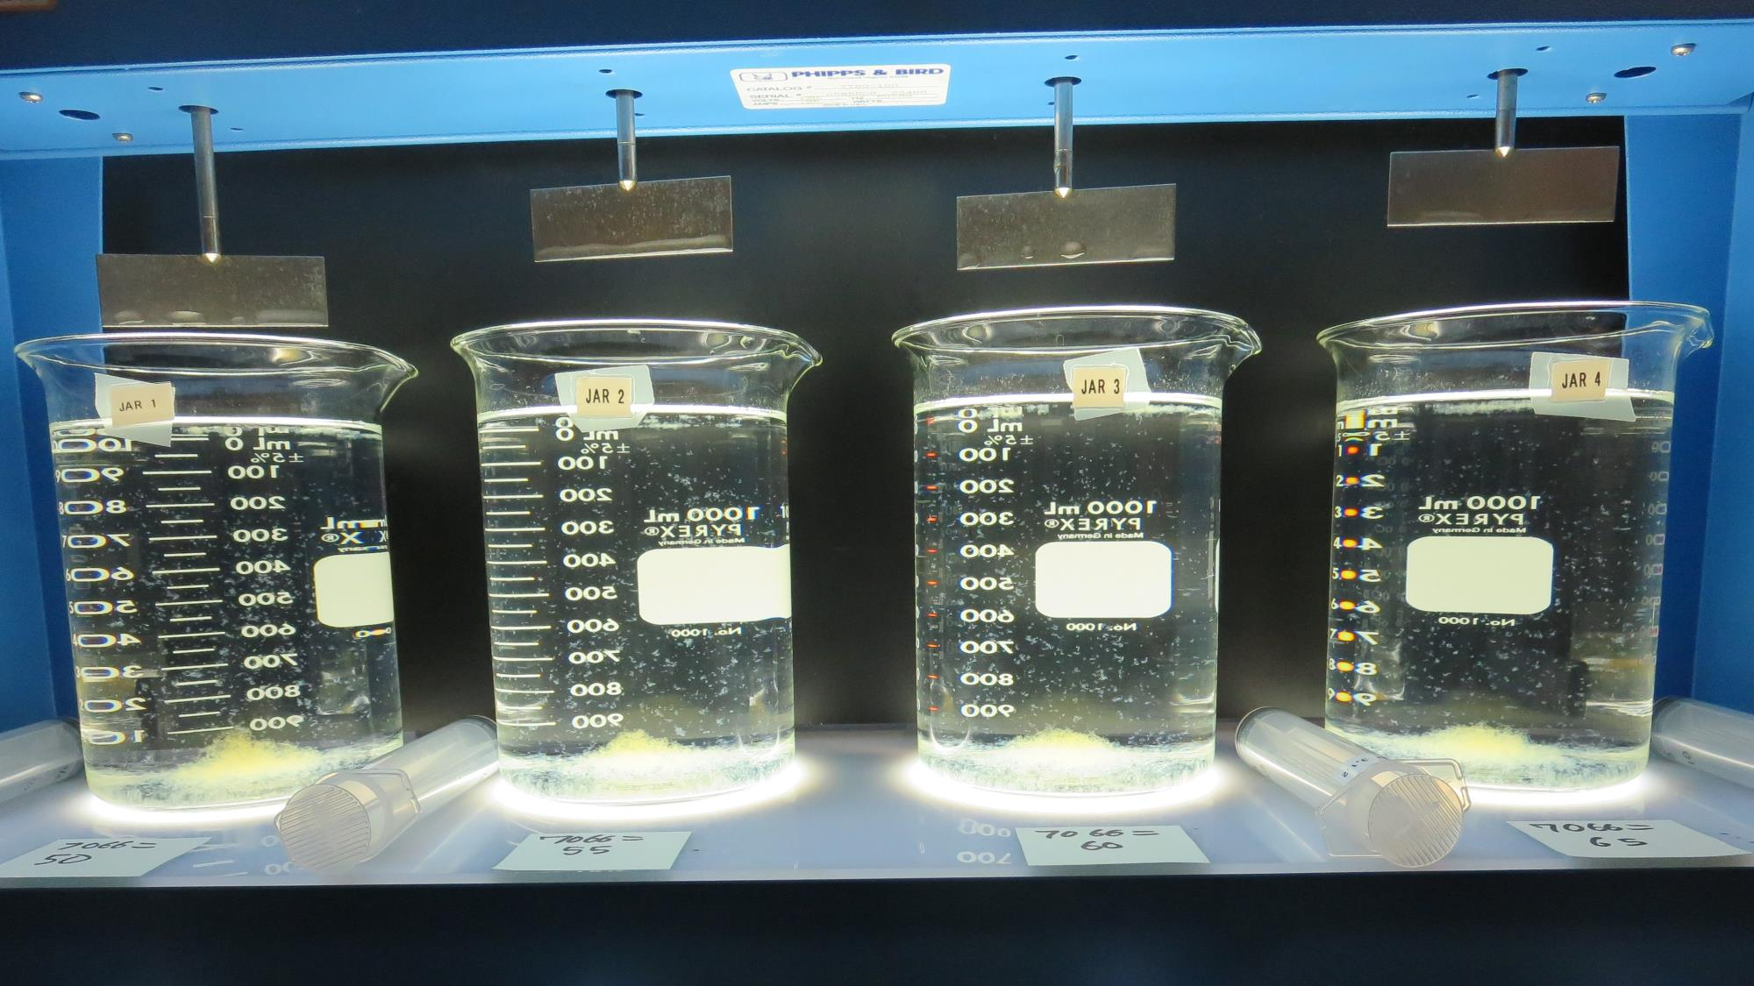
Jars 29-32: After 5 min of settling, 25 mL is syringed for filterability and %UVT/UVA

Slide 43
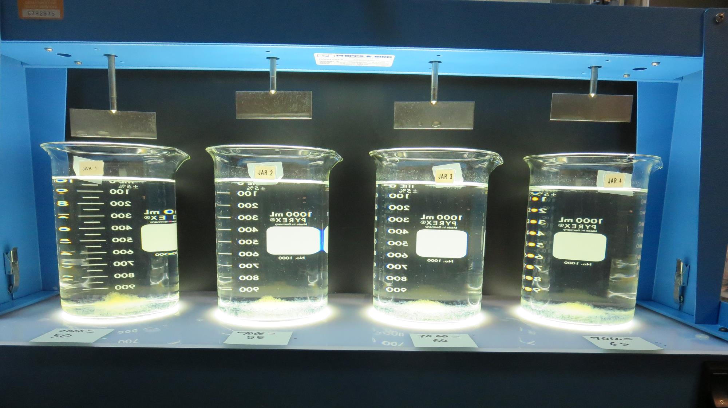
Jars 29-32: After 25-minutes of settling, settled water turbidity is taken.
50 mg/L 7066
Filtrate: 0.08 NTU
UVT: 93.7%
UVA: 0.028/cm
Settled: 0.54 NTU
55 mg/L 7066
Filtrate: 0.14 NTU
UVT: 93.5%
UVA: 0.029/cm
Settled: 0.57 NTU
60 mg/L 7066
Filtrate: 0.10 NTU
UVT: 94.0%
UVA: 0.027/cm
Settled: 0.58 NTU
65 mg/L 7066
Filtrate: 0.14 NTU
UVT: 94.0%
UVA: 0.027/cm
Settled: 0.54 NTU

Slide 44
Jar Testing for 1-Liter Jars: Procedures for Most Treatment Plants
Fill jars with source water prior to coagulant injection and set paddle speed at 30 rpm
Add chemicals (i.e., NaOCl, primary coagulant, coagulant aid) to each jar
Flash mix for 15-60 seconds (200 rpm)
Slow mix for 5 minutes (20-30 rpm)
Settled for 5 minutes. Syringe 25 mL from each jar taken 1-inch below surface (25 mL/12 sec rate)
Filtered through 1.2 um isopore membrane into cuvette drip rate, 15 mL/(50-90 sec)
Measure filtrate turbidity, chlorine residual and %UVT/UVA
Measure settled water turbidity after 25 minutes of total setting
Record all data

Slide 45
Jar Test Filterability Test Equipment
Turbidity Instrument
Syringe w/Luer-Lock Tip, 30 cc
(part#: 2225800, by Hach)
Swinnex Filter Holder, 25 mm (part#: SX0002500)
Isopore Membrane Filter, 1.2 um absolute
pore size,
Φ= 25 mm , thickness: 24 um,
hydrophilic polycarbonate membrane
(part #: RTTP02500)
Go to Sigma-Aldrich for laboratory supplies http://www.sigmaaldrich.com/united-states.html

Slide 46
Isopore Membrane Information
Categories | Information
trade name | Isopore
filter color | White
chemistry | Polycarbonate (PC)
water flow rate | Avg. 175 mL/min x cm² (typical results @ 10 psi)
media | Isopore®
wettability | Hydrophilic
porosity | 14.7%
pore size | 1.2 µm
bubble point at 23 °C | 1.0 bar, air with water
thickness | 24 µm
filter diameter (ø) | 25 mm
material size | polycarbonate, Hydrophilic, 1.2 µm, 25 mm, white, plain, 100

Slide 47
Isopore Membrane Background Information
The Isopore membrane is a polycarbonate, track-etched screen filter recommended for all analyses in which the sample is viewed on the surface of the membrane. The Isopore membrane is composed of polycarbonate film, which has a smooth, glass-like surface for clearer sample observation. The unique manufacturing process of the membrane ensures a precise pore diameter and a consistent pore size for accurate separation of samples by size. Matched-weight filters are not usually required because of low, constant tar and ash weights. Features & Benefits: Membrane structure retains particles on the surface, simplifying counting and analysis

Slide 48
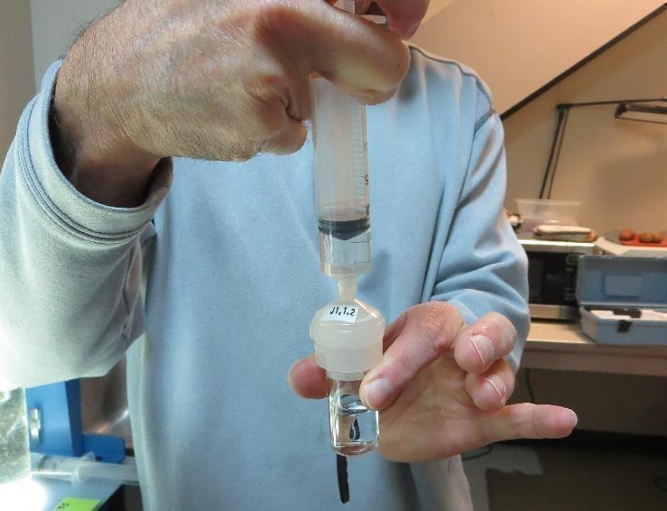
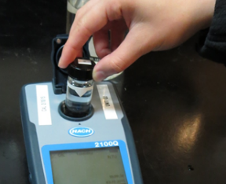
Jar Test - Filterability Test
Syringe ~ 25 mL from jar (after 5-minutes of settling)
Filter-to-waste 3-5 mL
Filter directly into clean cuvette
Measure turbidity
Note: Take several readings before recording final NTU results. Micro bubbles can adhere to glass causing false NTU readings. To remove bubbles, tilt cuvette up to 90 degrees.

Slide 49
Contact
Guy Schott, P.E.
State Water Resources Control Board
Division of Drinking Water
Santa Rosa, CA
Go to Stock Solution/Dose calculations/Jar Test Results for tools to download
www.waterboards.ca.gov/drinking_water/programs/districts/mendocino_district.html
Email: Guy Schott - Guy.Schott@waterboards.ca.gov
Office Number: 707-576-2732

