Slide 1
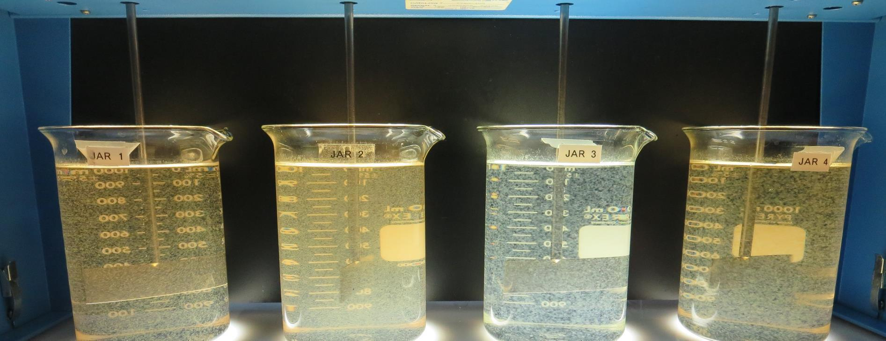
Nacimiento Water Company
CA4010027
San Luis Obispo County
Jar Test
by Guy Schott, P.E.
March 26, 2021

Slide 2
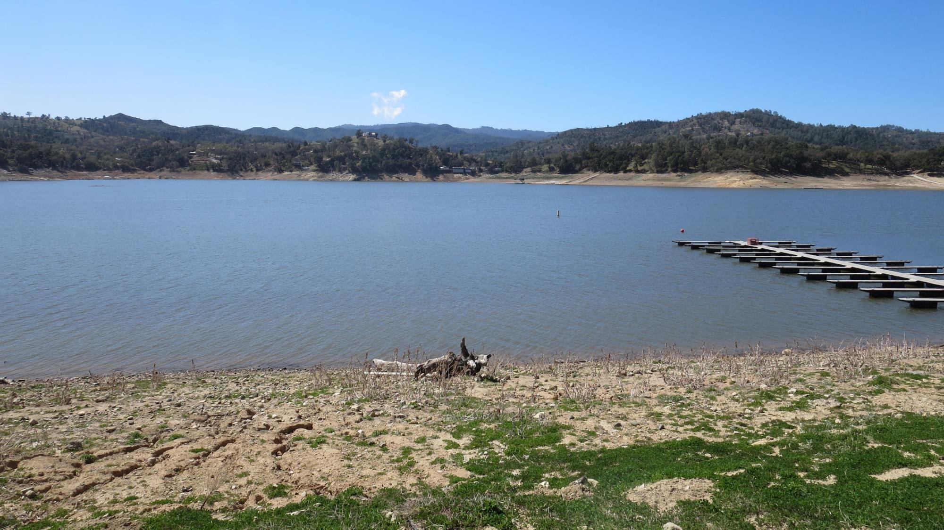
Source Water:
Nacimiento Lake

Slide 3
Schematice
CA4010027
Nacimiento Water Company
653 Service Connections
Population 1828

Slide 4
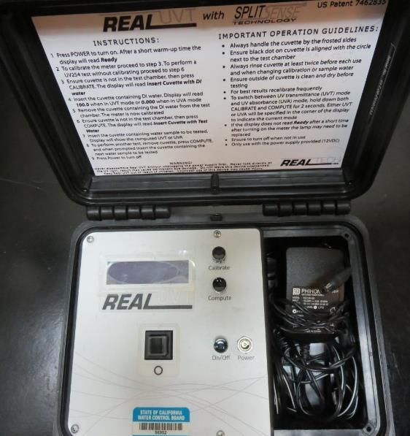
UVT/UVA, pathlength 10 mm
UV transmittance (UVT) is a measurement of the amount of ultraviolet light (254 nm) that passes through a water sample compared to the amount of light that passes through a pure water sample. The measurement is expressed as % UVT.
%UVT = 10^{(-UVA)} x 100%
UV absorbance (UVA) is calculated as a relative measure of the amount of light absorbed by a water sample compared with the amount of light absorbed by a pure water sample.
UVA = -log(%UVT/100)

Slide 5
Nacimiento Water Company Source & Treated Water Characteristics, March 26, 2021
Source
pH: 7.97
Alkalinity: 84 mg/L as CaCO₃
Turbidity: 7.8 NTU
UVT: 67.2%,
UVA: 0.172/cm
0.4 um Filtered
Turbidity: 1.13 NTU
UVT: 73.2%,
UVA: 0.135/cm
Plant Filtrate Water (pre-chlorination
pH: 7.98
Alkalinity: 86 mg/L as CaCO₃
Turbidity: 0.37 NTU
UVT: 85.6%,
UVA: 0.067/cm
0.4 um Filtered
Turbidity: 0.09 NTU
UVT: 85.7%,
UVA: 0.066/cm
Clearwell (post-chlorine)
Turbidity: 0.09 NTU
UVT: 90.3%,
UVA: 0.044/cm

Slide 6
Applied Coagulants for Jar Testing (1)
Aluminum Sulfate (Product)
Al₂(SO₄)₃*14.3H₂0 (Liquid)
48% Aluminum Sulfate
52% Water
8.2% Al₂O₃
4.3% Al
0% Basicity
SG = 1.32
NSF limit: 400 mg/L (product)
As hydrated Al₂(SO₄)₃*14.3H₂0
17% Al₂O₃
Brenntag (559-485-4150)
Solenis
Praestol 186KH
SG = 1.0 – 1.2
Viscosity: 200-500 centipoise
MW: 250,00 g/moles
pDADMAC (20% active, 80% H₂O)
NSF limit: 50 mg/L (product)
Product dose 5 mg/L = 1 mg/L pDADMAC active

Slide 7
Applied Coagulants for Jar Testing (2)
Kemira Chemicals, Inc.
Superfloc 4814RS
SG = 1.0 – 1.1
Polyacrylamide
NSF limit: 3.5 mg/L (product)
BWS, Inc.
AdvFloc-CTC-00011
Polyaluminum Hydroxy Chlorosulfate
12.55% Al₂O₃
6.64% Al
64.9% Basicity
SG = 1.299
NSF limit: 250 mg/L as Product
Gregory F. Nieckarz, Ph.D.
Principal Consultant
SWS Consulting, LLC.
+1.541.953.5112
gregn.swsc@gmail.com

Slide 8
Diallyldimethylammonium chloride or
N-allyl-N,N-dimethylprop-2-en-1-aminium chloride pDADMAC
C₈H₁₆ClN
MW: 161.67 g/mol
CH₃
CH₂
CH₂
CH
N
+
CH
CH₂
CH₂
CH₃
Cl⁻

Slide 9
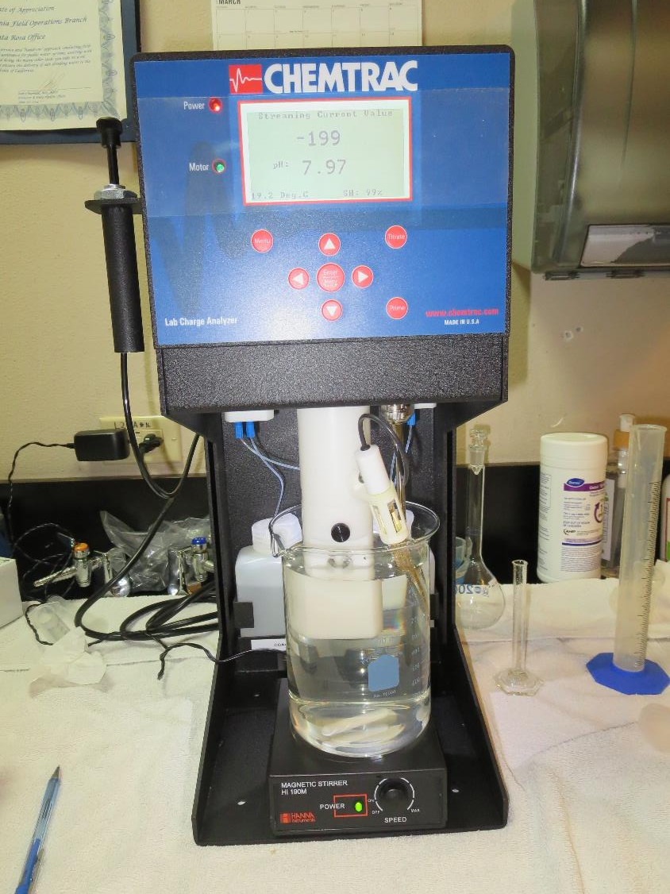
Laboratory Charge Analyzer
LCA: Used to determine coagulant demand of a source water entering the treatment plant.
Source pH: 7.8 (post KMnO₄ oxidation)
LCA #1: Alum: 44 mg/L as hydrated
pH adjusted to 6.7 with acetic acid
LCA #2: AdvFloc CTC-00011: 142 mg/L
pH adjusted to 7.7 with acetic acid

Slide 10
Coagulant Information
Unless stated otherwise, all coagulant doses are reported as Product (100% strength).
Aluminum Sulfate doses are reported as hydrated Al₂(SO₄)₃*14.3H₂0.
Preparation of coagulant stock solutions are generally 1.0 and/or 0.1 percent strength using 100 and/or 200 mL volumetric flasks.
Finnpipette F2 variable volume pipette, capacity 100-1000 micro liters is used for stock solution preparation and coagulant aid jar test dosing.
Finnpipette F2 variable volume pipette, capacity 0.5-5 mL is used for primary coagulant jar test dosing.

Slide 11
Nacimiento Water Company; Source: Nacimiento Lake
Summary of Plant Coagulant/Dose Jar vs. Optimum Dose and Coagulants
Jar# | KMnO4 mg/L | Alum mg/L | AdvFloc CTC-0011 mg/L | CatFloc 186KH mg/L | Filtrate NTU | Filtrate %UVT | Filtrate UVA/cm | %UVA Reduction | Settle NTU 25 min
A | 3.0 | 35 | 0 | 6.0 | 0.04 | 89.9 | 0.046 | 65.9 | 2.01
vs.
B | 3.0 | 80 | 0 | 6.0 | 0.04 | 93.2 | 0.030 | 77.8 | 2.01
C | 3.0 | 0 | 200 | 6.0 | 0.04 | 93.5 | 0.029 | 78.5 | 0.42

Slide 12
Jar Test – Filtrate Water Spiked with 2.2 mg/L NaOCl
Plant Coagulant Dose vs. Optimum Dose and Coagulant

Slide 13
Source Water: (pH: 7.97, Alkalinity: 84 mg/L)
Coagulant | Chemical Dose, mg/L | Alkalinity Consumed mg/L as CaCO₃ | Treated Water Alkalinity mg/L as CaCO₃
Alum (dry) | 35 | 17.5 | 66.5
Alum (dry) | 80 | 40.1 | 43.9
AdvFloc | 200 | 25.9 | 58.1

Slide 14
Nacimiento WC: TTHMs/HAA5s Laboratory Results
NaOCl dose after filtration: 2.4 mg/L (72 hrs hold time, 3 days);
Second NaOCl dose 1 mg/L (at 72 hrs), (48 hrs hold time, 2 days);
DBPs measurements (5 days total hold time)
Coagulant (Dose, mg/L) | Filtrate Aluminum mg/L | Filtrate %UVT | Filtrate UVA/cm | %UVA Reduction | TTHM ug/L | HAA5 ug/L | Cl2 Residual mg/L
Alum (35); 186KH (6.0) | - | 89.9 | 0.046 | 65.9 | 90 | 63 | 0.47
Alum (80); 186KH (6.0) | 0.031 | 93.2 | 0.030 | 77.8 | 59 | 40 | 0.77
CTC-0011 (200); 186KH (6.0) | 0.036 | 93.5 | 0.029 | 78.5 | 61 | 41 | 0.79

Slide 15
Nacimiento WC; Nacimiento Lake; Jar Test 1 - 8 Results
Flash Mix 200 RPM (20 sec); Floc Mix 30 RPM (5 min)
Jar# | Alum mg/L | Filtrate NTU | Filtrate %UVT | Filtrate UVA/cm | %UVA Reduction | Settle NTU 25 min
J1 | 35 | 0.24 | 85.4 | 0.068 | 49.6 | 4.67
J2 | 40 | 0.79 | 84.4 | 0.073 | 45.9 | 5.29
J3 | 45 | 0.49 | 86.2 | 0.064 | 52.6 | 3.92
J4 | 50 | 0.22 | 87.9 | 0.055 | 59.3 | 2.48
J5 | 55 | 0.30 | 87.7 | 0.056 | 58.5 | 2.60
J6 | 60 | 0.08 | 88.9 | 0.051 | 62.2 | 2.78
J7 | 65 | 0.35 | 88.5 | 0.052 | 61.5 | 2.58
J8 | 70 | 0.26 | 89.2 | 0.049 | 63.7 | 2.35

Slide 16
Nacimiento WC; Nacimiento Lake; Jar Test 9 - 16 Results
Flash Mix 200 RPM (20 sec); Floc Mix 30 RPM (5 min)
Jar# | Alum mg/L | CatFloc 186KH mg/L | Filtrate NTU | Filtrate %UVT | Filtrate UVA/cm | %UVA Reduction | Settle NTU 25 min
J9 | 70 | 0 | 0.09 | 89.9 | 0.046 | 65.9 | 2.25
J10 | 70 | 2.0 | 0.16 | 90.0 | 0.045 | 66.7 | 2.11
J11 | 70 | 4.0 | 0.08 | 90.6 | 0.042 | 68.9 | 2.57
J12 | 70 | 6.0 | 0.04 | 91.0 | 0.040 | 70.4 | 3.09
J13 | 65 | 6.0 | 0.06 | 91.3 | 0.039 | 71.1 | 2.45
J14 | 70 | 6.0 | 0.05 | 91.6 | 0.037 | 72.6 | 2.95
J15 | 75 | 6.0 | 0.04 | 91.9 | 0.036 | 73.3 | 2.67
J16 | 80 | 6.0 | 0.06 | 92.3 | 0.034 | 74.8 | 2.73

Slide 17
Nacimiento WC; Nacimiento Lake; Jar Test 17 - 24 Results
Flash Mix 200 RPM (20 sec); Floc Mix 30 RPM (5 min)
Jar# | AdvFloc CTC-0011 mg/L | Filtrate NTU | Filtrate %UVT | Filtrate UVA/cm | %UVA Reduction | Settle NTU 25 min
J17 | 140 | 0.07 | 90.5 | 0.043 | 68.1 | 0.58
J18 | 150 | 0.09 | 90.6 | 0.042 | 68.9 | 0.62
J19 | 160 | 0.11 | 90.5 | 0.043 | 68.1 | 0.71
J20 | 170 | 0.06 | 90.9 | 0.041 | 69.6 | 0.28
J21 | 180 | 0.09 | 91.0 | 0.040 | 70.4 | 0.57
J22 | 190 | 0.05 | 91.4 | 0.039 | 71.1 | 0.46
J23 | 200 | 0.09 | 91.4 | 0.039 | 71.1 | 0.51
J24 | 210 | 0.07 | 91.9 | 0.036 | 73.3 | 0.27

Slide 18
Nacimiento WC; Nacimiento Lake; Jar Test 25 - 32 Results
Flash Mix 200 RPM (20 sec); Floc Mix 30 RPM (5 min)
Jar# | AdvFloc CTC-0011 mg/L | CatFloc 186KH mg/L | Superfloc 4814RS mg/L | Filtrate NTU | Filtrate %UVT | Filtrate UVA/cm | %UVA Reduction | Settle NTU 25 min
J25 | 160 | 0.0 | 0.0 | 0.10 | 90.7 | 0.042 | 68.9 | 0.60
J26 | 160 | 6.0 | 0.0 | 0.10 | 91.6 | 0.038 | 71.9 | 1.09
J27 | 200 | 0.0 | 0.0 | 0.10 | 91.4 | 0.039 | 71.1 | 0.65
J28 | 200 | 6.0 | 0.0 | 0.08 | 92.0 | 0.036 | 73.3 | 0.90
J29 | 200 | 0.0 | 0.0 | 0.09 | 91.5 | 0.038 | 71.9 | 0.44
J30 | 200 | 6.0 | 0.0 | 0.08 | 92.2 | 0.035 | 74.1 | 0.92
J31 | 200 | 0.0 | 0.3 | 0.08 | 91.5 | 0.038 | 71.9 | 0.50
J32 | 200 | 6.0 | 0.3 | 0.09 | 92.1 | 0.035 | 74.1 | 0.80

Slide 19
Nacimiento WC; Nacimiento Lake; Jar Test 33 - 40 Results
Flash Mix 200 RPM (20 sec); Floc Mix 30 RPM (5 min)
Jar# | KMnO4 mg/L | Alum mg/L | AdvFloc CTC-0011 mg/L | CatFloc 186KH mg/L | Filtrate NTU | Filtrate %UVT | Filtrate UVA/cm | %UVA Reduction | Settle NTU 25 min
J33 | 0.0 | 80 | 0.0 | 6.0 | 0.05 | 91.5 | 0.038 | 71.9 | 2.86
J34 | 1.5 | 80 | 0.0 | 6.0 | 0.03 | 92.2 | 0.035 | 74.1 | 2.03
J35 | 2.5 | 80 | 0.0 | 6.0 | 0.06 | 92.5 | 0.033 | 75.6 | 2.38
J36 | 3.5 | 80 | 0.0 | 6.0 | 0.03 | 93.2 | 0.030 | 77.8 | xx
J37 | 3.0 | 35 | 0.0 | 6.0 | 0.06 | 89.2 | 0.049 | 63.7 | 2.13
J38 | 3.0 | 80 | 0.0 | 6.0 | 0.04 | 92.9 | 0.031 | 77.0 | 2.11
J39 | 0.0 | 0.0 | 200 | 6.0 | 0.09 | 92.8 | 0.032 | 76.3 | 0.53
J40 | 3.0 | 0.0 | 200 | 6.0 | 0.09 | 93.4 | 0.029 | 78.5 | 0.77

Slide 20
Nacimiento WC; Nacimiento Lake; Jar Test 41 - 44 Results
Flash Mix 200 RPM (20 sec); Floc Mix 30 RPM (5 min)
Jars 41, 42 & 44 were used for TTHM/HAA5 analysis
Jar# | KMnO4 mg/L | Alum mg/L | AdvFloc CTC-0011 mg/L | CatFloc 186KH mg/L | Filtrate NTU | Filtrate %UVT | Filtrate UVA/cm | %UVA Reduction | Settle NTU 25 min
J41 | 3.0 | 35 | 0.0 | 6.0 | 0.04 | 89.9 | 0.046 | 65.9 | 2.01
J42 | 3.0 | 80 | 0.0 | 6.0 | 0.04 | 93.2 | 0.030 | 77.8 | 2.01
J43 | 3.0 | 0.0 | 180 | 6.0 | 0.07 | 93.1 | 0.030 | 77.8 | 0.71
J44 | 3.0 | 0.0 | 200 | 6.0 | 0.04 | 93.5 | 0.029 | 78.5 | 0.42

Slide 21
Jars 1-4 Test
Flash Mix 30 Sec (200 RPM)
Floc Mix 5 min (20 RPM)
No Pre-Oxidation
Applied Coagulant
Alum

Slide 22
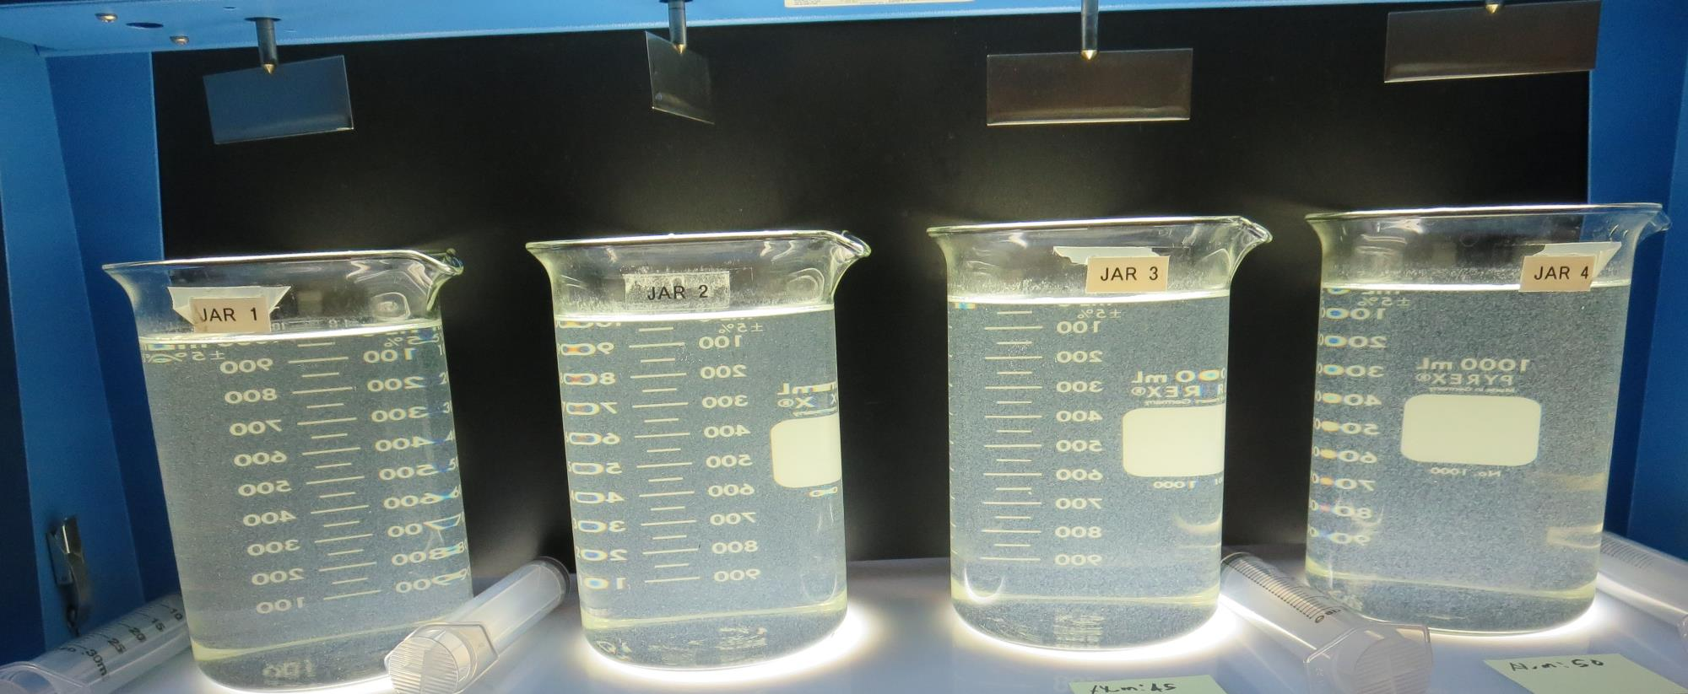
Jars 1-4: End of 5-minute flocculation (30 RPM) duration.
35 mg/L Alum
Filtrate 0.24 NTU
UVT: 85.4%
UVA: 0.068/cm
UVA Reduction 49.6%
Settled: 4.67 NTU
40 mg/L Alum
Filtrate 0.79 NTU
UVT: 84.4%
UVA: 0.073/cm
UVA Reduction 45.9%
Settled: 5.29 NTU
45 mg/L Alum
Filtrate 0.49 NTU
UVT: 86.2%
UVA: 0.064/cm
UVA Reduction 52.6%
Settled: 3.92 NTU
50 mg/L Alum
Filtrate 0.22 NTU
UVT: 87.9%
UVA: 0.055/cm
UVA Reduction 59.3%
Settled: 2.48 NTU

Slide 23
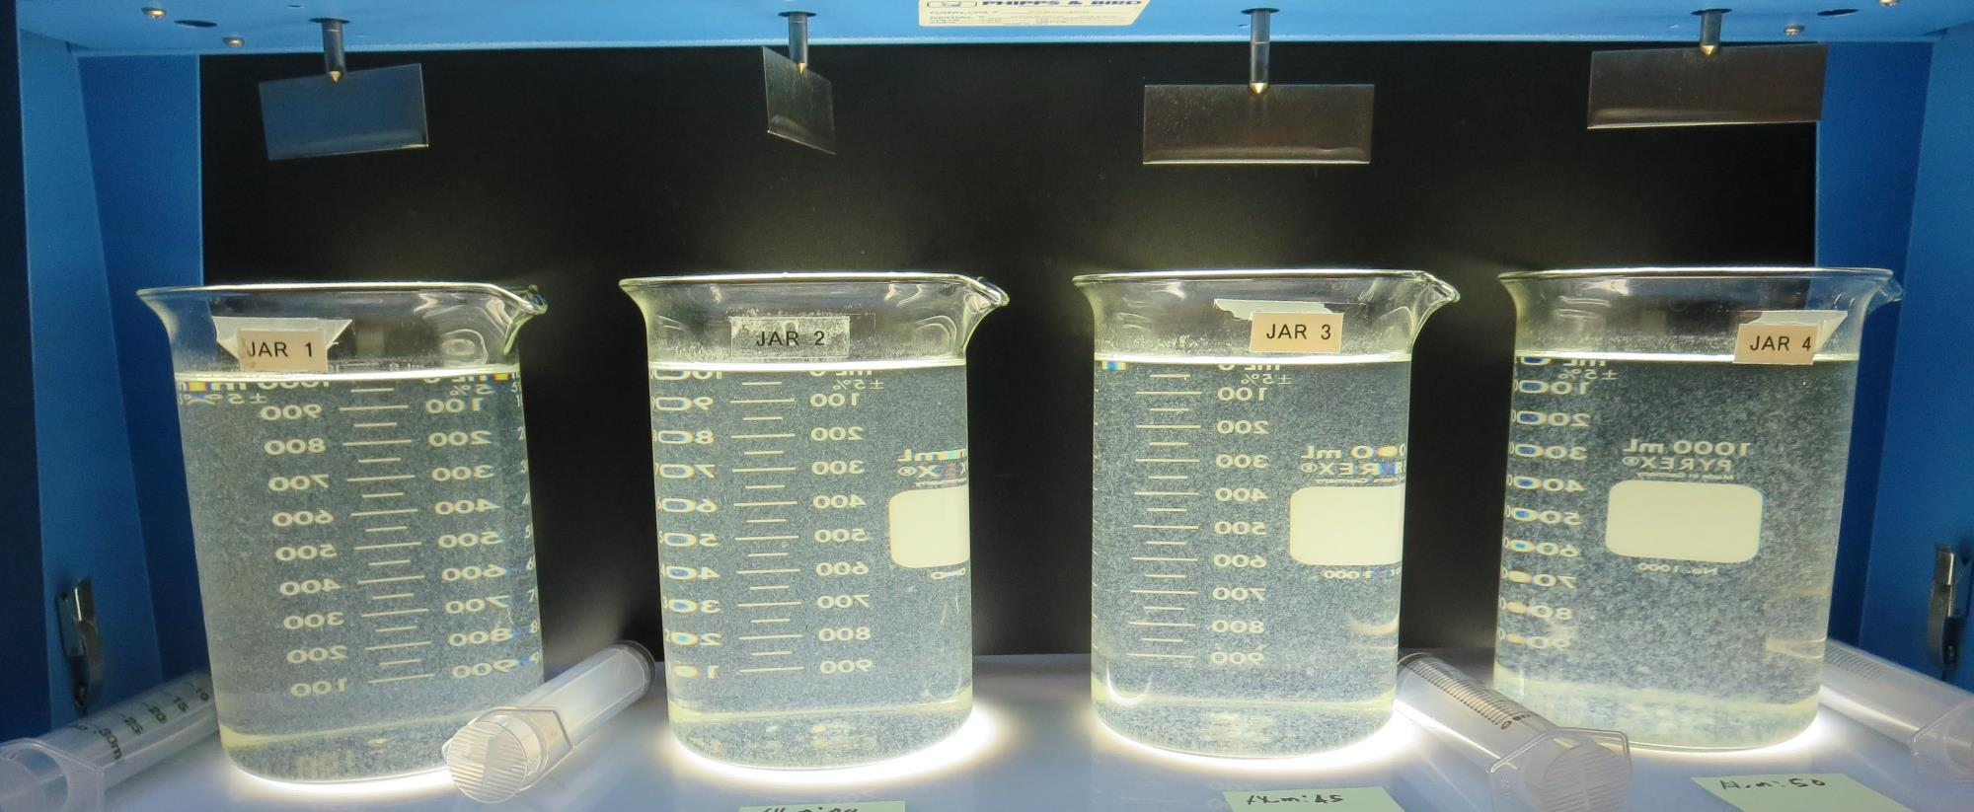
Jars 1-4: After 5 min of settling, 25 mL is syringed for filterability and %UVT/UVA.

Slide 24
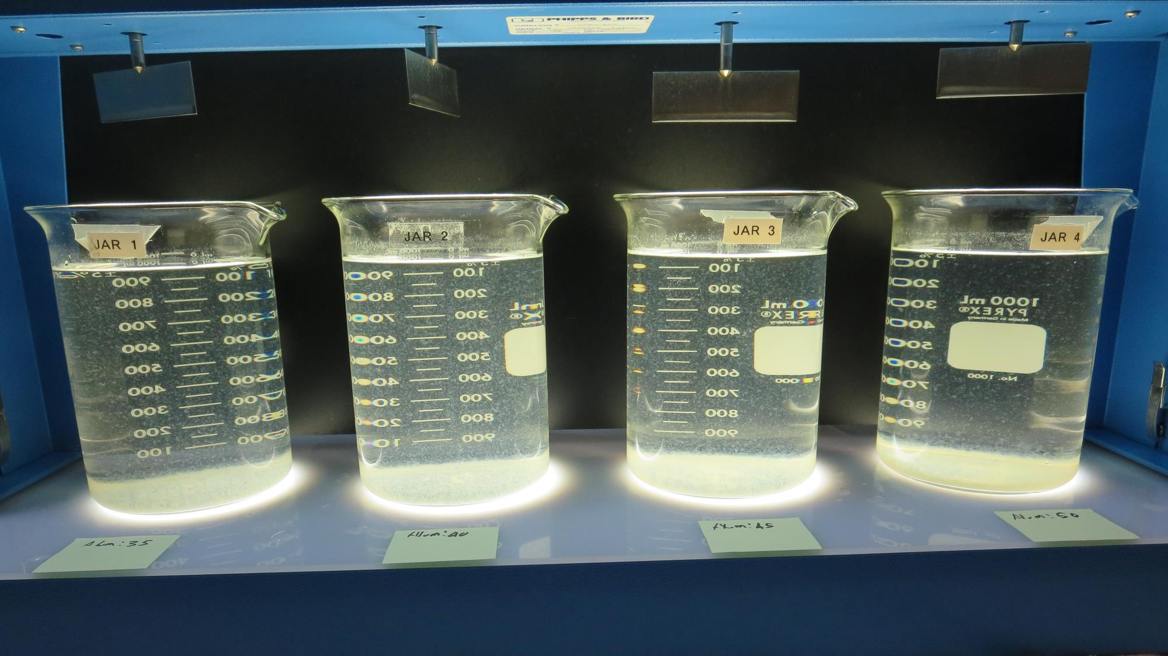
Jars 1-4: After 25-minutes of settling, settled water turbidity is taken.
35 mg/L Alum
Filtrate 0.24 NTU
UVT: 85.4%
UVA: 0.068/cm
UVA Reduction 49.6%
Settled: 4.67 NTU
40 mg/L Alum
Filtrate 0.79 NTU
UVT: 84.4%
UVA: 0.073/cm
UVA Reduction 45.9%
Settled: 5.29 NTU
45 mg/L Alum
Filtrate 0.49 NTU
UVT: 86.2%
UVA: 0.064/cm
UVA Reduction 52.6%
Settled: 3.92 NTU
50 mg/L Alum
Filtrate 0.22 NTU
UVT: 87.9%
UVA: 0.055/cm
UVA Reduction 59.3%
Settled: 2.48 NTU

Slide 25
Jars 5-8 Test
Flash Mix 30 Sec (200 RPM)
Floc Mix 5 min (20 RPM)
No Pre-Oxidation
Applied Coagulant
Alum

Slide 26
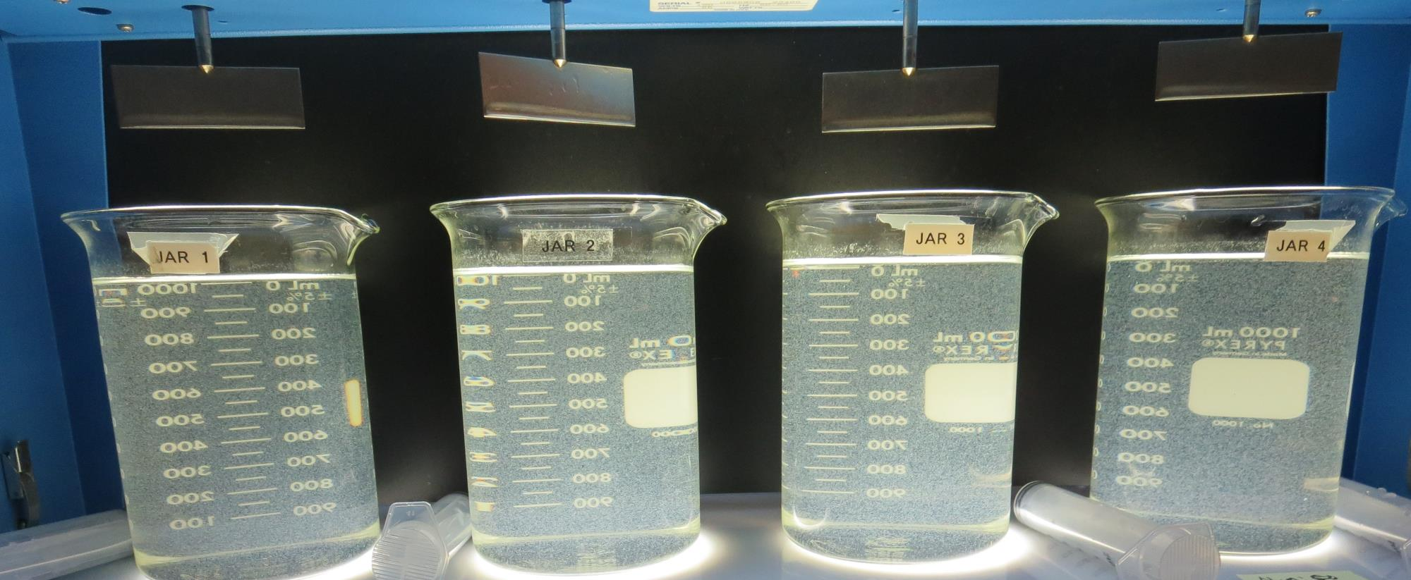
Jars 5-8: End of 5-minute flocculation (30 RPM) duration.
55 mg/L Alum
Filtrate 0.30 NTU
UVT: 87.7%
UVA: 0.056/cm
UVA Reduction 58.5%
Settled: 2.60 NTU
60 mg/L Alum
Filtrate 0.08 NTU
UVT: 88.9%
UVA: 0.051/cm
UVA Reduction 62.2%
Settled: 2.78 NTU
65 mg/L Alum
Filtrate 0.35 NTU
UVT: 88.5%
UVA: 0.052/cm
UVA Reduction 61.5%
Settled: 2.58 NTU
70 mg/L Alum
Filtrate 0.26 NTU
UVT: 89.2%
UVA: 0.049/cm
UVA Reduction 63.7%
Settled: 2.35 NTU

Slide 27
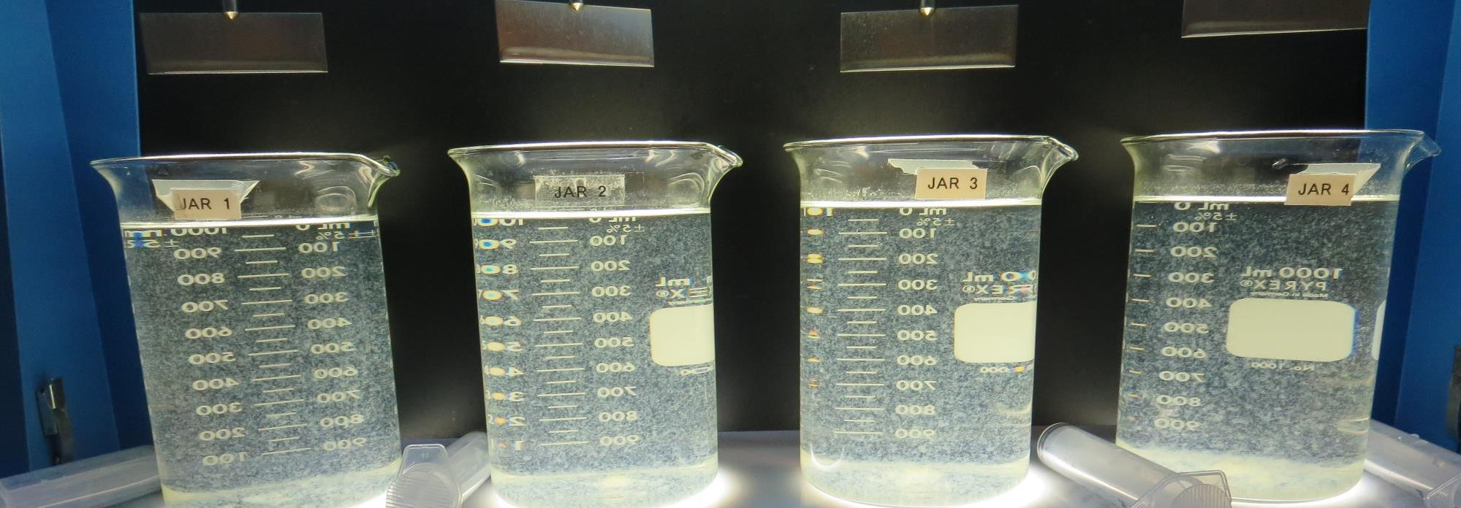
Jars 5-8: After 5 min of settling, 25 mL is syringed for filterability and %UVT/UVA.

Slide 28
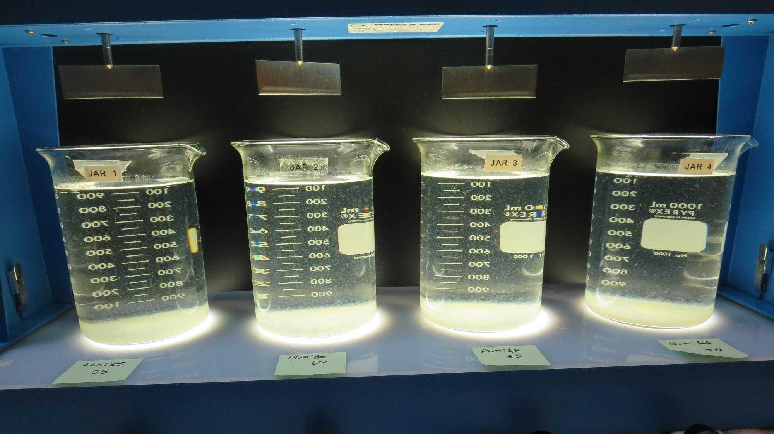
Jars 5-8: After 25-minutes of settling, settled water turbidity is taken.
55 mg/L Alum
Filtrate 0.30 NTU
UVT: 87.7%
UVA: 0.056/cm
UVA Reduction 58.5%
Settled: 2.60 NTU
60 mg/L Alum
Filtrate 0.08 NTU
UVT: 88.9%
UVA: 0.051/cm
UVA Reduction 62.2%
Settled: 2.78 NTU
65 mg/L Alum
Filtrate 0.35 NTU
UVT: 88.5%
UVA: 0.052/cm
UVA Reduction 61.5%
Settled: 2.58 NTU
70 mg/L Alum
Filtrate 0.26 NTU
UVT: 89.2%
UVA: 0.049/cm
UVA Reduction 63.7%
Settled: 2.35 NTU

Slide 29
Jars 9-12 Test
Flash Mix 30 Sec (200 RPM)
Floc Mix 5 min (20 RPM)
No Pre-Oxidation
Applied Coagulants
Alum
186KH

Slide 30
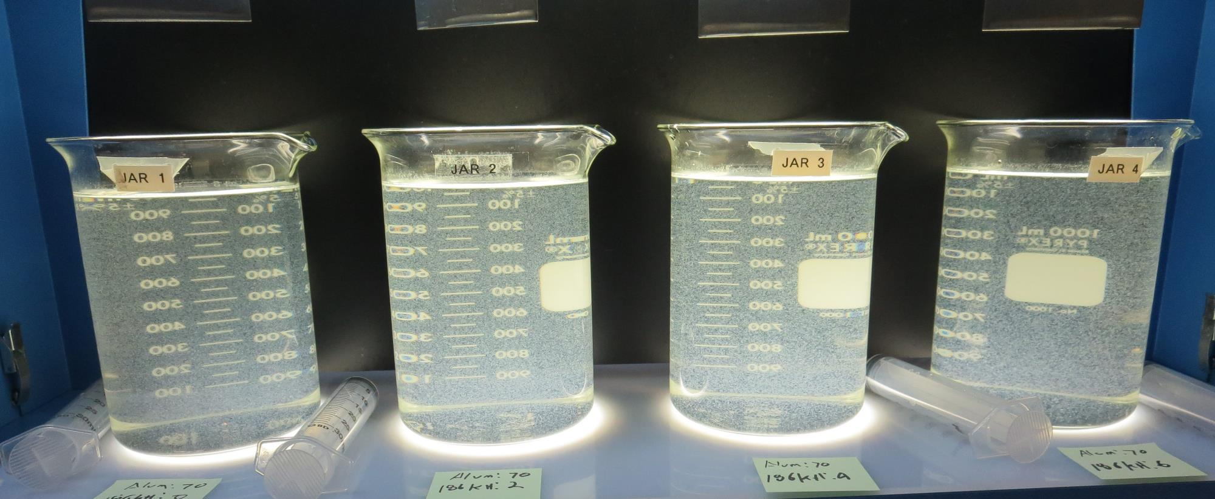
Jars 9-12: End of 5-minute flocculation (30 RPM) duration.
70 mg/L Alum
0.0 mg/L 186KH
Filtrate 0.09 NTU
UVT: 89.9%
UVA: 0.046/cm
UVA Reduction 65.9%
Settled: 2.25 NTU
70 mg/L Alum
2.0 mg/L 186KH
Filtrate 0.16 NTU
UVT: 90.0%
UVA: 0.045/cm
UVA Reduction 66.7%
Settled: 2.11 NTU
70 mg/L Alum
4.0 mg/L 186KH
Filtrate 0.08 NTU
UVT: 90.6%
UVA: 0.042/cm
UVA Reduction 68.9%
Settled: 2.57 NTU
70 mg/L Alum
6.0 mg/L 186KH
Filtrate 0.04 NTU
UVT: 91.0%
UVA: 0.040/cm
UVA Reduction 70.4%
Settled: 3.09 NTU

Slide 31
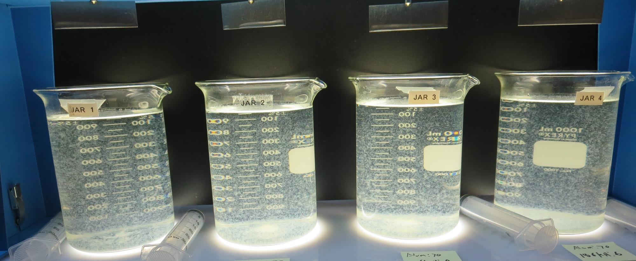
Jars 9-12: After 5 min of settling, 25 mL is syringed for filterability and %UVT/UVA.

Slide 32
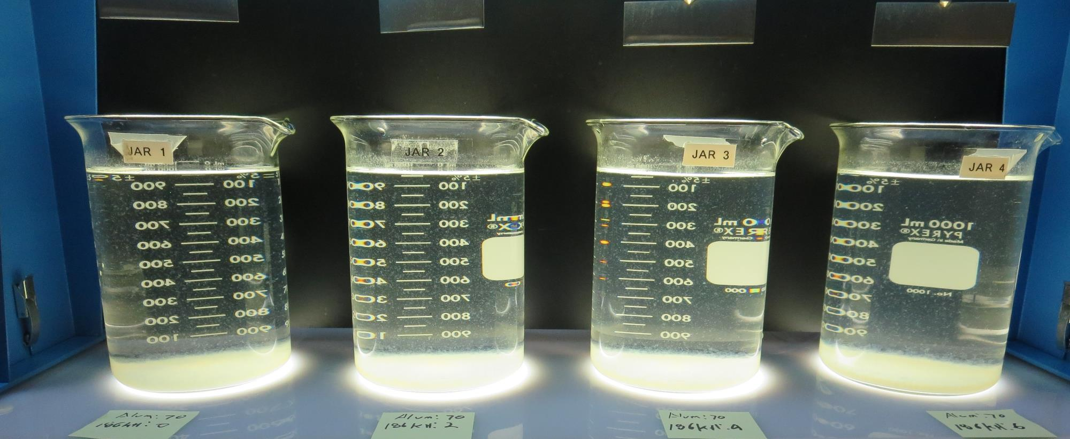
Jars 9-12: After 25-minutes of settling, settled water turbidity is taken.
70 mg/L Alum
0.0 mg/L 186KH
Filtrate 0.09 NTU
UVT: 89.9%
UVA: 0.046/cm
UVA Reduction 65.9%
Settled: 2.25 NTU
70 mg/L Alum
2.0 mg/L 186KH
Filtrate 0.16 NTU
UVT: 90.0%
UVA: 0.045/cm
UVA Reduction 66.7%
Settled: 2.11 NTU
70 mg/L Alum
4.0 mg/L 186KH
Filtrate 0.08 NTU
UVT: 90.6%
UVA: 0.042/cm
UVA Reduction 68.9%
Settled: 2.57 NTU
70 mg/L Alum
6.0 mg/L 186KH
Filtrate 0.04 NTU
UVT: 91.0%
UVA: 0.040/cm
UVA Reduction 70.4%
Settled: 3.09 NTU

Slide 33
Jars 13-16 Test
Flash Mix 30 Sec (200 RPM)
Floc Mix 5 min (20 RPM)
No Pre-Oxidation
Applied Coagulants
Alum
186KH

Slide 34
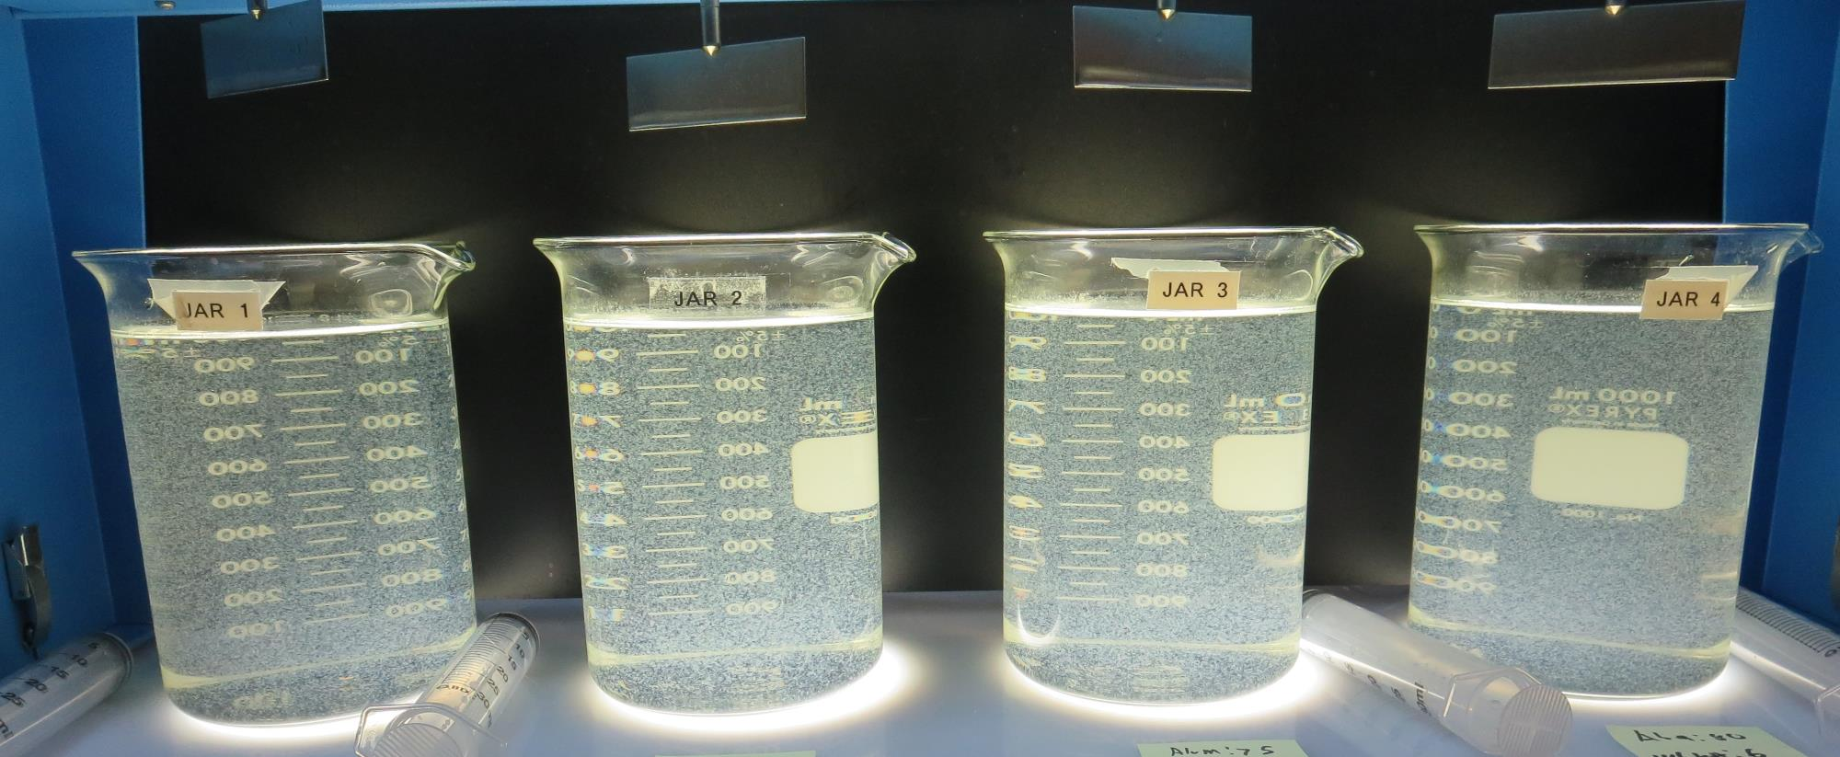
Jars 13-16: End of 5-minute flocculation (30 RPM) duration.
65 mg/L Alum
6 mg/L 186KH
Filtrate 0.09 NTU
UVT: 91.3%
UVA: 0.039/cm
UVA Reduction 71.1%
Settled: 2.45 NTU
70 mg/L Alum
6 mg/L 186KH
Filtrate 0.05 NTU
UVT: 91.6%
UVA: 0.037/cm
UVA Reduction 72.6%
Settled: 2.95 NTU
75 mg/L Alum
6 mg/L 186KH
Filtrate 0.04 NTU
UVT: 91.9%
UVA: 0.036/cm
UVA Reduction 73.3%
Settled: 2.67 NTU
80 mg/L Alum
6 mg/L 186KH
Filtrate 0.06 NTU
UVT: 92.3%
UVA: 0.034/cm
UVA Reduction 74.8%
Settled: 2.73 NTU

Slide 35
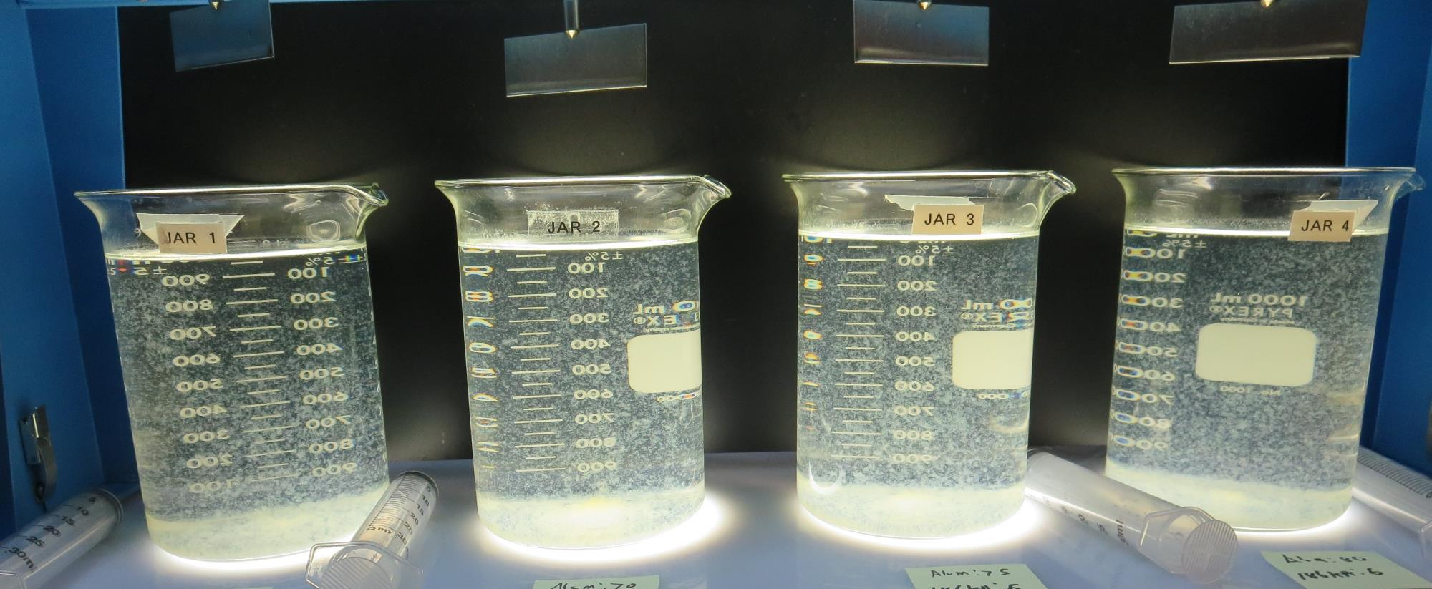
Jars 13-16: After 5 min of settling, 25 mL is syringed for filterability and %UVT/UVA.

Slide 36
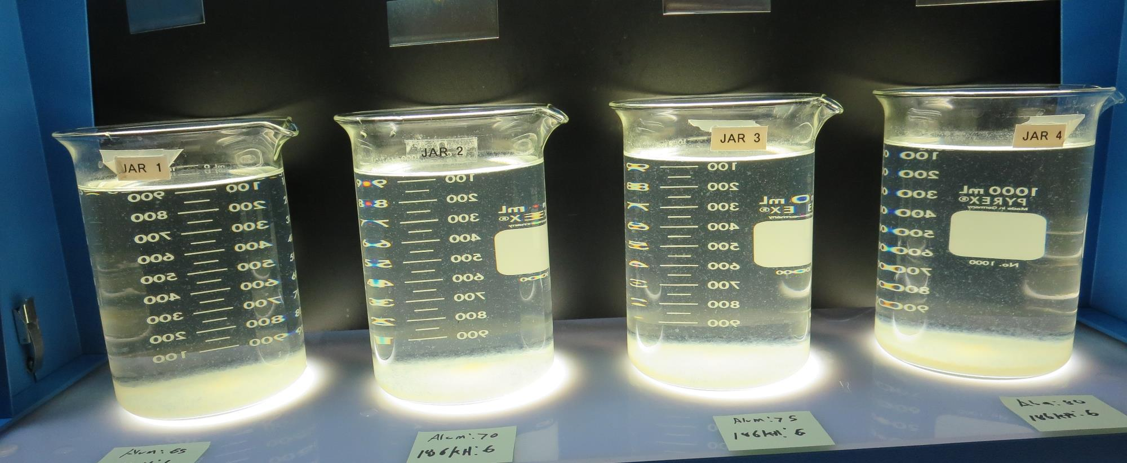
Jars 13-16: After 25-minutes of settling, settled water turbidity is taken.
65 mg/L Alum
6 mg/L 186KH
Filtrate 0.09 NTU
UVT: 91.3%
UVA: 0.039/cm
UVA Reduction 71.1%
Settled: 2.45 NTU
70 mg/L Alum
6 mg/L 186KH
Filtrate 0.05 NTU
UVT: 91.6%
UVA: 0.037/cm
UVA Reduction 72.6%
Settled: 2.95 NTU
75 mg/L Alum
6 mg/L 186KH
Filtrate 0.04 NTU
UVT: 91.9%
UVA: 0.036/cm
UVA Reduction 73.3%
Settled: 2.67 NTU
80 mg/L Alum
6 mg/L 186KH
Filtrate 0.06 NTU
UVT: 92.3%
UVA: 0.034/cm
UVA Reduction 74.8%
Settled: 2.73 NTU

Slide 37
Jars 17-20 Test
Flash Mix 20 Sec (200 RPM)
Floc Mix 5 min (20 RPM)
No Pre-Oxidation
Applied Coagulant
AdvFloc CTC-00011

Slide 38
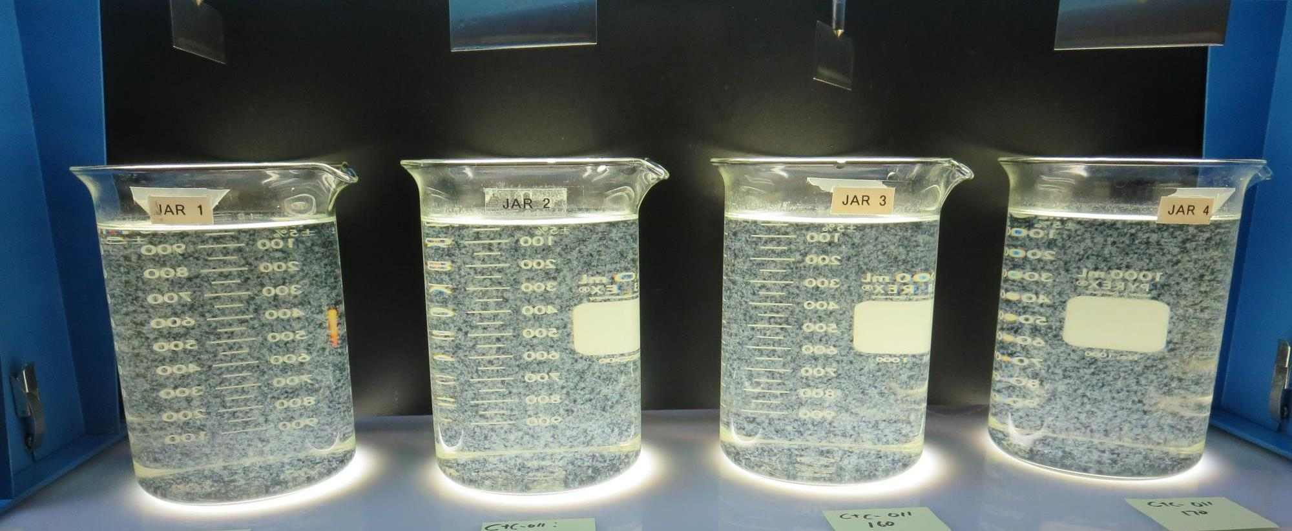
Jars 17-20: End of 5-minute flocculation (30 RPM) duration.
140 mg/L CTC-0011
Filtrate 0.07 NTU
UVT: 90.5%
UVA: 0.043/cm
UVA Reduction 68.1%
Settled: 0.58 NTU
150 mg/L CTC-0011
Filtrate 0.09 NTU
UVT: 90.6%
UVA: 0.042/cm
UVA Reduction 68.9%
Settled: 0.62 NTU
160 mg/L CTC-0011
Filtrate 0.11 NTU
UVT: 90.5%
UVA: 0.043/cm
UVA Reduction 68.1%
Settled: 0.71 NTU
170 mg/L CTC-0011
Filtrate 0.06 NTU
UVT: 90.9%
UVA: 0.041/cm
UVA Reduction 69.6%
Settled: 0.28 NTU

Slide 39
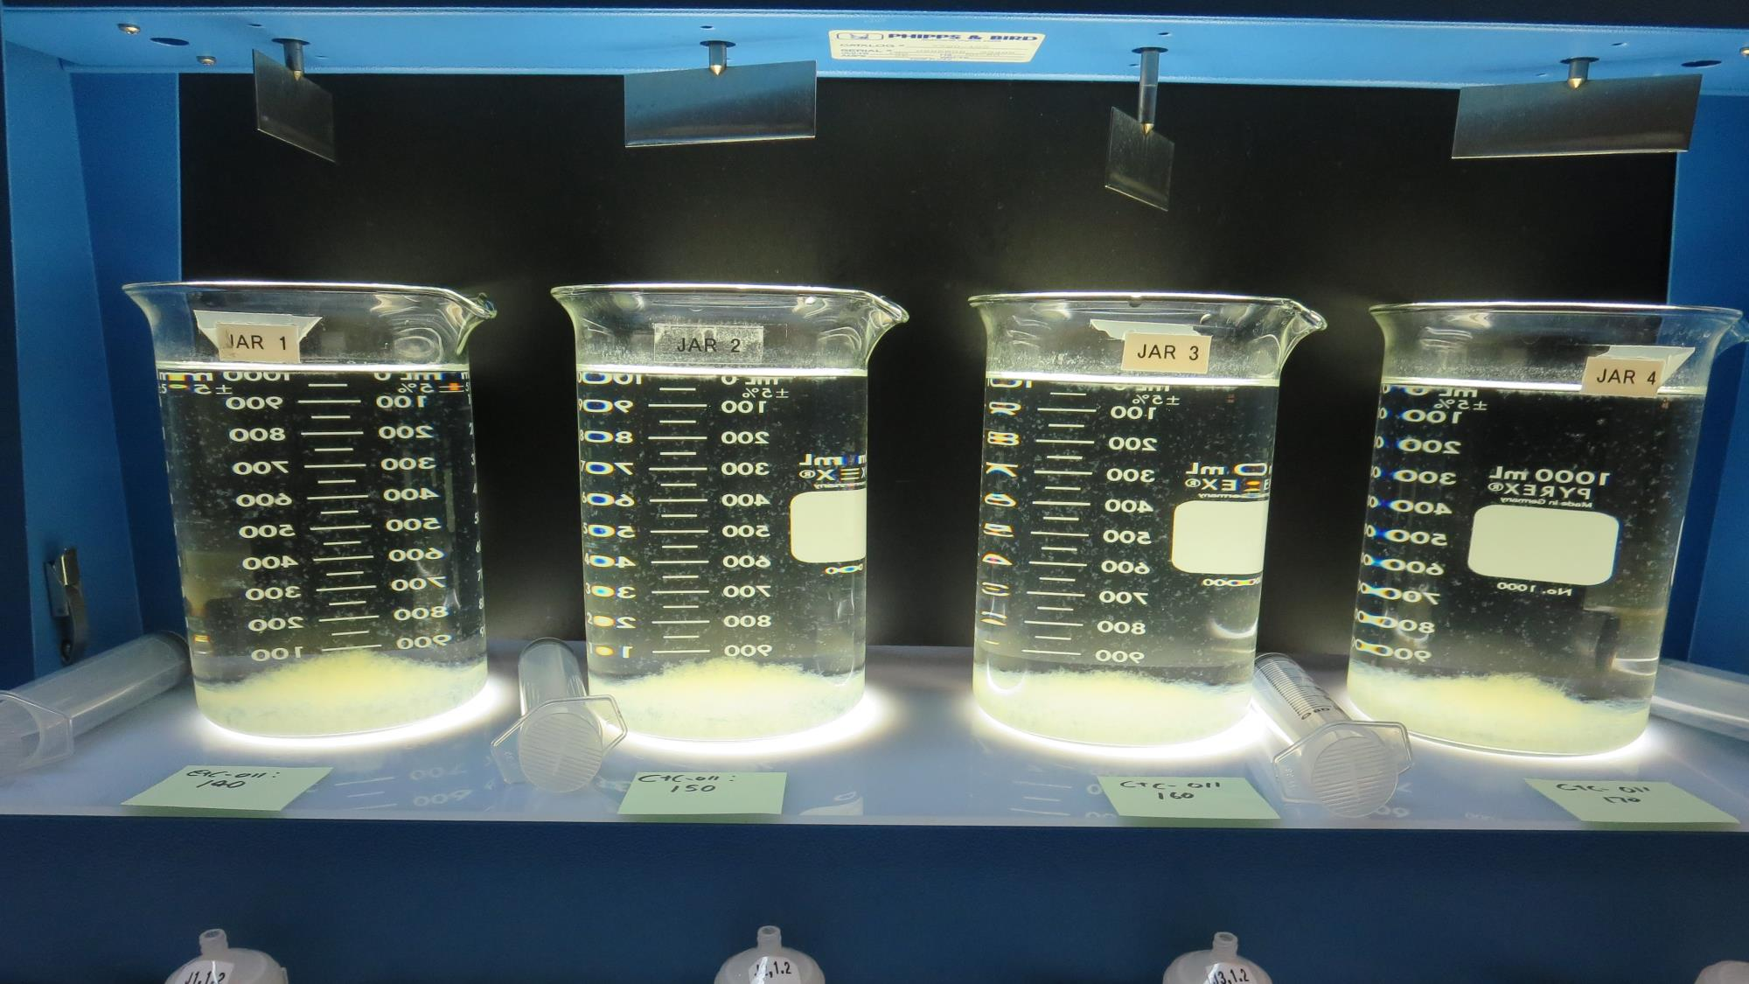
Jars 17-20: After 5 min of settling, 25 mL is syringed for filterability and %UVT/UVA.

Slide 40
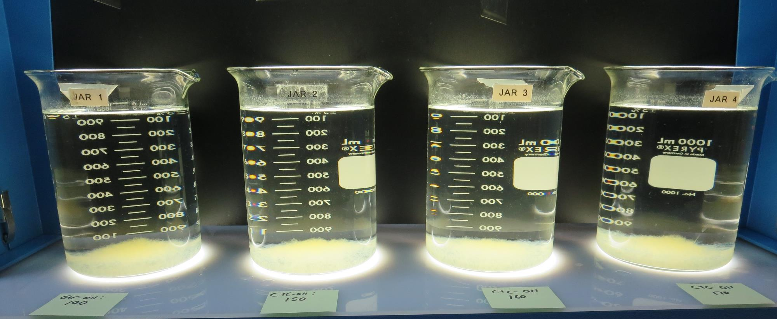
Jars 17-20: After 25-minutes of settling, settled water turbidity is taken.
140 mg/L CTC-0011
Filtrate 0.07 NTU
UVT: 90.5%
UVA: 0.043/cm
UVA Reduction 68.1%
Settled: 0.58 NTU
150 mg/L CTC-0011
Filtrate 0.09 NTU
UVT: 90.6%
UVA: 0.042/cm
UVA Reduction 68.9%
Settled: 0.62 NTU
160 mg/L CTC-0011
Filtrate 0.11 NTU
UVT: 90.5%
UVA: 0.043/cm
UVA Reduction 68.1%
Settled: 0.71 NTU
170 mg/L CTC-0011
Filtrate 0.06 NTU
UVT: 90.9%
UVA: 0.041/cm
UVA Reduction 69.6%
Settled: 0.28 NTU

Slide 41
Jars 21-24 Test
Flash Mix 20 Sec (200 RPM)
Floc Mix 5 min (20 RPM)
No Pre-Oxidation
Applied Coagulant
AdvFloc CTC-00011

Slide 42
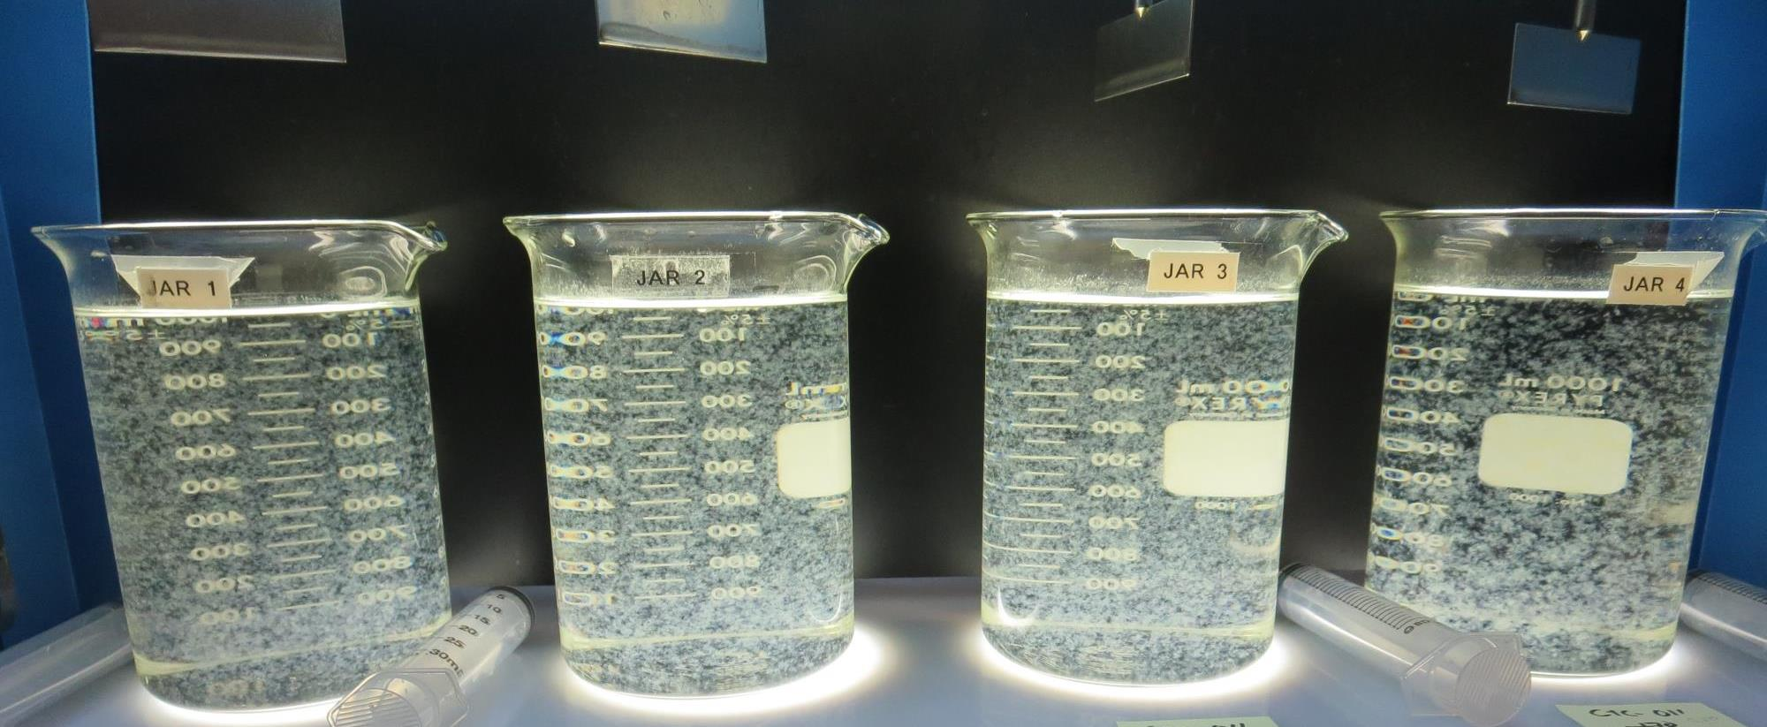
Jars 21-24: End of 5-minute flocculation (30 RPM) duration.
180 mg/L CTC-0011
Filtrate 0.09 NTU
UVT: 91.0%
UVA: 0.040/cm
UVA Reduction 70.4%
Settled: 057 NTU
190 mg/L CTC-0011
Filtrate 0.05 NTU
UVT: 91.4%
UVA: 0.039/cm
UVA Reduction 71.1%
Settled: 0.46 NTU
200 mg/L CTC-0011
Filtrate 0.09 NTU
UVT: 91.4%
UVA: 0.039/cm
UVA Reduction 71.1%
Settled: 0.51 NTU
210 mg/L CTC-0011
Filtrate 0.07 NTU
UVT: 91.9%
UVA: 0.036/cm
UVA Reduction 73.3%
Settled: 0.27 NTU

Slide 43
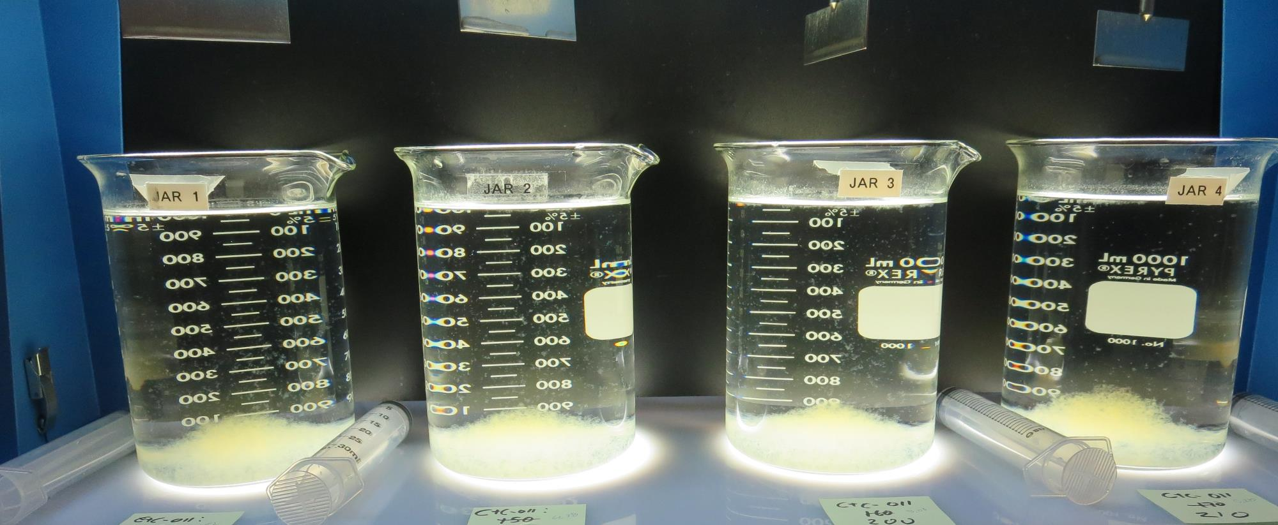
Jars 21-24: After 5 min of settling, 25 mL is syringed for filterability and %UVT/UVA.

Slide 44
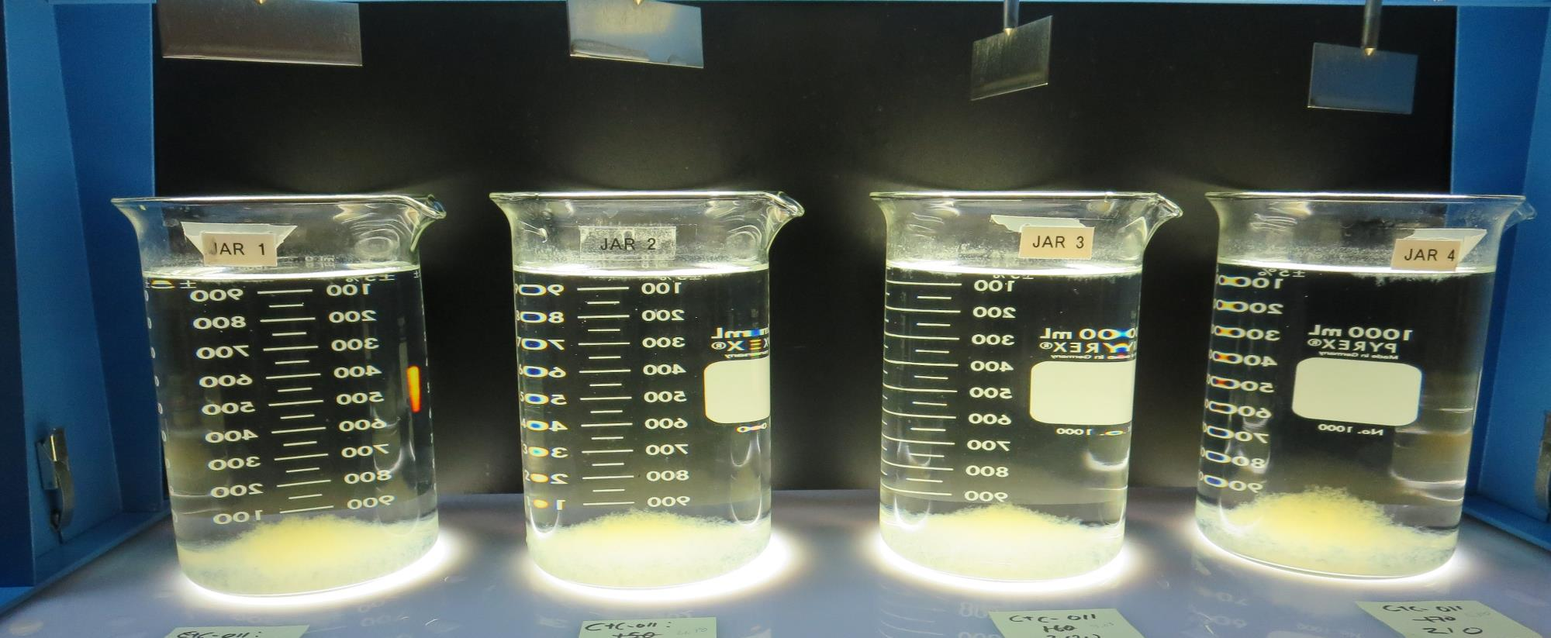
Jars 21-24: After 25-minutes of settling, settled water turbidity is taken.
180 mg/L CTC-0011
Filtrate 0.09 NTU
UVT: 91.0%
UVA: 0.040/cm
UVA Reduction 70.4%
Settled: 0.57 NTU
190 mg/L CTC-0011
Filtrate 0.05 NTU
UVT: 91.4%
UVA: 0.039/cm
UVA Reduction 71.1%
Settled: 0.46 NTU
200 mg/L CTC-0011
Filtrate 0.09 NTU
UVT: 91.4%
UVA: 0.039/cm
UVA Reduction 71.1%
Settled: 0.51 NTU
210 mg/L CTC-0011
Filtrate 0.07 NTU
UVT: 91.9%
UVA: 0.036/cm
UVA Reduction 73.3%
Settled: 0.27 NTU

Slide 45
Jars 25-28 Test
Flash Mix 20 Sec (200 RPM)
Floc Mix 5 min (20 RPM)
No Pre-Oxidation
Applied Coagulants
AdvFloc CTC-00011
186KH

Slide 46
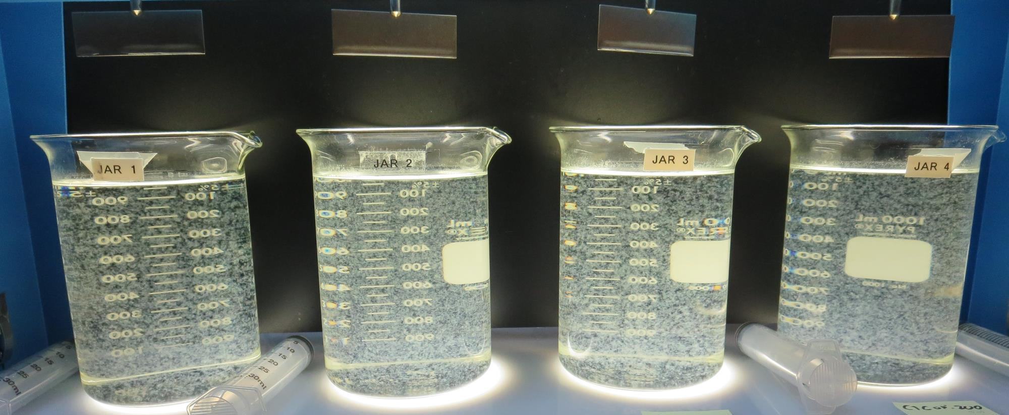
Jars 25-28: End of 5-minute flocculation (30 RPM) duration.
160 mg/L CTC-0011
0 mg/L 186KH
Filtrate 0.10 NTU
UVT: 90.7%
UVA: 0.042/cm
UVA Reduction 68.9%
Settled: 0.60 NTU
160 mg/L CTC-0011
6 mg/L 186KH
Filtrate 0.10 NTU
UVT: 91.6%
UVA: 0.038/cm
UVA Reduction 71.9%
Settled: 1.09 NTU
200 mg/L CTC-0011
0 mg/L 186KH
Filtrate 0.10 NTU
UVT: 91.4%
UVA: 0.039/cm
UVA Reduction 71.1%
Settled: 0.65 NTU
200 mg/L CTC-0011
6 mg/L 186KH
Filtrate 0.08 NTU
UVT: 92.0%
UVA: 0.036/cm
UVA Reduction 73.3%
Settled: 0.90 NTU

Slide 47
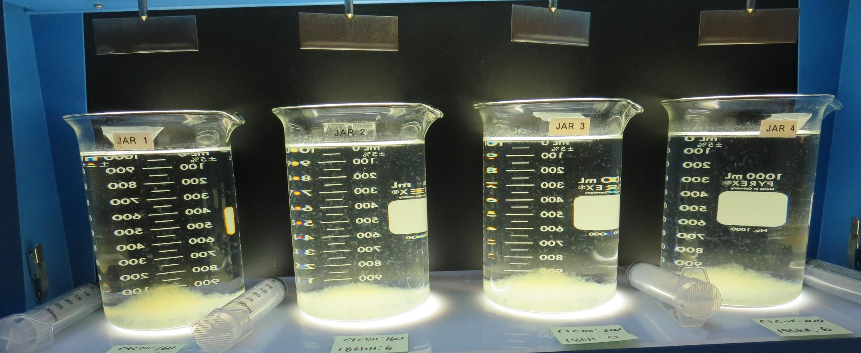
Jars 25-28: After 5 min of settling, 25 mL is syringed for filterability and %UVT/UVA.

Slide 48
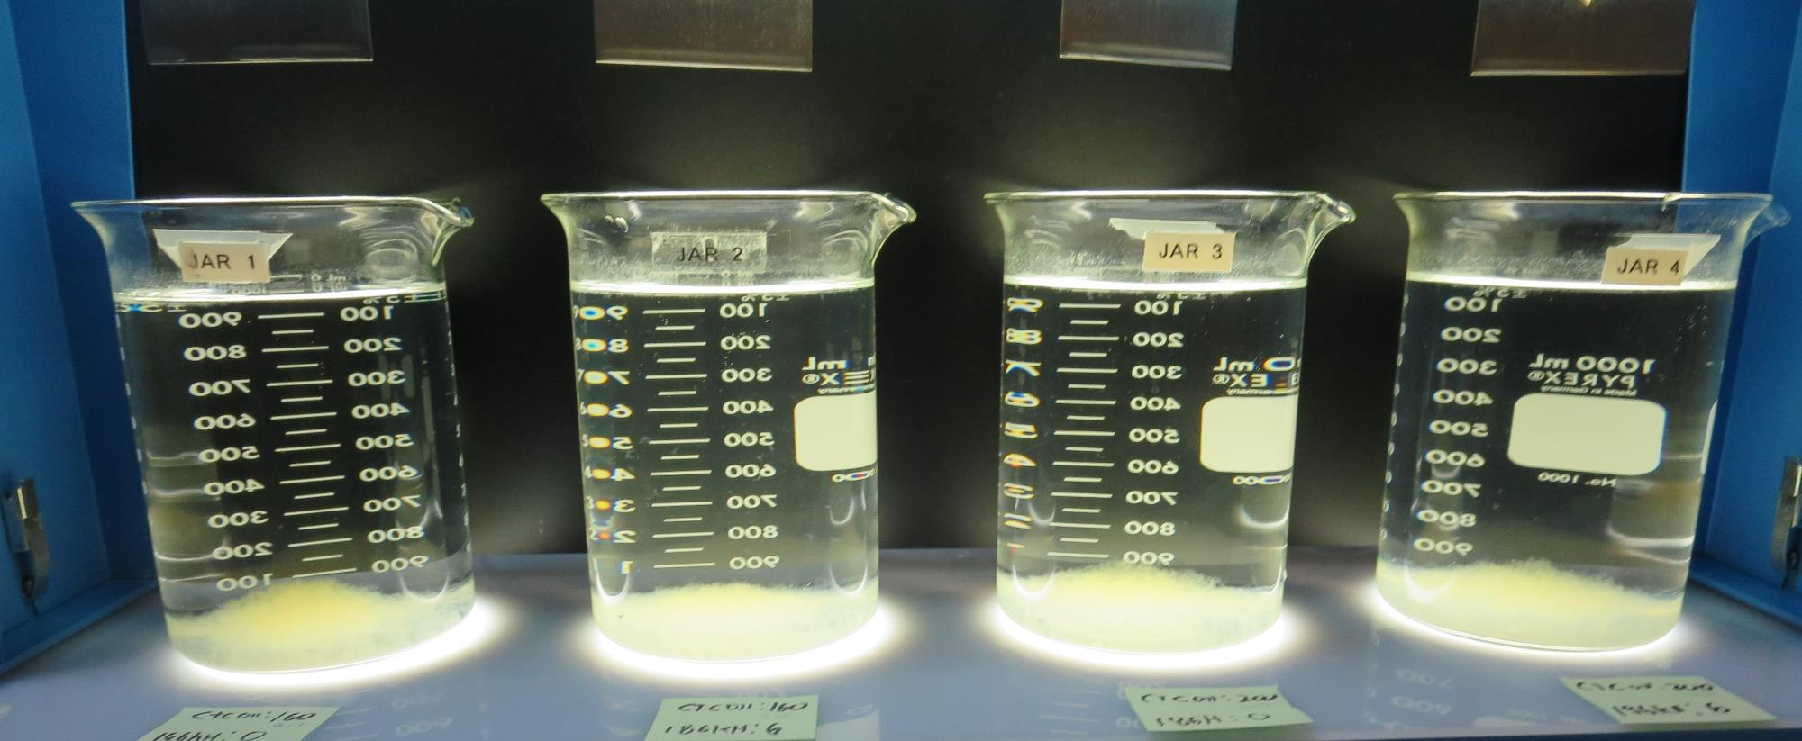
Jars 25-28: After 25-minutes of settling, settled water turbidity is taken.
160 mg/L CTC-0011
0 mg/L 186KH
Filtrate 0.10 NTU
UVT: 90.7%
UVA: 0.042/cm
UVA Reduction 68.9%
Settled: 0.60 NTU
160 mg/L CTC-0011
6 mg/L 186KH
Filtrate 0.10 NTU
UVT: 91.6%
UVA: 0.038/cm
UVA Reduction 71.9%
Settled: 1.09 NTU
200 mg/L CTC-0011
0 mg/L 186KH
Filtrate 0.10 NTU
UVT: 91.4%
UVA: 0.039/cm
UVA Reduction 71.1%
Settled: 0.65 NTU
200 mg/L CTC-0011
6 mg/L 186KH
Filtrate 0.08 NTU
UVT: 92.0%
UVA: 0.036/cm
UVA Reduction 73.3%
Settled: 0.90 NTU

Slide 49
Jars 29-32 Test
Flash Mix 20 Sec (200 RPM)
Floc Mix 5 min (20 RPM)
No Pre-Oxidation
Applied Coagulants
AdvFloc CTC-00011
186KH
Superfloc 4814RS

Slide 50
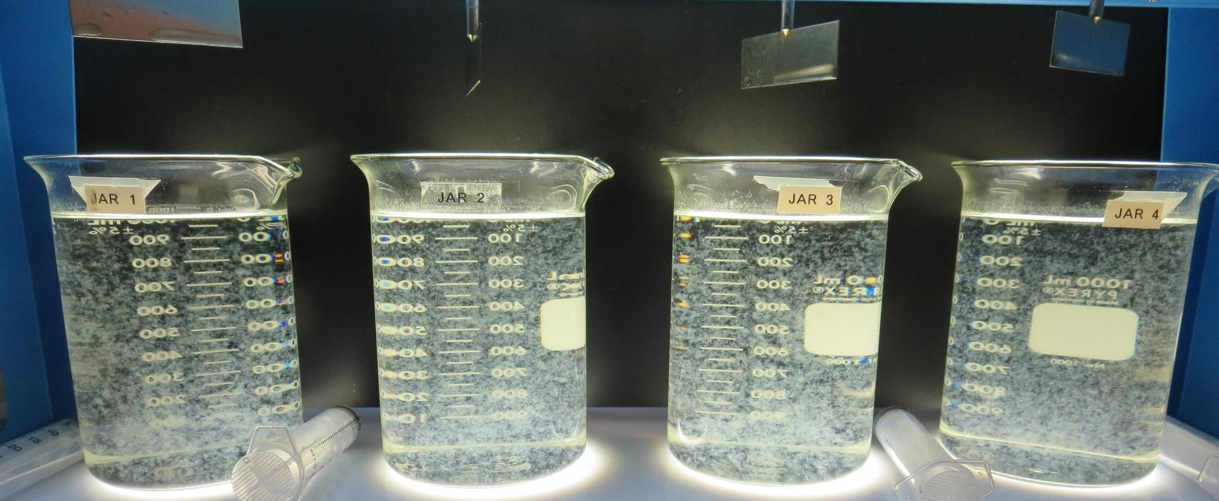
Jars 29-32: End of 5-minute flocculation (30 RPM) duration.
200 mg/L CTC-0011
0 mg/L 186KH
Filtrate 0.09 NTU
UVT: 91.5%
UVA: 0.038/cm
UVA Reduction 71.9%
Settled: 0.44 NTU
200 mg/L CTC-0011
6 mg/L 186KH
Filtrate 0.08 NTU
UVT: 92.2%
UVA: 0.035/cm
UVA Reduction 74.1%
Settled: 0.92 NTU
200 mg/L CTC-0011
0 mg/L 186KH
0.3 mg/L 4814RS
Filtrate 0.08 NTU
UVT: 91.5%
UVA: 0.038/cm
UVA Reduction 71.9%
Settled: 0.50 NTU
200 mg/L CTC-0011
6 mg/L 186KH
0.3 mg/L 4814RS
Filtrate 0.09 NTU
UVT: 92.1%
UVA: 0.035/cm
UVA Reduction 74.1%
Settled: 0.80 NTU

Slide 51
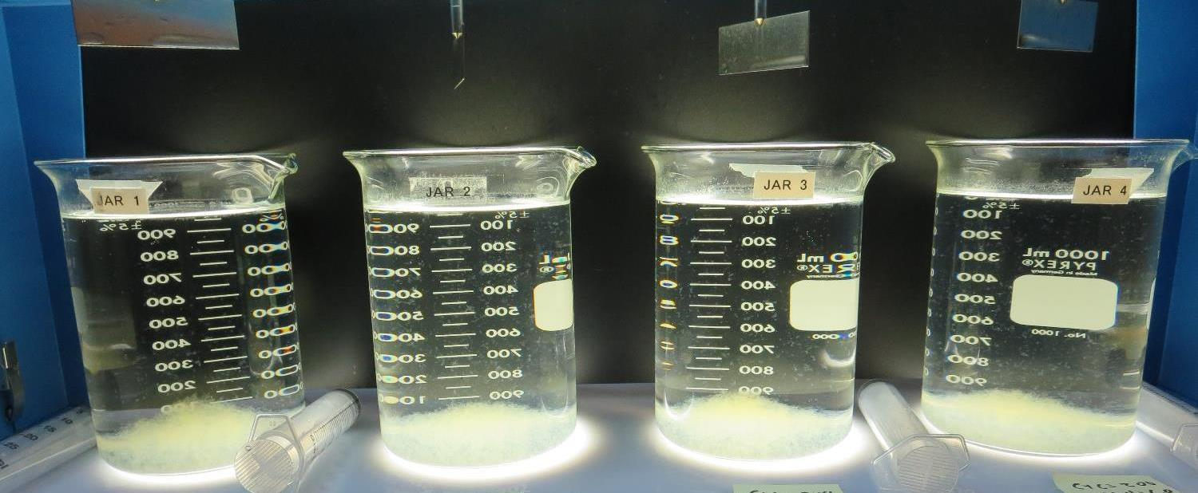
Jars 29-32: After 5 min of settling, 25 mL is syringed for filterability and %UVT/UVA.

Slide 52
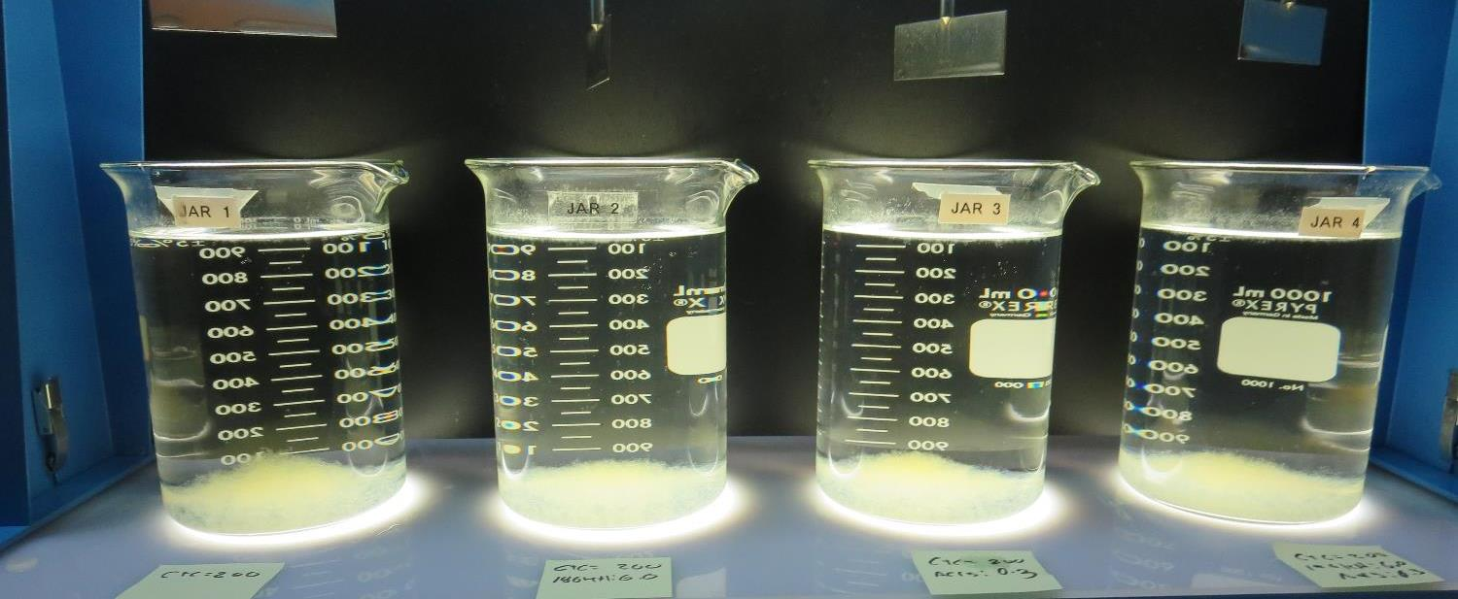
Jars 29-32: After 25-minutes of settling, settled water turbidity is taken.
200 mg/L CTC-0011
0 mg/L 186KH
Filtrate 0.09 NTU
UVT: 91.5%
UVA: 0.038/cm
UVA Reduction 71.9%
Settled: 0.44 NTU
200 mg/L CTC-0011
6 mg/L 186KH
Filtrate 0.08 NTU
UVT: 92.2%
UVA: 0.035/cm
UVA Reduction 74.1%
Settled: 0.92 NTU
200 mg/L CTC-0011
0 mg/L 186KH
0.3 mg/L 4814RS
Filtrate 0.08 NTU
UVT: 91.5%
UVA: 0.038/cm
UVA Reduction 71.9%
Settled: 0.50 NTU
200 mg/L CTC-0011
6 mg/L 186KH
0.3 mg/L 4814RS
Filtrate 0.09 NTU
UVT: 92.1%
UVA: 0.035/cm
UVA Reduction 74.1%
Settled: 0.80 NTU

Slide 53
Jars 33-36 Test
Flash Mix 20 Sec (200 RPM)
Floc Mix 5 min (20 RPM)
Pre-Oxidation KMnO₄ (70 min)
Applied Coagulants
AdvFloc CTC-00011
186KH

Slide 54
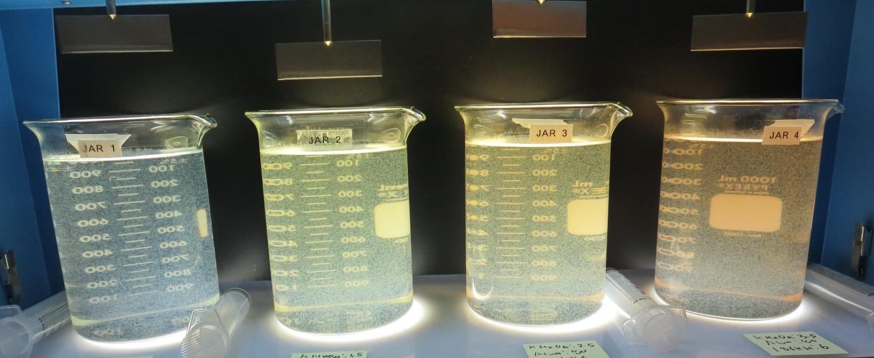
Jars 33-36: End of 5-minute flocculation (30 RPM) duration.
0 mg/L KMnO₄
80 mg/L Alum
6 mg/L 186KH
Filtrate 0.05 NTU
UVT: 91.5%
UVA: 0.038/cm
UVA Reduction 71.9%
Settled: 2.86 NTU
1.5 mg/L KMnO₄
80 mg/L Alum
6 mg/L 186KH
Filtrate 0.03 NTU
UVT: 92.2%
UVA: 0.035/cm
UVA Reduction 74.1%
Settled: 2.03 NTU
2.5 mg/L KMnO₄
80 mg/L Alum
6 mg/L 186KH
Filtrate 0.06 NTU
UVT: 92.5%
UVA: 0.033/cm
UVA Reduction 75.6%
Settled: 2.38 NTU
3.5 mg/L KMnO₄
80 mg/L Alum
6 mg/L 186KH
Filtrate 0.03 NTU
UVT: 93.2%
UVA: 0.030/cm
UVA Reduction 77.8%
Settled: 3.1 NTU

Slide 55
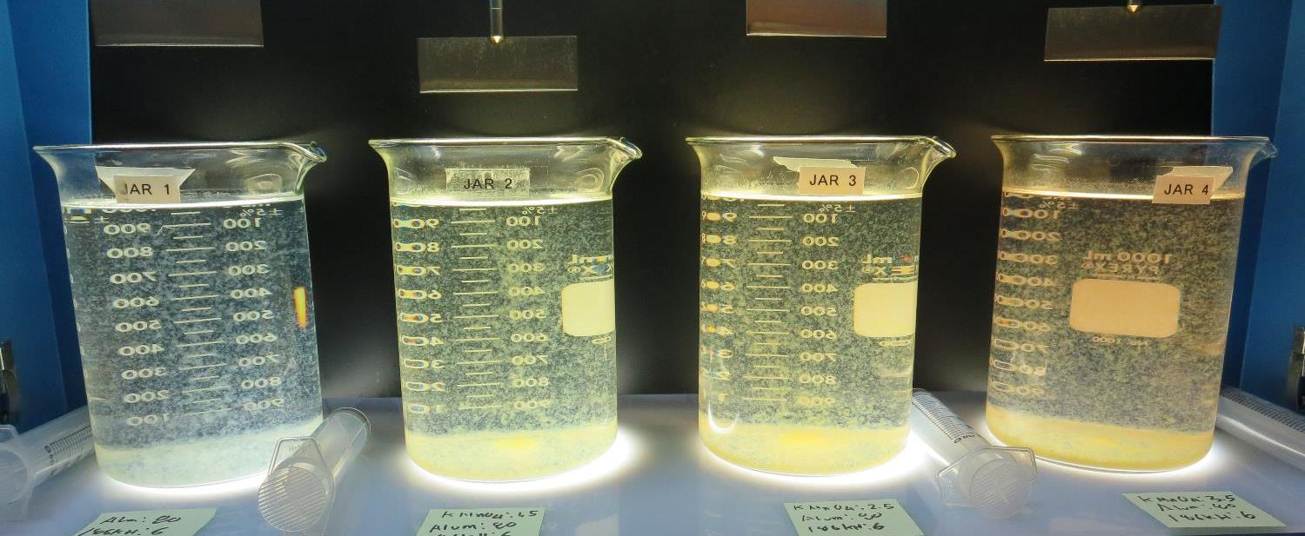
Jars 33-36: After 5 min of settling, 25 mL is syringed for filterability and %UVT/UVA.

Slide 56
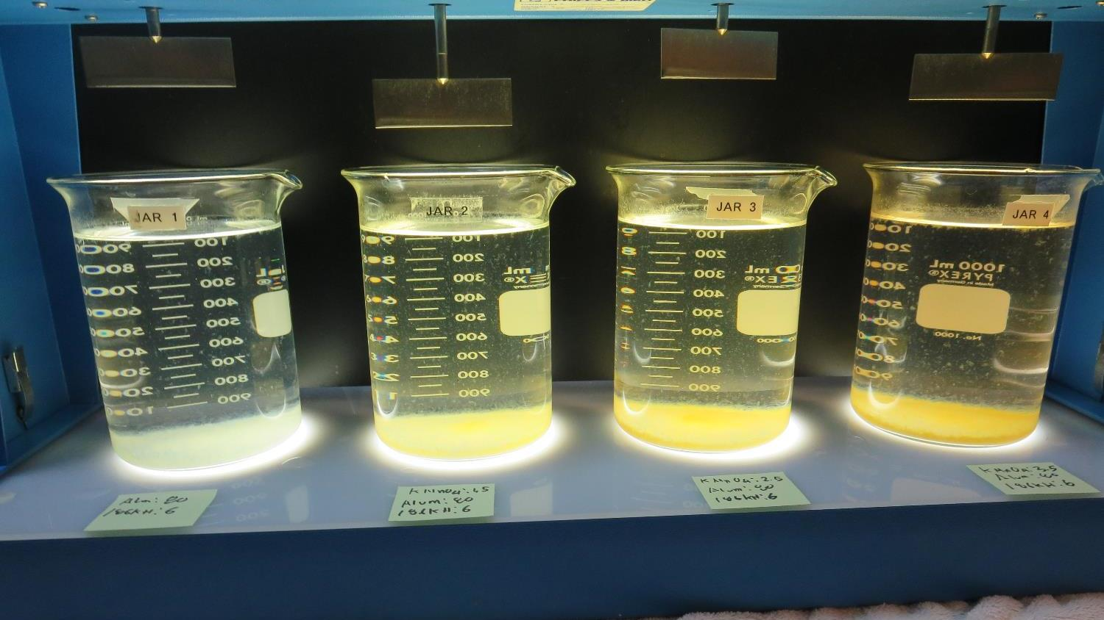
Jars 33-36: After 25-minutes of settling, settled water turbidity is taken.
0 mg/L KMnO₄
80 mg/L Alum
6 mg/L 186KH
Filtrate 0.05 NTU
UVT: 91.5%
UVA: 0.038/cm
UVA Reduction 71.9%
Settled: 2.86 NTU
1.5 mg/L KMnO₄
80 mg/L Alum
6 mg/L 186KH
Filtrate 0.03 NTU
UVT: 92.2%
UVA: 0.035/cm
UVA Reduction 74.1%
Settled: 2.03 NTU
2.5 mg/L KMnO₄
80 mg/L Alum
6 mg/L 186KH
Filtrate 0.06 NTU
UVT: 92.5%
UVA: 0.033/cm
UVA Reduction 75.6%
Settled: 2.38 NTU
3.5 mg/L KMnO₄
80 mg/L Alum
6 mg/L 186KH
Filtrate 0.03 NTU
UVT: 93.2%
UVA: 0.030/cm
UVA Reduction 77.8%
Settled: 3.1 NTU

Slide 57
Jars 37-40 Test
Flash Mix 20 Sec (200 RPM)
Floc Mix 5 min (20 RPM)
Pre-Oxidation KMnO₄
Applied Coagulants
Alum
AdvFloc CTC-00011
186KH

Slide 58
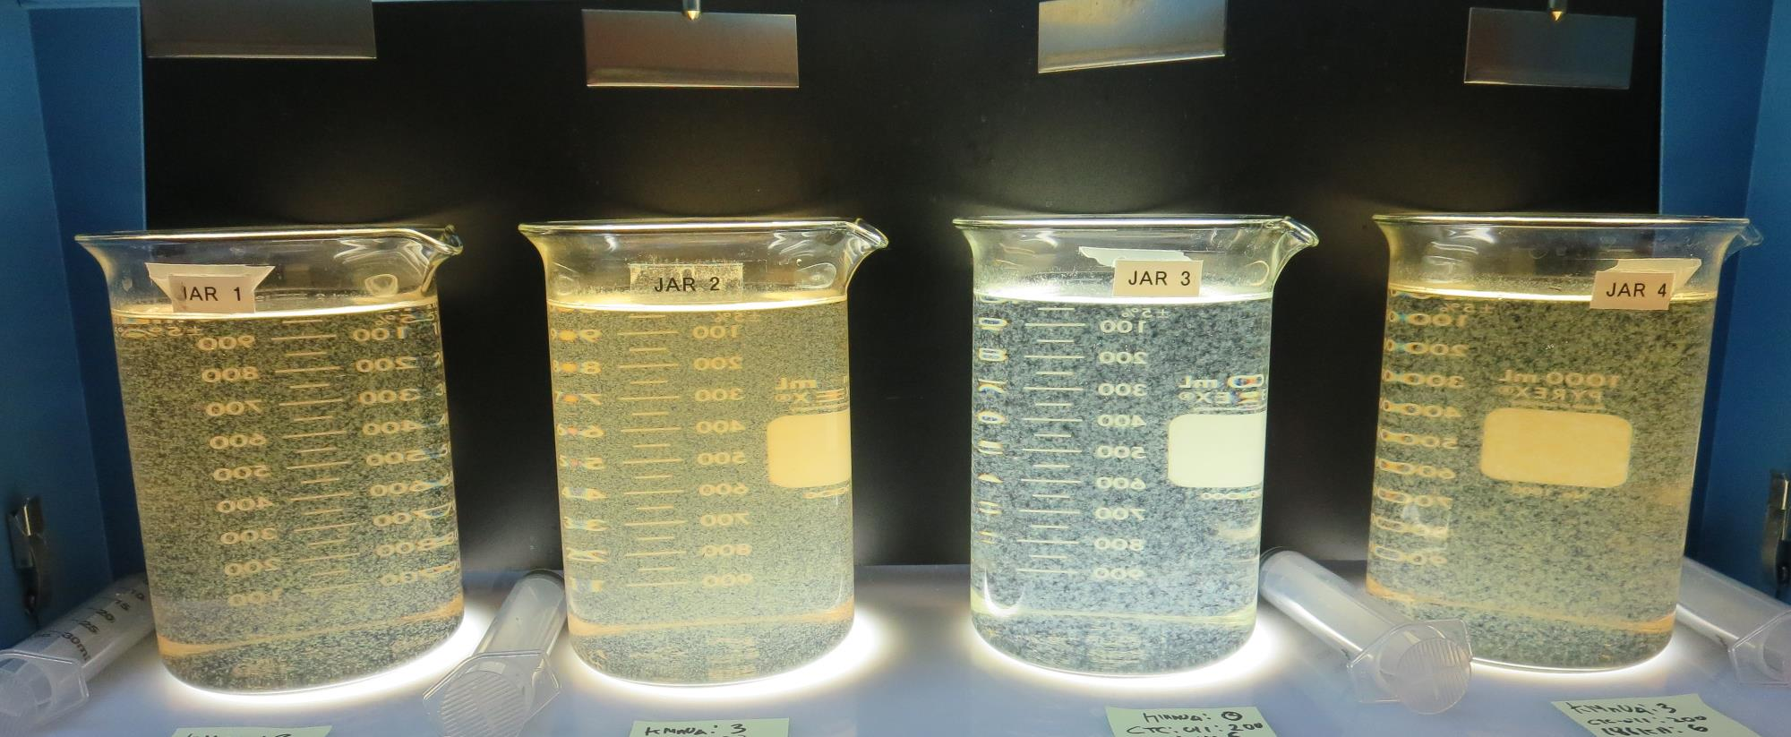
Jars 37-40: End of 5-minute flocculation (30 RPM) duration.
3 mg/L KMnO₄
35 mg/L Alum
6 mg/L 186KH
Filtrate 0.06 NTU
UVT: 89.2%
UVA: 0.049/cm
UVA Reduction 63.7%
Settled: 2.13 NTU
3 mg/L KMnO₄
80 mg/L Alum
6 mg/L 186KH
Filtrate 0.04 NTU
UVT: 92.9%
UVA: 0.031/cm
UVA Reduction 77.0%
Settled: 2.11 NTU
0 mg/L KMnO₄
200 mg/L CTC-0011
6 mg/L 186KH
Filtrate 0.09 NTU
UVT: 92.8%
UVA: 0.032/cm
UVA Reduction 76.3%
Settled: 0.53 NTU
3 mg/L KMnO₄
200 mg/L CTC-0011
6 mg/L 186KH
Filtrate 0.09 NTU
UVT: 93.4%
UVA: 0.029/cm
UVA Reduction 78.4%
Settled: 0.77 NTU

Slide 59
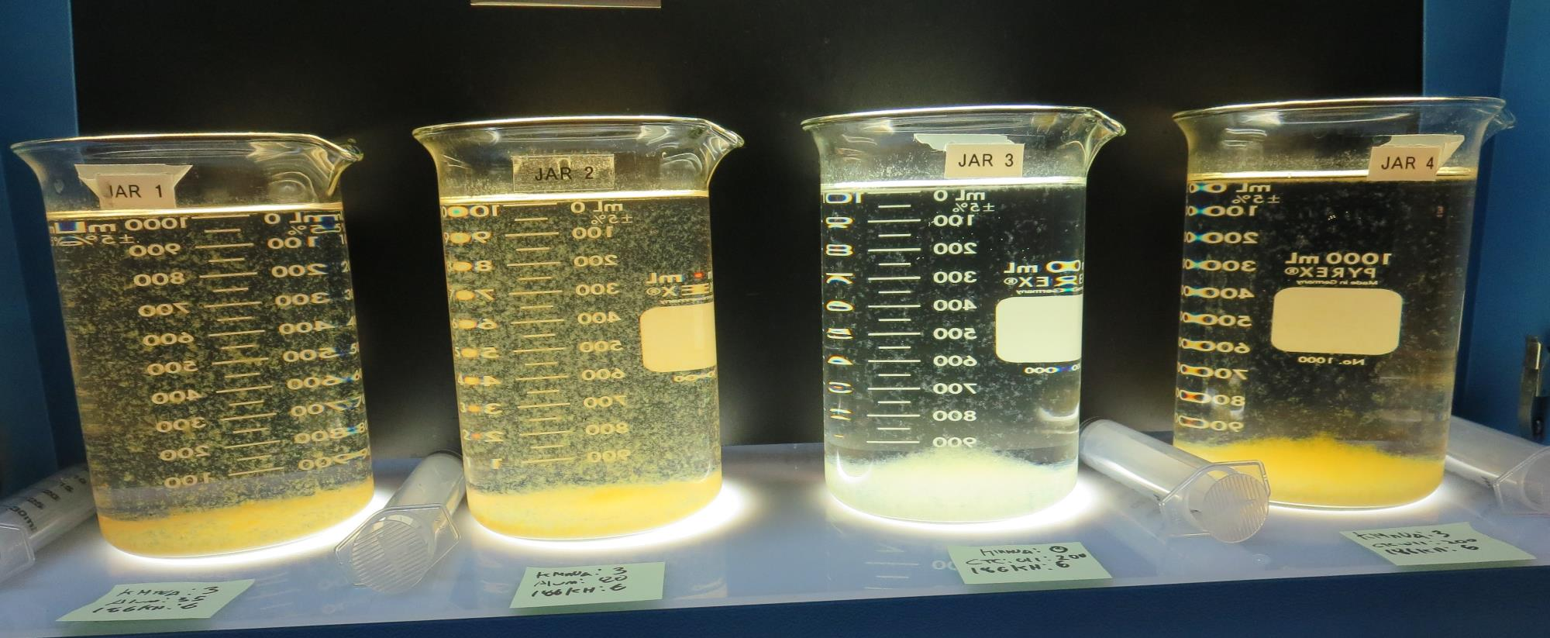
Jars 37-40: After 5 min of settling, 25 mL is syringed for filterability and %UVT/UVA.

Slide 60
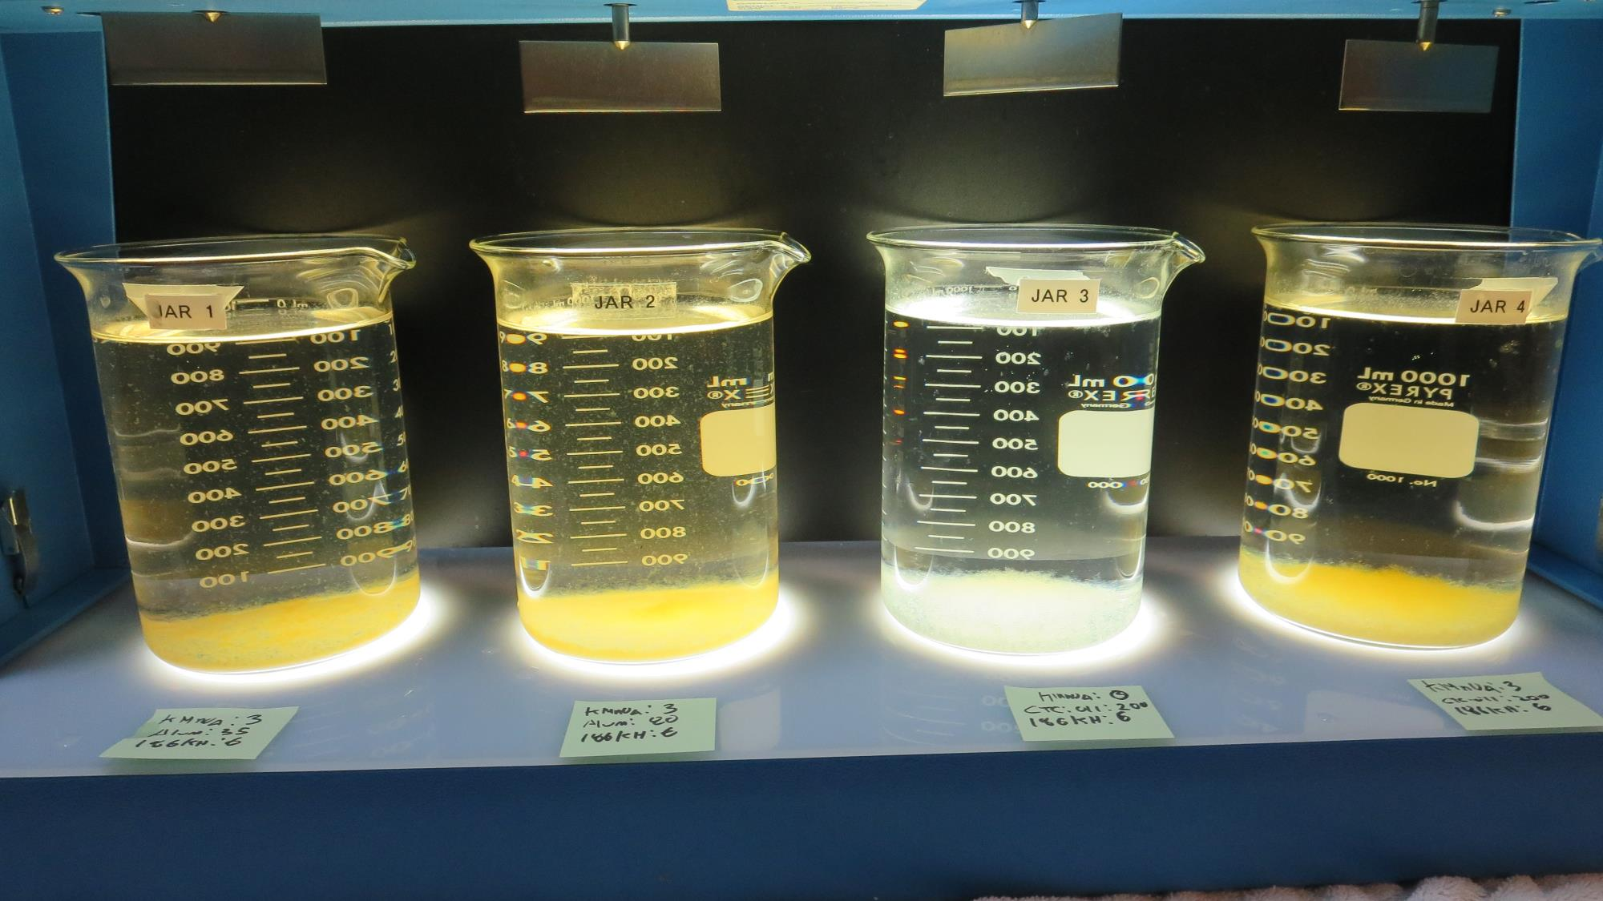
Jars 37-40: After 25-minutes of settling, settled water turbidity is taken.
3 mg/L KMnO₄
35 mg/L Alum
6 mg/L 186KH
Filtrate 0.06 NTU
UVT: 89.2%
UVA: 0.049/cm
UVA Reduction 63.7%
Settled: 2.13 NTU
3 mg/L KMnO₄
80 mg/L Alum
6 mg/L 186KH
Filtrate 0.04 NTU
UVT: 92.9%
UVA: 0.031/cm
UVA Reduction 77.0%
Settled: 2.11 NTU
0 mg/L KMnO₄
200 mg/L CTC-0011
6 mg/L 186KH
Filtrate 0.09 NTU
UVT: 92.8%
UVA: 0.032/cm
UVA Reduction 76.3%
Settled: 0.53 NTU
3 mg/L KMnO₄
200 mg/L CTC-0011
6 mg/L 186KH
Filtrate 0.09 NTU
UVT: 93.4%
UVA: 0.029/cm
UVA Reduction 78.4%
Settled: 0.77 NTU

Slide 61
Jars 41-44 Test
Flash Mix 20 Sec (200 RPM)
Floc Mix 5 min (20 RPM)
Pre-Oxidation KMnO₄
Applied Coagulants
Alum
AdvFloc CTC-00011
186KH

Slide 62
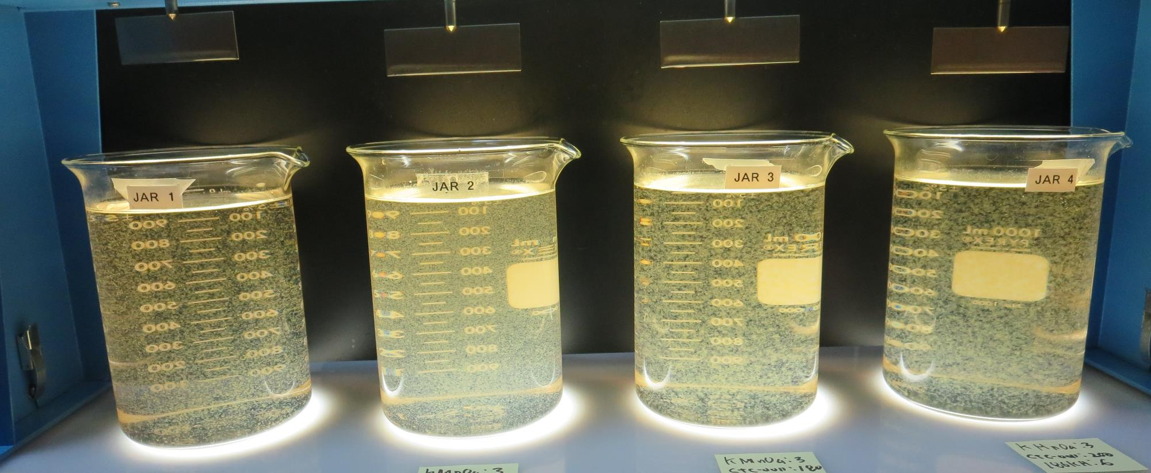
Jars 41-44: End of 5-minute flocculation (30 RPM) duration.
3 mg/L KMnO₄
35 mg/L Alum
6 mg/L 186KH
Filtrate 0.04 NTU
UVT: 89.9%
UVA: 0.046/cm
UVA Reduction 65.9%
Settled: 2.01 NTU
3 mg/L KMnO₄
80 mg/L Alum
6 mg/L 186KH
Filtrate 0.04 NTU
UVT: 93.2%
UVA: 0.030/cm
UVA Reduction 77.8%
Settled: 2.01 NTU
3 mg/L KMnO₄
180 mg/L CTC-0011
6 mg/L 186KH
Filtrate 0.07 NTU
UVT: 93.1%
UVA: 0.030/cm
UVA Reduction 77.8%
Settled: 0.71 NTU
3 mg/L KMnO₄
200 mg/L CTC-0011
6 mg/L 186KH
Filtrate 0.04 NTU
UVT: 93.5%
UVA: 0.029/cm
UVA Reduction 78.5%
Settled: 0.42 NTU

Slide 63
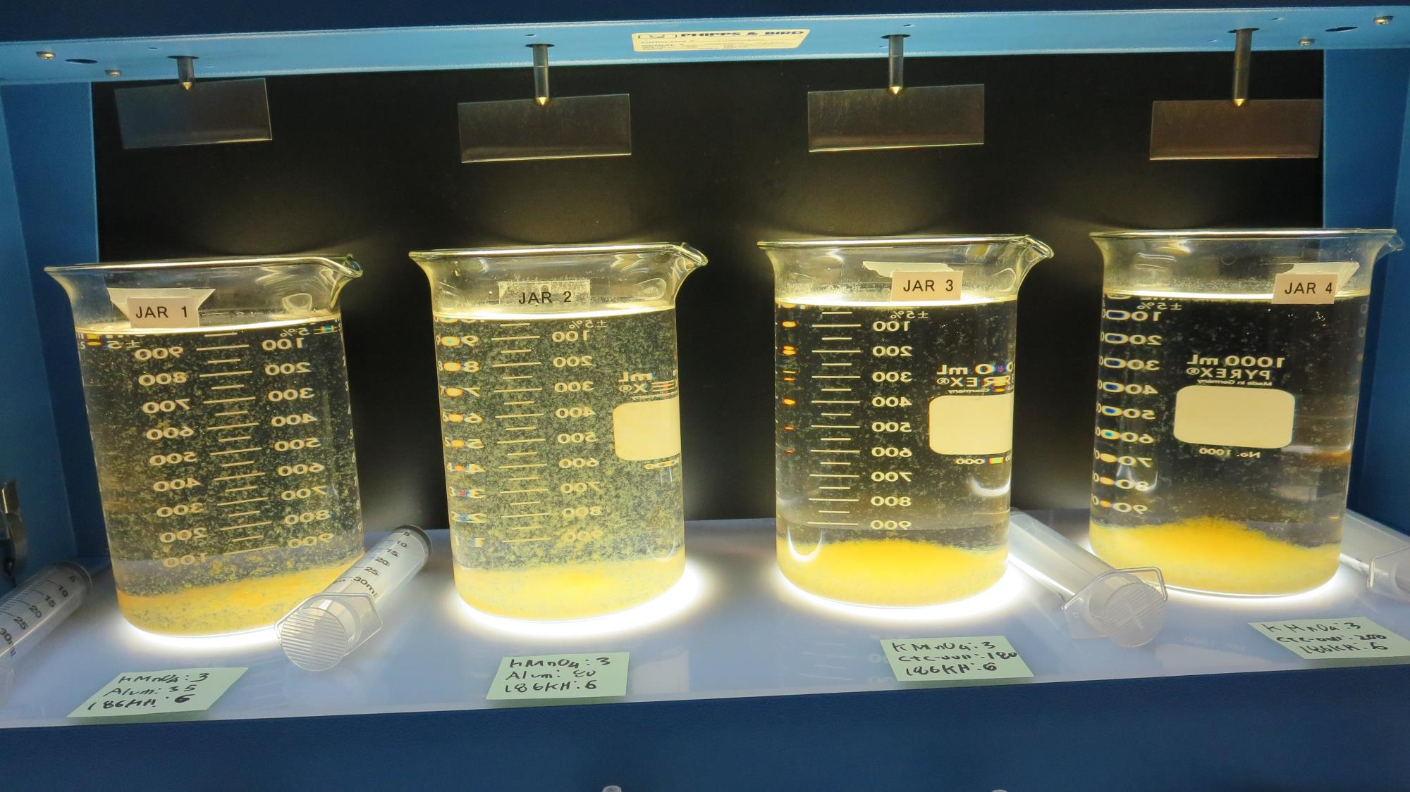
Jars 41-44: After 5 min of settling, 25 mL is syringed for filterability and %UVT/UVA.

Slide 64
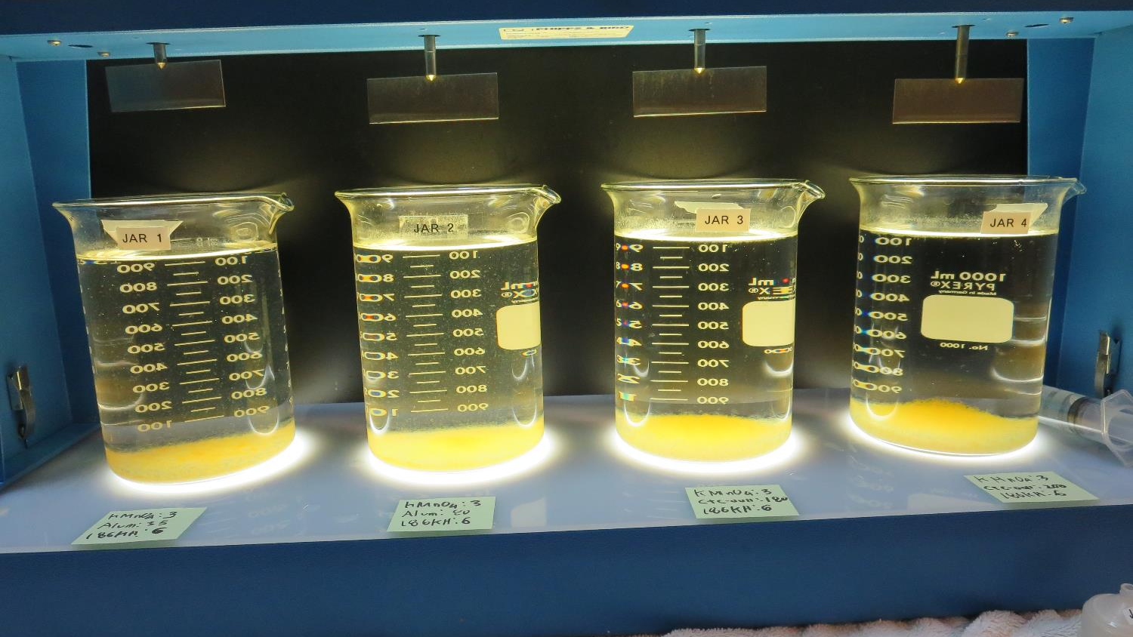
Jars 41-44: After 25-minutes of settling, settled water turbidity is taken.
3 mg/L KMnO₄
35 mg/L Alum
6 mg/L 186KH
Filtrate 0.04 NTU
UVT: 89.9%
UVA: 0.046/cm
UVA Reduction 65.9%
Settled: 2.01 NTU
3 mg/L KMnO₄
80 mg/L Alum
6 mg/L 186KH
Filtrate 0.04 NTU
UVT: 93.2%
UVA: 0.030/cm
UVA Reduction 77.8%
Settled: 2.01 NTU
3 mg/L KMnO₄
180 mg/L CTC-0011
6 mg/L 186KH
Filtrate 0.07 NTU
UVT: 93.1%
UVA: 0.030/cm
UVA Reduction 77.8%
Settled: 0.71 NTU
3 mg/L KMnO₄
200 mg/L CTC-0011
6 mg/L 186KH
Filtrate 0.04 NTU
UVT: 93.5%
UVA: 0.029/cm
UVA Reduction 78.5%
Settled: 0.42 NTU

Slide 65
Jar Testing for 1-Liter Jars:
Procedures for Most Treatment Plants
Fill jars with source water prior to coagulant injection and set paddle speed at 30 rpm
Add chemicals (i.e., NaOCl, primary coagulant, coagulant aid) to each jar
Flash mix for 15-30 seconds (200 rpm)
Slow mix for 5 minutes (20-30 rpm)
Settled for 5 minutes. Syringe 25 mL from each jar taken 1-inch below surface (25 mL/12 sec rate)
Filtered through 1.2 um isopore membrane into cuvette drip rate, 15 mL/(50-90 sec)
Measure filtrate turbidity, chlorine residual and %UVT/UVA
Measure settled water turbidity after 25 minutes of total setting
Record all data

Slide 66
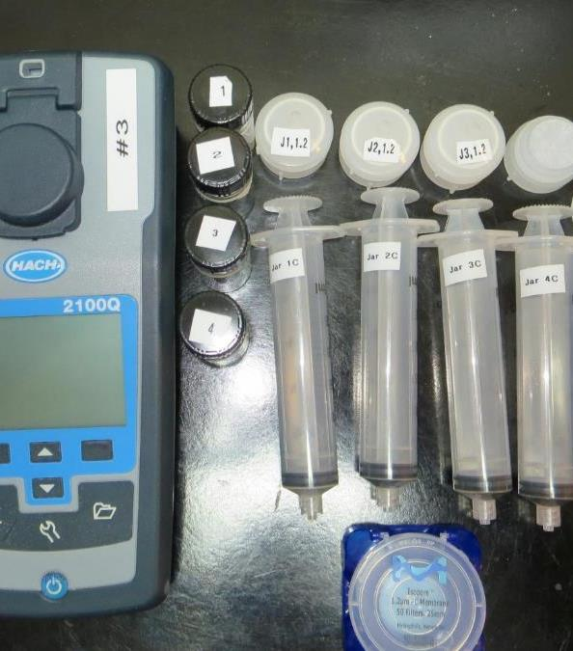
Jar Test
Filterability Test Equipment
Turbidity Instrument
Syringe w/Luer-Lock Tip, 30 cc
(part#: 2225800, by Hach)
Swinnex Filter Holder, 25 mm (part#: SX0002500)
Isopore Membrane Filter, 1.2 um absolute
pore size,
Φ= 25 mm , thickness: 24 um,
hydrophilic polycarbonate membrane
(part #: RTTP02500)
Go to Sigma-Aldrich for laboratory supplies http://www.sigmaaldrich.com/united-states.html

Slide 67
Isopore Membrane Information
Categories | Information
trade name | Isopore
filter color | White
chemistry | Polycarbonate (PC)
water flow rate | Avg. 175 mL/min x cm² (typical results @ 10 psi)
media | Isopore®
wettability | Hydrophilic
porosity | 14.7%
pore size | 1.2 µm
bubble point at 23 °C | 1.0 bar, air with water
thickness | 24 µm
filter diameter (ø) | 25 mm
material size | polycarbonate, Hydrophilic, 1.2 µm, 25 mm, white, plain, 100

Slide 68
Isopore Membrane Background Information
The Isopore membrane is a polycarbonate, track-etched screen filter recommended for all analyses in which the sample is viewed on the surface of the membrane. The Isopore membrane is composed of polycarbonate film, which has a smooth, glass-like surface for clearer sample observation. The unique manufacturing process of the membrane ensures a precise pore diameter and a consistent pore size for accurate separation of samples by size. Matched-weight filters are not usually required because of low, constant tar and ash weights.
Features & Benefits:
Membrane structure retains particles on the surface, simplifying counting and analysis

Slide 69
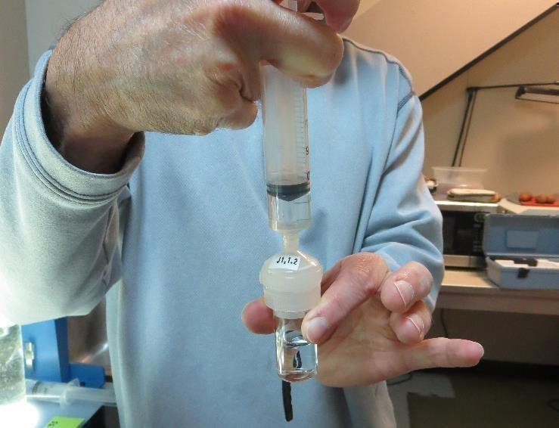
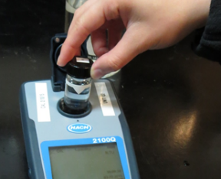
Jar Test - Filterability Test
Syringe ~ 25 mL from jar (after 5-minutes of settling)
Filter-to-waste 3-5 mL
Filter directly into clean cuvette
Measure turbidity
Note: Take several readings before recording final NTU results. Micro bubbles can adhere to glass causing false NTU readings. To remove bubbles, tilt cuvette up to 90 degrees.

Slide 70

Contact
Guy Schott, P.E.
State Water Resources Control Board
Division of Drinking Water
Santa Rosa, CA
Go to Stock Solution/Dose calculations/Jar Test Results for tools to download
www.waterboards.ca.gov/drinking_water/programs/districts/mendocino_district.html
Email: Guy Schott - Guy.Schott@waterboards.ca.gov
Office Number: 707-576-2732

