Slide 1
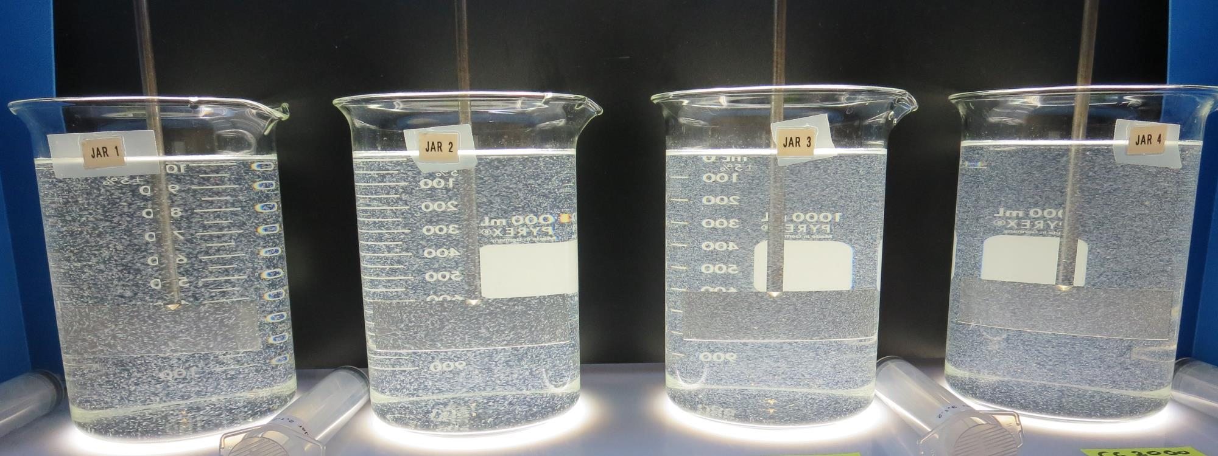
Modesto Irrigation District CA5010038 Stanislaus County Jar Test
by Guy Schott, P.E.
February 28, 2019

Slide 2
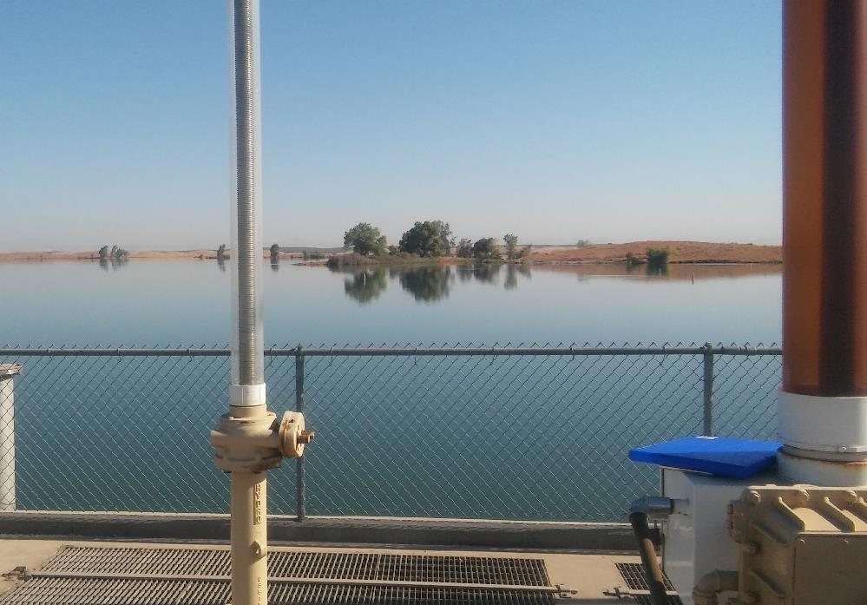
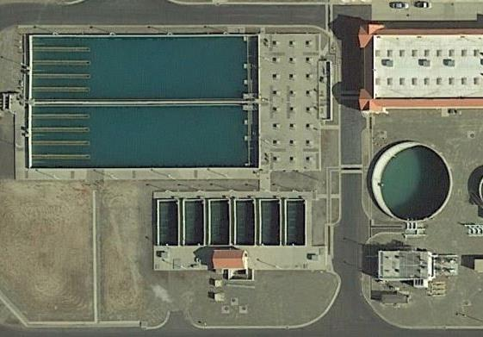
Modesto Irrigation District Source Water: Modesto Reservoir Conventional Water Treatment

Slide 3
Modesto Irrigation District Source Water: Modesto Reservoir Conventional Treatment (pre-ozonation/ coagulation/ flocculation/ Sedimentation/Media filtration/Chlorination)
Source
Turbidity: 8 NTU
pH: 7.24
UVT: 76.1%
UVA: 0.119/cm
0.4 um Filtered
UVT: 89.3%
UVA: 0.049/cm
Source Post Ozone
Turbidity: 8.2 NTU
pH: 7.16
UVT: 79.1%
UVA: 0.102/cm
0.4 um Filtered
UVT: 93.3%
UVA: 0.030/cm

Slide 4
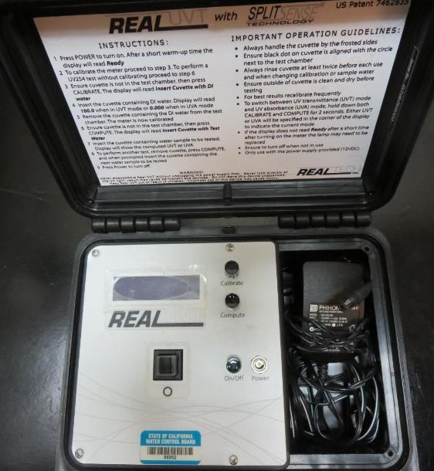
UVT/UVA
UV transmittance (UVT) is a measurement of the amount of ultraviolet light (commonly at 254 nm due to its germicidal effect) that passes through a water sample compared to the amount of light that passes through a pure water sample. The measurement is expressed as a percentage, % UVT.
%UVT = 10^{(-UVA)} x 100%
UV absorbance (UVA) is calculated as a relative measure of the amount of light absorbed by a water sample compared with the amount of light absorbed by a pure water sample.
UVA = -log(%UVT/100)

Slide 5
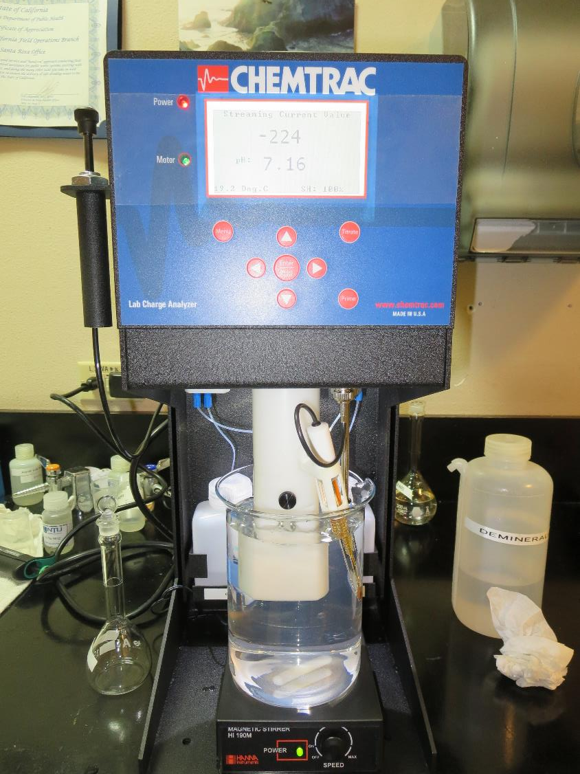
Laboratory Charge Analyzer
LCA: Used to determine coagulant demand of a source water entering the treatment plant.
Source pH: 7.24
LCA #1: 9800: 10 mg/L as product
LCA #2:
9890: 1 mg/L as product manually added
9800: 8.9 mg/L as product
LCA#3: Source (Post Ozone), pH: 7.16
9800: 9.45 mg/L as product
LCA#4: Source (Post Ozone)
9890: 1 mg/L as product manually added
9800: 8.05 mg/L as product

Slide 6
Applied Coagulants for Jar Testing
CalChem
35-45% Aluminum Chlorohydrate
SG = 1.2-1.34
CC 2000
50% Aluminum Chlorohydrate
50% Water
SG = 1.34
Pro Pac 9890 (NTU Technologies)
30-40% Aluminum Chlorohydrate
30-40% Water
30% Trade Secret
SG = 1.25-1.34
Pro Pac 9800 (NTU Technologies)
50% Aluminum Chlorohydrate
50% Water
SG = 1.34

Slide 7
Coagulant Information
Unless stated otherwise, all coagulant doses are reported as Product (100% strength). Aluminum sulfate is reported as Alum.
Preparation of coagulant stock solutions are generally 1.0 and/or 0.1 percent strength using 100 and/or 200 mL volumetric flasks.
Finnpipette F2 variable volume pipette, capacity 100-1000 micro liters is used for stock solution preparation and coagulant aid jar test dosing.
Finnpipette F2 variable volume pipette, capacity 0.5-5 mL is used for primary coagulant jar test dosing.

Slide 8
Modesto Irrigation District: Jar Test 1-8 Results, Pre-Ozone Source
Jar # | 200 RPM Flash Mix seconds | 30 RPM Floc Duration minutes | 9800 mg/L | 9890 mg/L | Filtrate NTU | Filtrate %UVT | Filtrate UVA/cm | Settle NTU 25 min
J1 | 60 | 5 | 9 | 0 | 0.29 | 95.4 | 0.020 | 5.5
J2 | 60 | 5 | 10 | 0 | 0.07 | 95.6 | 0.020 | 4.6
J3 | 60 | 5 | 11 | 0 | 0.05 | 96.2 | 0.017 | 9.0
J4 | 60 | 5 | 12 | 0 | 0.06 | 96.4 | 0.016 | 10.2
J5 | 60 | 5 | 8 | 0.8 | 0.20 | 95.2 | 0.021 | 4.2
J6 | 60 | 5 | 9 | 0.9 | 0.16 | 95.7 | 0.019 | 4.3
J7 | 60 | 5 | 10 | 1.0 | 0.18 | 95.7 | 0.019 | 5.3
J8 | 60 | 5 | 11 | 1.1 | 0.07 | 96.1 | 0.017 | 6.6

Slide 9
Modesto Irrigation District: Jar Test 9-12 Results, Pre-Ozone Source
Jar # | 200 RPM Flash Mix seconds | 30 RPM Floc Duration minutes | NaOCl mg/L | 9800 mg/L | Filtrate NTU | Filtrate %UVT | Filtrate UVA/cm | Settle NTU 25 min
J9 | 60 | 5 | 1.5 | 9 | 0.14 | 95.6 | 0.020 | 4
J10 | 60 | 5 | 1.5 | 10 | 0.10 | 95.8 | 0.019 | 4
J11 | 60 | 5 | 1.5 | 11 | 0.07 | 95.9 | 0.018 | 5.2
J12 | 60 | 5 | 1.5 | 12 | 0.05 | 96.2 | 0.017 | 5.8

Slide 10
Modesto Irrigation District: Jar Test 13-20 Results, Post Ozone Source
Jar # | 200 RPM Flash Mix seconds | 30 RPM Floc Duration minutes | 9800 mg/L | 9890 mg/L | Filtrate NTU | Filtrate %UVT | Filtrate UVA/cm | Settle NTU 25 min
J13 | 60 | 5 | 8.5 | 0 | 0.09 | 97.1 | 0.013 | 5.2
J14 | 60 | 5 | 9.5 | 0 | 0.07 | 97.4 | 0.011 | 5.3
J15 | 60 | 5 | 10.5 | 0 | 0.20 | 97.0 | 0.013 | 8.0
J16 | 60 | 5 | 11.5 | 0 | 0.05 | 96.8 | 0.014 | 11
J17 | 60 | 5 | 7 | 0.7 | 0.25 | 96.5 | 0.015 | 5.6
J18 | 60 | 5 | 8 | 0.8 | 0.07 | 97.4 | 0.011 | 5.7
J19 | 60 | 5 | 9 | 0.9 | 0.22 | 97.0 | 0.013 | 6.5
J20 | 60 | 5 | 10 | 1.0 | 0.05 | 97.6 | 0.011 | 8.5

Slide 11
Modesto Irrigation District: Jar Test 21-28 Results, Post Ozone Source
Jar # | 200 RPM Flash Mix seconds | 30 RPM Floc Duration minutes | CalChem mg/L | Filtrate NTU | Filtrate %UVT | Filtrate UVA/cm | Settle NTU 25 min
J21 | 60 | 5 | 7 | 0.06 | 97.1 | 0.013 | 4.8
J22 | 60 | 5 | 8 | 0.06 | 97.2 | 0.012 | 5.4
J23 | 60 | 5 | 9 | 0.05 | 97.4 | 0.011 | 7.7
J24 | 60 | 5 | 10 | 0.06 | 97.5 | 0.011 | 10.4
J25 | 60 | 5 | 5 | 0.26 | 96.6 | 0.015 | 7.7
J26 | 60 | 5 | 6 | 0.06 | 97.2 | 0.012 | 6.5
J27 | 60 | 5 | 7 | 0.08 | 97.4 | 0.011 | 6.8
J28 | 60 | 5 | 8 | 0.06 | 97.4 | 0.011 | 5.8

Slide 12
Modesto Irrigation District: Jar Test 29-36 Results, Post Ozone Source
Jar # | 200 RPM Flash Mix seconds | 30 RPM Floc Duration minutes | Cal- Chem mg/L | 9800 mg/L | Filtrate NTU | Filtrate %UVT | Filtrate UVA/cm | Settle NTU 25 min
J29 | 60 | 10 | 8 | 0 | 0.06 | 97.2 | 0.012 | 2.8
J30 | 60 | 10 | 9 | 0 | 0.06 | 97.4 | 0.011 | 3.7
J31 | 60 | 10 | 0 | 8.5 | 0.05 | 97.2 | 0.012 | 4.2
J32 | 60 | 10 | 0 | 9.5 | 0.06 | 97.2 | 0.012 | 4.0
J33 | 60 | 15 | 8 | 0 | 0.12 | 97.3 | 0.012 | 2.8
J34 | 60 | 15 | 9 | 0 | 0.22 | 97.2 | 0.012 | 6.1
J35 | 60 | 15 | 0 | 8.5 | 0.09 | 97.2 | 0.012 | 2.7
J36 | 60 | 15 | 0 | 9.5 | 0.05 | 97.4 | 0.011 | 2.8

Slide 13
Modesto Irrigation District: Jar Test 37-40 Results, Post Ozone Source
Jar # | 200 RPM Flash Mix seconds | 30 RPM Floc Duration minutes | Cal- Chem mg/L | CC 2000 mg/L | Filtrate NTU | Filtrate %UVT | Filtrate UVA/cm | Settle NTU 25 min
J37 | 60 | 10 | 8 | 0 | 0.06 | 97.1 | 0.013 | 3.6
J38 | 60 | 10 | 9 | 0 | 0.12 | 97.2 | 0.012 | 3.6
J39 | 60 | 10 | 0 | 8.5 | 0.07 | 97.3 | 0.012 | 3.2
J40 | 60 | 10 | 0 | 9.5 | 0.12 | 97.3 | 0.012 | 3.4

Slide 14
Jars 1-4 Test Flash Mix 60 Sec (200 RPM) Floc Mix 5 min (30 RPM) Pre-Ozone Source Applied Coagulant 9800

Slide 15
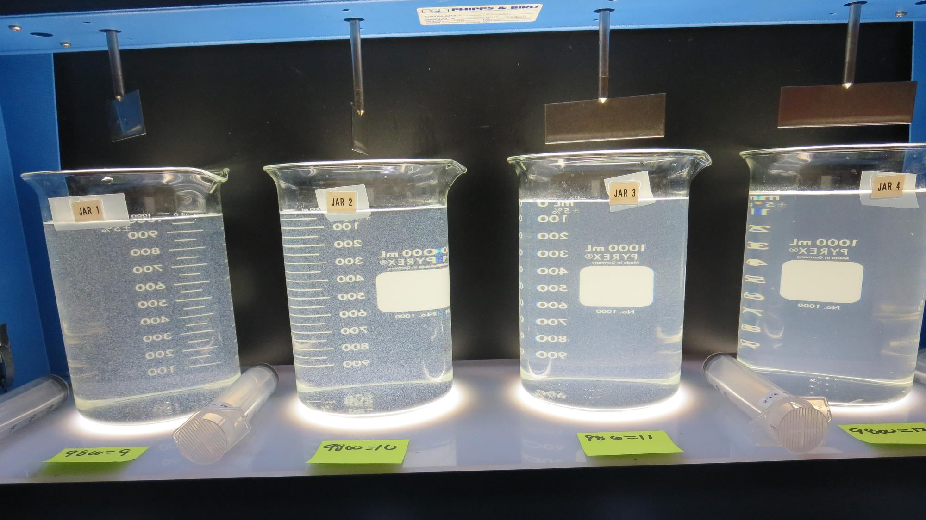
Jars 1-4: End of 5-minute flocculation (30 RPM) duration.
9 mg/L 9800
Filtrate 0.29 NTU
UVT: 95.4%
UVA: 0.020/cm
Settled: 5.5 NTU
10 mg/L 9800
Filtrate 0.07 NTU
UVT: 95.6%
UVA: 0.020/cm
Settled: 4.6 NTU
11 mg/L 9800
Filtrate 0.05 NTU
UVT: 96.2%
UVA: 0.017/cm
Settled: 9 NTU
12 mg/L 9800
Filtrate 0.05 NTU
UVT: 96.4%
UVA: 0.016/cm
Settled: 10 NTU

Slide 16
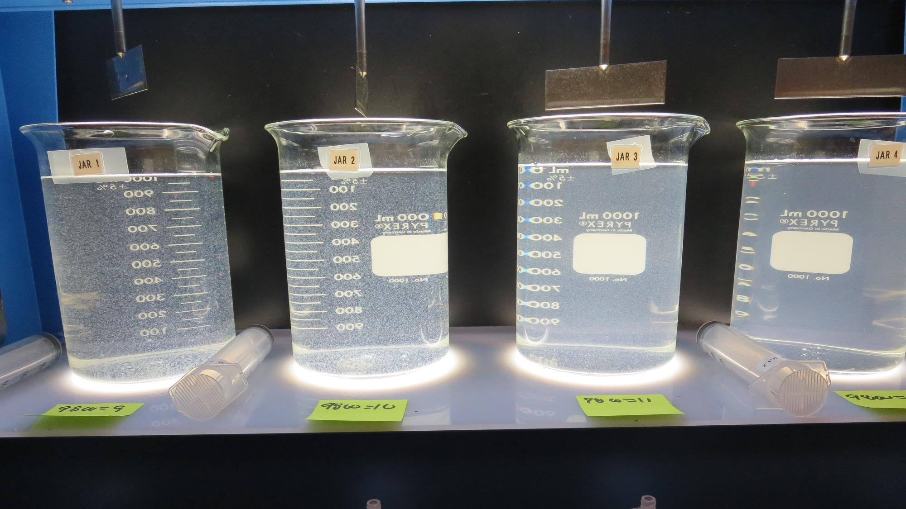
Jars 1-4: After 5 min of settling, 25 mL is syringed for filterability and %UVT/UVA

Slide 17
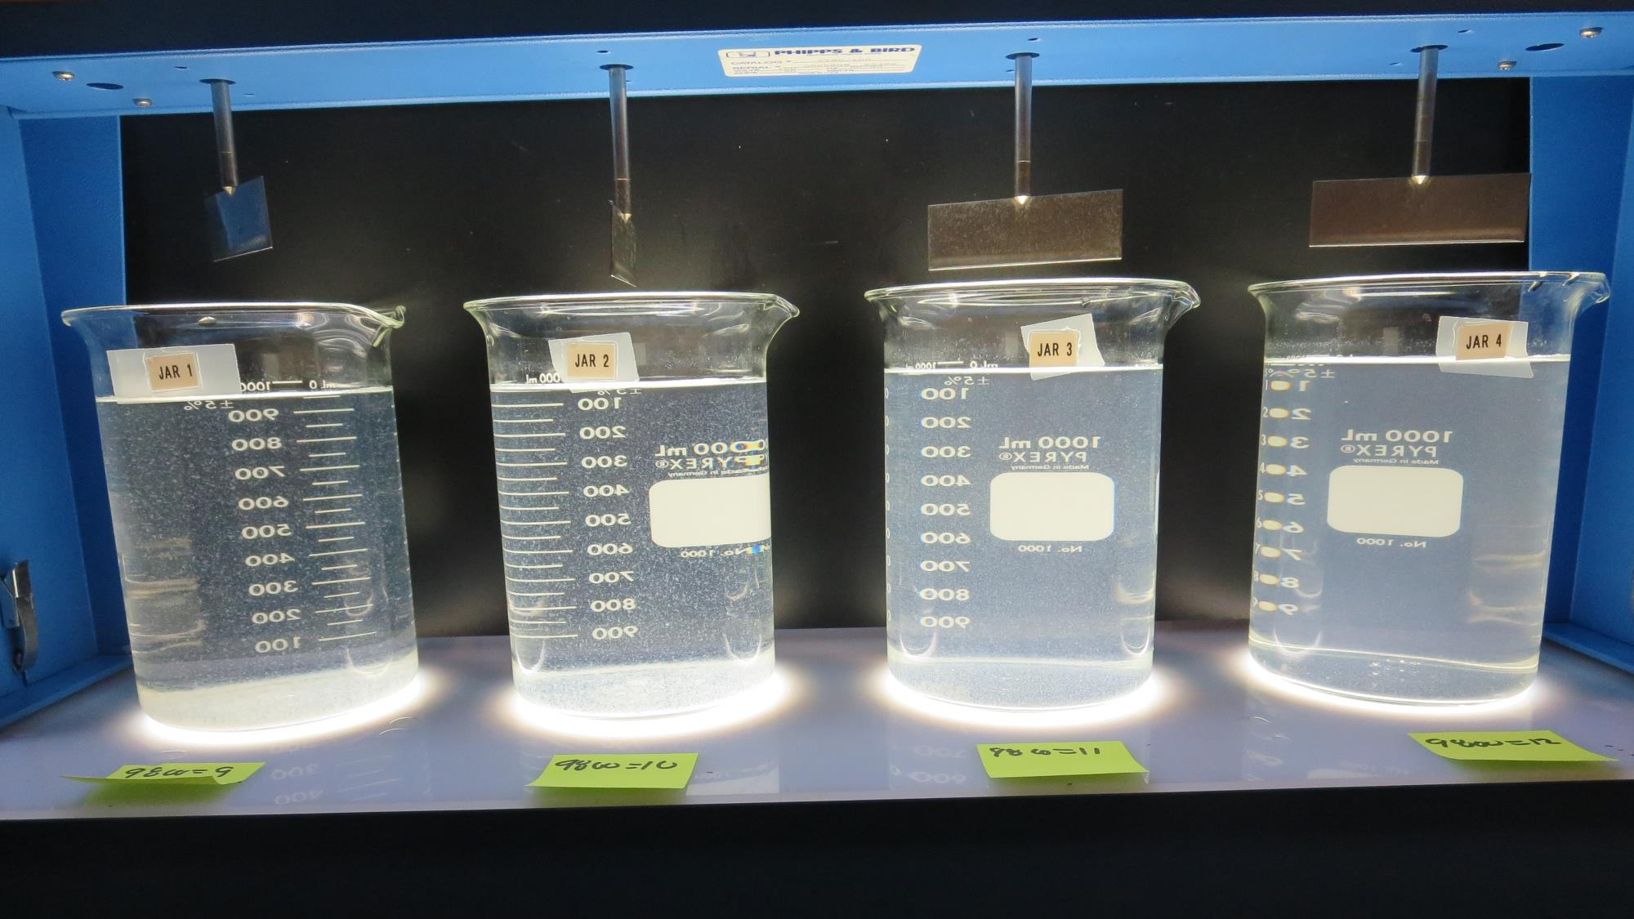
Jars 1-4: After 25-minutes of settling, settled water turbidity is taken.
9 mg/L 9800
Filtrate 0.29 NTU
UVT: 95.4%
UVA: 0.020/cm
Settled: 5.5 NTU
10 mg/L 9800
Filtrate 0.07 NTU
UVT: 95.6%
UVA: 0.020/cm
Settled: 4.6 NTU
11 mg/L 9800
Filtrate 0.05 NTU
UVT: 96.2%
UVA: 0.017/cm
Settled: 9 NTU
12 mg/L 9800
Filtrate 0.05 NTU
UVT: 96.4%
UVA: 0.016/cm
Settled: 10 NTU

Slide 18
Jars 5-8 Test Flash Mix 60 Sec (200 RPM) Floc Mix 5 min (30 RPM) Pre-Ozone Source Applied Coagulants 9800/9890

Slide 19
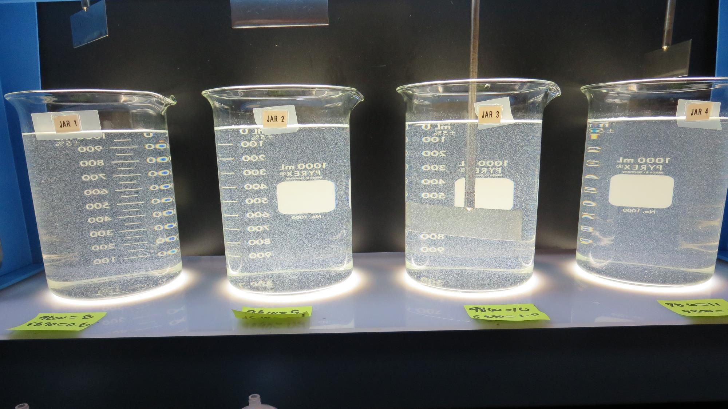
Jars 5-8: End of 5-minute flocculation (30 RPM) duration.
8 mg/L 9800
0.8 mg/L 9890
Filtrate 0.20 NTU
UVT: 95.2%
UVA: 0.021/cm
Settled: 4.2 NTU
9 mg/L 9800
0.9 mg/L 9890
Filtrate 0.16 NTU
UVT: 95.7%
UVA: 0.019/cm
Settled: 4.3 NTU
10 mg/L 9800
1.0 mg/L 9890
Filtrate 0.18 NTU
UVT: 95.7%
UVA: 0.019/cm
Settled: 5.3 NTU
11 mg/L 9800
1.1 mg/L 9890
Filtrate 0.07 NTU
UVT: 96.1%
UVA: 0.017/cm
Settled: 6.6 NTU

Slide 20
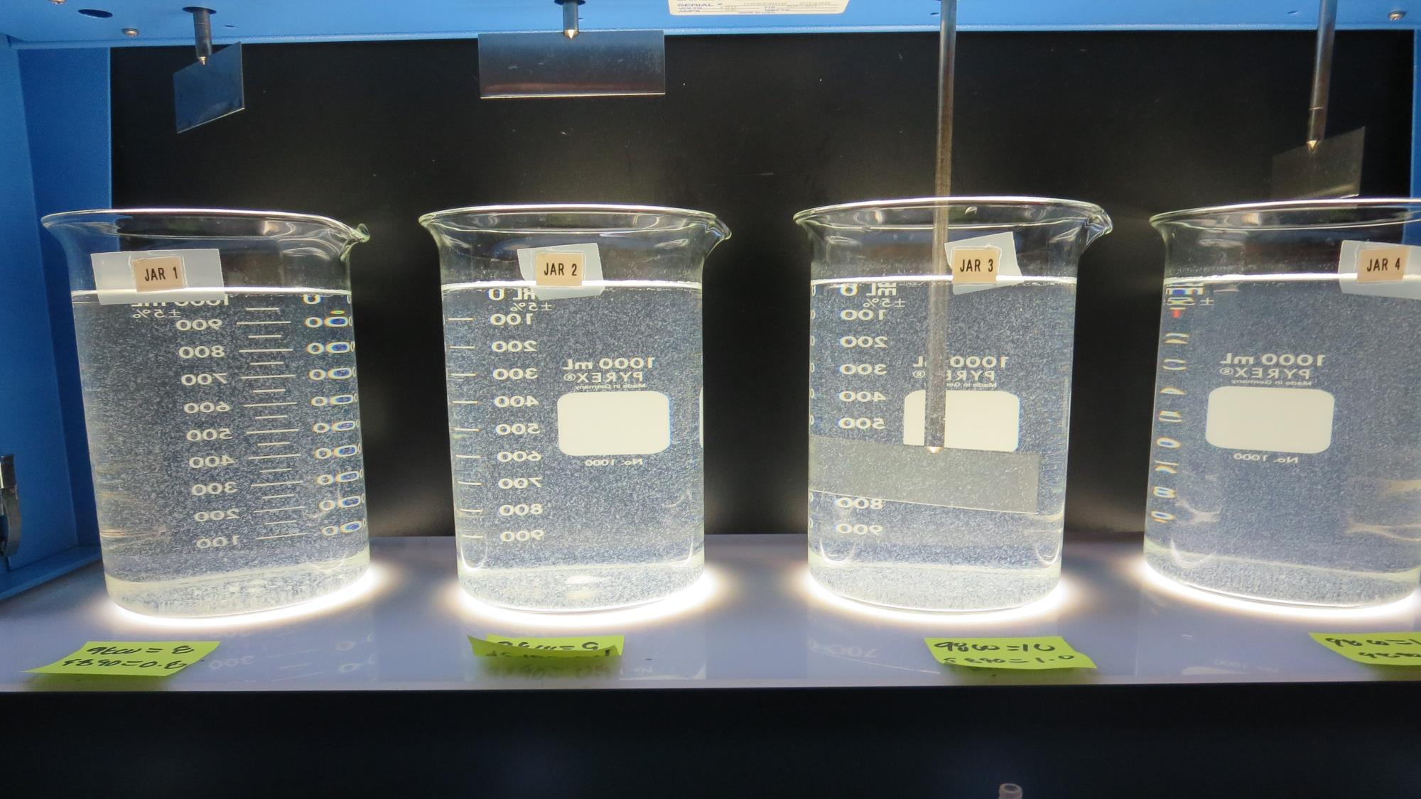
Jars 5-8: After 5 min of settling, 25 mL is syringed for filterability and %UVT/UVA

Slide 21
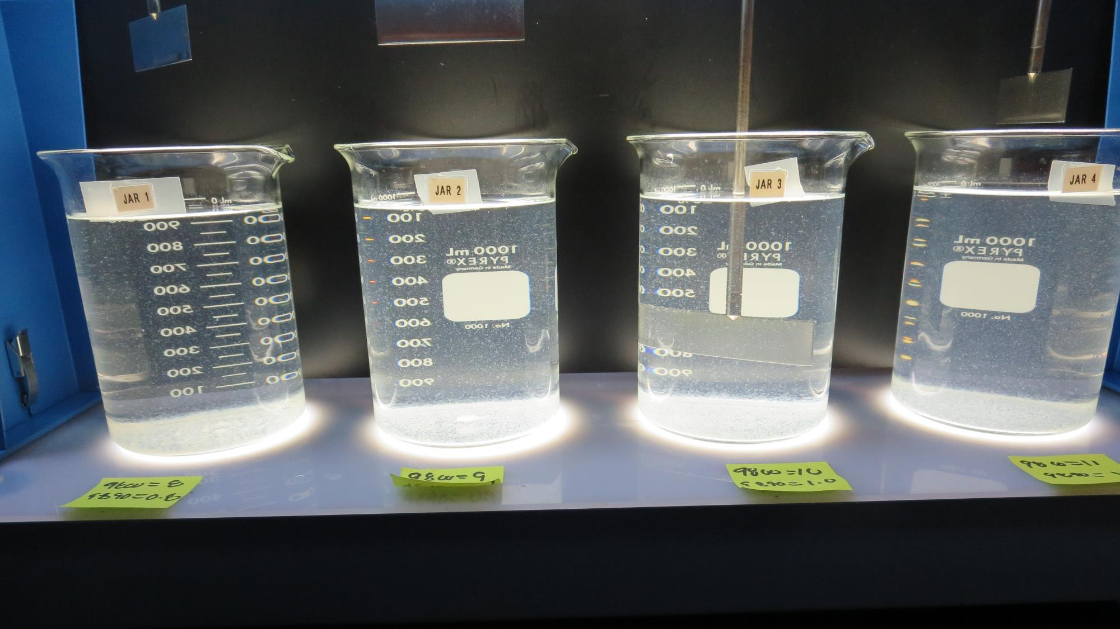
Jars 5-8: After 25-minutes of settling, settled water turbidity is taken.
8 mg/L 9800
0.8 mg/L 9890
Filtrate 0.20 NTU
UVT: 95.2%
UVA: 0.021/cm
Settled: 4.2 NTU
9 mg/L 9800
0.9 mg/L 9890
Filtrate 0.16 NTU
UVT: 95.7%
UVA: 0.019/cm
Settled: 4.3 NTU
10 mg/L 9800
1.0 mg/L 9890
Filtrate 0.18 NTU
UVT: 95.7%
UVA: 0.019/cm
Settled: 5.3 NTU
11 mg/L 9800
1.1 mg/L 9890
Filtrate 0.07 NTU
UVT: 96.1%
UVA: 0.017/cm
Settled: 6.6 NTU

Slide 22
Jars 9-12 Test Flash Mix 60 Sec (200 RPM) Floc Mix 5 min (30 RPM) Pre-Ozone Source Applied Coagulant 9800 w/NaOCl

Slide 23
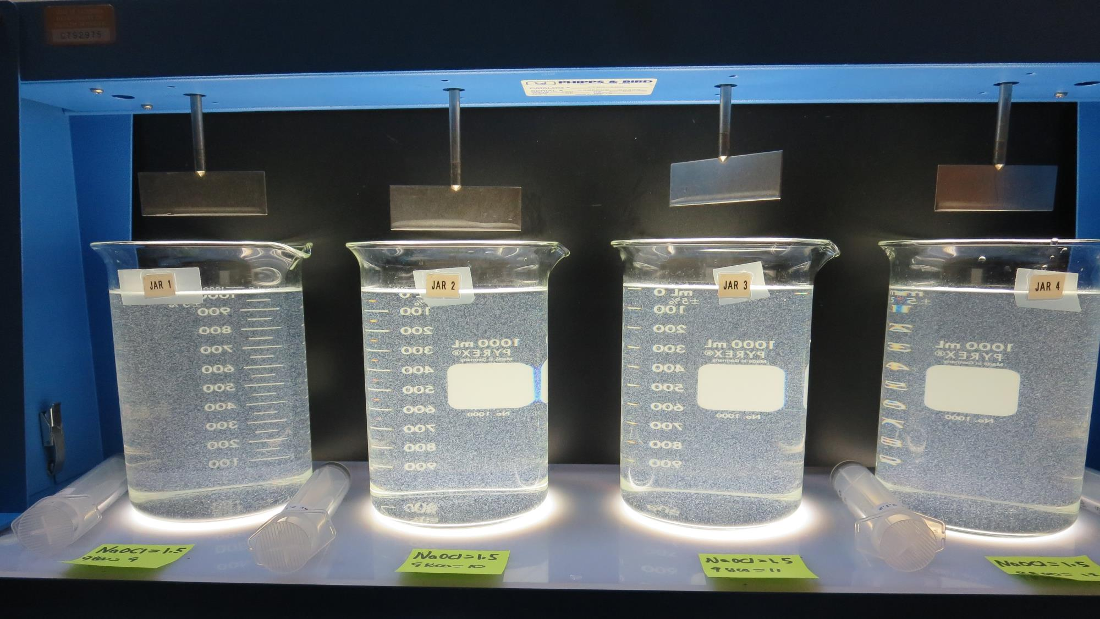
Jars 9-12: End of 5-minute flocculation (30 RPM) duration.
1.5 mg/L NaOCl
9 mg/L 9800
Filtrate 0.14 NTU
UVT: 95.6%
UVA: 0.020/cm
Settled: 4 NTU
1.5 mg/L NaOCl
10 mg/L 9800
Filtrate 0.10 NTU
UVT: 95.8%
UVA: 0.019/cm
Settled: 4 NTU
1.5 mg/L NaOCl
11 mg/L 9800
Filtrate 0.07 NTU
UVT: 95.9%
UVA: 0.018/cm
Settled: 5.2 NTU
1.5 mg/L NaOCl
12 mg/L 9800
Filtrate 0.05 NTU
UVT: 96.2%
UVA: 0.017/cm
Settled: 5.8 NTU

Slide 24
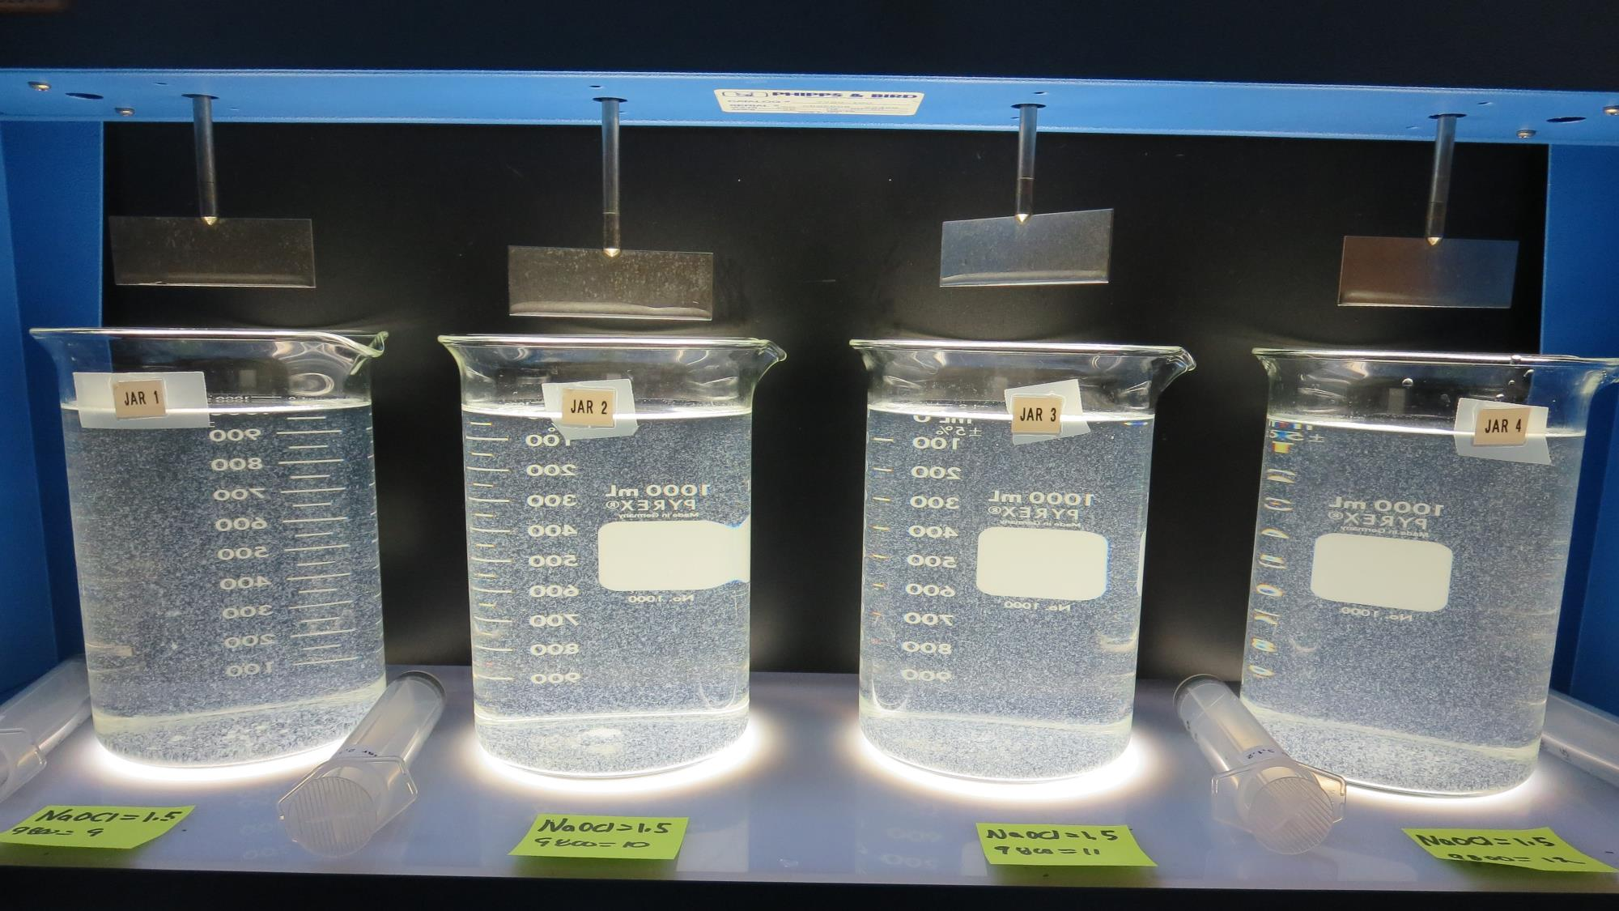
Jars 9-12: After 5 min of settling, 25 mL is syringed for filterability and %UVT/UVA

Slide 25
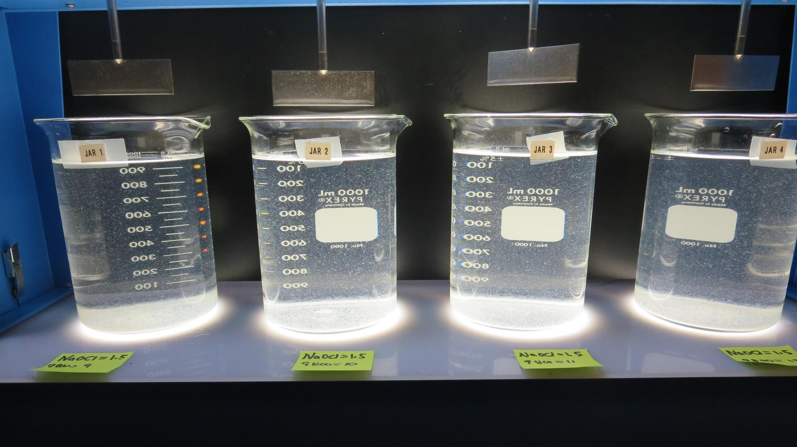
Jars 9-12: After 25-minutes of settling, settled water turbidity is taken.
1.5 mg/L NaOCl
9 mg/L 9800
Filtrate 0.14 NTU
UVT: 95.6%
UVA: 0.020/cm
Settled: 4 NTU
1.5 mg/L NaOCl
10 mg/L 9800
Filtrate 0.10 NTU
UVT: 95.8%
UVA: 0.019/cm
Settled: 4 NTU
1.5 mg/L NaOCl
11 mg/L 9800
Filtrate 0.07 NTU
UVT: 95.9%
UVA: 0.018/cm
Settled: 5.2 NTU
1.5 mg/L NaOCl
12 mg/L 9800
Filtrate 0.05 NTU
UVT: 96.2%
UVA: 0.017/cm
Settled: 5.8 NTU

Slide 26
Jars 13-16 Test Flash Mix 60 Sec (200 RPM) Floc Mix 5 min (30 RPM) Post-Ozone Source Applied Coagulant 9800

Slide 27
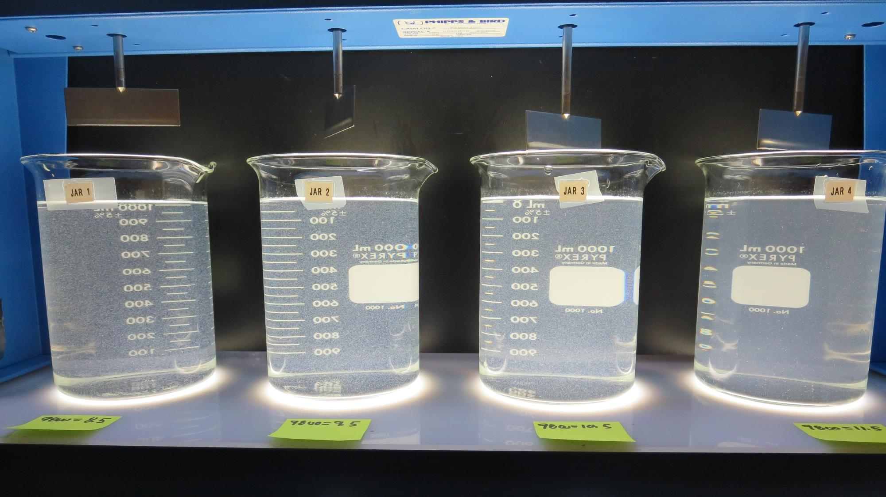
Jars 13-16: End of 5-minute flocculation (30 RPM) duration.
8.5 mg/L 9800
Filtrate 0.09 NTU
UVT: 97.1%
UVA: 0.013/cm
Settled: 5.2 NTU
9.0 mg/L 9800
Filtrate 0.07 NTU
UVT: 97.4%
UVA: 0.011/cm
Settled: 5.3 NTU
10.5 mg/L 9800
Filtrate 0.20 NTU
UVT: 97.0%
UVA: 0.013/cm
Settled: 8 NTU
11.5 mg/L 9800
Filtrate 0.05 NTU
UVT: 96.8%
UVA: 0.014/cm
Settled: 11 NTU

Slide 28
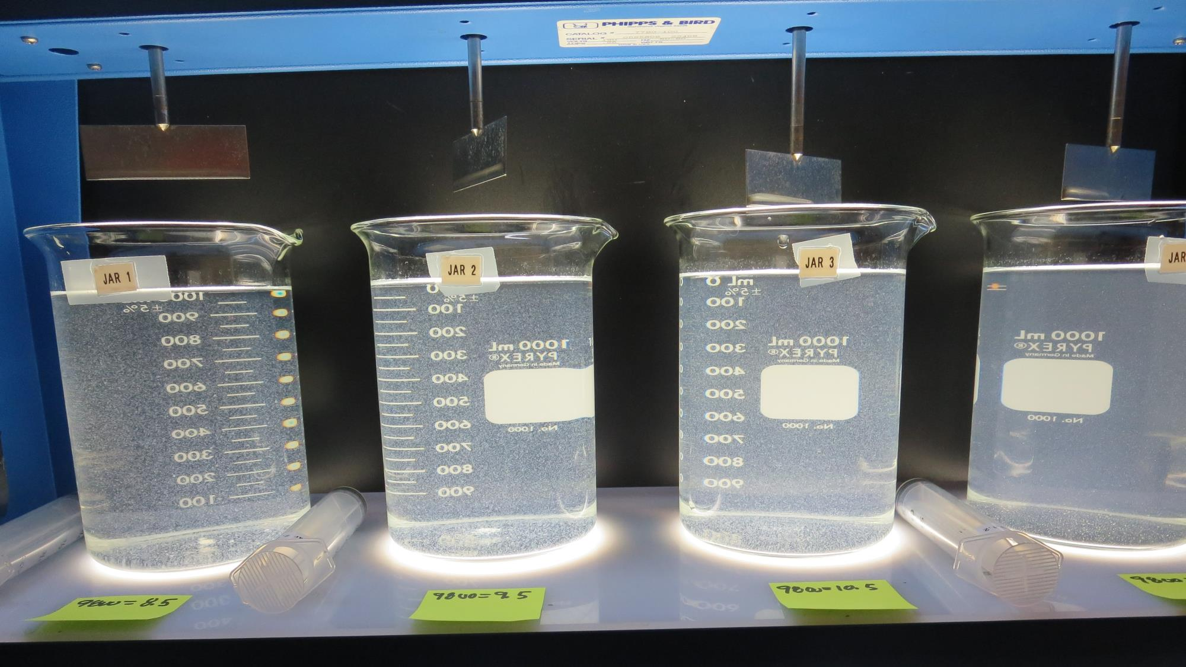
Jars 13-16: After 5 min of settling, 25 mL is syringed for filterability and %UVT/UVA

Slide 29
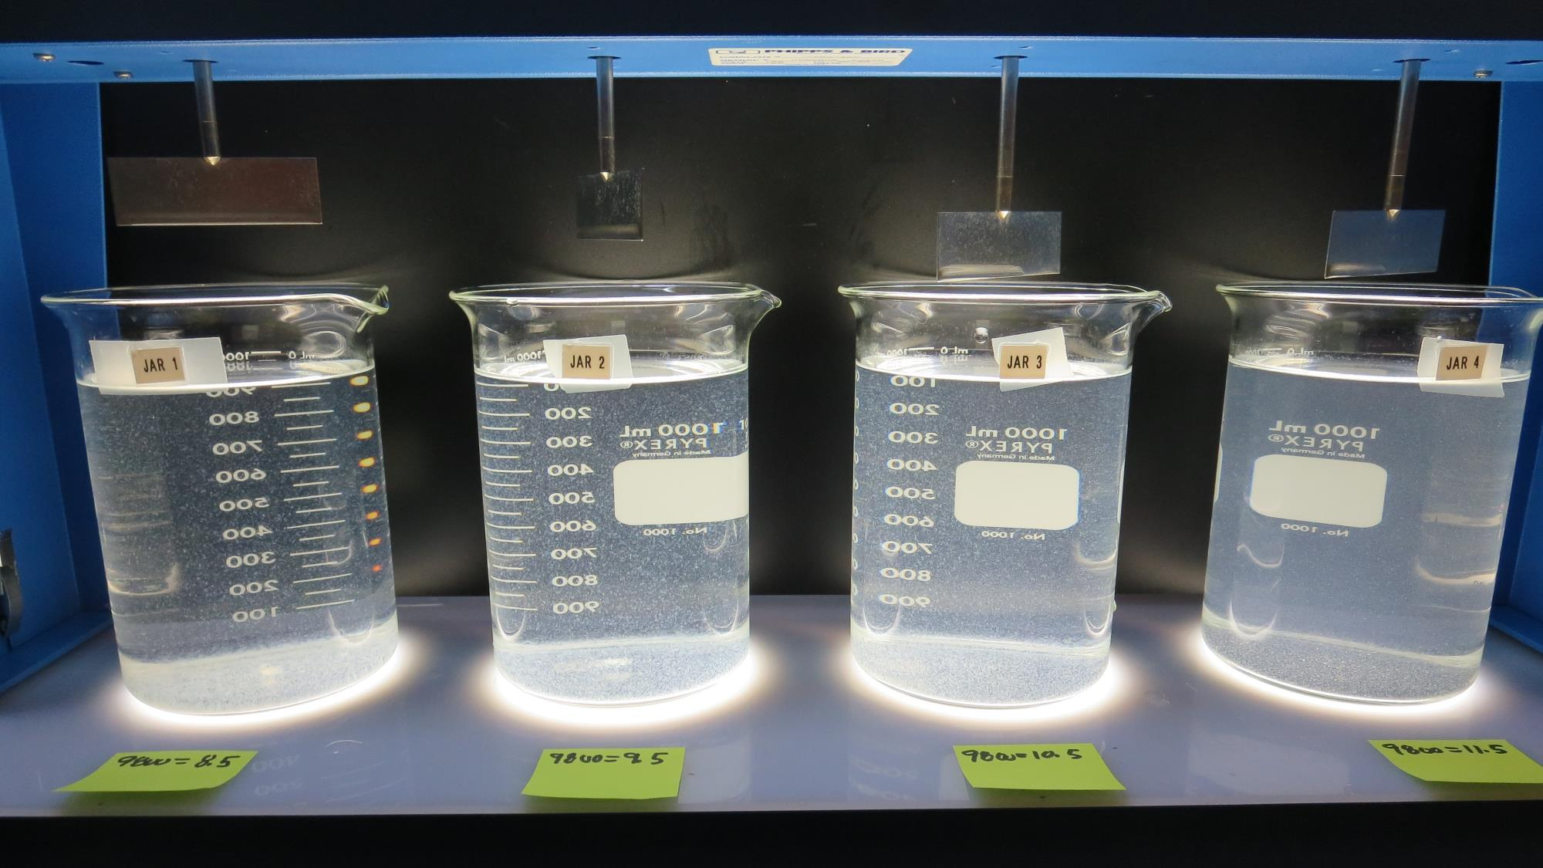
Jars 13-16: After 25-minutes of settling, settled water turbidity is taken.
8.5 mg/L 9800
Filtrate 0.09 NTU
UVT: 97.1%
UVA: 0.013/cm
Settled: 5.2 NTU
9.0 mg/L 9800
Filtrate 0.07 NTU
UVT: 97.4%
UVA: 0.011/cm
Settled: 5.3 NTU
10.5 mg/L 9800
Filtrate 0.20 NTU
UVT: 97.0%
UVA: 0.013/cm
Settled: 8 NTU
11.5 mg/L 9800
Filtrate 0.05 NTU
UVT: 96.8%
UVA: 0.014/cm
Settled: 11 NTU

Slide 30
Jars 17-20 Test Flash Mix 60 Sec (200 RPM) Floc Mix 5 min (30 RPM) Post-Ozone Source Applied Coagulants 9800/9890

Slide 31
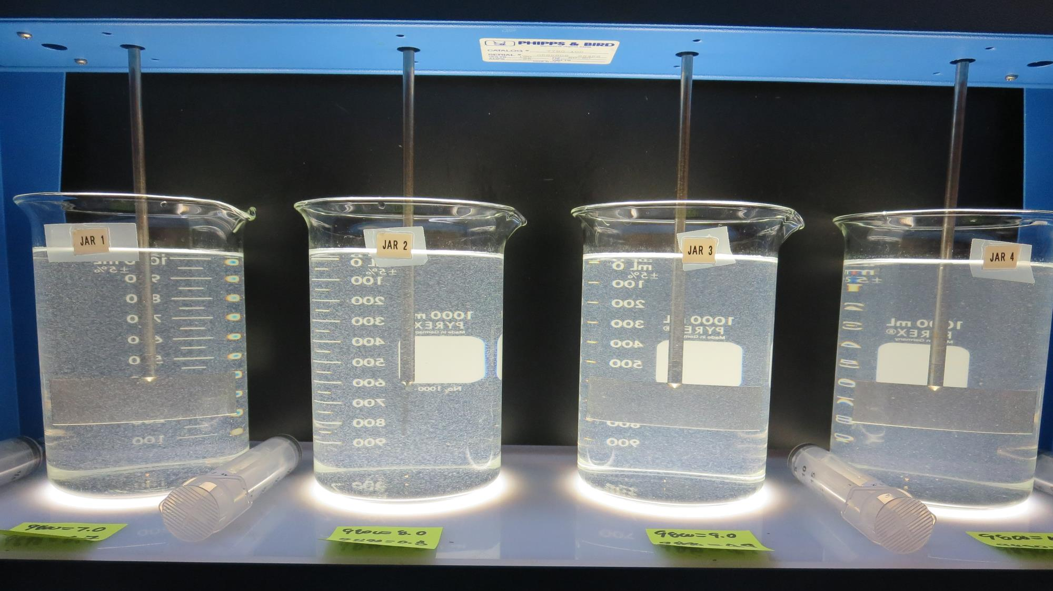
Jars 17-20: End of 5-minute flocculation (30 RPM) duration.
7 mg/L 9800
0.7 mg/L 9890
Filtrate 0.25 NTU
UVT: 96.5%
UVA: 0.015/cm
Settled: 5.6 NTU
8 mg/L 9800
0.8 mg/L 9890
Filtrate 0.07 NTU
UVT: 97.4%
UVA: 0.011/cm
Settled: 5.7 NTU
9 mg/L 9800
0.9 mg/L 9890
Filtrate 0.22 NTU
UVT: 97.0%
UVA: 0.013/cm
Settled: 6.5 NTU
10 mg/L 9800
1.0 mg/L 9890
Filtrate 0.05 NTU
UVT: 97.6%
UVA: 0.011/cm
Settled: 8.5 NTU

Slide 32
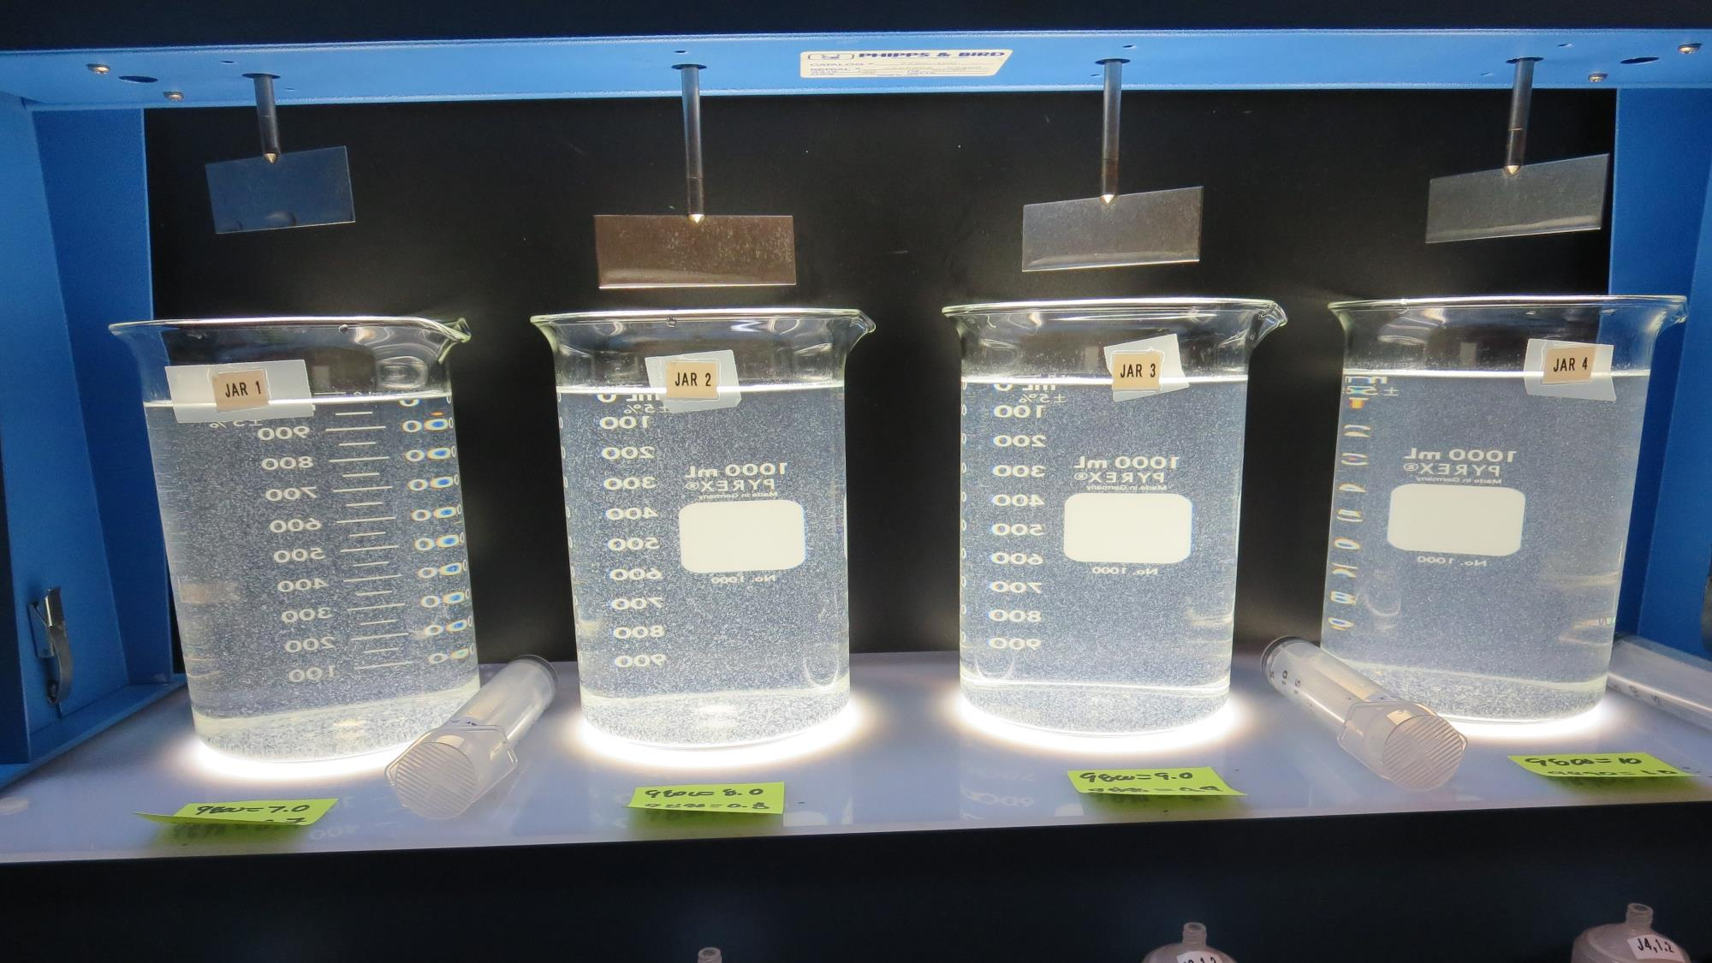
Jars 17-20: After 5 min of settling, 25 mL is syringed for filterability and %UVT/UVA

Slide 33
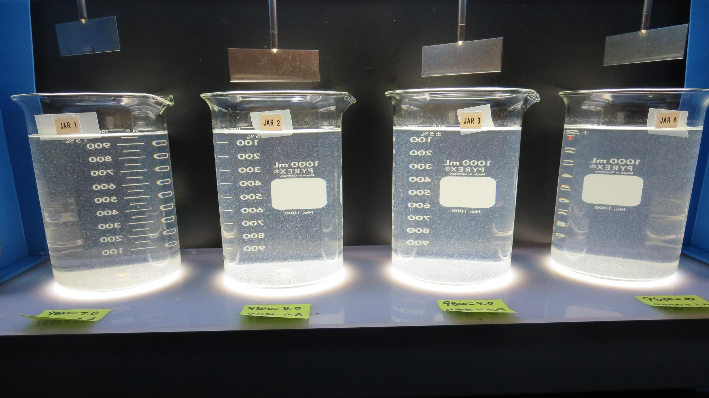
Jars 17-20: After 25-minutes of settling, settled water turbidity is taken.
7 mg/L 9800
0.7 mg/L 9890
Filtrate 0.25 NTU
UVT: 96.5%
UVA: 0.015/cm
Settled: 5.6 NTU
8 mg/L 9800
0.8 mg/L 9890
Filtrate 0.07 NTU
UVT: 97.4%
UVA: 0.011/cm
Settled: 5.7 NTU
9 mg/L 9800
0.9 mg/L 9890
Filtrate 0.22 NTU
UVT: 97.0%
UVA: 0.013/cm
Settled: 6.5 NTU
10 mg/L 9800
1.0 mg/L 9890
Filtrate 0.05 NTU
UVT: 97.6%
UVA: 0.011/cm
Settled: 8.5 NTU

Slide 34
Jars 21-24 Test Flash Mix 60 Sec (200 RPM) Floc Mix 5 min (30 RPM) Post-Ozone Source Applied Coagulant CalChem

Slide 35
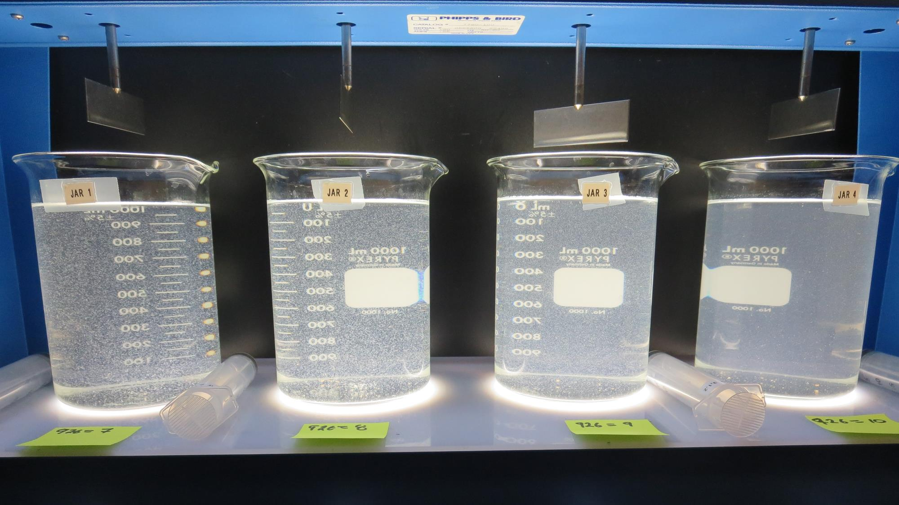
Jars 21-24: End of 5-minute flocculation (30 RPM) duration.
7 mg/L CalChem
Filtrate 0.06 NTU
UVT: 97.1%
UVA: 0.013/cm
Settled: 4.8 NTU
8 mg/L CalChem
Filtrate 0.06 NTU
UVT: 97.2%
UVA: 0.012/cm
Settled: 5.4 NTU
9 mg/L CalChem
Filtrate 0.05 NTU
UVT: 97.4%
UVA: 0.011/cm
Settled: 7.7 NTU
10 mg/L CalChem
Filtrate 0.06 NTU
UVT: 97.5%
UVA: 0.011/cm
Settled: 10.4 NTU

Slide 36
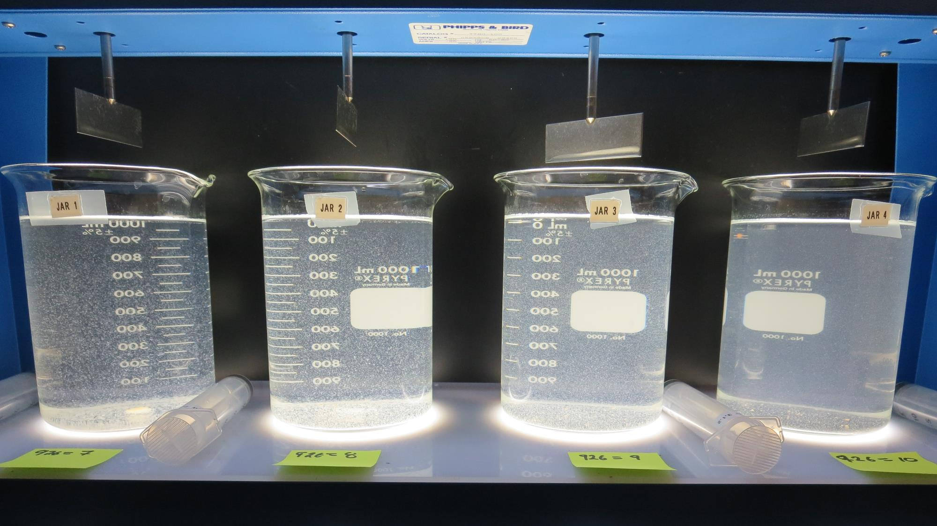
Jars 21-24: After 5 min of settling, 25 mL is syringed for filterability and %UVT/UVA

Slide 37
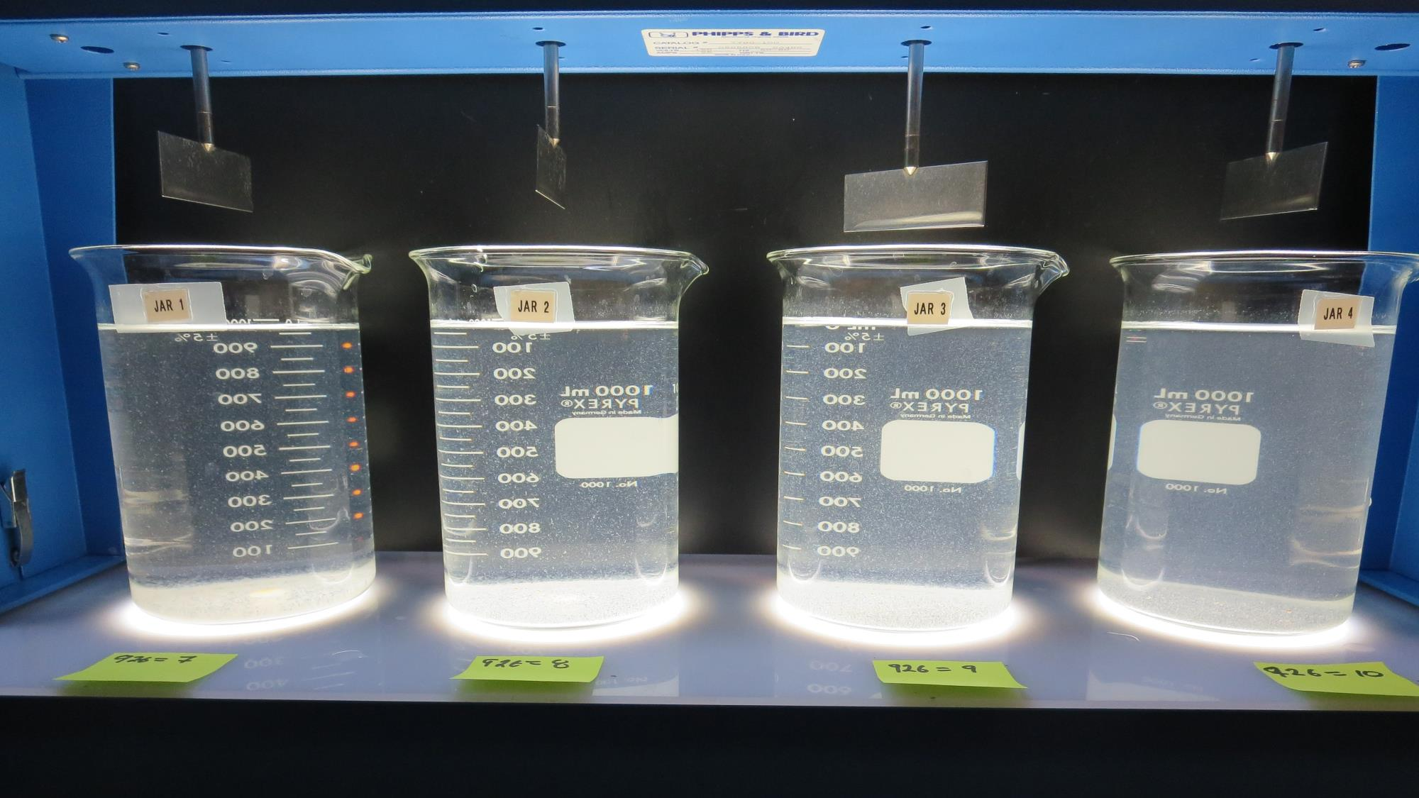
Jars 21-24: After 25-minutes of settling, settled water turbidity is taken.
7 mg/L CalChem
Filtrate 0.06 NTU
UVT: 97.1%
UVA: 0.013/cm
Settled: 4.8 NTU
8 mg/L CalChem
Filtrate 0.06 NTU
UVT: 97.2%
UVA: 0.012/cm
Settled: 5.4 NTU
9 mg/L CalChem
Filtrate 0.05 NTU
UVT: 97.4%
UVA: 0.011/cm
Settled: 7.7 NTU
10 mg/L CalChem
Filtrate 0.06 NTU
UVT: 97.5%
UVA: 0.011/cm
Settled: 10.4 NTU

Slide 38
Jars 25-28 Test Flash Mix 60 Sec (200 RPM) Floc Mix 5 min (30 RPM) Post-Ozone Source Applied Coagulant CalChem

Slide 39
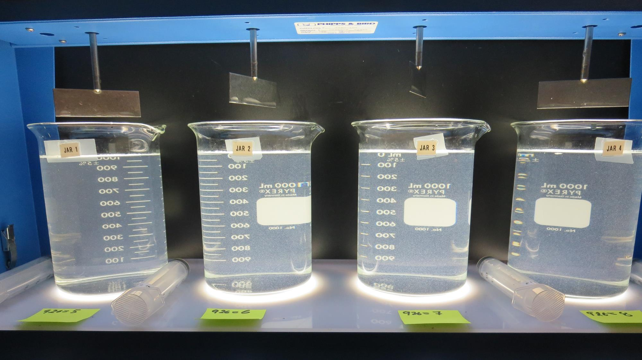
Jars 25-28: End of 5-minute flocculation (30 RPM) duration.
5 mg/L CalChem
Filtrate 0.06 NTU
UVT: 96.6%
UVA: 0.015/cm
Settled: 7.7 NTU
6 mg/L CalChem
Filtrate 0.06 NTU
UVT: 97.2%
UVA: 0.012/cm
Settled: 6.5 NTU
7 mg/L CalChem
Filtrate 0.08 NTU
UVT: 97.4%
UVA: 0.011/cm
Settled: 6.8 NTU
8 mg/L CalChem
Filtrate 0.06 NTU
UVT: 97.4%
UVA: 0.011/cm
Settled: 5.8 NTU

Slide 40
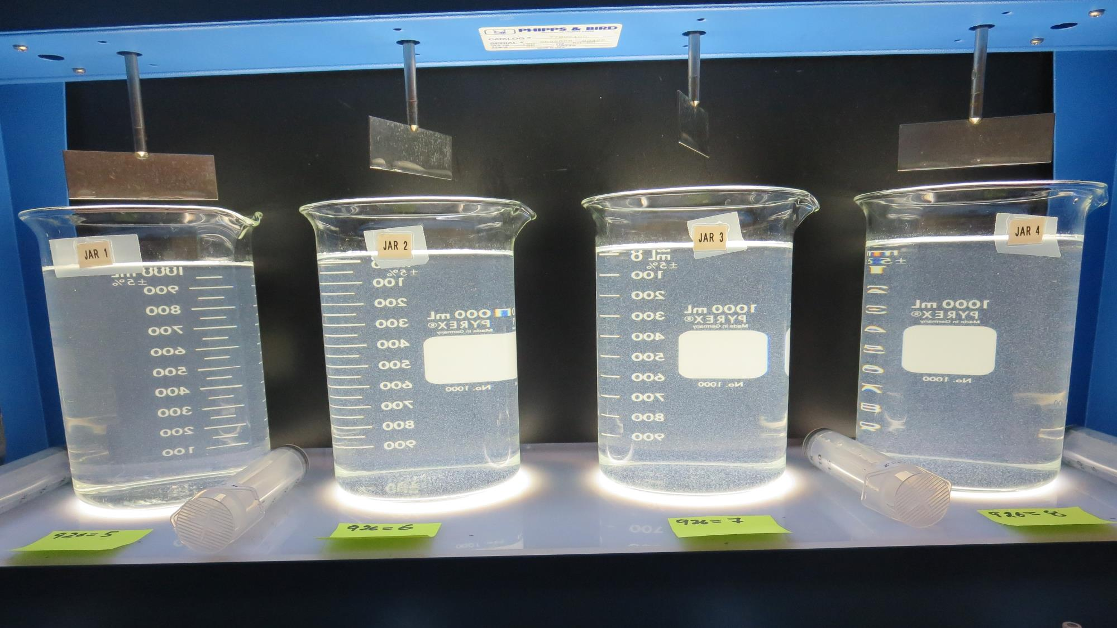
Jars 25-28: After 5 min of settling, 25 mL is syringed for filterability and %UVT/UVA

Slide 41
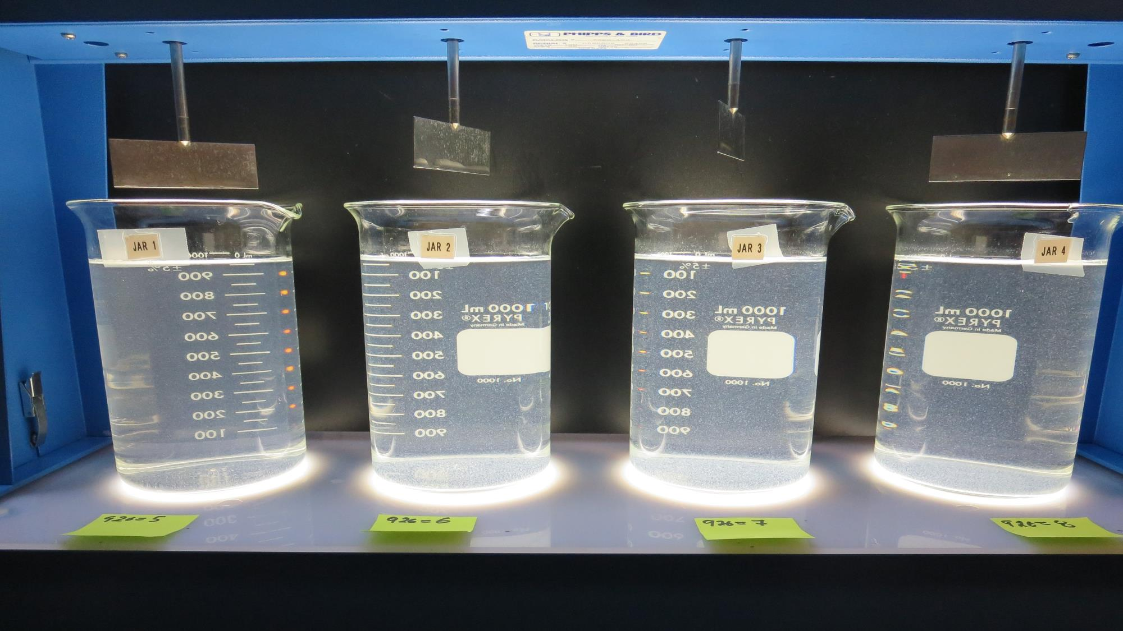
Jars 25-28: After 25-minutes of settling, settled water turbidity is taken.
5 mg/L CalChem
Filtrate 0.06 NTU
UVT: 96.6%
UVA: 0.015/cm
Settled: 7.7 NTU
6 mg/L CalChem
Filtrate 0.06 NTU
UVT: 97.2%
UVA: 0.012/cm
Settled: 6.5 NTU
7 mg/L CalChem
Filtrate 0.08 NTU
UVT: 97.4%
UVA: 0.011/cm
Settled: 6.8 NTU
8 mg/L CalChem
Filtrate 0.06 NTU
UVT: 97.4%
UVA: 0.011/cm
Settled: 5.8 NTU

Slide 42
Jars 29-32 Test Flash Mix 60 Sec (200 RPM) Floc Mix 10 min (30 RPM) Post-Ozone Source Applied Coagulants CalChem/9800

Slide 43
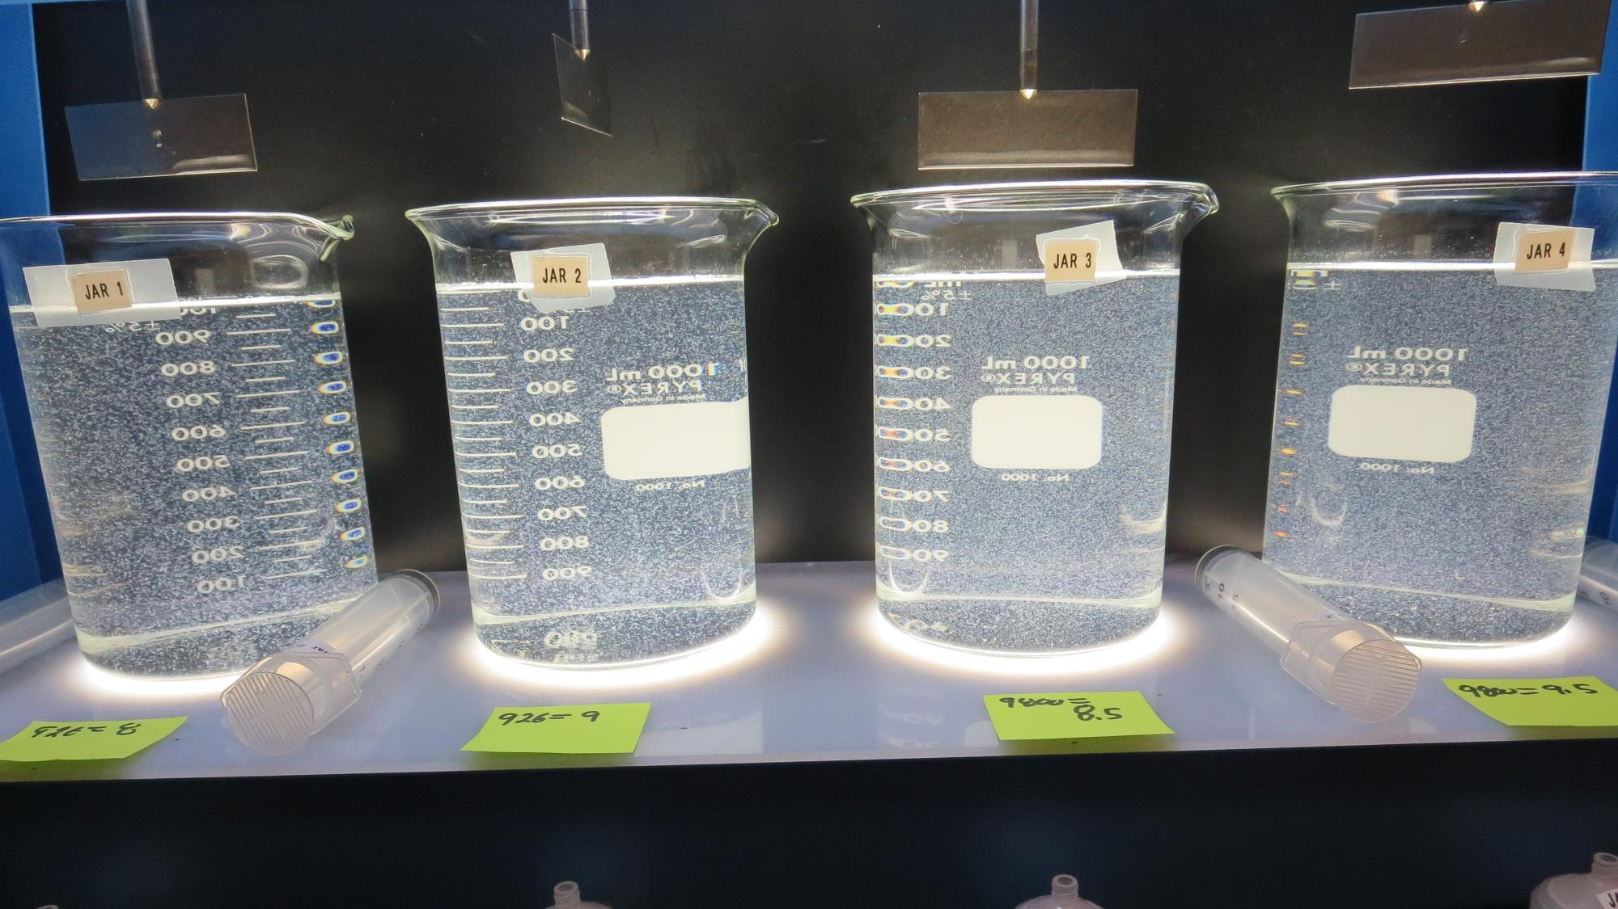
Jars 29-32: End of 10-minute flocculation (30 RPM) duration.
8 mg/L CalChem
Filtrate 0.06 NTU
UVT: 97.2%
UVA: 0.012/cm
Settled: 2.8 NTU
9 mg/L CalChem
Filtrate 0.06 NTU
UVT: 97.2%
UVA: 0.012/cm
Settled: 2.8 NTU
8.5 mg/L 9800
Filtrate 0.05 NTU
UVT: 97.2%
UVA: 0.012/cm
Settled: 4.2 NTU
9.5 mg/L 9800
Filtrate 0.06 NTU
UVT: 97.2%
UVA: 0.012/cm
Settled: 4.0 NTU

Slide 44
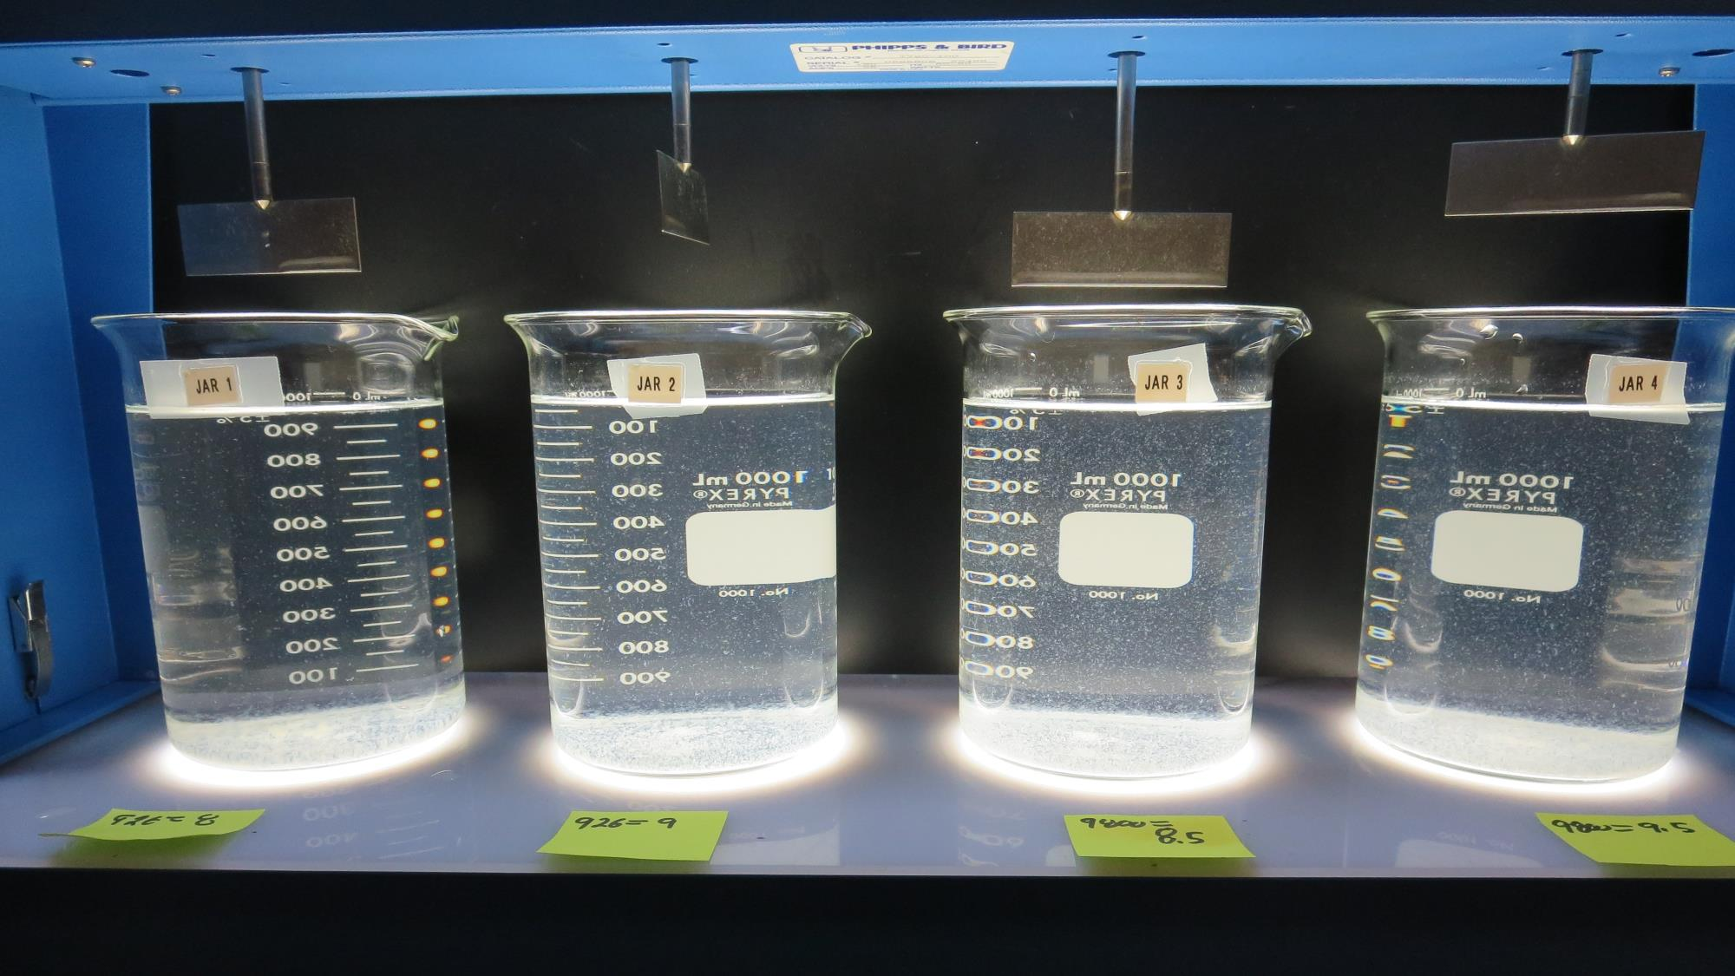
Jars 29-32: After 25-minutes of settling, settled water turbidity is taken.
8 mg/L CalChem
Filtrate 0.06 NTU
UVT: 97.2%
UVA: 0.012/cm
Settled: 2.8 NTU
9 mg/L CalChem
Filtrate 0.06 NTU
UVT: 97.2%
UVA: 0.012/cm
Settled: 2.8 NTU
8.5 mg/L 9800
Filtrate 0.05 NTU
UVT: 97.2%
UVA: 0.012/cm
Settled: 4.2 NTU
9.5 mg/L 9800
Filtrate 0.06 NTU
UVT: 97.2%
UVA: 0.012/cm
Settled: 4.0 NTU

Slide 45
Jars 33-36 Test Flash Mix 60 Sec (200 RPM) Floc Mix 15 min (30 RPM) Post-Ozone Source Applied Coagulants CalChem/9800

Slide 46
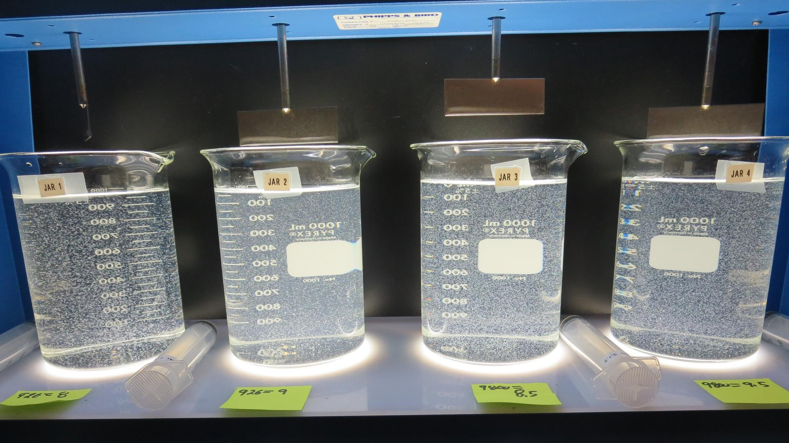
Jars 33-36: End of 15-minute flocculation (30 RPM) duration.
8 mg/L CalChem
Filtrate 0.12 NTU
UVT: 97.3%
UVA: 0.012/cm
Settled: 2.8 NTU
9 mg/L CalChem
Filtrate 0.22 NTU
UVT: 97.2%
UVA: 0.012/cm
Settled: 6.1 NTU
8.5 mg/L 9800
Filtrate 0.09 NTU
UVT: 97.2%
UVA: 0.012/cm
Settled: 2.7 NTU
9.5 mg/L 9800
Filtrate 0.05 NTU
UVT: 97.4%
UVA: 0.011/cm
Settled: 2.8 NTU

Slide 47
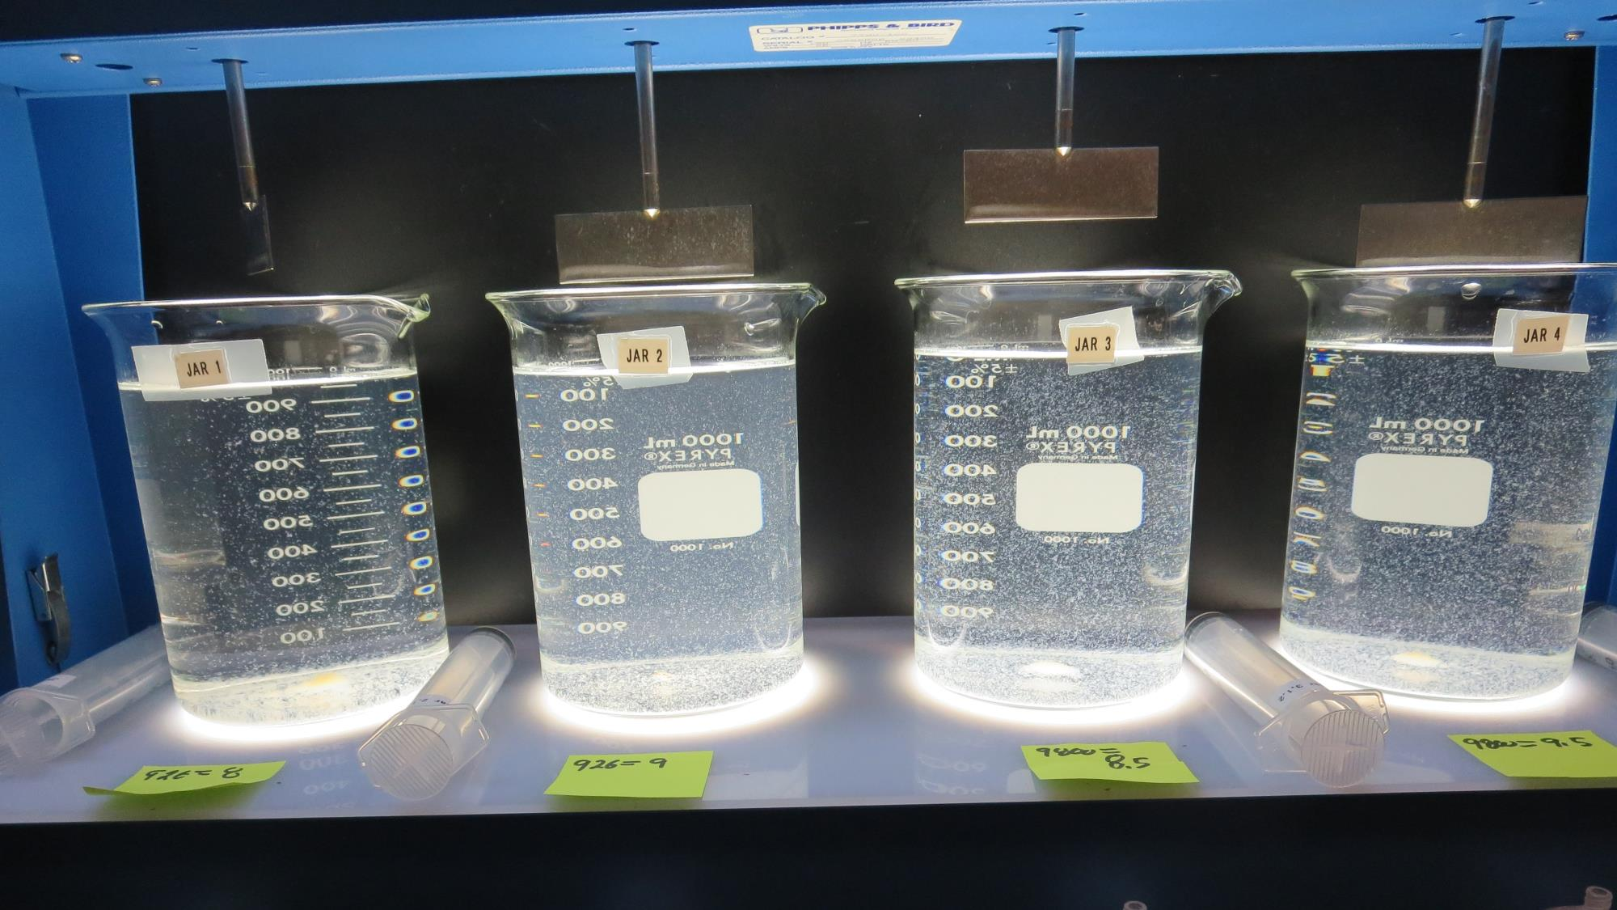
Jars 33-36: After 5 min of settling, 25 mL is syringed for filterability and %UVT/UVA

Slide 48
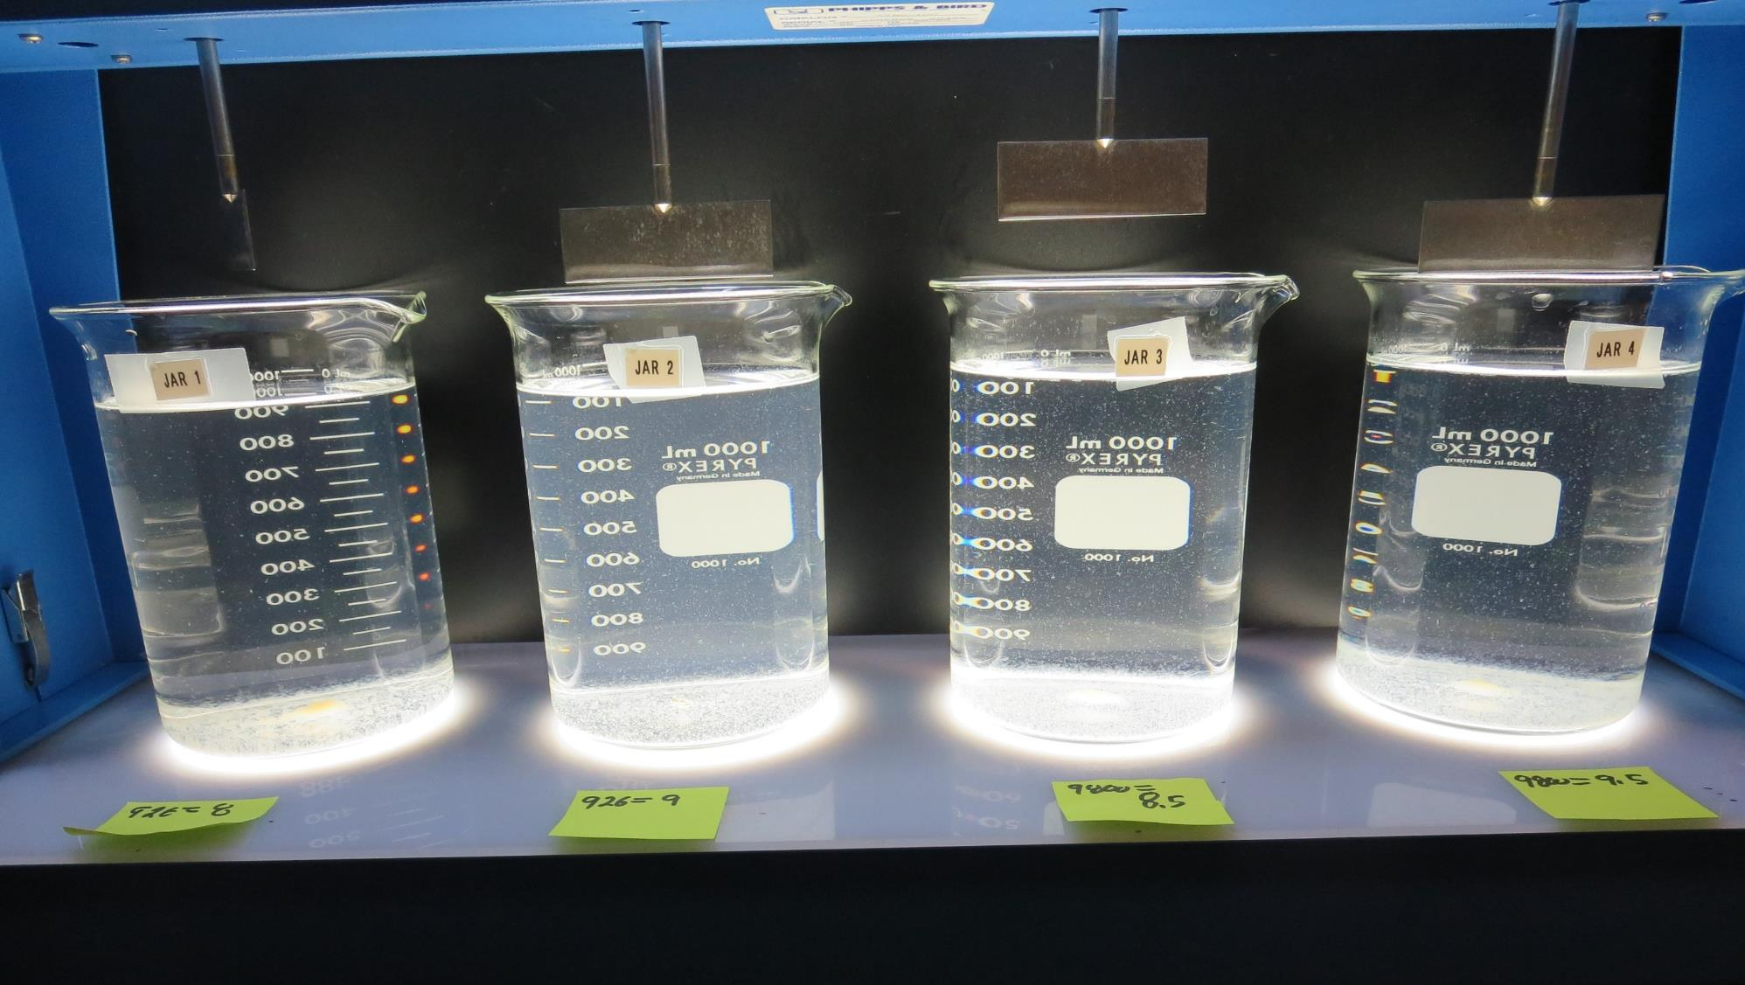
Jars 33-36: After 25-minutes of settling, settled water turbidity is taken.
8 mg/L CalChem
Filtrate 0.12 NTU
UVT: 97.3%
UVA: 0.012/cm
Settled: 2.8 NTU
9 mg/L CalChem
Filtrate 0.22 NTU
UVT: 97.2%
UVA: 0.012/cm
Settled: 6.1 NTU
8.5 mg/L 9800
Filtrate 0.09 NTU
UVT: 97.2%
UVA: 0.012/cm
Settled: 2.7 NTU
9.5 mg/L 9800
Filtrate 0.05 NTU
UVT: 97.4%
UVA: 0.011/cm
Settled: 2.8 NTU

Slide 49
Jars 37-40 Test Flash Mix 60 Sec (200 RPM) Floc Mix 10 min (30 RPM) Post-Ozone Source Applied Coagulants CalChem/CC 2000

Slide 50
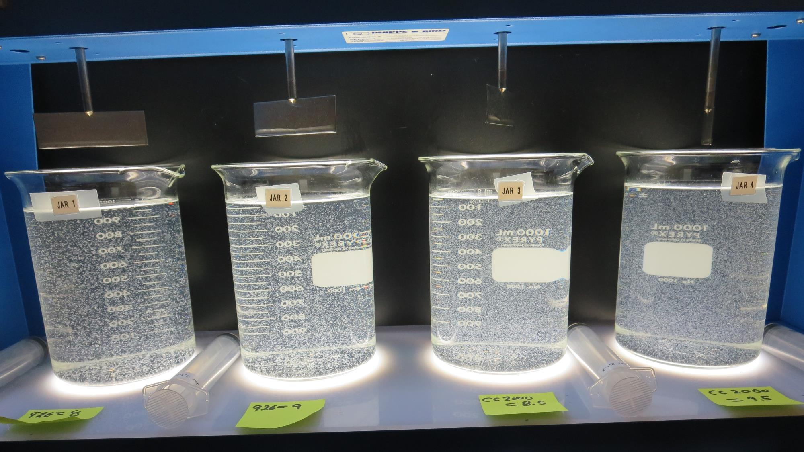
Jars 37-40: End of 10-minute flocculation (30 RPM) duration.
8 mg/L CalChem
Filtrate 0.06 NTU
UVT: 97.1%
UVA: 0.013/cm
Settled: 3.6 NTU
9 mg/L CalChem
Filtrate 0.12 NTU
UVT: 97.2%
UVA: 0.012/cm
Settled: 3.6 NTU
8.5 mg/L CC 2000
Filtrate 0.07 NTU
UVT: 97.3%
UVA: 0.012/cm
Settled: 3.2 NTU
9.5 mg/L CC 2000
Filtrate 0.12 NTU
UVT: 97.3%
UVA: 0.012/cm
Settled: 3. NTU

Slide 51
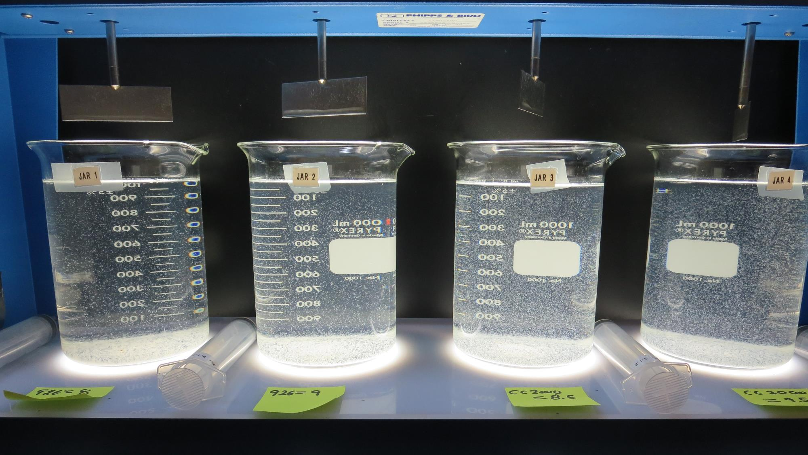
Jars 37-40: After 5 min of settling, 25 mL is syringed for filterability and %UVT/UVA

Slide 52
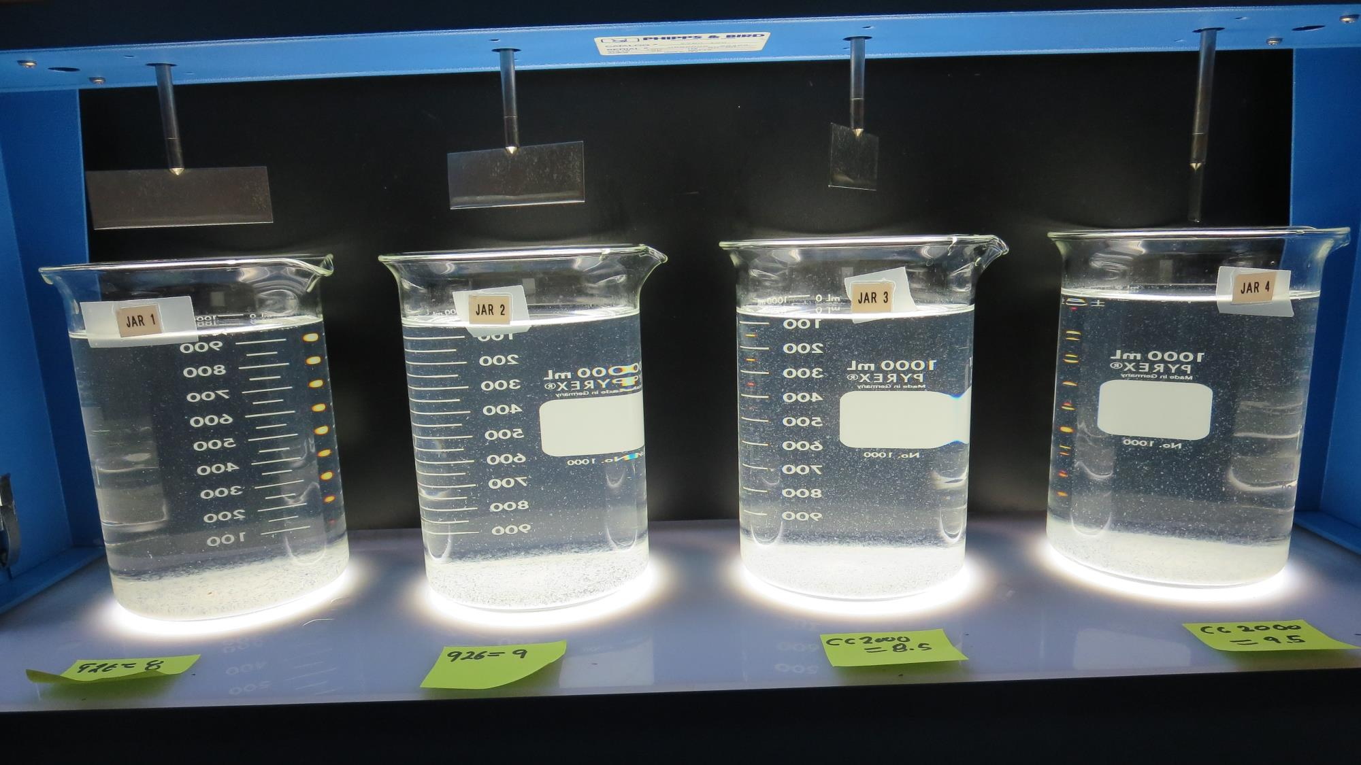
Jars 37-40: After 25-minutes of settling, settled water turbidity is taken.
8 mg/L CalChem
Filtrate 0.06 NTU
UVT: 97.1%
UVA: 0.013/cm
Settled: 3.6 NTU
9 mg/L CalChem
Filtrate 0.12 NTU
UVT: 97.2%
UVA: 0.012/cm
Settled: 3.6 NTU
8.5 mg/L CC 2000
Filtrate 0.07 NTU
UVT: 97.3%
UVA: 0.012/cm
Settled: 3.2 NTU
9.5 mg/L CC 2000
Filtrate 0.12 NTU
UVT: 97.3%
UVA: 0.012/cm
Settled: 3. NTU

Slide 53
Jar Testing for 1-Liter Jars: Procedures for Most Treatment Plants
Fill jars with source water prior to coagulant injection and set paddle speed at 30 rpm
Add chemicals (i.e., NaOCl, primary coagulant, coagulant aid) to each jar
Flash mix for 15-60 seconds (200 rpm)
Slow mix for 5 minutes (20-30 rpm)
Settled for 5 minutes. Syringe 25 mL from each jar taken 1-inch below surface (25 mL/12 sec rate)
Filtered through 1.2 um isopore membrane into cuvette drip rate, 15 mL/(50-90 sec)
Measure filtrate turbidity, chlorine residual and %UVT/UVA
Measure settled water turbidity after 25 minutes of total setting
Record all data

Slide 54
Jar Test Filterability Test Equipment
Turbidity Instrument
Syringe w/Luer-Lock Tip, 30 cc
(part#: 2225800, by Hach)
Swinnex Filter Holder, 25 mm (part#: SX0002500)
Isopore Membrane Filter, 1.2 um absolute
pore size,
Φ= 25 mm , thickness: 24 um,
hydrophilic polycarbonate membrane
(part #: RTTP02500)
Go to Sigma-Aldrich for laboratory supplies http://www.sigmaaldrich.com/united-states.html

Slide 55
Isopore Membrane Information
Categories | Information
trade name | Isopore
filter color | White
chemistry | Polycarbonate (PC)
water flow rate | Avg. 175 mL/min x cm² (typical results @ 10 psi)
media | Isopore®
wettability | Hydrophilic
porosity | 14.7%
pore size | 1.2 µm
bubble point at 23 °C | 1.0 bar, air with water
thickness | 24 µm
filter diameter (ø) | 25 mm
material size | polycarbonate, Hydrophilic, 1.2 µm, 25 mm, white, plain, 100

Slide 56
Isopore Membrane Background Information
The Isopore membrane is a polycarbonate, track-etched screen filter recommended for all analyses in which the sample is viewed on the surface of the membrane. The Isopore membrane is composed of polycarbonate film, which has a smooth, glass-like surface for clearer sample observation. The unique manufacturing process of the membrane ensures a precise pore diameter and a consistent pore size for accurate separation of samples by size. Matched-weight filters are not usually required because of low, constant tar and ash weights. Features & Benefits: Membrane structure retains particles on the surface, simplifying counting and analysis

Slide 57
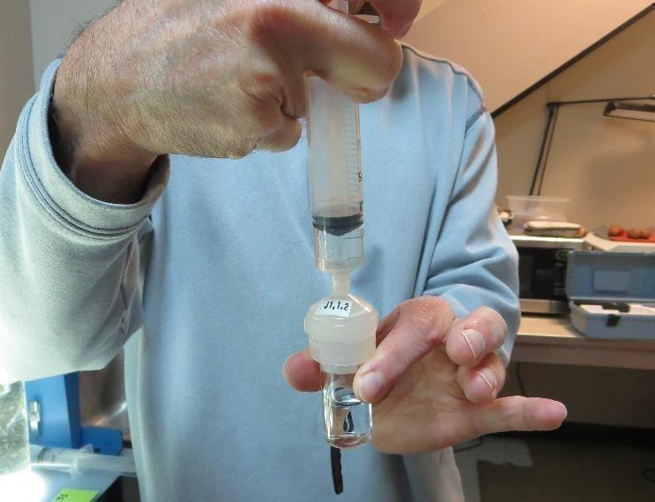
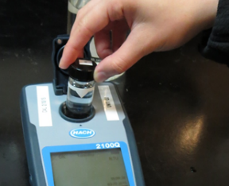
Jar Test - Filterability Test
Syringe ~ 25 mL from jar (after 5-minutes of settling)
Filter-to-waste 3-5 mL
Filter directly into clean cuvette
Measure turbidity
Note: Take several readings before recording final NTU results. Micro bubbles can adhere to glass causing false NTU readings. To remove bubbles, tilt cuvette up to 90 degrees.

Slide 58
Contact
Guy Schott, P.E.
State Water Resources Control Board
Division of Drinking Water
Santa Rosa, CA
Go to Stock Solution/Dose calculations/Jar Test Results for tools to download
www.waterboards.ca.gov/drinking_water/programs/districts/mendocino_district.html
Email: Guy Schott - Guy.Schott@waterboards.ca.gov
Office Number: 707-576-2732

