Slide 1
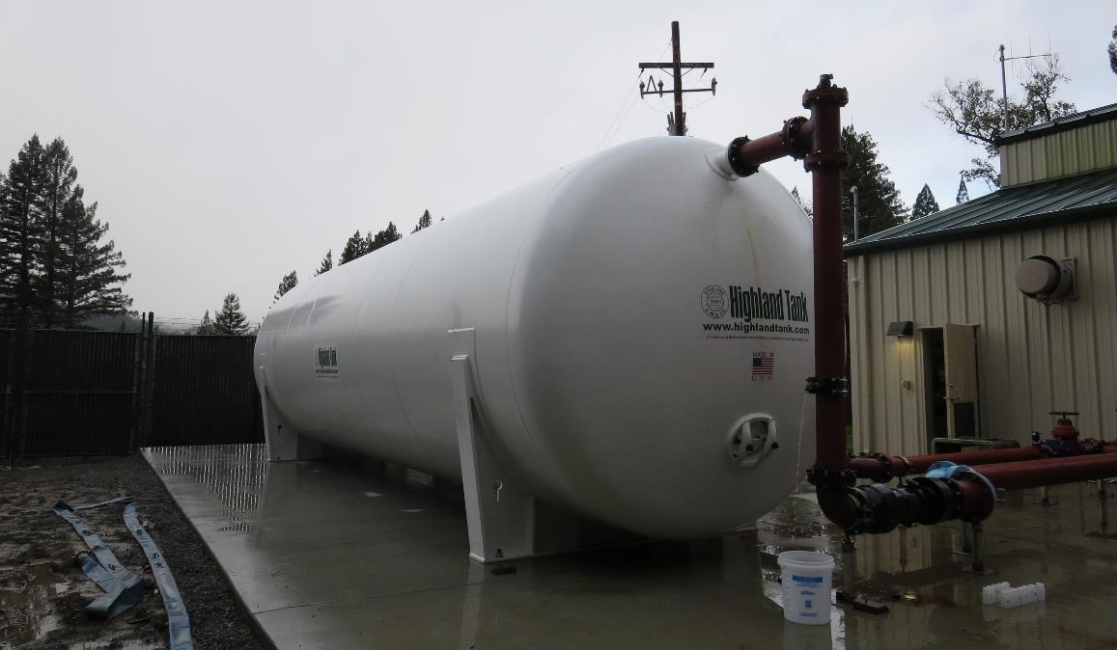
Garberville Sanitary District
CA1210008
Tracer Study
February 4, 2019
Tracer Study:
Reactor: Pressure Vessel
Volume: 20,000 Gallons
Diameter: 10 ft
Length: 36 ft
Baffled Tank (over/under)
Inlet/Outlet Full Perforated Baffles
Performed by:
Guy Schott, P.E.
CA Division of Drinking Water

Slide 2
Table of Content
Summary of Tracer Results
Reactor Design
Tracer Sample Locations
Graph 1: Modified Step-Dose Curve
Graph 2: Normalized Modified Step-Dose Curve to F-Curve
Purpose of a Tracer Test
Disinfection Exposure Time of Fluid in Vessel for Determining Ct₁₀
Ct₁₀ Value
Baffling Factor (BF)
Tracer Test Method
Method of Analysis and Equipment

Slide 3
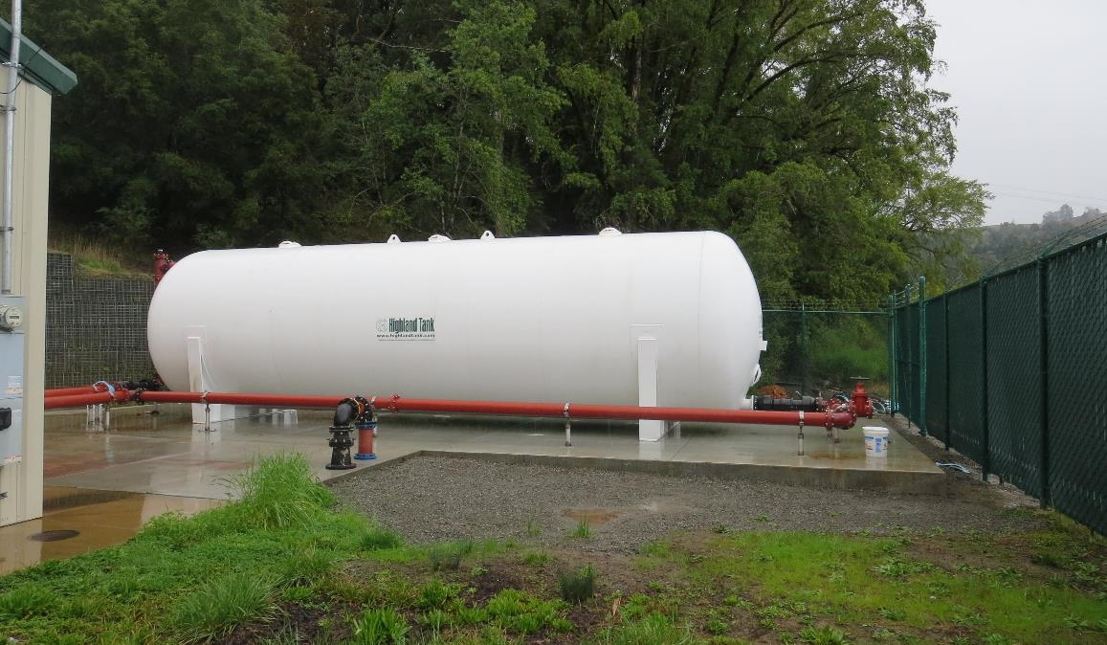
Garberville SD
Tracer Test Results
Modified Step-Dose
Test Date: 2/4/19
Baffling Factor (t₁₀/HRT): 0.54
Average Flow: 204 gpm
HRT: 98 minutes
t₁₀: 53 minutes
Tracer: Fluoride (2.55 mg/L)
Inlet Sample Frequency:
  5 gallon bucket (fill duration 4 -5 min)
  12 samples (6 – 59 min range)
Outlet Sample Frequency:
  0 – 40 min (4 min)
  40 – 69 min (1 min)

Slide 4
Horizontal Pressure Clearwell Design
The inlet baffled holes were plugged off except the 12 holes within the highlighted boundary.

Slide 5
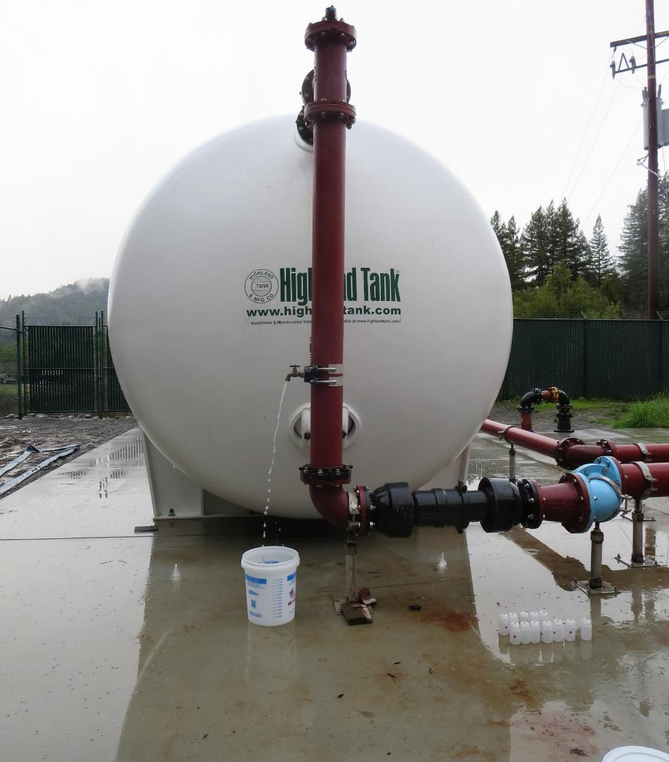
Inlet Tracer Sample Location
The applied tracer dosage is determined by grab sampling downstream of the tracer injection point before the tank inlet. Sample water is allowed to flow into a 5 gallon bucket for 4-5 minutes then sample is taken from bucket. This provides an average tracer dosage concentration. Samples are taken throughout the tracer study.

Slide 6
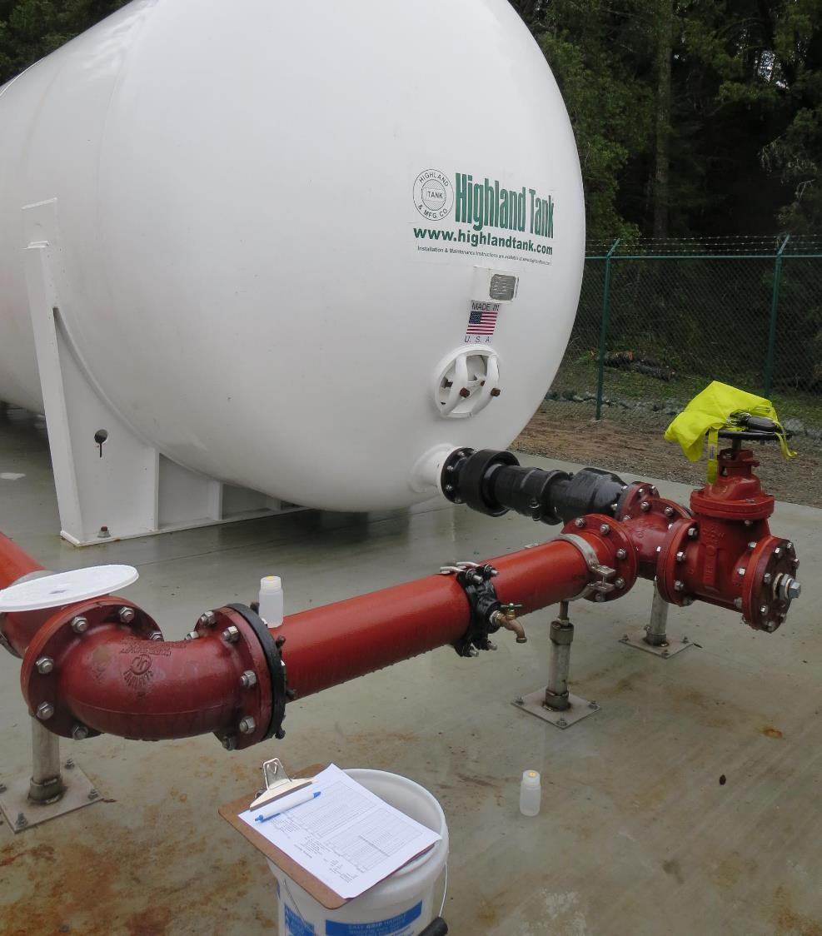
Outlet Tracer Sample Location
Samples are taken from the outlet to determine the time it takes for 10% of the applied tracer dosage to exit the tank. Sample frequency is increased in the time range of the expected 10% dosage mass.
Sample Frequency for this test:
0 – 40 minutes (4 minute intervals)
40 – 69 minutes ( 1 minute intervals)

Slide 7
Garberville SD – Modified Step-Dose Curve
Dosage: 2.64 mg/L
0.26 mg/L at t₁₀
t₁₀: 53 min
HRT: 98 min
t₁₀/HRT = 0.54

Slide 8
Garberville SD – Modified Step-Dose Curve Normalized to F-Curve
t₁₀/HRT = 0.54

Slide 9
Purpose of a Tracer Study
To determine the hydraulic efficiency or disinfectant exposure time of water through one or more reactors.
The addition of known quantities of a nonreactive chemical (tracer) is added in the form of a pulse (slug) or step-input.
The time of travel or disinfectant exposure time through the reactor is related to:
  Flow rate
  Reactor water volume
  Water Depth
  Reactor configuration

Slide 10
Disinfection Exposure Time of Fluid in Vessel for Determining Ct₁₀
“C” is the disinfectant residual (mg/L) at the point of inactivation compliance.
The disinfection exposure time of water used for Ct₁₀ calculation is the time (t₁₀) it takes for 10 percent of the water entering the reactor to exit the reactor.
To determine this, a marker (nonreactive tracer) is introduced into the water and is monitored leaving the reactor.
Example: 1.0 Kg of tracer is slug-dose; t₁₀ is that time when 0.1 Kg of tracer material (10%) has exit the reactor.

Slide 11
Ct₁₀ Value
- Log inactivation is based on the Delivered Dose, “Ct₁₀”
  “C” is the disinfectant residual (mg/L)
  “t₁₀” is the exposure or contact time (minutes)
  Multiply them:
C • t₁₀ = mg/L • min (delivered dose)
The calculated Ct₁₀ value is looked up in EPA Ct tables to determine the log inactivation based on specific monitoring parameters (pH, disinfectant residual and/or temperature).

Slide 12
Baffling Factor (BF)
Baffling factor or short-circuiting factor:
  Determined from tracer study or estimated
  BF = t₁₀/ HRT from tracer study
  HRT (hydraulic residence time) = reactor volume divided by reactor flow
Once the BF is determined, then it is applied to the operations of the reactor for determining the disinfectant exposure time.
Example:
  Clearwell operating volume: 20,000 gallons
  Exit flow: 200 gpm
  BF: 0.50, from tracer study
  Calculated contact or disinfection exposure time:
    20,000 gal ÷ 200 gpm × 0.50 = 50 minutes = t₁₀

Slide 13
Test Method
Modified Step-Dose Method
It is a continue feed of tracer at constant rate and plant flow throughout the duration of the test. The “Step-Dose” test is run to 3-4 HRT to achieve reactor outlet steady-state tracer concentration. The time “t₁₀” is determined when 10% of the tracer dose concentration has exist the reactor. The “Modified Step-Dose” test allows the test to be completed in less than 1 HRT by physical measurements of the tracer inlet flow concentration to verify dosage.

Slide 14
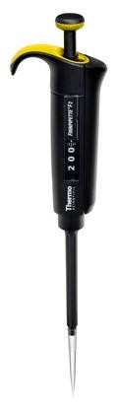
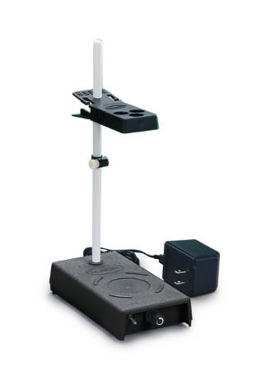
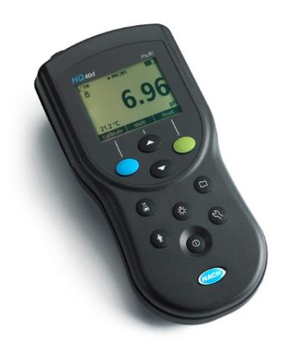
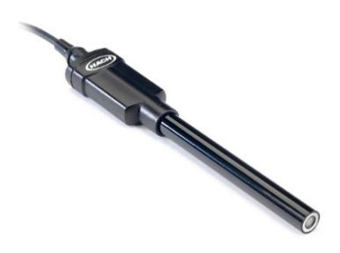
Method of Analysis and Equipment
Intellical™ ISEF121 Fluoride (F⁻) Ion Selective Electrode (ISE)
HQ40d Portable ISE Multi-Parameter Meter
Fluoride Ionic Strength Adjustor (ISA)
Fluoride Standards (0.2/2.0 & 0.5/ 5.0 mg/L)
50 mL graduated cylinder
Finnpipette F2 variable volume pipette, capacity 0.5 - 5 mL
Electrode stirrer stand
50 mL beakers
Stir Bar, Magnetic, Polygon

Slide 15

Contact
Guy Schott, P.E.
State Water Resources Control Board
Division of Drinking Water
Santa Rosa, CA
Guy.Schott@waterboards.ca.gov
707-576-2732

