Slide 1
Gualala Community Services District
Wastewater Treatment Plant
Sonoma County, CA
Modal Contact Time (t_{modal})
Tracer Study #3
August 9, 2017
by Guy Schott, P.E.
Water Resources Control Board,
Division of Drinking Water
Guy.schott@waterboards.ca.gov
707-576-2732

Slide 2
Chlorine Contact - Pipeline
Pipeline volume: 21,500 gallons
Pipeline diameter: 48-inches (4 feet)
Pipeline length: 229 feet
Material: concrete (buried)
L:D ratio: 57
Treated water flows from: Sea Ranch and Gualala
Orifice Pipeline: 1.5” PVC, 80-ft, 1/8” holes spaced 18 inches

Slide 3
Final Results
Test Date: August 9, 2017
Test by: GCSD & WRCB, Division of Drinking Water
Tracer Test Method: Slug-Dose using Fluoride
Reactor Tested: Concrete Pipeline (underground)
Pipeline Length & Diameter (D): 229 ft & 48 inches (4-ft)
L:D Ratio: 57
Pipeline Volume (Vol_{Pipe}): 21,500 gallons (operating volume)
Flows to Modal Contact Time: 20-140 gpm (63 gpm weighted avg)
Weighted Avg Test Flow: 63 gpm (based on total test duration)
HRT: 340 minutes (5.7 hours, based on total test duration)
t_{modal}: 210 minutes (to peak fluoride concentration @ 63 gpm)
Cumulative Volume (Vol_{cum}) to t_{modal}: 13,300 gallons (treated)
Modal Baffling Factor: 0.62 (Vol_{cum}/Vol_{pipe})
Calculated Field Modal Time:
Ct_{modal-cal}: Cl₂ x t_{modal-cal}

Slide 4
Tracer Study – Overview 1
On August 9, 2017 a third tracer study was conducted at the Gualala CSD WWTP. This test was to evaluate the modal contact time for the underground 4-ft diameter concrete pipeline (229-ft) for a recently installed orifice pipeline jetting system. In Manhole B was installed a ½ HP submersible pump attached to a 80-foot long, 1.5-in diameter PVC pipe with 1/8 orifices spaced 18-inches to promote mixing within the 21,500 gallon underground concrete pipeline. The modal contact value (t_{modal}) is that time at which the slug-dose curve is at its peak concentration.
The modal contact time for Tests 1 and 2 was 90 minutes (without pipeline jetting system) and 210 minutes for Test 3.

Slide 5
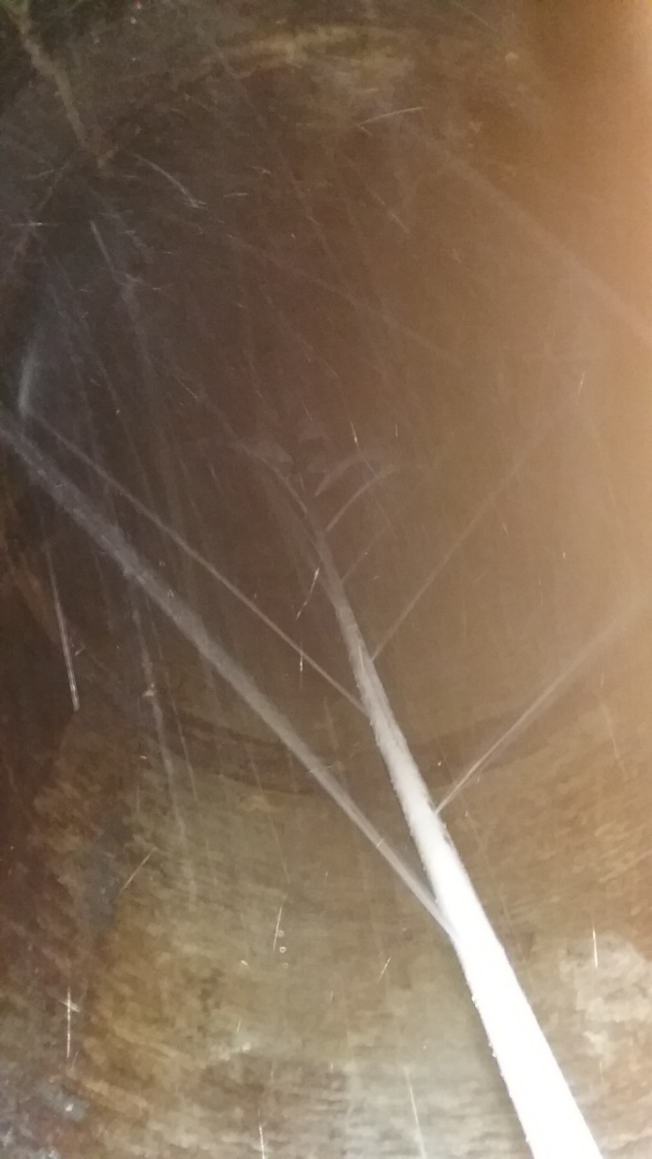
Shown is empty concrete
pipeline with installed PVC piping and orifices.

Slide 6
Tracer Study – Overview 2
Tracer Method: Slug-Dose
Injection Point of Tracer: Poured into filter overflow weir connected to 8-inch line
Sample Point: Pipeline outlet (Manhole “B”)
Tracer Analysis: Ion Selective Fluoride Probe
Sampler: Gualala CSD Operators
Analyses by: Guy Schott, Division of Drinking Water

Slide 7
Tracer Material Overview
Tracer Material: Hydrofluorosillicic Acid (H₂SiF₆)
Tracer Bulk Density: 10.3 lbs/gal
Tracer Product Strength: 24% as H₂SiF₆
Molecular Weight: 144.09 g/mole (H₂SiF₆)
Fluoride Concentration: 79.11% (144 g/mole)
H₂SiF₆ Tracer Added: ~2.7 lbs. (1,000 mL)
Fluoride mixed w/2.5 gal of water in bucket
Fluoride (F) Tracer Added: 0.517 lbs. (224 g)
Method of Injection: Slug-Dose (poured, < 20 sec)

Slide 8
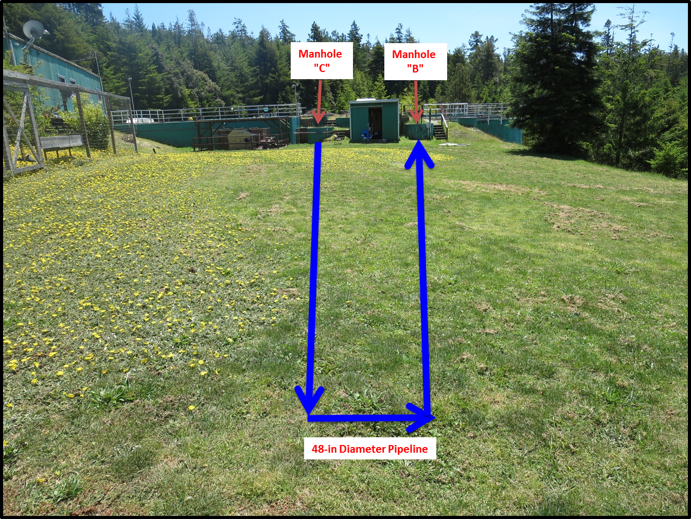
Pipeline Contactor (21,500 gallons)
Added
Tracer
Tracer
Sampling

Slide 9
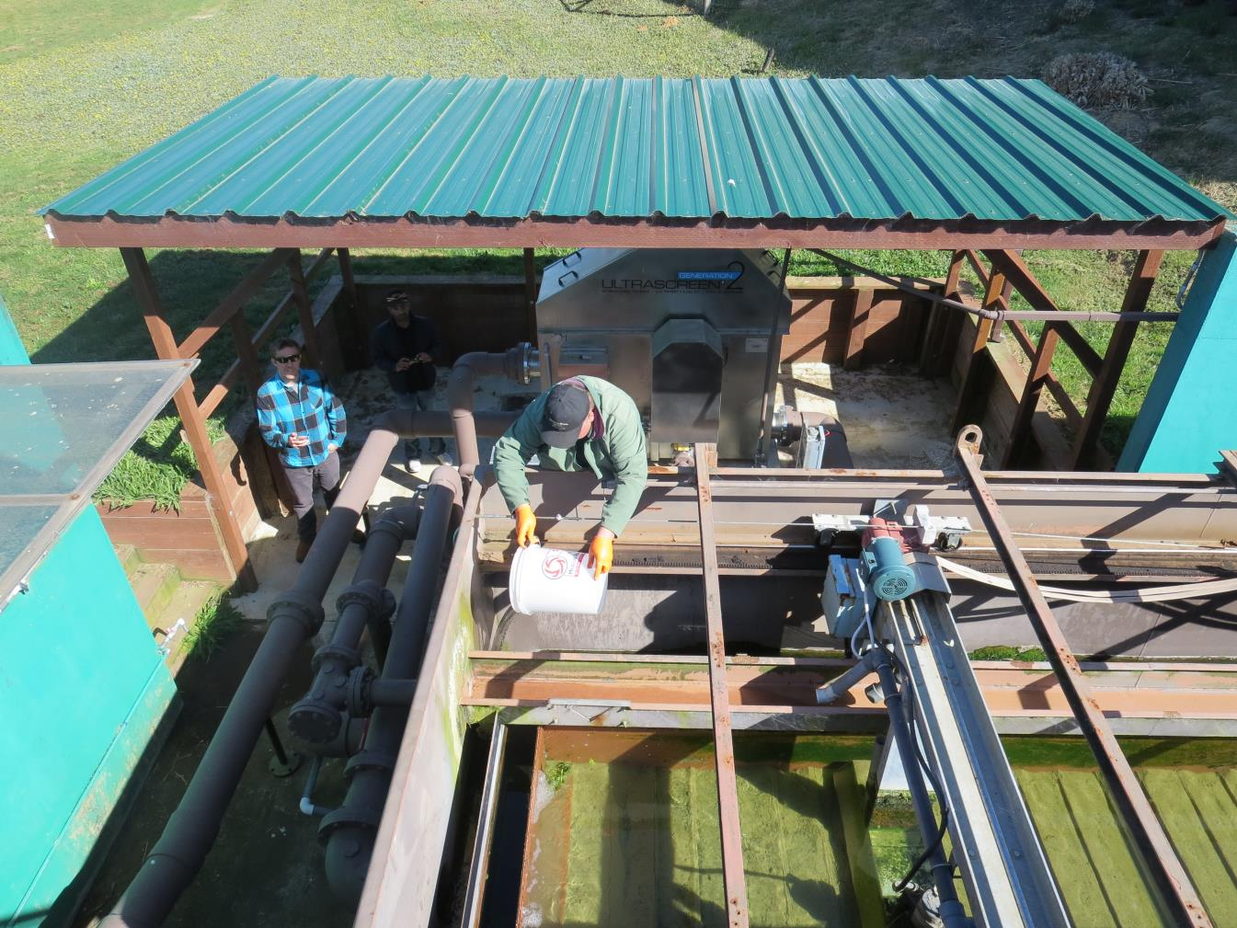
Tracer Slug-Dose
Adding
Tracer

Slide 10
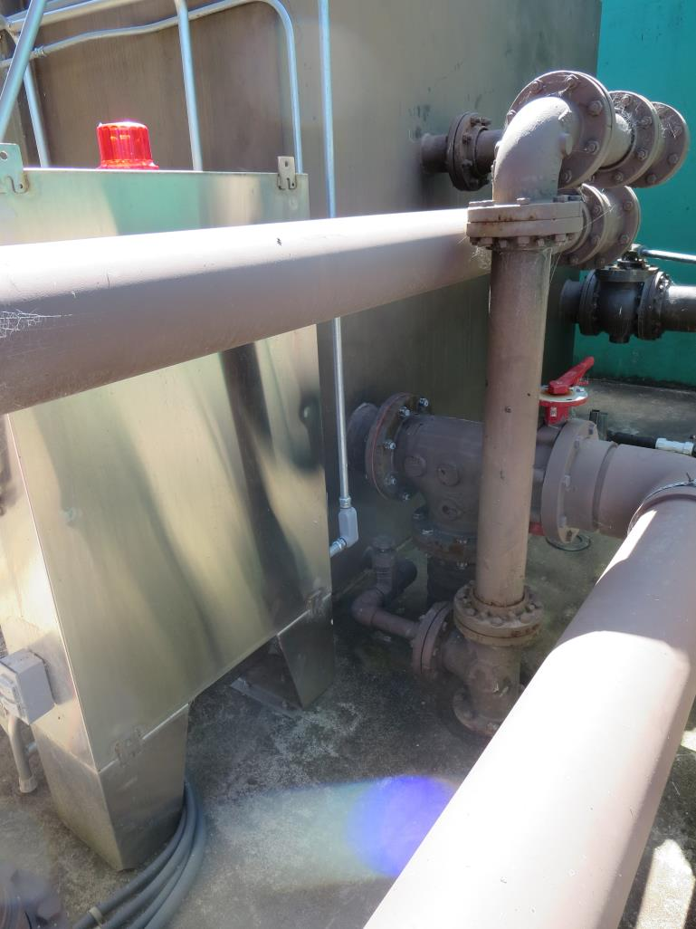
Hydraulic Tracer Mixing
After tracer is poured into effluent filter trough, the mixed water flows into an 8-in line to Manhole “C”.

Slide 11
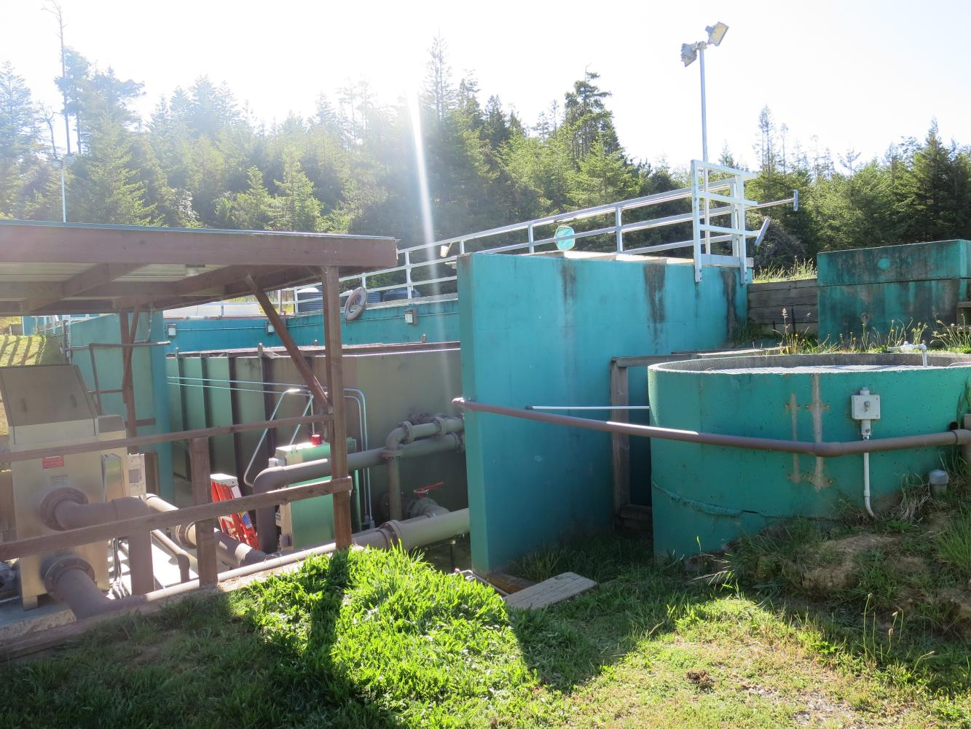
Manhole “C” Entry to Pipeline
Manhole
“C”

Slide 12
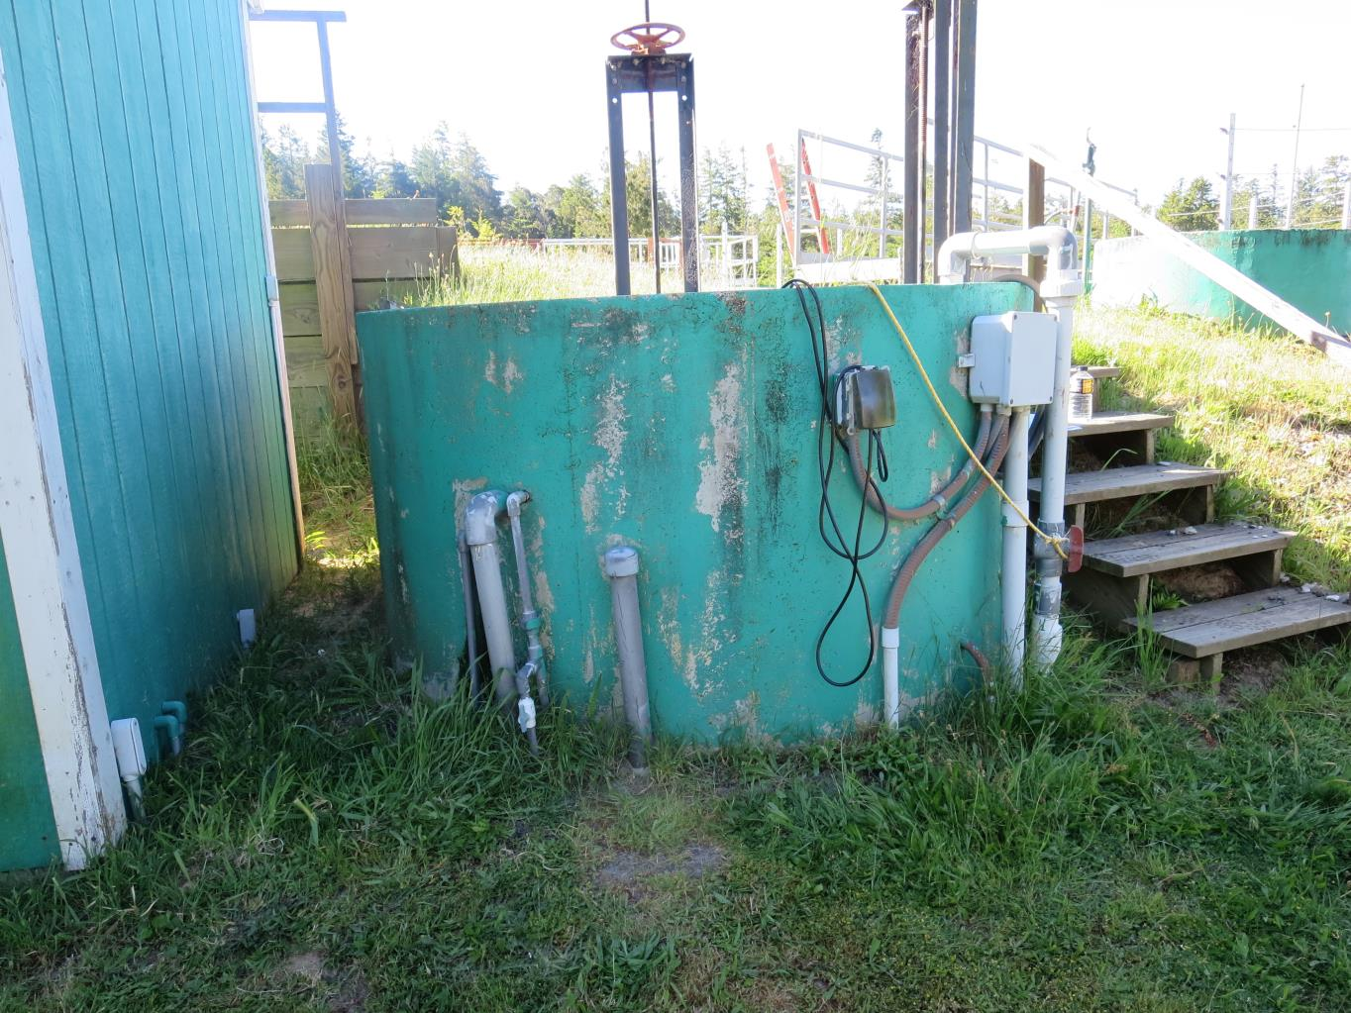
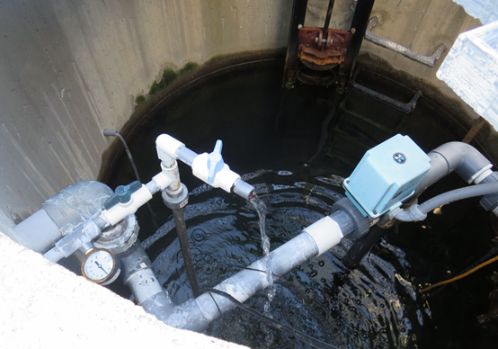
Manhole “B” Pipeline Exit - Sample Station
Manhole
“B”
Sample Tap

Slide 13
Tracer Field Results

Slide 14
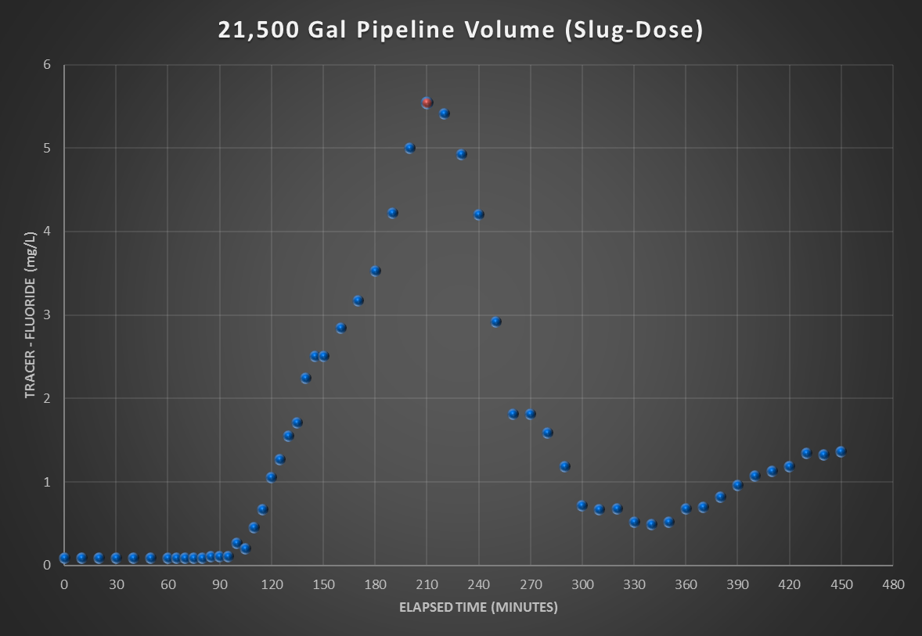
Average Flow Test Duration: 63 gpm
HRT: 340 minutes
t_{modal}: 210 minutes
Average flow up to t_{modal}: 63 gpm

Slide 15
Tracer Study – Conclusion
With the installation of the 80-ft pipeline orifice spray system, the modal contact time increased from 90 to 210 minutes. It appears that temperature stratification was eliminated in the first 80 feet of pipe section. To maintain the modal contact time, the orifice sprayer will need to operated anytime the treatment plant is in service for achieving disinfection compliance.
Additional contact time may be improved by installing the same orifice sprayer on the pipeline connected to Manhole “C”.

Slide 16
Manhole
“C”
Manhole
“B”
Mixing Zone
Flow Manitude
48-in Pipeline

