Slide 1
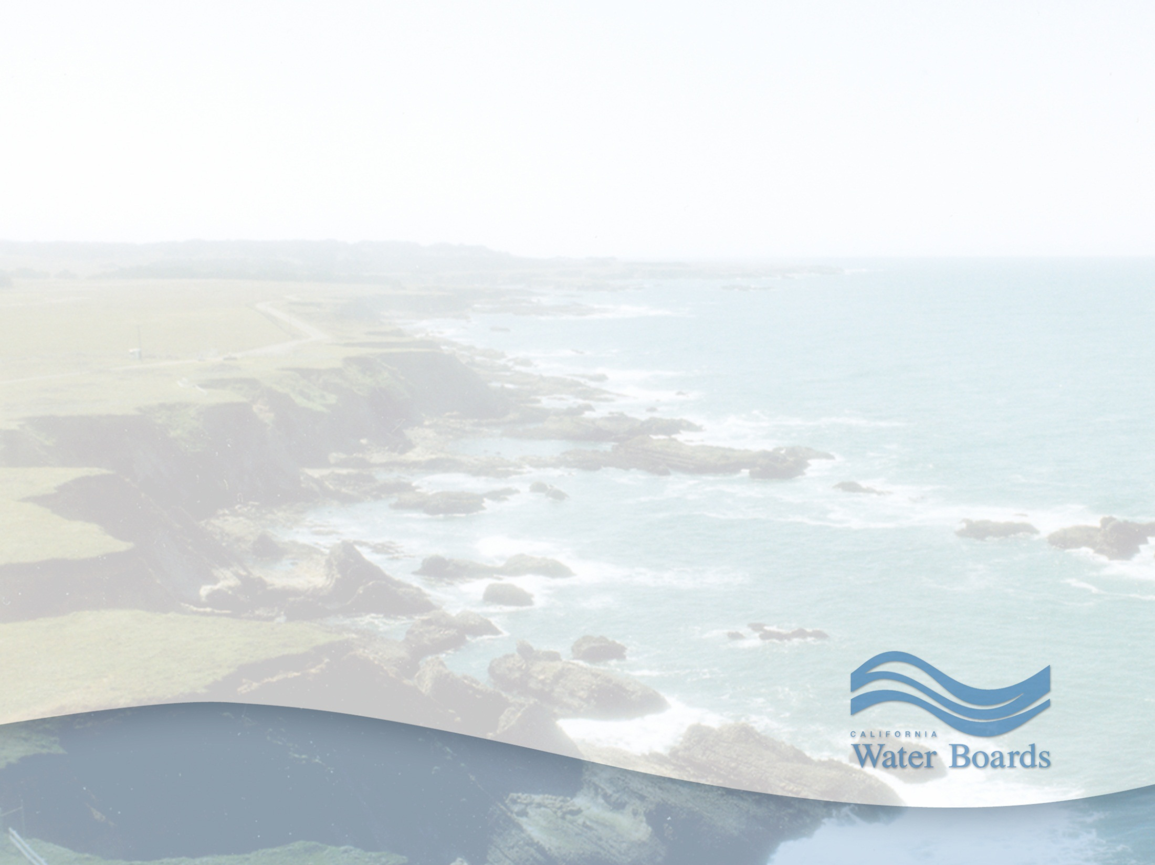
Waste Discharge Requirements for Cold Water Concentrated Aquatic Animal Production Facility Discharges to Inland Surface Waters, Enclosed Bays and Estuaries
Item No. 5
Order No. R1-2021-0010
Justin McSmith, NPDES Unit WRCE
June 17, 2021
Notes:
Good morning Chairman Guisti, members of the Board. My name is Justin McSmith and I am an Engineer in your NPDES Unit and current caseworker for the Cold Water Concentrated Aquatic Animal Production General Order (also known as the CAAP General Order. I want to express my gratitude for the co-operation between regional water board staff and the California Department of Fish and Wildlife, who are our only enrollees. We have met on a number of occasions during the development of this NPDES Permit and that time together has been invaluable in producing the quality documents in front of you today.

Slide 2
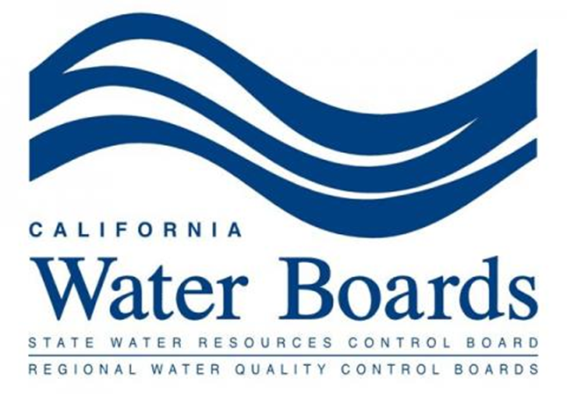
Overview
Coverage Eligibility
Facility Locations
Proposed NPDES General Permit
Key Comments
Staff Responses to Comments
Changes in Response to Comments
Recommendation
Notes:
During this presentation I will discuss the current CAAP (say full name not acronym and state you will refer as CAAP moving forward) Facility enrollee locations, the new permit requirements in the Proposed Permit in front of you today, the key comments received during the public comment period, staff’s responses to those comments and the changes made to the proposed permit in response to the public comments. Finally, I will provide my recommendation to the board.

Slide 3
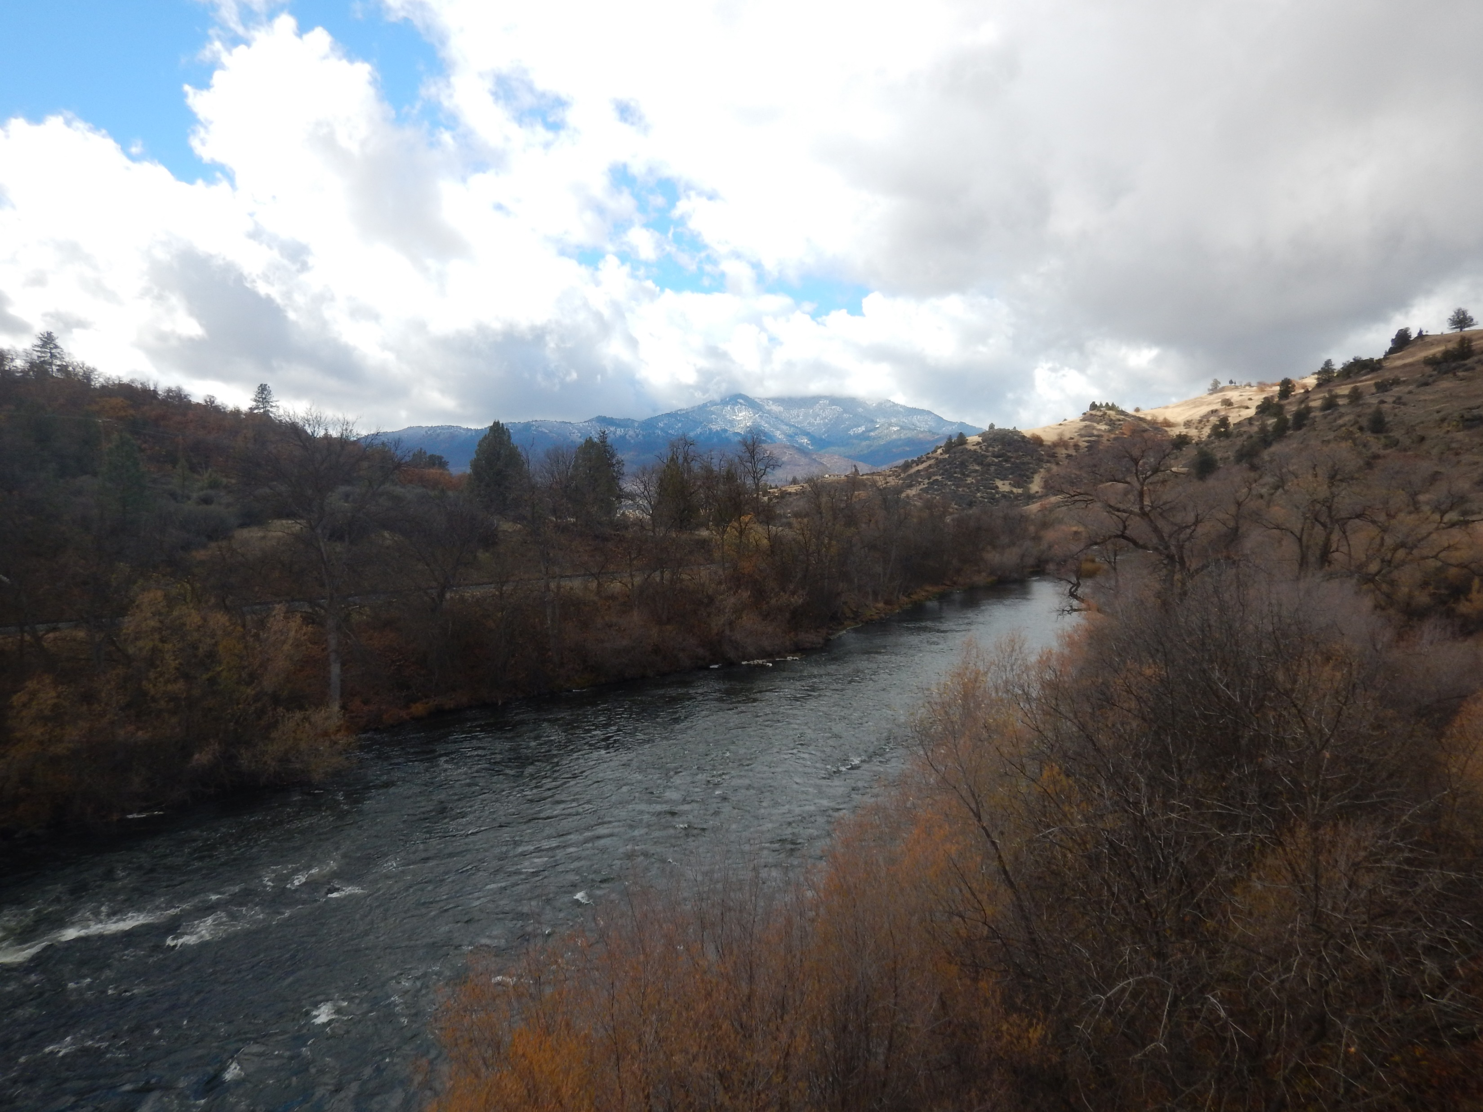
Coverage Eligibility
Eligible Facilities
Inland Surface Waters, Enclosed Bays and Estuaries Only
Klamath River
Notes:
Eligibility - To be eligible for coverage under this General Order, a hatchery, fish farm, or other facility must contain, grow, or hold cold water fish species or other cold-water aquatic animals in ponds, raceways, or other similar structures. Facilities covered by this General Order discharge at least 30 calendar days per year, produce at least 20,000 pounds harvest weight of aquatic animals per year, and feed at least 5,000 pounds of food during the calendar month of maximum feeding. Facilities that do not meet the above criteria may also be designated a cold water CAAP facility upon determination that the facility is a significant contributor of pollution to waters of the United States. However, CAAP Facilities discharging to the Pacific Ocean are not eligible for enrollment under this Order.
ISWEBE – The Proposed Permit is only for discharges from CAAP Facilities to inland surface waters, enclosed Bays and Estuaries. We contemplated included potential Ocean dischargers in the Proposed Permit, but the inclusion of Ocean Plan requirements and Inland surface waters requirements made the General Order too broad.

Slide 4
Notes:
Facility Locations:
The current enrollees are Mad River Hatchery in Humboldt County, Trinity River Hatchery in Trinity County, Warm Springs Hatchery at the base of Sonoma Lake in Sonoma County and Coyote Valley Fish Facility at the base of Lake Mendocino in Mendocino County. All current enrollees are land-based aquaculture facilities. Mad River Hatchery is a recirculating aquaculture facility while the other three are flow through aquaculture facilities. All facilities are operated and managed by CDFW.

Slide 5
Proposed General NPDES Permit
Minimal changes from the previous general permit
Dissolved Oxygen Receiving Water Limitations
Chemical Controls, Verification Monitoring and Reporting Plan only for New Enrollees
Notes:
There were minor changes from the previous permit to the permit in front of you. The Facilities operations have not changed since the last permit term and there was no reasonable potential for new effluent limitation. The Proposed Permit retains effluent limitations for total suspended solids and settleable solids, implementation of Best Management Practices Plan as required by Effluent limitation Guidelines promulgated by the EPA and effluent and receiving water monitoring for constituents of concern.
One new change to the permit is the addition of the Dissolved Oxygen receiving water limitation that you have seen included several times in previous NPDES permits brought before you. The dissolved oxygen limitation in the proposed permit reflects the new Basin Plan dissolved oxygen water quality objectives for the protection of the spawn beneficial use.
Another subtle change to the permit is that only new enrollees need to submit a Chemicals Controls, Verification Monitoring and Reporting Plan. The current enrollees that I spoke about above have already submitted this Plan to provide information on potential toxicity in the discharge.

Slide 6
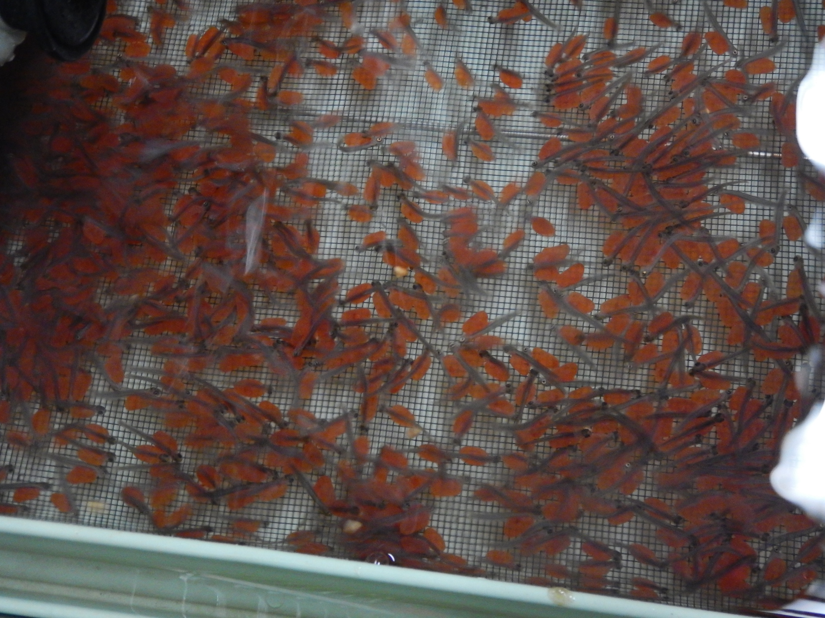
Key Comments
Basin Plan Discharge Prohibition
Priority Pollutant Sampling
Hardness Sampling Frequency
Carcass Disposal
Recently hatched salmon in the Hatchery Building
Notes:
These are the key comments from the comment period. I will touch on each of these in slides to come. There is a robust response to comments document that includes detailed responses to each one.
Regional Water Board staff received a single comment letter from the California Department of Fish and Wildlife who are the current enrollees under the CAAP General Order.
Key Comments on the Proposed General Permit are related to a discharge prohibition from the Basin Plan’s POLICY ON THE REGULATION OF FISH HATCHERIES, FISH REARING FACILITIES, AND AQUACULTURE OPERATIONS (also known as the Hatchery Policy), Priority Pollutant Sampling requirements, Receiving water hardness monitoring frequency and a new disposal method for carcasses at Trinity River Hatchery.

Slide 7
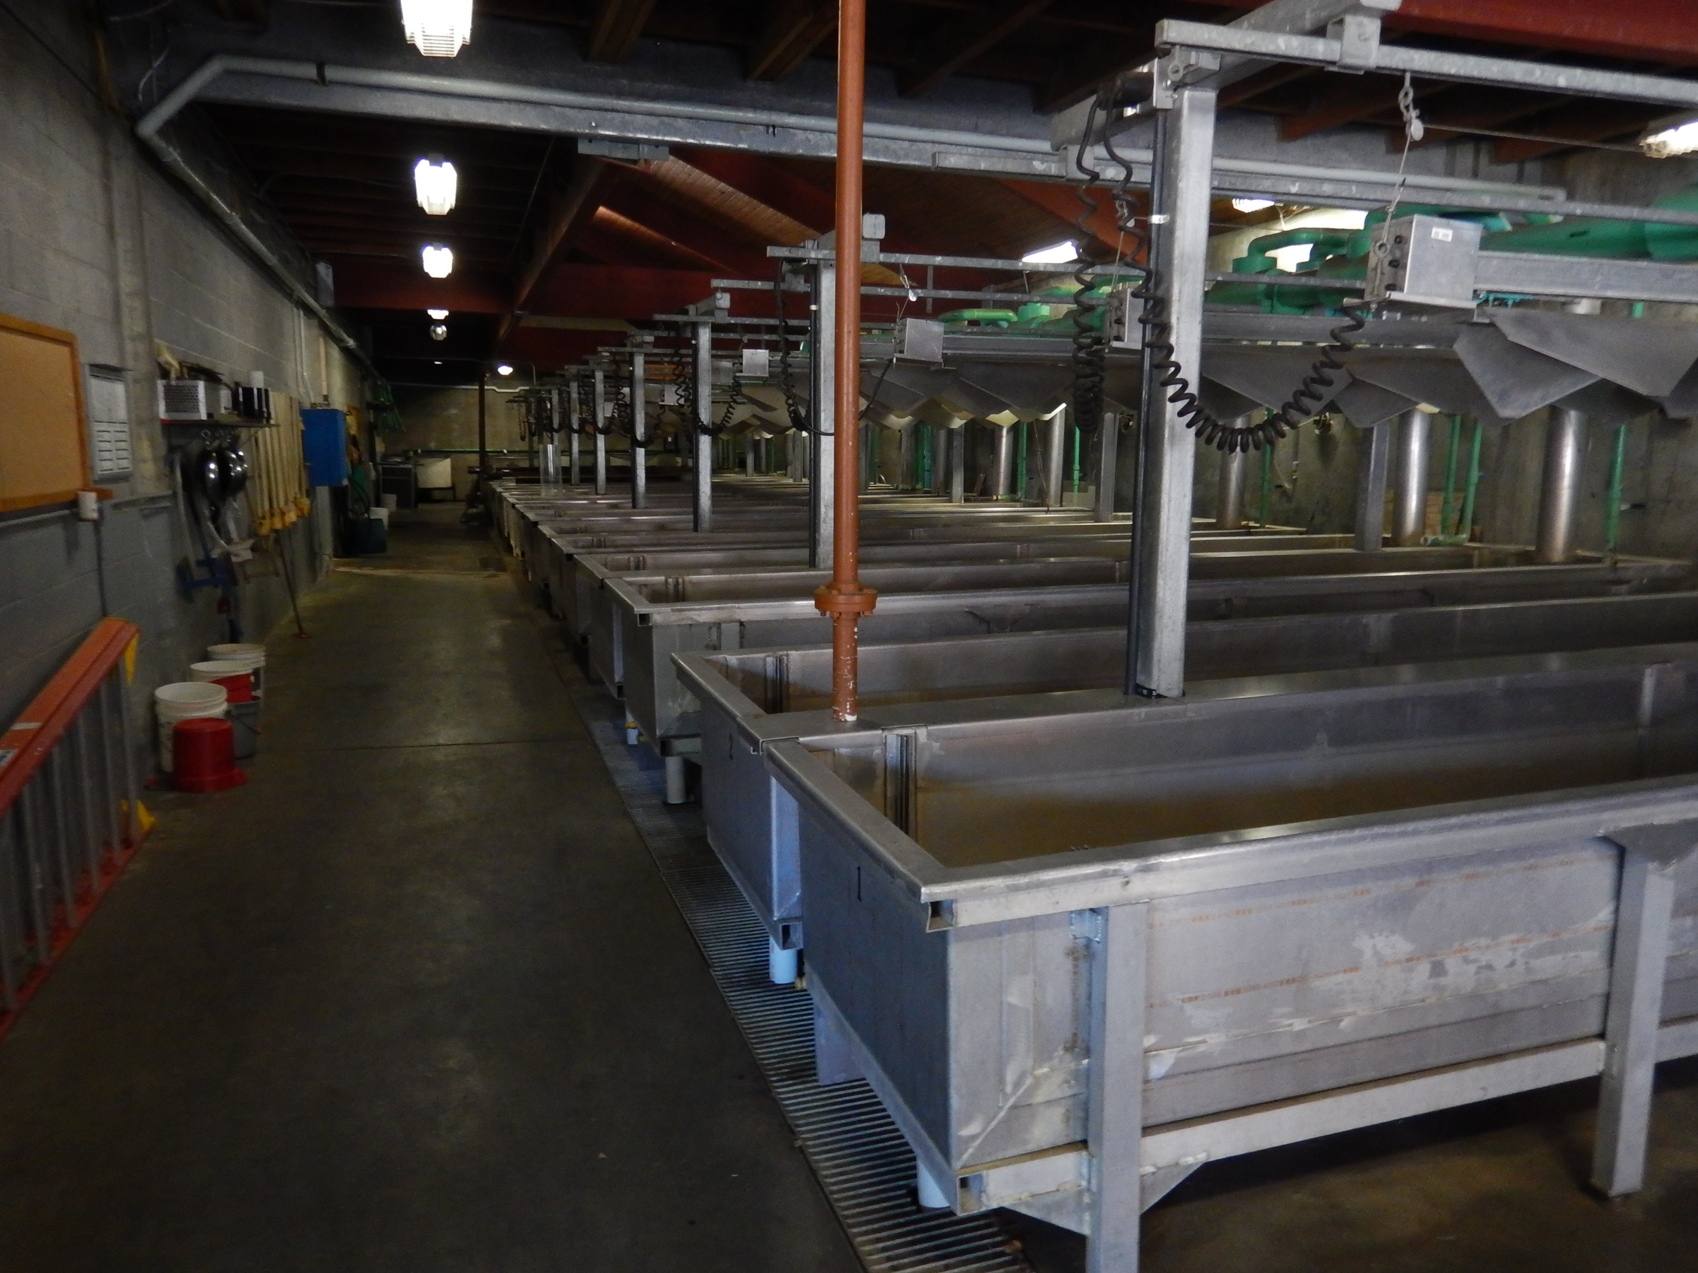
Basin Plan Discharge Prohibition
Policy on the Regulation of Fish Hatcheries, Fish Rearing Facilities, and Aquaculture Operations
The discharge of detectable levels of chemicals used for the treatment and control of disease, other than salt (NaCl) shall be prohibited.
Hatchery building at Warm Springs Hatchery
Notes:
As noted above, the discharge prohibition is contained in the Basin Plan’s Hatchery Policy and prohibits “the discharge of detectable levels of chemicals used for the treatment and control of disease, other than salt (NaCl)”.
A main concern expressed by CDFW is the ability for CAAP facilities to comply with the prohibition on discharge of detectable levels of chemicals used for the treatment and control of disease. With improvements to laboratory and field tests, CDFW is concerned with its ability to meet lower detection limits for such chemicals.

Slide 8
Basin Plan Discharge Prohibition
Prevent Discharge of Chemicals at Levels that (a) cause toxicity, (b) exceed water quality objectives, or (c) otherwise impair beneficial uses.
Chemical Verification Monitoring and Reporting Plan – Review to Assess Compliance with the Discharge Prohibition
The Discharge Prohibition of chemicals and drugs other than salt has been retained in the Proposed General Order
Notes:
Staff continues to believe that it is reasonable to conclude that the Hatchery Policy is best applied in a manner to prevent discharge of chemicals at levels that (a) would cause toxicity, (b) exceed water quality objectives, or (c) otherwise impair beneficial uses.
During the term of the previous General Order, each enrollee submitted a Reduction and Verification MRP. The data submitted as part of the Reduction and Verification MRP have shown that there is not reasonable potential for the enrollee’s discharge to cause or contribute to toxicity in the receiving waters and staff interpreted these results as compliant with the Hatchery Policy prohibition.
RWB Staff intends to inspect each CDFW hatchery and meet with CDFW staff and discuss compliance with a discharge prohibition.
The Discharge prohibition of chemicals and drugs other than salt has been retained in the Proposed General Order.

Slide 9
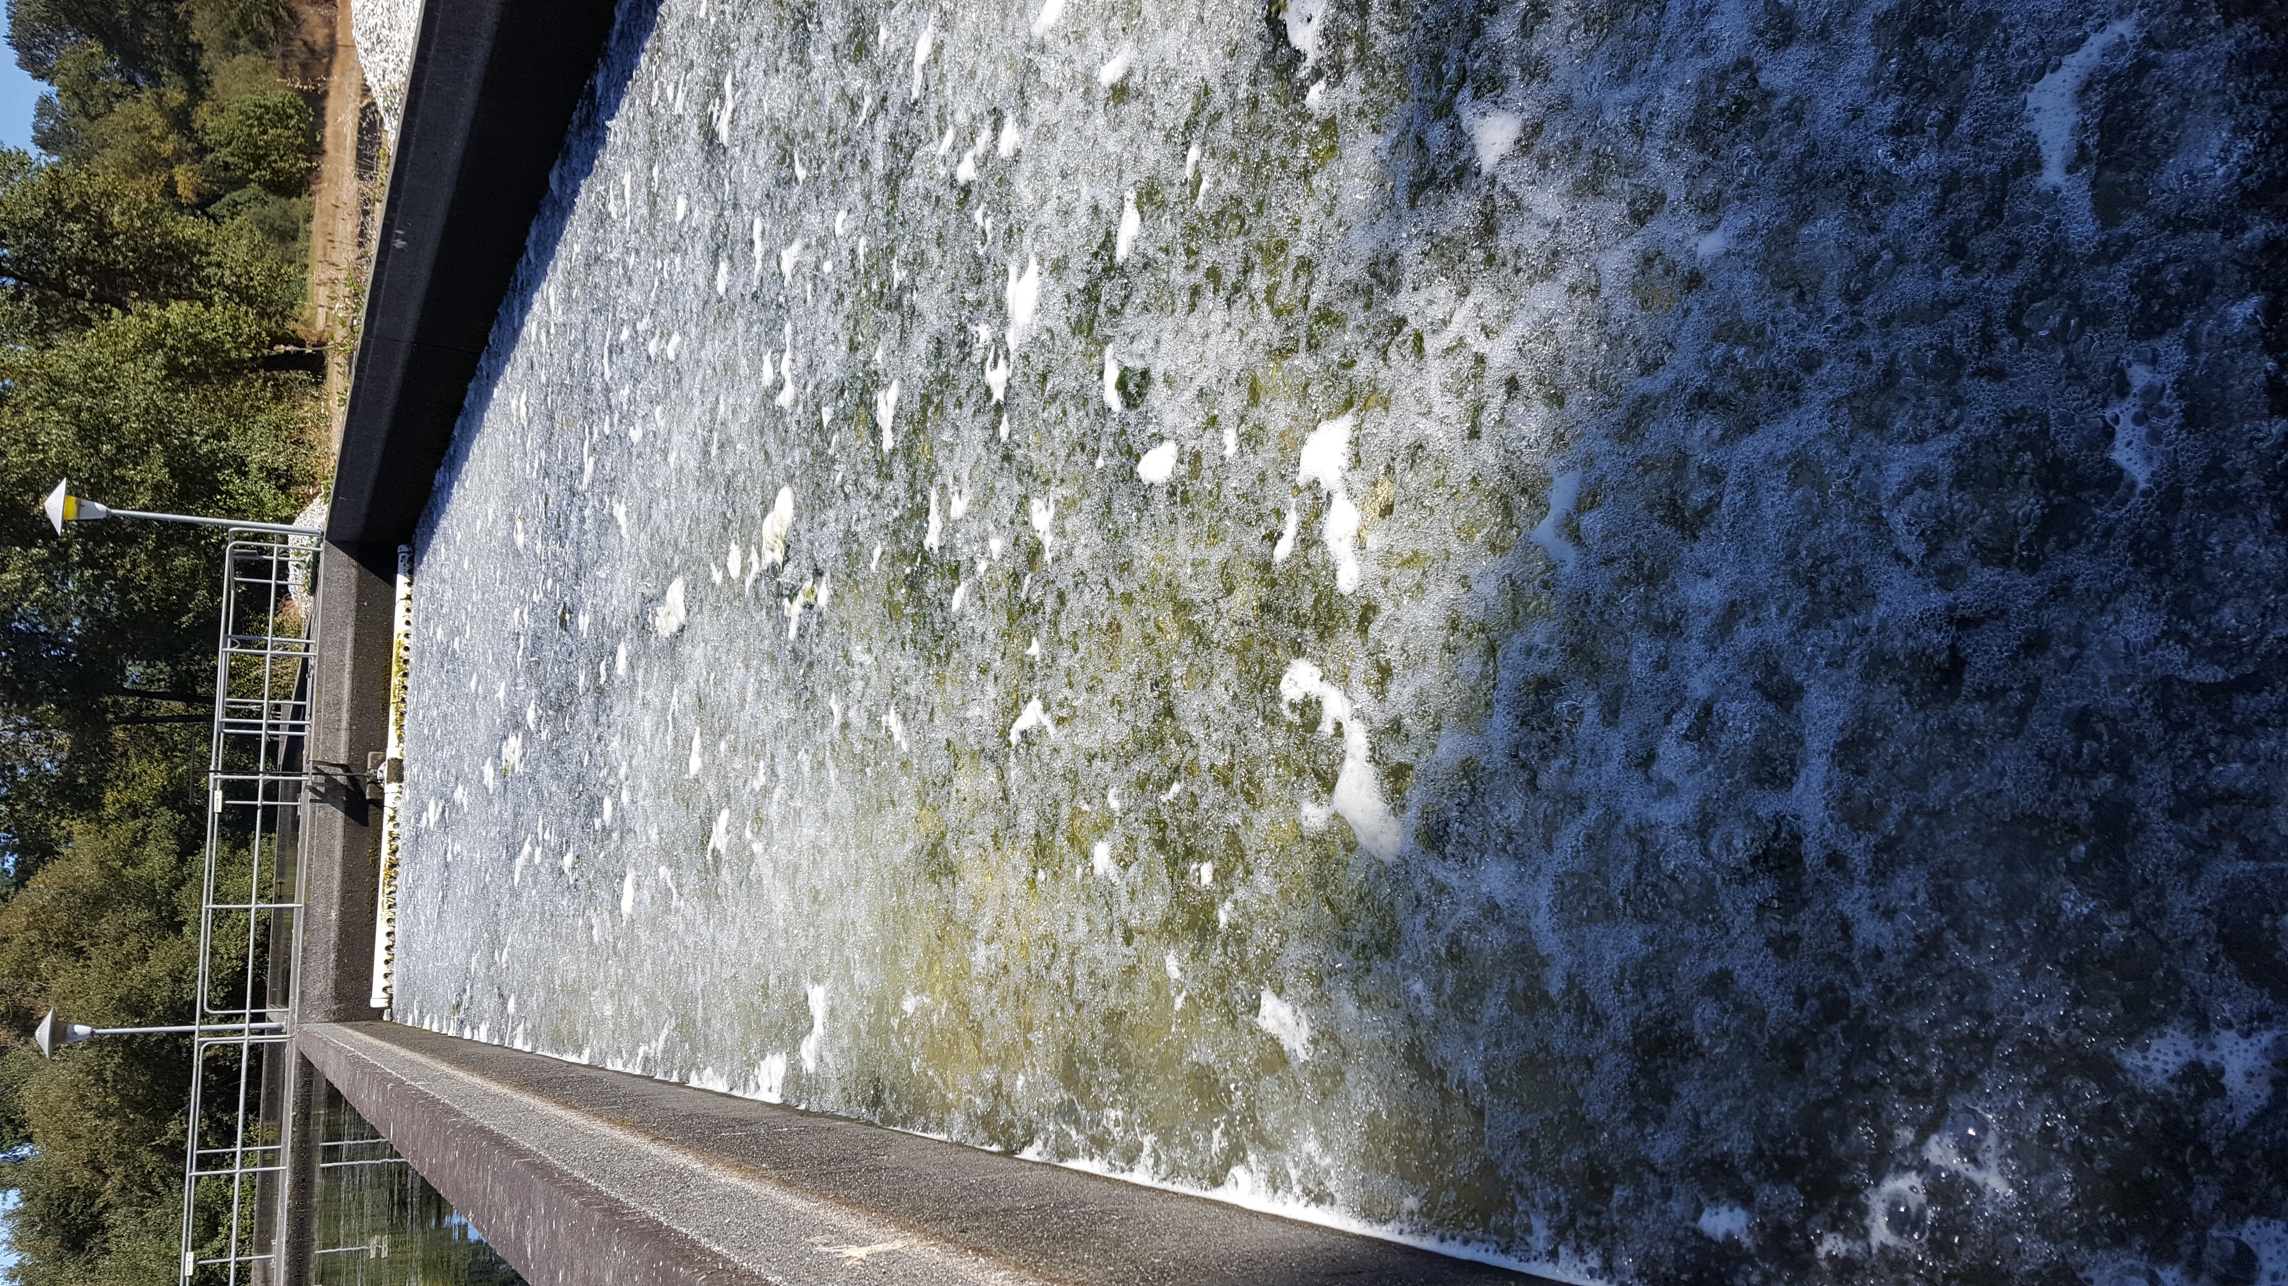
Priority Pollutant Sampling
Permit Requires 126 Priority Pollutant Scan
CDFW Requested for Metals Only Priority Pollutant Scan
A full priority pollutant scan has been retained in the Proposed General Order, as required by the SIP.
Oyster Shell Filter at Mad River Hatchery
Notes:
The Permittee contends that sampling for all 126 CTR Priority Pollutants is excessive, is an unnecessary additional cost, and is inconsistent with NPDES permits for fish hatcheries throughout the rest of the state. There is no Reasonable Potential of exceedance of the most stringent water quality objectives for more than 116 of the listed Priority Pollutants. The Permittee requested to sample for only 14-20 Priority Pollutant Metals, depending on the watershed, (i.e., Antimony, Arsenic, Barium, Beryllium, Cadmium, Chromium (III), Chromium (VI), Copper, Cyanide, Iron, Lead, Manganese, Mercury, Nickel, Selenium, Silver, Thallium, Zinc) 1x during the permit cycle.
Staff acknowledges that the Permittees’ historical priority pollutant data, collected during the previous permit term, shows that discharge of priority pollutants other than metals are unlikely. However, the Policy for Implementation of Toxics Standards for Inland Surface Waters, Enclosed Bays, and Estuaries of California (SIP) requires monitoring for all 126 priority pollutants.
Specifically, the SIP states, “The RWQCB shall require periodic monitoring (at least once prior to the issuance and reissuance of a permit) for pollutants for which criteria or objectives apply and for which no effluent limitations have been established; however, the RWQCB may choose to exempt low volume discharges, determined to have no significant adverse impact on water quality, from this monitoring requirement.”
The Facilities currently enrolled under the previous Hatchery General Order do not meet the qualifications for exemptions for low volume dischargers. Therefore, all 126 priority pollutants are required to be sampled once during the Proposed Permit

Slide 10
Hardness Sampling Frequency
Draft Order Required Quarterly Hardness Sampling for Five Years
CDFW Requested Quarterly for One Year
Proposed General Order reduces sampling from Quarterly for Five Years to Quarterly for Two Years
Notes:
The Draft Permit required quarterly sampling over the life of the permit term.
CDFW requested that hardness be measured 4 times, 1 in each Quarter for 1 year only, to verify the season with the lowest hardness.
Staff reduced hardness monitoring to two years of quarterly sampling. This will still provide a robust and variable enough data set for reasonable potential analysis of hardness dependent metals while also reducing sampling and operation costs.

Slide 11
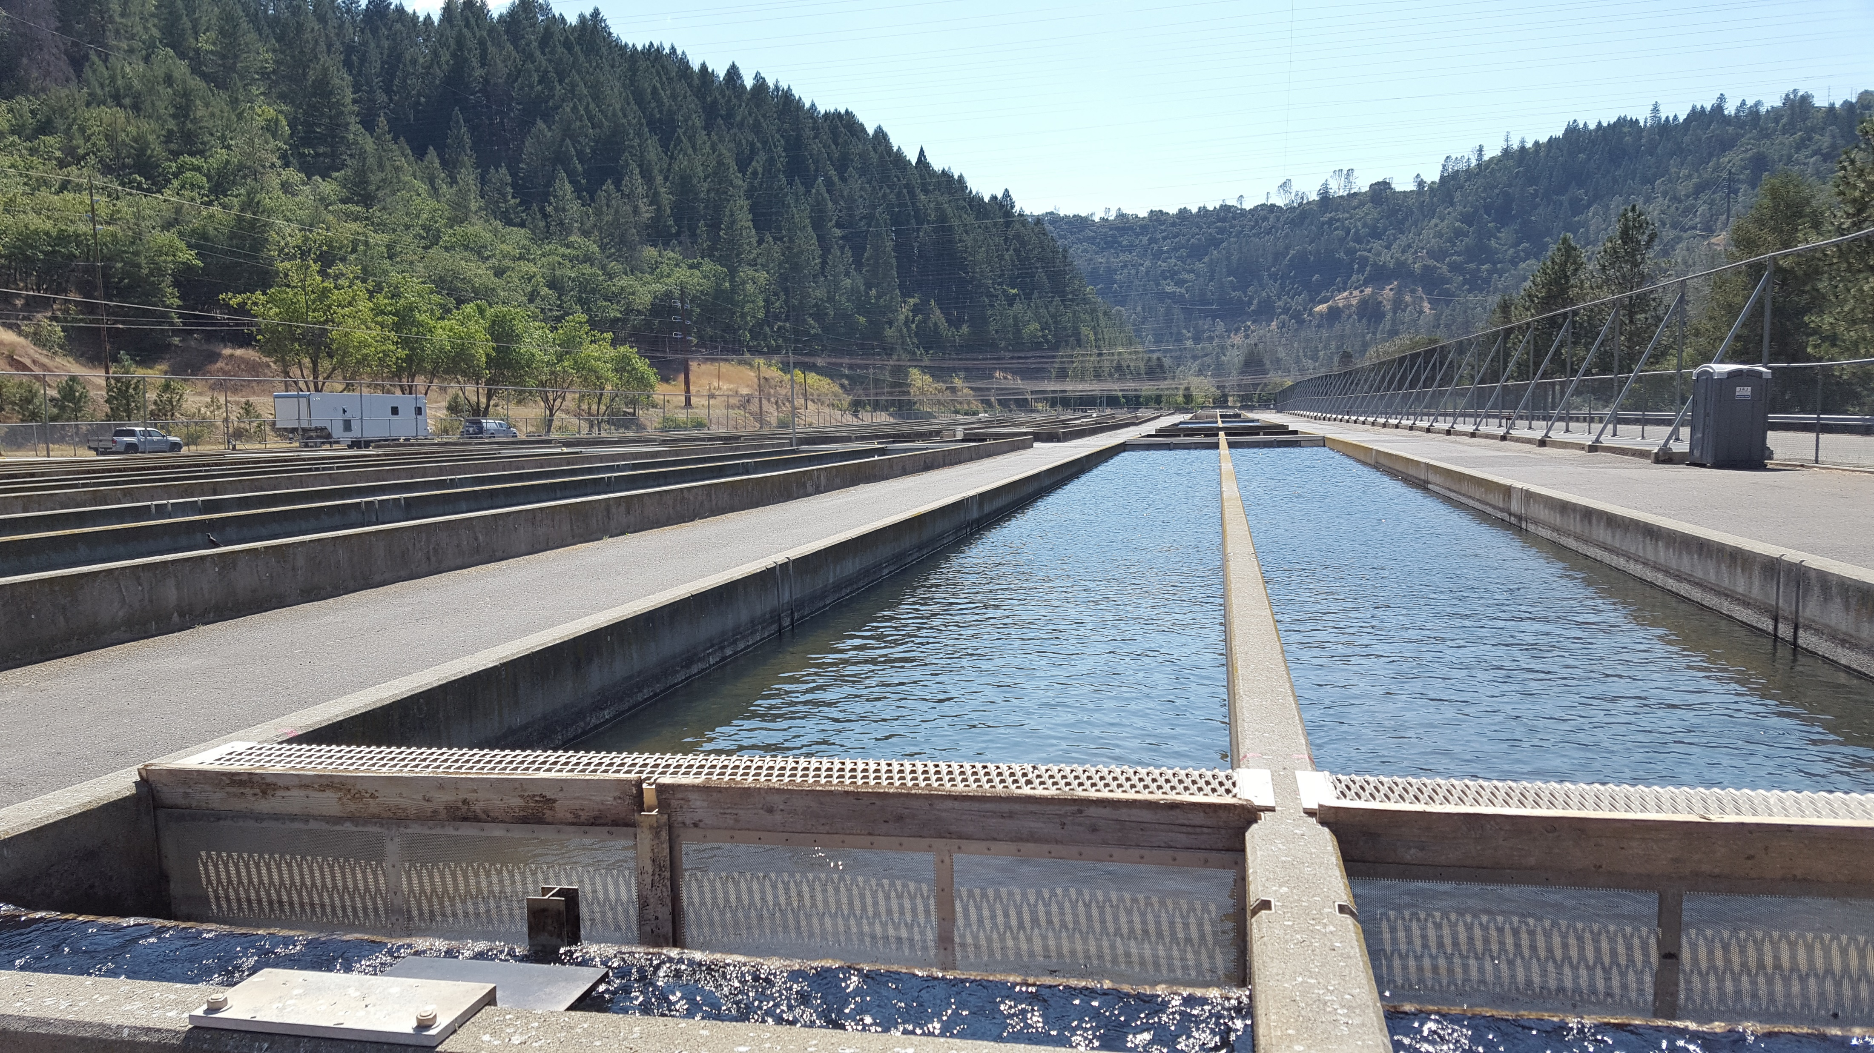
Carcass Disposal
CDFW Requested Carcass Disposal in Trinity River
Proposed General Order Amended to Accommodate Carcass Disposal via a Notice of Intent Submittal
Production raceways at Trinity River Hatchery
Notes:
The Draft Permit included language that stated, “The application to land of collected screenings and other solids, including fish carcasses is not covered or authorized by this Order”.
The Permittee requested to return a small portion of fish carcasses to the Trinity River in response to a TRH Biological Opinion from the National Marine Fisheries Service (NOAA) that states that some salmon carcasses will be placed into the tributaries during the winter to increase Marine Derived Nutrients.
I am going to read an excerpts from the Trinity River Hatchery Biological Opinion (BO): NMFS recommends that the Permittee begin to distribute as many salmon and steelhead carcass from TRH as possible within the mainstem Trinity River and tributaries of the Trinity River. This is expected to substantially improve conditions for individual rearing of endangered Coho salmon, as well as their critical habitat. The flesh from decaying salmon and marine derived nutrients are an important component of healthy salmon stream and would greatly improve the ecology of the river system including benthic macroinvertebrates that Coho salmon prey upon, riparian plant species, wildlife, and other ecological processes. Some carcasses of adult salmon and steelhead that are spawned and/or die in the TRH trap and holding tanks are returned to the river in order to nutritionally benefit the aquatic environment.
Staff recognizes that, per the BO cited above, there is a water quality benefit in introducing fish carcasses to the Trinity River. It is staff’s opinion that the disposal of fish carcasses to Trinity River can be done in a manner that will not adversely impact water quality and beneficial uses. Staff believes that carcasses can be disposed of in Trinity River while still protecting water quality.
CDFW will be required to re-enroll its facilities upon permit adoption. For each Facility, CDFW will be required to provide supplemental information to it’s Notice of Intent (or NOI) to Enroll under the Order. information provided to the Regional Water Board regarding the number of fish carcasses to be disposed in a receiving water would be a supplement to the original NOI. Each Facility proposing to deposit carcasses back into the receiving water will need to provide, as part of the NOI submittal, the amount (in pounds) of fish carcasses that is proposed to be put back into the river, reference to the BO, and provide copies of any permits that are required by other agencies.

Slide 12
Summary of Changes from Comments
Discharge Prohibition Retained
Full Priority Pollutant Scan Retained
Hardness Sampling Reduced from Five Years to Two Years of Quarterly Sampling
Carcass Disposal Language Added to Permit
Notes:
The Discharge prohibition of chemicals and drugs other than salt has been retained in the Proposed General Order. Also, a full priority pollutant scan of the 126 priority pollutants has been retained in the Proposed General Order as required by the SIP.
Staff was able to reduce the monitoring from quarterly over the five your term of the General Order to two years of quarterly monitoring. Also, Carcass disposal language was added to the Proposed General Order to improve water quality in the Trinity River as cited in the NMFS Biological Opinion.

Slide 13
Recommendation
Adopt NPDES General Order No. R1-2021-0010
Justin McSmith
Water Resource Control Engineer
NPDES Wastewater and Storm Water Unit
Justin.McSmith@waterboards.ca.gov
Notes:
With that, I conclude my presentation on the CAAP General Order in front of you today. Staff recommends adoption of NPDES General Order R1-2021-0010. Thank you for your consideration and it is my understanding that CDFW has a speaker card prepared.

