Slide 1
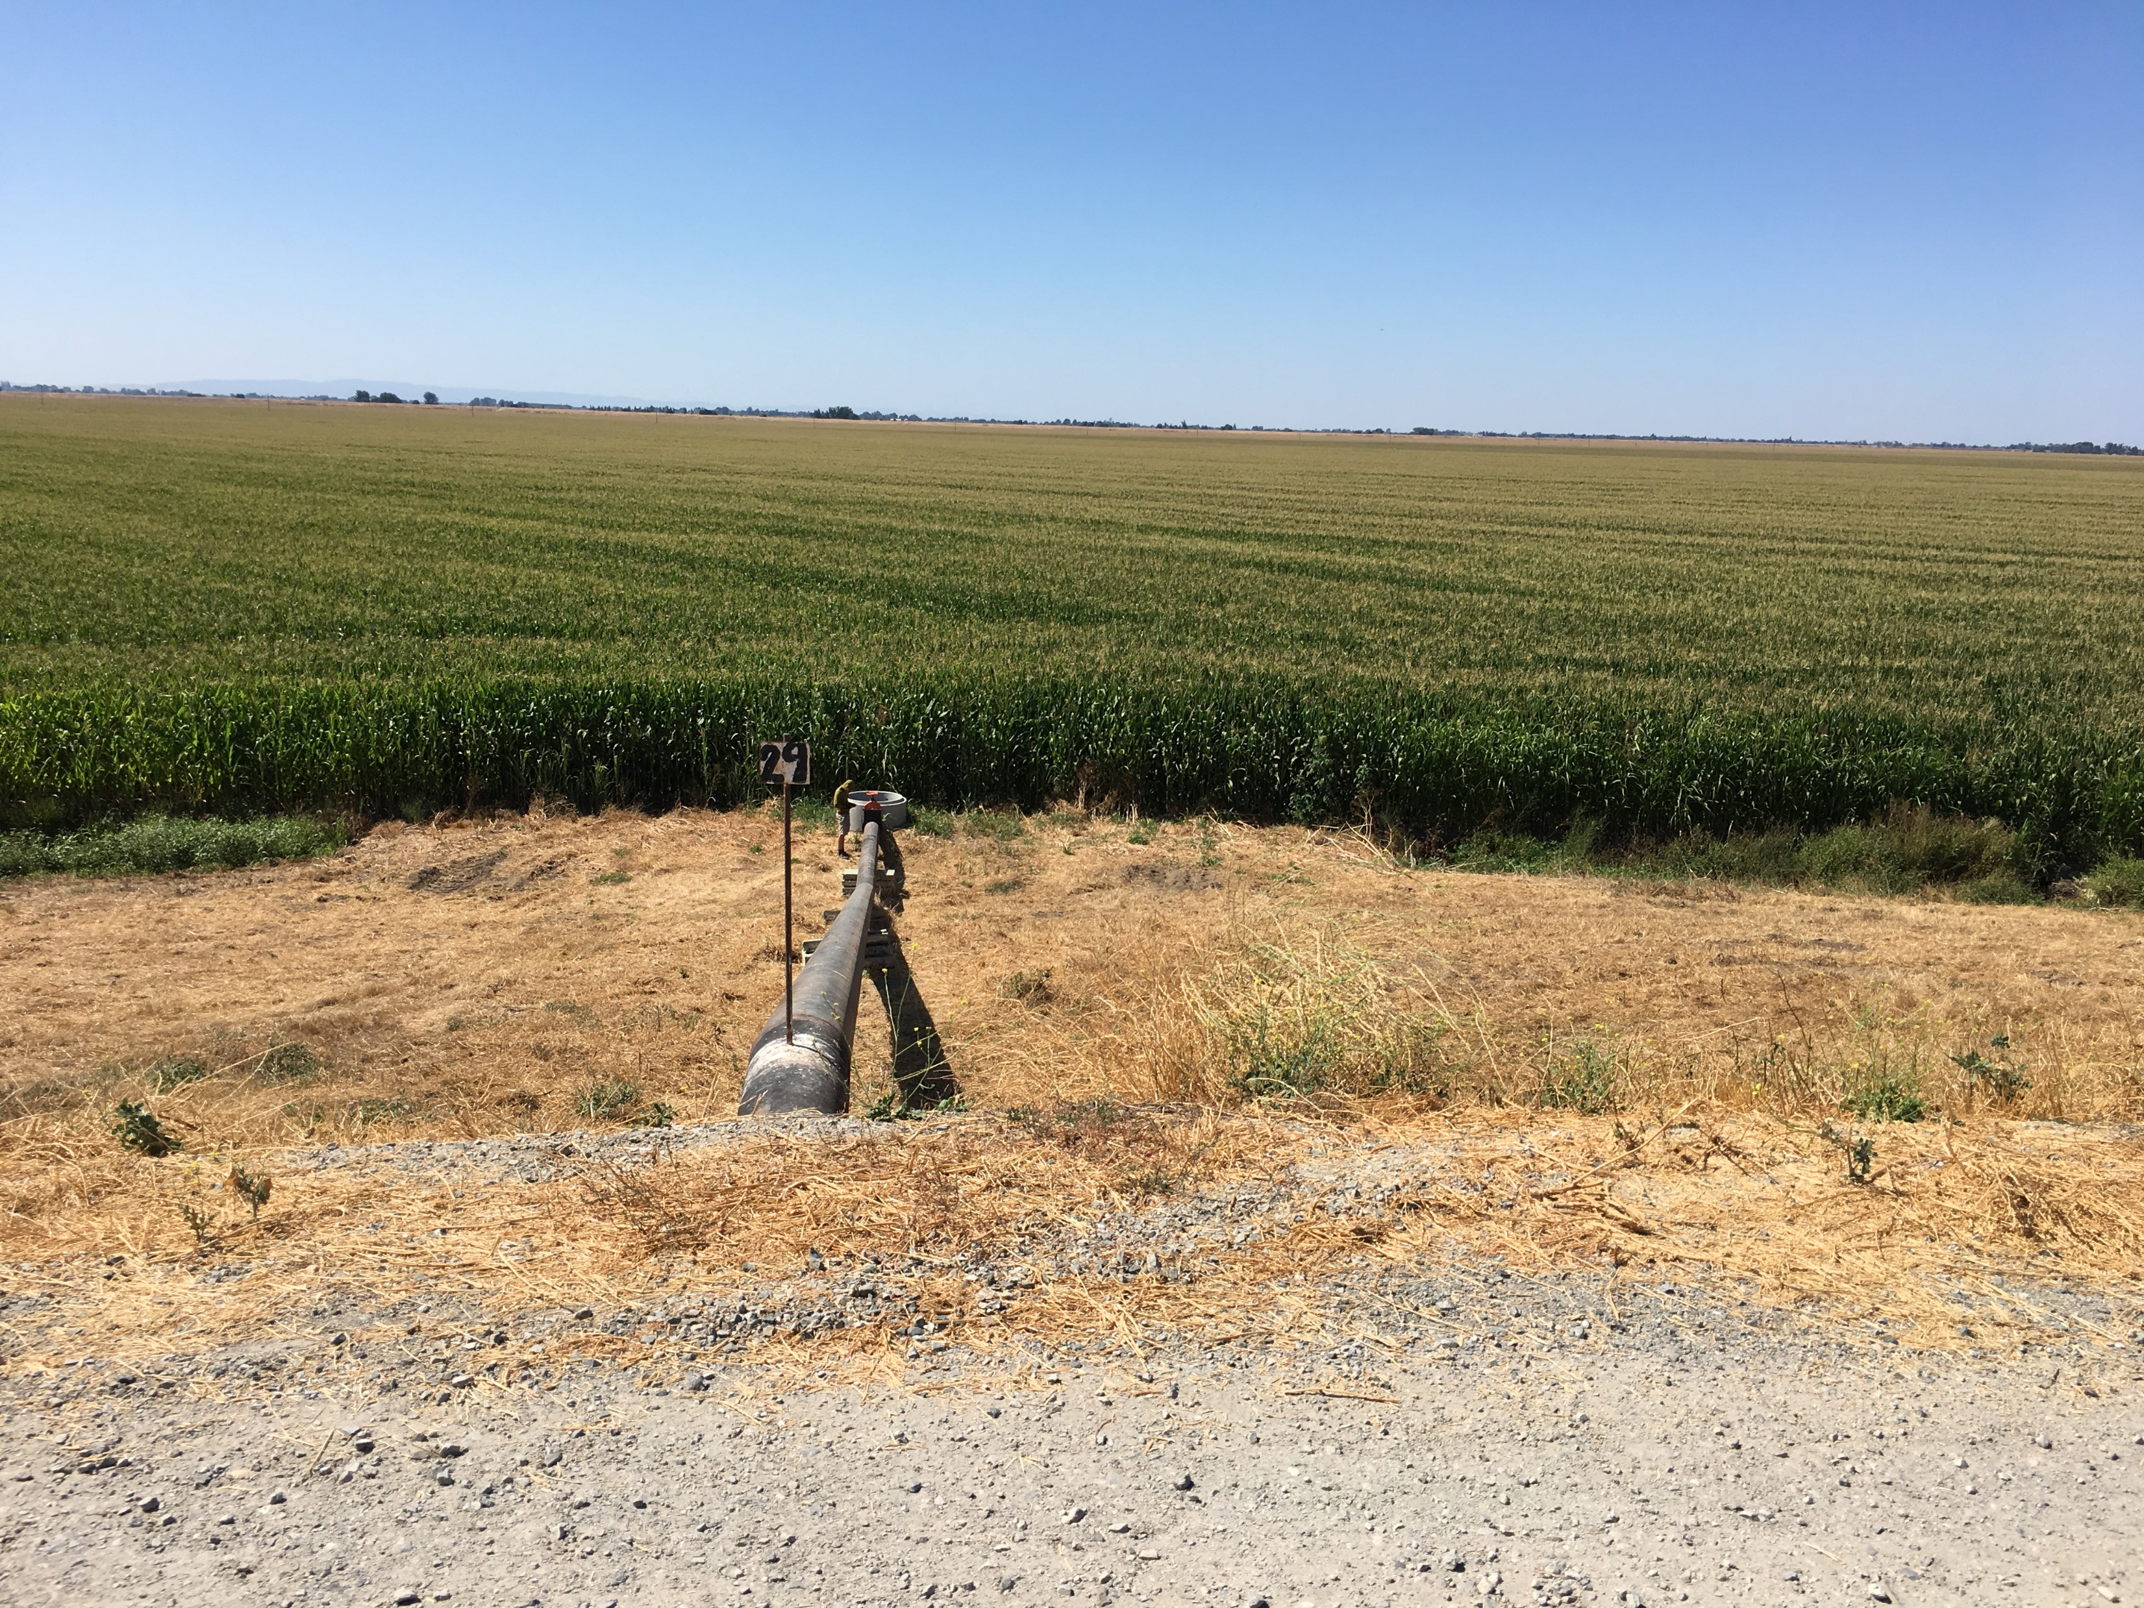

Staten Island Flow Monitoring
Fall 2019 Progress Update
Kirk Klausmeyer
October 24, 2019

Slide 2

The fireswamp?
Its not that bad…

Slide 3
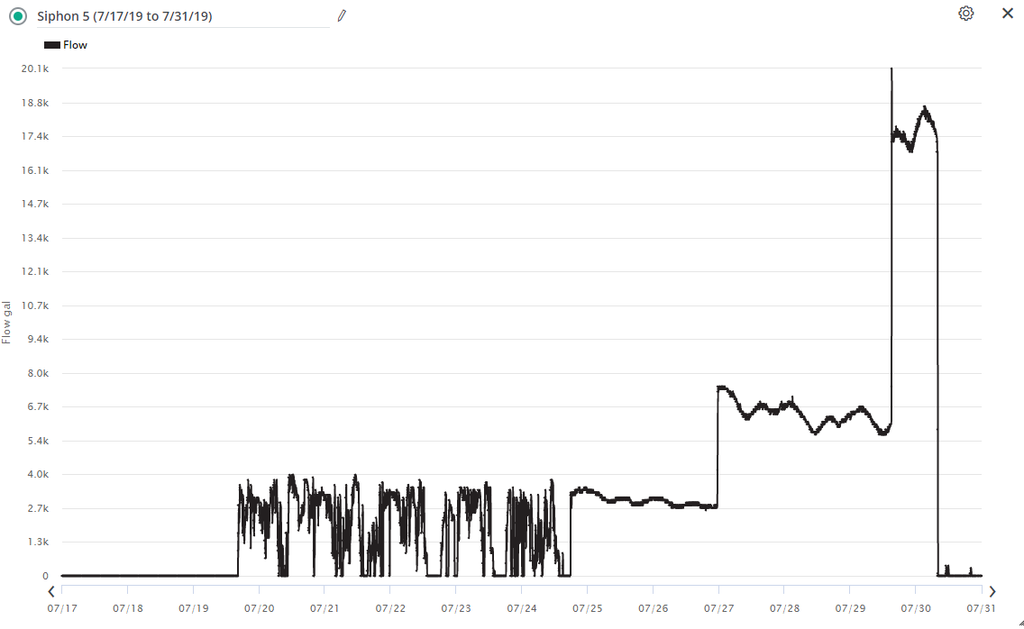
Meters are working better
Our contractor fixed installation issues on July 24th, 2019

Slide 4
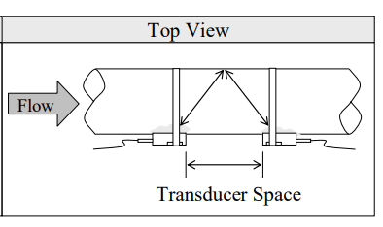
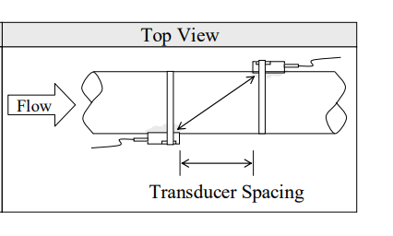

We are learning more about the meters
V Method:
Not as good pipes greater than 10 inches
Z Method:
Better for pipes greater than 10 inches

Slide 5
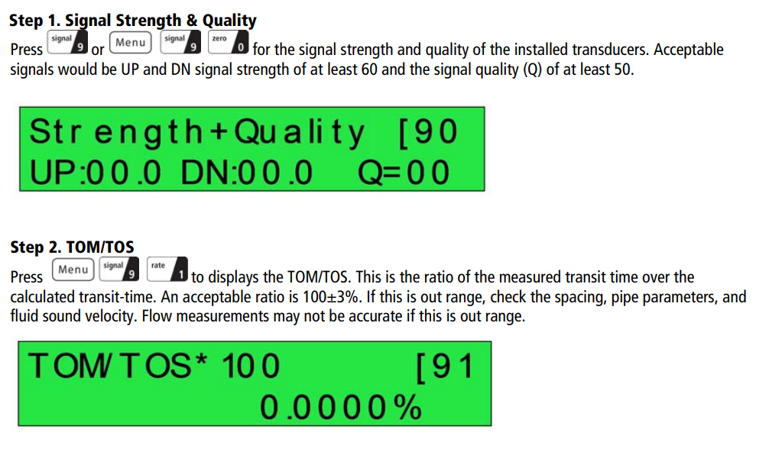
We are learning more about the meters
When installing the transducers, be sure to check the signal strength and TOM/TOS values

Slide 6
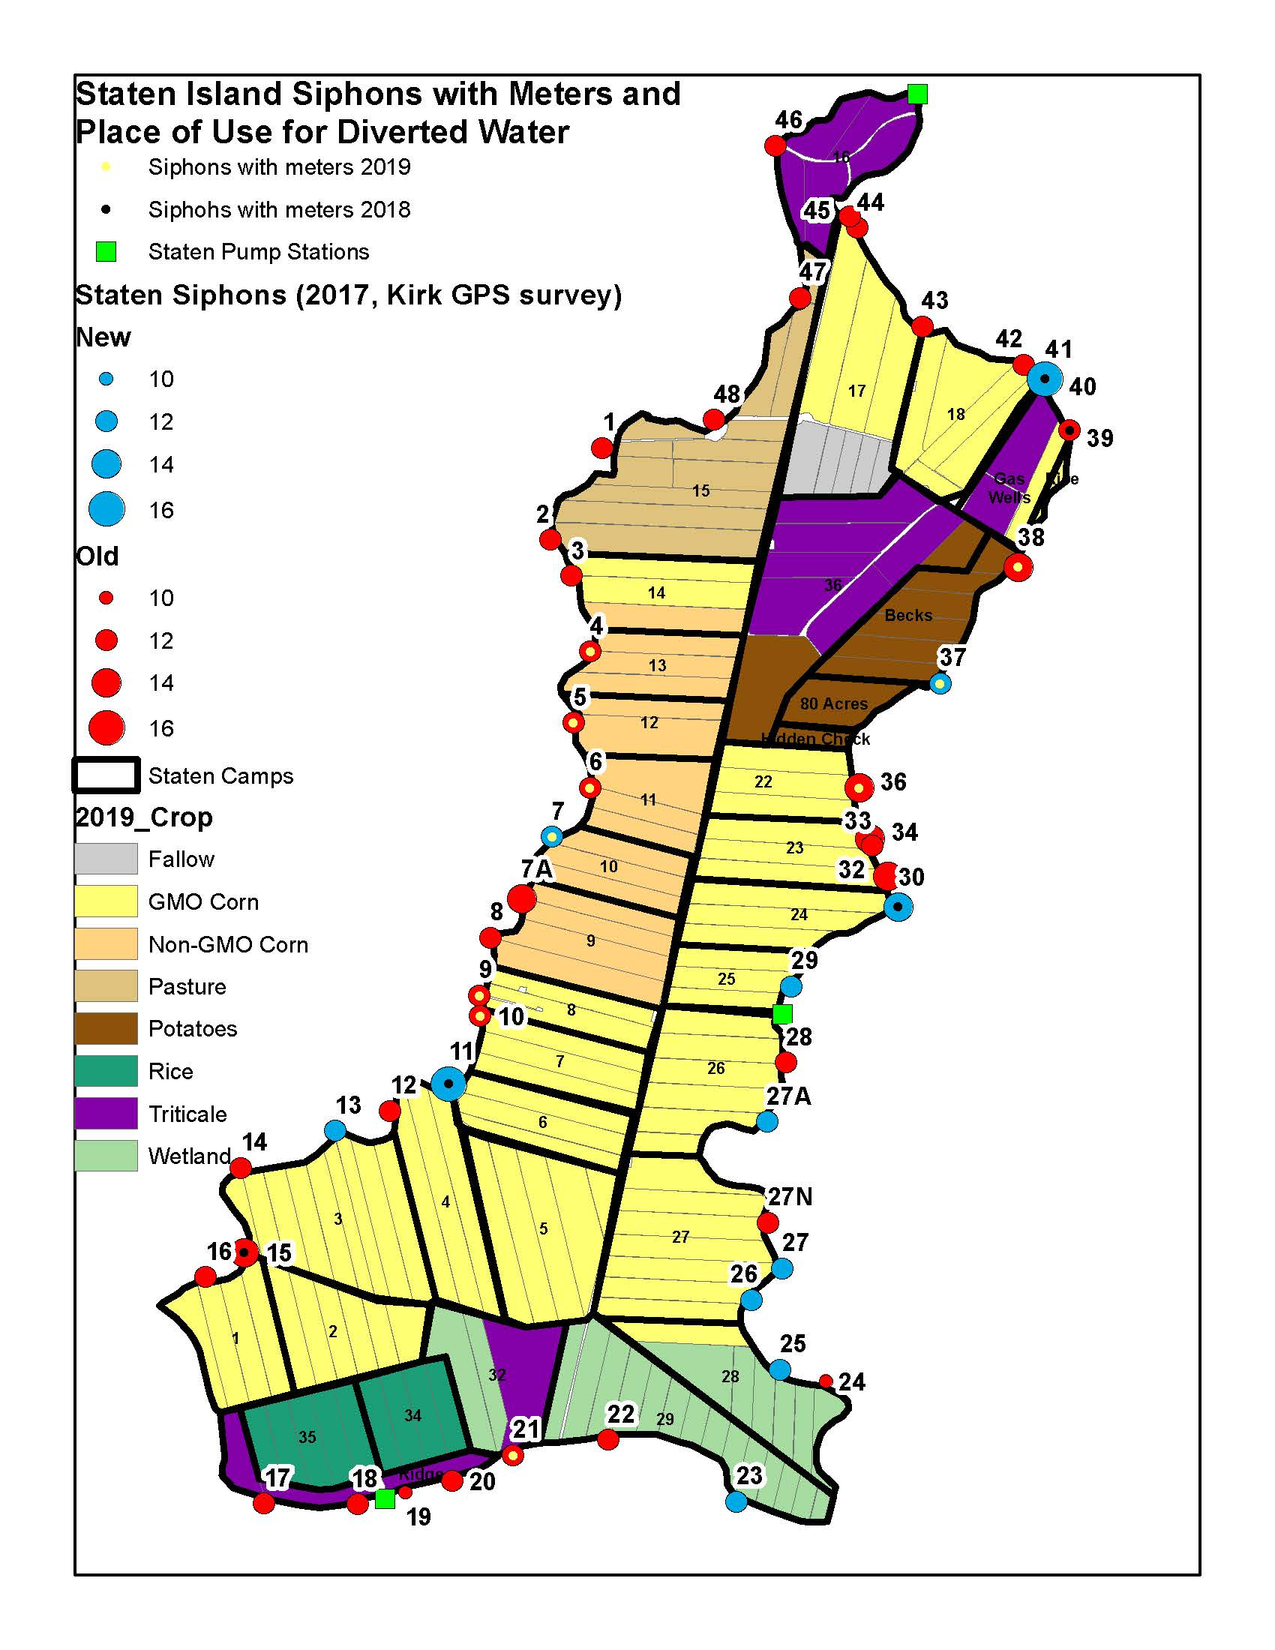
10 of 49 Siphons have meters…
… so what about the other 39?

Slide 7
Next Steps
Building rating curves for all the siphons based on valve position.

Slide 8
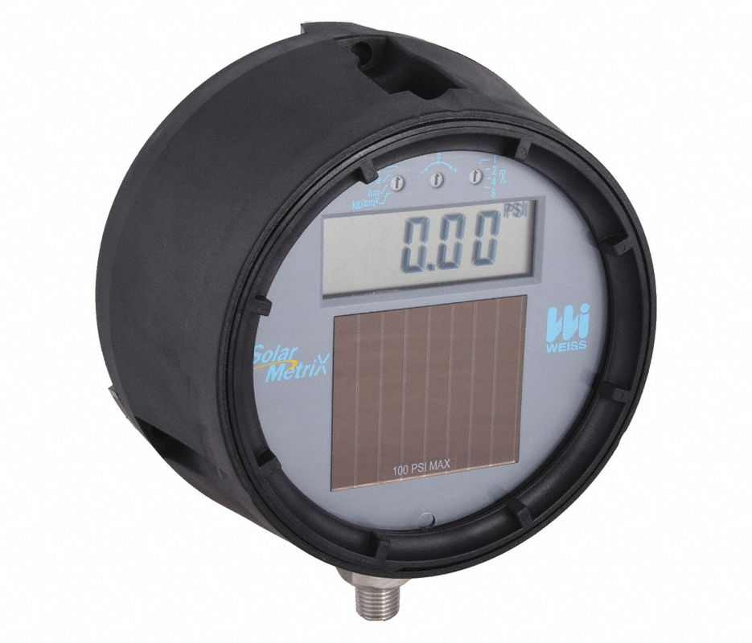
Next Steps
Use low cost devices to estimate flow / valve position. For example, this Weiss compound gage measures both vacuum and pressure ($207)

Slide 9
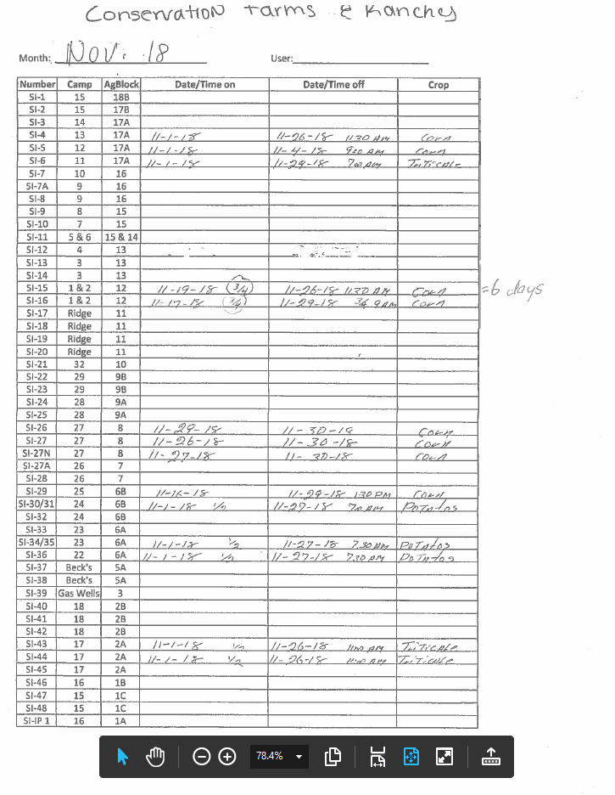
Next Steps
Improve data collection sheets to include more information

Slide 10
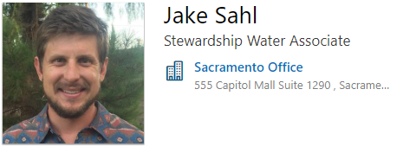
Welcome Jake!

Slide 11

Happily ever after?

