Slide 1
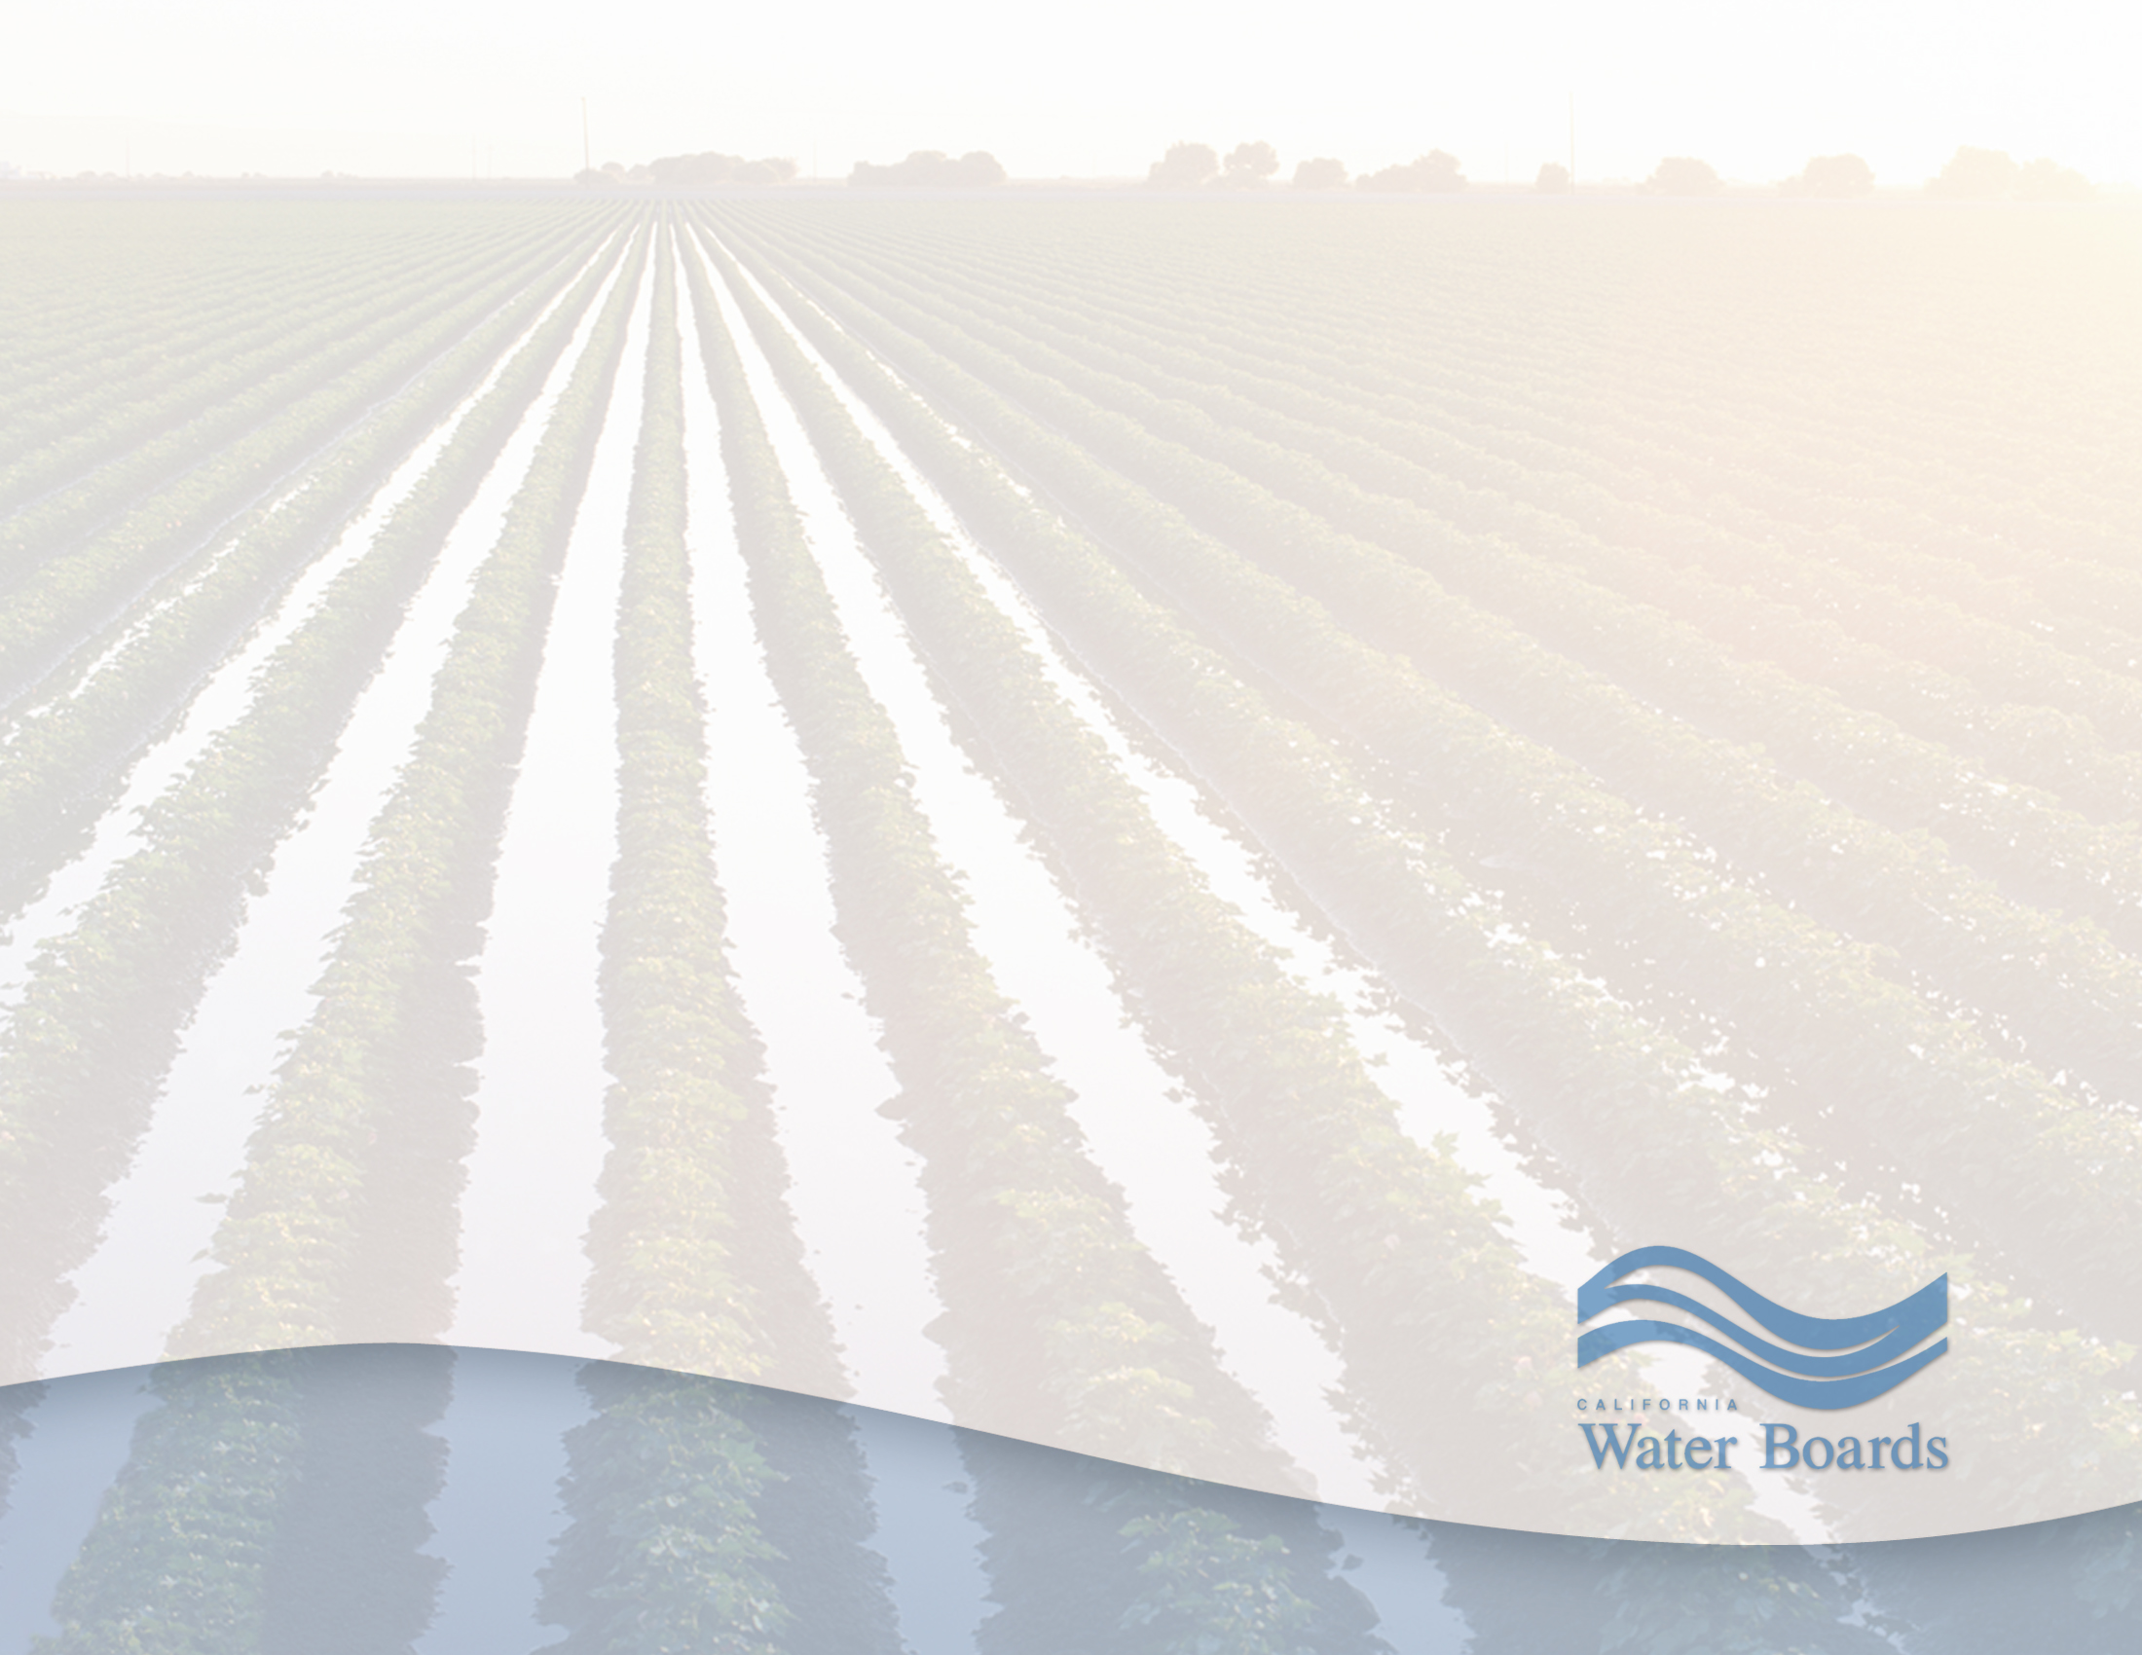
Quarterly Update to the
Delta Protection Commission
Michael Patrick George, Delta Watermaster
Lauren Barva, Communications & Outreach Specialist
Delta Stewardship Council
March 24, 2016

Slide 2
Overview
Report on 2015 Diversion Reduction Program among in-Delta Riparians
Comparative Study of Consumptive Use in the Delta
Salinity Hot Spots in the South Delta
Implementation of New Measurement Regulation
Enforcement Actions
Consolidating Drought Lessons and Data

Slide 3
Program Background
April 2015: Facing a 4th year of drought, threat of curtailments, minimal snowpack, Governor Brown extended emergency drought proclamation
Central and South Delta farmers proposed a voluntary program to reduce their surface water diversions during the summer months – June through September
Goal: reduce 2015 agricultural irrigation diversions by 25% vs. 2013 baseline in order to reduce stress on the water system
SWRCB agreed, in return, to refrain from enforcing deeper curtailments against if ordered later in the season

Slide 4
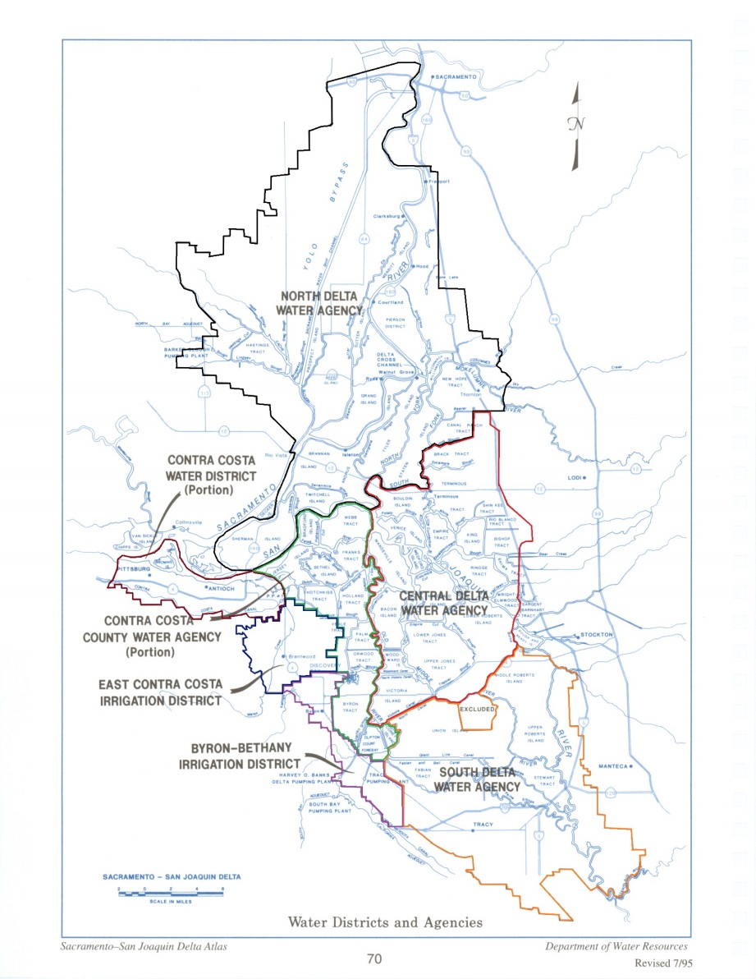
Program Terms
Participation was voluntary
Enrollment was offered only to riparian water right claimants within the Delta
Participants were required to file their plans for reducing diversions by 25% on or before June 1
Reduction strategies were kept flexible to accommodate the variety of circumstances
Plan implementation was subject to verification inspections during the program period
Participants were required to file an “after-action” report on plan implementation in November 2015.

Slide 5
Diversion Reduction Program Report Issued on March 11
Headlines:
  217 Plans Prepared, Covering 2/3 of the Central and South Delta: 180,000 acres (and portion of CCCo)
  Program Overachieved Target: 32% Reduction Reported
  Flexibility and Voluntary Nature of the Program Incentivized Creativity and Micro-response
  Likely Helped to Avert Riparian Curtailment
  Great Example of Voluntary Action to Address a Common Problem
  Achieved Results without Waiving Cherished Rights, Going to Court, or Triggering Regulation
  Report Posted on Watermaster Website http://waterboards.ca.gov/water_issues/programs/delta_watermaster/docs/diversion_reduction15.pdf

Slide 6
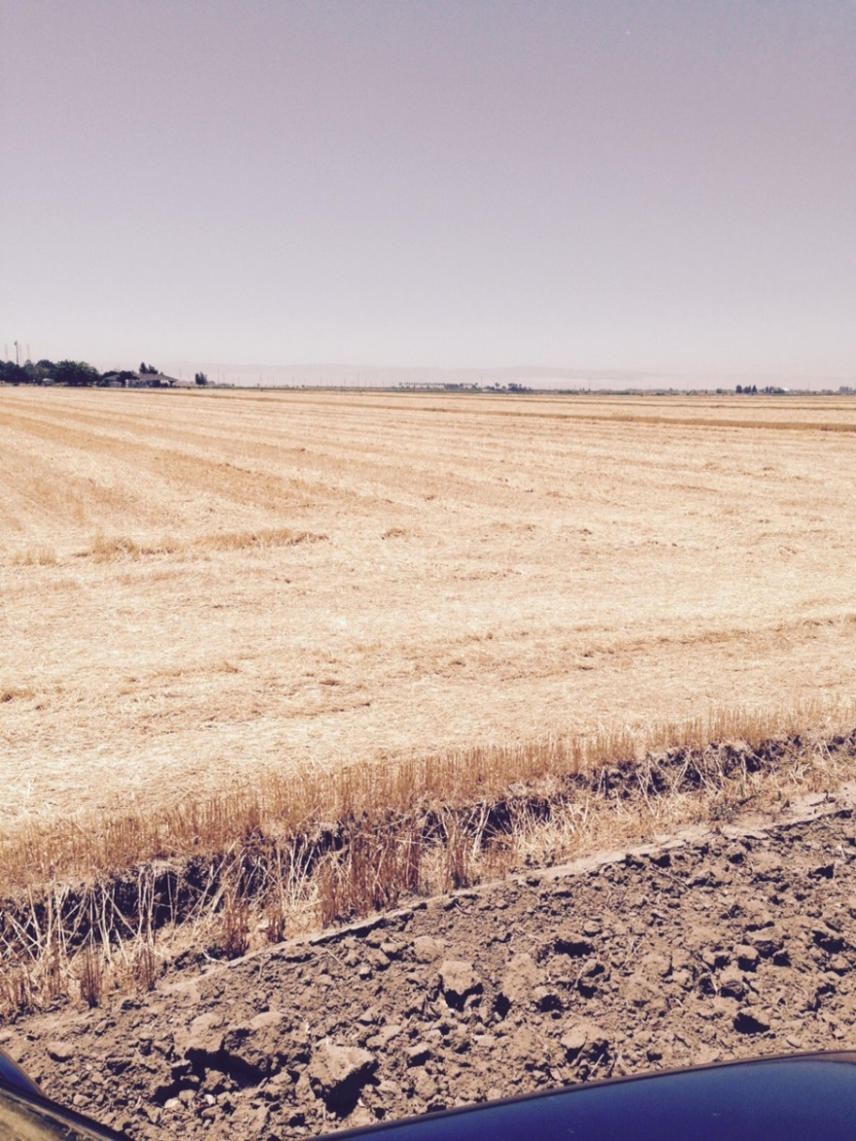
Methods for Reducing Diversions
Fallowing
Rotating to less water intensive crops
Reducing irrigation frequency
Employing more efficient irrigation equipment and/or techniques
Field reconfiguration

Slide 7
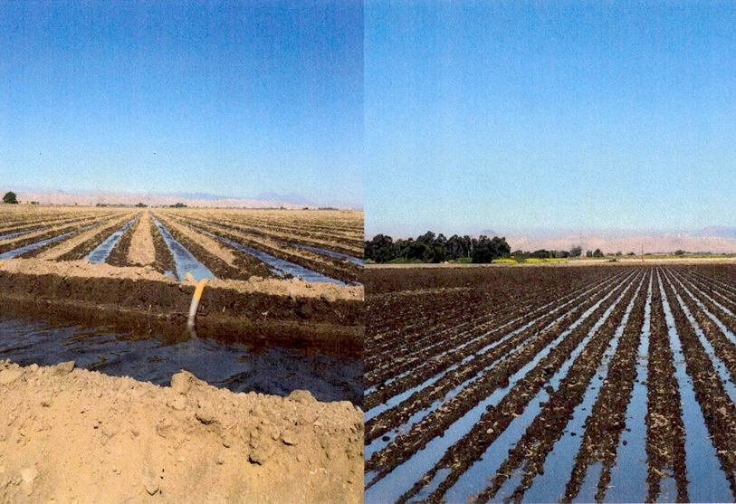
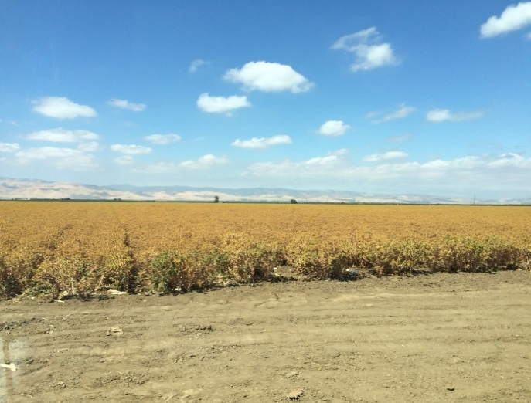
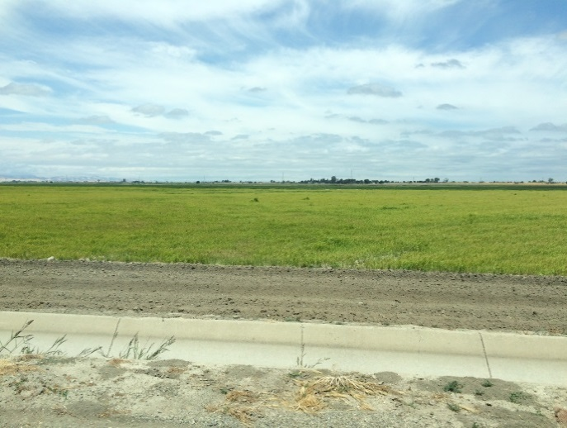
Examples
Irrigation with 60” beds
Irrigating with 30” beds
Crop Rotation
Safflower
Sudan

Slide 8
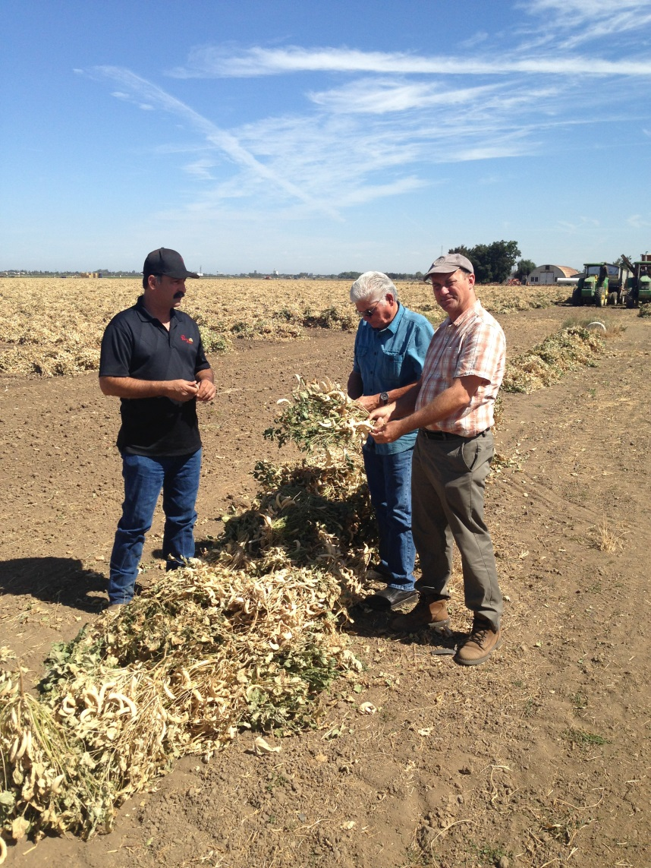
Verification Inspections
1st prioritized the larger plans in terms of total acreage
2nd visited smaller family owned and operated farms often without much professional support
Findings:
  Even a lawyer can learn a lot riding in a pickup with a farmer
  Participants in the program operated to exceed the 25% target for reduced diversion
  Peer relationships were supportive of success in the program
  Farmers took pride in contributing to drought amelioration

Slide 9
Statistical Overview
Total acres in Central and South Delta: 268,000
Total acres enrolled in the diversion reduction program: 180,119¹
Number of conservation plans submitted: 217
Acre-feet reported as diverted in summer 2013: 486,754
Acre-feet reported as diverted in summer 2015: 333,082
Reductions in diversions reported from program implementation: 153,672
Percent of reduced diversions reported: 32%
Acre-feet diverted per acre of irrigated land in summer 2013: 2.70
Acre-feet diverted per acre of irrigated land in summer 2015: 1.91
Disclaimer: The data compiled and reported in the this report—based on reports prepared by program participants and their advisors.
¹ A total of 15,005 acres enrolled in the program are located in Contra Costa County, outside the Central and South Delta Water Agencies boundaries.

Slide 10
Observations from the Program
No verification of water rights
Riparian curtailments were narrowly avoided
Apparent influence on Delta outflow
Long-term concerns over salt build-up
Need for improved measurement of diversions
Managing conflicting riparian and priority systems in extreme shortage exposed fissures in our water system

Slide 11
Today’s Update on CU Study
Meeting of Study Participants on March 17
Fully Funded, Subject to Partial Reimbursement
UC Davis Center for Watershed Science is Lead
Five Additional CIMIS Stations Have Been Deployed
Land Use Survey: from trucks to satellites
2015/2016 Field Campaign for Reference
Creation of Open Data with QA/QC
Eight Methods to be Blind Tested & Compared
Report Due in March of 2017
Study Results will Inform Policy

Slide 12
Salinity Hot Spots in South Delta
Six “Exceedances” of Project Permit Conditions Centered on Tracy Blvd. Monitor
Complex, Long-term Problem Creates Friction and Tests Regulatory Credibility
Watermaster Coordinating with Regional Board
DWR Commissioned a New Study of Causes and Potential Remediation Options
Collaborative Process Aims at Resolution

Slide 13
Measurement Regulation Implementation
New Regulation (Jan. 19) Implements SB 88
Sets Measurement Accuracy Performance Standard for Diversions Greater than 10AFA
May be Met with “Device” or “Method”
Alternative Compliance Plan Allows Bespoke Response
No Regulatory “Approval”
Outreach Underway
Data Avalanche Presents a Management Challenge

Slide 14
Enforcement of Water Right System
Notices of Insufficient Supply Issued in 2015
Challenges Ensued
  Authority, Jurisdiction, Data, Methodology, etc.
  Both Court and Board Review
  Actions against WSID and BBID are Currently before the Water Board
  Also, a Tentative Decision in the Tanaka Case was Issued on Feb. 22 and Re-argued Mar. 11

Slide 15
Drought Lessons
Challenge is to Consolidate the 2015 Chaos
Current Hydrology Provides a Respite
Need to Test Policies in Court Resolutions
Insights from Administration of Water Rights in Extreme Shortage Should Inform Policies
  Projects’ Petition for Change in Water Rights
  Update of Delta Water Quality Control Plan
  Delta Plan Update and Implementation
  Future Water Right Administration
  Data Management and Use
  Curtailments among Riparian and Priority Claimants

