Slide 1
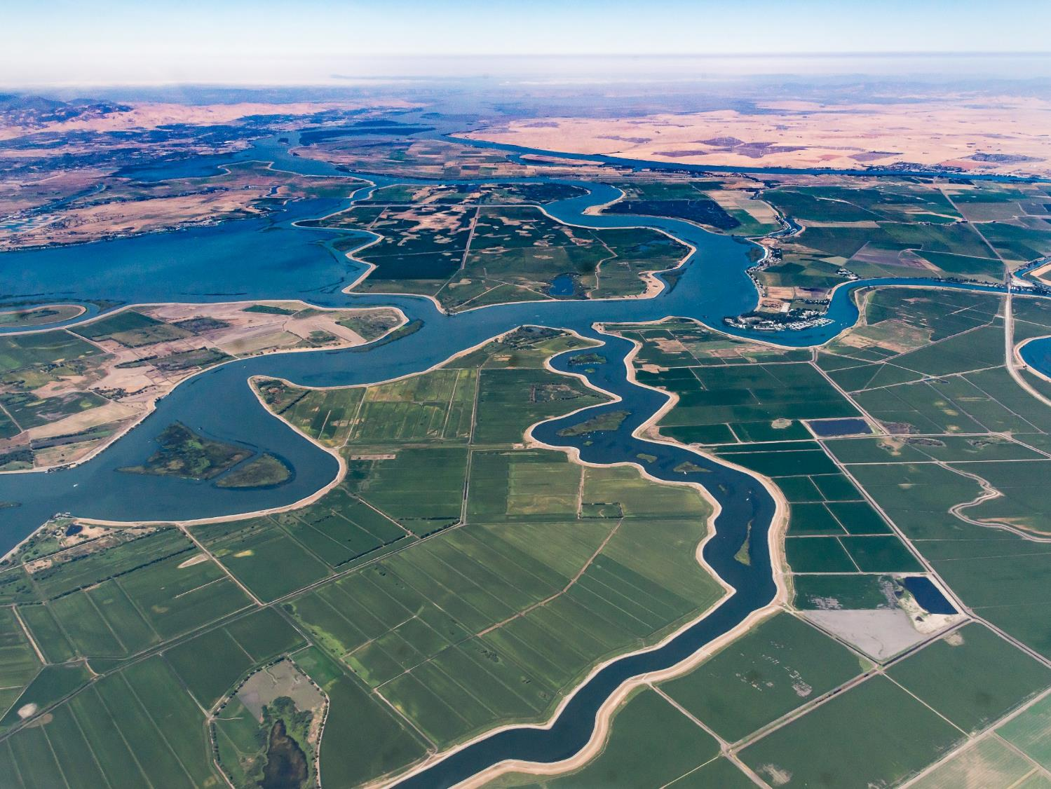
SB 88 Monitoring Method and Alternative Compliance Plan Validation and Refinement Progress
Stephanie Tatge
Research & Outreach Specialist
15 October 2020

Slide 2
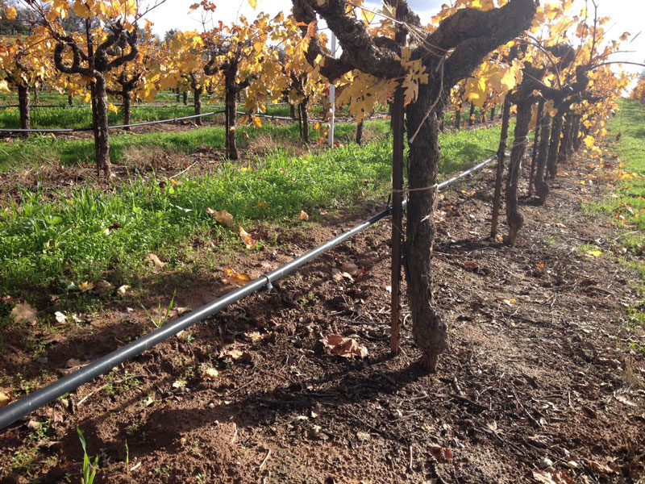
Presentation Contents
Progress:
2020 Reporting
Comparison Study
Scaling Study
Modelling Refinement & Sensitivity
Questions and Discussion

Slide 3
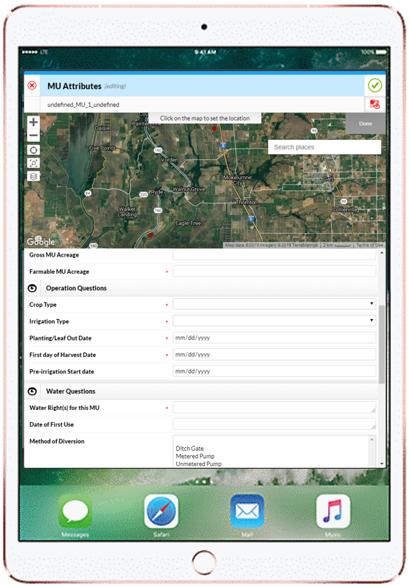
2020 Reporting: Complete
TFT manually filed 165 eWRIMS reports
Remaining challenges to tackle:
Client data management: team is determining best way to update database as new client information/data comes in
Efficiencies needed working with landowners (invoices) and tenants (farm management data)
Determining POU boundaries remains a challenge

Slide 4
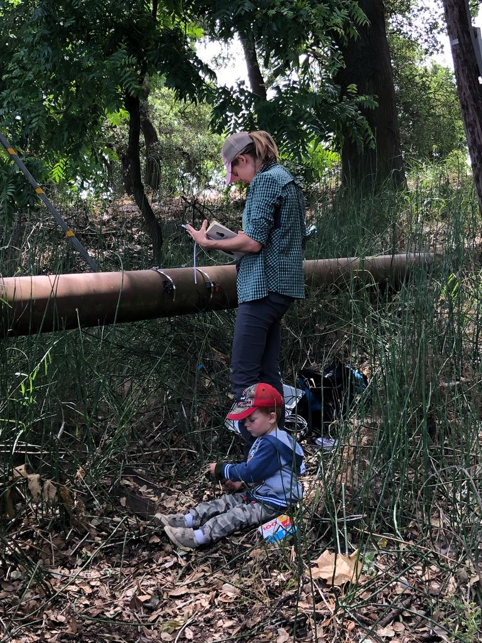
Comparison Study
Five participants’ meter data will be compared to Innovasonic data and our modelled data starting July 15th for the remainder of the irrigation season
We included various meter types, crop types, and irrigation types for representativeness
TFT will collaborate with TNC again this year to compare our model outputs with their Staten Island metered siphons

Slide 5
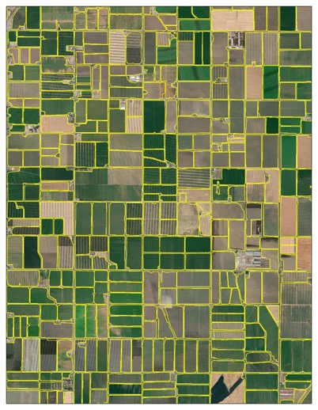
Scaling Study
Data Collection: how to ask landowners to define their POU polygons associated with each water report to maximize efficiency and accuracy?
Planting & harvest date sensitivity: TFT is quantifying the sensitivity of irrigation demands of various crops by comparing reported planting & harvest dates to default CUP+ planting & harvest dates

Slide 6
Modelling Refinements & Sensitivity
New crop ET information provided by Dr. Morteza Orang
New conservation credit methodology using irrigation efficiency factors
New way of modelling winter crops, whose growing season does not match calendar year

Slide 7
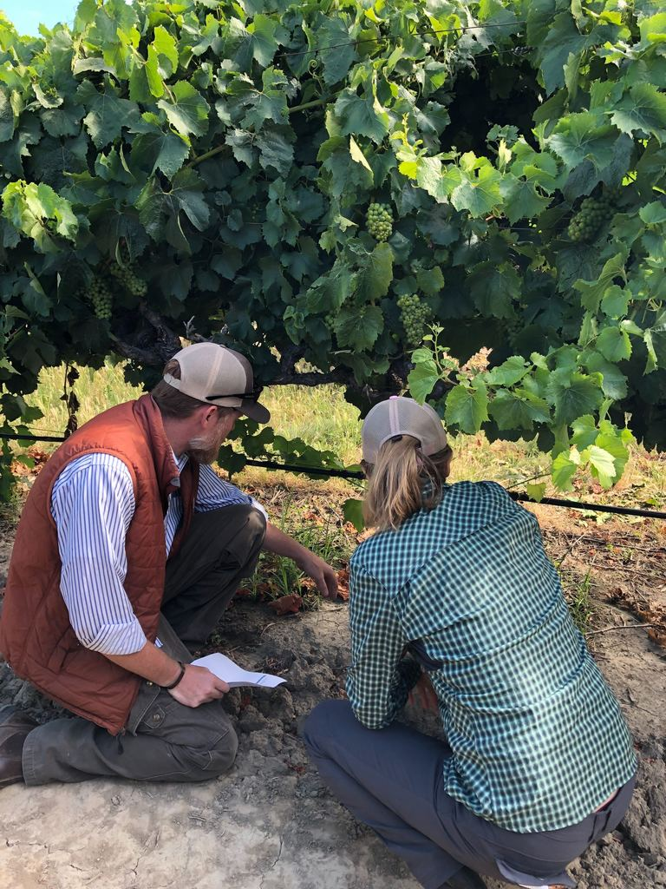
Questions & Discussion

